Slide 1
El Salvador Ecological Forecasting II
Utilizing NASA Earth Observations to Predict Deforestation and Forest Degradation in El Salvador
Britta Dosch (Project Lead)
Rebekke Muench
Garrett Kidd
Jacob Patrick
Labreshia Mims
Amy Wolfe

Slide 2
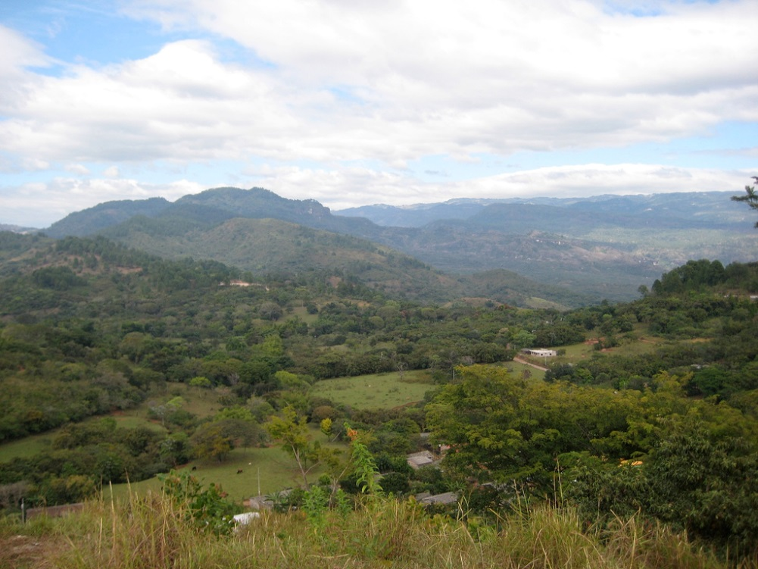
Objectives
Develop methodology for monitoring and forecasting ecological change in study area
Delineate Land Use/Land Cover (LULC) dominate tree species, agriculture and pastoral plots, and urban development
Identify patterns in LULC changes, specifically looking at changes forest cover
Image Credit: Allison Keller

Slide 3
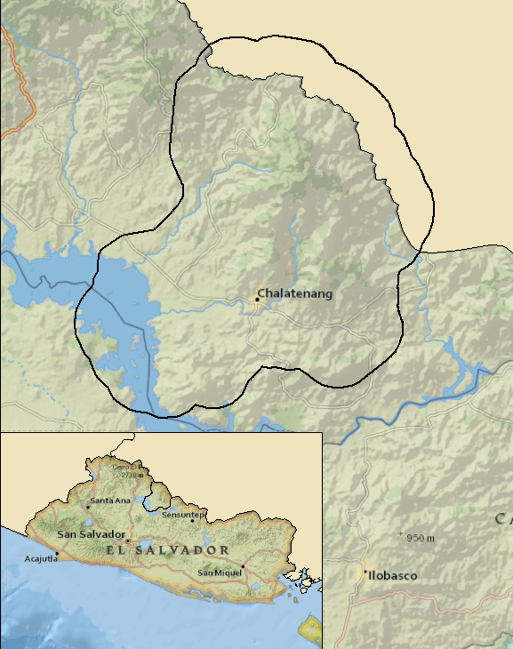
Study Area
La Mancomunidad
La Montañona, Chalatenango, El Salvador
Study Period
1986-2015 Dry Season

Slide 4
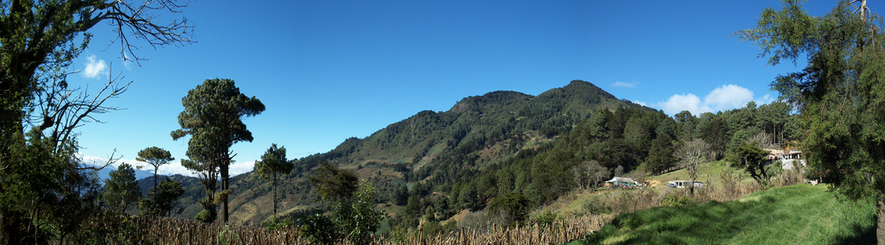
Community Concerns
El Salvador population density and deforestation
Subsistence farmers rely on forests for ecosystem services
The pine oak forest is threatened by encroachment
Image Credit: Otto Rodriguez

Slide 5



Partner Organizations
USAID El Salvador Mission
The Earth Institute, Columbia University
  Agroforestry for Biodiversity and Ecosystem Services
  (ABES Project)
Ministerio de Medio Ambiente y Recursos Naturales (MARN)
Image Credits: USAID, MARN, The Earth Institute

Slide 6


Methodology
Data Acquisition
Data Processing
Data Analysis
End Product
Landsat CDR 4/5 & 8
ABES Project Field Survey
MARN
USAID GeoCenter
Landsat 8
Landsat 4/5

Slide 7
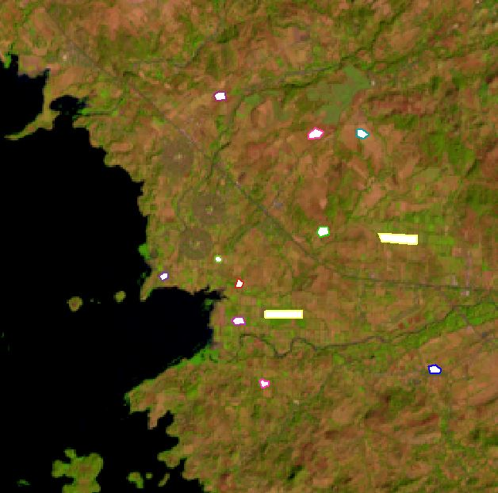
Methodology
Data Acquisition
Data Processing
Data Analysis
End Product
Landsat scenes
QuickBird and RapidEye imagery
Training sites created in ArcGIS
Notes:
Landsat Scenes clipped using Google Earth Engine (GEE) Code Editor
QuickBird and RapidEye imagery resampled in ArcGIS to fit resolution of Hansen and Landsat data
Hansen dataset clipped to QuickBird extant
Training sites created in ArcGIS

Slide 8
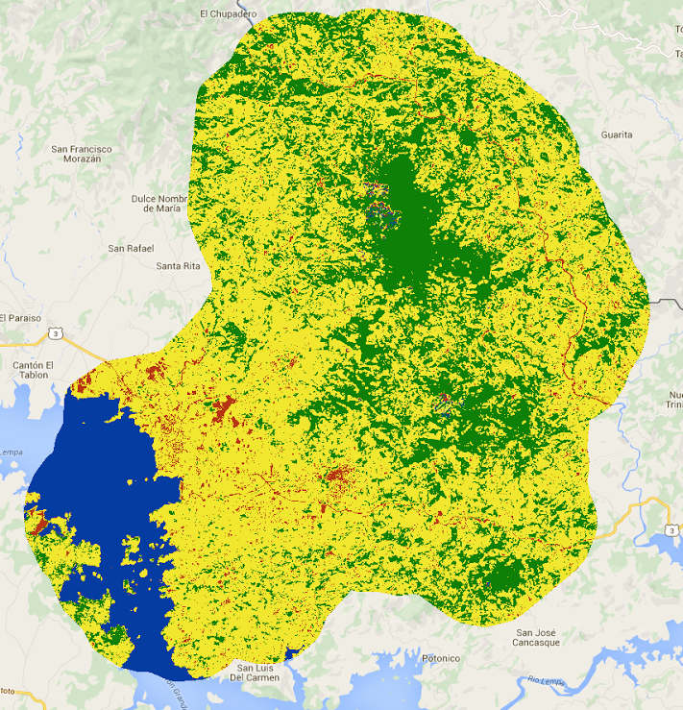
Methodology
Data Acquisition
Data Processing
Data Analysis
End Product
Maximum entropy and random forest classification
Accuracy assessment
Notes:
Maximum entropy and random forest classification
Accuracy assessment preformed using RapidEye imagery and Landsat comparison

Slide 9
Methodology
Data Acquisition
Data Processing
Data Analysis
End Product
LandTrends historical land change patterns and forecasting model
RFI accuracy checked with field surveys, RapidEye, and GeoCenter imagery

Slide 10
Conclusions

Slide 11
Errors/ Uncertainties

Slide 12
Moving Forward

Slide 13
Advisors
Dr. Kenton Ross, NASA DEVELOP National Program
Emily Adams, NASA DEVELOP National Program
Partners
La Mancomunidad La Montanona, Chalatenango
Ministerio de Medio Ambiente y Recursos Naturales (MARN)
Contributors
The Earth Institute, Columbia University (ABES Project)
Previous contributors from Fall 2015 - Jordan Ped, Courtney Duquette, Clarence Kimbrell, Susannah Miller, and Stephen Zimmerman

