Slide 1
Maryland Ecological Forecasting
Utilizing NASA Earth Observations to Monitor and Strengthen the Survivorship of Maryland’s Sea Turtles
Chris Long (Project Lead)
Erica Scaduto
Kiersten Newtoff
Notes:
Good morning! Thank you for coming today. My name is Chris, (I’m Erica; and I’m Kiersten) and we are part of the Maryland Ecological Forecasting team. Specifically, we are utilizing NASA Earth Observations to monitor and strengthen the survivorship of Maryland’s sea turtles.

Slide 2
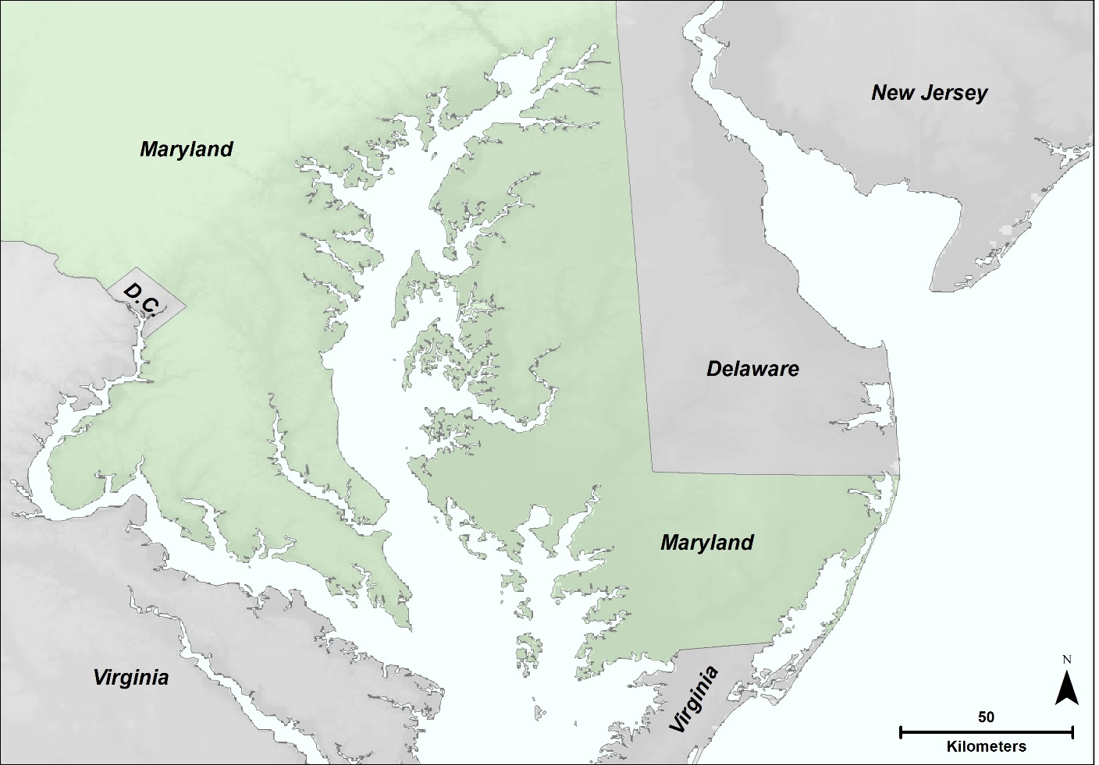
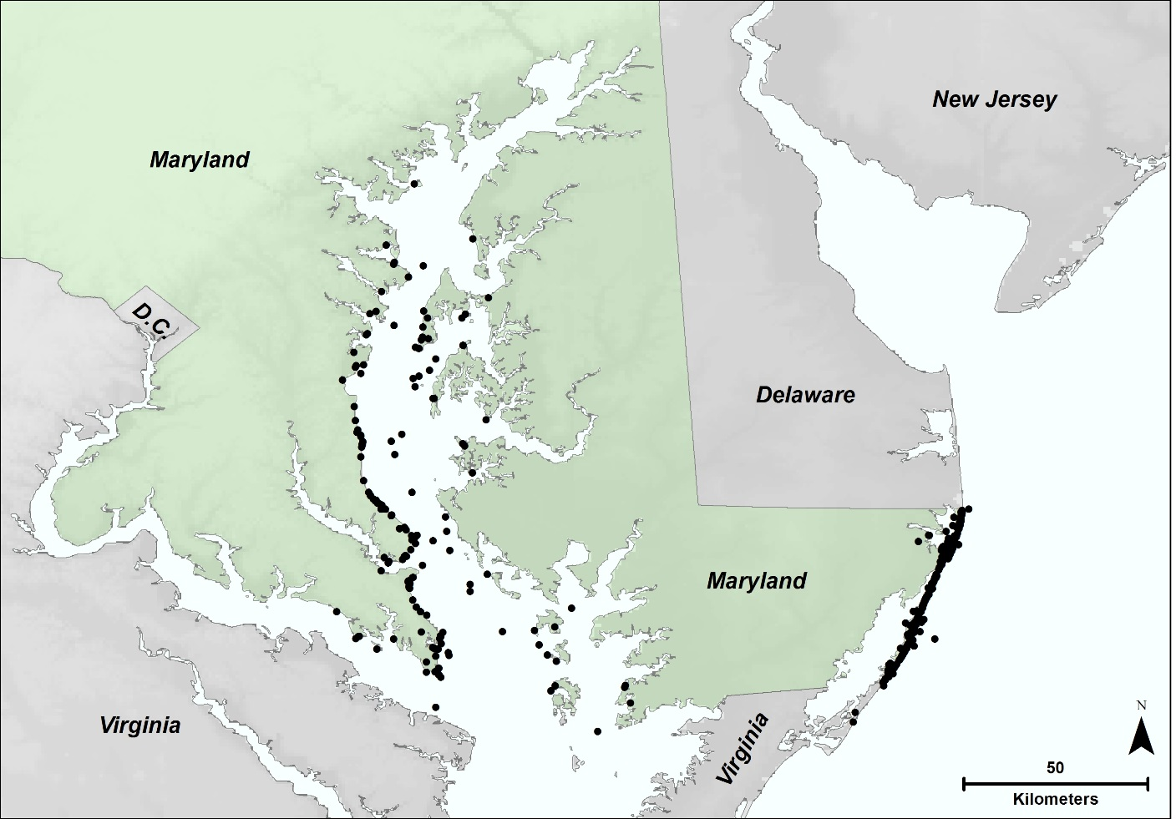
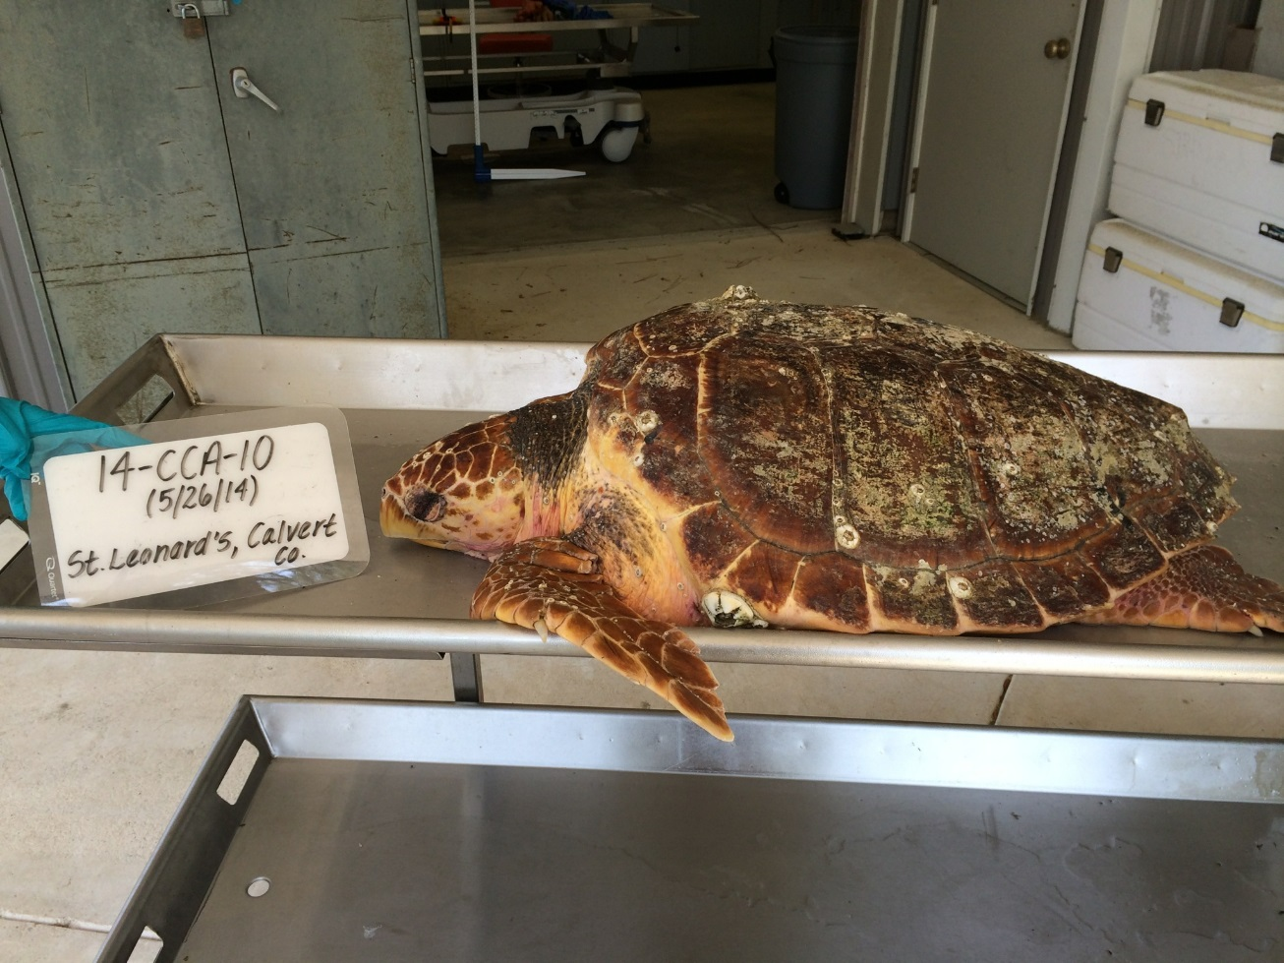
Study Region
Atlantic and Chesapeake Bay coast of Maryland
460 loggerhead strandings since 1991
Rare nesting events
Managed by the Maryland Department of Natural Resources
Amanda Weschler
Sea Turtle Stranding (1991-2014)
Source: Maryland Department of Natural Resources
Notes:
For this study, we focused on Maryland’s coastline which touches the Atlantic Ocean and Chesapeake Bay. Since 1991, there have been 460 loggerhead sea turtle strandings which are marked here with black dots. During this time period other sea turtles have stranded including Kemp’s Ridleys and green sea turtles, but to a much lesser degree. Sea turtle strandings refer to dead sea turtles that have either washed up on shore or were identified from boat. Since 80% of the strandings were loggerheads, they are the focus of our study. The cause of the strandings are sometimes easy to determine such as a boat strike, but other times environmental variables such as temperature of algae activity can cause death. Outside of strandings, we are also interested in improving survivorship through nesting. However, nesting events are rare in Maryland at the moment.
Our end-users, the Maryland Department of Natural Resources is responsible for all interactions with Maryland’s sea turtles. When a turtle washes on shore, the MD DNR responds and evaluates the carcass and brings it back to the lab to necropsy if it is in good condition. In conjunction with the Assateague Island National Park staff, they also respond to sea turtle nesting events by fencing them off and recording data on nesting and hatching.

Slide 3
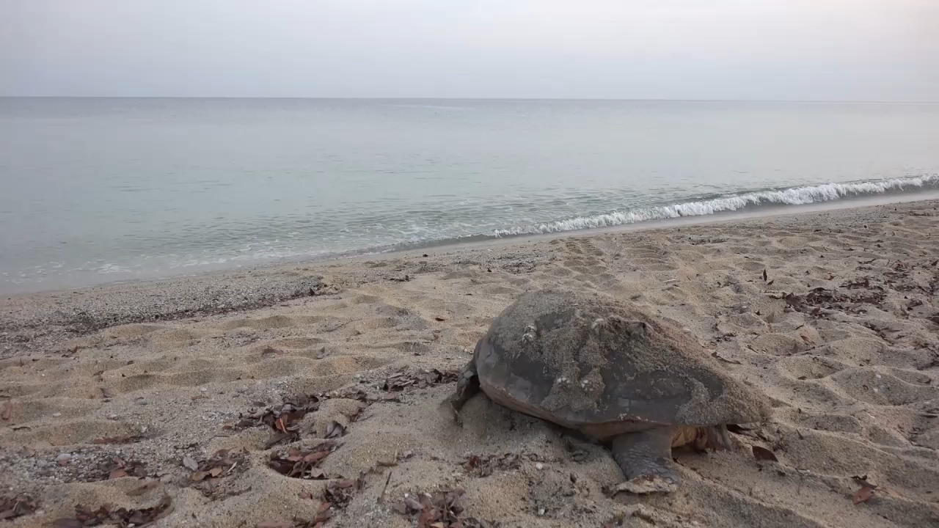
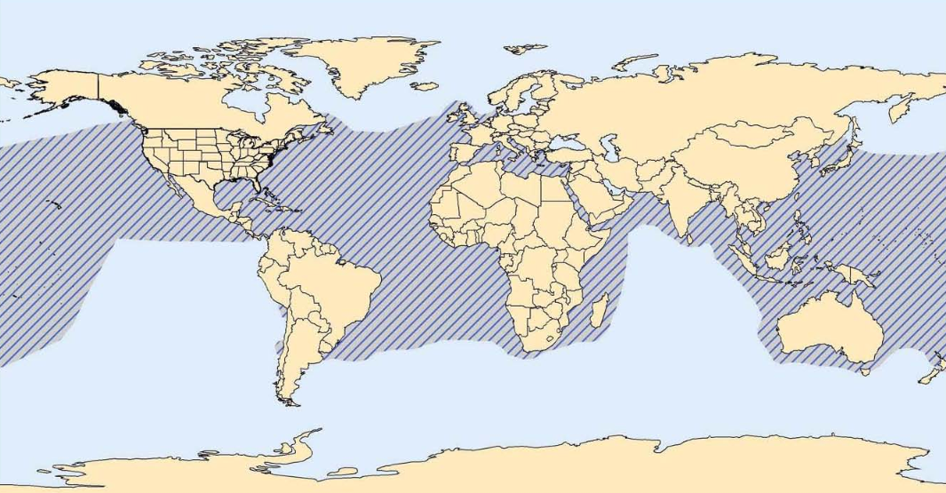
Study Species
Loggerhead sea turtle (Caretta caretta)
Threatened in U.S.
Endangered worldwide
Worldwide distribution
Nests subtropical to warm temperate climates
Fish Grove Co., LTD.
National Marine Fisheries Service, Office of Protected Resources
Notes:
Due to the high prevalence of stranding, we focused our research on the loggerhead sea turtle, Caretta caretta. In the United States they are listed as threatened on the Endangered Species List. Their worldwide distribution is Endangered on the IUCN Red list. Although they can be found across the globe, their nesting is limited to warm temperate climates and the subtropics due to the need for warmer temperatures for hatchlings. In the Untied States, the largest loggerhead nesting colonies occur every summer in Florida. Large nesting colonies gather as far north as North Carolina. Since it is much cooler in Maryland, loggerhead nesting events are rare with one or two nests a season at most.
Loggerhead video source: Fish Grove Co. LTD: https://www.youtube.com/watch?v=Tvxk2DGvRb8 (Creative commons)
Distribution image source: NOAA Marine Fisheries Service: http://www.nmfs.noaa.gov/pr/pdfs/rangemaps/loggerhead_turtle.pdf (Creative commons)

Slide 4
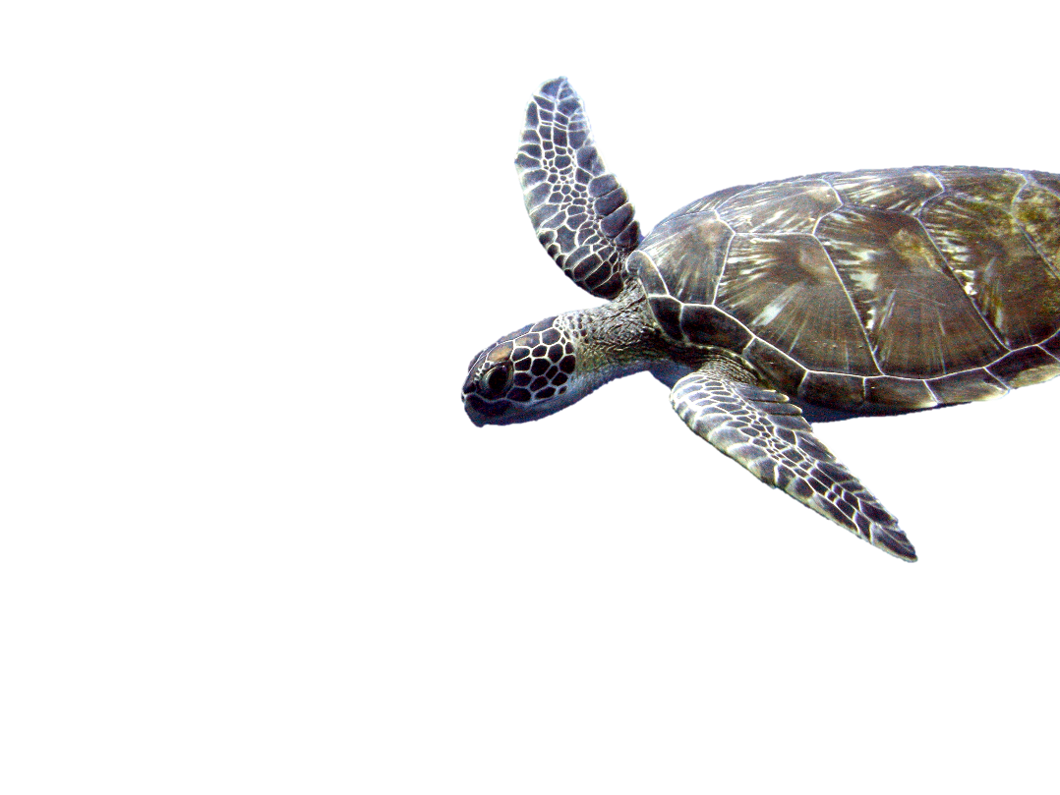
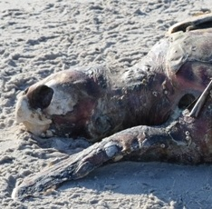
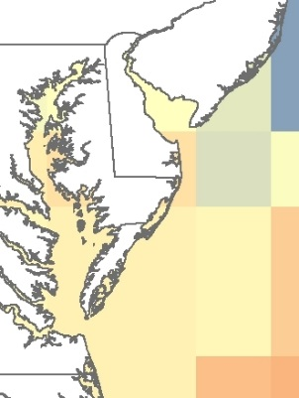

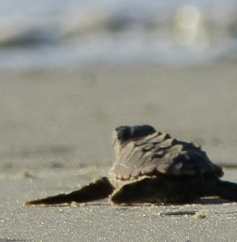
Objectives
Matt Kleffer
Analyze correlations between loggerhead strandings and chlorophyll a and sea surface temperature.
Stranding
Amanda Weschler
Climate Change
Climate Change
Predict changes in nest site use and availability
Predict changes in nest site use and availability
Nesting
Nesting
Identify optimal nesting locations along Atlantic Coast
Identify optimal nesting locations along Atlantic Coast
Becky Skiba
Notes:
Overall, our objectives for this study focus on three major topics: stranding, nesting, and climate change. For stranding, our goal is to determine if there is a relationship between sea surface temperatures, chlorophyll a, and sea turtle strandings to better aid the DNR in recovery. Although strandings are rare in Maryland, we wanted to see how climate change would affect their breeding distribution in Maryland. Finally, if loggerhead nesting does increase in coastal Maryland, we wanted to identify regions that are most suitable for nesting and are least affected by sea level rise.
Stranding image: From end-user Amanda Weschler from MD DNR.
Nestling image: Becky Skiba (Creative Commons): https://www.flickr.com/photos/usfwssoutheast/7644512048/in/photolist-cDuZLs-cDwaAE-cDwd1U-cAr4MQ-cAr2KC-cAqmC7-cAqoPw-cAq5Uh-cAqjos-cAq5QW-cDvumq-cDvzAL-cDvMQC-cDvJGA-cDvCTo-cDvwGW-cDw86S-cAq9CL-cDvkUq-cDvi1q-cDuQiA-cDvFJJ-cDuPgu-cDvciG-w2LJ9-cDvrXy-cDvf8s-cDuT21-cDwfDW-cDv9VS-cDuYVq-cDuW1h-cDvoBJ-cDvZb1-cDw5tm-cDw2NW-cDv76W-cDv4tb
Turtle in corner image: Matt Kleffer (Creative commons): https://www.flickr.com/photos/mattkieffer/5287428193/in/photolist-94esc4-kHp2XC-cFvwL1-8qDP7G-jdbqM3-ehDM8y-bpytkw-dskgub-9A1NoD-or4kzn-5n59LX-nZRToJ-ohaMxN-7fji-aZX74r-4Uk5be-666WTD-paP35u-b4TnDv-7JzePt-9tfMjB-9tiJhN-9tiJCJ-smA95B-4UpnoJ-mZ3SWr-mZ5H6G-mZ3SpX-mZ3T4c-fq2qSf-fq2gNY-fq2eh1-bBv2j4-5m7doh-aCZYKs-7vriAM-4UpnmY-6F7VEy-nPPfAv-5rF57M-4Uk59D-7o6mWZ-5rF54T-qyhReF-9AHJGq-fpLVXH-fpLT8n-mZ3THi-fpLQQk-bUnkHQ

Slide 5
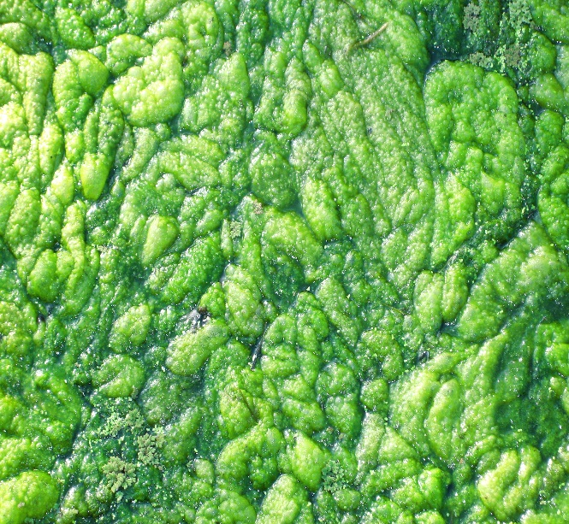
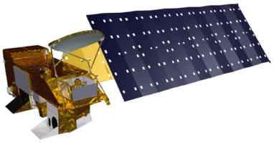
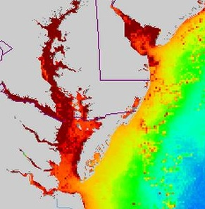
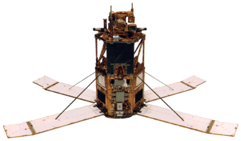
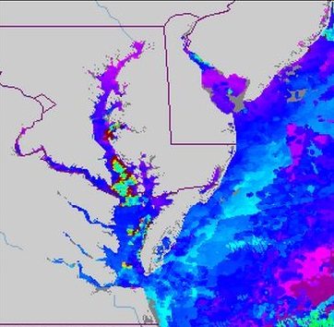

Stranding: Data Acquisition
Aqua
2003-2015
Chlorophyll-a
(Algal Blooms)
OrbView-2
1998-2002
Diana House
Sea Surface Temperature
Terra
2000-2015
NOAA Coast Watch Program and NASA’s Goddard Space Flight Center, Ocean Color Web
Notes:
To further understand loggerhead strandings, 8 day composites of chlorophyll-a, which is a proxy for algal bloom activity and depending on the species are known to release harmful bio toxins, were obtained via SeaWiFs sensor on OrbView-2 and MODIS sensor on Aqua. While, sea surface temperatures were acquired from MODIS sensor on Terra, which were all obtained 1 to 4 days prior to each stranding date, dependent upon the level of decomposition. The decomposition values were available from 2002 to 2012 which were specified in the stranding datasets obtained from the Maryland Department of Natural Resources.
https://www.flickr.com/photos/suavehouse113/1481834136
By Diana House
Flickr

Slide 6
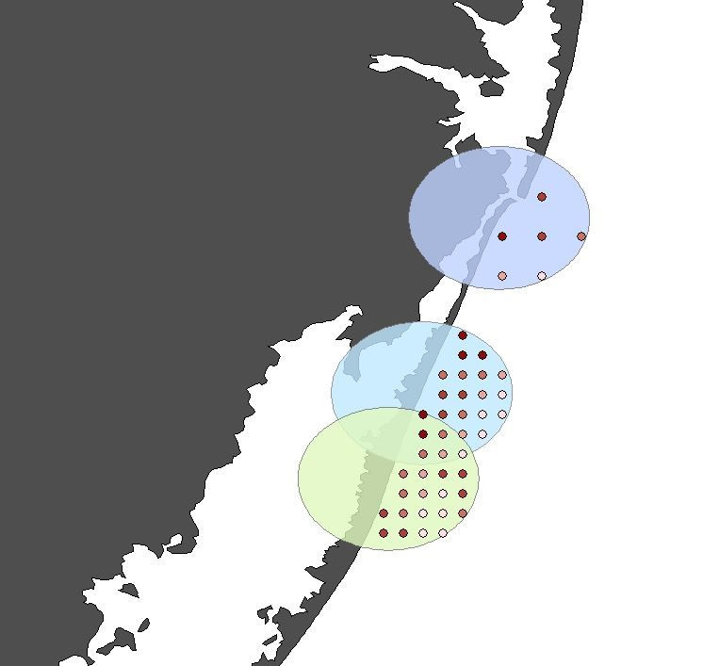
Stranding: Methodology
1. Average oceanic datasets within 5km of stranding
1. Average oceanic datasets within 5km of stranding
2. Calculate Pearson’s r Correlation Coefficient
2. Calculate Pearson’s r Correlation Coefficient
3. Create Risk Map for potential areas of stranding concern
3. Create Risk Map for potential areas of stranding concern
Notes:
Data acquisition, and data processing were done mainly through running Python scripts in order to effectively automate the process. Once the values of the oceanic variables were obtained, they were averaged in a 5 km buffer zone for each stranding event, which represents the greatest likelihood of exposure. The Pearson’s r correlation coefficient were calculated to determine the relationship between stranding and the oceanic variables. Finally, the correlation values were used as a guide to create the 2015 risk map relative to historical stranding events and the oceanic variables using the weighted overlay method.

Slide 7
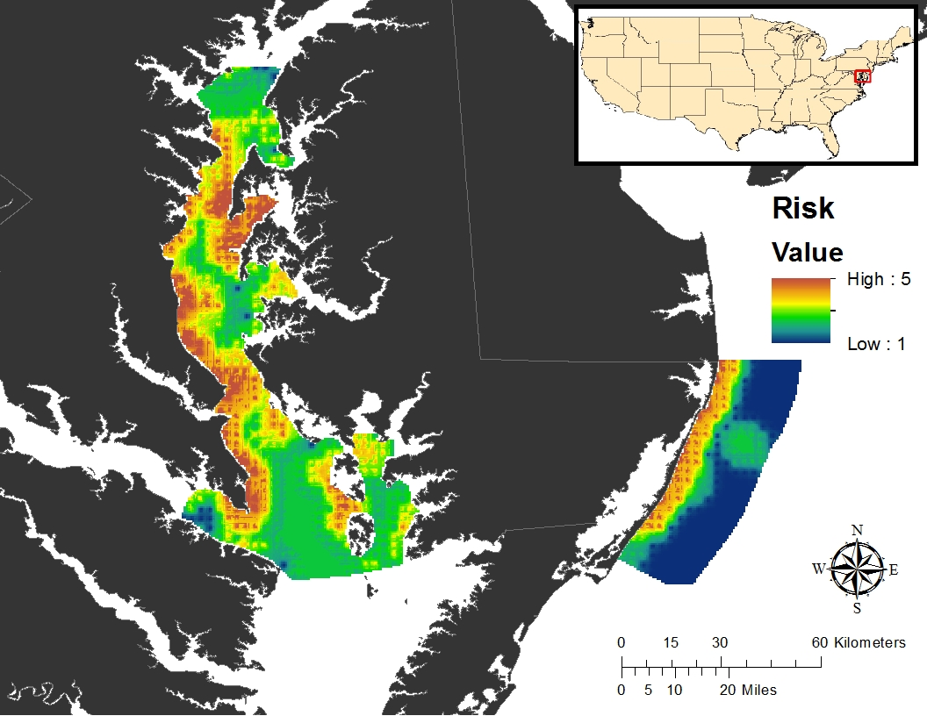
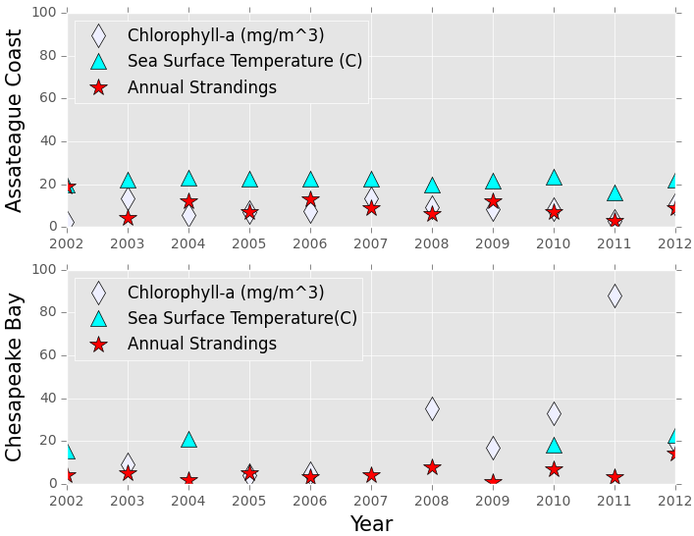
Stranding: Results
Parameter | Pearson’s r Correlation | P | CORR
Chl-a | -0.00397 | 0.991 | - None
SST | 0.551 | 0.098 | + Strong
Parameter | Pearson’s r Correlation | P | CORR
Chl-a | -0.00397 | 0.991 | - None
SST | 0.551 | 0.098 | + Strong
Parameter | Pearson’s r Correlation | P | CORR
Chl-a | -0.308 | 0.419 | - Mod
SST | 0.525 | 0.648 | + Strong
Parameter | Pearson’s r Correlation | P | CORR
Chl-a | -0.308 | 0.419 | - Mod
SST | 0.525 | 0.648 | + Strong
Notes:
The graph illustrates a comparison between the annually averaged chlorophyll-a concentrations, sea surface temperatures, and stranding counts for two distinct regions, Assateague Coast (top) and Chesapeake Bay (bottom). The annual averages of exposed sea surface temperature range from about 15 ℃ to 24 ℃. While, average exposure to chlorophyll-a range from 2 to 85 mg/m^3. Overall, sea turtles are exposed to a higher range of chlorophyll values in the Chesapeake Bay, whereas the Assateague coastline exhibit a relatively steady trend. The Pearson’s r correlation values reveal a strong, positive correlation between sea surface temperature and annual stranding events. However, warmer temperatures may not be the direct cause of mortality. Instead, it may provide great conditions for bacteria, fungi, and viruses and can also signal prey to leave typical loggerhead foraging grounds.
Finally, the risk map was created to identify spatial distribution of potential areas of concern for stranding events in 2015 which may be helpful for future mitigation efforts.

Slide 8
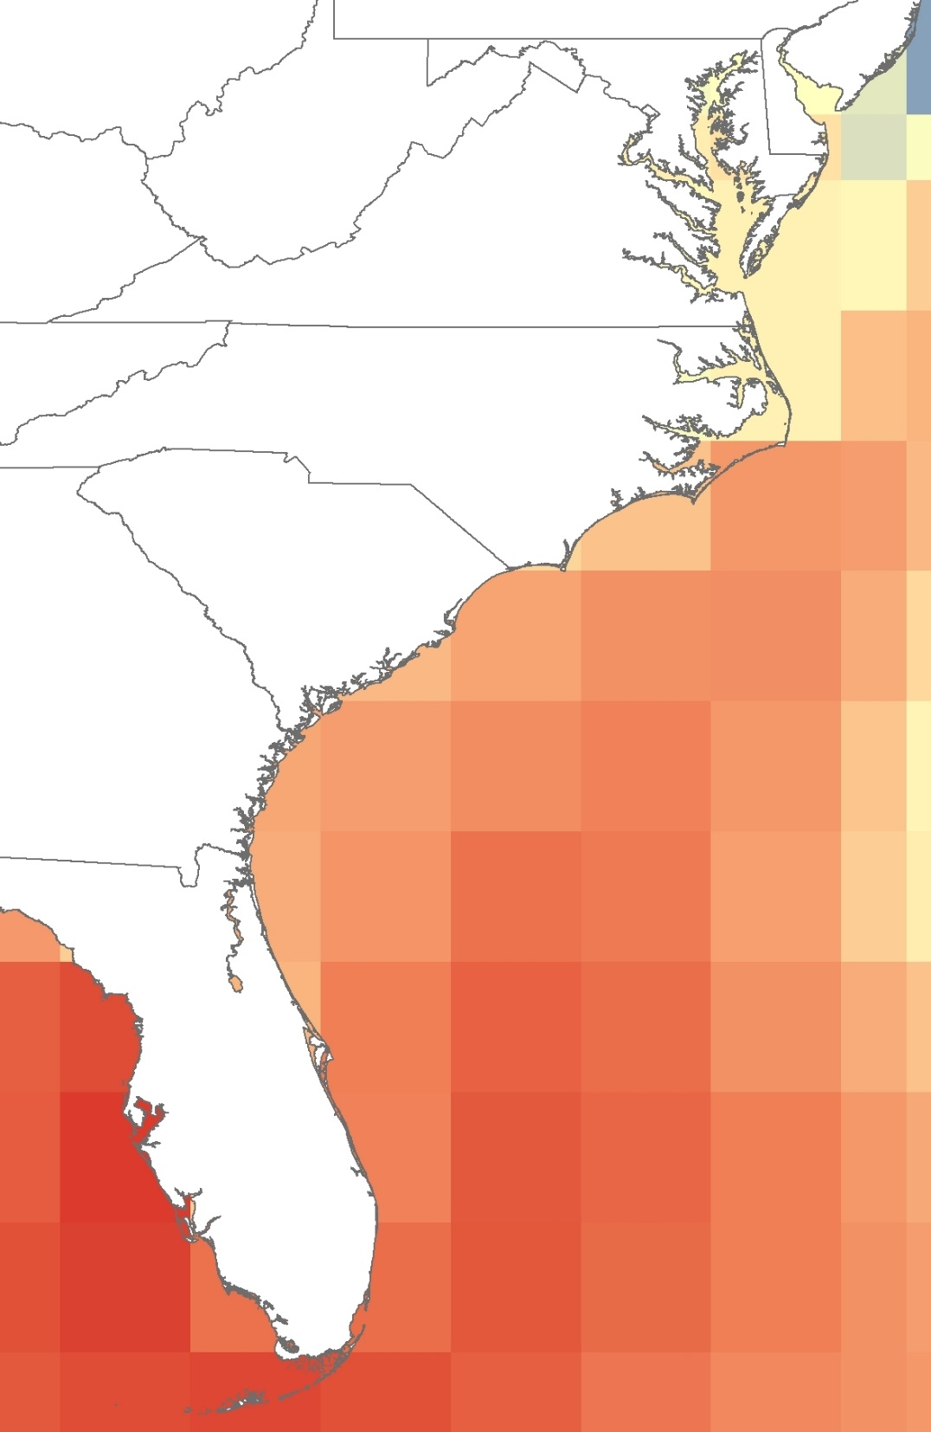
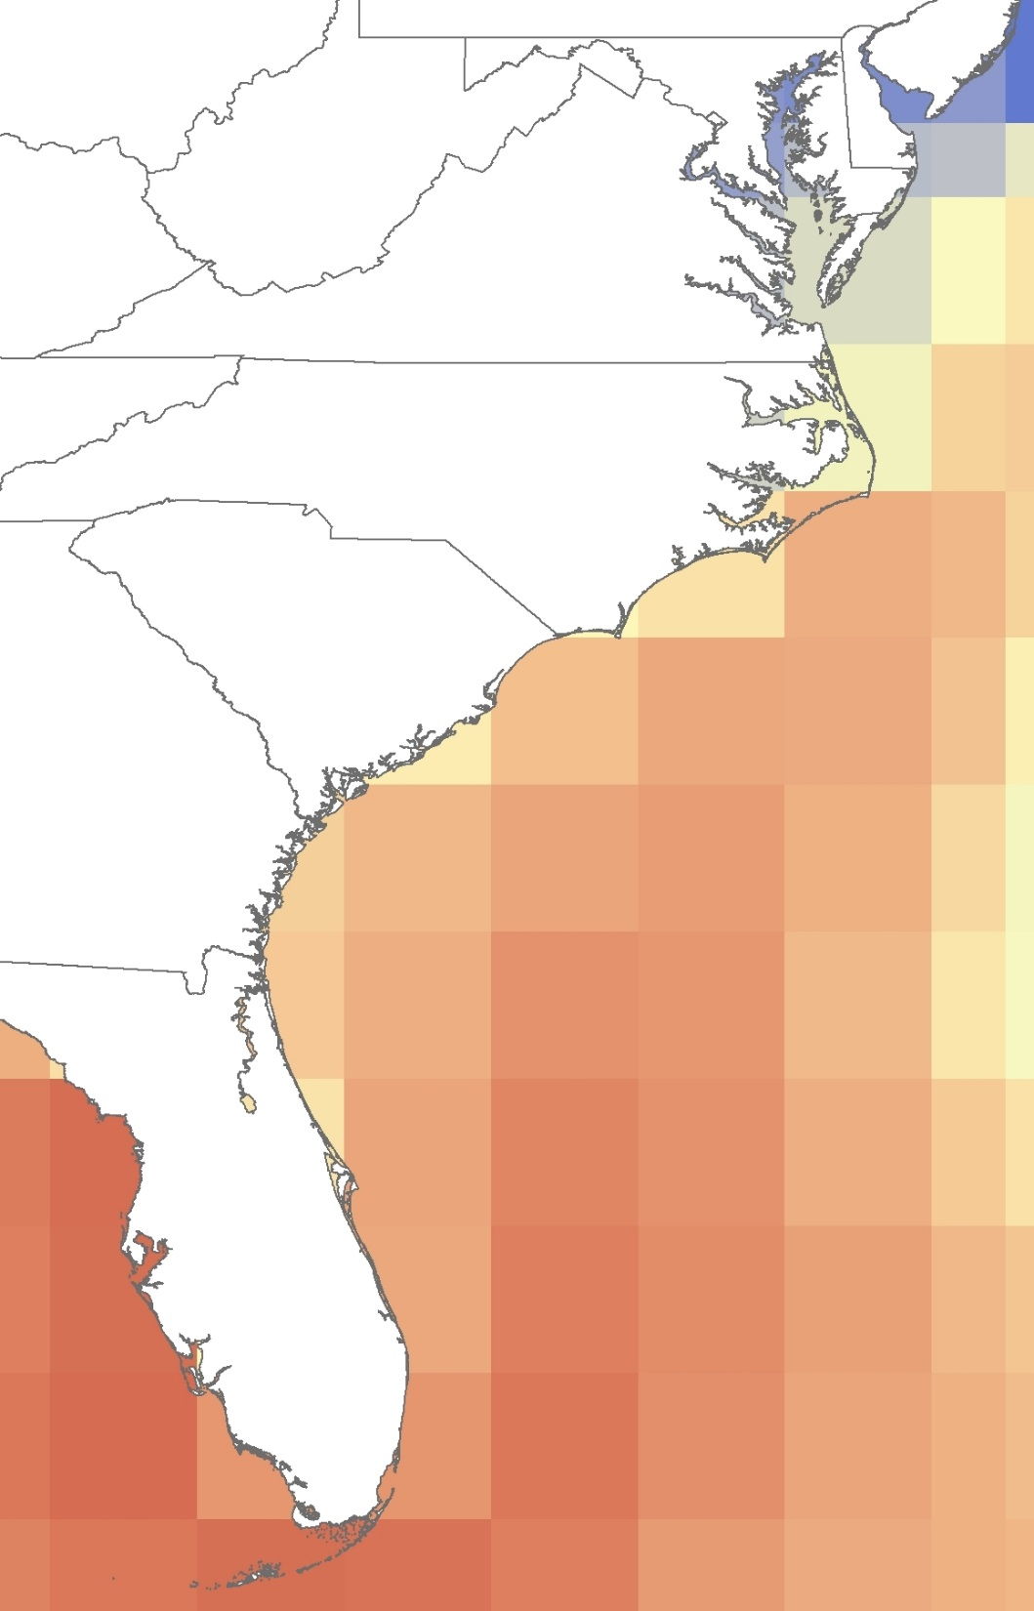
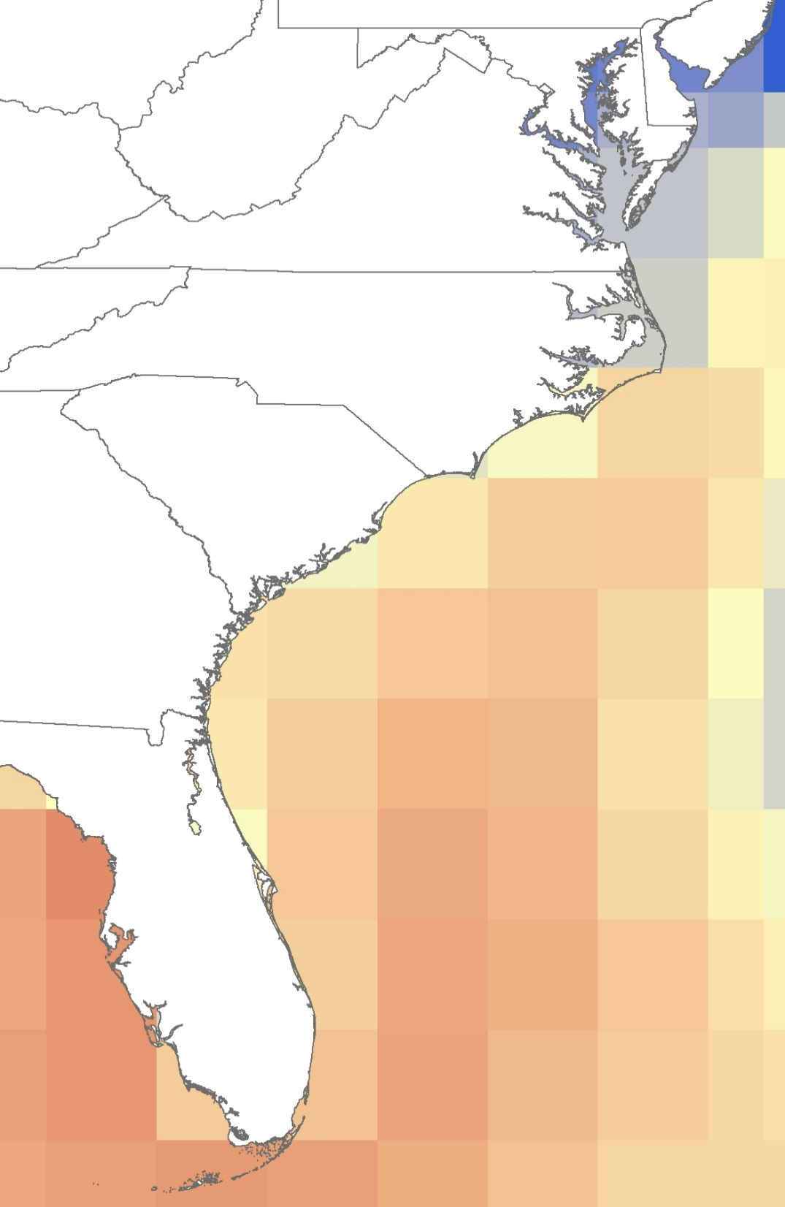
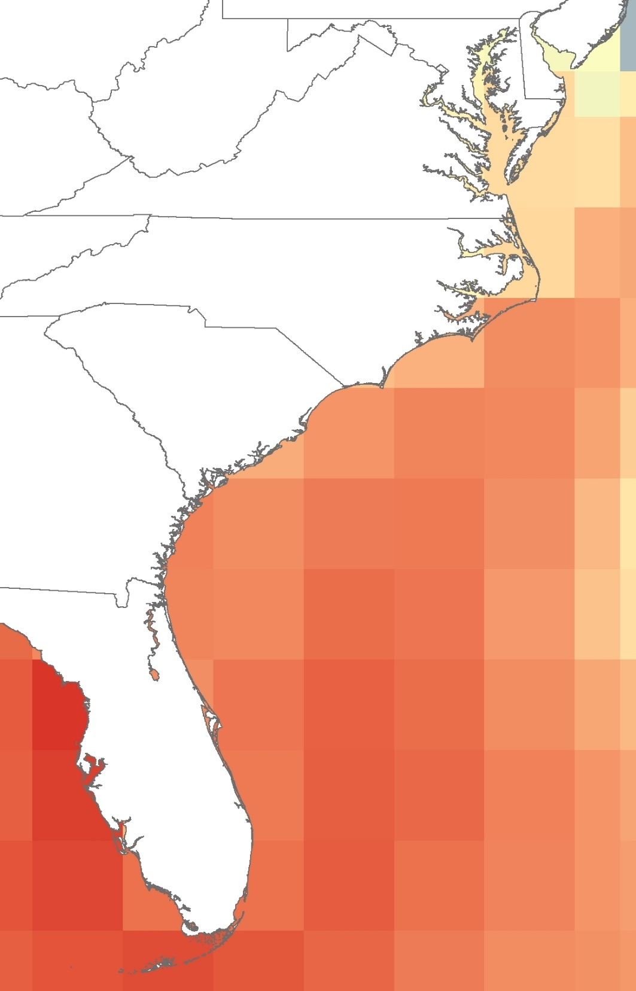

Climate Change
Methods
National Center for Atmospheric Research (NCAR)
Community Climate System Model 3
4th International Panel on Climate Change (IPCC)
Breeding range
Commit
29.75°C
23.11°C
High A2
Low B1
Med A1B
Notes:
Currently the breeding range of loggerheads spans from Florida to North Carolina and is limited by surface temperature. We investigated how future climate change will affect nest site distribution in Maryland using NCAR’s Community Climate System Model 3 which are derived from the 4th IPCC. We analyzed four different surface temperature scenarios, shown here for July in the year 2050. The Commit scenario assumes constant emissions since 2000. The others assume low, B1, medium, A1B, and high, A2, emissions. There is a higher emissions scenario not tested here, but current society is along track the A2 scenario. As you can see, the future climate in Maryland changes drastically depending on the scenario.

Slide 9
Climate Change: Results
May
July
Current nesting temp from FL - NC
Surface temperature (°C)
June
August
Nest site fidelity?
Notes:
We identified the range of temperatures during their current breeding season, which runs from May to August, along North Carolina to Florida, with the higher temperatures along the Florida coast. For example, in May 2015, the surface temperature along Florida was near 26 degrees while it was near 22 degrees in North Carolina. We then compared the offshore temperature in Maryland over the four scenarios until 2099 for each month. In May, only the highest emission scenario lead to significant nesting in Maryland by 2080. The trend is similar in June, but nesting increases by 2070. In July, loggerheads most active nesting period, the medium and highest scenarios reach breeding temperatures around 2040. The increase is most drastic in August. where breeding temperatures are reached by 2030 across most scenarios.

Slide 10
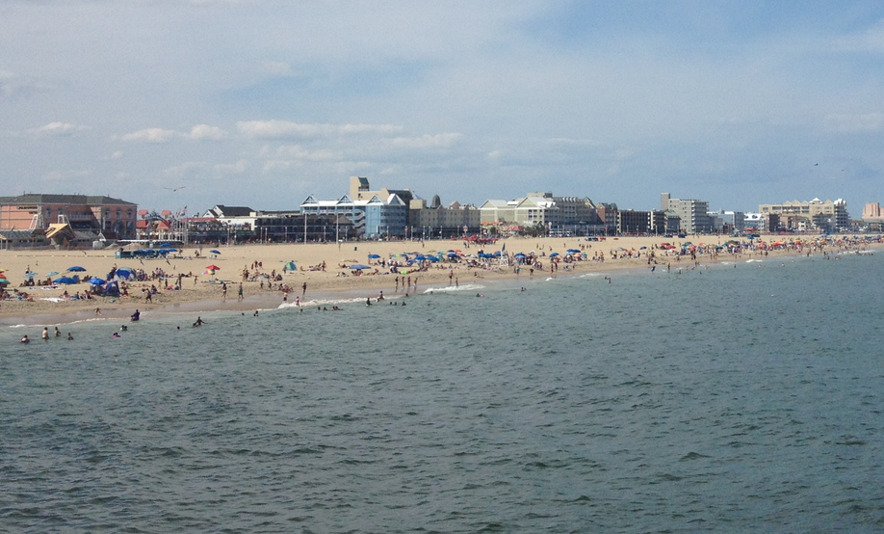
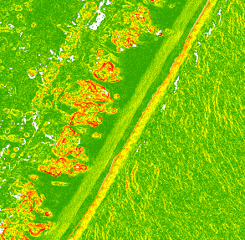
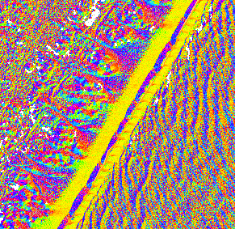
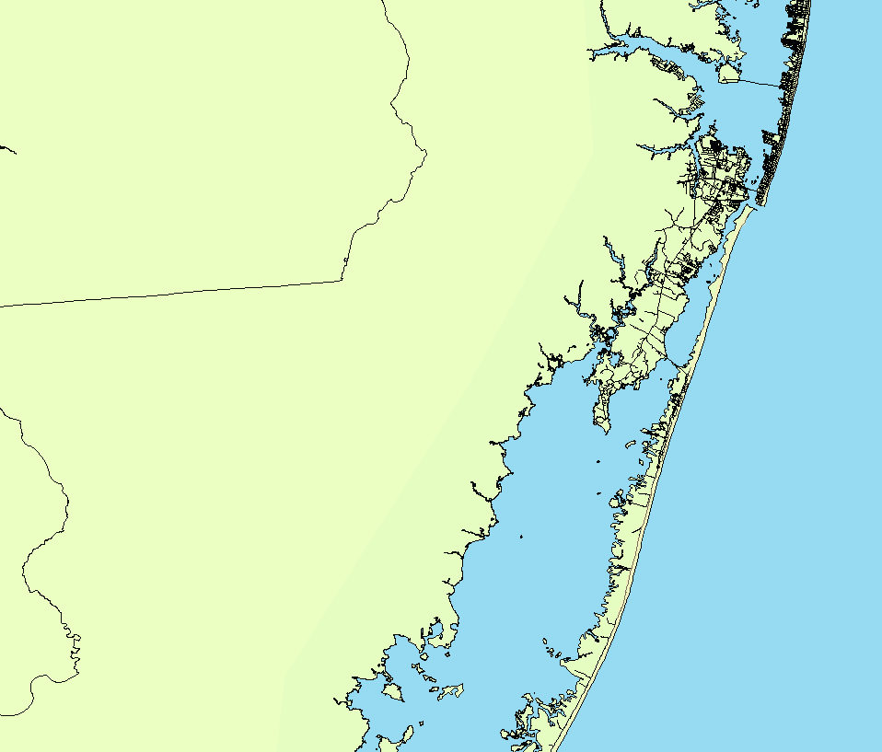

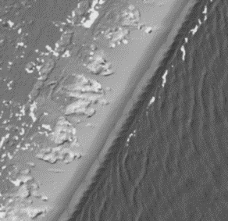
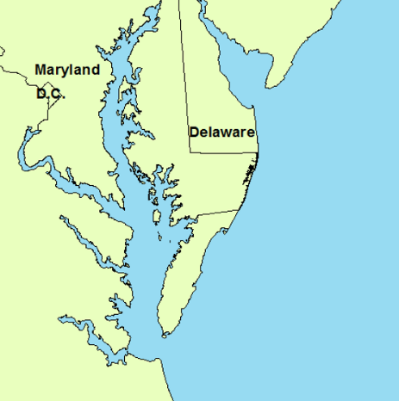
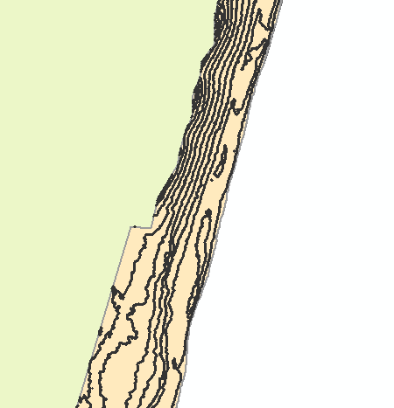

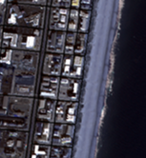
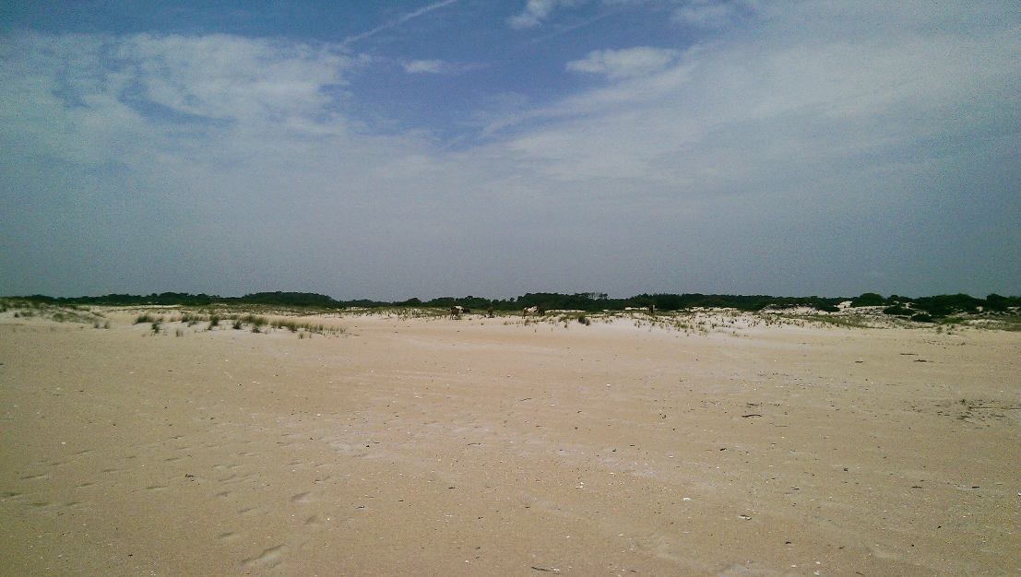
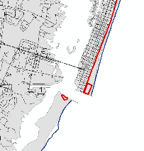

Nesting: Data Acquisition
DEM Products
Slope
Aspect
Data Acquisition
DEM
Ocean City
NOAA LiDAR Survey
Contour
Imagery
Wikicommons: dough4872
WV2 Satellite
Assateague Island
MD Atlantic Coastline
Roads
Dev.
Boundary
TIGER Layers
Notes:
If climate change results in a northern shift in sea turtle nesting range, nesting events may become more common in Maryland. We modeled potential suitable nesting habitat along Maryland’s coast to determine how much suitable habitat exists, where it is, and what impacts sea level rise may have on nesting. We focused on the Maryland Atlantic coast, which stretches about 30 miles from Ocean City to Assateague Island, with varying amounts of land use occurring on the barrier-island beaches found in this region. For this region, we obtained data from a NOAA LiDAR survey, imagery from WV2, and vectors from the TIGER database. The LiDAR-derived DEM was used to create products (slope, aspect, contour). Satellite imagery was obtained from the WV2 satellite, and the roads layer (along with imagery) was used to create a development boundary layer.

Slide 11
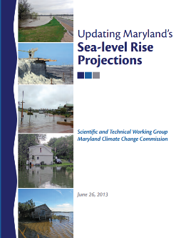
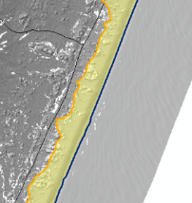
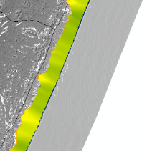
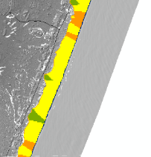
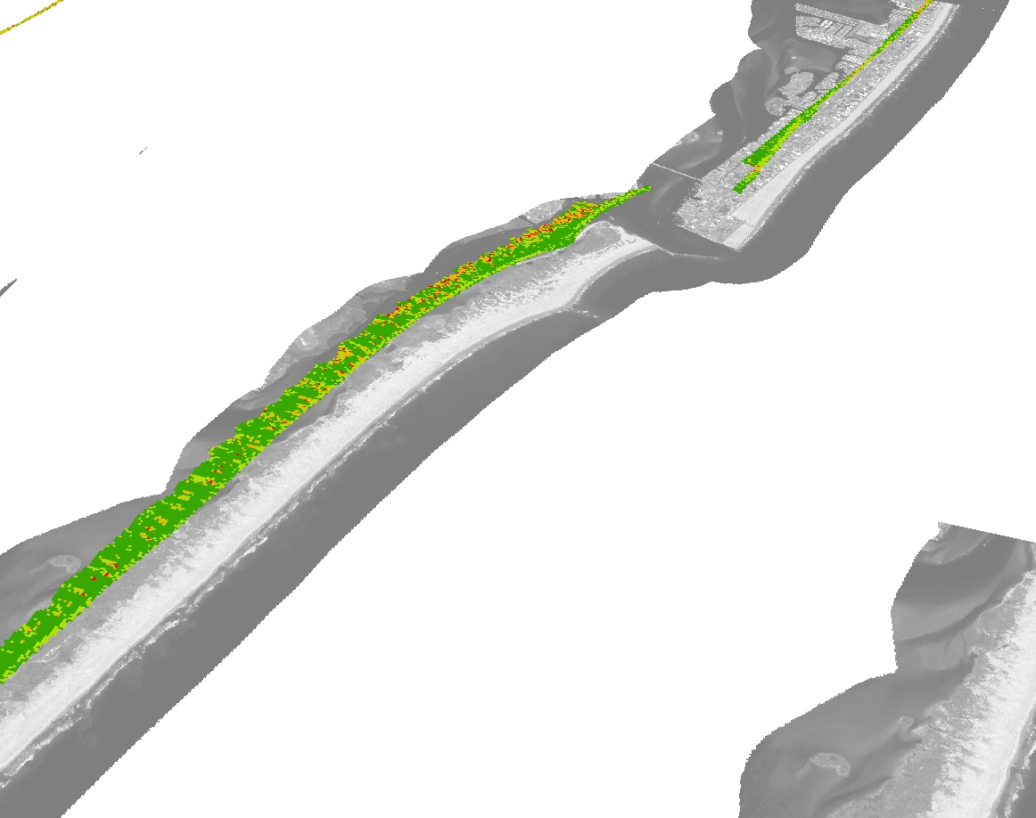
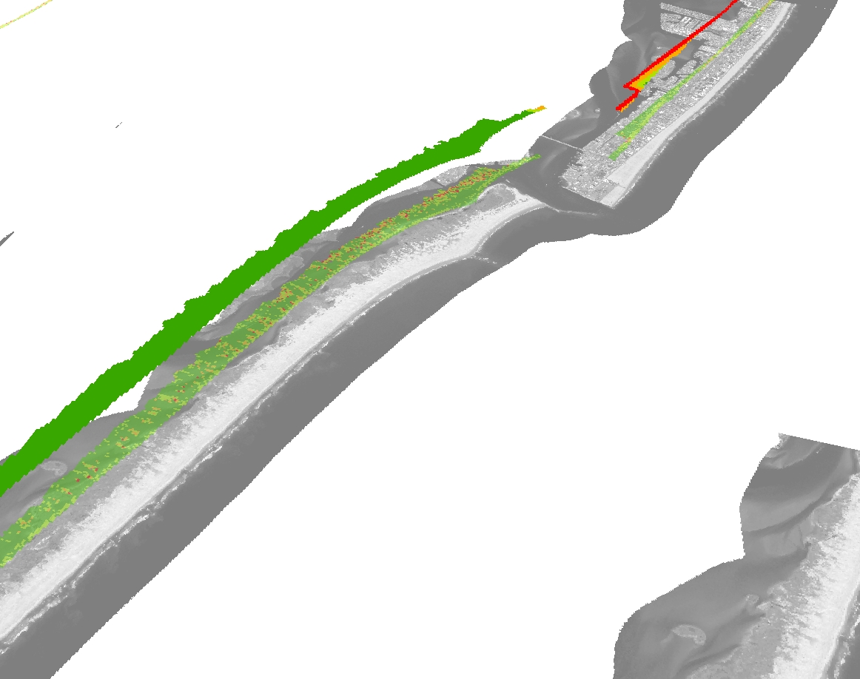
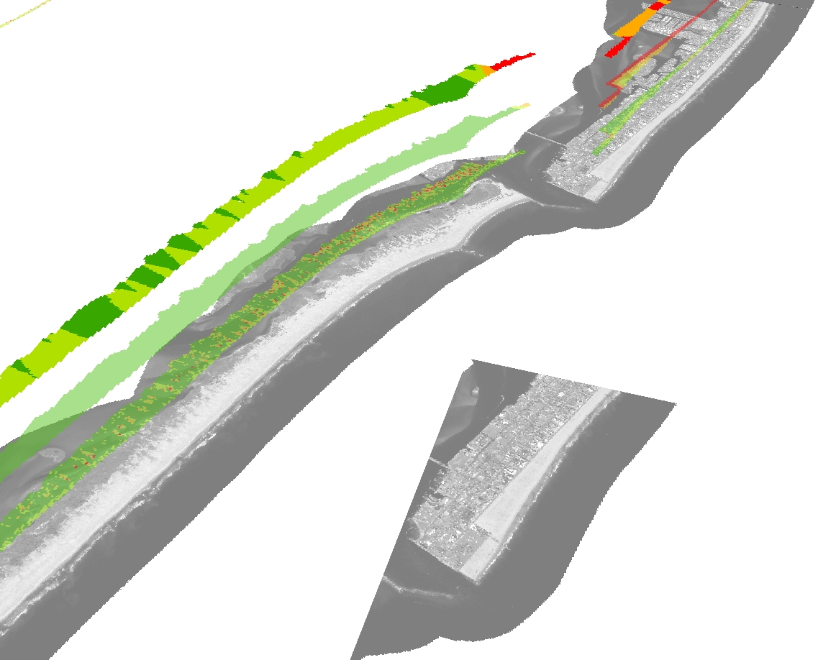
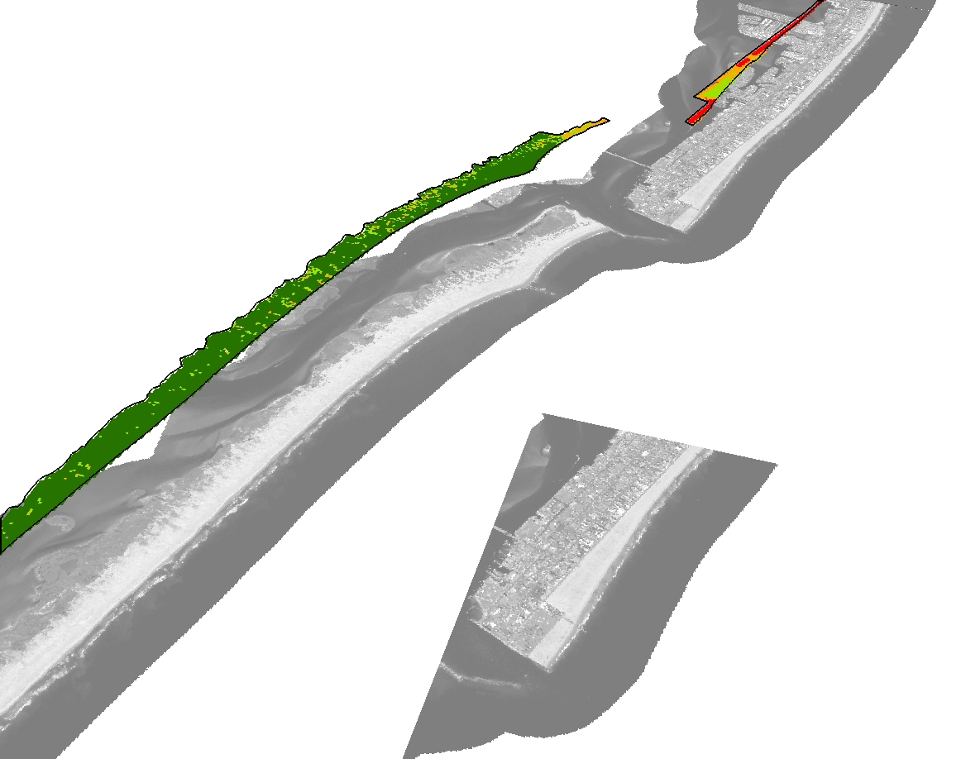
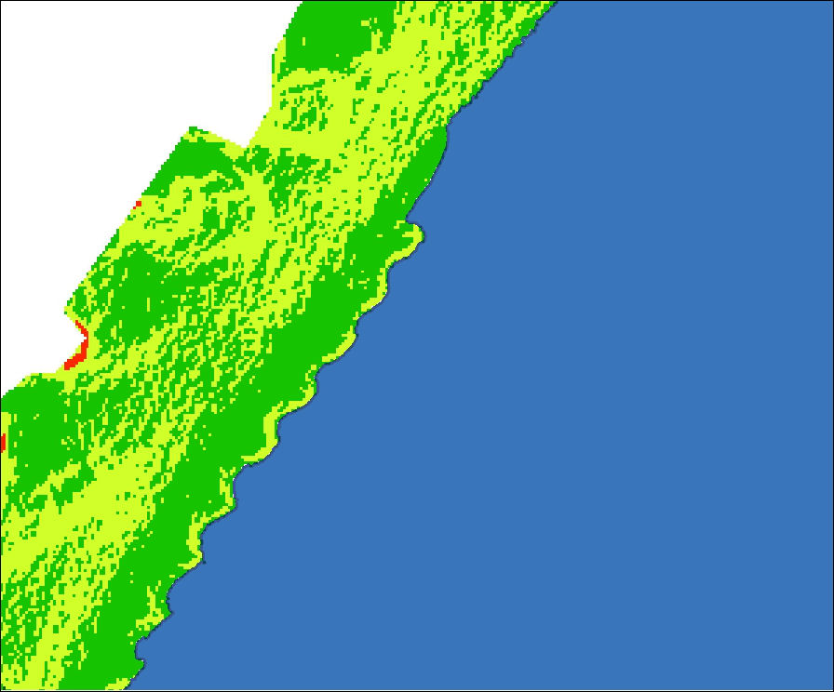
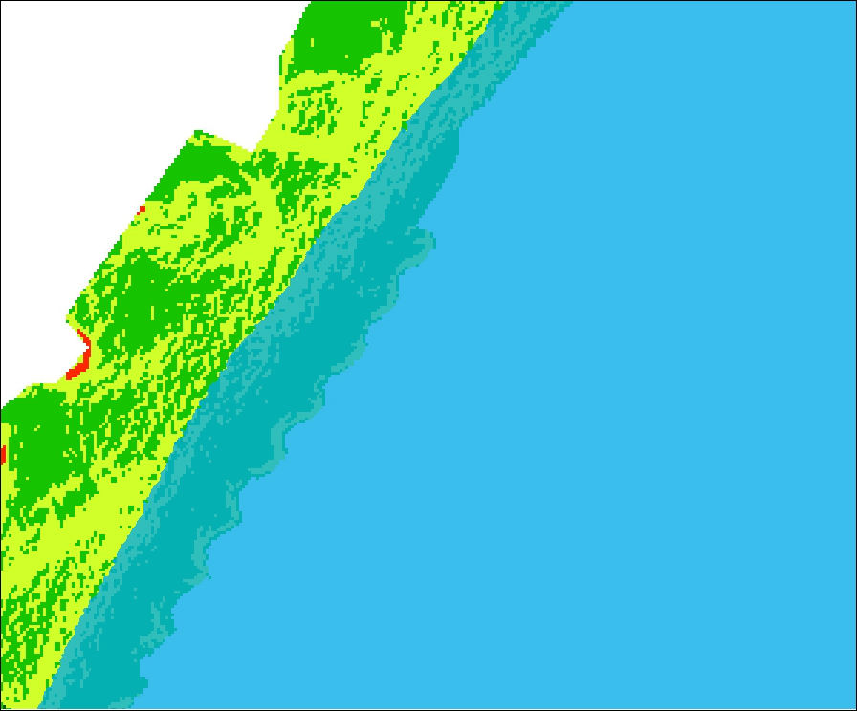
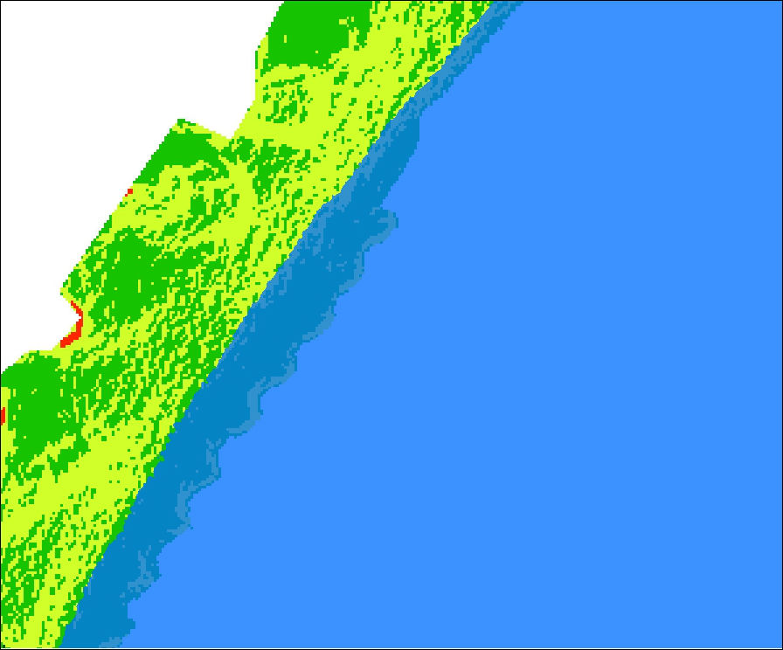
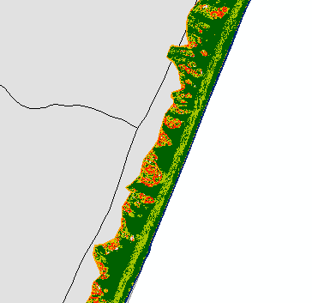
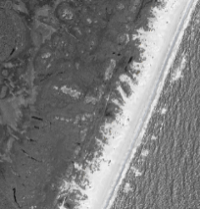
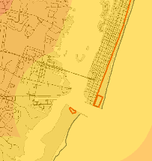
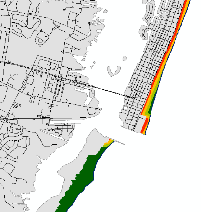
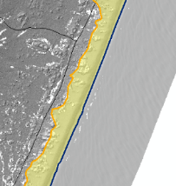
Nesting: Methodology
Beach Zone Digitization
Beach Width
DEM
Beach
Zone
Beach
Width
Suitability
+1m (2050)
+2m (2100)
+0m (current)
Maryland-specific sea level rise projections
Slope
Slope &
Aspect
Anomalies
Width
Contours
Overall Nesting Suitability
Distance to Development
DEM
Slope
Suitability
Slope
Imagery
Distance to Development
Dev.
Boundary
Distance
to Dev.
Suitability
Beach
Zone
Notes:
To create suitability layers, we first needed to delineate the beach/nesting zone along the beach area studied. We used the DEM and products to identify anomalies near the water-land barrier from the LiDAR data; this and imagery was used to ID the shoreline. We used the upland vegetation line, manmade barriers, or a 150-m buffer from the ocean to create the upland boundary of this zone: the distance of 150m was used as turtles do not crawl farther than this to lay a nest.
Using this beach zone, width suitability was created from distance layers of the shore and land boundary. Slope suitability was created from the slope layer and reclassified to turtle’s slope preference (which has been found to be for gentler slopes. Finally, distance to development was modeled using the boundary layer from TIGER layers. This served as an index of human disturbance, which includes impacts on sand coarseness, salinity, aeration, as well as debris, trash, and direct interaction to nesting and hatching turtles and their nest sites
We overlaid these three suitability layers using the weighted overlay tool. Beach width was a basic index of suitability, with wider beaches simply offering more possible choices and greater resistance to erosion, sea level rise, or development. Thus this layer was weighted less. Slope was the most important factor to nesting we studied, so it received a greater weight. Distance to development received an intermediate weight in this analysis.
We also wanted to investigate effects of climate-change derived sea-level rise on nesting grounds. We used projections from an updated report on Maryland-specific sea level rise to “flood” the suitability layer; a 1 and 2m rise by 2050 and 2100 was selected, and flooded by finding the closest continuous contour line to the corresponded elevation. This allowed us to visualize and quantify nesting habitat loss under these scenarios.

Slide 12
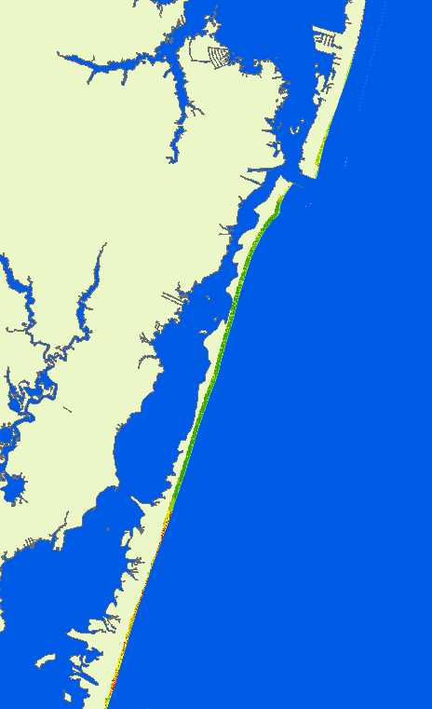
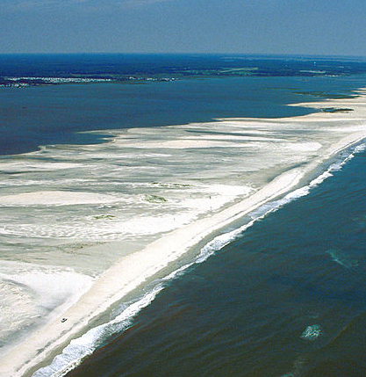
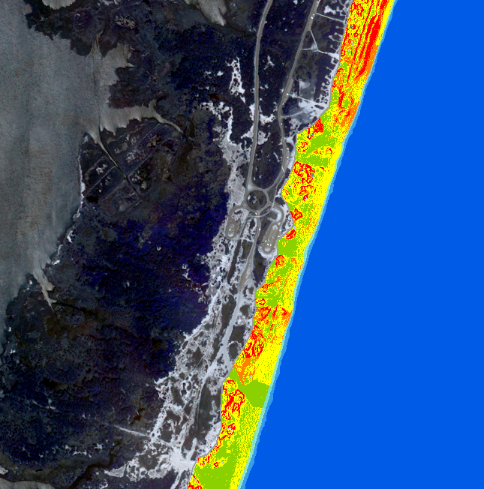




Nesting: Results
U.S. Army Corps of Engineers Digital Visual Library
Notes:
Our analysis identified 5.5 square km of habitat, with approximately 3.7 of this has highly suitable habitat. We found that sea level rise results in an 8 and 14% loss of total habitat for 1 and 2 meter rises, respectively. Looking at specific suitability class loss, most of this is in the medium and high suitable classes; with an up to 20% loss seen.
These insets show the variety of habitat along the study area. Assateague Island has the most suitable habitat, but has some areas experiencing habitat loss due to flooding. Likewise, while Ocean City has fairly poor habitat, it experiences great loss under sea level rise and has some regions that may host nests. There are a lot of regions in Assateague that are more resistant to flooding and have highly suitable habitat. However, some regions such as near campgrounds and vehicle access are less suitable. Overall, these areas show regions of concern or conservation focus for future nesting monitoring and conservation efforts.

Slide 13



Conclusions
Increased temperatures correlated to increased strandings, potentially due to more bacteria
Climate change is expected to increase
nesting in Maryland, particularly in July
and August
Suitable nesting sites are plentiful outside of Ocean City, with some regions more resilient to sea level rise than others
Increased temperatures correlated to increased strandings, potentially due to more bacteria
Climate change is expected to increase
nesting in Maryland, particularly in July
and August
Suitable nesting sites are plentiful outside of Ocean City, with some regions more resilient to sea level rise than others
Increased temperatures correlated to increased strandings, potentially due to more bacteria
Climate change is expected to increase
nesting in Maryland, particularly in July
and August
Suitable nesting sites are plentiful outside of Ocean City, with some regions more resilient to sea level rise than others
Becky Skiba
Notes:
To summarize, we did find some correlations between environmental variables and strandings, specifically sea surface temperature. It’s likely not the temperature itself that is causing physiological distress, but factors correlated with temperature like bacterial growth. Climate change modeling indicates that we can expect greater nesting in Maryland, particularly if society stays along the A2 scenario within the next decade. As climate change pushes loggerhead nesting northward, it’s critically important to protect their nesting grounds. Most of the critical habitat is located along Assateague Island which is a National Park, but human activities should be reduced in these optimal regions for nesting.

Slide 14

Advisor
Dr. John Bolten (NASA Goddard Space Flight Center)
Partners
Cindy Driscoll (Maryland Department of Natural Resources)
Amanda Weschler (Maryland Department of Natural Resources)
Others
Gary Strand (National Climate and Atmosphere Research)
Notes:
We would like to thank our science advisor Dr. John Bolten for all of his assistance as well as Gary Strand who helped us immensely with the climatological modeling. Thank you to Cindy and Amanda of the MD DNR for their help in this project and supplying us with datasets and taking us into the field to visit stranding and nesting sites. Thank you, are there any questions?

