Slide 1
Northwest United States Agriculture II
Evaluating Suitability for Apple Cultivation Based on Accumulated Chill Hours in Washington State from 2003-2065
Lydia Cuker (Project Lead)
Laura Lykens
Alyssa Walzak
Tim Stelter

Slide 2
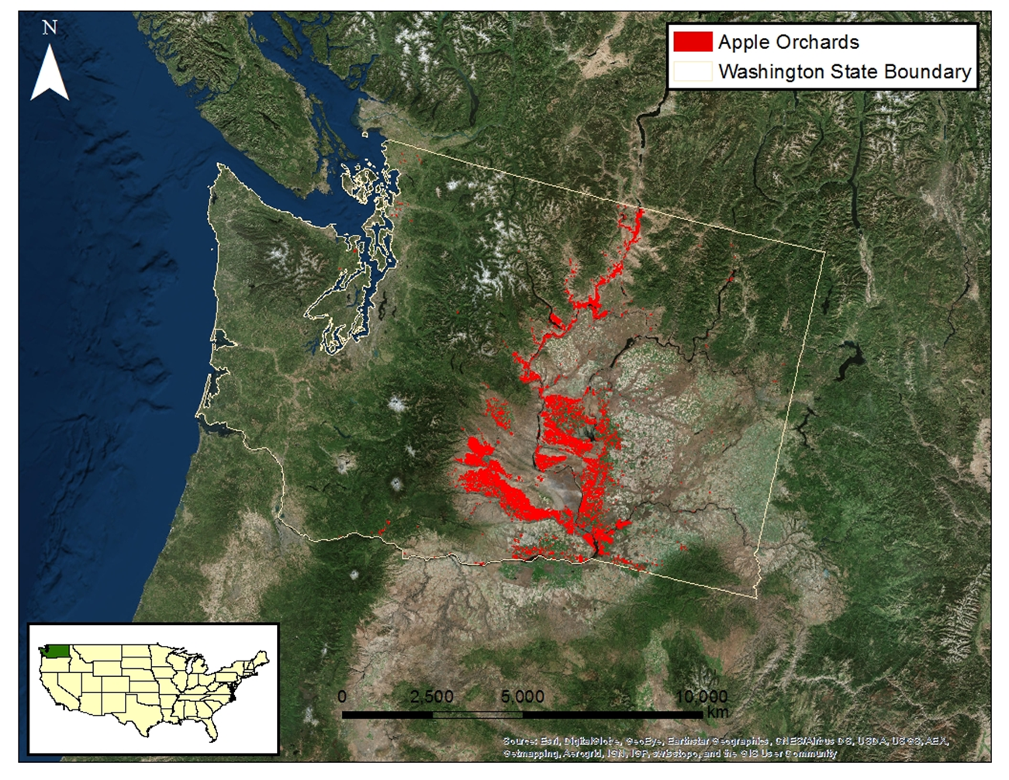
Study Area: Washington, USA
Top apple producing state in US (USDA)
Majority of apple orchards are east of the Cascade Mountains
Study Period: 2003 – 2013, 2040 – 2070

Slide 3
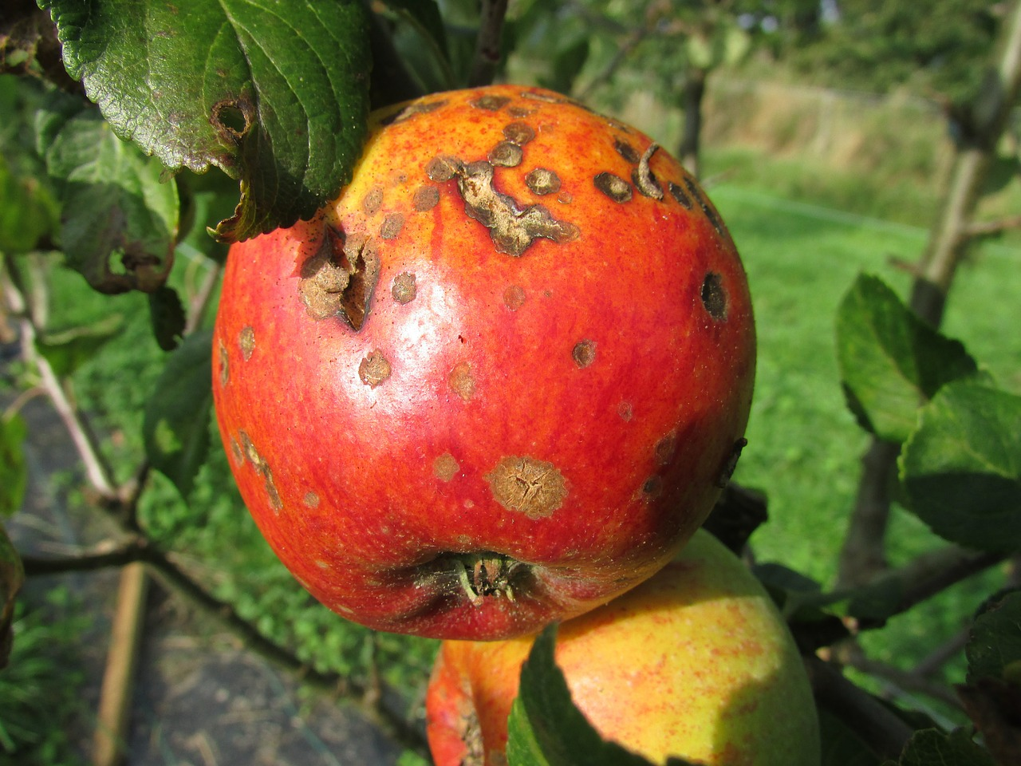
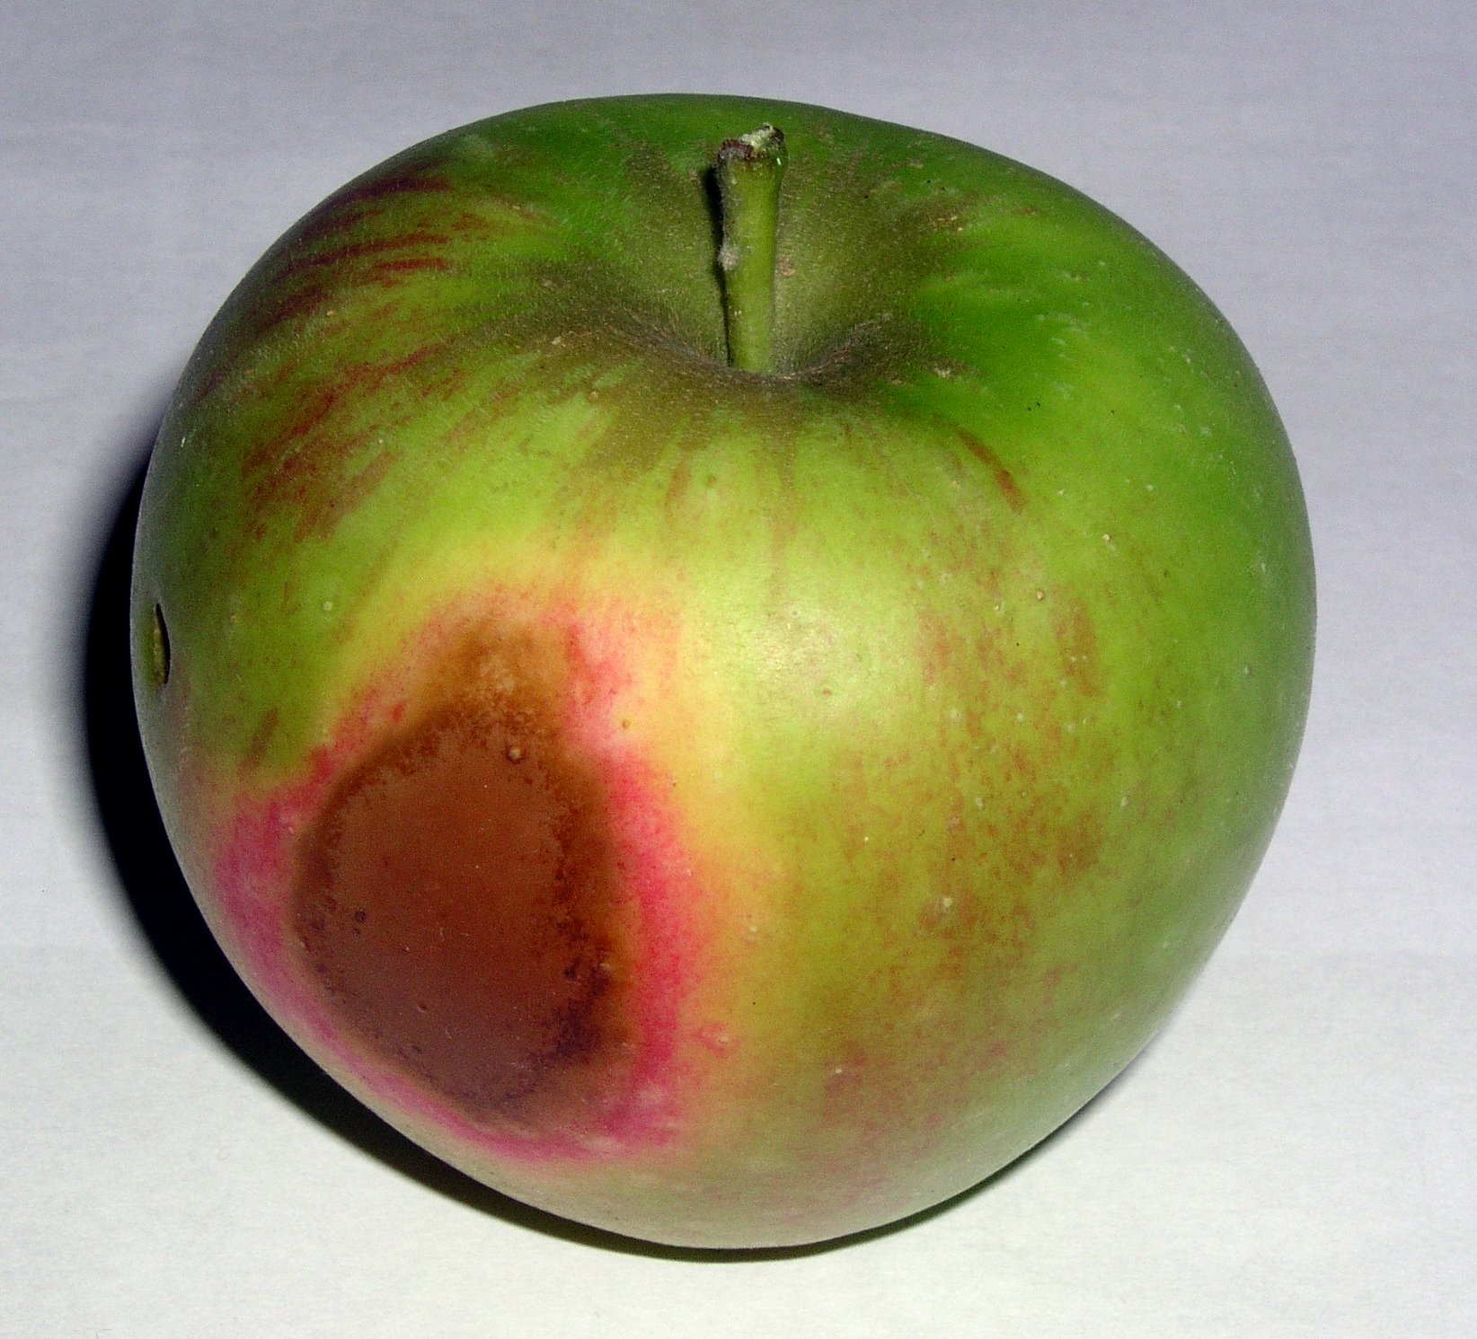
Community Concerns
Climate fluctuations may alter temperature trends, resulting in negative impacts on apple growth
If temperatures rise there could be
  A reduction in accumulated chill hours for locations where apples are currently grown
  An increased demand for irrigation resources, which could raise the cost of apple production
Apple Blight
Apple Sunburn
Source: Kasman
Source: J. Stein

Slide 4
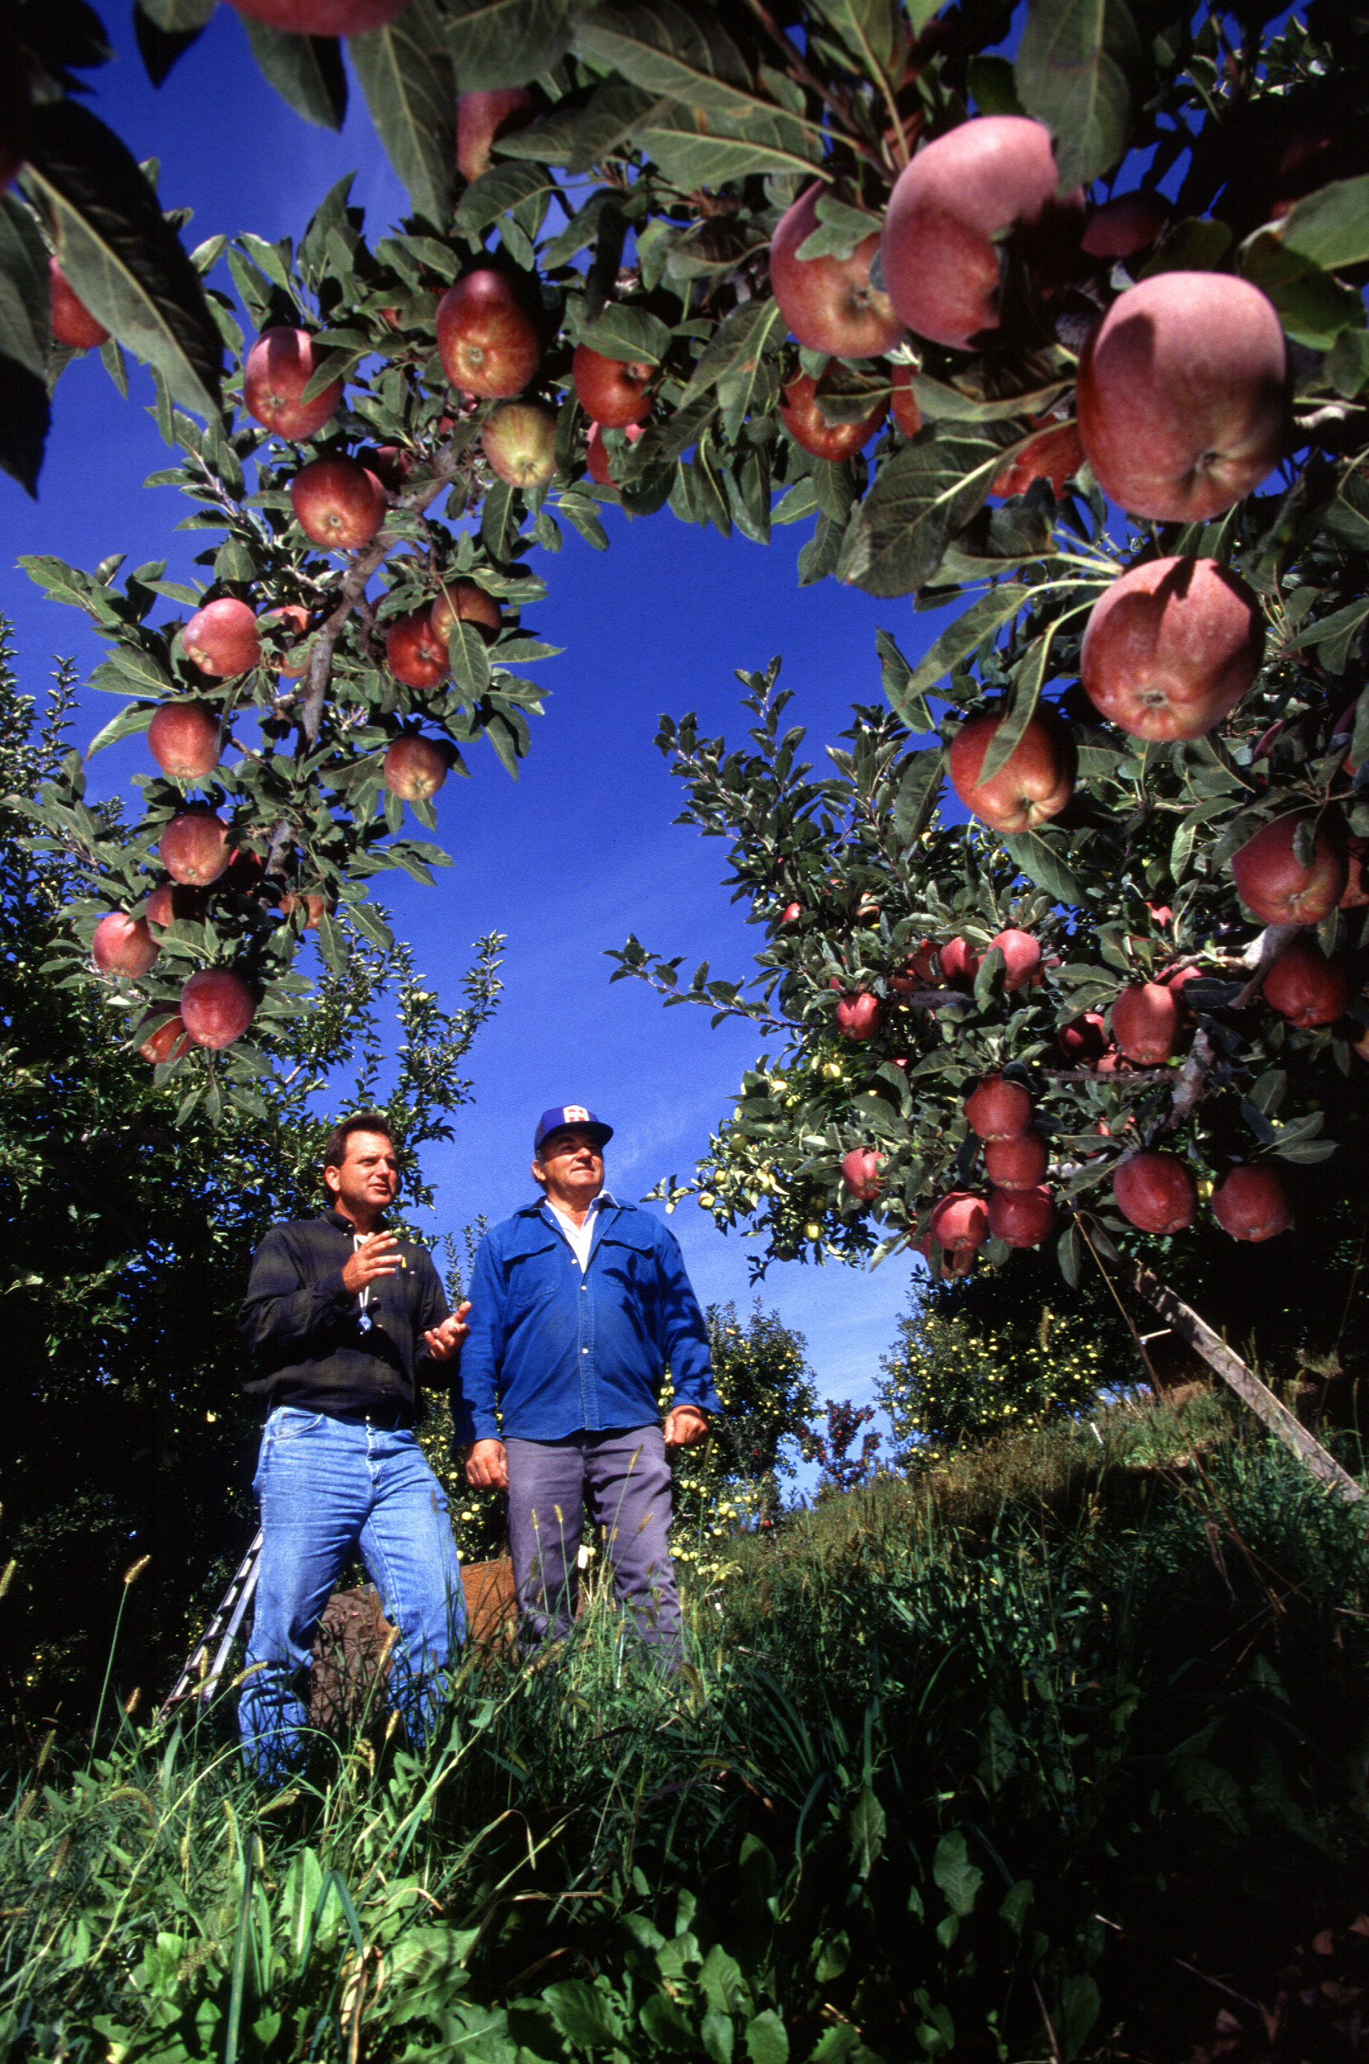

Objective & Project Partner
Map accumulated chill units
  Current Accumulated Chill Units
  Forecasted Accumulated Chill Units
Dr. Michael Glenn
Appalachian Fruit Research Station
USDA - Agriculture Research Service
Source: S. Bauer, USDA - ARS

Slide 5
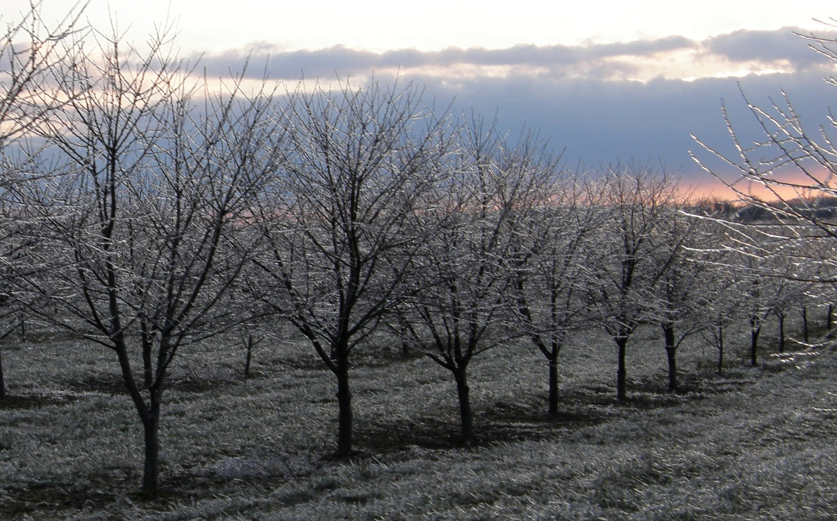
Chill Hours
The number of hours that fruit trees experience within a specific temperature range
  1.4ºC < T_{air} ≤ 12.4ºC
Apple trees require 500-1000 chill hours to thrive
Source: fauxto_digit

Slide 6
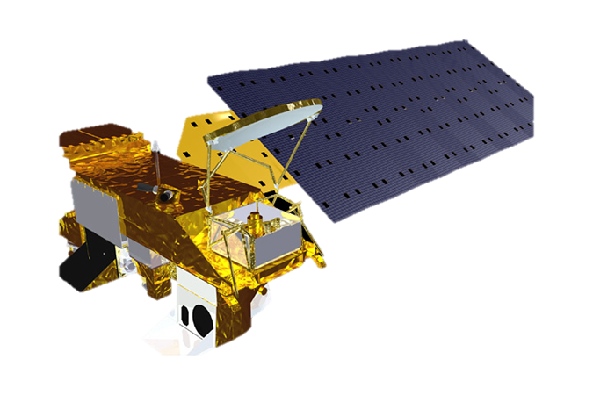

Earth Observations
Aqua MODIS
MODIS Lands Surface Temperature (LST)
Terra MODIS

Slide 7
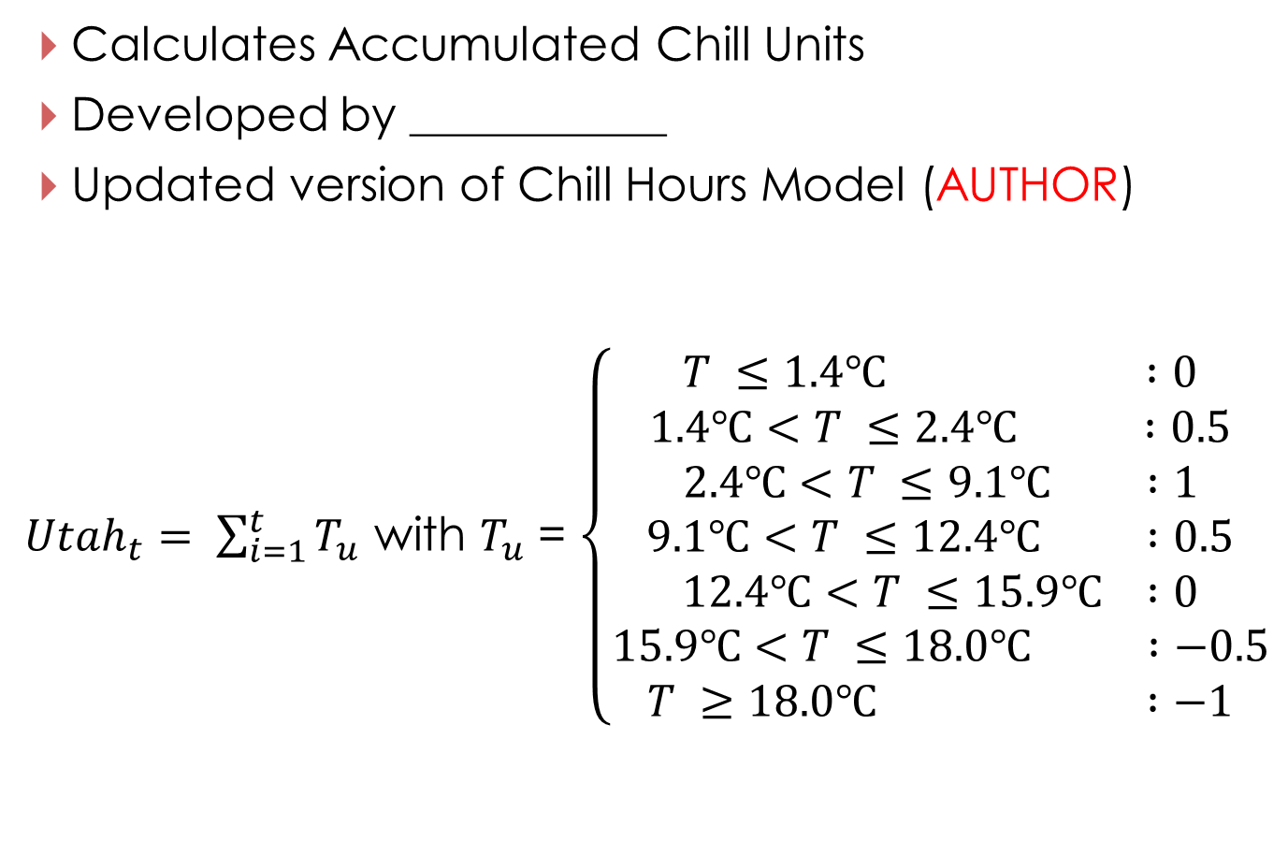
Utah Model
Calculates Accumulated Chill Units
Developed by ___________
Updated version of Chill Hours Model (AUTHOR)
${Utah}_{t}= \sum_{i=1}^{t}{T_{u}}$ with $T_{u}$ = $\left\{\begin{aligned}T ≤1.4℃ :0 \\ 1.4℃<T ≤2.4℃ :0.5 \\ 2.4℃<T ≤9.1℃ :1 \\ 9.1℃<T ≤12.4℃ :0.5 \\ 12.4℃<T ≤15.9℃ :0 \\ 15.9℃<T ≤18.0℃ :−0.5 \\ T ≥18.0℃ :−1\end{aligned}\right.$

Slide 8
Project Methodology
Data Acquisition
Data Processing
Data Analysis
Hourly Temperature
NOAA Ground
Weather Stations
2003 – 2013
Average hourly
temperature per day
Utah Model
Current Accumulated
Chill Units
Convert to T_{air}
Land Surface
Temperature (LST)
MODIS
2003 – 2013
Apply temperature fluctuation curve to daily T_{max} and T_{min}
Utah Model
Current Accumulated
Chill Units
Forecasted Air Surface Temperature (tas)
CMIP5 North American CORDEX Climate Model
2040 – 2070
Add forecasted changes
to T_{max} and T_{min}
Utah Model
Forecasted Accumulated Chill Units
Fit temperature curve to forecasted T_{max} and T_{min}

Slide 9
Project Methodology
Data Acquisition
Data Processing
Data Analysis
Hourly Temperature
NOAA Ground
Weather Stations
2003 – 2013
Average hourly
temperature per day
Utah Model
Current Accumulated
Chill Units
Convert to T_{air}
Land Surface
Temperature (LST)
MODIS
2003 – 2013
Apply temperature fluctuation curve to daily T_{max} and T_{min}
Utah Model
Current Accumulated
Chill Units
Forecasted Air Surface Temperature (tas)
CMIP5 North American CORDEX Climate Model
2040 – 2070
Add forecasted changes
to T_{max} and T_{min}
Utah Model
Forecasted Accumulated Chill Units
Fit temperature curve to forecasted T_{max} and T_{min}

Slide 10
Project Methodology
Data Acquisition
Data Processing
Data Analysis
Hourly Temperature
NOAA Ground
Weather Stations
2003 – 2013
Average hourly
temperature per day
Utah Model
Current Accumulated
Chill Units
Convert to T_{air}
Land Surface
Temperature (LST)
MODIS
2003 – 2013
Apply temperature fluctuation curve to daily T_{max} and T_{min}
Utah Model
Current Accumulated
Chill Units
Forecasted Air Surface Temperature (tas)
CMIP5 North American CORDEX Climate Model
2040 – 2070
Add forecasted changes
to T_{max} and T_{min}
Utah Model
Forecasted Accumulated Chill Units
Fit temperature curve to forecasted T_{max} and T_{min}

Slide 11
Project Methodology
Data Acquisition
Data Processing
Data Analysis
Hourly Temperature
NOAA Ground
Weather Stations
2003 – 2013
Average hourly
temperature per day
Utah Model
Current Accumulated
Chill Units
Convert to T_{air}
Land Surface
Temperature (LST)
MODIS
2003 – 2013
Apply temperature fluctuation curve to daily T_{max} and T_{min}
Utah Model
Current Accumulated
Chill Units
Forecasted Air Surface Temperature (tas)
CMIP5 North American CORDEX Climate Model
2040 – 2070
Add forecasted changes
to T_{max} and T_{min}
Utah Model
Forecasted Accumulated Chill Units
Fit temperature curve to forecasted T_{max} and T_{min}

Slide 12
Results
Results
Discussion
Uncertainty/Error Analysis

Slide 13
Conclusions
Conclusions
Benefits of Research
Any Future Work (if applicable)

Slide 14
Acknowledgements
Dr. Kenton Ross
NASA DEVELOP National Program
Science Advisor
Dr. Noel Baker
NASA Postdoctoral Program Fellow
Nathan Owen
NASA DEVELOP – Langley Center Lead
Jeffry Ely
NASA DEVELOP Geoinformation Scientist
Chad Smith
NASA DEVELOP – Langley Assistant Center Lead
This material is based upon work supported by NASA through contract NNL11AA00B and cooperative agreement NNX14AB60A.

