Slide 1
Colorado Water Resources
Utilizing NASA Earth Observations to Identify Water Quality Sampling Sites in Denver, Colorado
Geordi Alm (Project Lead)
Janice Maldonado Jaime
Rachel Wolf
Amanda Collins

Slide 2
Water Resources
Globally, less than 0.01% of surface water is stored in freshwater lakes, streams, and rivers.
Primary source:
Runoff produced by snowmelt
Photo by Jimmy Thomas CC BY 2.0
Notes:
Water is an important and necessary n
The primary source of freshwater in some mountainous and arid regions is runoff produced by snowmelt, as in the state of Colorado. Seasonal snowmelt from these mountains provides the water that eventually makes its way into the Denver Water Collection System. Situated in the eastern part of the Front Range of the Rocky Mountains, and in the South Platte River Valley, the city of Denver receives a mean annual snowfall and precipitation of 147.32 cm and 38.07 cm, respectively (NWS-WFO Denver-Boulder, 2015). Denver Water uses five mountain reservoirs to collect surface water from streams, rivers, and lakes over a watershed of 8,000 km² (Denver Water, 2014). Historically, these reservoirs have provided over 1.3 million people with clean water; in 2014, Denver Water reported that several contaminants from sources such as mine sites, agriculture, and oil wells, had been detected in the water supply (Denver Water, 2014).
atural resource essential to the survival and health of ecosystems and all forms of life.

Slide 3
Denver Water Collection System
Denver Climatology:
Mean Annual Snowfall 147.32 cm
Mean Annual Precipitation 38.07 cm
Five mountain reservoirs collect surface water over a watershed of 8,000 km²
Provides clean water for over 1.3 million people
Several contaminants had been detected in the water supply
Insert Picture
Suggestions: Basemap of Denver, DW collection map, some reservoir, faucet running water…

Slide 4
Major Wildfires
Destructive fires can affect watersheds and largely reduce vegetative land cover.
Colorado’s semi-arid climate natural re-growth takes several years.
Loss of Vegetation Exposure of Soil
Increase Water Runoff
Photo by USDA CC BY 2.0
Photo by David Stein CC BY 2.0
Notes:
Fires result in loss of vegetation exposure of soil to erosion and increased water runoff that may lead to flooding increased sediment debris flows and damage to critical natural and cultural resources.
Forest fires, depending on the severity, can have a massive impact on an area’s watershed. A destructive fire will largely reduce vegetative cover which leaves the soil vulnerable to raindrop impact and reduces rainfall infiltration and storage, thus allowing erosive overland flow to occur more easily (Elliot and Vose, 2006). As a result, more sediment is washed into the water and water temperatures rise. The sediment often contains organic carbon, which contaminates the water supply; the increased water temperature changes the ecology of the water system, including the rate that contaminants are cycled through the ecosystem (UMCES, 2010). Vegetative re-growth can reverse the damage to the soil caused by fire, but in Colorado’s semi-arid climate natural re-growth takes several years (Nijhuis, 2012). If a major rainstorm or flood occurs before the area is able to re-grow its vegetation, all the loose sediments will be carried into the nearby creeks, streams, and rivers. These sediments often contain contaminants such as uranium and nitrate, which stem from the erosion of natural deposits, and organic carbon, which is often added into the water system by agriculture and urban runoff (Allain and Jones, 2013; Denver Water, 2014). Organic carbon is a major contributing factor for the decline in water quality, for it readily reacts to the chlorine used to treat water. The reaction forms trihalomethanes and haloacetic acids, which at elevated levels increase chances of cancer and birth defects (New Hampshire Department of Environmental Services, 2006; Allain and Jones, 2013; EPA, 2013). The amount of organic carbon that enters the water system is determined mostly by the type of soil it is in. Different soils will dispel the carbon at different rates; those with greater organic content dispel carbon more quickly, causing the water system to have increased amounts of organic carbon (Allain and Jones, 2013).

Slide 5
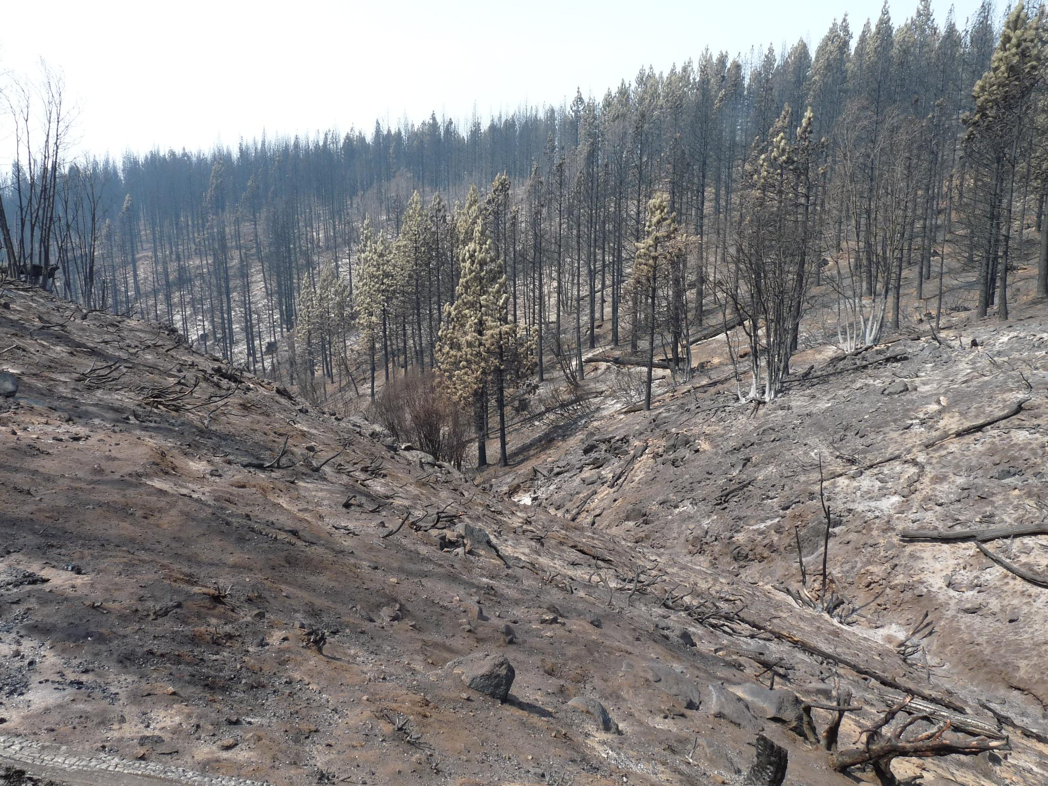
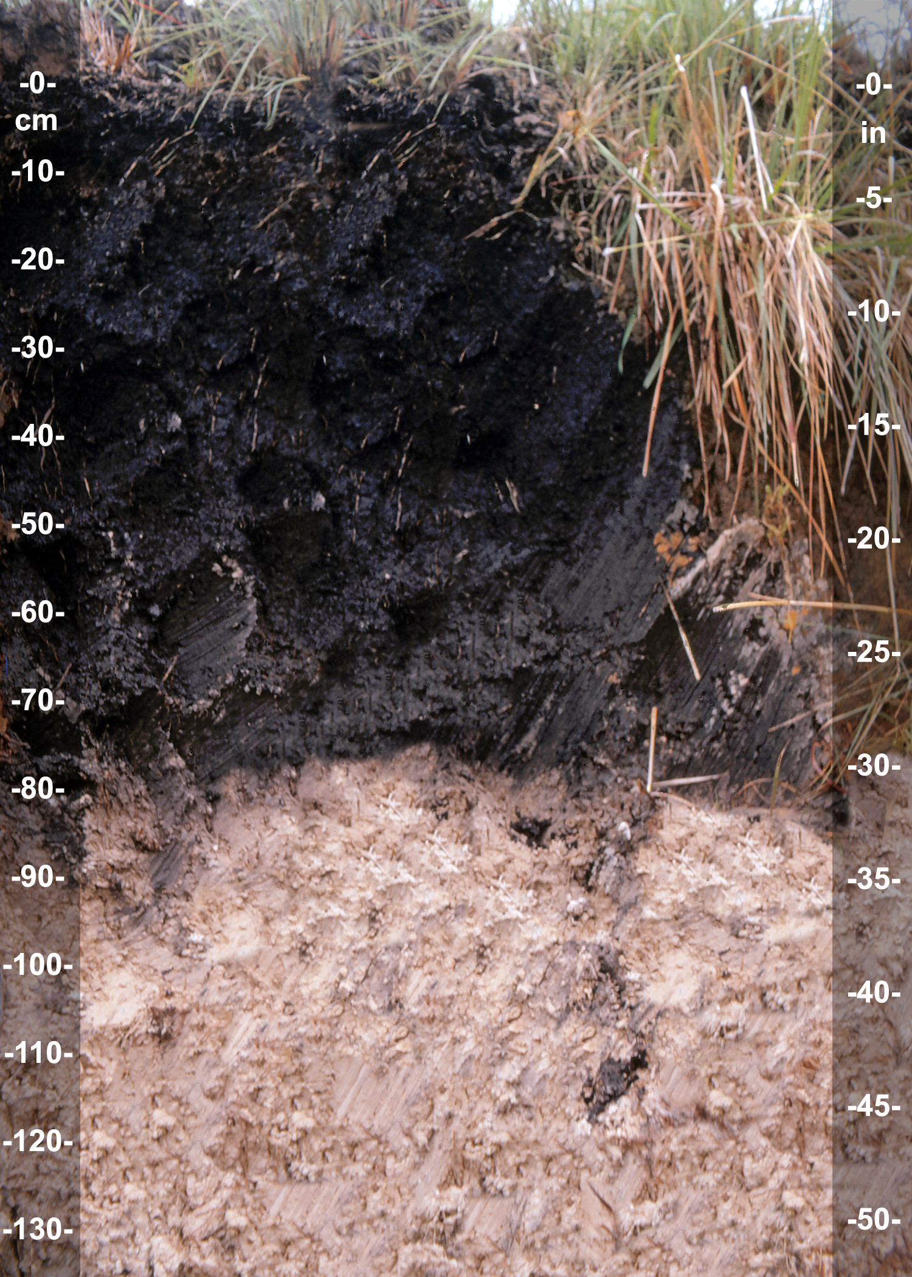
Major Wildfires
Wildfires produce organic carbon, which contaminates the water supply
Contributing factor for the decline in water quality
Photo by USDA CC BY 2.0
Photo by Soil Science CC BY 2.0

Slide 6
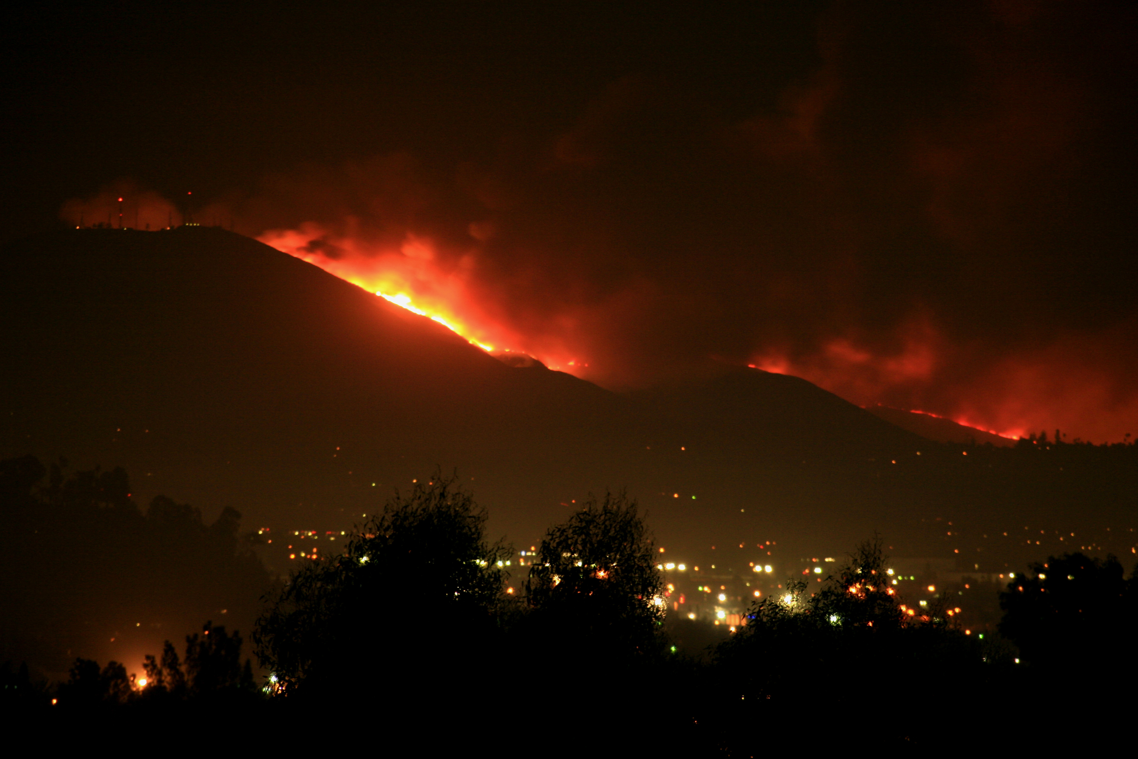
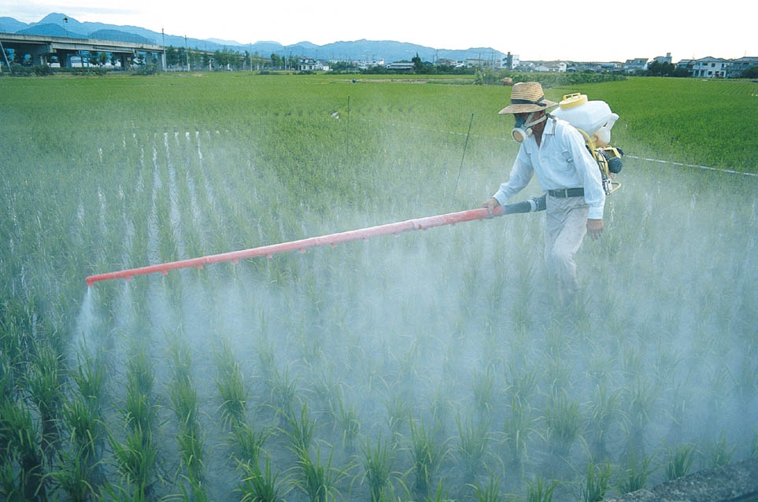
Community Concerns
Wildfires: Organic Carbon
Source Contaminants
Wildfires: Organic Carbon
Mine: Uranium
Agriculture: Pesticides, Nitrates
Photo by Slworking2 CC BY 2.0
Photo by Global Water Partnership CC BY 2.0
Agriculture: Nitrate and Pesticides
Photo by Al_HikesAZ CC BY 2.0
Mine: Uranium

Slide 7
Project Partners
Denver Water
Diego Portillo ● Linda Rosales ● Sheila Pelczarksi
Photo by elPadawan CC BY 2.0

Slide 8
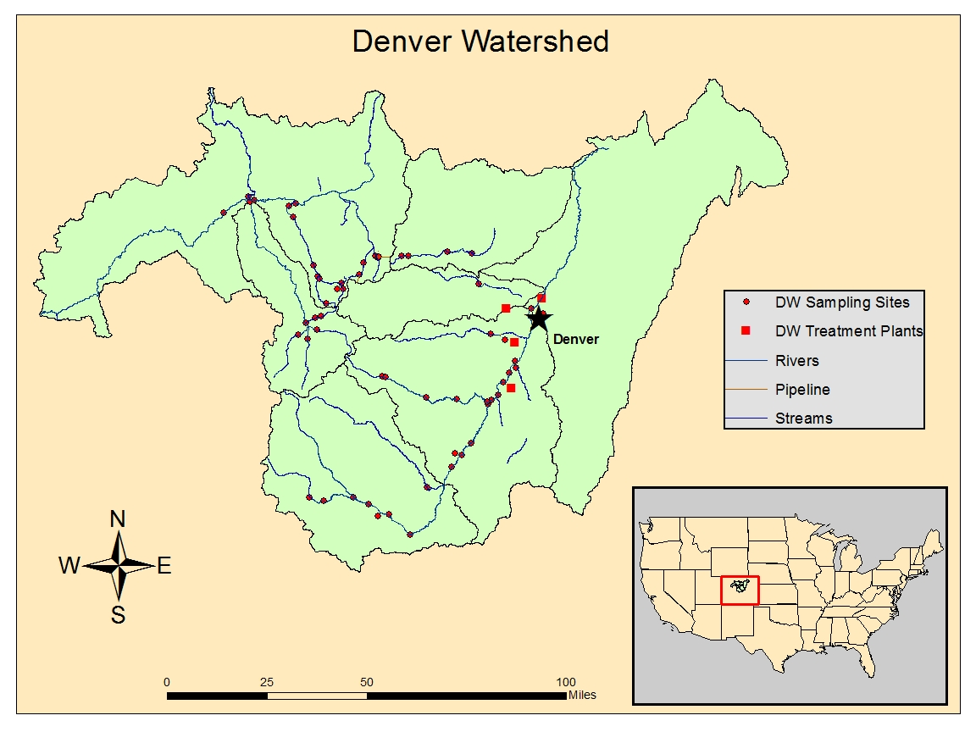
Study Area
Study Period
May 1994 – June 2013

Slide 9
Objectives
Utilize land cover data to identify existing infrastructure and possible pollution sources in the Denver Water Collection System
Assess the placement of current water sampling sites
Create a map identifying optimal sampling sites
Photo by elPadawan CC BY 2.0
Notes:
Utilize land cover data from Denver and surrounding areas to identify existing infrastructure and possible pollution sources in the Denver Water collection system
Assess the placement of current water sampling sites
Create a map identifying optimal sampling sites

Slide 10
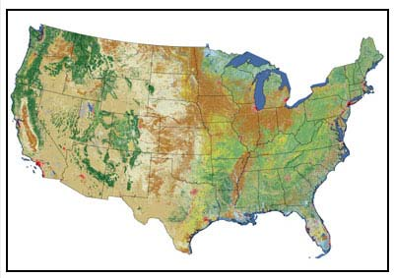
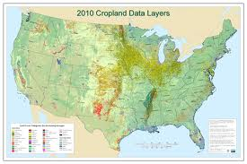
NASA Earth Observations
National Land Cover Database (2011)
Landsat 7
Sensor: Enhanced Thematic Mapper +
(ETM +)
Used for Land Cover
Cropland Data Layers
Landsat 7
Landsat 7
Landsat 7

Slide 11
Methodology
Data
Acquisition
Data
Processing
Data
Analysis
Land Cover
Landsat 7 ETM+
National Land Cover Database (2011)
Cropland Data Layer
Land Cover Classes and Crop Types Identification
Revised Universal Soil Loss Equation (RUSLE)
Risk Areas Classification and Validation
Water Sampling Sites
Denver Water
Point Source Contaminant Assessment
Wildfires
Denver Water
Mapping potential areas for water sampling sites
Soil Types
USDA
Data Acquisition
Data Processing
Data Analysis
Data Acquisition
Data Processing
Data Analysis
Land Cover
Landsat 7 ETM+
National Land Cover Database (2011)
Cropland Data Layer
Land Cover Classes and Crop Types Identification
Revised Universal Soil Loss Equation (RUSLE)
Land Cover
Landsat 7 ETM+
National Land Cover Database (2011)
Cropland Data Layer
Land Cover Classes and Crop Types Identification
Revised Universal Soil Loss Equation (RUSLE)
Point Source Contaminant Assessment
Risk Areas Classification and Validation
Point Source Contaminant Assessment
Risk Areas Classification and Validation
Water Sampling Sites
Denver Water
Water Sampling Sites
Denver Water
Wildfires
Denver Water
Wildfires
Denver Water
Mapping potential areas for water sampling sites
Mapping potential areas for water sampling sites
Soil Types
USDA
Soil Types
USDA
Notes:
NASA Earth observations
Landsat 7 ETM+
Landsat 8 OLI/TIRS
Acquisition & Processing
Denver Water provided us with the current water sampling sites and the areas of the fires
The National Hydrological Dataset (NHD) provided watersheds, rivers, streams, and water bodies
Crop, soil type, and land data was obtained from ___
Using the RUSLE model, a pollution risk assessment map was created
[other types of processing things we’re going to do]
Analysis

Slide 12
Methodology
Data
Acquisition
Data
Processing
Data
Analysis
Land Cover
Landsat 7 ETM+
National Land Cover Database (2011)
Cropland Data Layer
Land Cover Classes and Crop Types Identification
Revised Universal Soil Loss Equation (RUSLE)
Risk Areas Classification and Validation
Water Sampling Sites
Denver Water
Point Source Contaminant Assessment
Wildfires
Denver Water
Mapping potential areas for water sampling sites
Soil Types
USDA
Data Acquisition
Data Processing
Data Analysis
Data Acquisition
Data Processing
Data Analysis
Land Cover
Landsat 7 ETM+
National Land Cover Database (2011)
Cropland Data Layer
Land Cover Classes and Crop Types Identification
Revised Universal Soil Loss Equation (RUSLE)
Land Cover
Landsat 7 ETM+
National Land Cover Database (2011)
Cropland Data Layer
Land Cover Classes and Crop Types Identification
Revised Universal Soil Loss Equation (RUSLE)
Point Source Contaminant Assessment
Risk Areas Classification and Validation
Point Source Contaminant Assessment
Risk Areas Classification and Validation
Water Sampling Sites
Denver Water
Water Sampling Sites
Denver Water
Wildfires
Denver Water
Wildfires
Denver Water
Mapping potential areas for water sampling sites
Mapping potential areas for water sampling sites
Soil Types
USDA
Soil Types
USDA
Notes:
NASA Earth observations
Landsat 7 ETM+
Landsat 8 OLI/TIRS
Acquisition & Processing
Denver Water provided us with the current water sampling sites and the areas of the fires
The National Hydrological Dataset (NHD) provided watersheds, rivers, streams, and water bodies
Crop, soil type, and land data was obtained from ___
Using the RUSLE model, a pollution risk assessment map was created
[other types of processing things we’re going to do]
Analysis

Slide 13
Methodology
Data
Acquisition
Data
Processing
Data
Analysis
Land Cover
Landsat 7 ETM+
National Land Cover Database (2011)
Cropland Data Layer
Land Cover Classes and Crop Types Identification
Revised Universal Soil Loss Equation (RUSLE)
Risk Areas Classification and Validation
Water Sampling Sites
Denver Water
Point Source Contaminant Assessment
Wildfires
Denver Water
Mapping potential areas for water sampling sites
Soil Types
USDA
Data Acquisition
Data Processing
Data Analysis
Data Acquisition
Data Processing
Data Analysis
Land Cover
Landsat 7 ETM+
National Land Cover Database (2011)
Cropland Data Layer
Land Cover Classes and Crop Types Identification
Revised Universal Soil Loss Equation (RUSLE)
Land Cover
Landsat 7 ETM+
National Land Cover Database (2011)
Cropland Data Layer
Land Cover Classes and Crop Types Identification
Revised Universal Soil Loss Equation (RUSLE)
Point Source Contaminant Assessment
Risk Areas Classification and Validation
Point Source Contaminant Assessment
Risk Areas Classification and Validation
Water Sampling Sites
Denver Water
Water Sampling Sites
Denver Water
Wildfires
Denver Water
Wildfires
Denver Water
Mapping potential areas for water sampling sites
Mapping potential areas for water sampling sites
Soil Types
USDA
Soil Types
USDA
Notes:
NASA Earth observations
Landsat 7 ETM+
Landsat 8 OLI/TIRS
Acquisition & Processing
Denver Water provided us with the current water sampling sites and the areas of the fires
The National Hydrological Dataset (NHD) provided watersheds, rivers, streams, and water bodies
Crop, soil type, and land data was obtained from ___
Using the RUSLE model, a pollution risk assessment map was created
[other types of processing things we’re going to do]
Analysis

Slide 14
Results
Final Maps
Discussion
Validation:
Uncertainty/Error Analysis

Slide 15
Conclusions

Slide 16
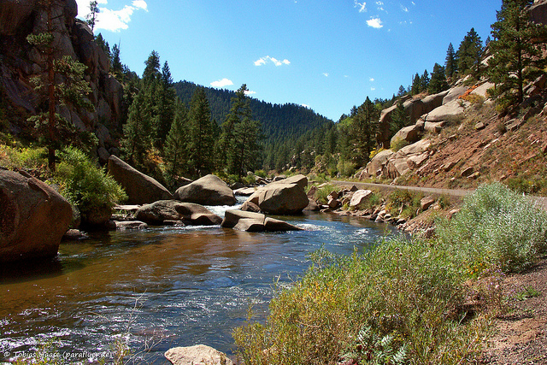
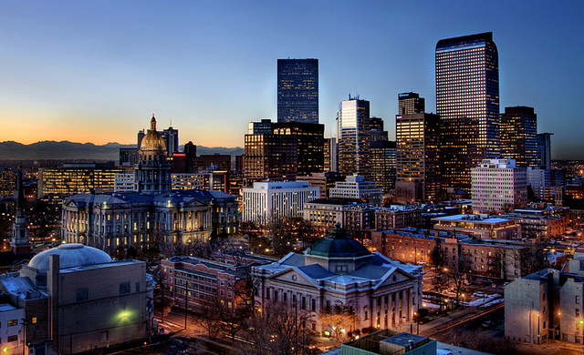
Benefits to End Users
Improve efficiency of water monitoring system.
Support Denver Water’s mission to provide high-quality water to Denver and its surrounding suburbs using a resilient and reliable system.
Photo by Tobias CC BY 2.0
Photo by Matt Santomarco CC BY 2.0

Slide 17
Limitations

Slide 18
Future Work
Assess placement of water sampling sites after the Front Range and Eastern Colorado Floods
September 2013
Photo by littlegreenfroggy CC BY 2.0

Slide 19
Acknowledgements
Dr. Kenton Ross
NASA DEVELOP National Program- Science Advisor
Diego Portillo
Denver Water
Linda Rosales
Denver Water
Sheila Pelczarksi
Denver Water
Nathan Owen
NASA DEVELOP - Langley Center Lead
This material is based upon work supported by NASA through contract NNL11AA00B and cooperative agreement NNX14AB60A.

