Slide 1
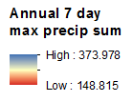
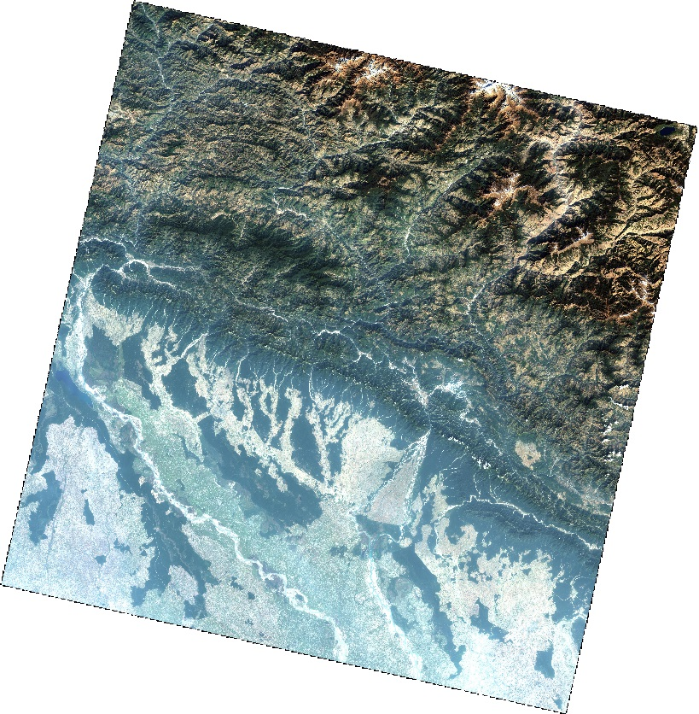
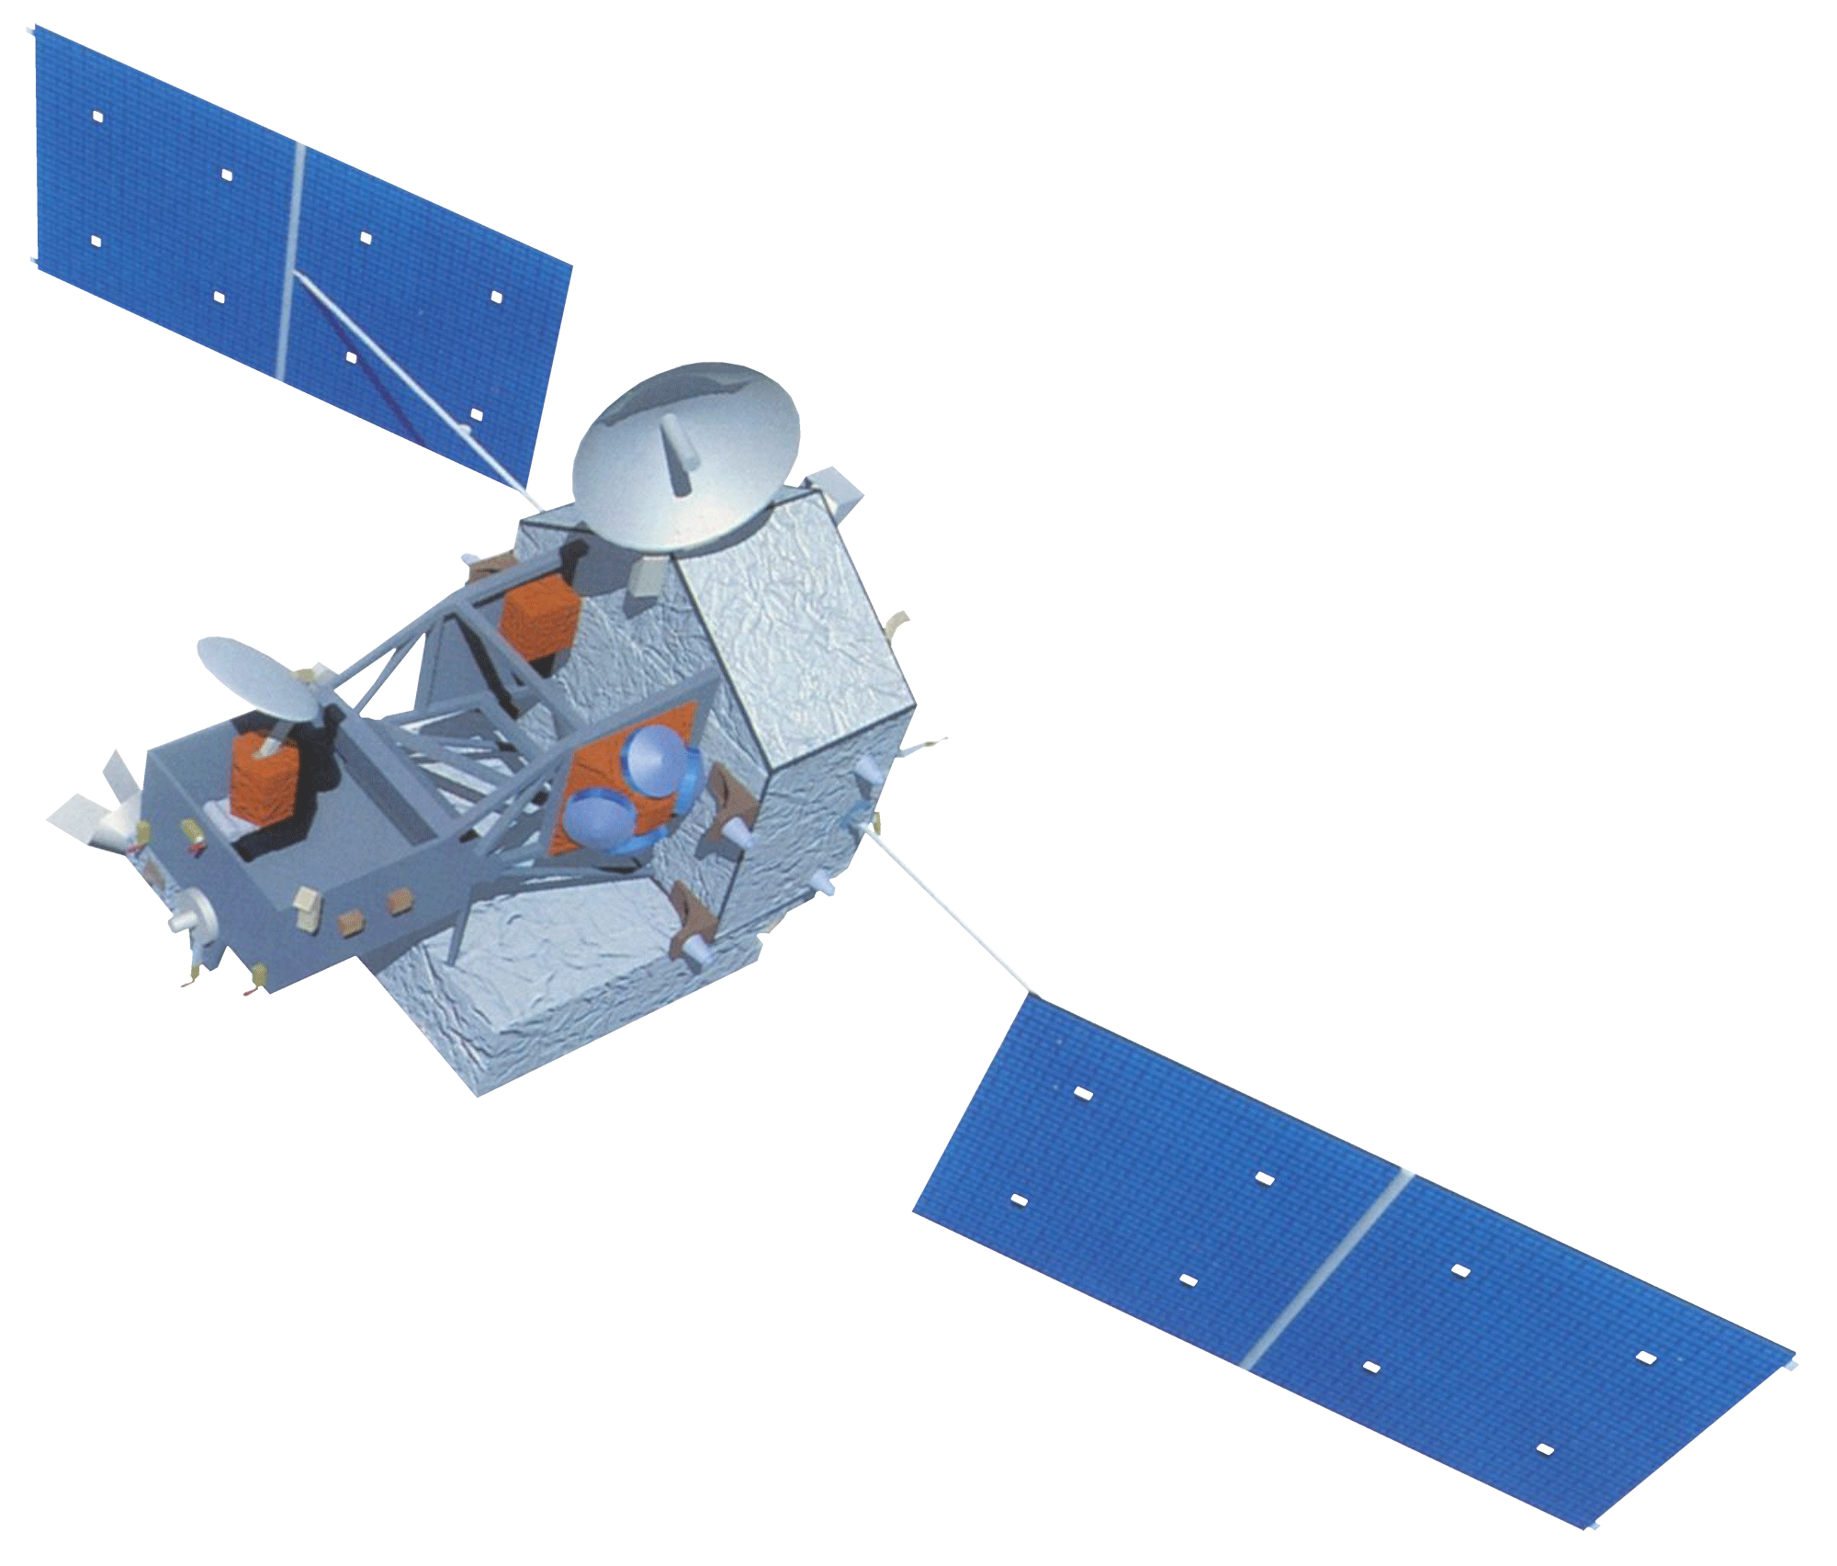
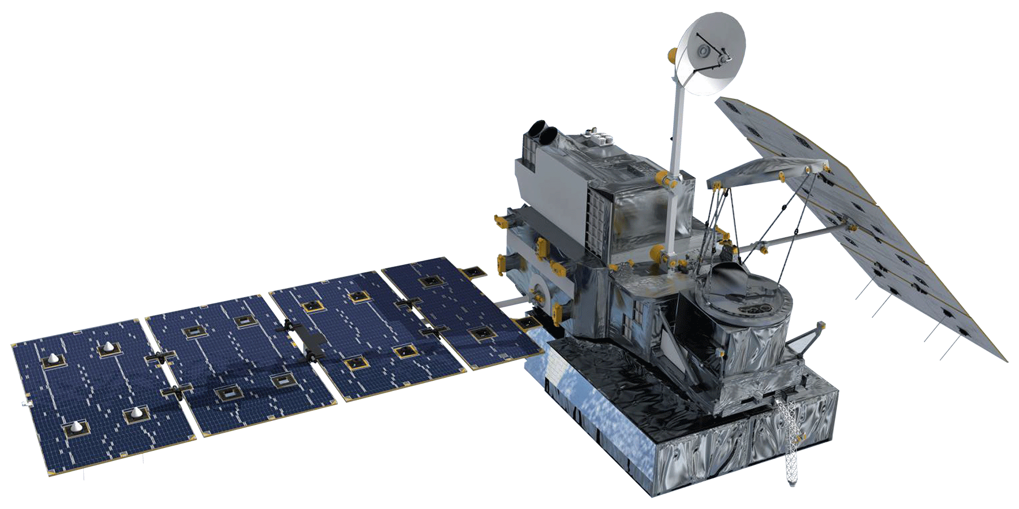
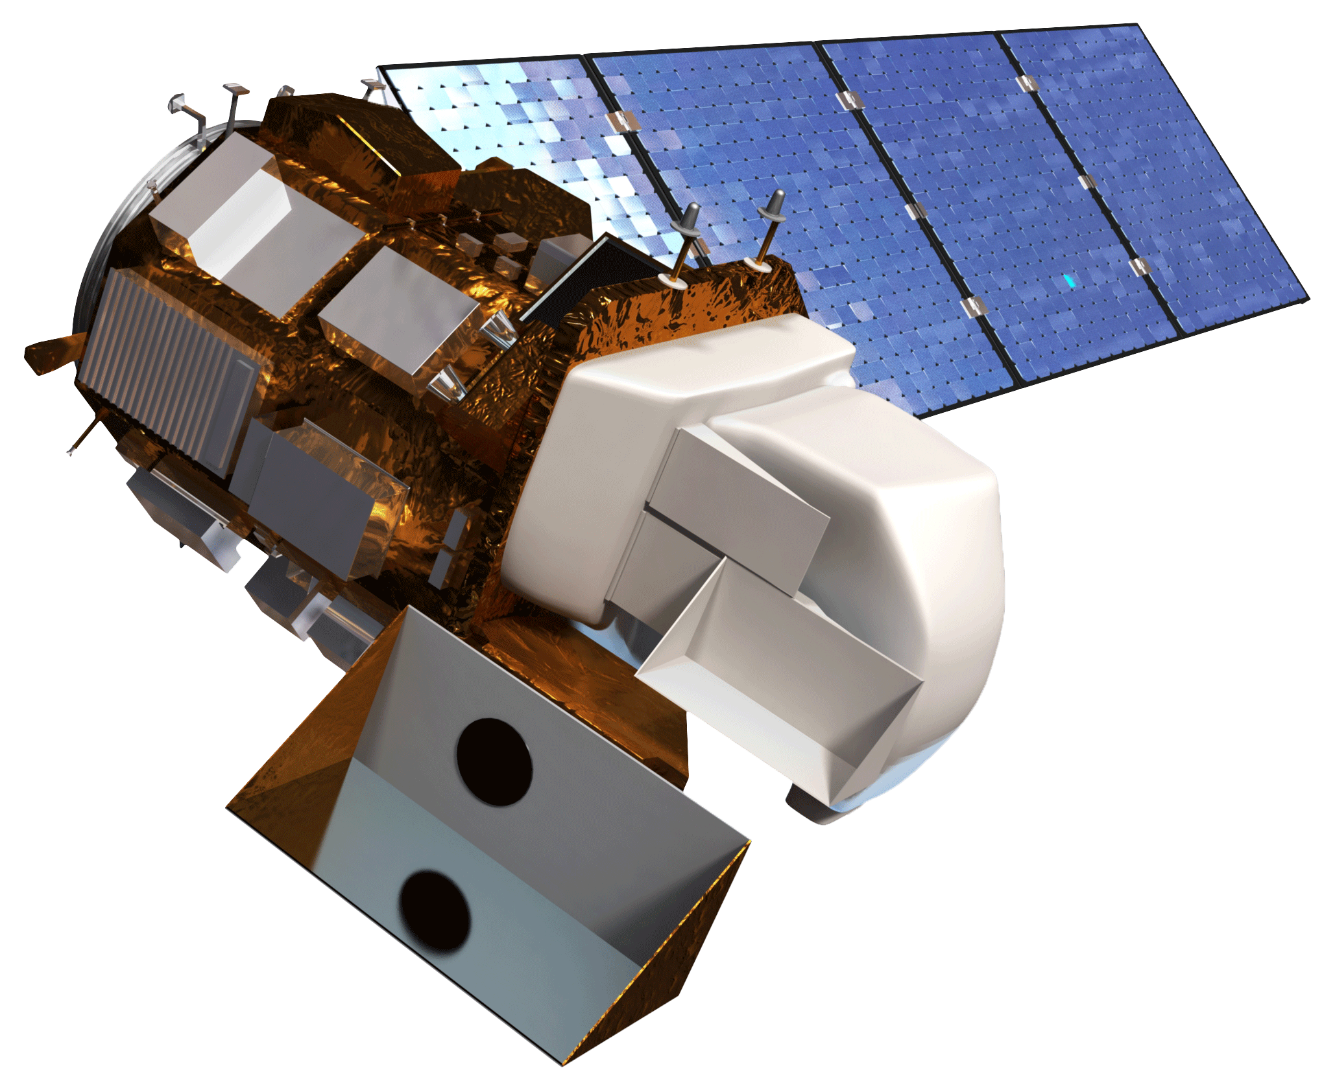
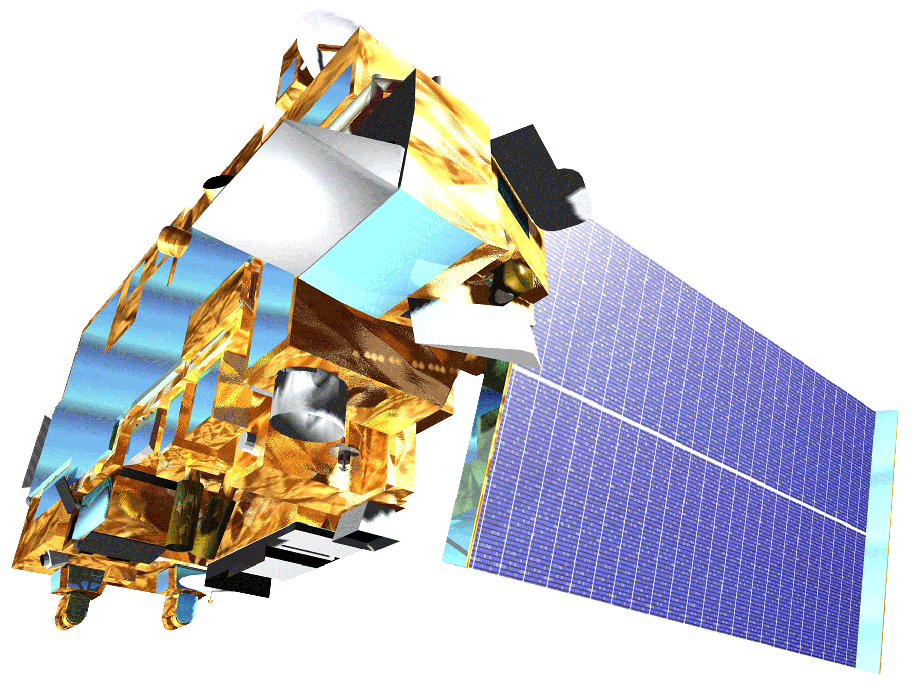
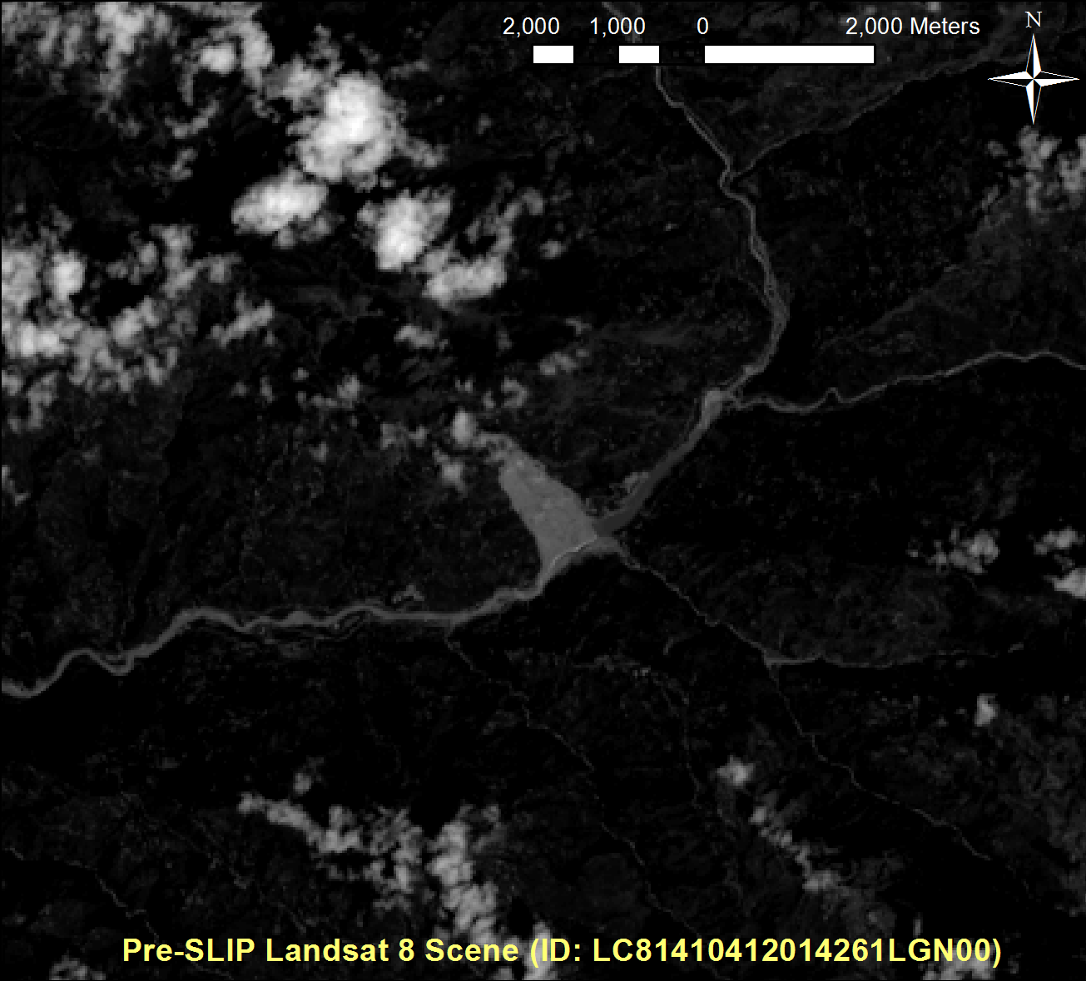
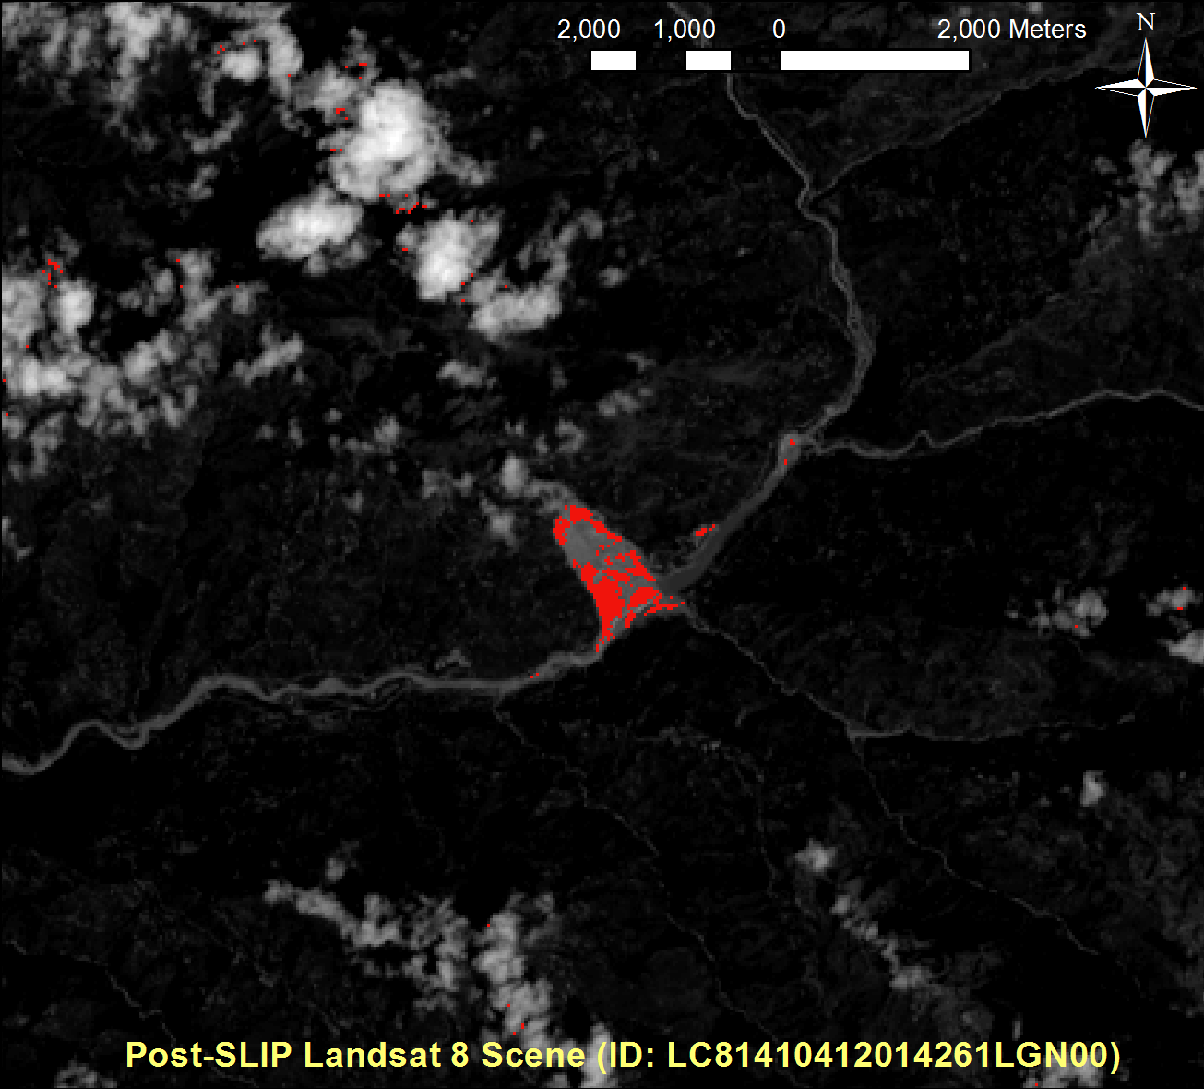
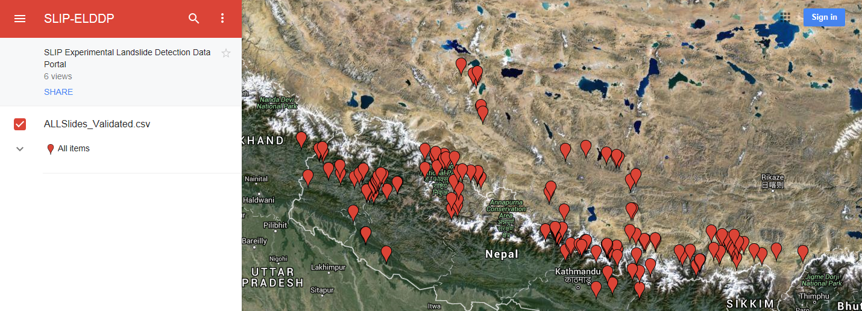
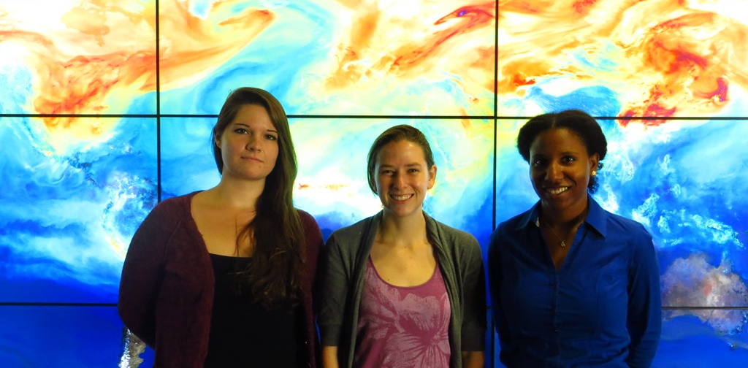
Himalaya Disasters III
Utilizing a Landslide Identification Product and a Real-time Rainfall Detection Tool for Enhanced landslide Detection in Nepal
Amanda Rumsey (Project Lead), Jordan Scheffler, Jessica Fayne
DEVELOP National Program at NASA Goddard Space Flight Center
Abstract
Objectives
Nepal is a hotspot for landslide activity due to its mountainous topography, complex terrain, and monsoon rains. Previous related studies combined NASA Earth observation data from Landsat 8, Shuttle Radar Topography Mission (SRTM), Advanced Spaceborne Thermal Emission and Reflection Radiometer (ASTER), Tropical Rainfall Measuring Mission (TRMM) and the Global Precipitation Measurement Mission (GPM) with various ancillary datasets to create two products for use in the region: the Sudden Landslide Identification Product (SLIP), and Detecting Real-time Increased Precipitation (DRIP). SLIP will help identify landslides in near real-time using Landsat 8 and elevation products, as well as provide damage assessments by mapping landslides automatically after a disaster such as the Gorkha earthquake in May 2015. DRIP will monitor precipitation levels extracted from the GPM-IMERG 30-minute product to create alerts when current rainfall levels exceed calculated threshold values. SLIP and DRIP were also integrated to provide a more comprehensive landslide notification system for the region. The objective of this study was to support the results of SLIP and DRIP by assessing their global prediction capabilities, and to develop a web-based data portal that can host SLIP and DRIP and will allow end-users to collect and download landslide event and rainfall event information. The DRIP-SLIP model combination will be used by the International Centre for Integrated Mountain Development (ICIMOD) to protect and manage ecosystems and villages in Nepal, prevent future loss of life and infrastructure due to landslides, and reduce poverty through integrated natural resource management and regional cooperation.
Validate the results of SLIP using digitized landslide event information collected using Landsat 8 imagery
Develop a web-based platform to display the results of the SLIP and DRIP products
Package SLIP and DRIP into a usable program for ICIMOD
Perform rainfall threshold analysis and comparative rain gauge and TRMM analysis for Nepal
Methodology
Study Area
SLIP and DRIP
Validation
GPM
Historical TRMM data was used to calculate monthly mean thresholds used to detect anomalies in near real-time with GPM
Monitors GPM IMERG data every 30 minutes looking for anomalies compared with calculated threshold values
Precipitation Monitoring by DRIP
SLIP
DRIP
IMERG 30-Minute
Data Collection
TRMM
Thresholds
Comparison
Exceeds No Thresholds
TMPA-RT 3B42
Exceeds One of Three Thresholds
Exceeds Two of Three Thresholds
Exceeds All Thresholds
Landsat 8
Cloud Mask
QA band from Landsat 8 is used to remove clouds
Landslide Detection by SLIP (Yellow)
Landsat 8
IR
SWIR
Red Increase
Calculate percent change between two Red band images
Earth Observations
Red
QA
SLIP
Data Collection
Compare two images’ moisture using IR and SWIR bands
SRTM
Moisture Index
TRMM TMPA
GPM IMERG
Landsat 8 OLI/TIRS
Terra MODIS
ASTER
Slope Analysis
Remove pixels with slopes lower than 15%
Alert!
Data Comparison
If current rainfall levels are higher than thresholds, an alert is created
Accuracy Assessment
Results
Conclusions
DRIP
SLIP Validation
Landslides can be mapped automatically in near real-time using NASA Earth Observations
DRIP can detect vulnerable areas based on current rainfall conditions
SLIP had been updated to reduce the amount of landslide over-detection in mountainous regions
The DRIP-SLIP model will be used by ICIMOD to protect lives, preserve infrastructure, and manage local ecosystems
Path | Row | Julian Date | Year | High Confidence | Low Confidence
139 | 41 | 250 | 2015 | 35.4% | 79.2%
140 | 41 | 110 | 2014 | 23.3% | 63.8%
141 | 40 | 21 | 2014 | 28.0% | 84.0%
141 | 41 | 216 | 2015 | 54.1% | 78.4%
143 | 40 | 275 | 2014 | 28.0% | 76.0%
143 | 40 | 198 | 2015 | 22.5% | 46.9%
144 | 40 | 237 | 2015 | 15.4% | 76.9%
SLIP
Acknowledgements
Team Members
Dr. Dalia Kirschbaum (GSFC)
Thomas Stanley (GSFC)
Sebastian Wesselman (ICIMOD)
Justin Roberts-Pierel (GSFC)
Aakash Ahamed (GSFC)
Jamie Shiplet (Towson University)
Project Partner
Left to Right: Jordan Scheffler, Amanda Rumsey, Jessica Fayne
International Centre for Integrated Mountain Development (ICIMOD)

