Slide 1
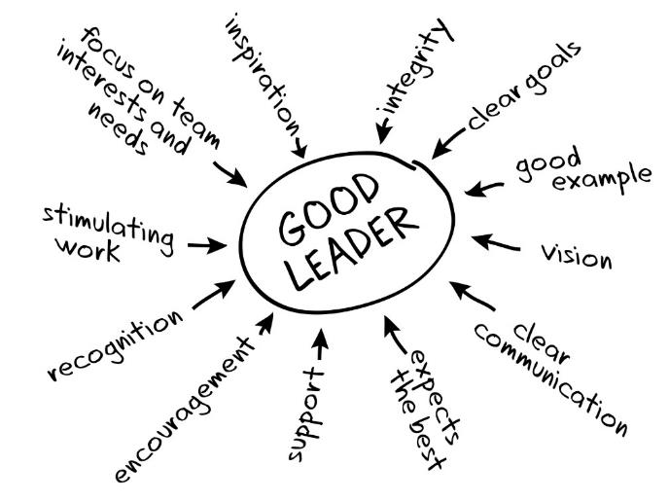
Leadership & Management
Orientation for Center LeadersHIP

Slide 2
About DEVELOP
History
NASA Personnel & Hierarchy
Management Team
Elevator Speech
Locations

Slide 3
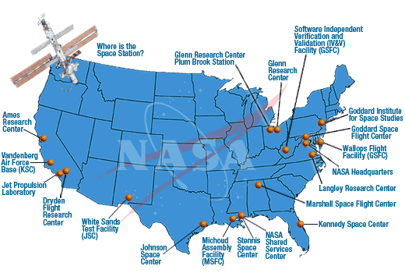
History
NASA History
"An Act to provide for research into the problems of flight within and outside the Earth's atmosphere, and for other purposes." With this simple preamble, the US Congress and President Dwight D. Eisenhower established the National Aeronautics and Space Administration (NASA) on July 29, 1958.
NASA began operations on October 1, 1958, absorbing into itself the earlier National Advisory Committee for Aeronautics (NACA) intact: 8,000 employees, an annual budget of $100 million, three major research laboratories - Langley Aeronautical Laboratory, Ames Aeronautical Laboratory, and Lewis Flight Propulsion Laboratory - and two smaller test facilities.
DEVELOP History
In 1998, three interns at NASA Langley Research Center co-authored the white paper “Practical Applications of Remote Sensing” (Bauer et al., 1998). At that time, the Digital Earth Initiative, a federal interagency project dedicated to creating a virtual representation of the Earth to further human understanding of the world, was piloting an effort to increase public access to federal information about the Earth and the environment. A proposal combining NASA’s Digital Earth Initiative and the students’ paper advocated the formation of a program, and in 1999 DEVELOP was officially formed. Beginning in 2001, new offices were established across the country and expansion has continued to today. DEVELOP is always looking for new opportunities to expand the DEVELOP network and those benefiting from DEVELOP activities.

Slide 4
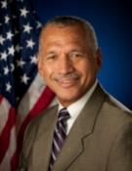
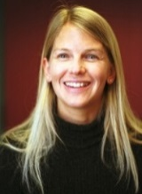
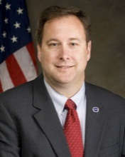
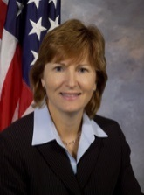
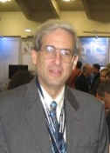
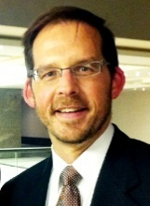
NASA Personnel & Hierarchy
Office of the Administrator
Administrator: Charles Bolden, Jr.
Deputy Administrator: Dava Newman
Associate Administrator: Robert Lightfoot
Deputy Associate Administrator: Lesa Roe
Administrator Staff Offices
Chief Scientist: Ellen Stofan
International & Interagency Relations: Michael O’Brien
Mission Directorates
Science, Associate Administrator: John Grunsfeld
Earth Science, Director: Mike Freilich
Applied Sciences Program, Director: Lawrence Friedl
Capacity Building Program, Program Manager: Nancy Searby
Space Technology, Associate Administrator: Steve Jurczyk
Charles Bolden
Dr. Dava Newman
Robert Lightfoot
Lesa
Roe
Dr. John Grunsfeld
Dr. Mike Freilich
Resources:
NASA Org Structure w/Names: http://www.nasa.gov/about/org_index.html
Science: http://science.nasa.gov/
Earth Science: http://science.nasa.gov/earth-science/
Applied Sciences Program: http://appliedsciences.nasa.gov/
Lawrence Friedl
Dr. Nancy Searby

Slide 5
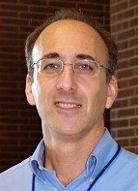
NASA’s Applied Sciences Program
“Discovering Innovative & Practical Applications of NASA Earth Science”
Lawrence Friedl
Director
Partner with public and private organizations
Discover innovative NASA Earth science applications
Support environmental decision-making activities
Demonstrate practical benefits of NASA Earth science
Help improve the quality of life and strengthen the economy
ASP Program Managers (NASA HQ)
Brad Doorn
Water
Woody Turner
Eco
John Haynes
Health/AQ
David Green
Disasters
Lucien Cox
Operations
Manager
Nancy Searby
Capacity
Building
National Application Areas + Capacity Building Elements
Agriculture
Climate
Disasters
ARSET
Eco Forecasting
Energy
Health & AQ
DEVELOP
Oceans
Water Resources
Weather
SERVIR
Notes:
ASP is organized thematically around 9 application areas and 3 capacity building elements that aim to improve domestic and international skills and capabilities in the use of NASA Earth science.

Slide 6
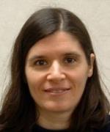
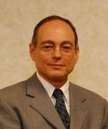
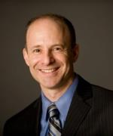
ASP’s Capacity Building Program
Engages current and future decision makers in a spectrum of activities to improve skills and capabilities in the United States and developing countries to access and apply NASA Earth science.
Three elements: ARSET, DEVELOP, SERVIR
(GOMI recently graduated)
Nancy Searby
Program Manager
CBP Element Leads
Ana Prados
ARSET
NASA Goddard
Mike Ruiz
DEVELOP
NASA Langley
Dan Irwin
SERVIR
NASA Marshall
ARSET
Online and hands-on NASA remote sensing training
DEVELOP
Dual workforce capacity building using collaborative feasibility projects
SERVIR
Building international capacity in
developing countries

Slide 7
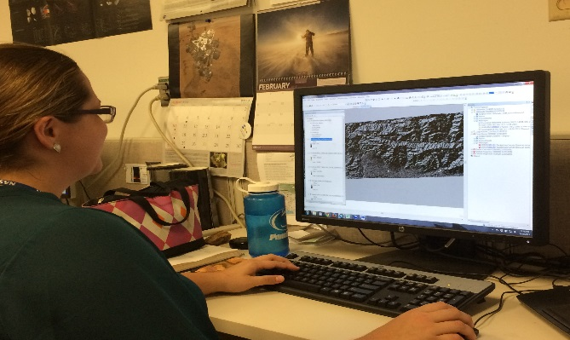
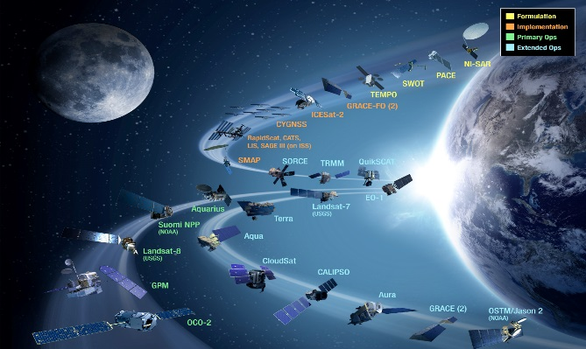
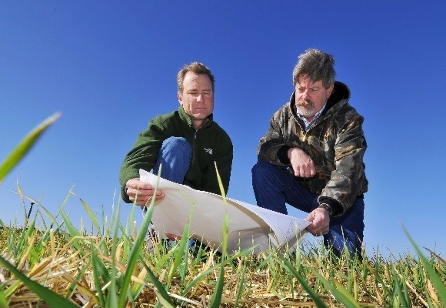
CBP’s DEVELOP National Program
“Shaping the future by integrating Earth observations into global decision making.”
Participants + Earth Observations + Decision Makers
DEVELOP bridges the gap between NASA Earth Science and society, building capacity in both its participants and end-user organizations
to better prepare them to handle the environmental challenges
that face society.

Slide 8
Mission, Vision & Core Values
MISSION
VISION
Integrating NASA Earth observations
with society to foster future innovation and cultivate the professionals of tomorrow by addressing diverse environmental issues today.
Shaping the future
by integrating Earth observations into global decision making.
COLLABORATION
Cultivating teamwork, multi-disciplinary solutions, and open communication to bridge the gap between science and society
INNOVATION
Fostering rapid feasibility projects to harness ingenuity and demonstrate the applications of Earth science
PASSION
Pursuing all endeavors with energy, excitement, and enthusiasm to sustain a high level of excellence and respect
DISCOVERY
Exploring the potential of NASA’s investment in Earth science to make the extraordinary possible

Slide 9
DEVELOP Node Locations
NASA Center Locations
Can only accept US citizens (exception: MSFC)
Advising: supported through NASA and volunteer basis
Contracted through SSAI, Inc.
Regional Locations
Can accept foreign nationals (exception: NCEI)
Advising: volunteer basis
Contracted through Wise County
Things to Note:
Locations evolve
Not all are active every term
Active nodes are listed on Application

Slide 10
DEVELOP People to Know
DEVELOP
NPO
Karen Allsbrook
Mike Bender
Lauren Childs-Gleason
Jamie Favors
Lindsay Rogers
Dr. Kenton Ross
Mike Ruiz
Jennifer Tindell
Senior Fellows
Tiffani Miller
Georgina Crepps
DEVELOP
Fellows
Vishal Arya (LaRC)
Emma Baghel (NCEI)
Mark Barker (JPL)
Kimberly Berry (WC)
Teresa Fenn (SSC/LaRC)
Vickie Ly (ARC)
Ryan Schick (MSFC)
Jordan Vaa (LaRC)
Brittany Zajic (JPL)
Ames
Chippie Kislik (CL)
Vickie Ly (ACL)
Fort Collins
Brian Woodward (CL)
Goddard
Sean McCartney (CL)
Amanda Clayton (ACL)
Idaho
Jenna Williams (CL)
DEVELOP Node Leadership
IRI
Jerrod Lessel (CL)
JPL
Nick Rousseau (CL)
Brittany Zajic (ACL)
Langley
Emily Adams (CL)
Rebekke Muench (ACL)
Marshall
Leigh Sinclair (CL)
Daryl Ann Winstead (ACL)
Mobile
Tyler Lynn (CL)
NCEI
Jessica Sutton (CL)
Emma Baghel (ACL)
UGA
Caren Remillard (CL)
Sean Cameron (ACL)
Wise County
Raj Rajappan (CL)
Kimberly Berry (ACL)

Slide 11
Question? Contact…
Contracts & Payroll
Status Reports/Invoices
Schedule Adjustments
Applications
SSAI-funded Personnel
Travel
Deliverables/Deadlines
Conferences & Close Outs
Project Ideas/Requests
Wise County Personnel
Export Control
Fellow Class
International Activities
State/Local Govt Activities
Legislative Affairs
Proposals
Partner Engagement
Project Hand-Offs
Contact
Karen Allsbrook
Contact
Lauren Childs-Gleason
Contact
Jamie Favors
Military Engagement
DEVELOPedia
DEVELOP Exchange
DEVELOP Website
Software Release Authority
Software/Hardware
Socioeconomic Impact Analysis
Tracking Metrics
Results Frameworks
Partner History/Analyses
Participant/Alumni Survey
Publications
Social Media
Newsletter
VPS - Videos & Transcripts
Recruiting/Outreach
Micro-Journal
Contact
Mike Bender
Contact
Georgina Crepps
Contact
Tiffani Miller

Slide 12
Project Management
Proposals
Characteristics
Preview Telecons
Deliverables
Partner Interaction
Tracking Progress
Continuation of Projects
Highlight Projects
Resources Available
PCT Team
Logistics

Slide 13
Proposals - Overview
Notice of Intent (NOI): first call for titles from NPO 1 month before proposal submission deadline
International projects: if a proposal has an international study area, an international checklist must be completed. NPO will review and approve/reject for proposal submission. Due same time as proposal NOI.
NASA HQ tracks our geographic “impact”
HQ & NPO-set targets: 10-25% International, 35 states annually w/all 50 impacted over a rolling 3 year basis
Proposal writing commences using the NPO-provided template
Changes for each term (typically small updates, but they are important!)
Proposals are submitted by CL to Project Coordination Team
Considerations:
Responding to HQ/partner requests
Matching # of projects to space and slot allotments
App area requirements (ex. Eco approvals rely on a forecasting/prediction piece to the project)
Underutilized/new/future sensor usage

Slide 14
Proposals - Partner Interaction
Set clear expectations of timeline and approval process
Share the timeline: proposal deadline, process for approvals, term start and end dates
Letters of support are great to include with proposal
Set clear expectations with partners for “how it works” if project is accepted:
No funds transferred or formal agreements
Only a 10 week term!
DEVELOP team is funded through NASA and team sits at the node
Will hand-off project results & methodologies at end of the term
Communicate the planned length of the project (1, 2 or 3 terms)
Ideal outcome: they take the results & methods and use them in decision making
Team would touch base with the partner throughout the term (weekly or biweekly tag ups, with a handoff at end)
Partner would fill out the pre-term (few weeks before) and post-term forms (few weeks after handoff)

Slide 15
Proposals - Approval Process
Notice of Intent: first call for titles comes from NPO 1 month before proposal submission deadline
Includes short title & subtitle and an international checklist if study area is outside the US
NPO does first round of review with international projects, accepts/rejects
Proposal writing commences for US projects and approved international projects using the NPO-provided template
Proposals are submitted to Project Coordination Team by CL
PCT reviews
Edited proposals are returned to CL
CL responds to feedback, creates a final “clean” draft without comments and resubmits to NPO
NPO compiles all proposals by application area, sends to NASA HQ PMs
PMs review, NPO sets discussion appointments to get their feedback with an approval/rejection for each proposal
NPO takes approved proposals and coordinates with nodes to identify if proposals align with number of participants allotted to the node
Project portfolio finalized and shared

Slide 16
Proposals - Timeline
Summer 2016 Proposals
NOI First Look: Nov 25
Proposals Due: Jan 8
Review Schedule: TBD
Fall 2016 Proposals
NOI First Look: Mar 25
Proposals Due: Apr 22
Review Schedule: TBD

Slide 17
Project Characteristics for Proposals
Address a real community concern aka environmental issue
Collaborate with local, state, regional, federal and/or international organization(s) who can benefit from using NASA Earth observations to enhance decision making
Meaningful use of NASA Earth observations - really highlight their application!
Appropriate scope of project - resolution of sensors, study area size, team size, amount of work to be accomplished, etc.

Slide 18
Preview Telecons
Timeline - takes the place of the national telecon the week before the term begins
Feel free to invite advisors
Benefits:
See a synoptic overview of the upcoming term’s projects
Identify projects that may have similarities with yours
Satellite data/models usage
Study areas
Partner organizations
Methodologies
Be able to coordinate communication between your teams and other nodes teams

Slide 19
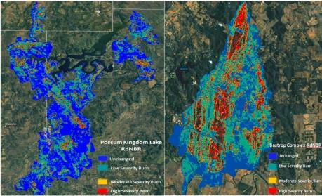
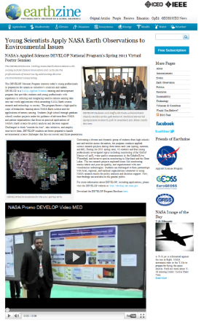
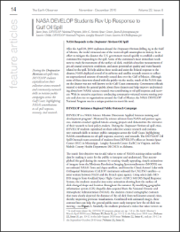
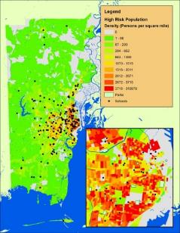
Deliverables
Mandatory & optional deliverables
Deadlines - set by NPO prior to each term, CL can set parallel deadlines ahead of the NPO deadlines for CL review
Submission process - DEVELOPedia, large files through NASA LFT or Google

Slide 20
Main Deliverables
Project Summary
Digestible compilation of project information.
Use: reporting and outreach materials, project booklets, annual reports, close out presentations, quarterly program reviews, monthly status reports, the virtual poster session, and content for DEVELOPedia page.
Tech Paper
Provides a synopsis of the project with technical details for partners and future DEVELOP teams to replicate and understand. Methods should be the focus. It should be no longer than 12 pages and use the template unless permission is previously granted to use a different style. Any distribution or publications of this work must go through NASA Export Control.
Innovative Content - DEVELOP is exploring the establishment of a micro-journal focused on applications of Earth observations. This would be an opportunity to take tech papers from successful projects and publish them. The micro-journal format requires ‘innovative content’ to make the articles interactive for the reader. Options for types of IC can be found in the template.
Use: content for publications, provide to partners, improving technical writing skills for participants, etc.
Presentation
A visually appealing means of telling the “story” of the project and provide a flow of information that carries the viewer from abstract to conclusions. The page structure in the template is a guide, feel free to amend it to fit your project. It must include full speaker notes. Typical length is 6-20 slides, depending on the presentation venue.
Use: report to project partners, NASA HQ, conferences, improving communication of science and presentation skills of participants, etc.
VPS: Video & Transcript
The VPS deliverable consists of the video and full transcription of audio in the video. The transcript is mandatory, as the video must be compliant with Section 508 of the US Rehabilitation Act. Videos must not be longer than 4 minutes, include the mandatory DEVELOP beginning and ending clips, and provide a good overview of the project. Creativity is appreciated, however “goofy” is not. A good rule of thumb is to ask yourself if you would feel comfortable sending the video to your project partners. Keep in mind that you are representing NASA.
Use: Videos are the most visible outward-facing deliverable, provide potential partners, applicants, etc. the type of work DEVELOP does, can be used as innovative content for the micro-journal articles, highly praised by NASA HQ, improve video-making skills of participants, and can be referenced in future job interviews, etc.
Poster
Visual display of the project and its results in one overview. Content is often the same/similar to the presentation content. Posters are presented in a variety of venues. Creating a successful poster to demonstrate results is great skill and a standard practice in science.
Use: close-out events, conferences, meetings, improving science communication and presentation skills of participants, etc.

Slide 21
New & Optional Deliverables
New Mandatory Deliverables
Optional Deliverables
DEVELOPedia Page
Home page for your project with a description and all related materials for DEVELOPers to access for perpetuity.
Use: Future DEVELOP teams understanding your projects, gaining lessons learned, identifying methods used, etc.
Tutorial
Description of methodologies for data acquisition, processing and analysis; useful for hand-offs to partners/end-users and future DEVELOP teams. These are being collected for inclusion in DEVELOPedia and made available to future teams.
Software Release Forms
Projects that are creating specific types of decision support tools are required by NASA to submit the tools through NASA’s Software Release Authority process before they can be disseminated outside of NASA. These projects are identified through the proposal and project summary submissions. Talk to your CL and the Geoinformatics Team to discern whether this deliverable is required.
One Pager / Brochure
Useful for hand-offs and close out presentations. Similar content to the poster and project summary with imagery included.
AGOL Map
Useful for sharing w/partners/end-users, share maps with general public. Experience w/AGOL is a good resume builder. The account is still being sorted out, so contact the Geoinformatics Team if you are interested.
Imagery Gallery
Used for brochures, close out print material, posters, presentations, social media, etc. Compiles all the beautiful images from your project in one place for later use. Highly appreciated by NPO but optional.

Slide 22
Deliverables
Templates - change each term, big revamp before each summer
VPS - typically launches on the Full Moon near the end of the term (yes it’s weird, we know… it’s an Earthzine thing)
Resources available - PC & Geo Teams have videos that teams can watch, open door times with PCT, DEVELOPedia for examples, etc.
Sharing work outside DEVELOP/NASA - export control and software release authority requirements must be met. There are new regulations for these going into FY16. Contact NPO before anything is shared! Also, take into consideration the type of products you will create and the timeline involved for their approval.

Slide 23
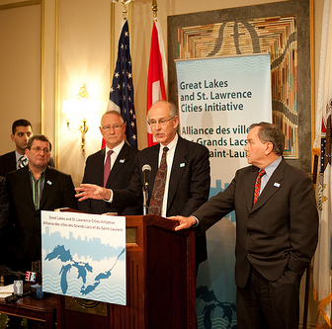
Partner Engagement & Communication
A cornerstone of DEVELOP projects is the engagement of management and policy makers who can benefit from the integration of NASA Earth observations in their decision making process. All DEVELOP projects strive to engage at least one decision-making organization to hand off project results and methodologies to.
Communication Strategies Commonly Employed:
Open communication lines with your partners, see what their needs and meeting abilities are, devise a plan, then be flexible!
Team-Partner greeting telecon during the first or second week
Weekly or bi-weekly telecons & emails with status updates
Hand-off event at the end of the term

Slide 24
Understanding Partner Needs
Prepare for your first team communication with your partner by compiling questions relating to the following areas. Ideally this happens ahead of the proposal writing process.
Community Concern or Policy
Background, current policies, and upcoming/ongoing decisions relating to the issue at hand
Economic impact (ex. cost of fighting a wildfire or drought impacts to crops in a region)
Technology
Do they currently use GIS and/or remote sensing?
What data types are they familiar with?
Do they have access to Arc/ENVI/Matlab/etc. or whatever software you will use? If not, would they be able to purchase it? (this can guide the team’s use of open source software)
Partnership and Transition
Clarify expected level of involvement - how much can the partner interact with the team?
What organizations do they partner with?
What tutorials would be of use? What format should end-products be in to be useful?
What is the best transition approach? Email, telecon, videocon, in-person (consider distance for this one - if you’re 3000 miles apart choose a different option unless the partner can fund)

Slide 25
Checklist: Working with Partners
Ensure professionalism in all interactions - you are representing yourself, your team, your advisors, your node, DEVELOP, Applied Sciences, and NASA!
Have a plan and schedule.
Be realistic in what you promise and the expectations of the partner, in fact don’t “promise” anything, but ensure the plan you are working to is clear and that there is a healthy understanding of challenges and potential obstacles/risks.
Clearly communicate timelines and important dates involved (proposal timelines, term dates, end of project, close out events, etc.)
Keep in mind the limitations of resolution (spatial and temporal) of NASA data and work within them.
Understand the partner’s needs - what kind of data/tools are useful, what software do they have access to, what tutorials or products would be helpful?
Keep communication lines open and ensure the team follows through. Generally speaking, the Project Lead should be the POC for communicating with a partner unless it is specifically delegated to another team member.
All emails to partners should be approved by the Center Lead and the CL should always be cc’d. This is for continuity and follow-on communication after the term.

Slide 26
Pre- and Post-Project Partner Forms
A Pre-Project Partner Form was sent out before the term to gather information about partner needs and expectations. A Post-Project Partner Form will follow the completion of the term to collect information regarding the perceptions of success of collaborating with DEVELOP.
Were the project results and methodologies useful?
Was the experience a good one?
Is the partner using the results or methodologies in their decision-making process?
Timeline: Center Leads send out the Pre-Project survey link a couple weeks before the beginning of the term. The Post-Project survey link will be sent to partners at the end of the term. In case of a project that has multiple terms, the survey goes out following the project’s final term.
Please communicate to your partners that DEVELOP will stay in touch and send a brief survey at the end of the project’s final term.

Slide 27
Partner Classifications
Partner: Umbrella term for any outside organization DEVELOP engages with through projects, nodes, or other activities
2 Types of Partners: differences lie in use of the project results/methods in decision making.
End-User: Organization or individual that receives results and methodologies from DEVELOP (either directly from a DEVELOP project team or through a collaborator/boundary organization) and can use the project’s products or methodologies to make a decision or policy. They may also provide some kind of resources (advising, data, model, software, funding, etc.), but it is not required. Ex. The Texas Forest Service’s Predictive Services that can use the products/methodologies from the DEVELOP project in their risk mapping creation.
Collaborator: Organization or individual that works directly with a DEVELOP project team and provides some kind of leveraged resource (advising, data, model, software, funding, etc.), but are not actually using the project’s products or methodologies to make a decision or policy. Ex. A researcher from a university who provides a team with an ancillary dataset to validate their results.
Additional classifier :
Boundary Organization: In addition to either being a Collaborator or End-User, an organization or individual that disseminates the project’s results to other end-users, decision makers, policy-makers, etc. can be distinguished as a Boundary organization. This classification is in addition to the two types listed above. The Applied Sciences Program defines a boundary organization as “an organization outside of your own that broadens your reach across the boundary into the operational domain (i.e. policymakers, decision makers, and other key stakeholders).” Ex. The Smithsonian Conservation Biology Institute works with local groups in Myanmar and helped DEVELOP disseminate results from the Myanmar Ecological Forecasting project to those in-country groups.

Slide 28
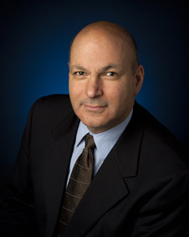
Scientific Integrity
“The iconic success of NASA is planted firmly on three foundational elements: innovation, inspiration, and integrity. While innovation and inspiration are visible through our endeavors and successes, it is our integrity – how we work, and our commitment to excellence and openness – that earns us the trust of the public and ensures our continued ability to inspire and innovate. Integrity is woven throughout the fabric of NASA. It has always been there. And each and every day, we recommit ourselves to keeping it there.”
Dr. Waleed Abdalati
Former NASA
Chief Scientist
NASA SI Policy: http://www.nasa.gov/pdf/611201main_NASA_SI_Policy_12_15_11.pdf

Slide 29
Presenting & Publishing DEVELOP Work
For purposes of ensuring appropriate export control review, performance metric tracking, and reporting to NASA HQ, any and all presentations or publications related to DEVELOP (projects or the program in general) must be communicated to and approved by NPO before the registration/acceptance of the presentation/publication.
Submitting work for presentation or publication is encouraged; however, ALL research is the property of NASA and therefore, you must have permission prior to submitting your research anywhere. Also, to minimize duplication of effort, the NPO oversees all publications and presentations.
As the Center Lead you are the main POC and should email Karen.N.Allsbrook@nasa.gov and Lauren.M.Childs@nasa.gov before registering or saying someone can attend with the following information will suffice:
Description of the activity - conference, presentation to a class, publication, etc.
Timeline for the activity - when the event is or deadline for publication, etc.
A copy of the material/content (because often presentations can be large, a PDF is good enough for a quick review)
Cost estimate (if DEVELOP funding would be needed, if not just mention it’s leveraged and by who)

Slide 30
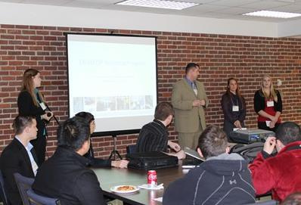
Hand-Offs
Hand-offs are an important step in transitioning results and methodologies to end-users, and working towards the goal of the end-user integrating NASA Earth observations in their decision making process.
Commonly Used Hand-off Styles
Email of deliverables (tech paper, tutorials, presentation, etc.)
Teleconference or videoconference presenting the results and methodologies
In-person presentation of results and methodologies
Get creative in how and what you hand-off. Interesting idea? Speak to your teams & NPO about it!
Depending on what you are handing off, be cognizant that you must get them approved by NASA prior to handoff.

Slide 31
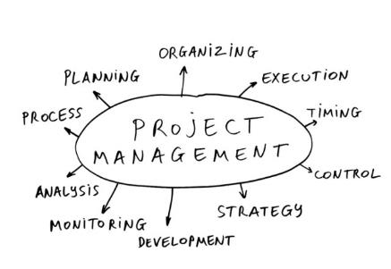
Tracking Progress
How are projects tracked?
PSI scores
Annual Reporting
Quadcharts
Check ins with teams
Project Tracking Spreadsheet (maintained by PCT)
HQ metrics -
Application areas
Study areas: geographic impact - intl. v US
Partners - unique per year

Slide 32
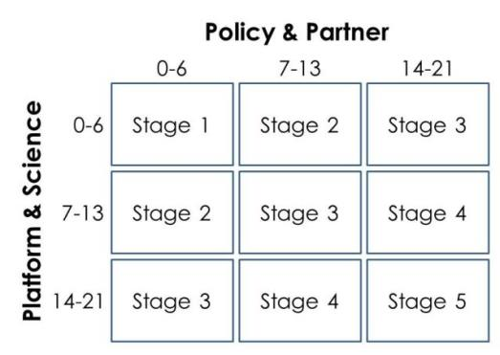
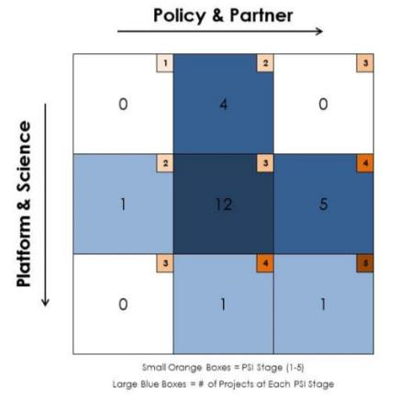
DEVELOP Project Strength Index
DEVELOP projects have consistently improved and matured over the Program’s last 15+ years. A means of assessing project progression and comparing project success has, to date, been subjective. This project strength index provides DEVELOP a means of objectively evaluating projects and tracking progress.
A series of questions are answered earning a total of 21 points in two sections: 1. Policy & Partner and 2. Platform & Science. The score for each category is then placed on the index to receive the project’s current stage (1 to 5).
Stage 1: Basic Research
Stage 2: Application Concept Complete
Stage 3: Application Demonstration Successful
Stage 4: Application Verified / End-User Engaged
Stage 5: Transition to End-User / Decision Enhanced

Slide 33
Project Continuation
DEVELOP only does projects that last between 10 and 30 weeks (i.e., always less than one year)
This is a gap that DEVELOP uniquely fills for ASP
1 Term (60%), 2 Terms (20%), and 3 Terms (10%)
Need a compelling reason during proposal phase for why a project should go two or three terms
Clearly layout phased approach to project in proposal
Partner engagement is critical for multi-term project approval
When a project should/can go into a 2nd/3rd term
What happens to a project after DEVELOP?

Slide 34
Highlight Projects
The program is always looking for great projects to highlight. You will be asked at different points during the year to submit potential highlight projects to NPO (e.g., annual report, AESAS)
What to look for in a project:
Top PSI scores
Strong partnership (e.g., handoffs)
Partner using tool in decision making
Novel use of NASA Earth observations
Use of newly available NASA Earth observations
Partner testimonials
Unique partners or partnerships

Slide 35
Miscellaneous Projects Logistics
Masters Thesis: Taking a DEVELOP project and using it as a foundation for a Masters thesis: ok, but must credit team and must get approval from advisor that group work can be used.
Personal Gain: if after a DEVELOP project has ended, someone wanted to do something more with a methodology or tool (after export control was completed) it is open for the world to do. We do not take on projects with that in mind and we do not accept money during the project.
Ownership of Work: all participants sign multiple handbook forms relating to ownership. Also, as in all research the team is an owner so to do anything with the work takes NPO and team approvals.
Software Release: specific types of products/tools created by the team must go through NASA’s SRA process prior to ANY sharing outside DEVELOP (as in with partners or anyone). Review the DEVELOP page on this for more information.
Export Control: all publications, conference and meeting presentations, and hand-off materials (mainly PPTs, Word Docs, PDFs, etc. as some file types are not able to be put into the system) will need to go through Export Control before being shared outside DEVELOP. Lead time needed: typically 2 weeks.
Building Websites/GUIs: DEVELOP should not really be building websites for other organizations, there are a lot of complications and any GUI/outward facing website that will be developed, procured or maintained by NASA-funding will have to be 508 compliant. Avoid websites as an end-product and only in very special circumstances is the creation of a GUI allowable. Talk to NPO to discuss if you have an idea that includes this to talk through logistics.

Slide 36
Office Management
Calendar
Computers & Software
Badges
PII
Orientations
Handbook & Paperwork
Progress Tracking & Reporting
Advisor Engagement
Term & Interim Planning
Dress Code

Slide 37
FY Calendar
Oct |  |  |  | Nov |  |  |  | Dec |  |  |  |  | Jan |  |  |  | Feb |  |  |  | Mar |  |  |  |  | Apr |  |  |  | May |  |  |  | Jun |  |  |  |  | Jul |  |  |  | Aug |  |  |  |  | Sep
Fall Term |  |  |  |  |  |  |  |  |  |  |  |  |  |  |  | Spring Term |  |  |  |  |  |  |  |  |  |  |  |  |  |  |  |  |  | Summer Term
 |  |  |  |  |  | Proposals |  |  |  |  |  |  |  |  |  |  |  |  |  |  |  |  |  |  | Proposals |  |  |  |  |  |  |  |  |  |  |  |  |  |  |  |  |  |  |  |  |  | Proposals
 |  |  |  |  |  |  |  |  |  |  |  |  | Su Apps |  |  |  |  |  |  |  |  |  |  |  |  |  |  |  |  |  |  |  | Fa Apps |  |  |  |  |  |  |  |  |  |  |  |  |  |  | Sp Apps
 | Selections |  |  |  |  |  |  |  |  |  |  |  |  |  |  |  |  |  | Selections |  |  |  |  |  |  |  |  |  |  |  |  |  |  |  |  |  |  |  |  | Selections
CL Competition |  |  |  |  |  |  |  |  |  |  |  |  |  |  |  |  | CL Competition |  |  |  |  |  |  |  |  |  |  |  |  |  |  |  |  | CL Competition
 |  |  |  |  |  |  |  |  | Retreat |  |  |  |  |  |  |  |  |  |  |  |  |  |  |  |  |  |  |  |  |  |  |  | Alumni Survey |  |  |  |  |  |  |  |  | AESAS

Slide 38
2016 Spring Deliverable Deadlines
January
Week 1 (1/29): Handbook Forms
February
Week 3 (2/11): Project Summary Rough Draft, Software Release Forms
Week 4 (2/15): Offices Closed for President’s Day
Week 4 (2/18): Tech Paper Rough Draft
Week 5 (2/25): Poster Rough Draft
March
Week 6 (3/3): Presentation Rough Draft
Week 7 (3/10): Project Summary Final Draft, VPS Image
Week 9 (3/22): VPS Video, Transcript
Week 9 (3/24): DEVELOPedia Page
Week 10 (3/31): Technical Paper Final Draft, Final Poster & Final Presentation
April
Week 10 (4/1): Optional Deliverables
After Term
4/7: VPS Launch
4/7-15: Round 1 Dialogue Period
4/22: Category Winners Announced
4/25-29: Final Dialogue Period
5/6: Announcement of Grand Prize Winner

Slide 39
Computers & Software
Each node has a different arrangement for who provides computers and software
NASA nodes - commonly provided by ACES (but not all)
Regional nodes - host entity provides
Troubleshooting - typically the CL should serve as the POC for any communication relating to issues. Identify who your POC is.
Some software programs are available from the NPO:
ArcGIS
Quantity: Unlimited
Eligibility:
Computers at NASA Centers
Computers solely used by NASA DEVELOP for DEVELOP projects
Computers purchased by NASA funds
ENVI/IDL
Quantity: 5 Full, 150 Temp per term
Eligibility:
Computers solely used by DEVELOP participants for DEVELOP projects
TerrSet
Quantity: 8
Eligibility:
Computers solely used for DEVELOP projects at the following nodes: ARC, GSFC, IRI, JPL, LaRC, MCHD, SSC, WC
Imagine
Quantity: 125/yr
Eligibility:
Computers solely used by DEVELOP participants for DEVELOP projects
MATLAB
Quantity: 6
Eligibility:
Computers solely used by NASA DEVELOP for DEVELOP projects

Slide 40
Badges
Nodes that have to badge people:
NASA Centers
NOAA
Some regional nodes
Process:
Identify who the POCs for badging are
Coordinate the collection of all information needed in the badging process
Working with badge processing people to collect PII, how to/not to share it
What is PII? http://itcd.hq.nasa.gov/privacy/privacy.html

Slide 41
Email Signatures
Please use the standard DEVELOP Email Signature:
Name
YP Position | Center Position
NASA DEVELOP National Program – funding mechanism (SSAI or Wise County)
Node Name
Office: XXX-XXX-XXXX
Colors, fonts, etc. are up to you, but the above information and basic format should be used.
Ex.
Tiffani Miller
Communications Senior Fellow
NASA DEVELOP National Program – SSAI
Langley Research Center
757.864.3762 Office

Slide 42
What is PII?
PII = Personally Identifiable Information
PII is any information about an individual which can be used to distinguish or trace an individual's identity.
PII is also broken down into two categories at NASA. There is Protected PII and Public PII.
Public PII: Information available in public sources (telephone books, public Web sites, university listings, etc.) and includes, first and last name, address, work telephone number, e-mail address, home telephone number, and general educational credentials.
Protected PII: Defined as a social security number as a stand alone, or an individual's first name or first initial and last name in combination with any one or more types of the following information, including, but not limited to, social security number, passport number, credit card numbers, clearances, bank numbers, biometrics, date and place of birth, mother's maiden name, criminal, medical and financial records, etc. This information may be in the form of paper, electronic or any other media format.
More information: http://itcd.hq.nasa.gov/privacy/privacy.html

Slide 43
Use of Government Equipment (@NASA)
US Government computers are for authorized users only
It is NASA's policy to permit limited personal use of Government office equipment, including information technology (IT)
The limited personal use of Government office equipment by NASA employees and contractors shall not interfere with official business, violate existing laws, and should involve only minimal additional expense to the Government
Unauthorized use of the computer accounts and computer resources to which you are granted access is a violation of Federal Law; constitutes theft; and is punishable by law
Misuse of assigned accounts and accessing others' accounts without authorization is strictly forbidden
Failure to abide by these provisions may constitute grounds for termination of access privileges, administrative action, as well as civil or criminal prosecution
NASA 2540.1G & NPR 2810.1A: http://insidenasa.nasa.gov/ocio/policy/policy_direct/index.html

Slide 44
Privacy
Expect NO privacy when using a government computer.
Strict computer use policy in effect - every keystroke is stored, every NASA email is public domain.
NASA Policy:
NASA employees and contractors do not have a right to expect privacy while using Government office equipment at any time, including accessing the Internet and using email.
The Government maintains call details and network access records to monitor telephone activity and Internet access.
The Government also employs monitoring tools to track system performance and improper usage.
This applies to those emailing a NASA email as well.
NASA 2540.1G & NPR 2810.1A: http://insidenasa.nasa.gov/ocio/policy/policy_direct/index.html

Slide 45
Orientations
The Center Lead is in charge of giving your participants the national orientation at the start of every term, including returners
NPO sends out a new national orientation ahead of every term. It is the responsibility of the CL to review, ask any clarifying questions needed, then give the orientation to the participants.
It is ok to add additional information that is node-centric, but do not erase any of the national content
Timeline - conduct orientation by the end of the first week of the term.
Scheduling - whenever possible, identify a time you can have all participants join for one orientation in the first week. If schedules cannot overlap, schedule more than one that week.

Slide 46
Indicator Tracking
During each interim the NPO puts out a call to submit an indicator tracking spreadsheet
The current template is from the spring of 2015 and you just add to it as things progress
Tabs:
Intro - how to fill it in
Participants
Training & Development
Projects
Partners
Hand-Offs
Publications
Presentations
Recruiting
Leveraged Resources
Event Support
Leadership & Gender
Why? We have to report all these things to NASA HQ. NPO collects and compiles and submits to the CBP. These items feed the “Results Framework”
Tips:
Update as you go, it’s nearly impossible to remember everything months later!

Slide 47
Handbook & Paperwork
Handbook:
All participants should read - sets expectations, clarifies regulations
Paperwork
Handbook forms to sign
Invoices & Status Reports
How to submit them - alphabetical order by last name, invoice then status report
These should be printed portrait on individual pages (single page for status report, single page for invoice)
Fax: 757.864.4407 (do not use 3699 anymore)
Scan & email to Karen & Jennifer
Mail originals
Link on DEVELOPedia - check it out!
Timeline: Week 1

Slide 48
Advisor Engagement
Each node has different advising available:
In-house advising & offsite advising
Each node has a lead advisor or mentor onsite
Many project science advisors are offsite
Up to the CL to engage advisor/mentors in DEVELOP activities
Inform of calendar of events, requirements, etc.
Many lead advisors/mentors are generalists and can provide general advising to projects, but at times specialists may be needed. When this is the case, it is up to the CL to identify and reach out to their network and NPO for potential volunteers
Dr. Ross is the National Science Advisor, in this position he oversees the collective of advisors that contribute to the program. He is a resource for all teams (although is time is limited).
Lead Science Advisors have monthly tag ups to check-in and discuss topics and issues
When involving advisors (beyond the lead advisors/mentors)
Set clear expectations: volunteer basis, term dates, communication plan, how they can help (review results or deliverables, etc.)

Slide 49
Term Planning
Preparations needed:
Proposals
Participant Selections
Team Creation
Computer/Software Resources
Collecting Schedules
Preview Slides
DEVELOPedia pages & accounts
Preparing Handbook & orientations for incoming teams

Slide 50
First Week of the Term
First Week
Teach and be the beacon of knowledge regarding NASA organization & personnel, DEVELOP elevator speech, DEVELOP history, DEVELOP organization & personnel, project characteristics & execution timeline
Give orientation
Ensure handbooks are read, forms signed, and returned to NPO
Lead ice breaker activities for your teams
Have teams take the personality type tests, discuss the importance and usefulness of these tests (great ice breaker!)
Be familiar with the national project portfolio, tell teams about similar projects and make connections
Serve as the liaison to NPO, advisors, partners, other nodes
Be calm and organized (at least seem like you are)
Make others feel welcome and comfortable!

Slide 51
Interim Planning
Process for submitting request
Karen will send an email to CLs calling for interim requests a few weeks before the end of the term
The CL should identify what will be taking place during the interim and who will be in the office which weeks (CL and Fellow) and anyone else who
What an interim can be used for:
Prep for next term (final selections, team creation, term preview slides, communication with incoming participants, project prep work, computers/software set up, prep of orientation materials, badging logistics, communication with partners)
Reporting (weekly quadcharts, national telecons)
Proposal writing/editing
Publications
PSI scoring, indicator tracking updates, etc.
Conference/meeting presentations
Transition of leadership
What an interim cannot be used for:
Project work
Why? Funding is limited. Funds spent during an interim mean less for a term. DEVELOP has shifted significant resources to allow for full-time Fellows and CLs to be at nodes throughout the year. The DEVELOP model focuses all project work in terms, which aligns with reporting to HQ and provides the best allocation of resources and support to all teams simultaneously.

Slide 52
Dress Code
Why:
Our signature: Professionalism & Respect
Considerations:
Weekly casual day (jeans & DEVELOP T)
Interims
Presentations and/or mtngs w/visiting “higher-ups”
Details: Business Casual
Pants: Khakis or slacks
Skirts: Appropriate business skirts at/near knee length
Dresses: Appropriate length (at/near knee) dresses, no spaghetti straps
Shirt: Collared shirts, polo shirts, blouses, sweaters
Shoes: Dress shoes (no sandals, no sneakers, no flip flops)
Accessories & Make Up: Be conservative
Formal Presentations:
Formal Suits (Dark Colored - Black, Navy, Gray) & Dress Shoes
Dress Code Don’ts:
Jeans, tennis/running shoes (except on designated days)
Pants that droop and display underwear
Shorts
Shirks shorter than 3 inches above the knee when seated
Halter tops or exposed midriffs
Revealing, too tight clothing
Shirt straps narrower than 2 inches wide
Sweat pants, sweatshirts, T-shirts
Attire with vulgar, violent or explicit language or images
Multiple body piercings, hats, bandanas, etc.
No flip-flops of any kind
Unkempt attire

Slide 53
Travel
Process
Conference
Considerations

Slide 54
Background
DEVELOP is fortunate to be able to provide travel opportunities to its participants. This travel is a privilege and should be treated as such.
There are many considerations involved: relevance to ASP/DEVELOP, funding availability, liability, and perceptions - just to name a few.
If your node has an opportunity to present work at a conference or meeting, meet with partners, conduct field work, etc., reach out to the NPO to discuss details and gain approvals.
This process is for ANY travel relating to DEVELOP or involving DEVELOP project work, whether or not it is funded by DEVELOP.
Leveraged travel is great! We highly recommend seeking out opportunities to increase the amount of travel by your node, however leveraged travel must go through the same process as funded travel.
Each node is given an annual travel pot of $2k. There is no rollover between years of unused funds.
International travel is only allowed in rare cases and only when approved by NPO and NASA’s Office of International and Interagency Affairs. Contact NPO immediately with any potential opportunities, so we can make sure proper policies and procedures are followed.

Slide 55
Process for Requesting Travel
Contact NPO about interest (include a cost estimate)
Email Karen and Lauren if there is an event or activity your node is interested in participating in
Include a cost estimate (if DEVELOP funding is being requested) or mention if it’s a leveraged opportunity
NPO reviews
NPO takes into consideration:
Is the travel relevant to NASA’s Applied Sciences Program & DEVELOP?
Is the travel essential and/or necessary (as compared to discretionary or preferable)?
Does the travel contribute to the DEVELOP’s core mission (and thus NASA’s core mission)?
Is the participant traveling substantially involved with the purpose of the trip?
Are there any alternative methods of participating (e.g. phone, video conference, or pre-recorded video message)?
If all the above are met, is there funding available in the node’s travel pot?
If approval is given, travel forms & presentation materials will be requested:
Trip request & conference justification form (if travel is to a conference)
Any posters, presentations, or other content that would be presented
Once travel forms are received, NPO will input travelers into NCTS and content into export control
When approvals are received, travel arrangements will be made by DEVELOP (or if leveraged travel, by funder/participant)
Travel happens!

Slide 56
Considerations
Communication is key
Travel is a privilege, use it as a reward to your participants who go above and beyond
Work within your node travel budget
Always take into account perceptions - due to sequestration and other anti-federal govt. sentiments, DEVELOP must be diligent that all travel is relevant, essential, and approved
Approval process can be slow depending on specifics (ex. AGU Fall Meeting)
If for some reason a traveler wants to change their travel arrangements, contact NPO first!
Plane tickets cannot be transferred to someone else, so if a traveler backs out last minute for some reason there is no remedy - make sure before arrangements are made that the person is serious and able to go
The CL should coordinate the creation, collection and review of all conference materials – don’t forget everything must go through export control!
What is ok to fund out of travel pot? Conference travel, NASA meetings, close out events, meetings with partners (local), local field work (data collected should be used in project in a meaningful way), visiting nearby nodes, etc.

Slide 57
Participant Selections
Application Review
Interviews
Selections
Timelines
Handling PII

Slide 58
Review Process
Getting elevated privileges in online app system
You will be elevation to a “Location POC” and will then be able to review applications for your location
Running query, downloading spreadsheet & PDFs
Use your location’s acronym to find your candidates
Click the CSV or XLS orange buttons to download spreadsheet
The spreadsheet automatically created will have PII content, to make it so you can store the file on your computer, do these steps:
Delete street, city, & zip columns or password protect the spreadsheet
Delete the original file (including clearing the trash folder) at end of same computer Reviewing apps
Review all “Completed” and “Submitted”
Eligibility:
Candidates must have 3.0 GPA recent or cumulative, if both GPAs are under 3.0 they should only be considered for a volunteer position
18 or older & citizenship
You can download individual PDFs, however they contain PII so you cannot email them to advisors or anyone else and must delete or password protect them
Do not email PII materials

Slide 59
Interviews
Selecting who to interview
Can be all or a select group
Must provide justification to NPO of who wasn’t interviewed – should be fair, logical, and non-discriminatory
Returners - out of respect for returners who are currently at your node, you should select them for an interview
Scheduling interviews
Template email is available
Be sure to BCC candidates if you are emailing all at one time
Conducting interviews
Phone, video, or in-person
Interviews can last 20 minutes to one hour, typically
Interview questions provided by NPO for new & returning candidates
At least two DEVELOP representatives involved in all interviews – someone from NPO can join if needed
You can’t ask age or nationality in application or interview, however you can ask: “Do you meet the eligibility requirements of being at least 18 by the start of the term?”, “Do you meet the eligibility requirement of being a US citizen?”)
Be careful in communication timelines as there can be delays

Slide 60
Selections
Making selections
NPO will provide projected number of participants for upcoming term – this will be the number of “accepted” candidates you can select
Have a list of alternates in the event your initial candidates don’t all accept
Have your node’s advisor/mentor sign off on the selections
Send your suggested list to Karen & Lauren (coping your advisor/mentor) along with list not being accepted & your justifications.
NPO will review and confirm with you before candidates are notified
Considerations
Don’t ever inform candidate they were/weren’t selected – must come from NPO
We want people that contribute to the program, but also consider people that gain more from the program - were all about building capacity!
Notification process
Karen notifies all submitted/completed applications whether they are accepted or not accepted
Those prospective participants have a specific period in which to respond & accept their position
Those that accept will have a deadline to submit their work schedule to you – be sure these are within set office hours, include lunch breaks (at least 30 minutes), hours add up correctly and weekly total is included

Slide 61
Personnel Management
Team Morale
Personality Typing
Performance Reviews
Progression & Delegation
Succession Planning
Fellows
Advisors
Dealing w/Issues

Slide 62
Team Morale & Dynamic
Team Building
Set the team dynamic for your location
Lead team building exercises & planning of activities
Ensure that project teams are functioning well
Make everyone as comfortable as you can!
Capacity Building
Lead personal development activities (personality typing, networking opportunities, etc.)
Lead professional development activities (presentation practices, resume writing, GIS 101, etc.)

Slide 63
Personality Typing
Why
It’s interesting! You get to learn about yourself and teammates’ tendencies and motivations, strengths and weaknesses, and innate preferences.
Use the terminology as a common language to discuss with your team.
Allows for acceptance which helps alleviate pressure, make people feel comfortable and can serve as a great ice breaker activity.
What
NASA’s 4D System & MBTI
How
The CL and ACL should review the orientation materials and be prepared to talk through them with the team at the start of each term. Make it fun!
Resources Available
2 orientation modules
How DEVELOP Builds Teams I - 4D & MBTI
How DEVELOP Builds Teams II - Working w/Different Personality Types
Online resources (endless!)
Orange “What Type Am I?” books (many nodes have)

Slide 64
Performance Reviews
Performance Review
DEVELOP’s main objective is to assist participants in developing both professionally and personally. Part of this process is giving feedback in performance reviews at the middle and end of the term. Please consider this process constructive and take any feedback as goal for improvement.
Entrance Discussion - typically week 1 or 2
Midterm Review - typically weeks 5 or 6
End of Term Review - typically weeks 9 or 10
National Exit Survey
This is an online survey that we ask all participants to take. It is DEVELOP’s performance review and allows for a national perspective on the program, leadership, and advisors. It helps DEVELOP evolve and improve and we value your input greatly!
Timeline: Link shared in week 9, to be completed before August 6th

Slide 65
Progression & Delegation
Progression
Foster participants through the program
Identify potential leads
Delegation
Empower your team to help support the tasks at hand
DEVELOP is built to be a team experience
Delegation of duties not only helps you accomplish more, it also builds stronger teams
Examples:
Reviewing other teams deliverables
Leading communication with specific partners
Helping compile content for quadcharts and Indicator tracking
Team Member
Project Lead
Assistant Center Lead
Fellow
Center Lead
Senior Fellow
NPO Management Team

Slide 66
Succession Planning
Hire People That Are Better Than You Are!
Always have at least one viable candidate that could step in and take the CL position if needed
This could be an ACL, Fellow, or a participant at the node
Planned Departures
If you know you will be leaving at a specific time, communicate with NPO about the date and position will be included in the next Center Lead competition window
Depending on how the competition window lines up with your departure, a transition period with the incoming CL may or may not be an option
Prepare by identifying one or more participants that can begin helping out with CL tasks and would be interested in potentially applying for the position
If you leave before the competition window, an acting Center Lead will be selected to bridge until the formal competition of that position
Sudden Departures
An acting Center Lead will be selected to bridge until the formal competition of that position

Slide 67
Fellows
Fellows must be out of school, have a 3.0 GPA min from last degree, and be able to contribute to and gain from DEVELOP
Fellows are a resource to your node, but keep in mind part of their time (25-50%) are focused on national tasks
Node management participates in the Fellow application review and interview process during the summer (led by NPO)
Selection of a Fellow is shared decision between NPO and node
Inform NPO before the Fellow application window if you can’t host a Fellow in the next FY
Encourage participants at your node to apply during the application window
Candidates are often asked to support nodes they have never previously worked at, flexibility in applicants is appreciated
Generally, one Fellow per node
The Fellow positions are competed during the summer term

Slide 68
Dealing w/Personnel Issues
Things will arise!
#1 – don’t put anything in writing. Should a personnel issue arise, immediately and verbally communicate the situation up the chain
Do not send emails about the situation
Maintain a positive work environment where participants feel comfortable coming to you with issues they are having with other DEVELOPers
If someone up the chain is the issue, skip that link in the chain
If you need counseling for how to respond to a specific situation talk to NPO
You or the person having the issue can also drop a note in the anonymous dropbox (http://developexchange.com/dropbox.html)
You can (and should) inform mentors/advisors regarding any issues, however they cannot make decisions regarding action. That must come from your contracting organization’s representative (listed above right).
SSAI Rep: Karen Allsbrook
Wise Reps:
Lauren Childs-Gleason
& Jamie Favors
NPO
Center Lead
Project Lead
Team Member

Slide 69
Communications
Internal
Telecons
Quadcharts
External
Interacting w/Media Outlets
Strategic Talking Points
Social Media
DEVELOP Website
Recruiting
Alumni
Comm Team

Slide 70
Internal
Anyone within the DEVELOP “family”
NPO
Advisors
Participants
ACL
Project Leads
Fellows Class
Other Nodes
Less regulation, several opportunities in place

Slide 71
Communication w/NPO
Always feel free to email or call NPO
Lauren: (757)864-4204, Lauren.M.Childs@nasa.gov
Jamie: (804)692-0136, James.E.Favors@nasa.gov
Karen: (757)864-1276, Karen.N.Allsbrook@nasa.gov
Bender: (757)864-5552, Michael.R.Bender@nasa.gov
Lindsay: (757)864-7283, Lindsay.M.Rogers@nasa.gov
Dr. Ross: (757)864-3595, Kenton.W.Ross@nasa.gov
For important or time sensitive items don’t wait until the national telecon
Don’t worry about asking a lot of questions!
If new opportunities arise regarding DEVELOP, get the NPO involved early on
Personnel issues – don’t email, call!
Contact Sheet: updated draft on Exchange & emailed out each term

Slide 72
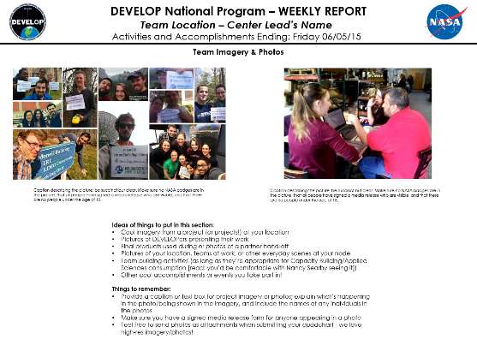
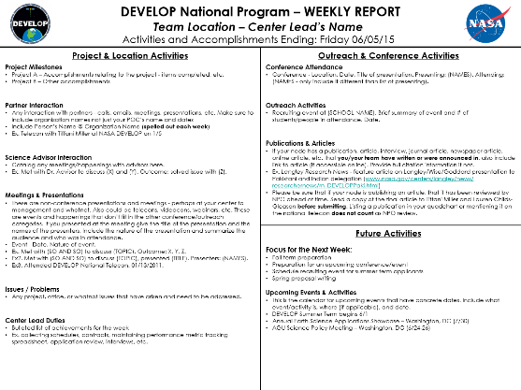
Telecons & Quadcharts
National Telecons
Weekly phone call with all the domestic locations
Report high level activities, important project breakthroughs, exciting opportunities, partner interactions of importance, any issues or questions, and anything else you deem worthy/important for the national audience
Questions and concerns (issues with data/analyses, etc.)
Wednesday 2pm Eastern – 1 (844) 467-6272 / pc: 220588
Quadcharts
Weekly reports with in depth details
Supplements telecon reporting
Compiled into reports for HQ
Due every Friday by COB
Email to:
Lauren.M.Childs@nasa.gov
Tiffani.N.Miller@nasa.gov

Slide 73
External
Anyone outside of DEVELOP
NASA HQ and node personnel
Media
Partners
Etc.
More guidelines involved

Slide 74
Interacting w/ the Media
NPO and NASA Public Affairs must be involved with all media interaction from the beginning.
If you are interested in working with the media, contact NPO first.
If someone from the media reaches out to you, contact NPO about a response or connect them with NPO directly.
NPO POC – Lindsay Rogers Lindsay.M.Rogers@nasa.gov

Slide 75
DEVELOP Elevator Speech
DEVELOP, part of NASA’s Applied Sciences Program, addresses environmental and public policy issues by conducting interdisciplinary feasibility projects that apply the lens of NASA Earth observations to community concerns around the globe. Bridging the gap between NASA Earth Science and society, DEVELOP builds capacity in both participants and partner organizations to better prepare them to address the challenges that face our society and future generations. With the competitive nature and growing societal role of science and technology in today’s global workplace, DEVELOP is fostering an adept corps of tomorrow’s scientists and leaders.
Strategic talking points are coming soon.

Slide 76
Social Media & Website
Benefit and use of existing venues was evaluated by the previous Comm team
Approval process to open new official accounts
Structuring content around various campaigns for the coming year
New website
Look for updates, feel free to make suggestions

Slide 77
Recruiting Guidelines
Actively recruit new candidates! You are responsible for leading recruiting efforts for your location.
DEVELOP’s CAC will also be holding recruiting events at their schools.
Direct all interested individuals to apply through the DEVELOP website. We do not accept DEVELOP applications through any other source.
Do not list DEVELOP on any third party website or list without prior approval.
Any flyers need to be approved by NPO before use. Contact Tiffani Miller Tiffani.N.Miller@nasa.gov.

Slide 78
Alumni
Consider ways to involve location alumni and keep them informed of current activities.
Invite alumni to local closeout events, as well as the Annual Earth Science Applications Showcase at NASA HQ in the fall.
The Annual Alumni Survey is sent out to all previous participants each summer.

Slide 79
Resources
The Comm team is available as a resource for communications and recruiting efforts.
Tiffani Miller – (757) 864-3762
Vickie Ly – (650) 604-3181
Mark Barker – (818) 354-6656
Ryan Schick – (256) 961-7709
Contact Tiffani to request bookmarks and brochures for your location.
Additional resources can be found on the DEVELOPedia Communcations page.

Slide 80
Publications
Process
Approvals
Export Control
Micro-Journal

Slide 81
Process
Contact Comm Team with initial interest
Select publication venue and draft article
If this happens during the term, the article draft can replace the tech paper. Email the Project Coordination Team if you plan to do this.
Submit draft to NPO for review before submitting to the journal
Comm team and project team go back and forth with edits to create a final submission
NPO submits final version into export control
Once approved, the content can be submitted to publication venue
Keep Tiffani in the loop with any and all edits from venue
The final-final version must be resubmitted to NASA Export control
NASA Export Control takes about 2-3 weeks.

Slide 82
EOX Micro Article Journal
A step between grey-literature and peer-reviewed journals
High-level projects each year will be selected for an internal review process
Articles will be shorter than full length articles, and will include interactive features for the reader (eg. maps)
Require a minimum of three “content innovation” additions

Slide 83
Resources
The Comm Team is the main resource for publication information.
Key POC is Tiffani Miller – (757)864-3762
Email the PC Team if you will be submitting an article in place of your tech paper.
Each journal will have information for authors to use when drafting and formatting an article for that specific journal.
NASA has a publication manual available online
Links to previous DEVELOP publications can be found on the DEVELOP website

Slide 84
NASA Logistics
Export Control
Software Release Authority
NCTS
Statements
Use of NASA Logo
Use of DEVELOP Logo

Slide 85
Required Statements
You will notice a line on each deliverable that mentions:
This material is based upon work supported by NASA through contract NNL11AA00B and cooperative agreement NNX14AB60A.
A new additional statement that is required is as follows and will be on all fall deliverable templates:
Any opinions, findings, and conclusions or recommendations expressed in this material are those of the author(s) and do not necessarily reflect the views of the National Aeronautics and Space Administration and partner organizations.
DEVELOP Node Location

Slide 86
NASA’s Export Control
What is a Export Control?
The NASA Export Control Program is based on the philosophy: “We want to maximize the benefits of our international efforts while ensuring that we comply with U.S. export control laws and regulations”. This is the personal responsibility of each employee or contractor to pursue appropriate international activities involving transfers of technologies, software, and commodities. The Agency’s Export Control Program is the mechanism that provides checks and safeguards at key steps to help manage international activities and ensures that NASA works within Export Administration Regulations (Department of Commerce) and the International Traffic in Arms Regulations (Department of State), which could result in criminal, civil, or administrative enforcement actions against NASA, individual employees, and/or private contractors.
NASA Administrator’s Export Control Policy:
"As a U.S. Government Agency on the forefront of technological development and international cooperation in the fields of space, aeronautics, and science, the National Aeronautics and Space Administration will strive to fulfill its mission for cooperative international research and civil space development in harmony with the export control laws and regulations of the United States. Due to heightened proliferation challenges facing the United States and the world, including risks posed by the spread of missile technologies and weapons of mass destruction, and in view of the significant criminal, civil, and administrative penalties that may affect the Agency and its employees as a result of a failure to comply with U.S. export control laws and regulations, it is the responsibility of every NASA official and employee to ensure that the export control policies of the United States, including nonproliferation objectives, are fully observed in the pursuit of NASA's international mission."

Slide 87
Export Control & Designated Countries
What is a Designated Country?
This list of “Designated Countries” is a compilation of 41 countries with which the United States has no diplomatic relations, countries determined by Department of State to support terrorism, countries under Sanction or Embargo by the United States, and countries of Missile Technology Concern.
What does this mean to me?
It means that for any project deliverables, products, decision support tools, etc. to be transferred to any partner (domestic or international) a review must take place first. The NPO ensures that DEVELOP works within NASA Export Control guidelines. The NPO must be made aware of any presentations, publications, or information transfer that take place before they occur. A transfer can be an email, publication, presentation, telecon, webinar, etc. Communication with partners in designated countries has restrictions, so coordinate with NPO ahead of opening communication lines.
But my partner is domestic/not in a designated country?
While your project partner may be in the United States or not on the designated country list, the assumption is that anything that leaves the Agency/DEVELOP could be in turn transferred to any individual or organization anywhere and thus we must ensure that all material is appropriate for a global audience.
Questions? Contact Lauren.M.Childs@nasa.gov
NASA Export Control: http://oiir.hq.nasa.gov/nasaecp/index.html

Slide 88
What is NASA’s Software Release Authority?
What is NASA’s Software Release Authority? NASA’s process for formally giving approval for software and tools to be released to the public for marketing, distribution, and use. All new “software” developed by NASA-funding must be made available through the Software Release Process, which coordinates export control review, intellectual property review, commercialization assessment, and software release actions and determines if it meets NASA policies and guidelines.
NEW - process involved:
Identify which projects are creating the types of tools that must go through SRA by means of the proposal and project summary deliverables
To review the full process and steps involved - visit: www.devpedia.developexchange.com/dv/index.php?title=Open_Source_Software_Development_and_Release
Other considerations:
All software released through NASA DEVELOP will be released open source.
All software released through NASA DEVELOP will be distributed through the NASA DEVELOP GitHub account after Software Release Approval. Caution partners that this may not occur during the term.
For questions about this form, refer to DEVELOPedia: Open Source Software Development and Release or contact Mike Bender at michael.r.bender@nasa.gov.
You cannot include any lines of code in presentations unless it has been approved through the software release process
You cannot handoff any coding tools/short scripts the team created to a partner until the software release process has been completed

Slide 89
What is NCTS?
NASA Conference Tracking System
In the past few years NASA has identified the NCTS as the means for the Agency to monitor and approve all conference related travel in response to sequestration.
All conference travel, including that of contractors and consultants who are being funded by and/or representing the Agency must be input into the system for approval.
The Agency has a 50 person limit for all conferences - NASA centers input their travelers, when a conference has more than 50 people signed up to go a waiver must be signed by NASA HQ if they deem it is appropriate.
Timeline:
Domestic conferences = 30+ days advance input
International conferences = 80+ days advance input
Template: the travel justification form is the content that must be input for each conference. Karen and Lindsay are the POC for all DEVELOP-related inputs.
Notes:
Approvals often take a very long time and are not always given in a timely manner that would allow for early registration and whatnot
Even if outside funding provides the opportunity for travel, if you are presenting DEVELOP work this is required
Some large conferences like the AGU Fall Meeting require input 6+ months ahead!

Slide 90
NASA Logo Usage
The NASA logo may not be used by persons who are not NASA employees or on products (including Web pages) that are not NASA-sponsored.
1221.110 Use of the NASA Insignia.
The NASA Insignia shall not be used in any manner that would imply that NASA endorses a commercial product, service, or activity or that material of a nonofficial nature represents NASA’s official position.
The NASA Insignia is authorized for use on the following:
(a) NASA articles. (1) Films, videotapes, and sound recordings produced by or for NASA. (2) Wearing apparel and personal property items used by NASA employees in the performance of their duties. (3) Required uniforms of contractor employees when performing public affairs, guard or fire protection duties, and similar duties within NASA Installations or at other assigned NASA duty stations, and on any required contractor-owned vehicles used exclusively in the performance of these duties, when authorized by NASA contracting officers. (4) NASA publications, including pamphlets, brochures, manuals, handbooks, house organs, bulletins, general reports, posters, signs, charts, exhibits, and items of similar nature for general use, as specified in the NASA Graphics Standards Manual and the NASA Insignia Standards Supplement.
(b) Personal articles—NASA employees. (1) Personal items used in connection with NASA employees’ recreation association activities. (2) Items for sale through NASA employees’ nonappropriated fund activities subject to paragraph (c) of this section.
Full regulations:
www.gpo.gov/fdsys/pkg/CFR-1999-title14-vol5/pdf/CFR-1999-title14-vol5-part1221-subpart1221-1.pdf
http://www.nasa.gov/audience/formedia/features/MP_Photo_Guidelines.html

Slide 91
DEVELOP Logo Usage
Rules for use of DEVELOP program identifier
Acceptable use:
Deliverables
DEVELOP Gear
DEVELOP business cards
Considerations:
Anything with the DEVELOP logo must be approved by the NPO prior to public dissemination
Print materials - typically use the NASA logo, not DEVELOP logo
DEVELOP’s logo cannot be used with any other logos or imply in anyway that DEVELOP endorses a commercial product, service, or activity or that material of a nonofficial nature
We aren’t allowed to have DEVELOP letterhead

Slide 92
Important Things To Note
DEVELOP IS part of NASA’s Applied Sciences Program
DEVELOP is NOT part of NASA’s Office of Education
NASA’s internships/activities have been consolidated and/or eliminated – DEVELOP is not one of those/part of that consolidation.
DEVELOP is very different from NASA’s internship opportunities in the way we approach projects, focus on teamwork, the level of responsibility and authority given to participants, the opportunities we provide, and the individuals and organizations we network with. Enjoy it while you are here!
NASA restricted travel under sequestration, meaning that new guidelines are in place to gain approval for travel. Travel is a privilege!

Slide 93
THANK YOU!
Have a Great Term!

