Slide 1
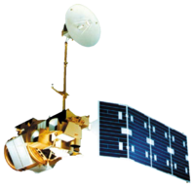
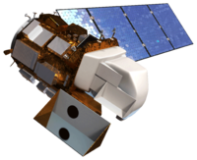
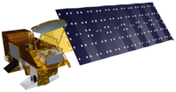
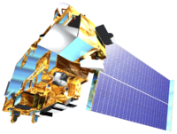
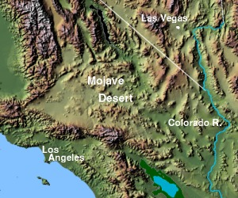
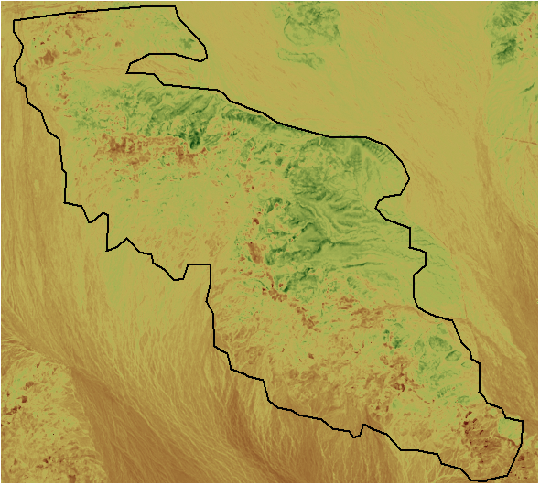
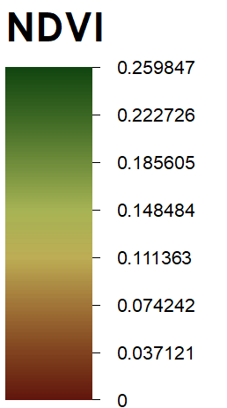
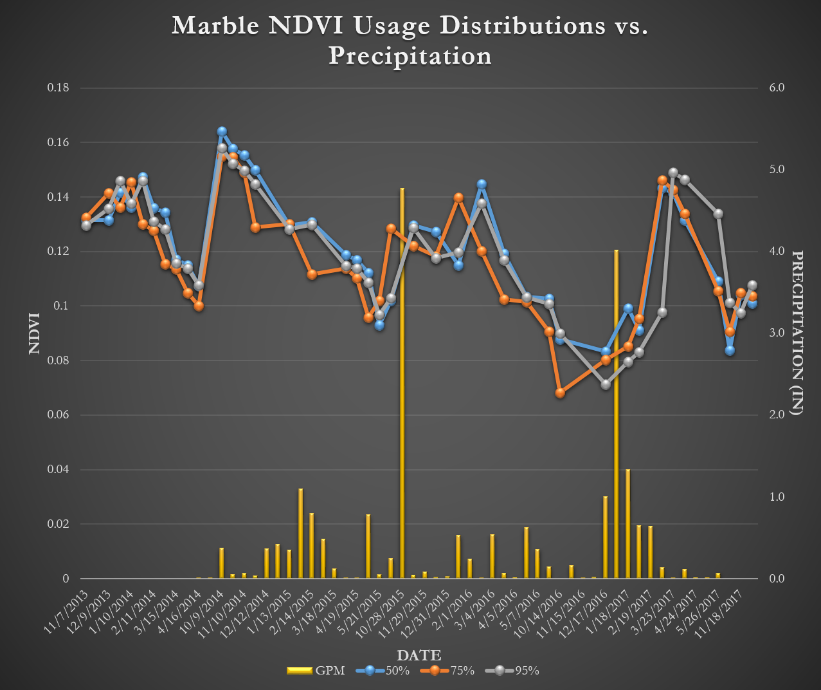
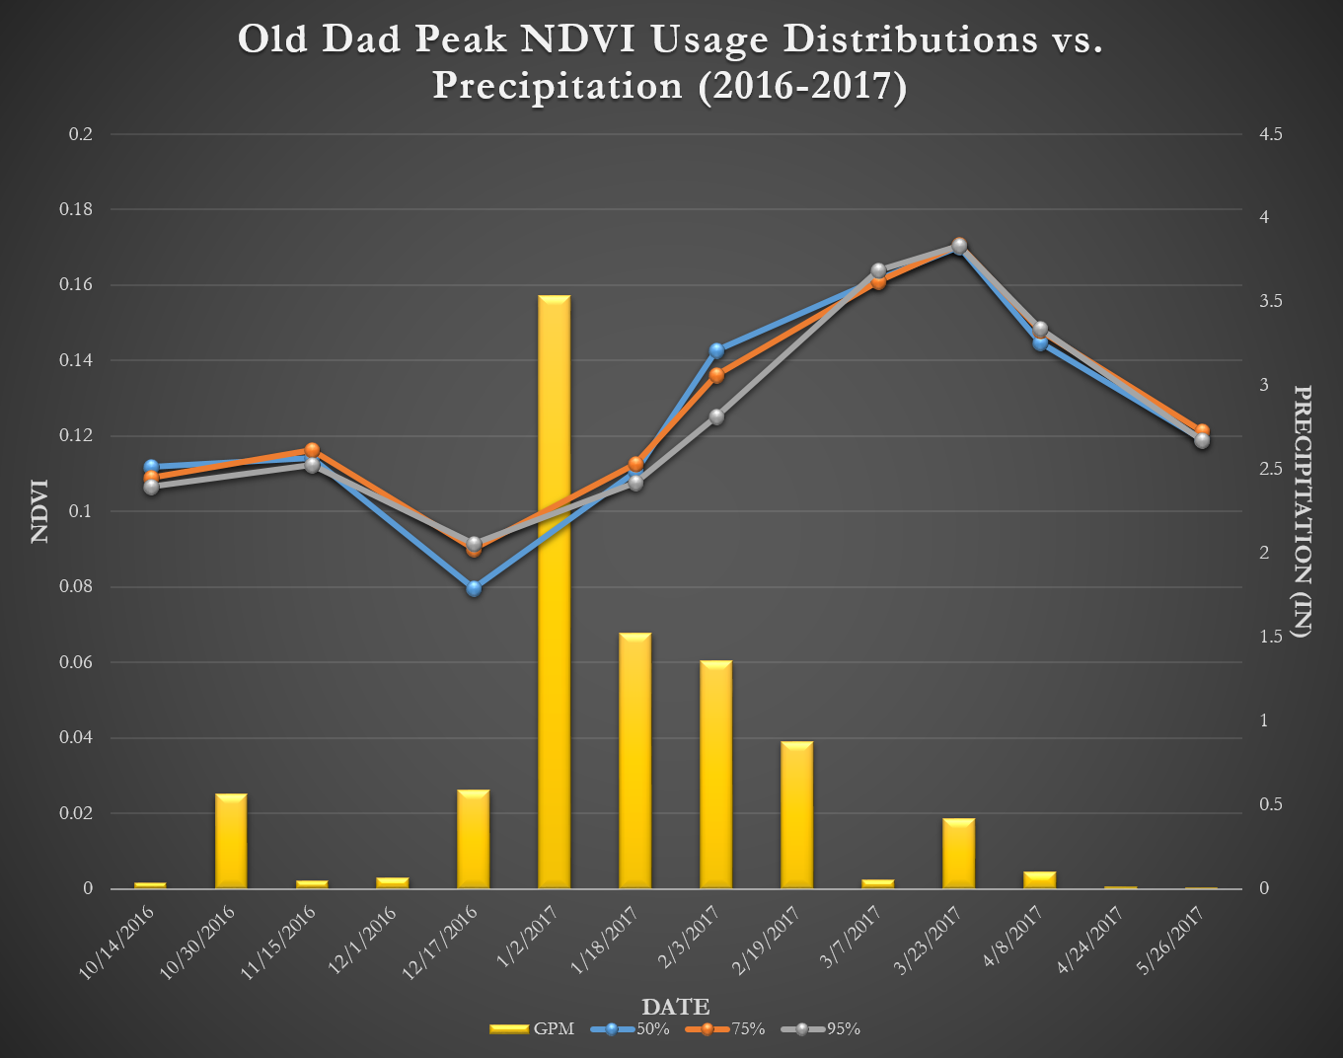
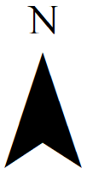
Assessing Vegetation and Precipitation Indices to Aid Bighorn Sheep Monitoring and Management
Abstract
Objectives
Desert bighorn sheep (Ovis canadensis; BHS) habitat selection is influenced by the relationship between precipitation patterns and habitat vegetation availability. The ability to effectively measure habitat resource quality and availability, and understand mortality rates caused by disease and predation is needed to enhance BHS habitat management. We applied NASA Earth observations, paired with in situ measurements of population distribution, to help assess availability of suitable BHS habitat. Satellite images from NASA’s Landsat 8 Operational Land Imager (OLI) and the Aqua and Terra Moderate Resolution Imaging Spectroradiometers (MODIS) were processed into monthly Normalized Difference Vegetation Index (NDVI) maps from 2013 to 2017. We plotted means and standard deviations to identify trends in forage quality and heterogeneity. We acquired precipitation accumulation measurements from the Parameter-elevation Relationship on Independent Slopes Model (PRISM) and the Global Precipitation Measurement (GPM) Integrated Multi-satellite Retrievals for GPM (IMERG) product and compared these precipitation variables to vegetation characteristics within habitat use polygons. Comparative analysis of vegetation indices and precipitation identified areas of perennial or seasonally green vegetation resources with vegetative growth related to persistent or burst precipitation patterns, respectively. The National Park Service and the California Department of Fish and Wildlife will use this information to better understand areas where BHS have steadily-available resources, and to continue the use of NASA Earth observations to aid in future management decisions.
Model habitat availability for BHS populations, using NASA EO and in situ data
Identify spatio-temporal trends in vegetation growth and precipitation to aid in conservation and management efforts
Assess relationships between precipitation and measured vegetation indices
Evaluate methods for measuring NDVI and precipitation to inform partner decisions beyond the duration of this study
Earth Observations
Study Area
Landsat 5 TM
Landsat 8 OLI
Aqua MODIS
Terra MODIS
Image: NRCS
Photo: USGS/ ESA
Methodology
CA
NV
UT
CO
Old Dad Peak
Bighorn Sheep Distributions
Distribution Vegetation Regression
AZ
NM
Marble Mountains
274 km
Image: Matthew Trump
Landsat,
MODIS
Zonal Statistics
10 km
NDVI, MSAVI2
Precipitation Impact on Vegetation
161 km
2013 - 2017
Processed Data
GPM
Precipitation
Results
Mean Oct. – May NDVI, Marble Mtns., 2013 - 2017
Fig 1: Mean NDVI values from winter seasons (Oct – May) from 2013-2017. Measures for south-facing slopes and exposed areas predominantly exhibit values approaching the soil line (0). Means were generally greater at higher elevations within the study areas.
Fig 2: Low ranges were demonstrated between different utilization levels in the Marble Mountains, though more selective intervals were often the greatest.
Fig 3: Though cloud interference created gaps in temporal coverage, rain events often preceded spikes in NDVI while dry spells preceded drops in the data.
Conclusions
Team Members
NDVI is better suited to the study area than soil-adjusted indices because it better adjusts for rugged topography.
Rainy periods were often followed by NDVI spikes. Gaps in the data due to cloud cover likely obscure some of these.
NDVI values did not show a clear relationship when compared to UD level at Old Dad. This may be explained by the heterogeneity of the vegetation within the area. However, more selective intervals were generally higher at Marble.
In the absence of hydrological data, the coarse resolution of satellite precipitation data and the scarcity of in situ data poses a challenge analysis in sporadic weather environments like the Mojave Desert.
Jake Ramthun
Project Lead
Devon Burks
Mariah Heck
Acknowledgements
Project Partners
Joseph Spruce (Consultant to Science Systems & Applications, Inc.) Dr. L. DeWayne Cecil & Annette Hollingshead (NOAA NCEI, Global Science and Technology, Inc.) Bob VanGundy (The University of Virginia’s College at Wise) Jeff Villepique, Paige Prentice, Dave German & Regina Abella (California Department of Fish and Wildlife, Wildlife Branch, Game Management) Nathan Galloway & Debra Hughson (NPS, Biological Resources Division, Wildlife Health Branch) Neal Darby (NPS, Mojave National Preserve) John Wehausen (Sierra Nevada Bighorn Sheep Foundation) Dr. Clinton Epps & Daniella Dekelaita (Oregon State University)
Eric White (NASA DEVELOP)
Emily Gotschalk (NASA DEVELOP)
National Park Service: Mojave National Preserve & Wildlife Health Branch
California Department of Fish and Wildlife
Oregon State University
Sierra Nevada Bighorn Sheep Foundation
Mojave Desert Water Resources
Virginia – Wise | Spring 2018

