Slide 1
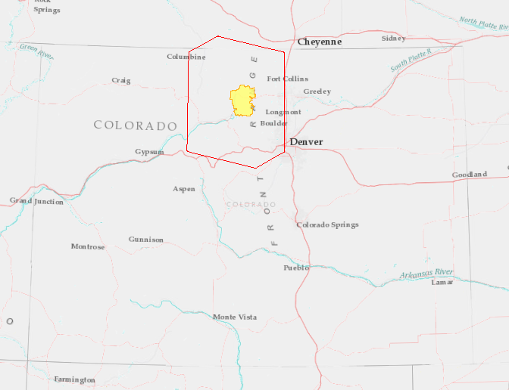
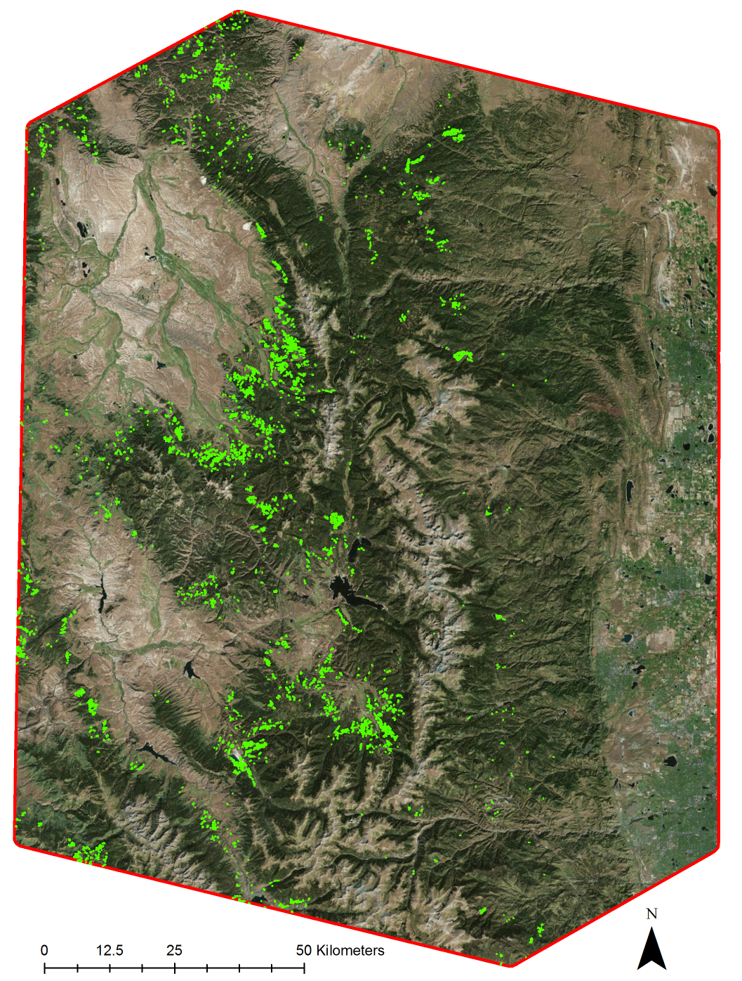
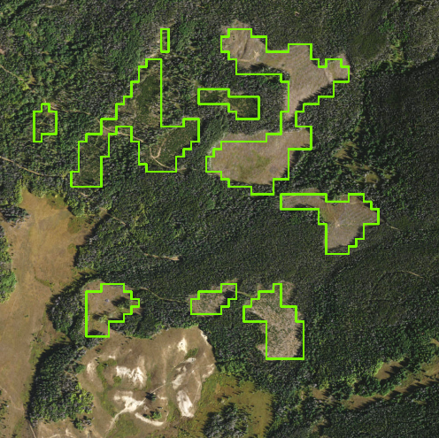
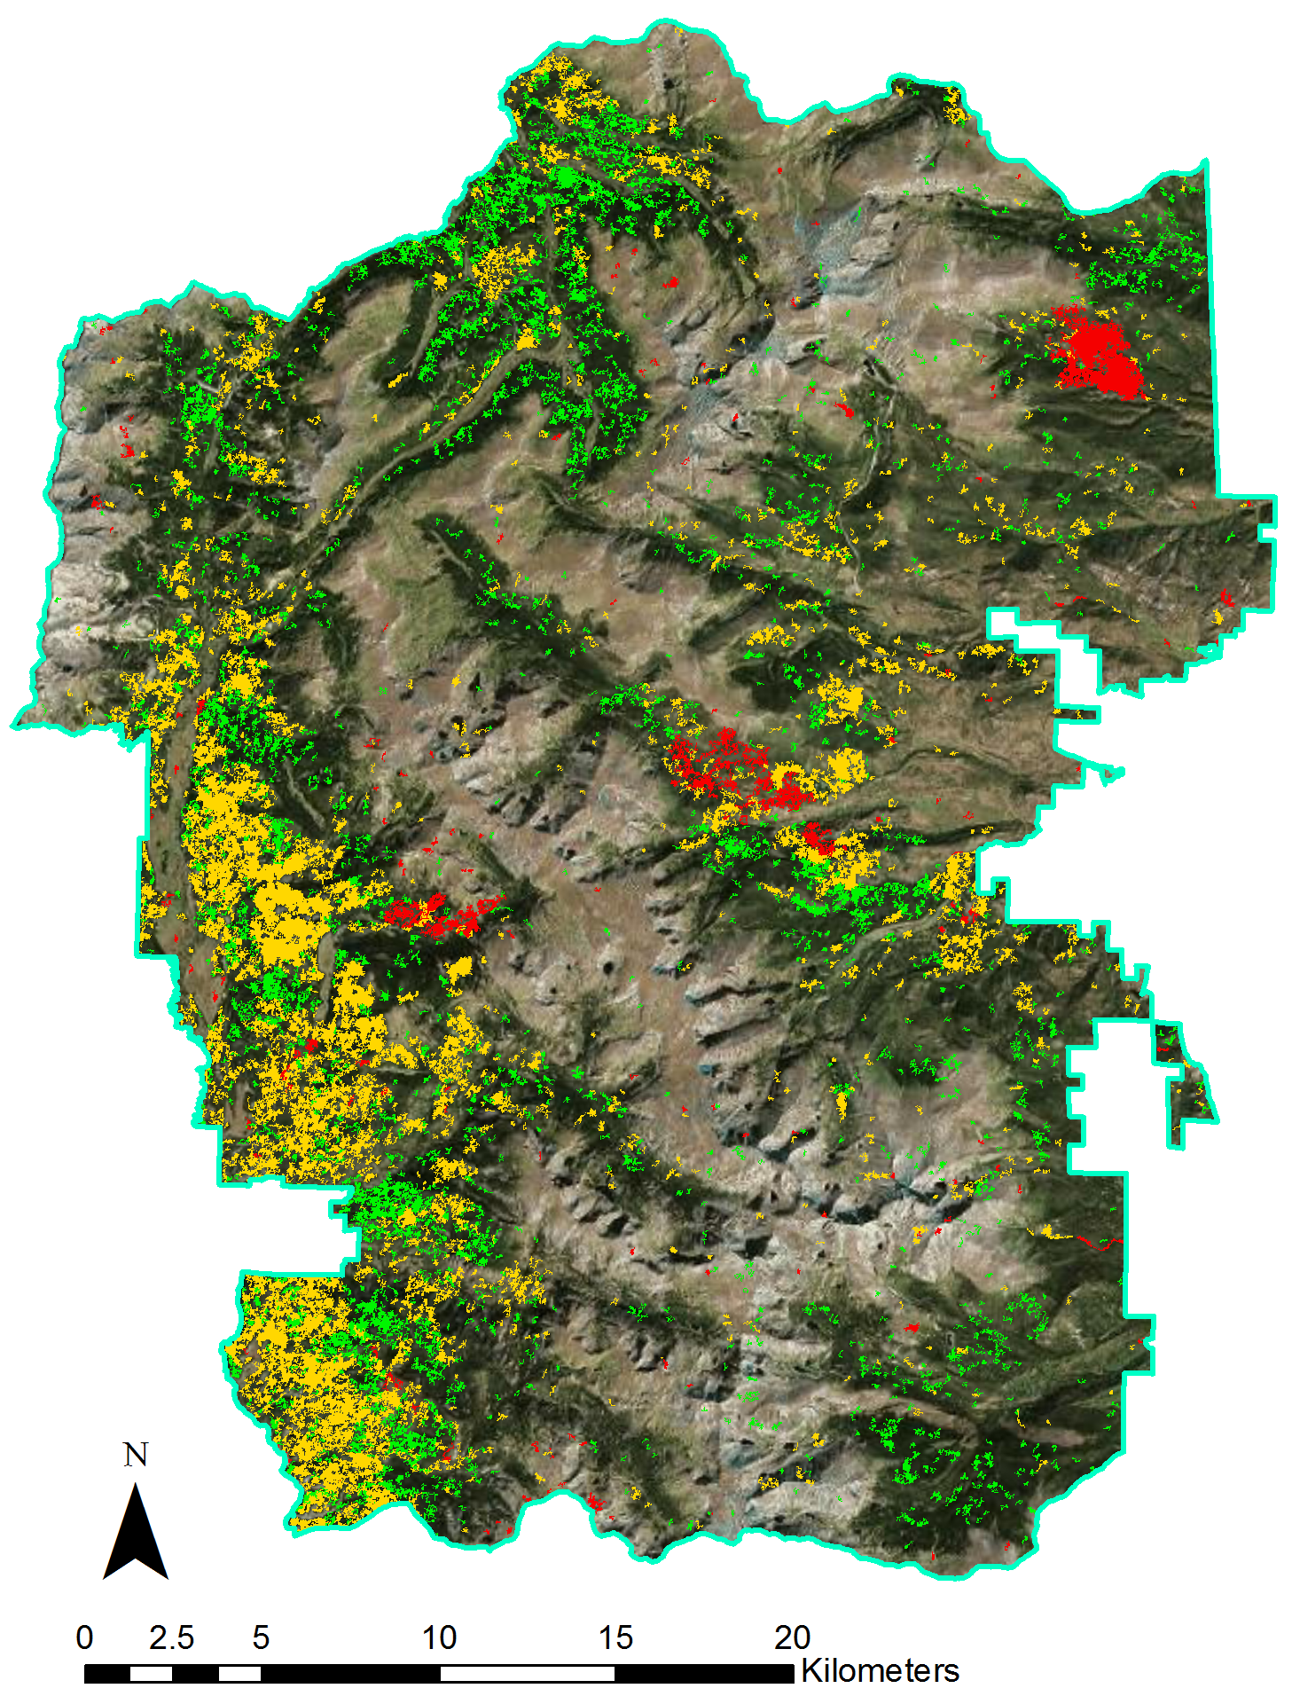
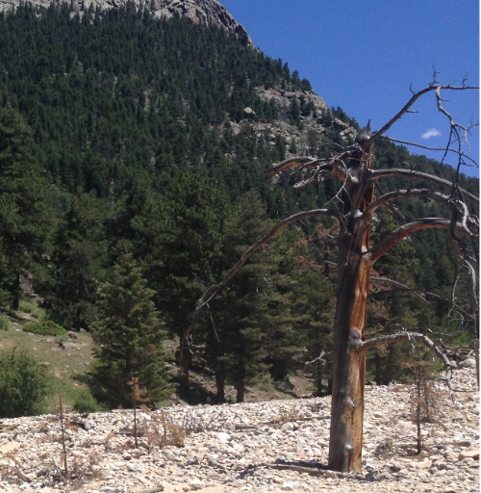
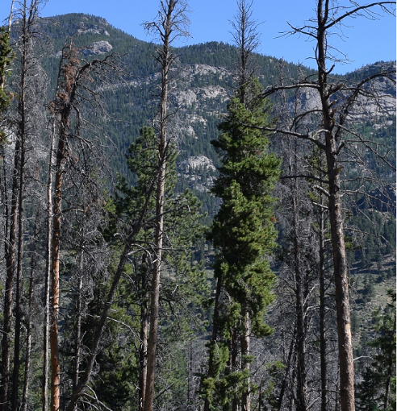
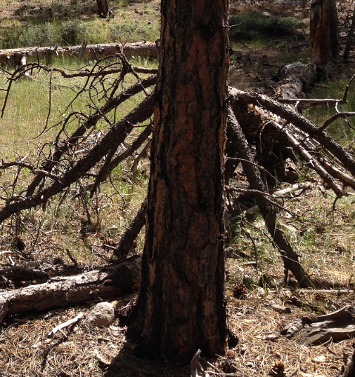
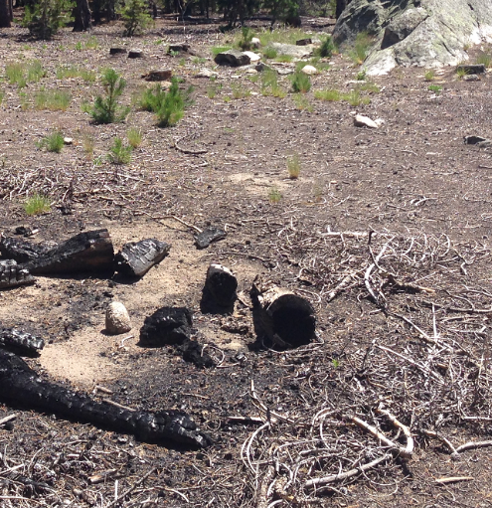
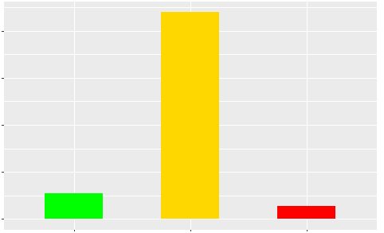
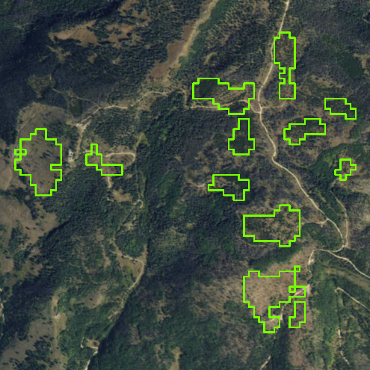
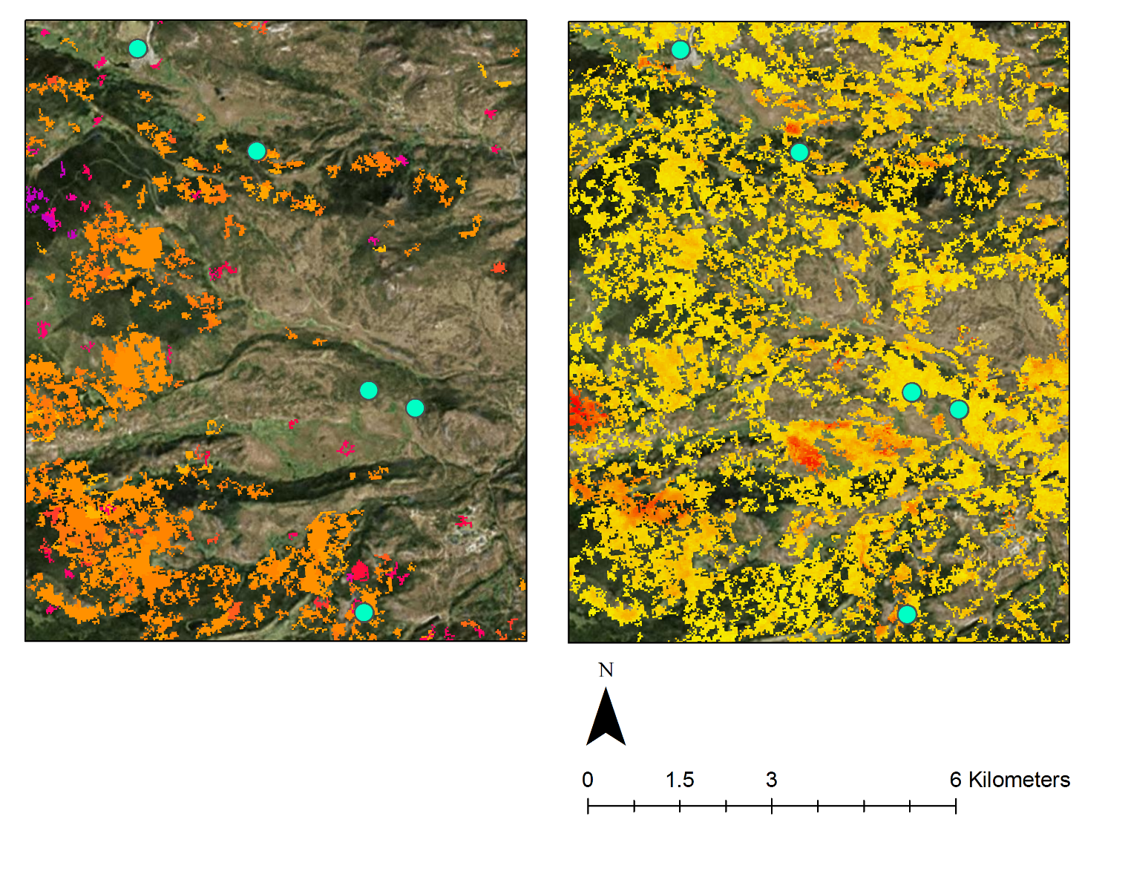
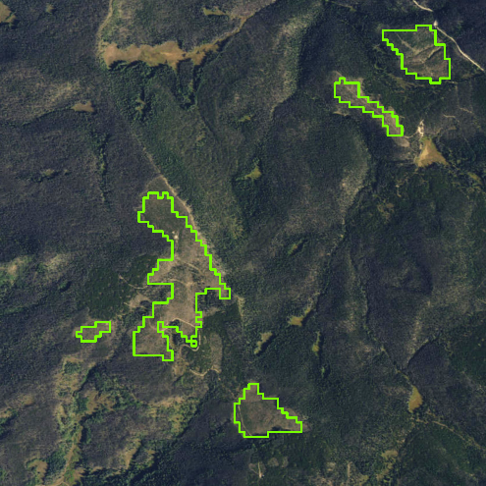
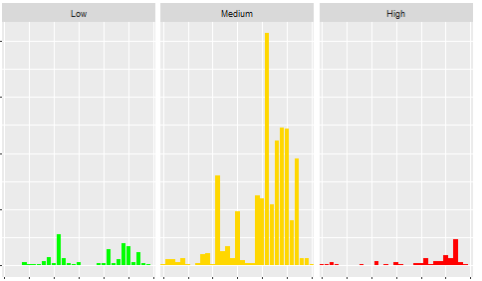





Utilizing NASA Earth Observations to Reconstruct and Identify Historical Forest Disturbances in the Southern Rocky Mountains for Enhanced Forest Management
Abstract
In recent decades, the Rocky Mountains of northern Colorado and southern Wyoming have experienced extremely high levels of forest disturbance. Methodologies for mapping and labeling disturbance and classifying historical harvest events on the landscape level have not been readily available in the past. However, recent literature has paved the way for refined approaches, such as change detection software and predictive classification models. This project provided a more complete dataset for the National Park Service Rocky Mountain National Park (RMNP), the Colorado Forest Restoration Institute (CFRI), and the Bioenergy Alliance Network of the Rockies (BANR) Feedstock Supply Team. Landsat 4 and 5 Thematic Mapper (TM), Landsat 7 Enhanced Thematic Mapper Plus (ETM+), and Landsat 8 Operational Land Imager (OLI) imagery were integrated into the LandTrendr algorithm to detect magnitude, duration, and extent of past forest disturbances. A suite of classification algorithms, including the Boosted Regression Trees (BRT) and the Random Forests (RF) classification models, were used to conduct analyses at the landscape level across a temporal scale of over 30 years. A labeled forest disturbance history was provided to project partners, which filled gaps in their past records and can lead to enhanced decision-making in the future.
Objectives
Earth Observations
Shuttle Radar Topography Mission (SRTM)
Delineate and characterize clearcut harvests over a 30-year Landsat time series
Classify a variety of forest disturbances within Rocky Mountain National Park
Evaluate the feasibility of identifying forest thinning treatments
Landsat 4 & 5 Thematic Mapper (TM)
Landsat 7
Enhanced Thematic Mapper Plus (ETM+)
Landsat 8
Operational Land Imager (OLI)
Study Area
Methodology
Study Area Boundary
Data
Data
Statistical
Analysis of
Rocky
Mountain
National
Park
Rocky Mountain National Park
Acquisition
Processing
Modeling
Results
National Forest Lands
Landsat
LandsatLinkr
Disturbance
Imagery
Software
Supervised
Maps of the
LandTrendr
Classification
Study Area
Digital
Software
Models
Elevation
Model
Topographic
Indices
Preliminary
Disturbance
Ancillary
Finalized
Outputs
Maps of
Data
Input Data
RMNP
Results
RMNP Disturbance Levels
Rocky Mountain Agriculture
2000
1500
Area (km²)
1000
500
0
Low Magnitude
Medium Magnitude
High Magnitude
400
RMNP Disturbance Levels
300
Area (km²)
200
Harvested Polygons
1985
1990
1995
2000
2005
2010
Low High
500
1985
1990
1995
2000
2005
2010
2015
1985
1990
1995
2000
2005
2010
2015
1985
1990
1995
2000
2005
2010
2015
Study Area Boundary
1986
1991
1996
2001
2006
2011
0
1987
1992
1997
2002
2007
2012
1988
1993
1998
2003
2008
2013
Low Magnitude
Medium Magnitude
High Magnitude
RMNP
1989
1994
1999
2004
2009
2014
Low Magnitude
Medium Magnitude
High Magnitude
Fig. 1: Clearcut harvest map for the study area (left) and close-up views of harvested polygons (right)
Fig. 2: Magnitude disturbance map for the full extent of Rocky Mountain National Park located within the study area
2015
Fig. 4: Total area by disturbance magnitude over 30 years (top) and area of disturbance by magnitude according to year (bottom) for Rocky Mountain National Park
Fig. 3: Disturbance photos (top), year of disturbance (left), and magnitude disturbance (right) for Moraine Park in Rocky Mountain National Park
Conclusions
Supervised classification model outputs successfully facilitated the delineation of clearcut harvest events at the landscape-scale throughout the study area.
Fine-scale disturbances were accurately identified within Rocky Mountain National Park through further analysis.
Final maps and other end products will better inform project partners and land managers about how their management decisions can improve forest resiliency.
Project Partners
Acknowledgements
The Rocky Mountain Agriculture team partnered with National Park Service Rocky Mountain National Park, Colorado Forest Restoration Institute, and Bioenergy Alliance Network of the Rockies Feedstock Supply Team.
We would like to thank our project partners Hanem Abouelezz, National Park Service Rocky Mountain National Park, Dr. Tony Cheng, Colorado Forest Restoration Institute, and Ryan Anderson, Bioenergy Alliance Network of the Rockies Feedstock Supply Team.
We would like to thank Mike Caggiano, Colorado Forest Restoration Institute, Justin Braaten, Oregon State University, Laboratory for Applications of Remote Sensing in Ecology, Catherine Jarnevich, United State Geological Survey, and Geoff Clark and David Frey, National Park Service Rocky Mountain National Park for their help.
We would also like to thank Dr. Paul Evangelista and Tony Vorster of Colorado State University Natural Resource Ecology Laboratory for their guidance throughout the project and Brian Woodward, Fort Collins DEVELOP Center Lead.
Any opinions, findings, and conclusions or recommendations expressed in this material are those of the author(s) and do not necessarily reflect the views of the National Aeronautics and Space Administration. This material is based upon work supported by NASA through contract NNL11AA00B and cooperative agreement NNX14AB60A.
Team Members
Peder Engelstad
Project Lead
Christopher Beddow
Stephanie Krail
Amandeep Vashisht
USGS at Colorado State University – Summer 2016

