Slide 1
San Francisco Bay Area Health & Air Quality
Maya Midzik
Using Aircraft and Ground-Based Observations to Improve
Methane Monitoring for the San Francisco Bay Area
Joey Abbate
Garima Raheja
Notes:
Hi, I’m Maya Midzik, and I’m a graduate of Yale University, where I studied Geology and Geophysics
Hi, I’m Garima Raheja- I’m a rising sophomore at UC Berkley studying Civil Engineering
Hi, I’m Joey Abbate- I’m a rising senior at DePaul University, studying Environmental Studies
And we’re the San Francisco Health and Air Quality team. We’re here to talk about how aircraft observations can help improve methane monitoring in the San Francisco Bay Area

Slide 2
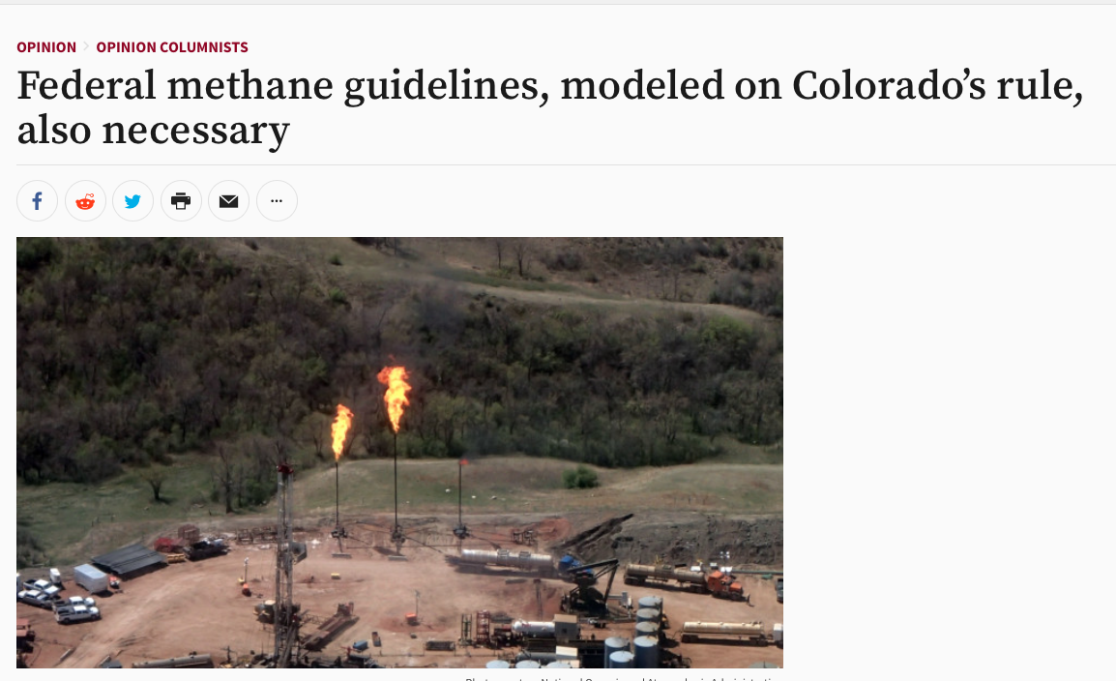
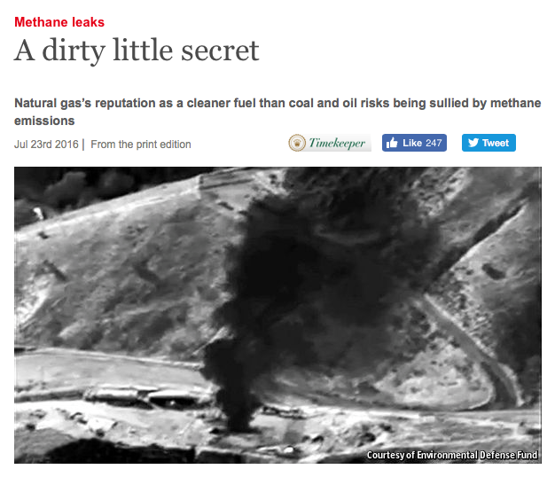
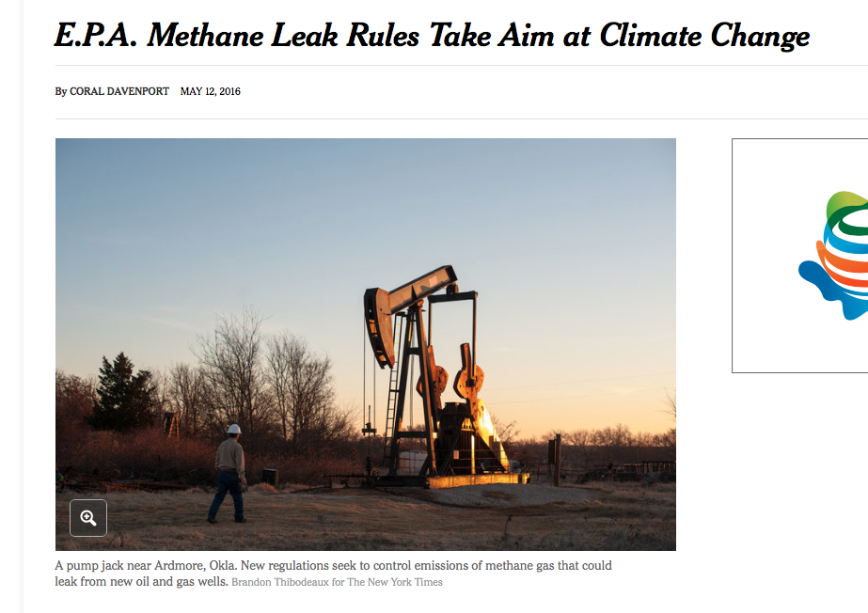
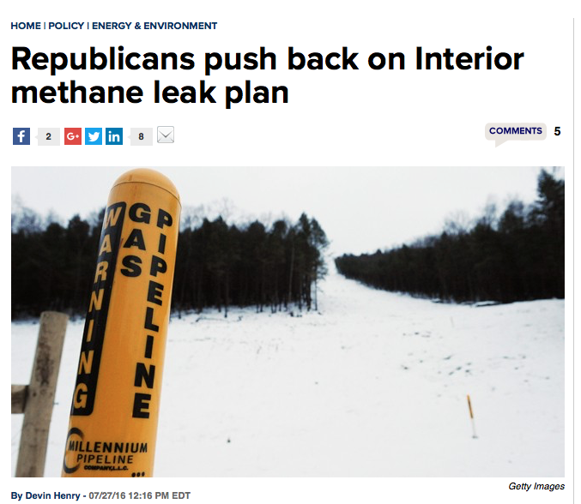
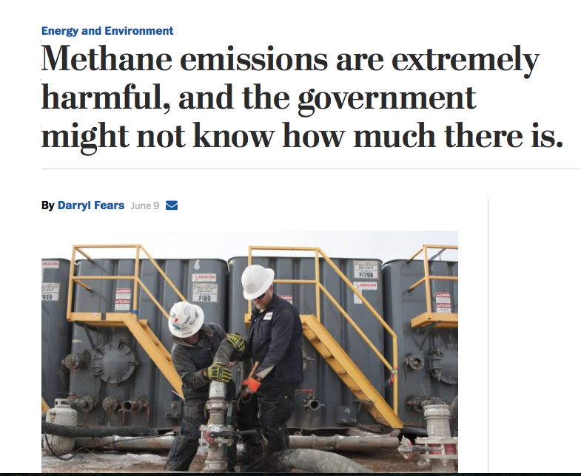
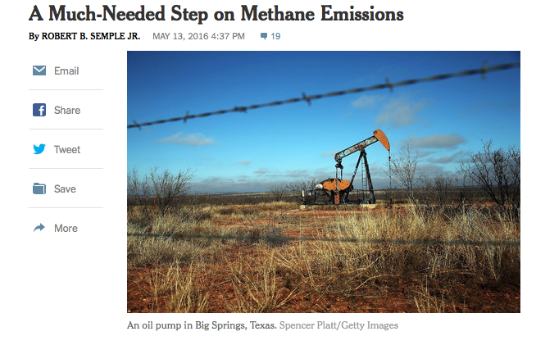
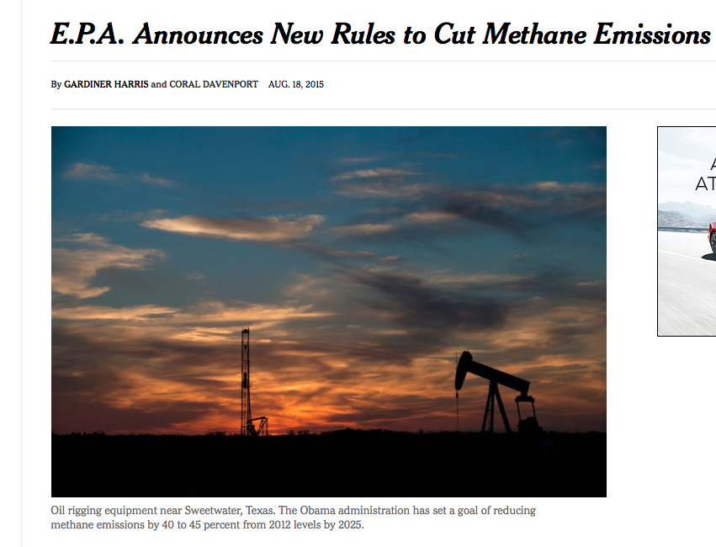
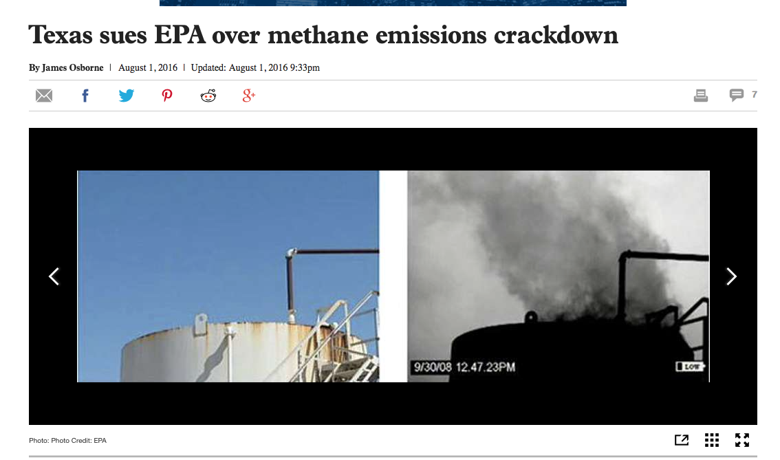
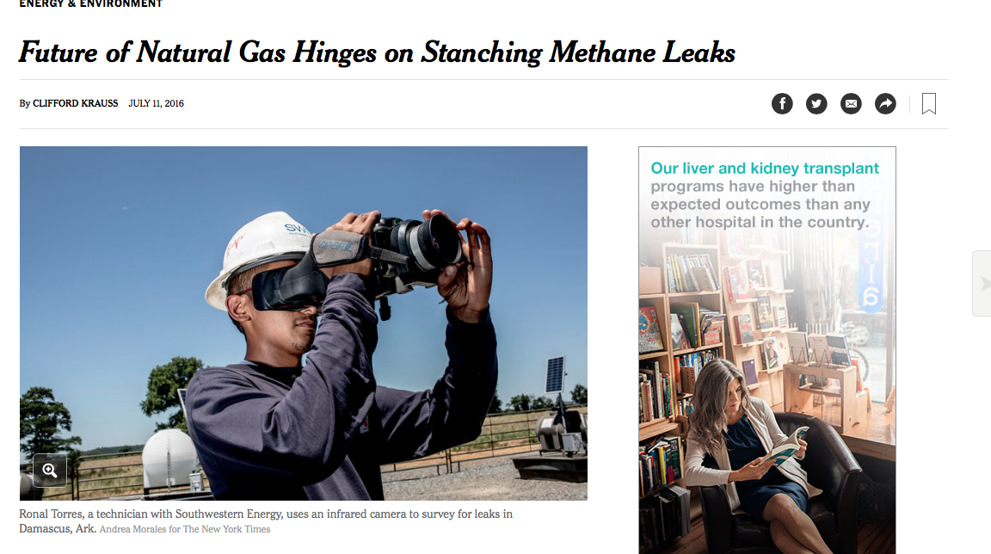
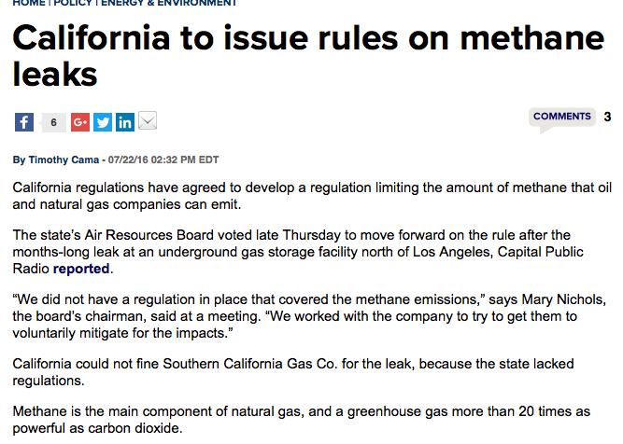
Background: Community Concerns
Notes:
Methane (CH₄ ) is a potent greenhouse gas.
It wasn’t regulated by the EPA until recently, and in the last few years it has become a major concern. Methane has been making headlines as scientists and policymakers have begun to realize the effects of methane on the climate, and the rising methane emissions caused by a variety of factors, including fossil fuel production, landfills, and livestock farms, and as we Bay Area citizens know, we’ve got all of those here.
We have methane being emitted every day from these sources. But we also have huge methane leaks -- you might have heard about the Aliso Canyon Natural Gas Leak. With fracking and gas leaks increasing rapidly, methane is on the rise.

Slide 3
Background: Community Concerns
1 pound CH₄
Notes:
And methane is powerful…

Slide 4
Background: Community Concerns
1 pound CH₄

Slide 5
Background: Community Concerns
1 pound CH₄
21 pounds CO₂
Notes:
Pound for pound, methane can absorb up to 21 times as much energy as carbon dioxide over a hundred years.

Slide 6
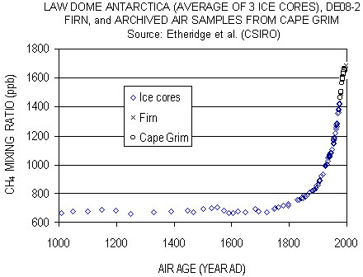
Background: Community Concerns
Etheridge et al., 1998 (CSIRO)
Notes:
And it is becoming more and more concerning. Methane levels have been rising rapidly in the atmosphere since the 1900s, and almost all of this rapid rise is being attributed to anthropogenic, or human-caused factors. This is our problem, and we need to find a way to monitor it, and fix it.
Image: http://www.giss.nasa.gov/research/features/200409_methane/
Original paper: http://onlinelibrary.wiley.com/store/10.1029/98JD00923/asset/jgrd5879.pdf;jsessionid=0E1955D1C6113D2E8AFC6662C9D5ED49.f03t04?v=1&t=iro2qku7&s=e2c22b976999016b2fad10c51a645eee9c36db5d

Slide 7
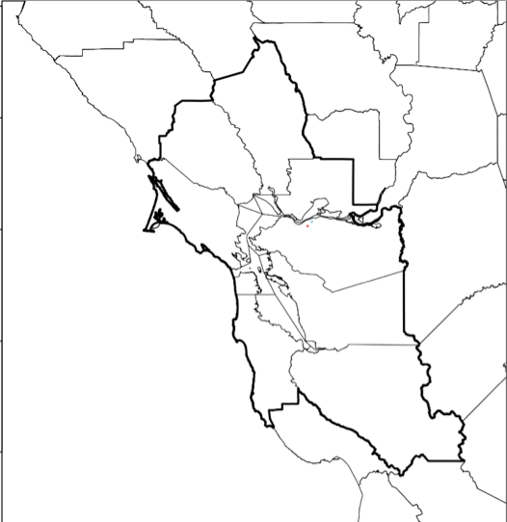
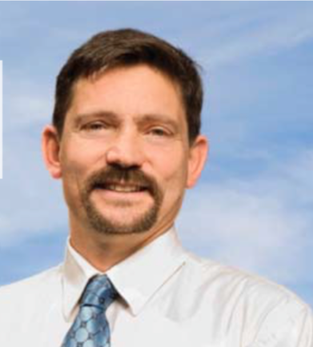
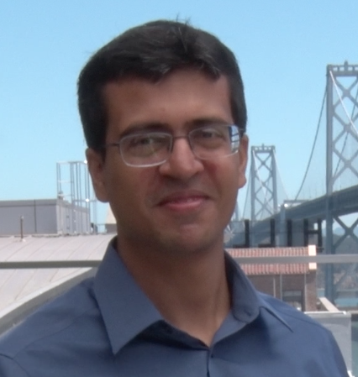
Background: BAAQMD
Bay Area Air Quality Management District (BAAQMD)
Regional Climate Protection Strategy
Abby Young
Climate Protection
Manager
Dr. Phil Martien
Air Quality
Engineer
Dr. Abhinav Guha
Air Quality
Engineer
Fischer and Jeong, 2014
Notes:
In the Bay Area, it is the Bay Area Air Quality Management District (BAAQMD) that regulates air pollution, creating rules and policies for emissions sources and doing research to find effective ways to counter pollution. We’ve had the honor to work with three really amazing BAAQMD air quality specialists: Abby Young, Dr. Phil Martien, and Dr. Abhinav Guha.

Slide 8
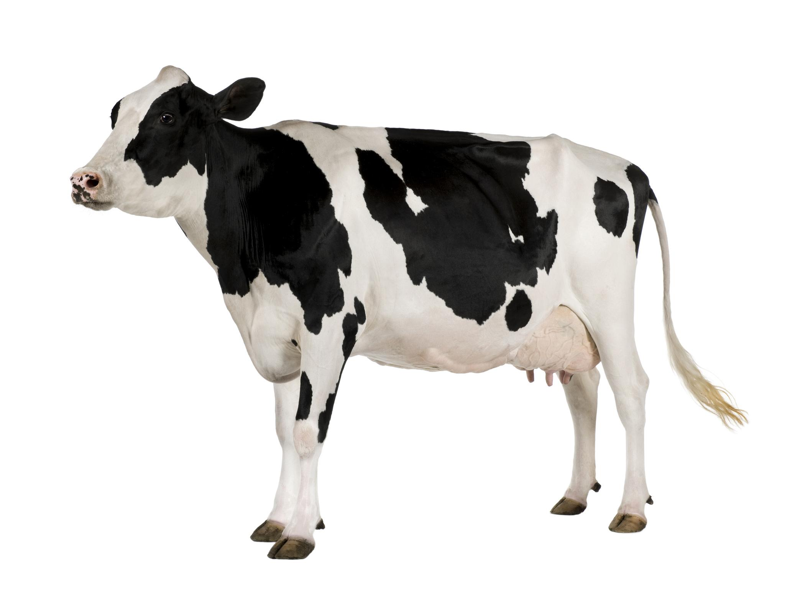
Background: Bottom-up CH₄ inventory
Notes:
As we learned from Dr. Guha, currently, Bay Area CH₄ emissions are estimated using a bottom-up inventory method, which aggregates local source sector totals with estimated emissions per unit factors.

Slide 9
Background: Bottom-up CH₄ inventory
Emission Factor
Mg CH₄/cow
Notes:
Which basically means that to estimate the emissions, say, for a dairy, you would take the number of cows in that dairy, and multiply it by the average methane produced by a cow in its lifetime, to get the total emissions for the area. And you’d repeat this for all the dairies and all the other emissions sources, like landfills and wastewater plants, kind of like creating an “inventory” for all the possible sources of methane.

Slide 10
Background: Bottom-up CH₄ inventory
Emission Factor
Mg CH₄/cow
CH₄ emissions for Dairy Livestock
Notes:
Which basically means that to estimate the emissions, say, for a dairy, you would take the number of cows in that dairy, and multiply it by the average methane produced by a cow in its lifetime, to get the total emissions for the area. And you’d repeat this for all the dairies and all the other emissions sources, like landfills and wastewater plants, kinda like creating an “inventory” for all the possible sources of methane.

Slide 11
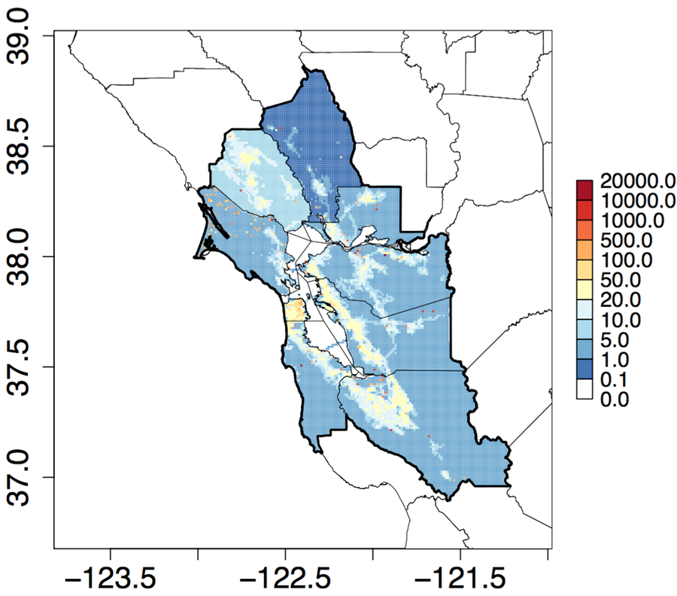
Background: Bottom-up CH₄ inventory
Fischer and Jeong, 2014
Gridded total anthropogenic CH₄ emissions (Mg CH₄/yr)
Notes:
This is what the BAAQMD regional bottom-up methane inventory looks like.

Slide 12
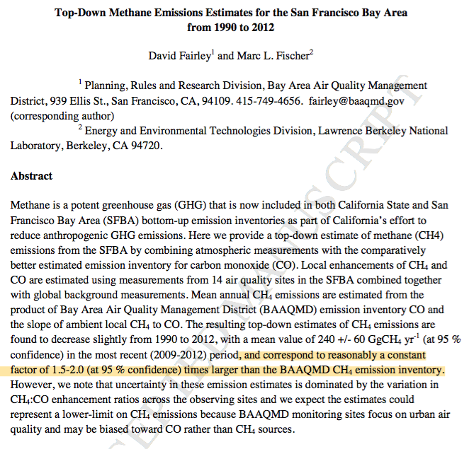
Background: Bottom-up CH₄ inventory
Fischer and Jeong, 2014
Gridded total anthropogenic CH₄ emissions (Mg CH₄/yr)
Notes:
However, we must keep in mind that this emissions inventory, although comprehensive and well researched, is only an estimate. It’s based on estimates of exact numbers of sources, and the “emissions per source” comes from national averages.
There’s reason to believe that all is not as it seems: a study by Dr. Marc Fischer and Dr. David Fairley at the Lawrence Berkeley National Labs claimed that “top-down estimates of methane correspond to reasonably a constant factor of 1.5 to 2.0 times larger than the BAAQMD methane emissions inventory.”

Slide 13
Background: Bottom-up CH₄ inventory
Underestimating CH₄ emissions by a factor of 1.5-2
Emission Factor
Mg CH₄/cow
CH₄ emissions for Dairy Livestock
Notes:
So, anytime we say “top-down,” it means that it’s coming from some sort of measurement, and anytime we say “bottom-up,” it means that it’s a cow times methane per cow type of estimate.
There could be many reasons for this-- perhaps the bottom-up emissions estimates are skewed, perhaps the top-down estimates are flawed, or perhaps we have a fundamental misunderstanding in how methane works.
We need to find out how much methane is actually over the Bay Area, and if we want to decrease methane emissions, we need to figure out who the major culprits area, who the biggest polluters are. Is animal agriculture the biggest source of methane emissions? Should we be regulating refineries more, or is that just small potatoes?

Slide 14
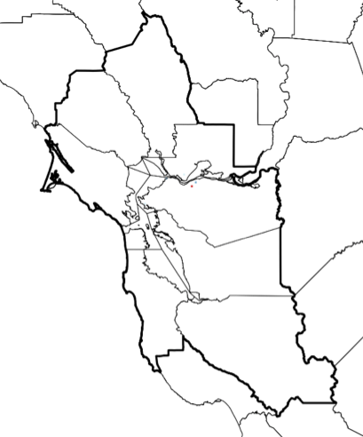
Background: GHG Monitoring Network
Bodega Bay
Bethel Island
Patterson Pass
San Martin
Locations of BAAQMD’s GHG monitoring network fixed-sites, which began operating in 2015/16
Notes:
As part of its Regional Climate Protection Plan, BAAQMD is developing a GHG monitoring network and mobile monitoring van to address exactly these issues.
Their fixed monitoring network consists of four sites: one “background” methane site at Bodega bay, which gets the fresh air coming in from the ocean, and 3 other sites located downwind of the major air plumes in the Bay Area, which, if compared to the background site, should help us understand how much the Bay Area is causing enhancements in methane levels. The sites began collecting data late 2015 / early 2016….

Slide 15
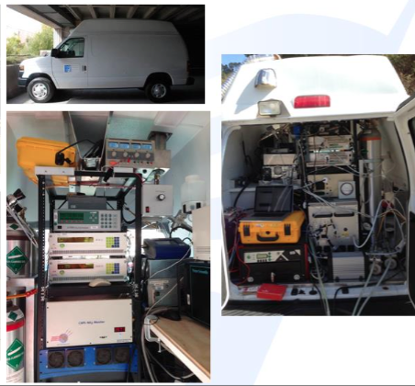
Background: Current Methane Monitoring
Bodega Bay
Bethel Island
Patterson Pass
San Martin
Locations of BAAQMD’s GHG monitoring network fixed-sites, which began operating in 2015/16
Air District’s mobile van, fitted with air monitoring instruments and calibration systems
Notes:
The BAAQMD mobile greenhouse gas monitoring van will begin driving later this year. This van is an excellent opportunity for investigating very specific areas of concern. It’s great for investigating “problems,” but before we can do that, we need to have some idea of where these “problems” might be located.

Slide 16
Background: DEVELOP Partnership
NASA Methane Measurements
BAAQMD Methane Regulation
Notes:
This is where we come in. Our project worked to bring NASA top-down methane data to BAAQMD, to advance the BAAQMDs knowledge of local methane emissions and dynamics

Slide 17
Background: Atmospheric Methane
Altitude (km)
Relative CH₄ Volume Mixing Ratio
800
Exosphere
400
200
Temperature
Thermosphere
100
Mesosphere
80
60
40
Stratosphere
20
10
8
6
4
Troposphere
2
1
-100
-60
-20
0
20
40
Temperature (ºC)
Notes:
However…
measuring local methane emissions isn’t easy.
Methane is a “well-mixed gas,” meaning that it is evenly distributed throughout earth’s lower atmosphere-- you can see in the red line that methane concentrations change a little, but not a whole lot, with rising altitude.
Earth’s atmosphere is divided into many layer, the lowest of which is the troposphere

Slide 18
Background: Atmospheric Methane
Altitude (km)
Relative CH₄ Volume Mixing Ratio
800
Exosphere
400
200
Temperature
Thermosphere
100
Mesosphere
80
60
40
Stratosphere
20
10
8
6
4
Troposphere
Planetary Boundary Layer (PBL)
2
1
-100
-60
-20
0
20
40
Temperature (ºC)
Notes:
And, at the bottom of troposphere, is the planetary boundary layer, or PBL
The planetary boundary layer, or the PBL, is the part of the earth’s atmosphere closest to the surface, so it receives all the local enhancements of methane. Within the PBL, local enhancements of methane and other pollutants are temporarily “trapped,” but, above the PBL, methane is evenly distributed. And since the PBL is very different from the layers above it -- it receives a lot of the heat from the surface -- there isn’t a lot of mixing across the boundary and methane in the PBL remains trapped there, and methane above the PBL is free to travel around vertically and also horizontally for hundreds of miles.
This means that satellite sensors that orbit hundreds of kilometers above earth’s surface see not only local methane enhancements, but also methane that has been transported from far away sources over many years.

Slide 19
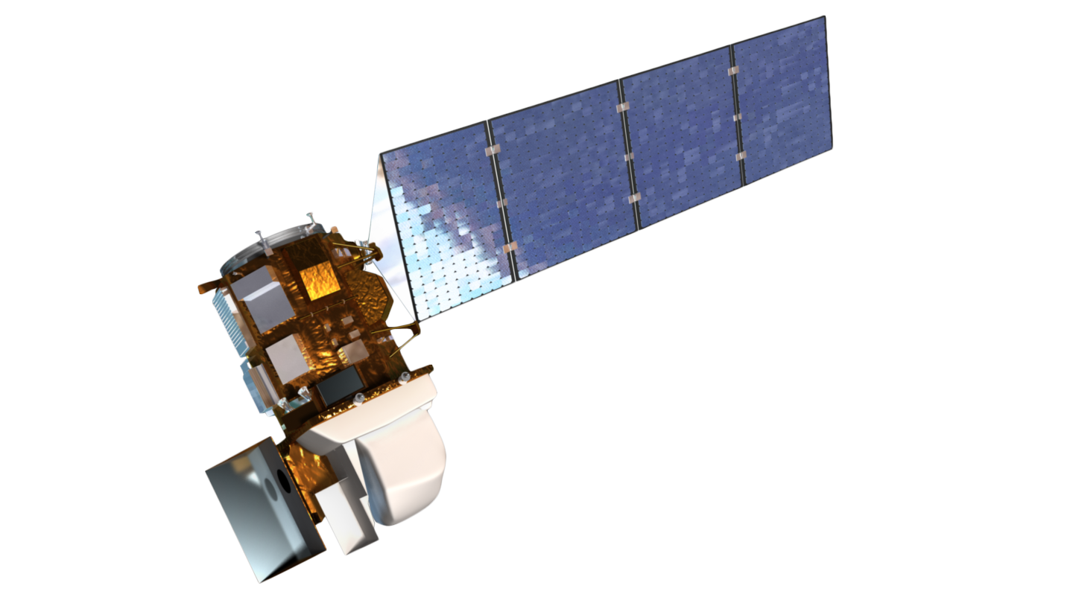
Background: Atmospheric Methane
Relative CH₄ Volume Mixing Ratio
TES
Altitude (km)
SCHIAMACHY
AIRS
800
Exosphere
400
200
Temperature
Thermosphere
100
Mesosphere
80
60
40
Stratosphere
20
10
8
6
4
Troposphere
Planetary Boundary Layer (PBL)
2
1
-100
-60
-20
0
20
40
Temperature (ºC)
Notes:
Take, for instance- TES, SCHIAMACHY OR AIRS- three greenhouse gas observing satellites that monitor methane.

Slide 20
Background: Atmospheric Methane
Relative CH₄ Volume Mixing Ratio
TES
Altitude (km)
SCHIAMACHY
AIRS
800
Exosphere
400
200
Temperature
Thermosphere
100
Mesosphere
80
60
40
Stratosphere
20
10
8
6
4
Troposphere
Planetary Boundary Layer (PBL)
2
1
-100
-60
-20
0
20
40
Temperature (ºC)
Notes:
Satellites seem like a really encouraging way to measure the atmosphere! And there are a few satellites up there that are measuring greenhouse gasses around the globe. But since the TES, AIRS, SCIAMACHY and GOSAT satellite missions are meant for understanding global aggregate methane levels, they are highly sensitive to the upper troposphere and the lower stratosphere, where most of the methane lives. They can’t measure methane at the surface level, and we know that the methane above the PBL could be anything: it could’ve been there for nine years, it could’ve been transported from China… all we know is that ten kilometers above a factory can’t be attributed to that factory.

Slide 21
Background: Atmospheric Methane
Relative CH₄ Volume Mixing Ratio
TES
Altitude (km)
SCHIAMACHY
AIRS
800
Exosphere
400
200
Temperature
Thermosphere
100
Mesosphere
80
60
40
Stratosphere
20
10
8
6
4
Troposphere
Planetary Boundary Layer (PBL)
2
1
-100
-60
-20
0
20
40
Temperature (ºC)

Slide 22
Background: Atmospheric Methane
Relative CH₄ Volume Mixing Ratio
TES
Altitude (km)
SCHIAMACHY
AIRS
800
Exosphere
400
200
Temperature
Thermosphere
100
Mesosphere
80
60
40
Stratosphere
20
10
8
6
4
Troposphere
Planetary Boundary Layer (PBL)
2
1
-100
-60
-20
0
20
40
Temperature (ºC)

Slide 23
Background: Atmospheric Methane
Relative CH₄ Volume Mixing Ratio
TES
Altitude (km)
SCHIAMACHY
AIRS
800
GOSAT
Exosphere
400
200
Temperature
Thermosphere
100
Mesosphere
80
60
40
Stratosphere
20
10
8
6
4
Troposphere
Planetary Boundary Layer (PBL)
2
1
-100
-60
-20
0
20
40
Temperature (ºC)
Notes:
GOSAT is a Japanese satellite that measures the total column of methane, all the way down to the surface level. But GOSAT is a targeted satellite, and, in the last five years, there have been no GOSAT measurements over the San Francisco Bay Area.

Slide 24
Background: Atmospheric Methane
Relative CH₄ Volume Mixing Ratio
TES
Altitude (km)
SCHIAMACHY
AIRS
800
GOSAT
Exosphere
400
200
Temperature
Thermosphere
100
Mesosphere
80
60
40
Stratosphere
20
10
8
6
4
Troposphere
Planetary Boundary Layer (PBL)
2
1
-100
-60
-20
0
20
40
Temperature (ºC)

Slide 25
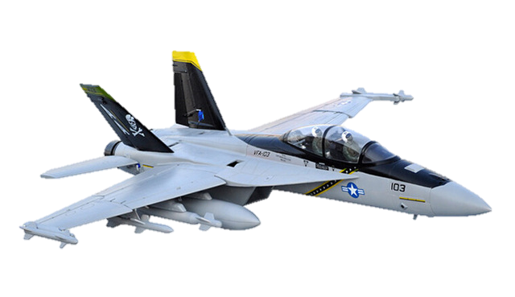
Background: Atmospheric Methane
Relative CH₄ Volume Mixing Ratio
TES
Altitude (km)
SCHIAMACHY
AIRS
800
GOSAT
Exosphere
400
200
Temperature
Thermosphere
100
Mesosphere
80
60
40
Stratosphere
20
10
8
6
4
Troposphere
Planetary Boundary Layer (PBL)
2
1
-100
-60
-20
0
20
40
Temperature (ºC)
Notes:
But you know what? NASA doesn’t stop at satellites. If you can’t measure methane from hundreds of kilometers away, you can use a plane to go up just a little bit, but just enough. Planes can fly below the PBL, and luckily, we have one such plane located right here at NASA AMES.

Slide 26
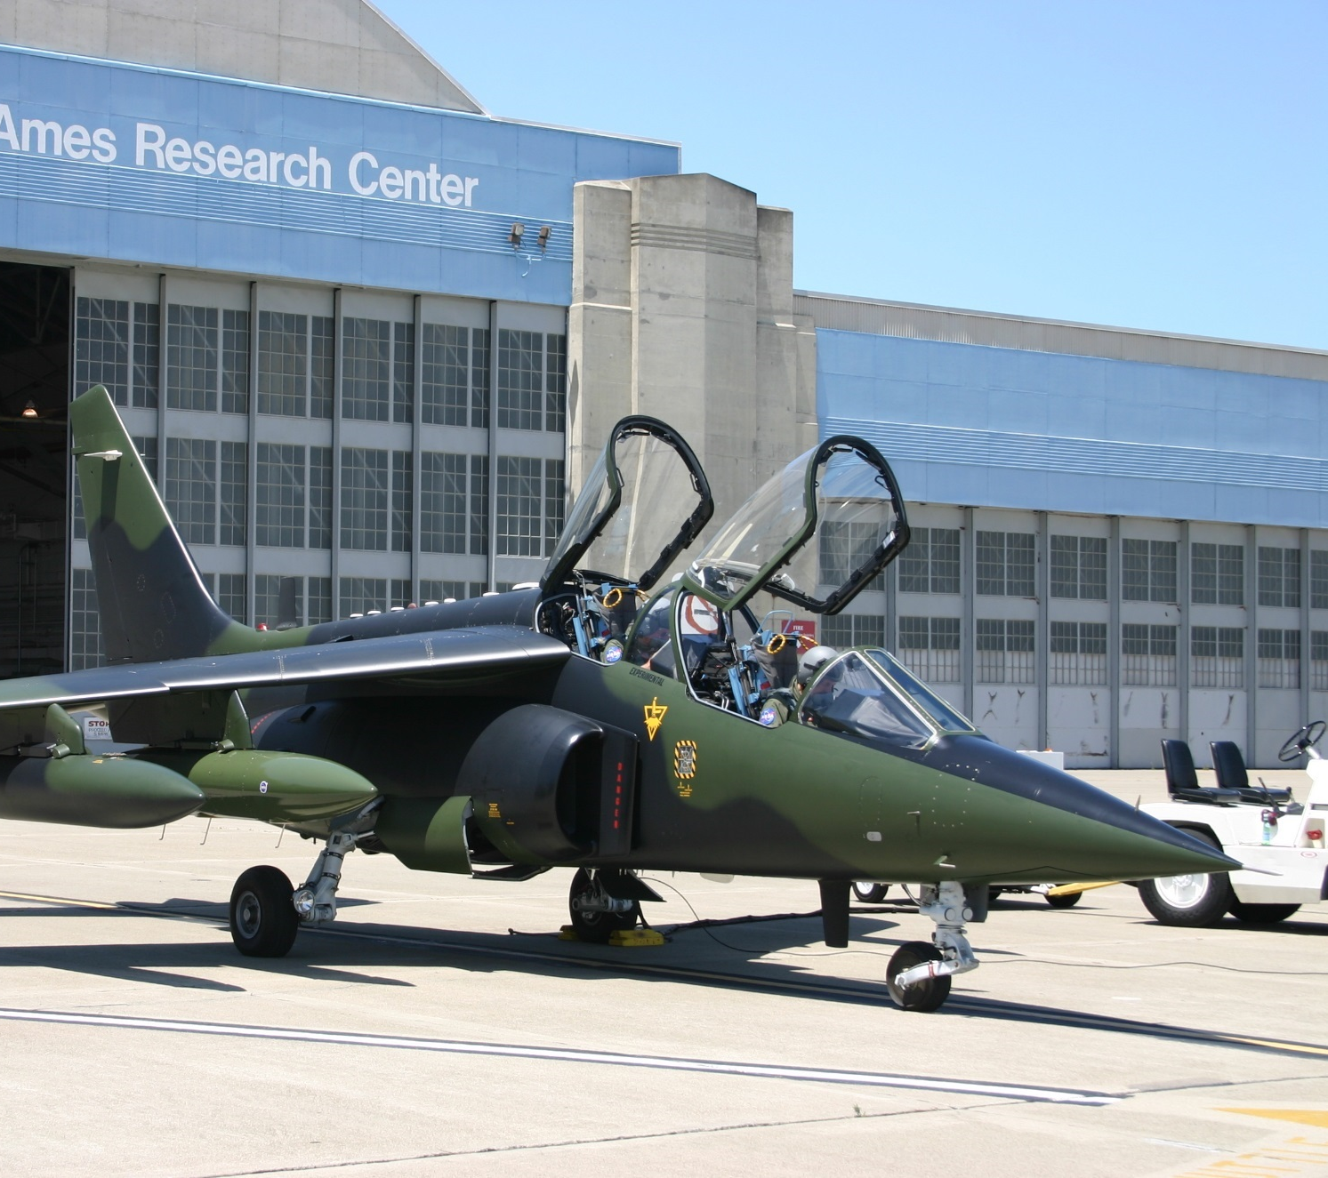
Background: NASA AJAX
Alpha Jet Atmospheric Experiment (AJAX)
Image Credit: NASA AJAX
Image Credit: Monet
Notes:
The NASA Alpha Jet Atmospheric Experiment (AJAX) has been collecting methane measurements over the San Francisco Bay area since 2011. Many of these flights have been low-altitude, providing below-PBL methane data over BAAQMD’s jurisdiction.
The Alpha Jet is a demilitarized aircraft shared between the H211 corporation and the NASA Ames Research Center through a Space Act Agreement
It is outfitted with an ozone monitor (2B Technologies, Inc., Model 205), Meteorological Measurement System (MMS), and cavity ring-down spectrometer (CRDS, Picarro, Inc., Model G 2301-m), which uses three wavelengths in the infrared to measure atmospheric concentrations of greenhouse gasses including CH₄, carbon dioxide, and water vapor (CO₂ at 1603 nm, and CH₄ and H₂O at 1651 nm).
The plane can fly wherever it needs to go, which makes it great for targeted missions. The plane has flown to Nevada for work on validating GOSAT total column measurements, it flew over the Aliso Canyon leak a few months ago, just last week it was flying over the wildfire in Big Sur, getting in really close and measuring methane all around the forest.

Slide 27
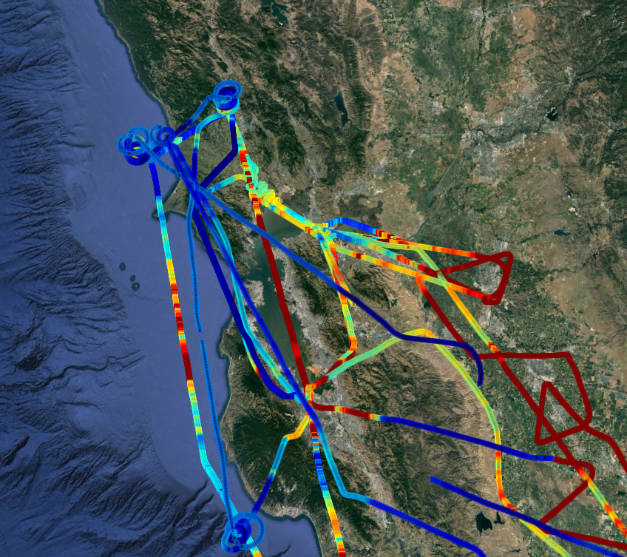
Background: NASA AJAX
Flights in/out of AMES RESEARCH CENTER:
Low-altitude Bay Area coverage
Associated with many campaigns: (OCO-2, EDGAR validation, GOSAT)
Image Credit: NASA AJAX
Image Credit: Monet
Notes:
AJAX flies in and out of the Ames Research center- right here!
This means that a portion of its flights over the area are low alitude- part of their landing or take-off legs.
During these flights ajax will often fly as far as railroad valley, NV or LA as part of various campaigns
However, because of it’s bay area base, AJAX provides an opportunities to provide new top-down measurements to local methane dynamics- adding to BAAQMD’s current inventory of methane emissions and dynamics
(And AJAX flies in and out of the Ames Research center, right, here, which means that we’re collecting data at low altitudes whenever the plane takes off or lands. Often the plane is flying to Nevada, or to LA, for a campaign, so it takes off rapidly and flies high for most of its flight, so not all of the AJAX data is below the PBL, but regardless, we’ve got quite a bit of low level data to work with, and there’s a lot that BAAQMD can learn from the AJAX top-down measurements all over the Bay Area. )

Slide 28
Objectives
CH₄ Hotspot Map
Develop a comprehensive spatially-resolved CH₄ map for the San Francisco Bay Area using NASA AJAX data
CH₄
Trajectory Analysis
Locate and investigate CH₄ “hotspots” using anomalies detected by AJAX to pinpoint specific sites for further monitoring via upcoming BAAQMD Mobile GHG Measurement Network
CH₄ time series for location
Evaluate local changes in CH₄ based on time-series data
Notes:
Our project had three main goals:
First, we wanted to develop a comprehensive spatially-resolved CH₄ map for the San Francisco Bay Area using NASA AJAX data.
Then, we wanted to evaluate local changes in methane based on time series of data taken over the same point
Finally, we wanted to locate and investigate CH₄ “hotspots” using anomalies detected by AJAX to pinpoint specific sites for further monitoring via upcoming BAAQMD Mobile GHG Measurement Van

Slide 29
Objectives
CH₄ Hotspot Map
Develop a comprehensive spatially-resolved CH₄ map for the San Francisco Bay Area using NASA AJAX data
CH₄
Trajectory Analysis
Locate and investigate CH₄ “hotspots” using anomalies detected by AJAX to pinpoint specific sites for further monitoring via upcoming BAAQMD Mobile GHG Measurement Network
CH₄ time series for location
Evaluate local changes in CH₄ based on time-series data

Slide 30
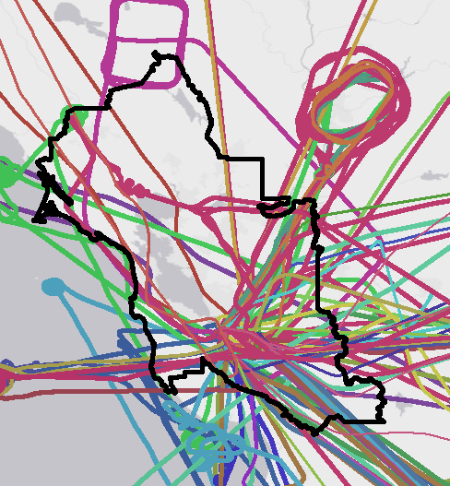
Methods: CH₄ Hotspot Map
165 flights total within the Bay Area
Centered around South Bay
AJAX CH₄ Flight Data
Determine PBL for each flight
Normalize CH₄ levels
CH₄ Hotspot Map
Image Credit: AJAX
Notes:
To start off, first we had to choose, out of the 165 flights, only the data that was located within the BAAQMD jurisdiction. You can see we have a lot of data over the South Bay, but not as much over the North Bay, Napa kind of areas.

Slide 31
Methods: CH₄ Hotspot Map
Altitude (km)
Relative CH₄ Volume Mixing Ratio
800
Exosphere
400
Thermosphere
Temperature
200
100
80
Mesosphere
60
40
Stratosphere
20
10
8
6
4
Troposphere
Planetary Boundary Layer (PBL)
2
1
-100
-60
-20
0
20
40
Temperature (ºC)
AJAX CH₄ Flight Data
Determine PBL for each flight
Normalize CH₄ levels
CH₄ Hotspot Map
Notes:
Second, although AJAX often flies low-altitude, their flights can reach an altitude of to up 8000 m over the bay area- depending on where they’re headed and what the research goal is
We need to ensure that the data we we’re using is below the planetary boundary layer, and representative of local methane emissions.
We needed to be sure we were only getting the local methane trapped within this layer, and not the methane above the PBL that could have be long-distance transport.

Slide 32
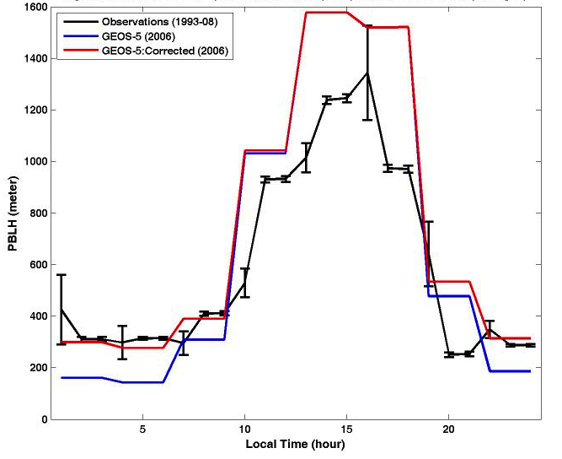
Methods: CH₄ Hotspot Map
PBL Height
(Erica McGrath-Spangler and Andrea Molod, GMAO)
Local Time (hour)
AJAX CH₄ Flight Data
Determine PBL for each flight
Normalize CH₄ levels
CH₄ Hotspot Map
Notes:
However, the planetary boundary layer isn’t a static line in the atmosphere- the air expands and contracts as the ground below it heats up.
Therefore, we needed to determine the height of the planetary boundary layer for each individual AJAX flight.

Slide 33
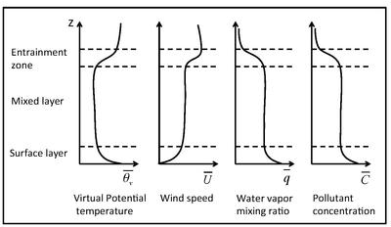
Methods: CH₄ Hotspot Map
ALTITUDE
(Stull, 1988)
AJAX CH₄ Flight Data
Determine PBL for each flight
Normalize CH₄ levels
CH₄ Hotspot Map
Notes:
The PBL height can be found by looking at a number of meteorological factors. You can see that temperature and wind speed change dramatically when you cross the PBL, so we can use them as indicators
So for each flight, we took the landings and the takeoffs and treated them as vertical profiles, and developed an algorithm to find the altitude with the most dramatic changes in meteorology, using the meteorological data collected on the AJAX plane.

Slide 34
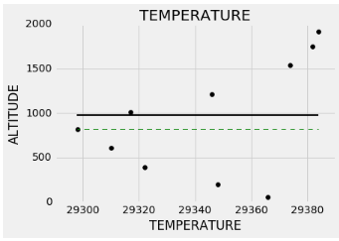
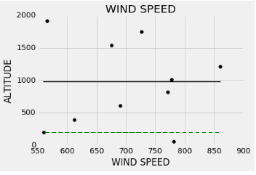
Methods: CH₄ Hotspot Map
AJAX CH₄ Flight Data
Determine PBL for each flight
Normalize CH₄ levels
CH₄ Hotspot Map
Notes:
So on these graphs, you can see that temperature points to a PBL height of around 900 meters, and wind speed estimates it a little bit higher at 1100 meters, so our algorithm chooses an average of 1000 meters.
Once we’ve found the PBL for each flight, we take only the data below that altitude in the flight. The PBL does change throughout the day, but since the AJAX flights usually only last a couple of hours, we can reasonably assume that the height of the PBL stays pretty constant throughout the flight, but of course, this is an area that needs to be explored further.

Slide 35
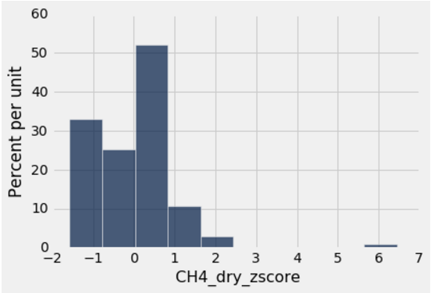
Methods: CH₄ Hotspot Map
AJAX CH₄ Flight Data
Determine PBL for each flight
Normalize CH₄ levels
CH₄ Hotspot Map
Notes:
Next, what we’ve done here is we’ve normalized the methane concentrations within each flight.
We really wanted to focus on finding hotspots, on finding areas of methane that are consistently higher than the areas around them.
Background methane levels are far from stable, and therefore it’s essential to remove the bias of background methane and focus on Bay Area enhancements.

Slide 36
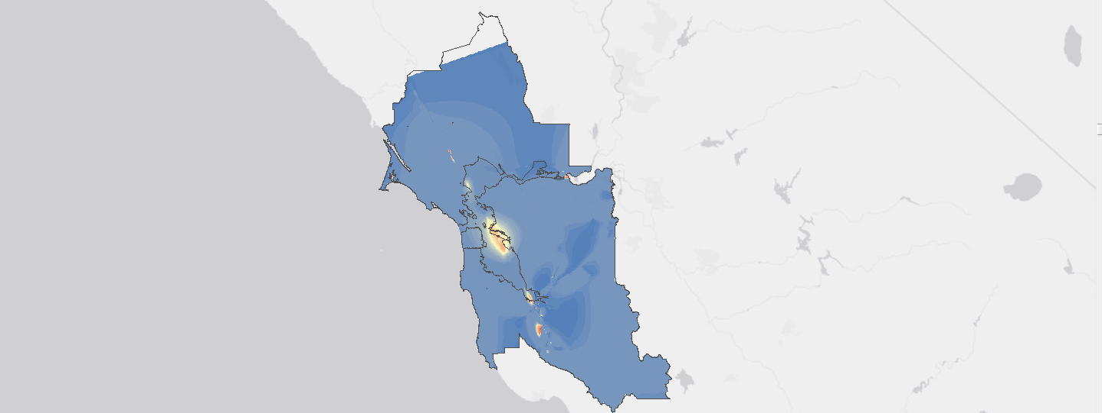
Methods: CH₄ Hotspot Map
High: 8.15 (z-score)
Low: 0.91 (z-score)
AJAX CH₄ Flight Data
Determine PBL for each flight
Normalize CH₄ levels
CH₄ Hotspot Map
Notes:
So we’ve normalized each flight and used the normalized z scores, and plotted those, instead of just the base concentrations, and we’ve interpolated those values in arcGIS to create a comprehensive map of methane enhancement over the area.
And here you can see the areas of high enhancements over the area, including the area over Oakland with lots of power plants, and the area around Ames, which we know has a lot of landfills. Now, we don’t know the locations of every source of methane in the bay area, but with a map like this we can look into the little red spots that are popping up and investigate them, and we can look at the areas that we don’t have a lot of data over, and if the data that we do have shows us reason for concern, then it’s worth investigating further.

Slide 37
Objectives
CH₄ Hotspot Map
Develop a comprehensive spatially-resolved CH₄ map for the San Francisco Bay Area using NASA AJAX data
CH₄
Trajectory Analysis
Locate and investigate CH₄ “hotspots” using anomalies detected by AJAX to pinpoint specific sites for further monitoring via upcoming BAAQMD Mobile GHG Measurement Network
CH₄ time series for location
Evaluate local changes in CH₄ based on time-series data

Slide 38
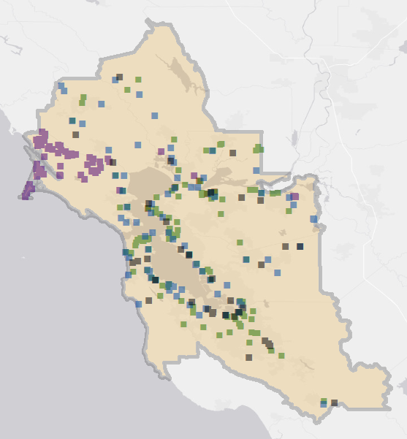
Results: Trajectory Analysis
CH₄ Hotspot Map
Landfill
Water treatment
Power plant
Refinery
Dairy
BAAQMD GHG inventory
CH₄
Trajectory Analysis
Notes:
To investigate the “hotspots” that we found, we plotted the sources that BAAQMD has in its emissions inventory-so they have quite a bit of data over landfills, water treatment plants, refineries and dairies all around the area.

Slide 39
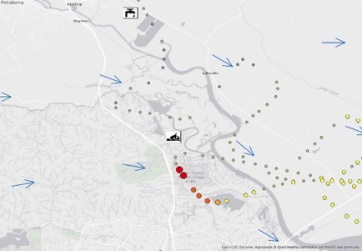
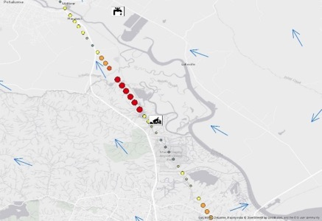
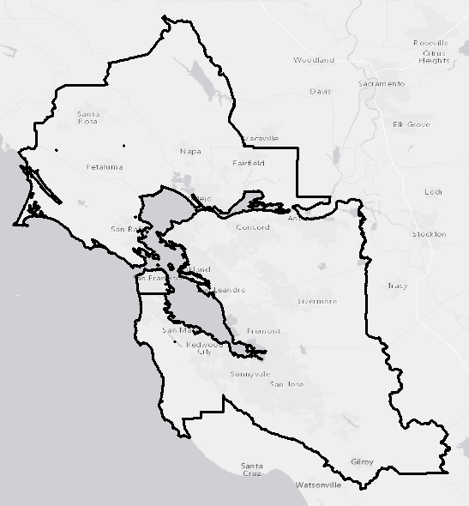
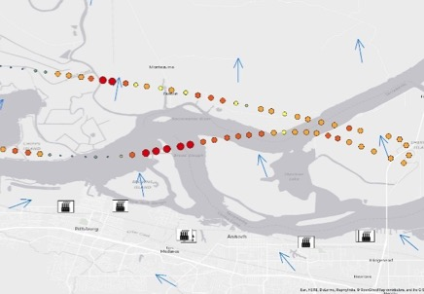
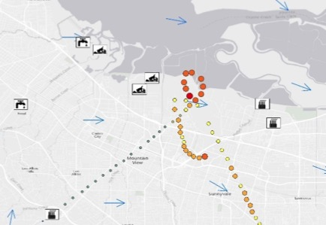
Results: Trajectory Analysis
CH₄ Hotspot Map
Petaluma
Petaluma
BAAQMD GHG inventory
San Pablo Bay
CH₄
Trajectory Analysis
Mountain View
1.9 ppmv CH₄
2.5 ppmv CH₄
Notes:
We took a closer look at some of the areas of concern that popped up in our comprehensive map of methane enhancements.
We found four areas of concern-- two over Petaluma, kind of in the northern Bay Area, one over San Pablo Bay, in the east, and one over Mountain View, right here near Ames.

Slide 40
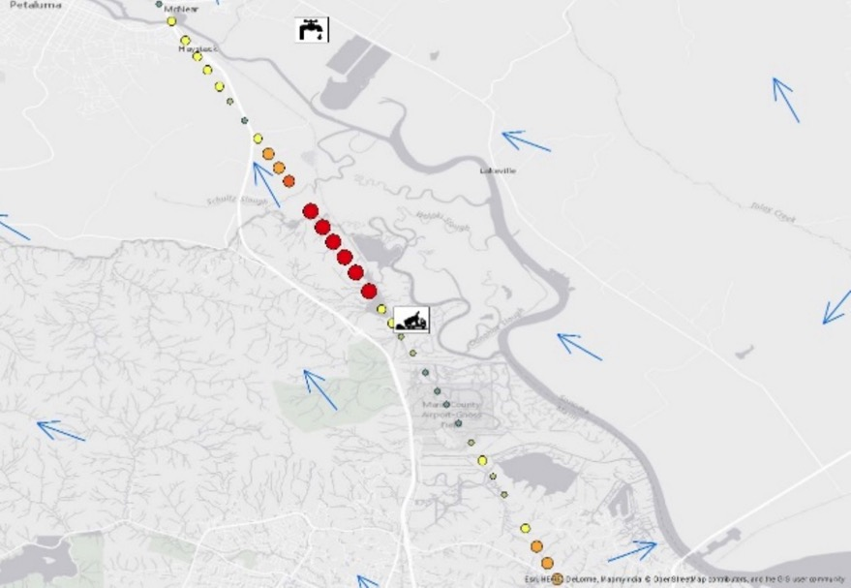
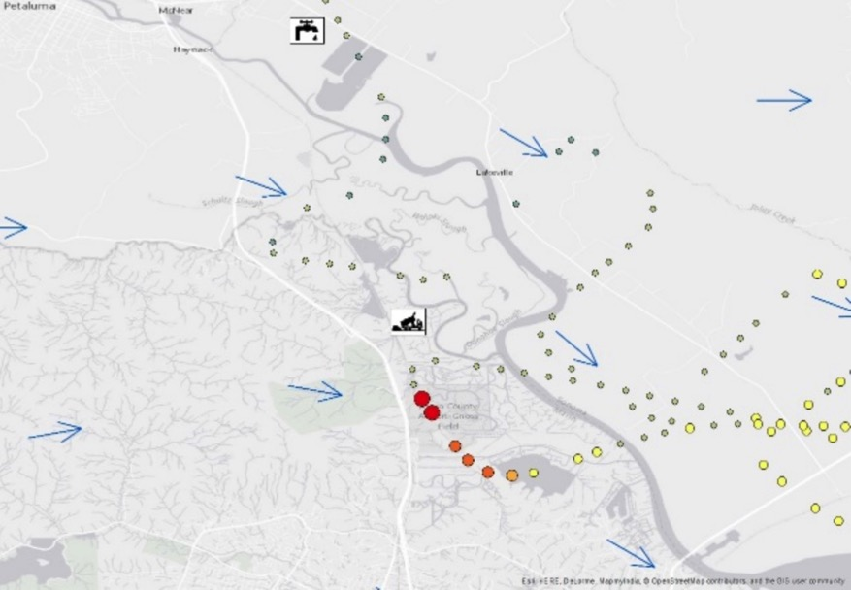
Results: Trajectory Analysis
Petaluma
Petaluma
1.9 ppmv CH₄
2.5 ppmv CH₄
Notes:
For each hotspot, we plotted the historical data on wind direction over the areas and looked at the area upwind of the hotspot.
In the case of Petaluma, you can see that the hotspot occurs north of the landfill when the wind is blowing to the north, and the hotspot occurs to the south when the wind is blowing the other way.

Slide 41
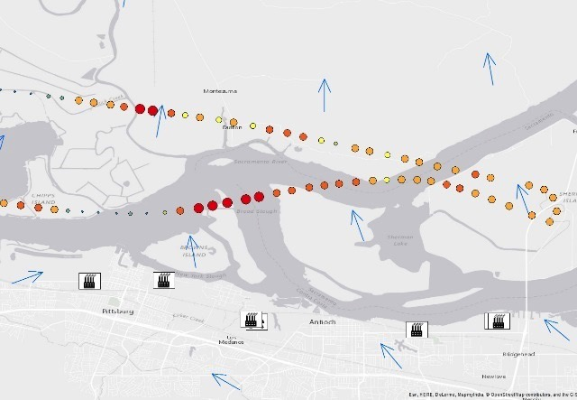
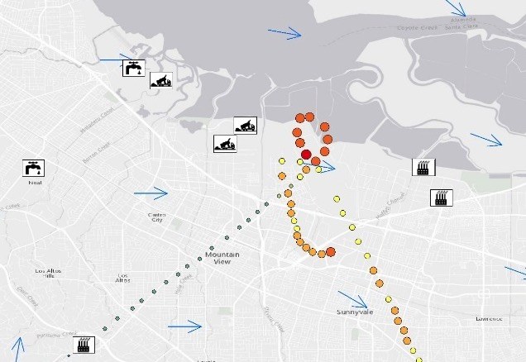
Results: Trajectory Analysis
San Pablo Bay
Mountain View
Petaluma
Petaluma
1.9 ppmv CH₄
2.5 ppmv CH₄
Notes:
In San Pablo Bay, we can see that the hotspots are occurring downwind from the refineries in the area. This gives us some hope that hotspots within AJAX flights can be used as indicators. And in the case of Mountain View, we see that there’s a hotspot over Ames, which is downwind of two landfills, but we also see this other string of high methane concentrations, but no source that’s obvious to the eye. Hotspots like these would be great areas of investigation by the BAAQMD van, and by finding landfills or refineries that weren’t previously accounted for in the inventory, we can take steps to regulating and reducing emissions from these sources.
These aren’t the most advanced methods for modeling methane plumes, but hopefully this work can help lead the way to a better understanding, a better idea of where we need to look. There’s a lot more to learn from data collected over these areas of concern that we’ve identified, and we can learn from future AJAX flights, or from the upcoming BAAQMD greenhouse gas measurement van, or perhaps from other top-down measurements taken over the Bay Area.

Slide 42
Objectives
CH₄ Hotspot Map
Develop a comprehensive spatially-resolved CH₄ map for the San Francisco Bay Area using NASA AJAX data
CH₄
Trajectory Analysis
Locate and investigate CH₄ “hotspots” using anomalies detected by AJAX to pinpoint specific sites for further monitoring via upcoming BAAQMD Mobile GHG Measurement Network
CH₄ time series for location
Evaluate local changes in CH₄ based on time-series data

Slide 43
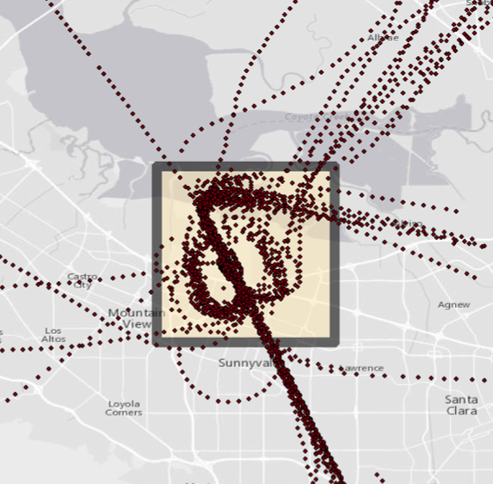
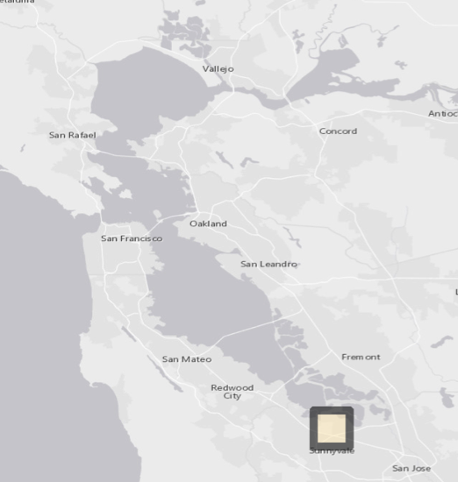
Methods: CH₄ Time Series
CH₄ Hotspot Map
Select high-density flight area over Ames
CH₄ time series for location
Notes:
And finally, we saw a lot of value in the fact that AJAX flies in and out of Ames every few days. This is consistent methane measurement over the same spot-- and there’s a lot to learn from that.

Slide 44
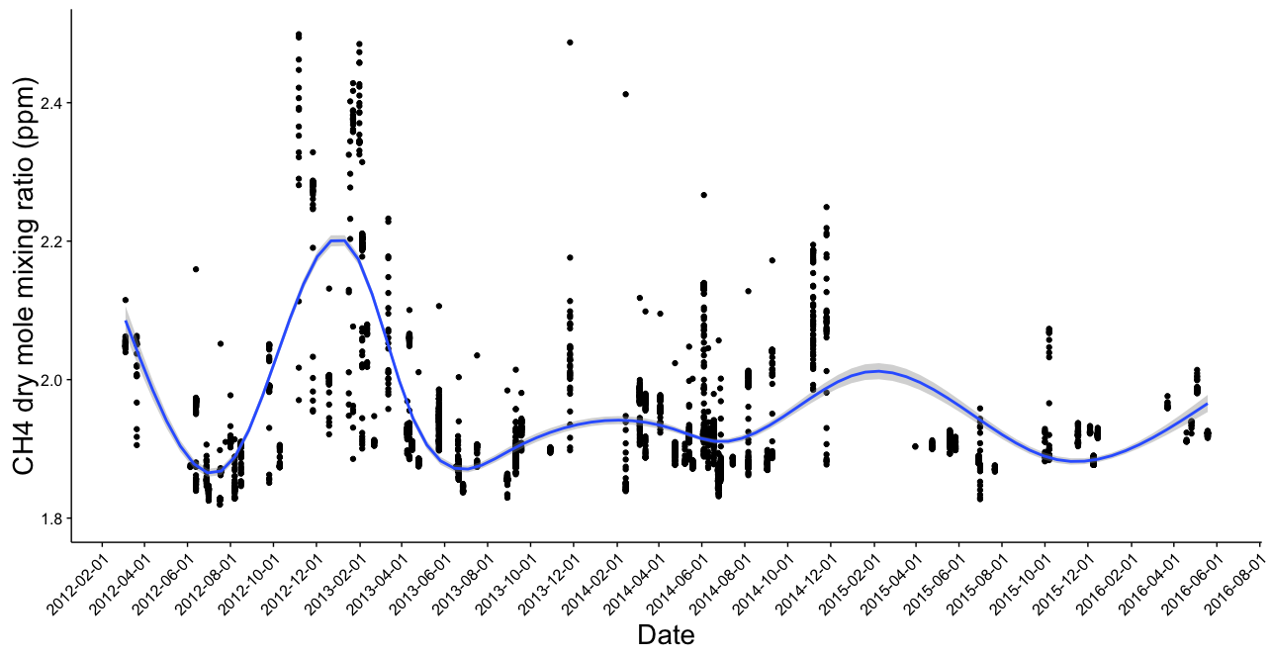
Results: CH₄ Time Series
CH₄ Hotspot Map
Select high-density flight area over Ames
CH₄ time series for location
Notes:
So using only the flights within this area, and below the PBL, we created a time series of methane levels over the NASA Ames Research Center. This time series can almost act like a sensor, and there’s potential to compare it to the four BAAQMD sensors, and find out if they’re telling us the same stories.

Slide 45
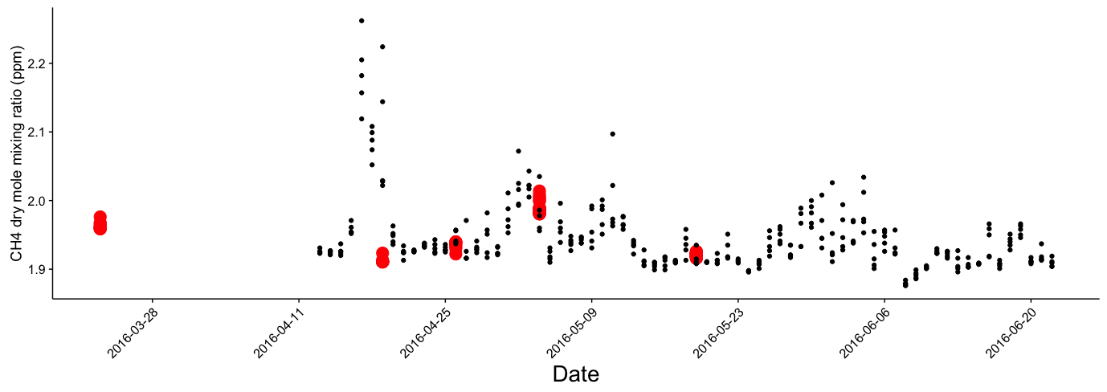
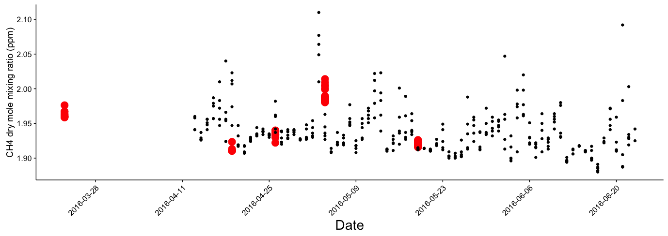
Results: CH₄ Time Series
Patterson Pass
NASA AJAX
BAAQMD GHG
San Martin
Patterson Pass
NASA ARC
NASA ARC
San Martin
Notes:
Finally, we evaluated a number of the areas of enhanced methane as recorded in AJAX flights, with the goal of better informing future BAAQMD mobile van monitoring and investigaiton
We’ve also created similar time series over the Patterson Pass and San Martin sensors that have just been put in. There’s a lot of potential for validation and research on vertical distribution of methane using these two sources of data together.

Slide 46
Uncertainties and Future Work
Image Credit: Planet Labs
High uncertainties associated with trajectory analysis: give only an overview of possible emissions sources.
Future collaboration with BAAQMD’s GHG mobile monitoring van could better explore/identify these sources.
Targeted, low-altitude AJAX flights over the Bay Area for better coverage
More BAAQMD-AJAX collaborations to come!
Notes:
We’ve come to see that airborne greenhouse gas data from below the planetary boundary layer (PBL) can be used in many ways to understand near-surface methane enhancements.
This data can give both a synoptic view of historical methane, and a more localized view of what’s enhancing the methane concentrations over the Bay Area. It can help us find areas of concern, areas where we need to investigate and regulate, it can help us find out how we can reduce emissions and lead the way to a cleaner, safer San Francisco Bay Area.

Slide 47
Conclusions
Image Credit: Planet Labs
Airborne in situ greenhouse gas concentration data from below the planetary boundary layer (PBL) can be utilized in understanding near-surface CH₄ concentrations
The San Francisco Bay Area has many CH₄ “hotspots” downwind of dairies, landfills, and areas of oil and gas production. A number of these sources appear to not be included in BAAQMD’s current emissions inventory.
Notes:
In conclusion,
Airborne in situ greenhouse gas concentration data from below the planetary boundary layer (PBL) can be utilized in understanding near-surface CH₄ concentrations
This data can give both a synoptic view of historical methane, and a more localized concentration-based view
The San Francisco Bay Area has many CH₄ “hotspots” downwind of dairies, landfills, and areas of oil and gas production. A number of these sources appear to not be included in BAAQMD’s current emissions inventory.

Slide 48
Bay Area Air Quality Management District
Dr. Abhinav Guha, Senior Air Quality Engineer
Dr. Phil Martien, Air Quality Engineering Manager
Ms. Abby Young, Climate Protection Manager
Dr. David Fairley, Statistician
Lawrence Berkeley National Laboratory
Dr. Marc Fischer, Dr. Seongeun Jeong
NASA Alpha Jet Atmospheric eXperiment
Dr. Laura Iraci, Dr. Josette Marrero,
Dr. Emma Yates, & Mr. Warren Gore
NASA Ames Research Center
Ms. Chippie Kislik, Ms. Vickie Ly, Dr. Juan Torres-Pérez
Notes:
Thanks!

Slide 49
QUESTIONS?

