Slide 1
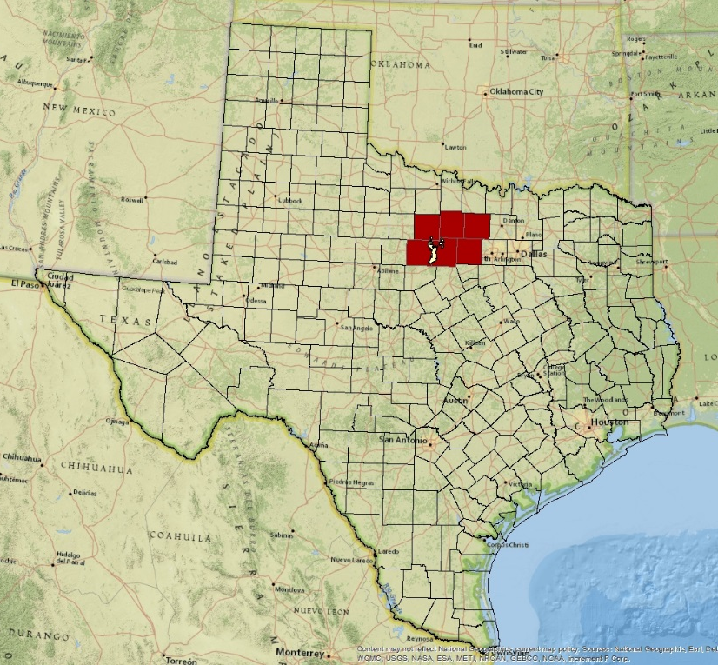
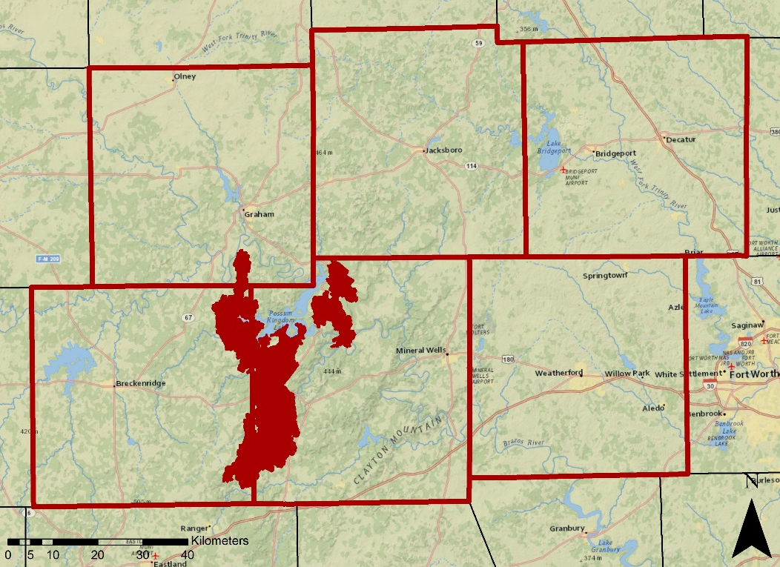
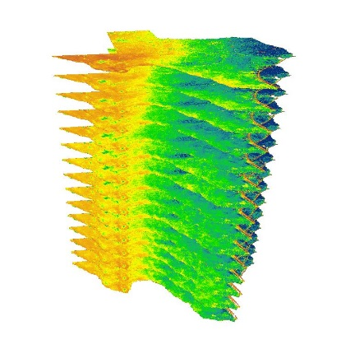
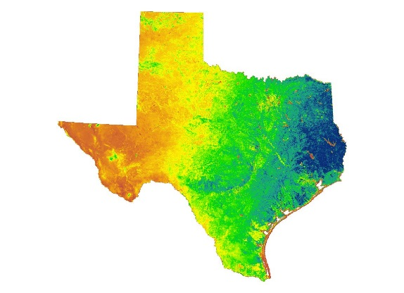
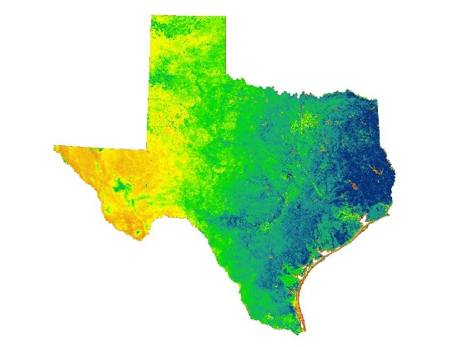
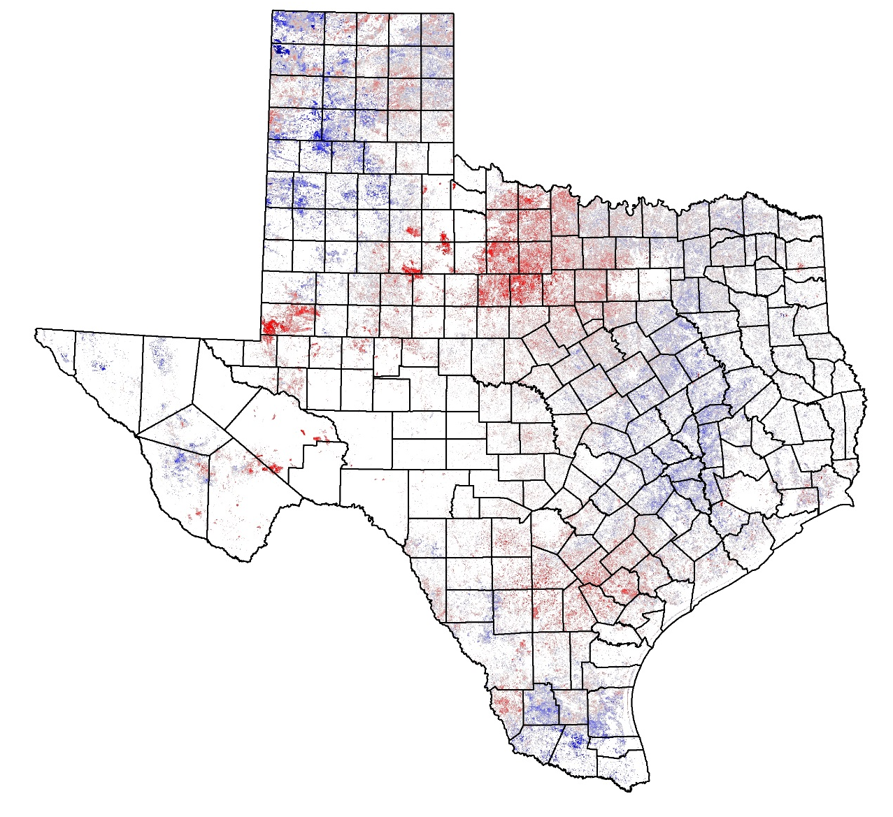


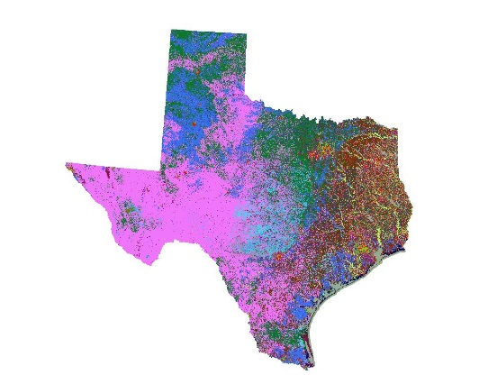
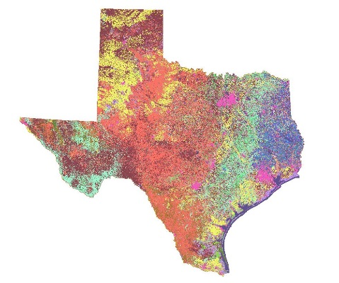
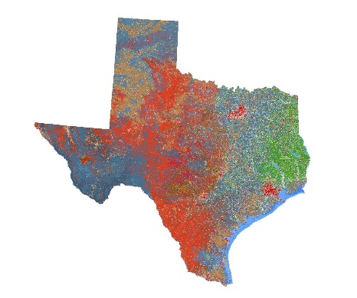
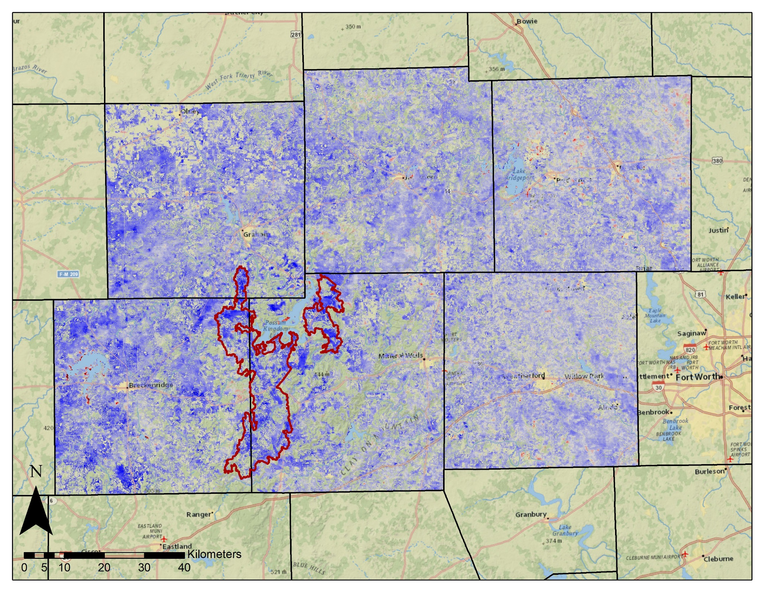
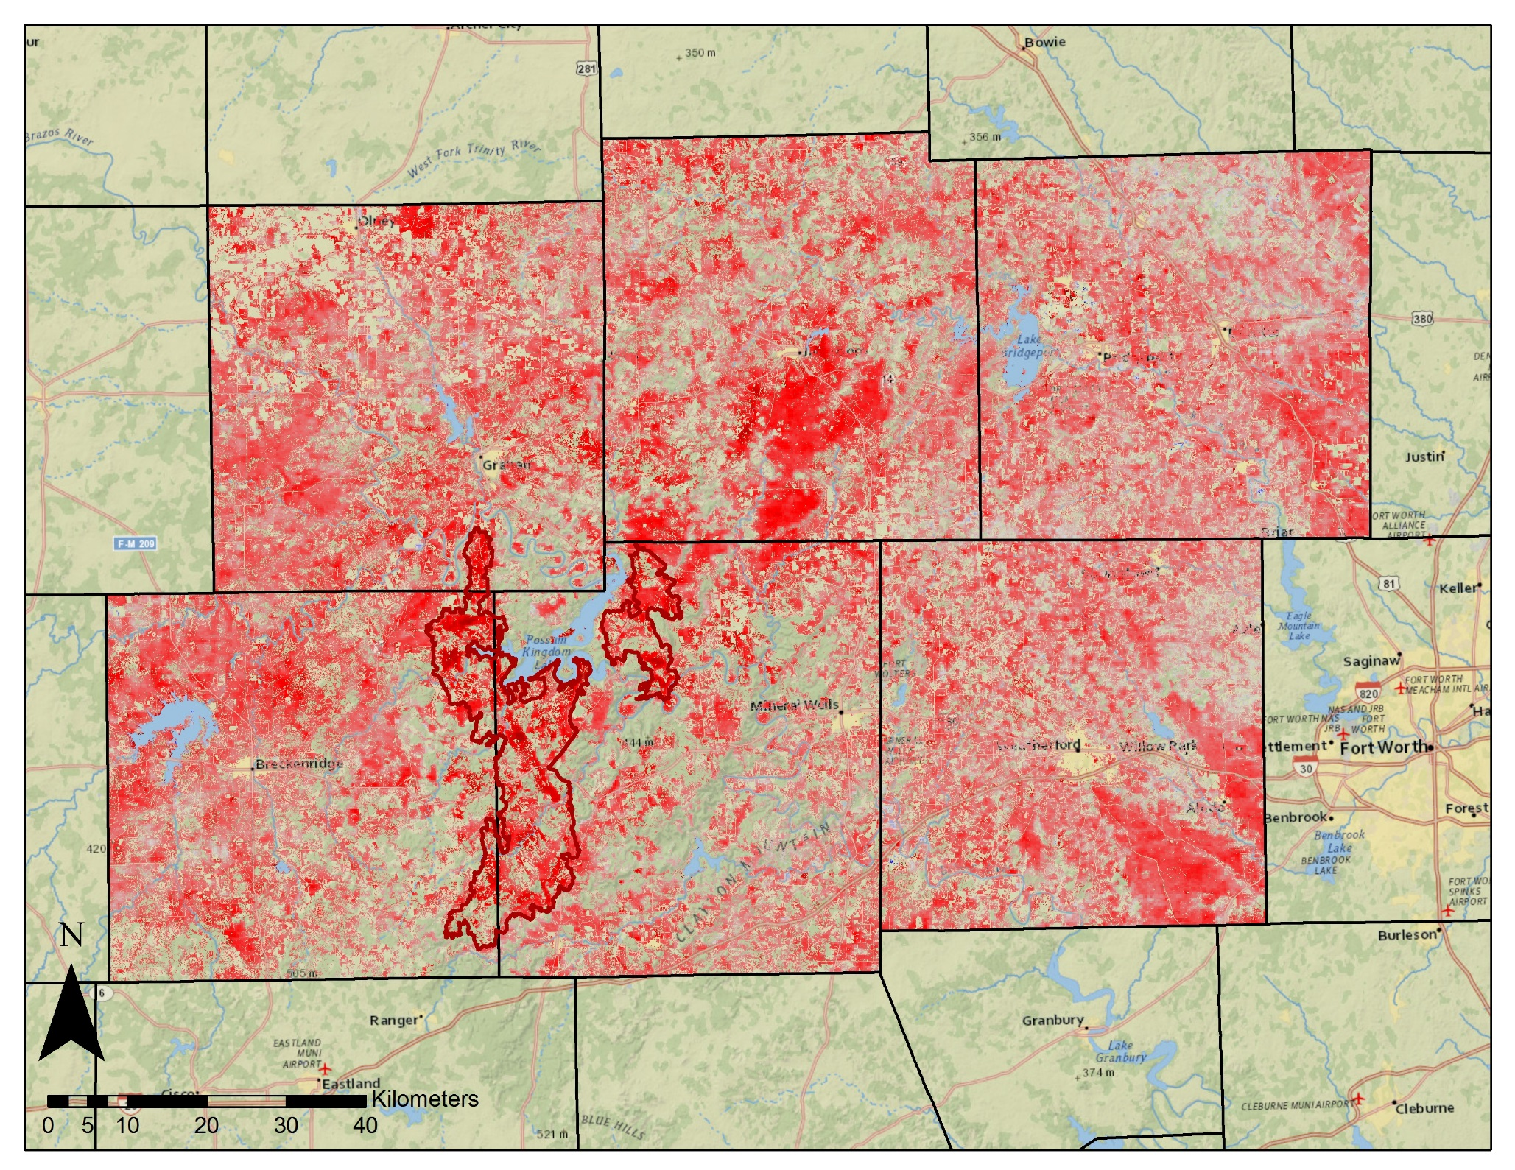
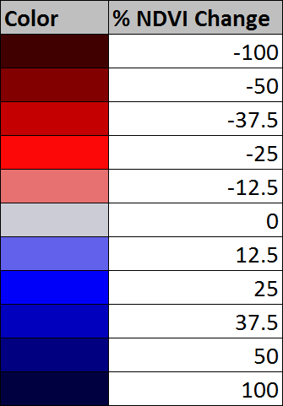
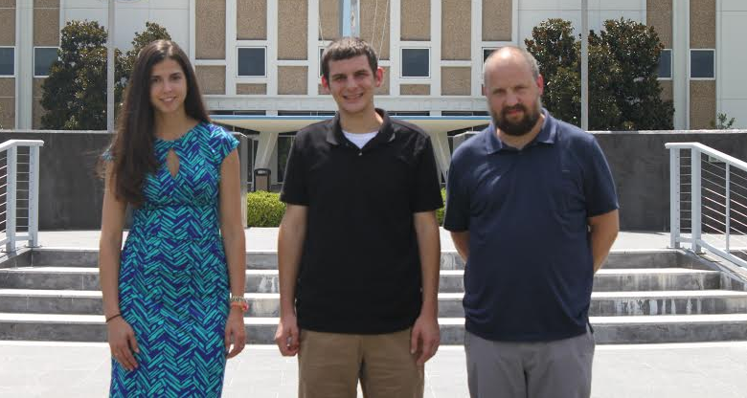
Texas Disasters
Utilizing NASA Earth Observations to Assist the Texas Forest Service in Mapping and Analyzing Fuel Loads in the Texas Grasslands
Ben Beasley (Project Lead), Alex Holland, Kristen Kelehan
NASA DEVELOP National Program at John C. Stennis Space Center
Abstract
Objectives
In recent years, the risk of severe wildfires has been increasing due to weather phenomena such as sequences of wet and drought years and recent urban expansion into wildland areas that are vulnerable to wildfire. The Texas Forest Service (TFS) is tasked with estimating and evaluating potential fire risk to manage and allocate resources for the prevention and containment of possible wildfires across the Texas landscape. A key for assessing fire risk is understanding vegetative fuel types and fuel loads. NASA Earth Observations provide a means for monitoring and evaluating wildfire fuel across a large temporal and spatial scales. This project aimed to assist the TFS by using MODIS and Landsat OLI data to calculate vegetation indices such as NDVI, and maps of fuel type and fuel load. This project leveraged the temporal advantages of MODIS with the more spatially resolved Landsat data to enable more informed wildfire risk assessment. This approach resulted in fuel maps that are more temporally resolved and updatable than the products derived previously with only Landsat data. Fuel maps were created for the 2010-2011 fire season, which saw some of the worst wildfires and drought impacts in recent history, and for the 2014-2015 season to provide a current assessment of wildfire fuels. The TFS are utilizing these products in order to better understand and evaluate wildfire risks throughout the state.
.
Enhance current fuel mapping capabilities using NASA Earth observation data
Use and demonstrate NASA data to help assess seasonal variations in fuel loads
Compile up-to-date fuel load maps that depict fuel conditions
Study Area
Methodology
NDVI
2000-2014
NDVI
15 Year Average
NDVI
Annual
Grassland Annual
Relative Fuel Load
The study covers the State of Texas with a case study of the Possum Kingdom Complex wildfires of 2011.
Earth Observations
Vegetation
Types
Surface Fuel Types
Combined
Vegetation and Fuels
Landsat 8 OLI
Terra and Aqua
MODIS
Project Partners
Texas Forest Service; Tom Spencer and Curt Stripling- Predictive Services
USDA Forest Service; William “Bill” Hargrove- PI for the ForWarn Early Warning System
Results
2010 (Wet Year)
2011 (Drought Year)
Acknowledgements
Joseph Spruce (Senior Scientist and Lead Science Advisor at NASA SSC)
James “Doc” Smoot (Senior Scientist and Assistant Science Advisor at NASA SSC)
Dr. Kenton Ross (NASA DEVELOP National Science Advisor, LaRC)
Team Members
Grassland Relative Fuel Loads – Comparison of 2010 and 2011 annual NDVI to 15 year average NDVI. Bluer areas represent greater than average and redder areas represent less than average NDVI response. The red outline indicates the Possum Kingdom Complex wildfires perimeter.
Conclusions
Geospatial information on grassland fuel loads are important for assessing wildfire risk.
Annual cumulative MODIS NDVI offers a means to monitor relative fuel loads.
Such MODIS NDVI products can serve as inputs to fuel load models.
Kristen Kelehan, Alex Holland, and Ben Beasley
NASA John C. Stennis Space Center

