Slide 1
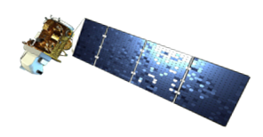
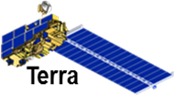
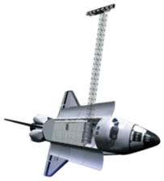
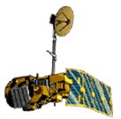
Ross Reahard (Project Lead)
Rudy Bartels
James Brooke
Meredith Williams
Joseph Spruce, NASA SSC
James “Doc” Smoot, NASA SSC
Dr. Kenton Ross, NASA SSC
Landsat 8
Terra
Space Shuttle
Landsat 5

Slide 2
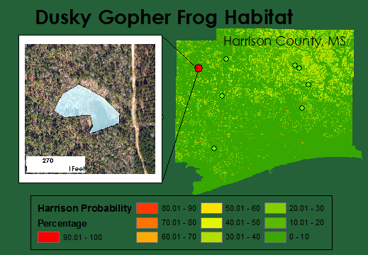
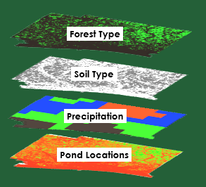
Using NASA Earth Observations to Locate Potential Habitat for the Dusky Gopher Frog
U.S. Forest Service
The Nature Conservancy
US Fish and Wildlife Service
U.S. Army Corp of Engineers
Southern Mississippi, 2005-Present
The dusky gopher frog (DGF), Lithobates sevosus, is the most endangered species of frog in North America and is listed as one of the top 100 endangered species in the world. Currently, this species is found in only four ponds in Southern Mississippi. DGF has the potential to become an extinct species. Historically, these frogs inhabited the long leaf pine ecosystem and utilized burrows from the gopher tortoise, which is also endangered. The reduction of long leaf pine forests, coupled with the highly specific habitat requirements of DGF, makes it especially challenging to federal land wildlife managers to maintain existing populations and increase the number of viable populations.
The suitability model discovered areas with 70% and above potential habitat in each county. Harrison county had the greatest potential habitat. St. Tammany Parish had the least likely potential habitat. The model proved to be 75% accurate after quality check. The final product of this project gives probable pond coordinates and potential habitat for the Dusky Gopher Frog.
This project extended methodologies developed at Stennis Space Center during the Summer 2015 DEVELOP Mississippi Ecological Forecasting project utilized NASA Earth Observations to locate potential habitat for the dusky gopher frog. The project used current decision making practices regarding where relocation and reintroduction ponds for the dusky gopher frog should be established to help monitor, protect, and restore this critically endangered species.

