Slide 1

Thailand
Disasters/Agriculture
Monitoring Risk and Extent of Drought for Enhanced Decision Making and Resource Allocation in the Kingdom of Thailand
Monitoring Food Crop Health and Stress Due to Changing Climate for Enriched Agricultural Land Management
Sean McCartney (Project Lead)
Srisunee Wuthiwongyothin
Timothy Klug (Project Lead)
Watanyoo Suksa-ngiam
Nobphadon Suksangpanya
Sahakait Benyasut
Komsan Rattanakijsuntorn
Arom Boekfah
Chisaphat Supunyachotsakul
Thanapat Vichienlux
Chayanit Choomwattana
Atipat Wattanuntachai

Slide 2
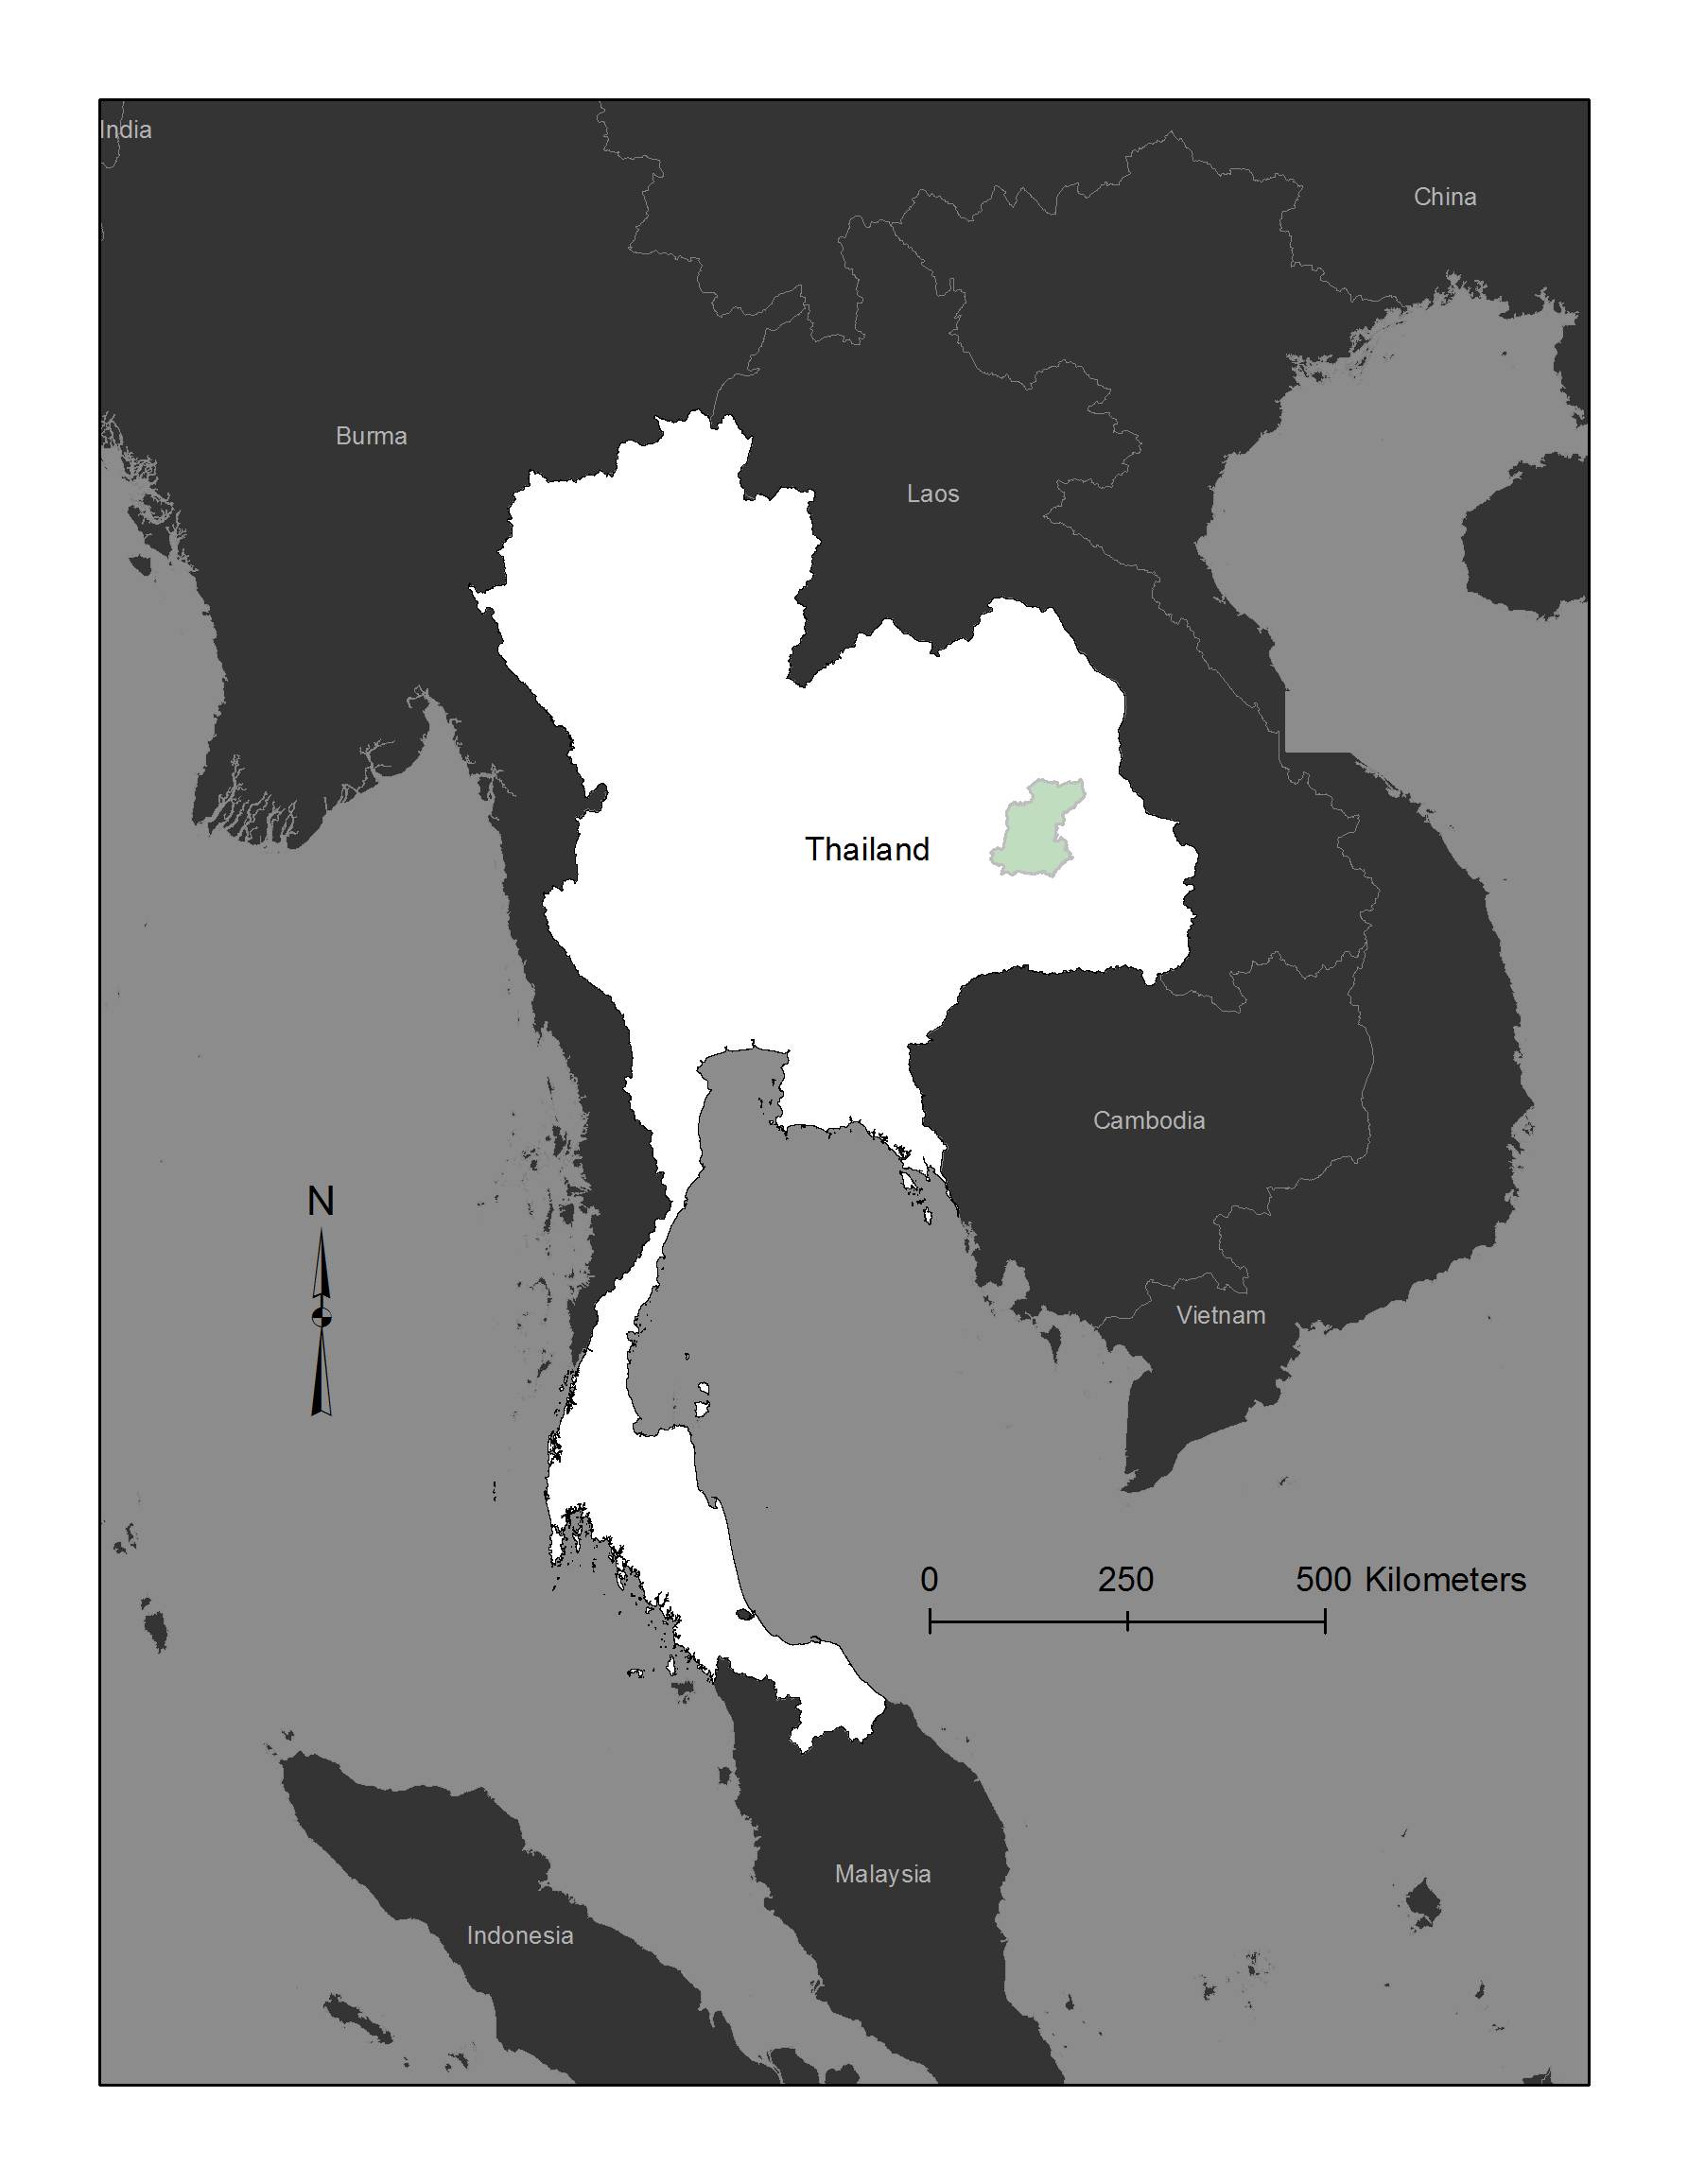
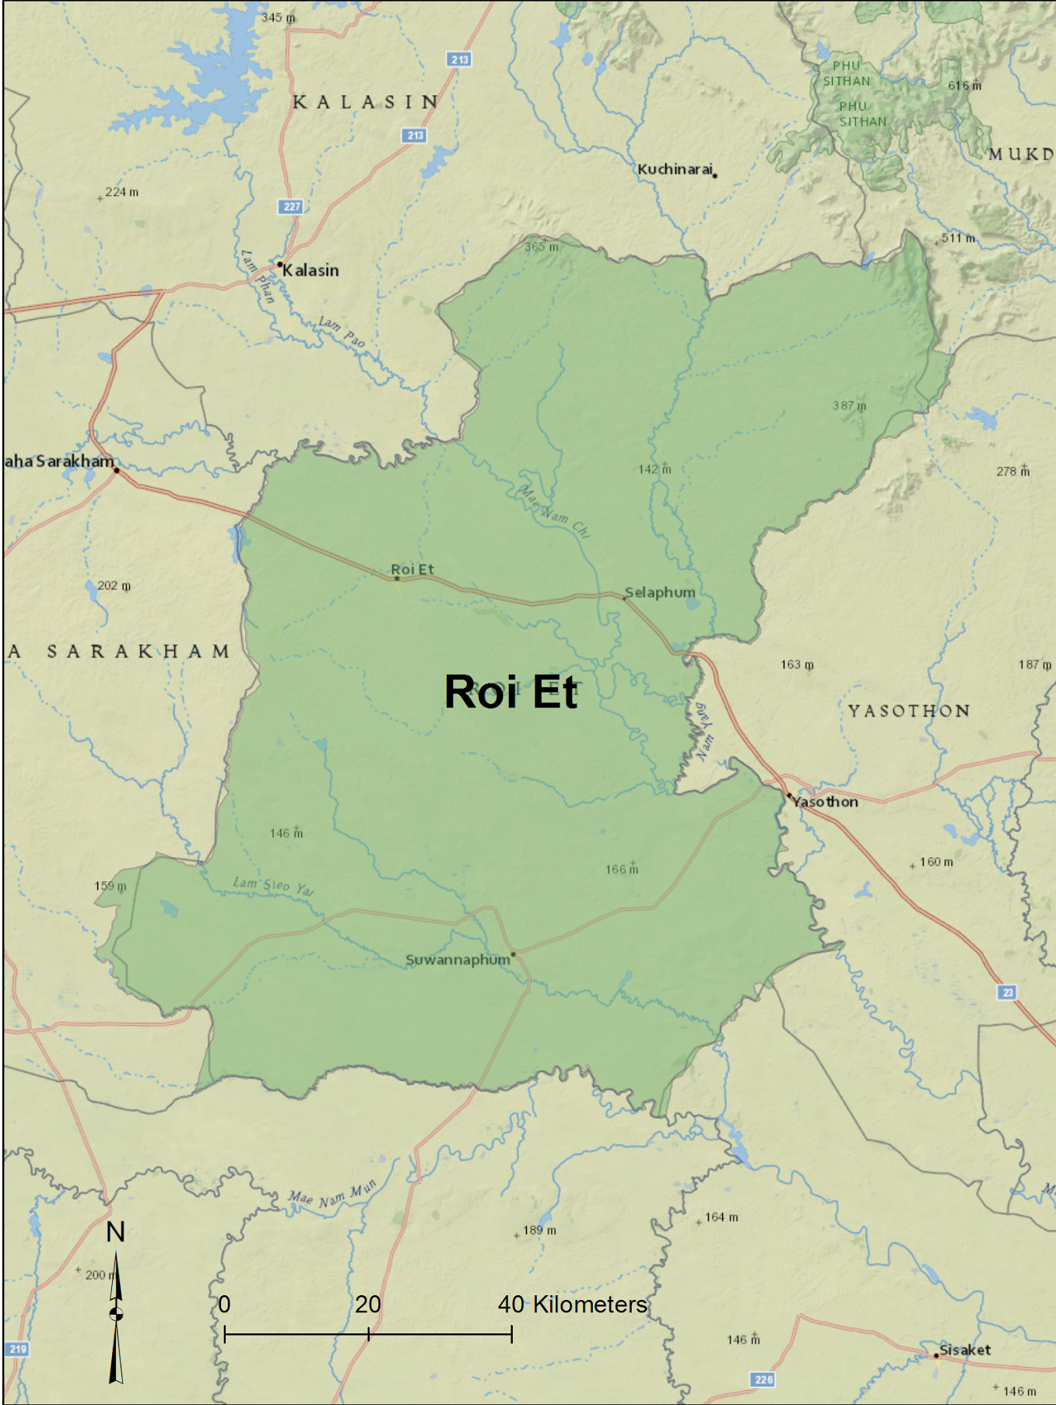
Study Area
Kingdom of Thailand
Area: 513,115 km²
Population: 66 million
One of the top three rice exporting countries in the world
47% of area is dedicated to agriculture
Roi Et is known for its jasmine rice production
Natural disasters: flooding and drought
Thailand Agriculture Study Area
Thailand Disaster Study Area
Notes:
Sahakait
• Thailand is one of the top three rice exporting countries in the world.
• 47% of the total area in the country is dedicated for agriculture.
• Thailand is frequently affected by drought which is a major impacts on agriculture, environment, economy, and livelihoods of citizens.
• The most recent drought in 2015 is considered the worst drought in 15 years and is reducing off-season crops export by higher that 30%.
• Thus, Thai government needs to monitor and assess the risk and then enact policies to conserve and provide water for agriculture and the welfare of the people.
Thailand Agriculture Project Area
Roi Et is known for producing large quantities of Jasmine rice
The province of Roi Et is located in the northeastern region of Thailand

Slide 3
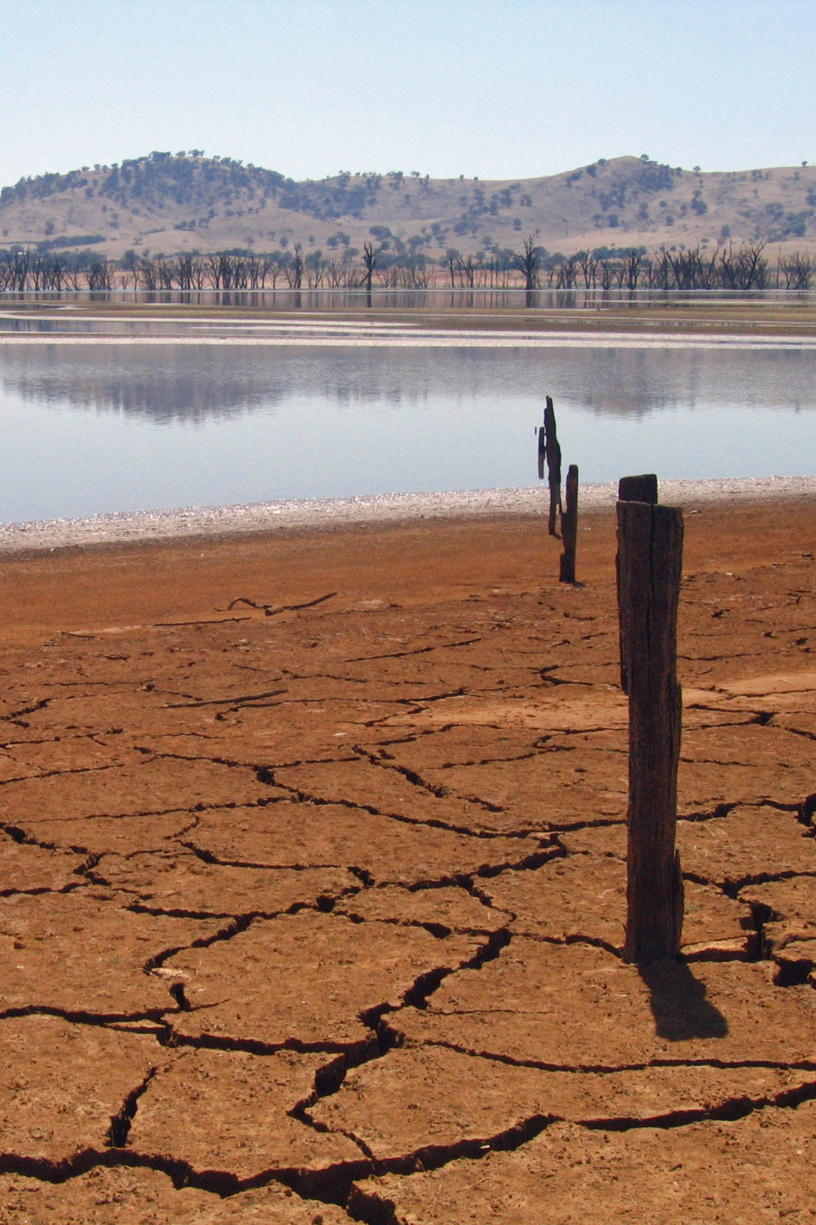
Thailand Disasters Overview
Analyze 3 types of drought
(1-month temporal resolution):
Meteorological Drought:
Standardized Precipitation Index (SPI)
Hydrological Drought:
Streamflow Drought Index (SDI)
Agricultural Drought:
Scaled Drought Condition Index (SDCI)
Soil Moisture Index (SMI)
Image Credit: suburbanbloke
Notes:
Image Source: https://upload.wikimedia.org/wikipedia/commons/e/ee/Lac_Hume.jpg
Srisunee:
For our Thailand Disaster project, we studied and developed a tool to monitor risk and extent of drought for the whole of Thailand.
In this research, we analyzed cause and the effects of drought from 3 different aspects: meteorological, hydrological, and agricultural.
These droughts were monitored by 4 different indices.

Slide 4
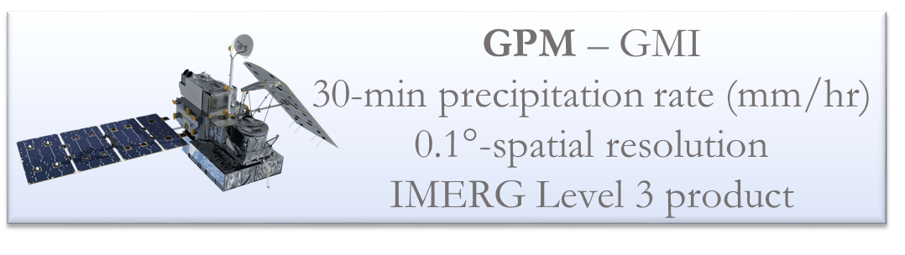
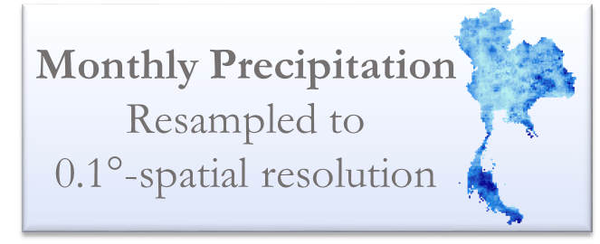
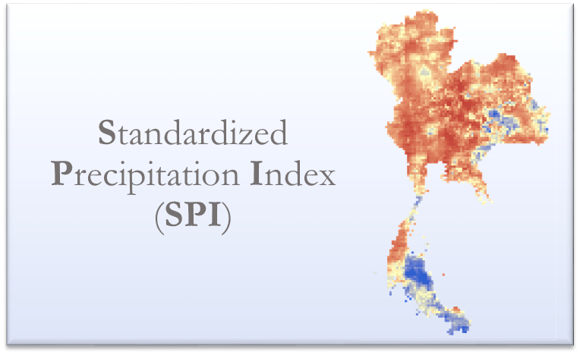
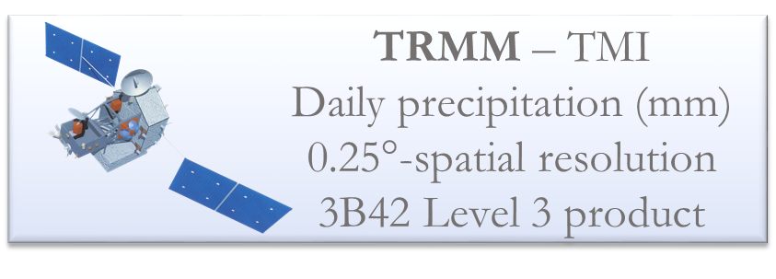
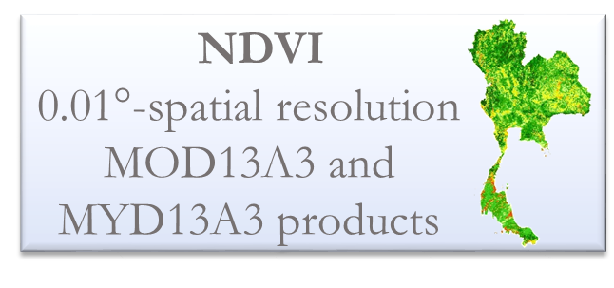
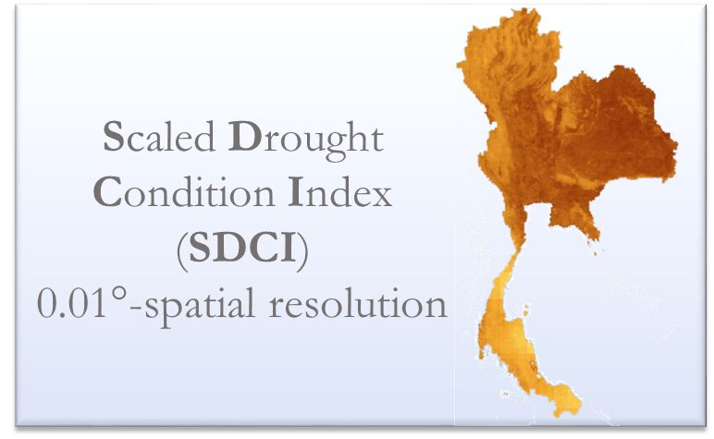
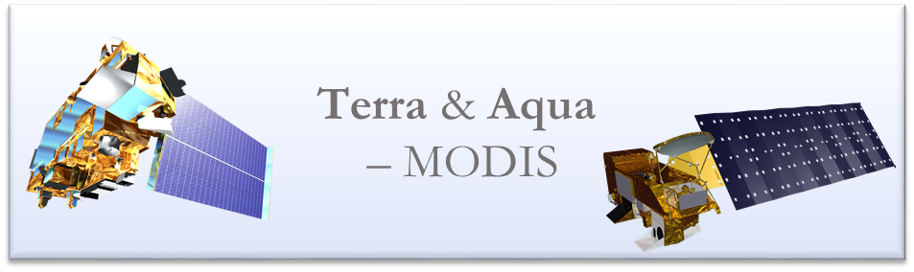
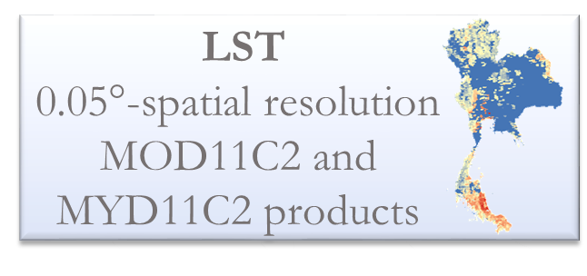
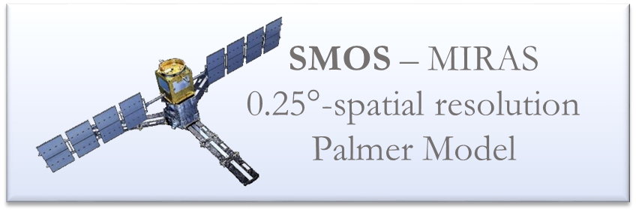
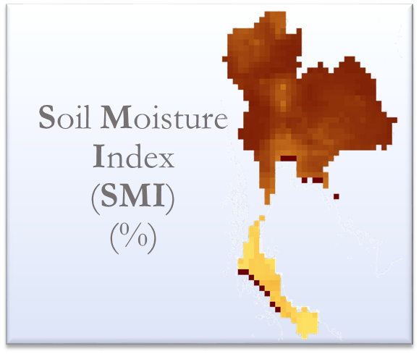
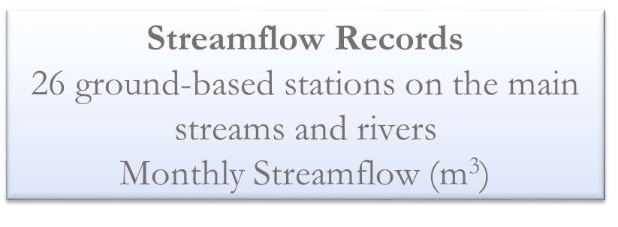
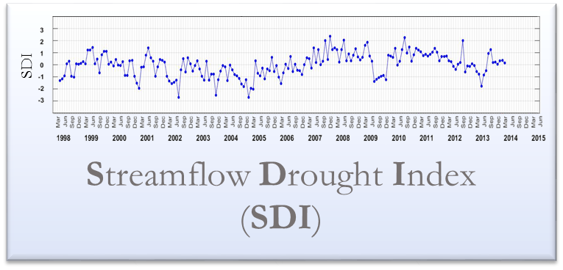
Thailand Disasters - Methodology
Notes:
Srisunee:
To derive the drought indices, we used NASA’s Earth Observing Satellites as well as in situ data.
We acquired data from TRMM and GPM satellites to obtain monthly precipitation from 1998-present. This was used to calculate the Standardized Precipitation Index, or SPI. This index is an indicator of the cause of meteorological drought.
Next, the Scaled Drought Condition Index, or SDCI, was used in determining agricultural drought. This index was analyzed by incorporating three factors. Land surface temperature and the Normalized Difference Vegetation Index were acquired as MODIS products from Terra and Aqua satellites, and precipitation was derived from TRMM and GPM to calculate the SDCI.
In addition, a Soil Moisture Index derived by processing SMOS satellite imagery was provided by Dr. John Bolten at Goddard Space Flight Center. This index helped to compare with other drought indices and find correlations with climatic variables.
Hydrological Drought can be monitored by looking at the streamflow on the main streams in Thailand. The monthly streamflow data from 26 ground stations was used to calculate a Streamflow Drought Index, or SDI, as a time series. This index provided the effect of drought based on streamflow from streams and rivers in Thailand.

Slide 5

Results & Discussion
Notes:
Srisunee:
This animation shows results from monthly variations in of the drought indices.
The time series plotted were analyzed to compare all indices. This approach allowed us to derive anomalies in identifying drought.
For example, in February 2005, all indices shown extreme drought in the Central region of Thailand.
The spatial map SPI index in red shows the area that has more severe droughts at that particular area. Whereas, the blue color shows wet conditions.
For SDCI and Soil Moisture, the dark brown color represents more droughts occur at that particular region and time.
In sum, we can use this spatial extent and series to monitor drought in Thailand.

Slide 6

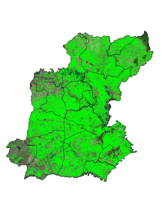

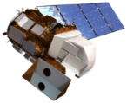
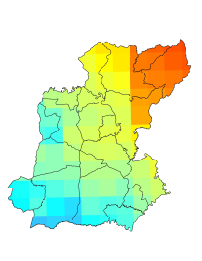
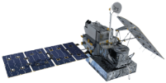
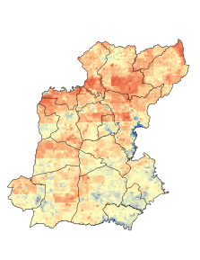
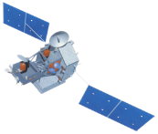
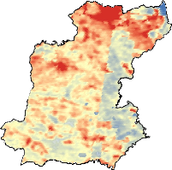
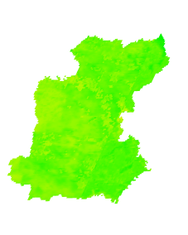

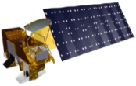
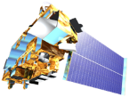
Methodology
Satellites/Sensors
Intermediate Data
End Products
Analysis
Land Cover Classification
Time series maps
Government Rice Yield Data
Landsat 5, 7, 8
TM, ETM+, OLI
Monthly Precipitation (averaged mm/hr)
GPM
Microwave Imager
SDCI
Scaled Drought Condition Index
Prediction Models
Linear Regression
TRMM
Precipitation Radar
Land Surface Temperature
Degrees C
NDVI
Normalized Difference Vegetation Index
Aqua/Terra
MODIS
Notes:
[Watanyoo] For the methodology of the Thailand Agriculture project
Three main classes of satellites and sensors were used in this project.
First, high resolution sensors from Landsat suite were used to classify rice area.
Second, precipitation radar data from GPM and TRMM were used to average monthly rainfall in part of calculating SDCI.
Third, land surface temperature and NDVI from Aqua/Terra were used in part of calculating SDCI.
Using Land Cover Classification, SDCI, Precipitation, and NDVI , we can develop prediction models.

Slide 7
Results
Pearson’s Correlation Table (N = 120)
 | Statistical Rice Yield | Yield per Area | Classified Rice Area | SDCI | NDVI | Precipitation
 | (ton) | (ton/km²) | (km²) |  |  | (mm/wet season)
Statistical Rice Yield | 1
Yield per Area | -0.0002 | 1
Classified Rice Area | 0.750*** | -0.245** | 1
SDCI | 0.095 | -0.099 | 0.252** | 1
NDVI | 0.116 | 0.304*** | -0.040 | -0.238** | 1
Precipitation | -0.114 | -0.220* | -0.013 | 0.347*** | 0.030 | 1
Two tailed significance, * p < 0.05;** p < 0.01; *** p < 0.001
Notes:
[Watanyoo] This table shows the correlation Matrix. In this table value one suggests that the two variables on the row and column are the same variable.
Based on our available satellite data and Pearson’s correlation , classified rice area from land cover classification has a significant positive correlation with the predicted rice yield.
the predicted rice yield per area has a significant negative correlation with classified rice area.
The predicted rice yield per area has a significant positive correlation with NDVI.
The predicted rice yield per area has a significant negative correlation with RAIN.
SDCI has a significant positive correlation with classified rice area and RAIN but a significant negative correlation with NDVI.

Slide 8
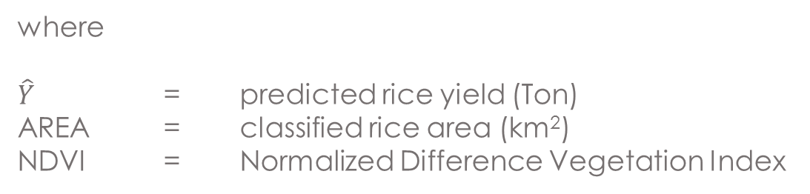
Results and Discussion (con’t)
Prediction Model:
Adjusted R Square = 0.576, the p-values < 0.05
Notes:
However, only two independent variables provide significant coefficients for the linear regression equation. These variables are classified rice area and NDVI.
We then obtain this regression equation
The significance levels of all the predictors and intercept are less than 0.05
The adjusted R square is equal to 0.576, meaning that 57 % of variance of predicted rice yield can be explained by Area and NDVI

Slide 9
Future Work
Thailand Disaster:
  Create a near-real time drought monitoring tool using Earth observing satellites that will aid in mitigating risk and improve resource allocation in the country.
  Calculate the lag correlation for the datasets by taking monthly averages and then analyzing 1,2,3, and 4 month lag correlations to demonstrate the relationship between all drought indices.
Thailand Agriculture:
  Create an agricultural monitoring model generalized to the entire country of Thailand with a variety of agricultural products. This model will include even more variables including land classifications, land surface temperature, precipitation, vegetation indices, and nitrogen content from crop fertilizers.
Image Credit: Loei Pittayakom School
Image Credit: Golden KKCC
Notes:
Sahakait:
For the future work, the tools we created in Thai Disaster project will be extended into a Near-Real Time web-based service which can automatically monitor and analyze drought in 1-month temporal resolution.

Slide 10
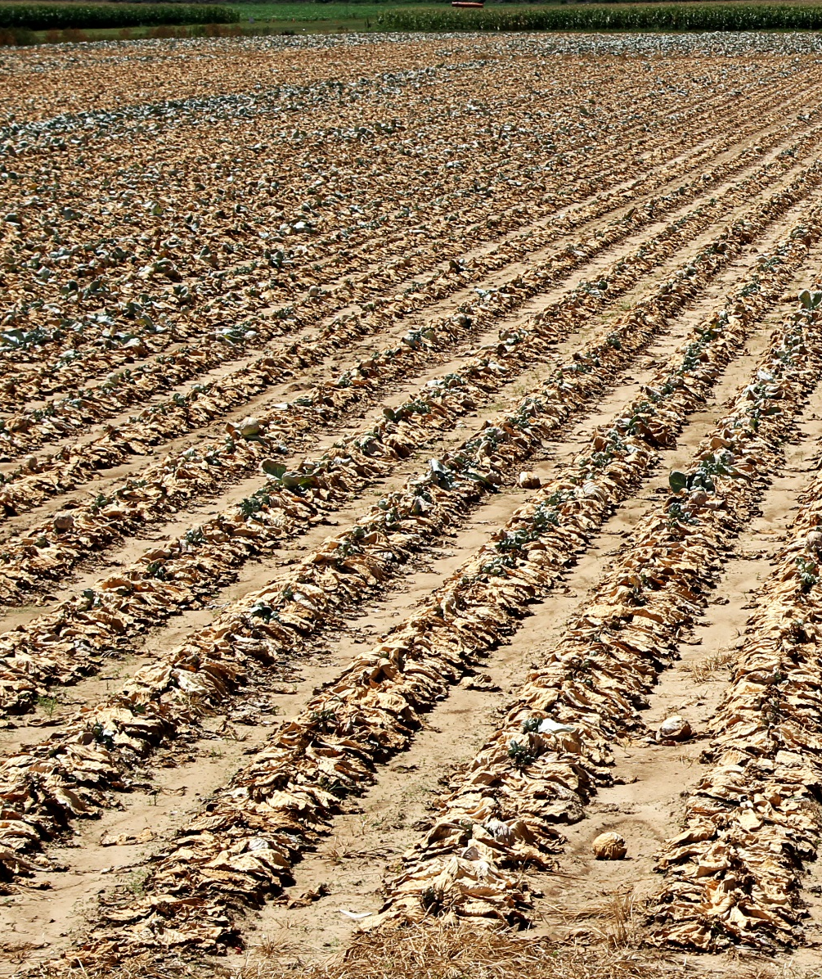
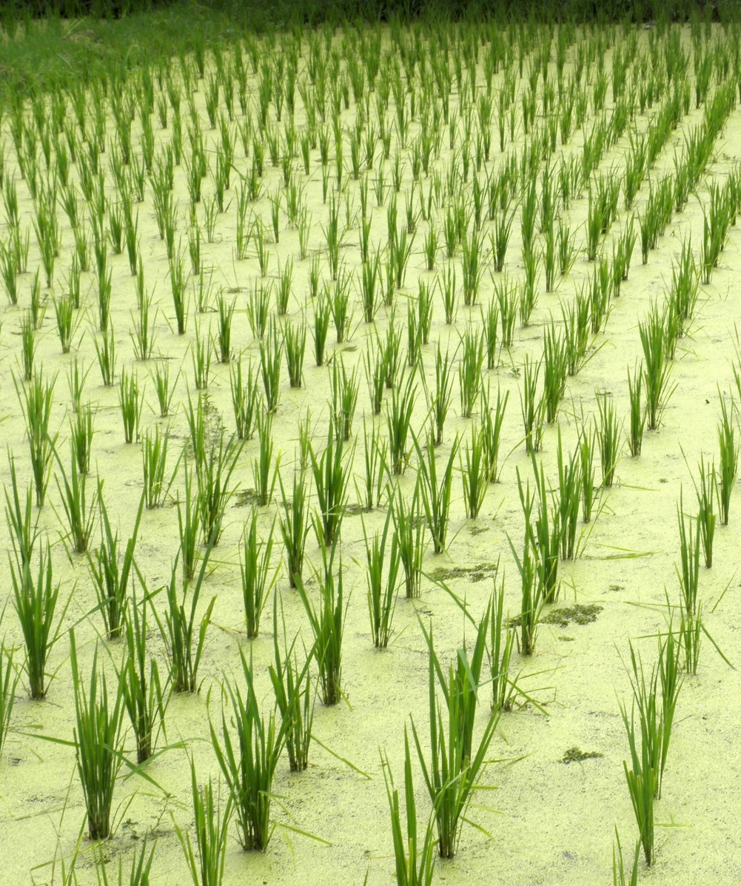
Outcome & Benefit
Thailand Disaster Project:
This drought monitoring system allows end users to access and characterize regional drought in Thailand, leading to better decision making processes that are necessary in mitigating the impacts of drought.
Image Credit: U.S. Department of Agriculture
Image Credit: Quentar
Agriculture Monitoring Project:
The rice area from land cover classifications, NDVI can be used to predict both the rice yield and yield per area in Roi Et, Thailand.
Notes:
Image Source (left): http://202.28.94.60/webcontest/2554/5429/signal/image/dry1.jpg
Image Source (right): http://2.bp.blogspot.com/-L5AQzyn2_fo/UXY-IYcNHEI/AAAAAAAAFgw/2_QebWTOaFo/s320/%E0%B8%95%E0%B9%89%E0%B8%99%E0%B8%82%E0%B9%89%E0%B8%B2%E0%B8%A7.jpg
Sahakait:

Slide 11
Advisors
Dr. John Bolten (NASA GSFC)
Colin Doyle (NASA GSFC)
Dr. Kenton Ross (NASA Langley Research Center)
Dr. Jeffrey Luvall (NASA at National Space Science and Technology Center)
Dr. Robert Griffin (University of Alabama in Huntsville)
Partners
Royal Thai Embassy
Collaborator/Boundary Organization,
POC: Bunyakiat(Gam) Raksaphaeng
Asian Disaster Preparedness Center/SERVIR Mekong
Collaborator/Boundary Organization
POC: Dr. Peter Cutter, Dr. Bill Crosson
Thai Department of Disaster Prevention and Mitigation
End-User
National Safety Council of Thailand
End-User

Slide 12
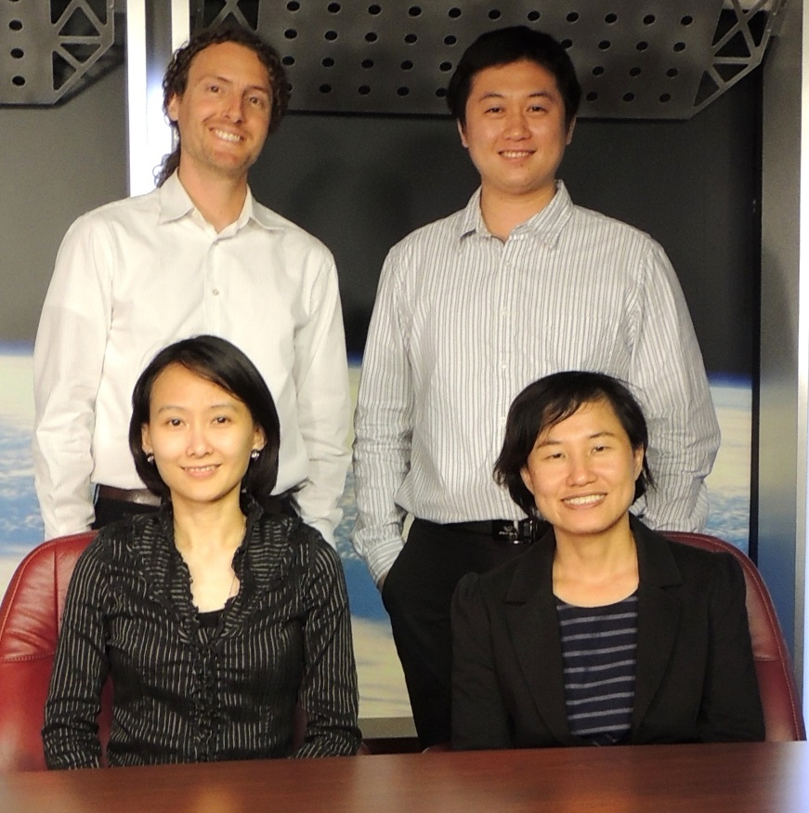
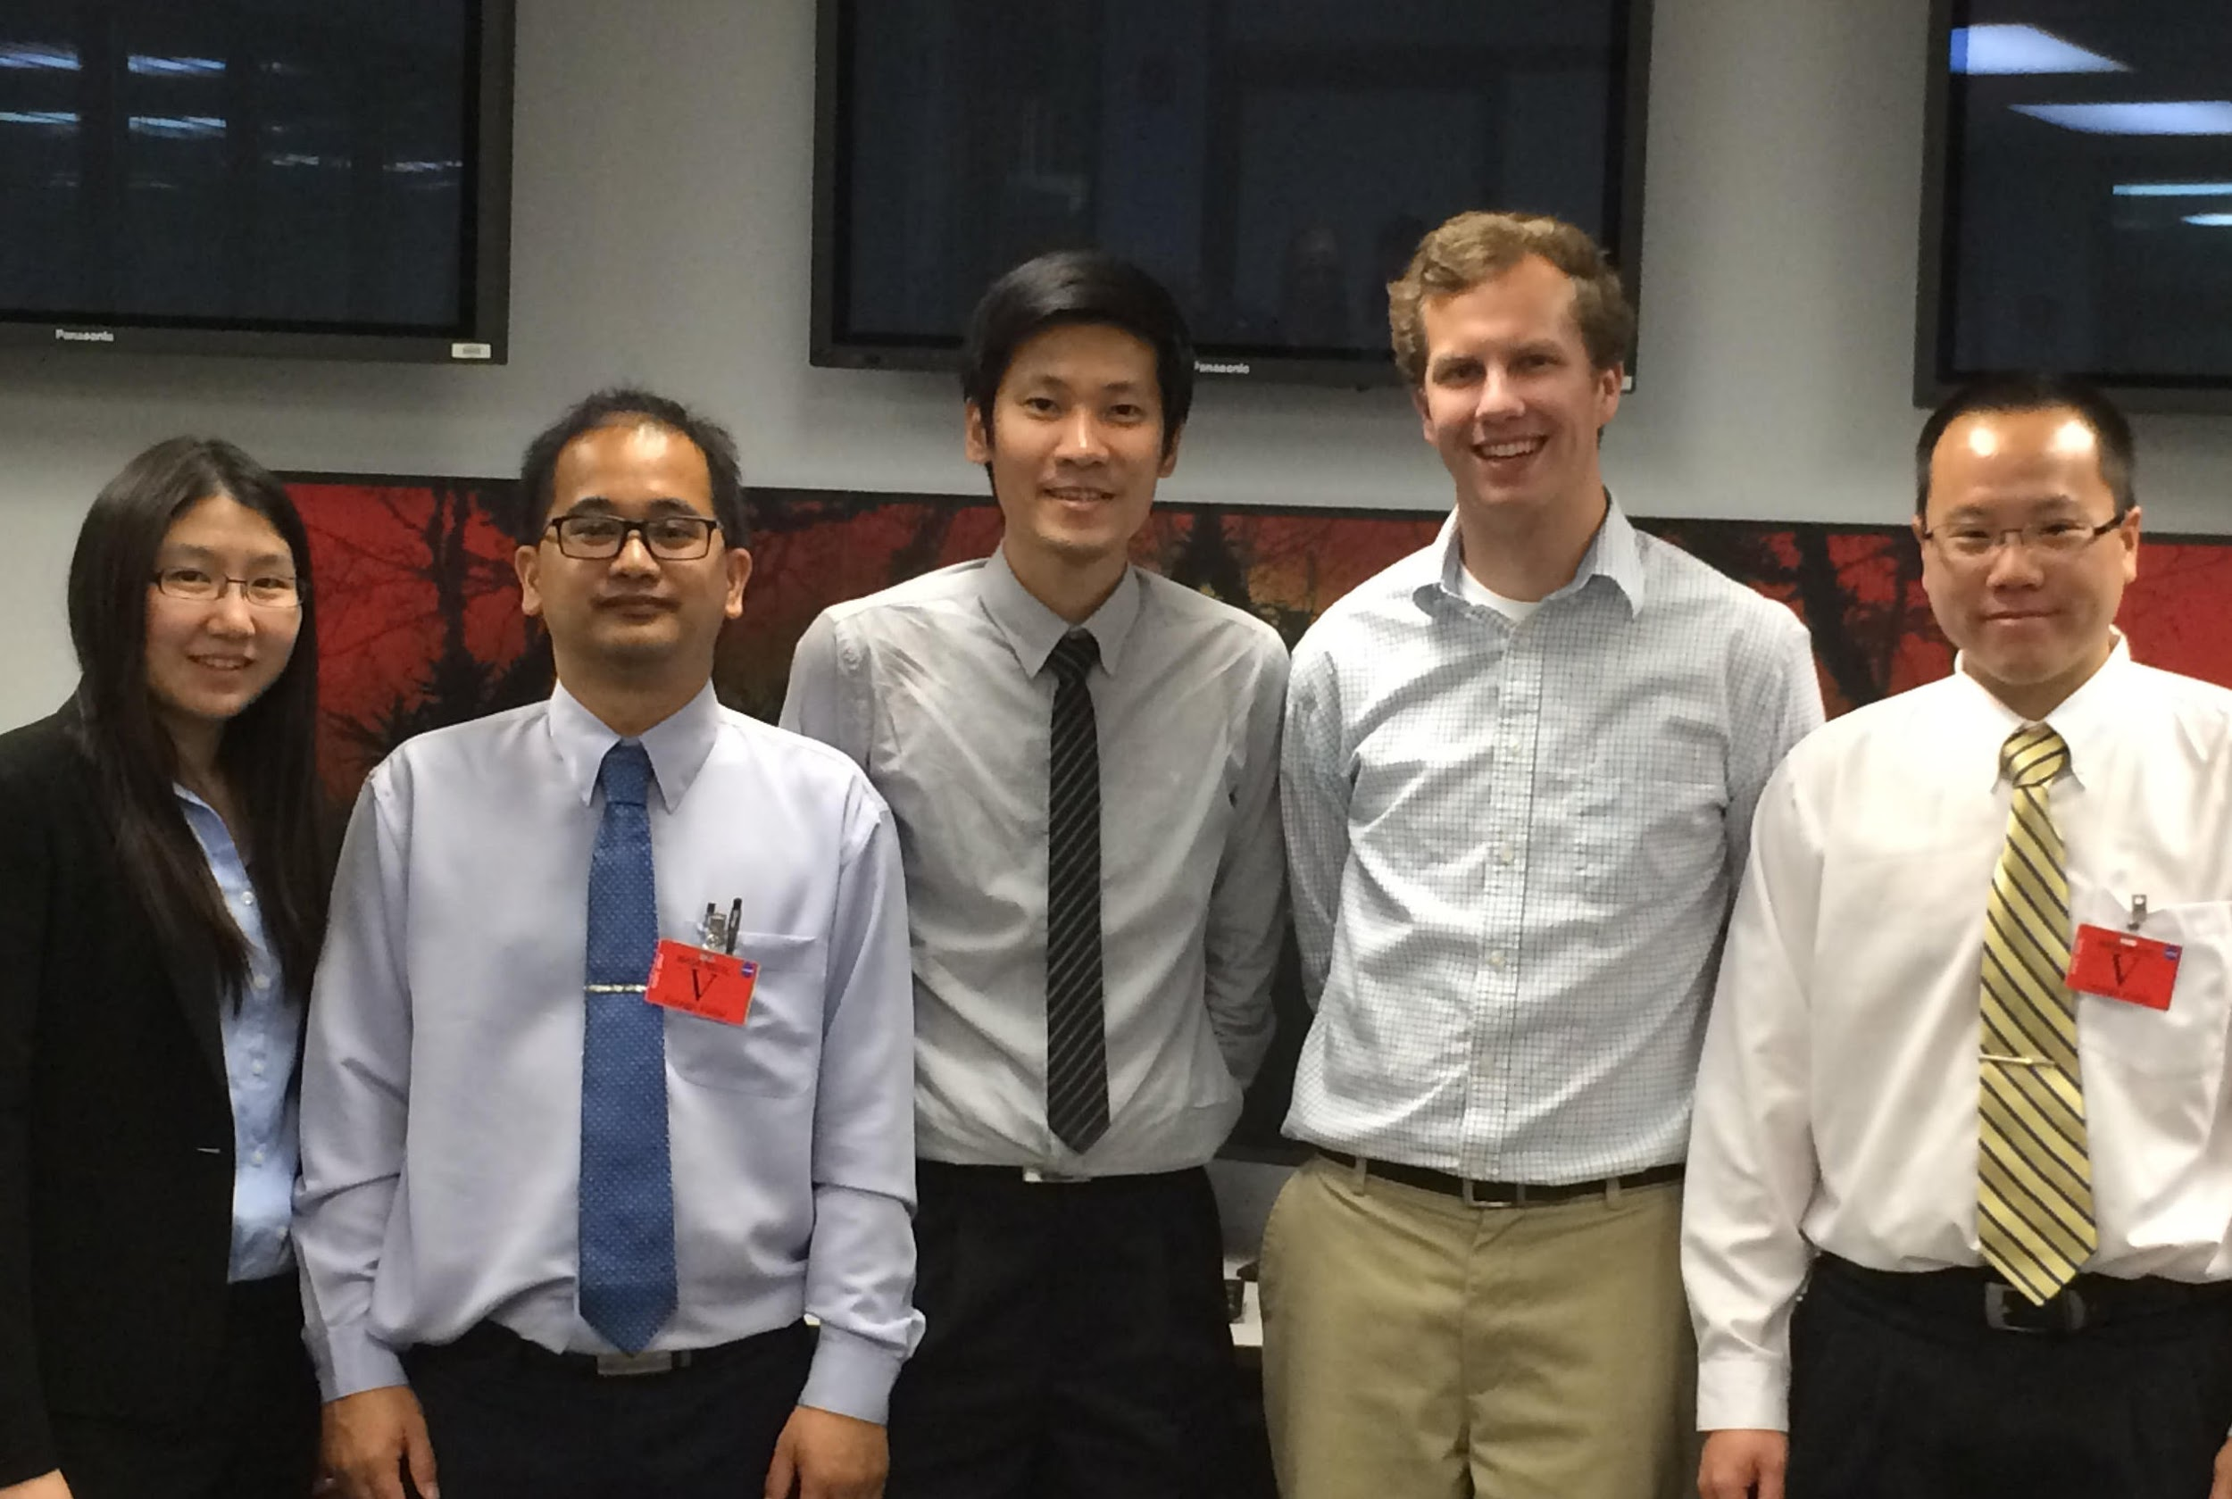
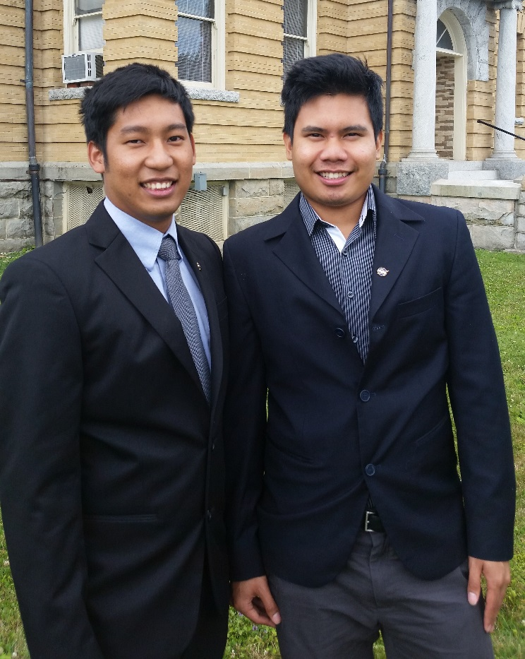

Thailand Disaster
Thailand Agriculture
(Top left to right) Sean McCartney, Nobphadon Suksangpanya
(Bottom left to right) Chisaphat Supunyachotsakul, Srisunee Wuthiwongyothin
(Left to right) Chayanit Choonwattana, Watanyoo Suksa-ngiam, Komsan Rattanakijsuntorn, Tim Klug, Arom Boekfah
(Left to right) Thanapat Vichienlux, Sahakait Benyasut
Atipat Wattanuntachai

