Slide 1
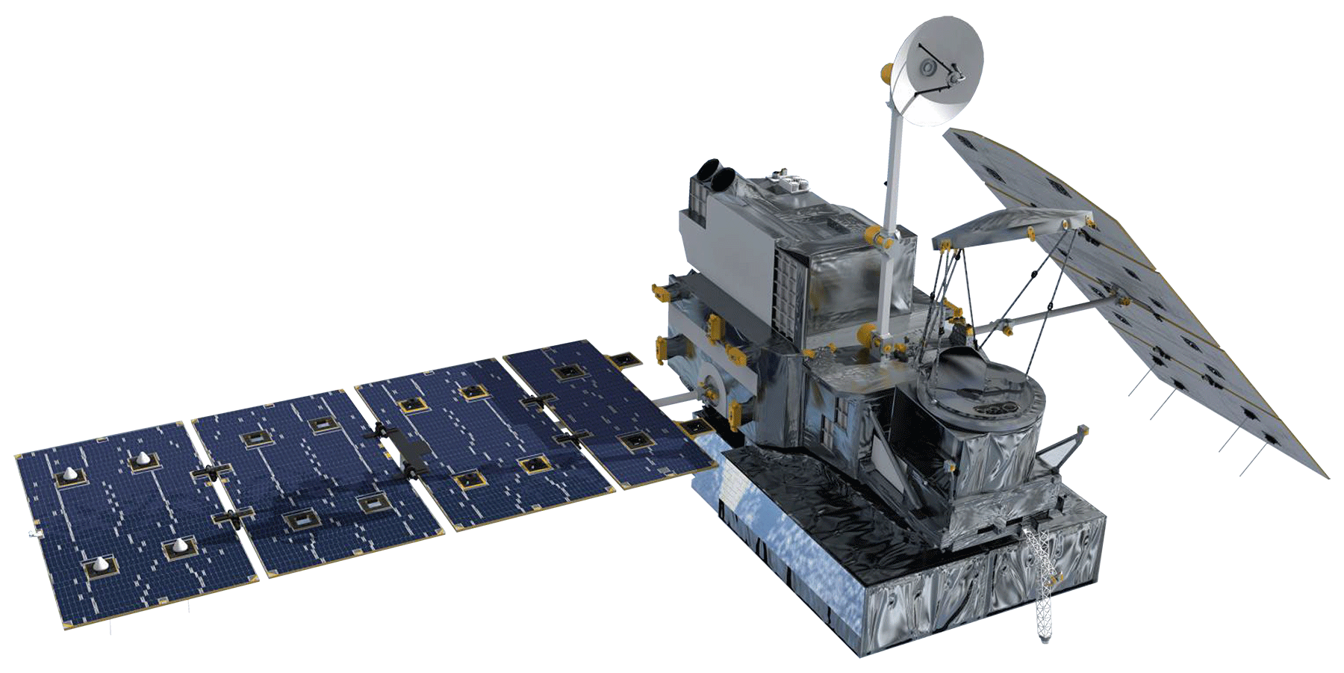
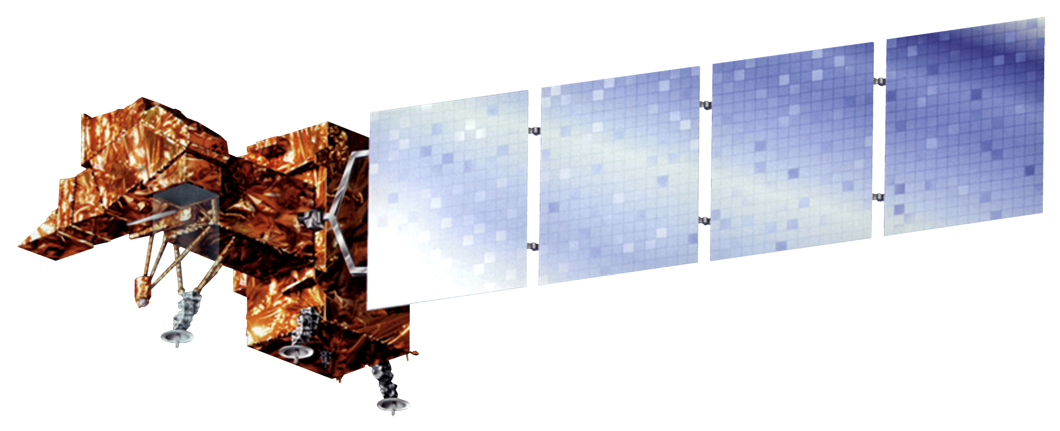
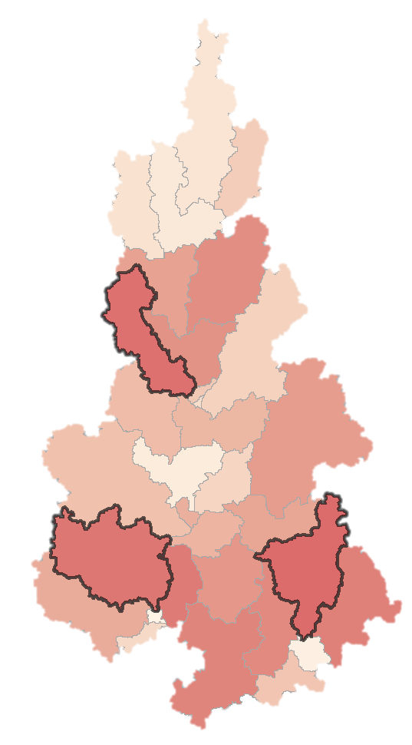
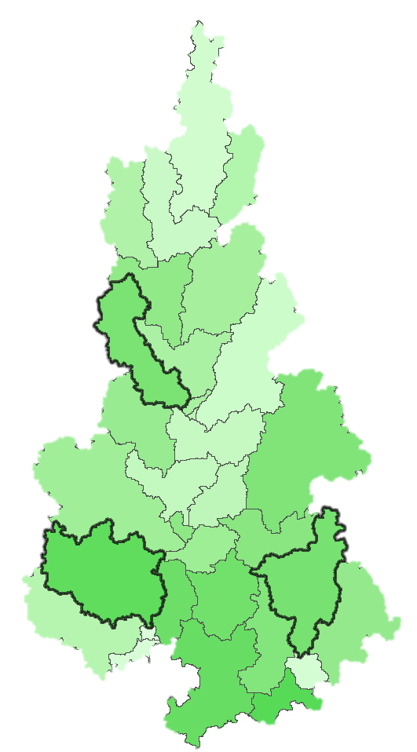
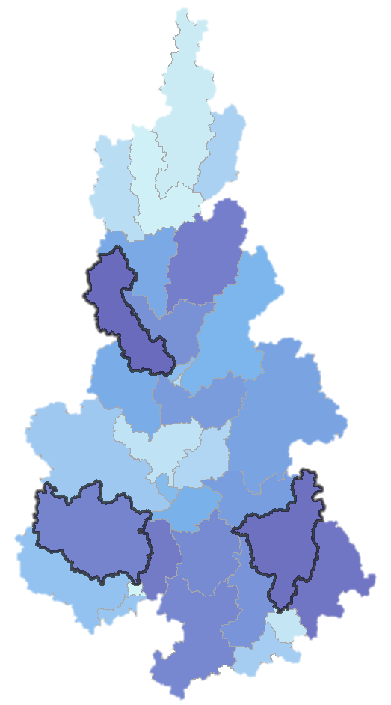
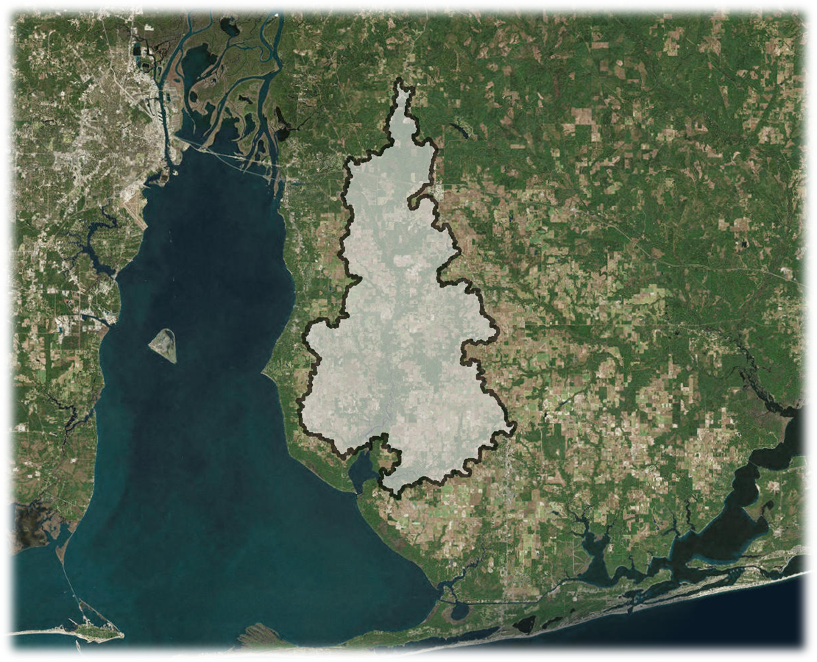
Using NASA Earth Observations to Evaluate Changes in Water Quality in the Weeks Bay Watershed
Abstract
Objectives
Weeks Bay is an estuarine system located along the southeastern shore of Mobile Bay in Baldwin County, Alabama. Its watershed encompasses approximately 149,000 acres of mixed-use land around the Fish and Magnolia Rivers. Weeks Bay and the surrounding coastal lands are currently protected as a National Estuarine Research Reserve (NERR) by the Alabama Department of Conservation and Natural Resources (ADCNR) and the National Oceanic and Atmospheric Administration (NOAA), but its watershed has been transformed from native forests and riparian land cover types to urban and agricultural areas over the last decade. These changes have resulted in increased stormwater runoff, flooding, soil erosion, and nutrient loading from the watershed into Weeks Bay. This project used NASA Earth observations from the Shuttle Radar Topography Mission (SRTM), Global Precipitation Measurement (GPM) Integrated Multi-satellite Retrievals for GPM (IMERG), and Landsat 7 Enhanced Thematic Mapper Plus (ETM+) along with ancillary data as inputs into the Soil and Water Assessment Tool (SWAT), which modeled the impacts of land use and land cover on water quality in Weeks Bay from January 2014 to January 2018 and forecasted possible future implications given continued land cover change. The SWAT model was also used to highlight sub-watersheds that impact water quality the most in order to prioritize them for conservation efforts. The outputs were then compared to a previous model created by an independent engineering firm that did not incorporate NASA precipitation data. The Weeks Bay NERR will use the findings of this project to support its watershed management and use of NASA Earth observations in future studies.
Identify sub-watersheds of special concern for prioritizing conservation efforts aimed at improving water quality in Weeks Bay
Demonstrate how to collect data from NASA Earth observations to contribute to the knowledge base of the Weeks Bay NERR
Conduct a comparative analysis of a previous SWAT model derived from in situ data to a SWAT model informed primarily by NASA Earth observations
Earth Observations
Landsat 7 ETM+
GPM IMERG
SRTM
Results
Methodology
NASA EO- Derived SWAT Outputs
Previous SWAT Outputs
SWAT Model
Soil Data SSURGO
Weather Data
Precipitation GPM IMERG Data
In situ Data Validation
SWAT Model
Thompson Engineering Data
C-CAP Land Cover & Use Data
Comparative Analysis
Sub-Basin Water Quality Impairment Risk Maps
8.2
29.6
30.5
Weeks Bay Water Resources
N
0.0
2.0
3.0
Phosphorus
kg/ha
Sediment
t/ha
Nitrogen
kg/ha
0
km
20
Overlay Showing Sub-Basins at Highest Risk
Study Area
Conclusions
Our simple model successfully identified sub-basins of concern for improving water quality.
Further calibration and validation would improve the model and increase its utility for modeling water quality parameters throughout the Weeks Bay Watershed.
This kind of modeling approach could be valuable to the Weeks Bay NERR in their efforts to manage and protect the estuary.
NASA Earth observations could fill in gaps in the Weeks Bay NERR’s current monitoring program.
N
Weeks Bay
Watershed
0
12.5
km
Project Partner
Mobile Bay
Alabama Department of Conservation and Natural Resources, Weeks Bay National Estuarine Research Reserve
Team Members
Acknowledgements
Dr. Scott Phipps, Weeks Bay National Estuarine Research Reserve
Sarah Johnston, Weeks Bay National Estuarine Research Reserve
Angela Underwood, Weeks Bay National Estuarine Research Reserve
Eric Brunden, Weeks Bay National Estuarine Research Reserve
Joe Spruce, Science Systems and Applications, Inc.
Dr. Kenton Ross, NASA Langley Research Center
Dr. Ibrahim N. Mohammed, Science Applications International Corporation
Bernard H. Eichold II, M.D., Dr. P.H., Mobile County Health Department
Madison Murphy, NASA DEVELOP
Kathrene Garcia, NASA DEVELOP
Vanessa Van Auken
Project Lead
Dillon Blankenship
Michelle Carver
Ara Metz
Alabama – Mobile | Spring 2019

