Slide 1
Texas and Arizona Ecological Forecasting
Utilizing NASA Earth Observations to Monitor and Manage Ocelot Habitat Loss
Daryl Ann Winstead (Project Lead)
Christina Fischer
Amberle Keith
Kaushik Narasimhan

Slide 2
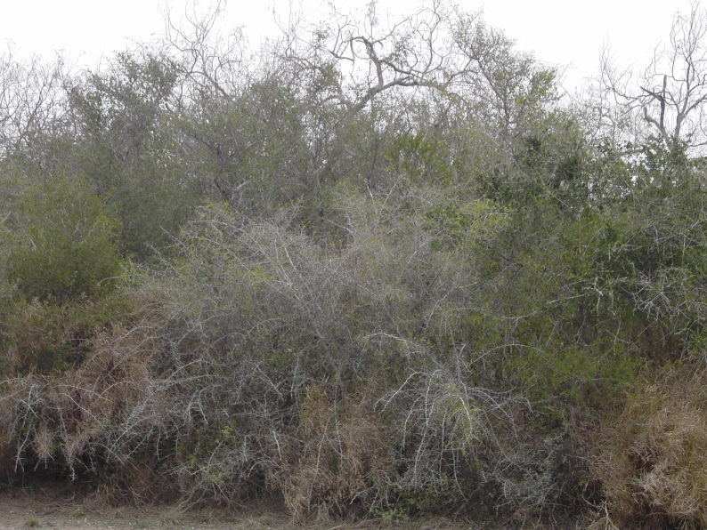
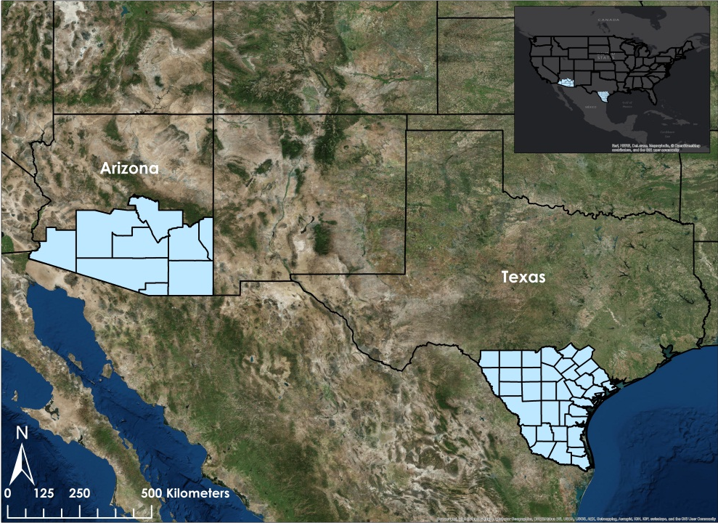
Study Area
January-March encompasses the dry season for these regions
Years: 1996-2014
Thornscrub
Source: USDA
Notes:
Data taken from 1996, 2005, and 2014 in Jan-Mar, +/- a month for cloudcover
Desired ocelot habitat: desert scrub, thornscrub, dense canopy cover

Slide 3
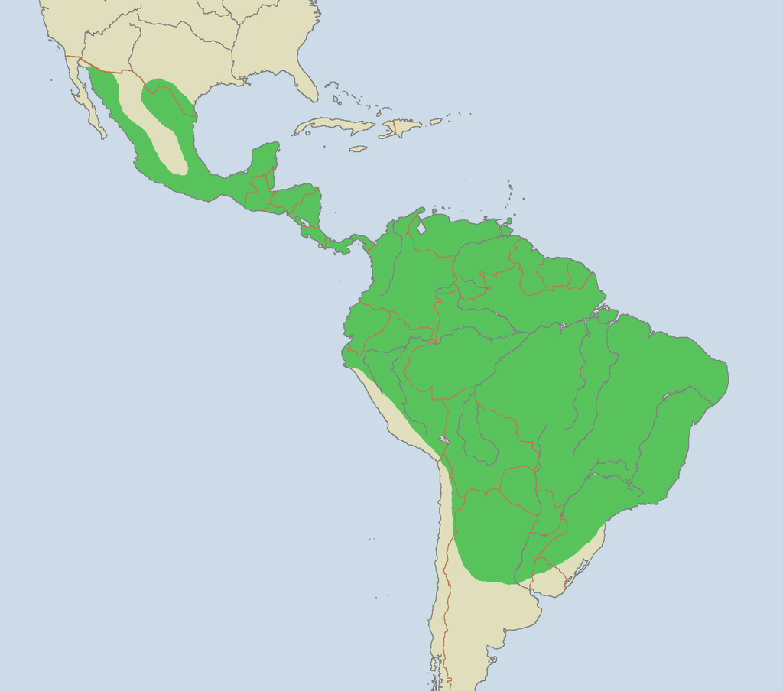
Background
Large historical range
Fewer than 100 ocelots in the United States
Largest remaining populations exist in refuges and in private ranches in southern Texas
Source: Brion VIBBER, Wikimedia commons
Notes:
Range extended from Argentina into Arizona, Texas, Louisiana, and Arkansas. Map displays current range
"Ocelot range". Licensed under CC BY-SA 3.0 via Wikimedia Commons - https://commons.wikimedia.org/wiki/File:Ocelot_range.png#/media/File:Ocelot_range.png
Laguna Atascosa National Wildlife Refuge (LANWR), surrounding wilderness refuge areas, and private ranchers are primarily responsible for conservation of remaining populations.

Slide 4
Background
Prefer dense, closed canopy thornscrub communities
Solitary and territorial
Small, yearly litters with long gestation period
Two subspecies: L. p. albescens in Texas and L. p. sonoriensis in Arizona
Source: USFWS
Notes:
Closed canopy is over 90% canopy cover. Dense thornscrub consists of species like honey mesquite.
Males maintain larger territories encompassing smaller female territories.
Ocelots are also elusive and nocturnal. Reproductive strategy makes them vulnerable to outside pressures.
The subspecies are related to congeners in different Mexican populations.

Slide 5
Community Concerns
Fastest growing counties in Texas contain ocelot habitat
95% of ocelot habitat has been destroyed
Remaining populations remain small and isolated
Privately-owned lands and partnerships with stakeholders vital to conservation
Source: USFWS
Notes:
16 counties in southern Texas that represent the majority of ocelot habitat are among the fastest growing counties in Texas, specifically Cameron and Willacy counties which are expected to grow by more than 80% in population.
Human encroachment and land conversion are the greatest pressures on ocelot habitat
Inbreeding depression, reduced reproductive success, and increasing competition from other mesopredators. Inbreeding depression leads to a host of genetic issues, including lack of disease resistance, and expression of harmful genes, infertility
The bobcat has an overlapping niche, but is much more of a generalist. Competition for food sources and territiories may be overwhelming for an already taxed population
Private lands on large ranches with prime ocelot habitat are a focus of conservation efforts.

Slide 6
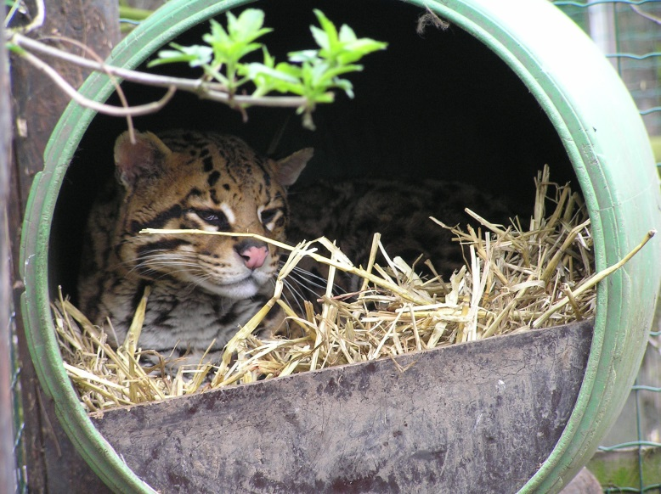
Project Partners
Secretaria de Medio Ambiente y Rescusos Naturales (SEMARNAT)
Caesar Kleberg Wildlife Wildlife Research Institute at Texas A&M University-Kingsville
The Denver Zoo
South Texas Refuge Complex
Texas Department of Transportation
Pittsburg Zoo & PPG Aquarium
East Wildlife Foundation
Photo by Chordata~cmmonswiki.
Notes:
Photo from Wikimedia Commons: https://commons.wikimedia.org/wiki/File:Ocelot_in_Uilen-_en_Dierenpark_De_Paay.JPG
For this project, we had a number of partners which included the Pittsburg Zoo & PPG Aquarium, the Caesar Kleberg Wildlife Research Institute at Texas A7M University-Kingsville, The Denver Zoo, the South Texas Refuge Complex, the Texas Department of Transportation, the Secretaria de Medio Ambiente y Rescusos Naturales (SEMARNAT), and the East Wildlife Foundation.

Slide 7
Objectives
Identify areas of potential ocelot habitat for conservation purposes
Study impact of urban and agricultural growth on ocelot habitat
Study impact of road development on ocelot populations
Source: USFWS
Notes:
The Objectives are to:
•Identify areas of potential ocelot habitat for conservation purposes
•Study impact of urban and agricultural growth on ocelot habitat
•Study impact of road development on ocelot populations

Slide 8
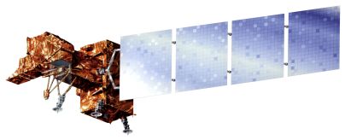
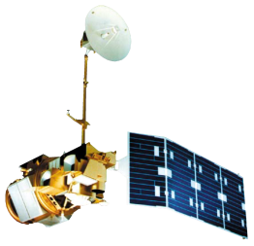
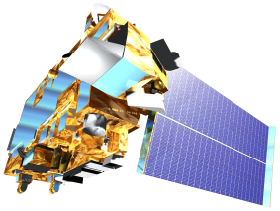
NASA Satellites & Sensors
Landsat 8
Operational Land Imager
Land Cover Classification
Landsat 7
Enhanced Thematic Mapper Plus
Land Cover Classification
Landsat 5
Thematic Mapper
Land Cover Classification
Terra
MODIS & GDEM
NDVI & Stream Network
Notes:
Landsat 8 Operational Land Imager, Landsat 7 Enhanced Thematic Mapper Plus, and Landsat 5 Thematic Mapper data were downloaded from USGS GloVis and used in ArcMap 10.2.1 to derive land cover classifications. Terra MODIS data were downloaded using a python package provided by the DEVELOP program and used to derive Normalized Difference in Vegetation Index. Terra Aster-based Global Digital Elevation Model data were downloaded from USGS Earth Explorer and used to derive stream networks within the study area.

Slide 9
Methodology
Land Cover Classification
Maximum Entropy Model
Land Use & Land Cover Change
Habitat Percent Cover Map
Habitat Probability Map
Proximity Risk Map
Notes:
Land cover classification was derived during 1996, 2005, and 2014. Normalized Difference in Vegetation Index (NDVI) was derived using Terra MODIS data and used to error check the areas of vegetation for the land cover classification in years 2005 and 2014. The land cover classification layers were used in a time series in order to assess land use and land cover change which aided in producing the Habitat Percent Cover Map. The land cover classification layer for 2014, along with in situ data, was used in Princeton Maximum Entropy model in R software which derived outputs which aided in the use of Fuzzy Logic in ArcMap 10.2.1 which then created the Habitat Probability Map. The Proximity Risk Map was then created by using multiband buffers which were then used to access the distance to road networks.

Slide 10
Results
This section in under construction. This slide will contain the Habitat Percent Cover Map.

Slide 11
Results
This section is under construction. This slide will contain the Habitat Probability Map.

Slide 12
Results
This section is under construction. This slide will contain the Proximity Risk Map.

Slide 13
Conclusions
This section is under construction.

Slide 14
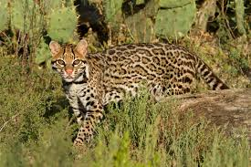
Image Credit: U.S. FWS
Errors & Uncertainties
This section is under construction.
Limited point data
Ground verification
Notes:
Point data on exact ocelot locations is very limited due to the information being sensitive. Without ground truthing, it is unsure how accurate the team’s derived information and maps are.

Slide 15
Future Work
This section is under construction.
Expanding study area
Other endangered species
Notes:
Expanding study area into the coastal areas of Mexico and then through Central America and eventually into South America. Using similar methods to look into suitable habitat for other endangered species.

Slide 16
Advisors
Dr. Jeffrey Luvall, NASA at NSSTC
Dr. Robert Griffin, University of Alabama in Huntsville, AL
Partners
Ken Kaemmerer, Pittsburg Zoo & PPG Aquarium
Dr. Joseph Gaspard, Pittsburg Zoo & PPG Aquarium
Dr. Michael Tewes, Caesar Kleberg Wildlife Research Institute at Texas A&M University-Kingsville
Humberto Perotto, Caesar Kleberg Wildlife Wildlife Research Institute at Texas A&M University-Kingsville
Nanette Bragin, The Denver Zoo
Mitch Sternberg, South Texas Refuge Complex
Dr. John Young Jr., Texas Department of Transportation
Dr. Arturo Caso, SEMARNAT
Dr. Tyler Campbell, East Wildlife Foundation
Others
Timothy Klug, NASA DEVELOP

Slide 17
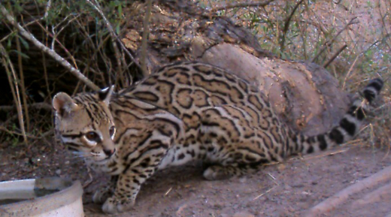
Questions?
Notes:
Are there any questions at this time?

