Slide 1
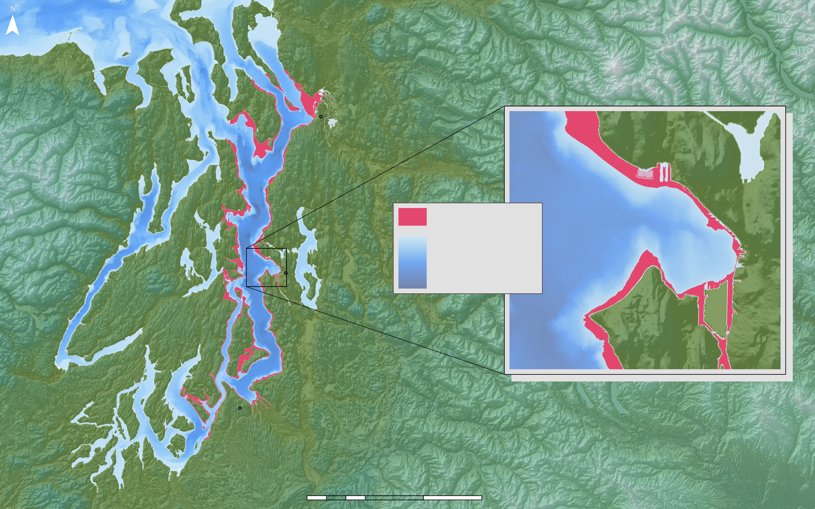
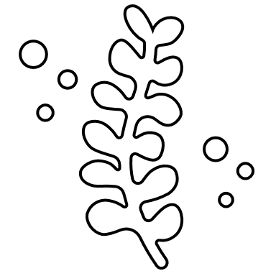
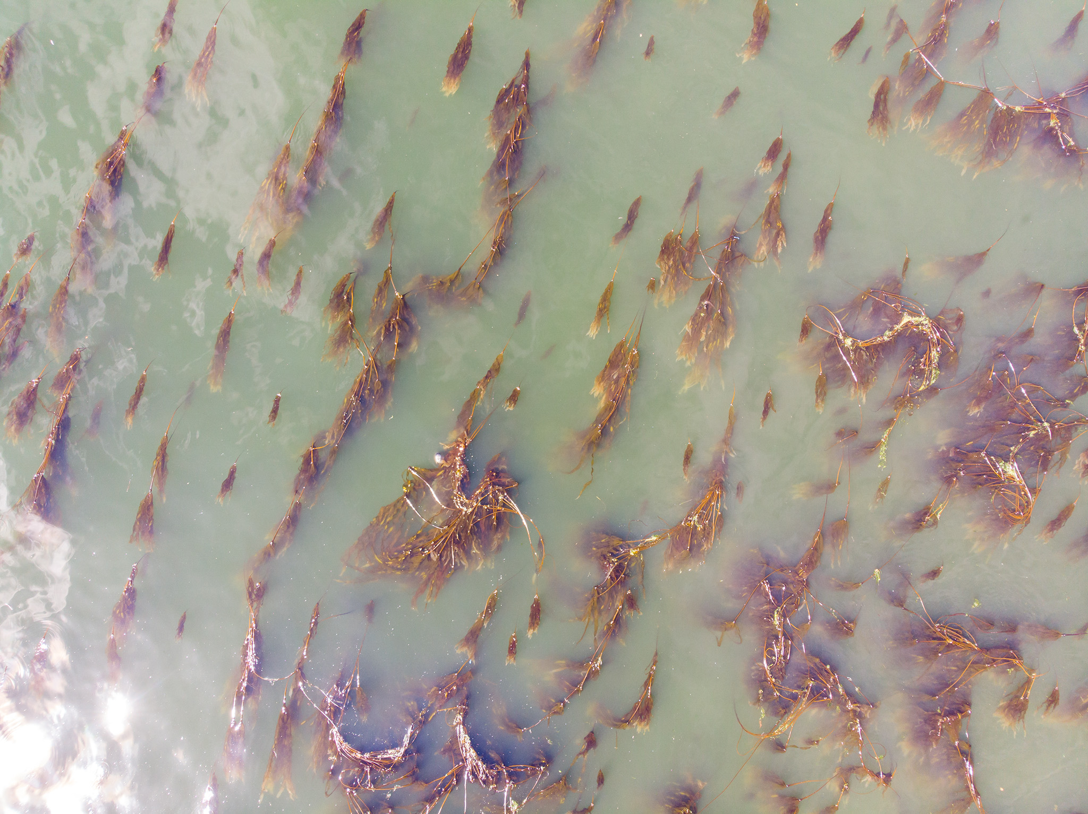
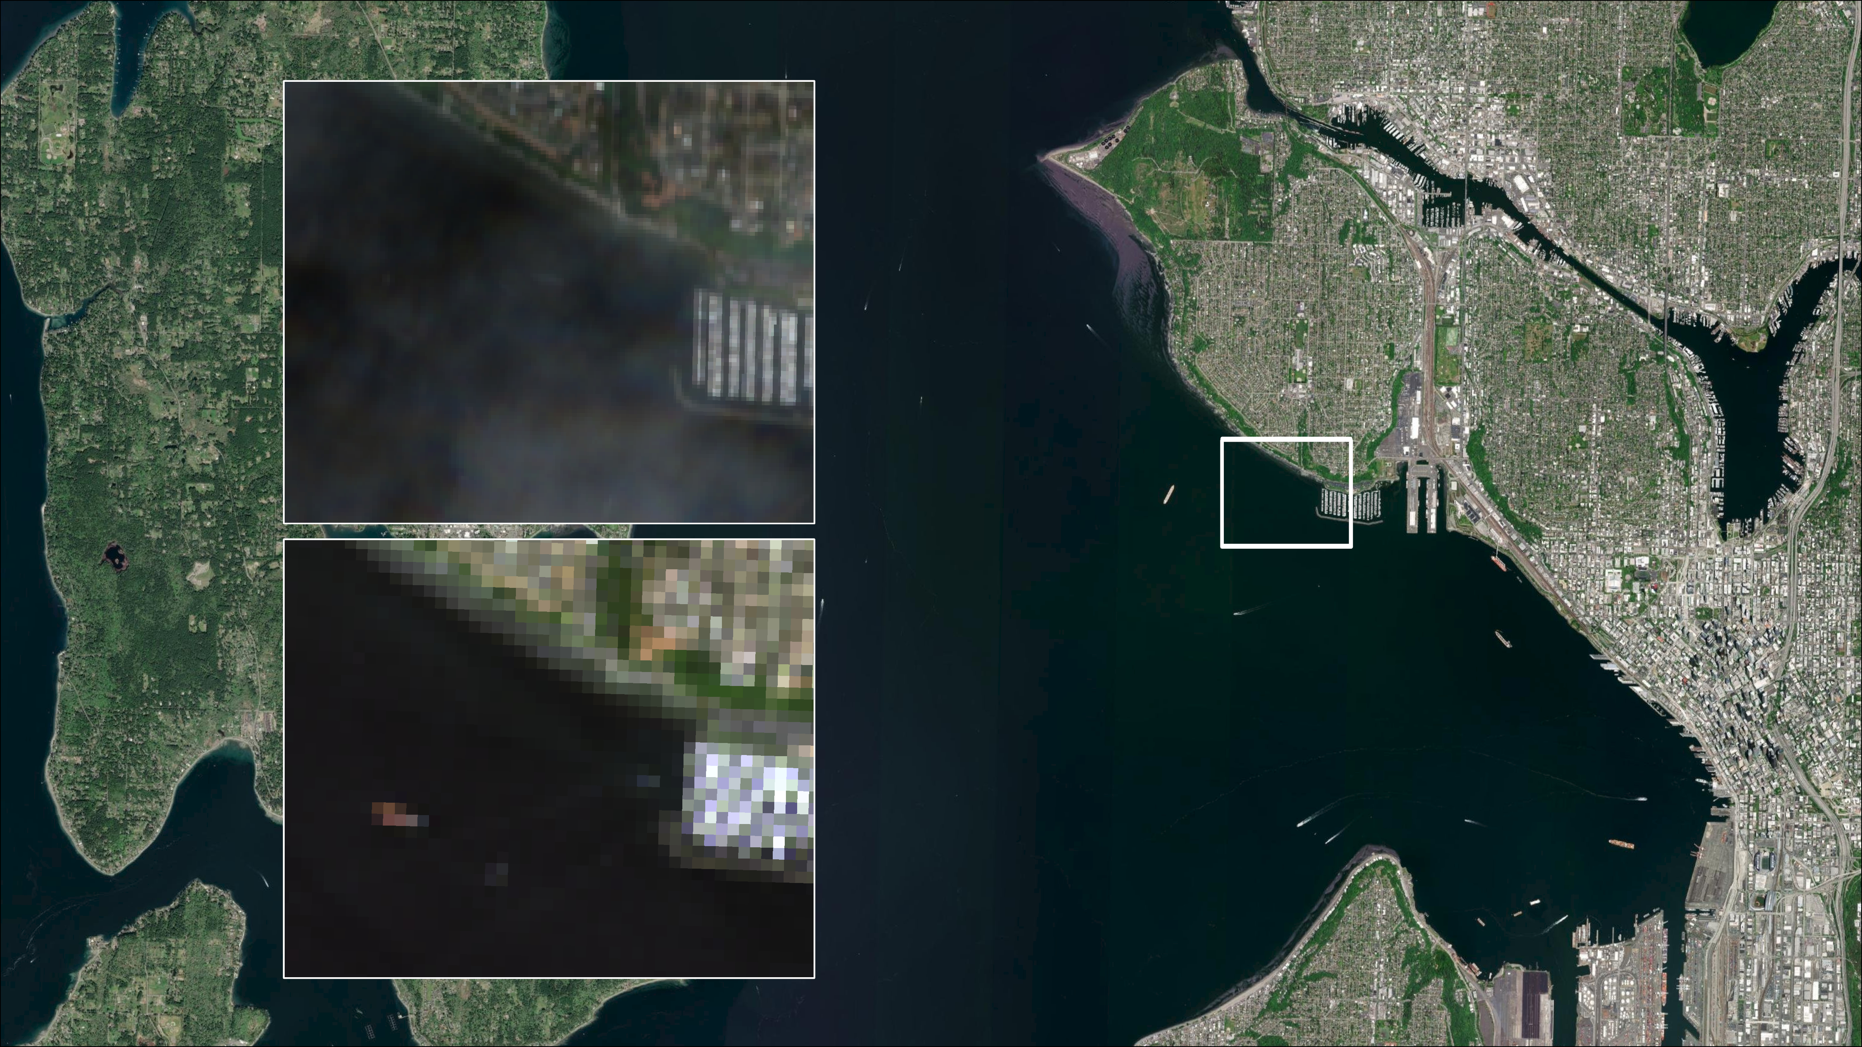
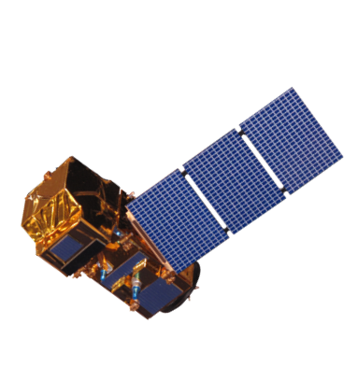
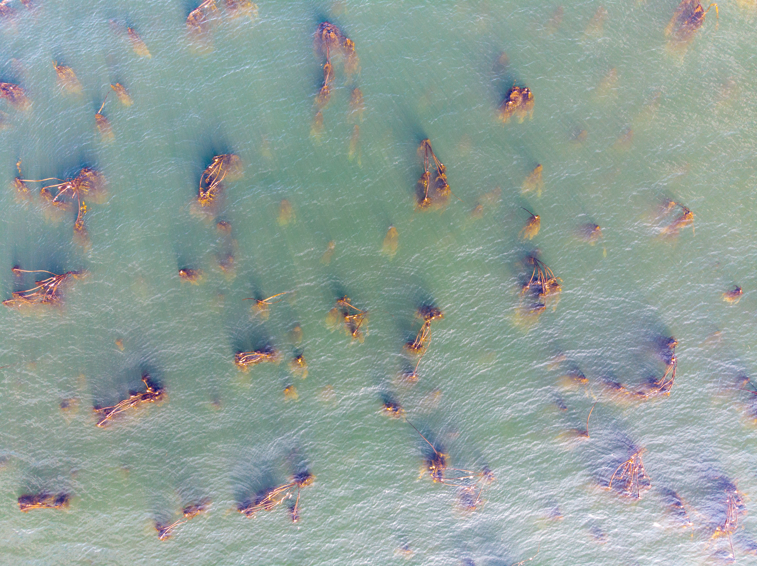
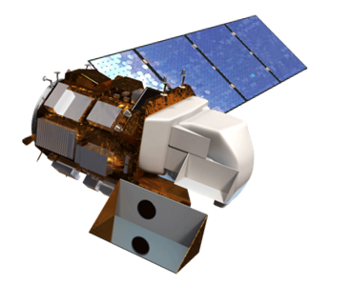
Using Earth Observations to Map Bull Kelp in the Puget Sound, Washington, to Support Conservation and Restoration
Why Map Kelp?
Puget Sound Water Resources
Kelp performs crucial ecosystem functions and is of cultural and historical significance among Coast Salish peoples.
Bull kelp extent is declining in the Puget Sound.
Gaps in local research on bull kelp trends and abundance hinder conservation efforts.
Everett
Study Area
Elliott Bay
0'
Seattle
Water Depth
-967'
Seattle
Tacoma
0
10
20
30
Miles
Basemap credit to Finlayson, D. P. (2005)
Clouds, tides, strong currents, and turbidity limit kelp detection.
- 3.98 ft (MLLW)
Sentinel-2 MSI (10m)
+ 9.71 ft (MLLW)
Landsat 8 OLI (30m)
Map Data: NASA, ESA, MAXAR, Earthstar Geographics
Satellite Illustrations: ESA, NASA/Goddard Space Flight Center Conceptual Image Lab
Takeaways
Partners:
Advisors:
Fellow:
Team Members:
Kathleen Hurley – Port of Seattle
Jon Sloan – Port of Seattle
Cinde Donoghue – WA Department of Natural Resources
Nicholas Young – Colorado State University
Peder Engelstad – Colorado State University
Dr. Paul Evangelista – Colorado State University
Dr. Anthony Vorster – Colorado State University
Dr. Catherine Jarnevich – Colorado State University
Sarah Hettema – Science Systems and Applications, Inc.
1
The rigid timing of Landsat 8 and Sentinel-2 imagery acquisition time is an important limitation on mapping bull kelp.
2
Higher resolution sensors and more frequent revisit times can help overcome many of the limitations of remotely sensing kelp extent.
3
While there are limitations, remote sensing can help support the monitoring of kelp, particularly when combined with field and aerial surveys.
Mike Hitchner
(Project Lead)
Lily Oliver
Sofia Fall
Lyndsay Zemanek
Colorado – Fort Collins
Notes:
Imagery Credits:
Drone images: Michael Hitchner/DEVELOP team
Satellite illustrations: ESA, NASA/Goddard Space Flight Center Conceptual Image Lab
"Why Map Kelp" icons: Microsoft PowerPoint
Kelp art: Lily Oliver/DEVELOP team
Basemap of Study Area Map: Finlayson D.P. (2005) Combined bathymetry and topography of the Puget Lowland, Washington State. University of Washington, (http://www.ocean.washington.edu/data/pugetsound/)

