Slide 1
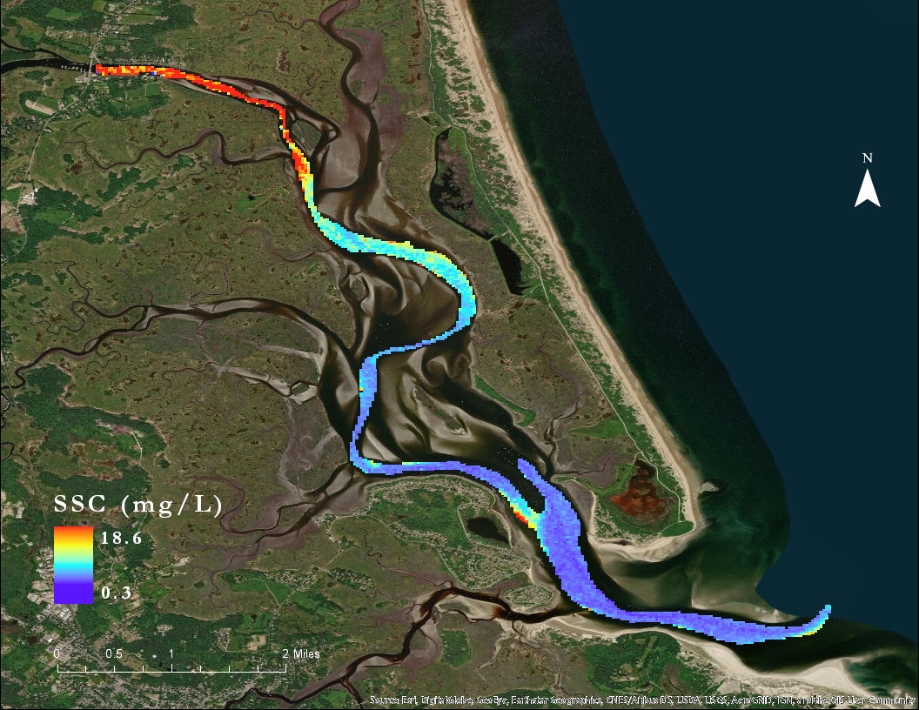
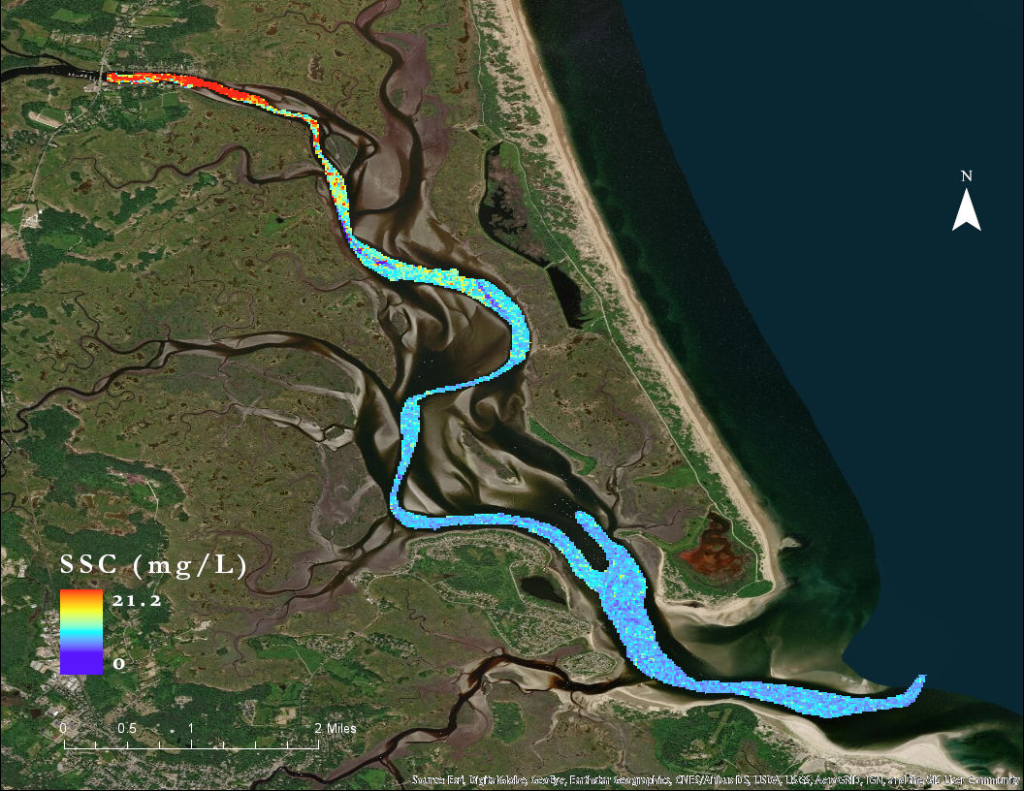
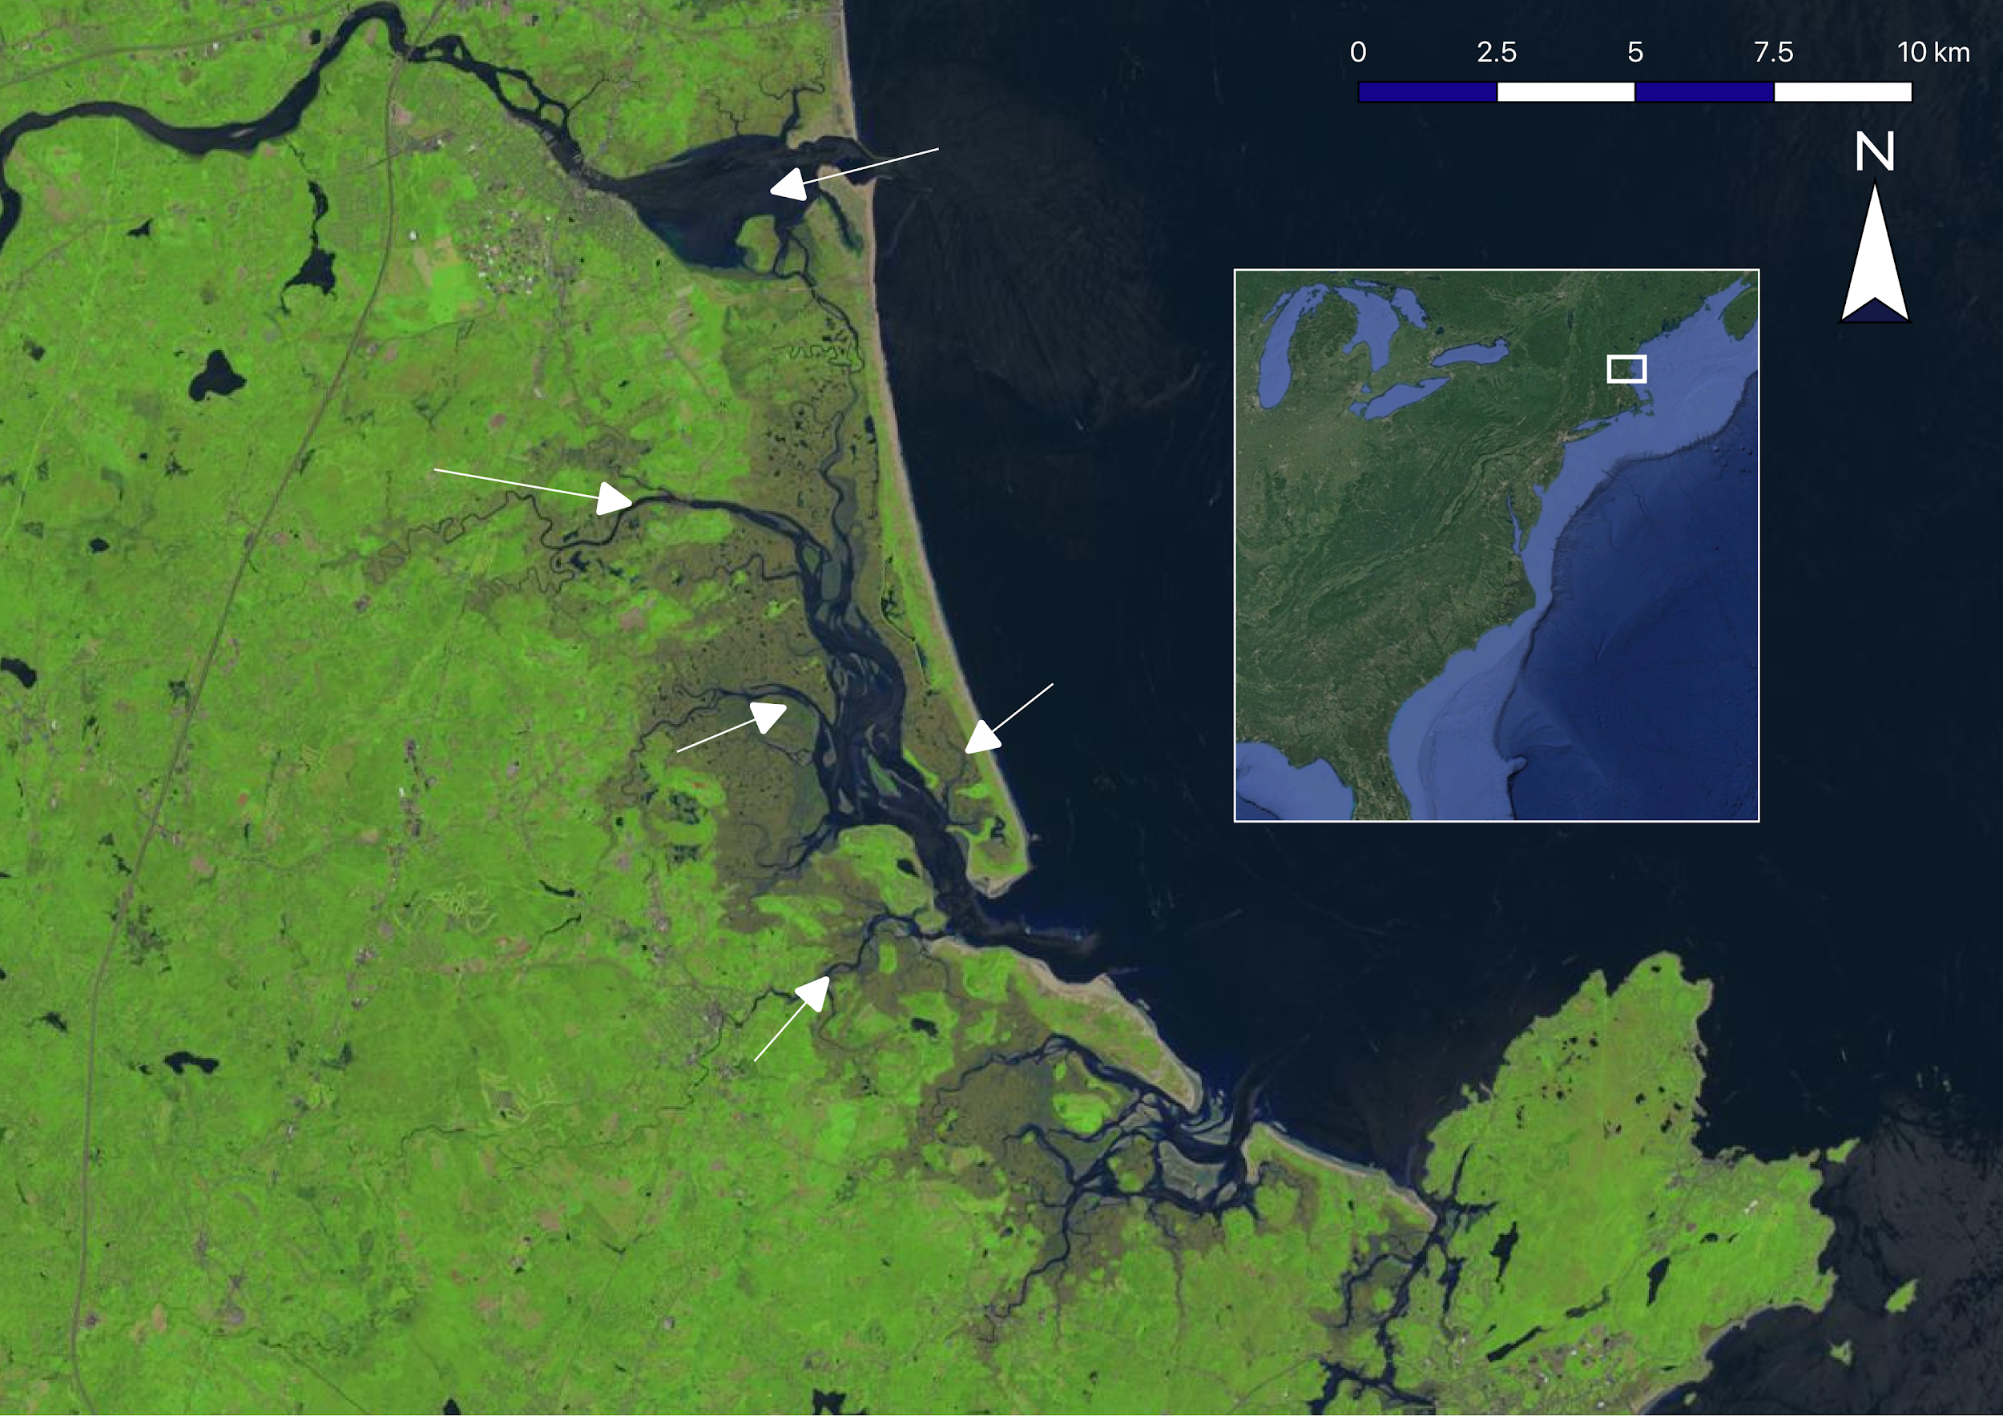
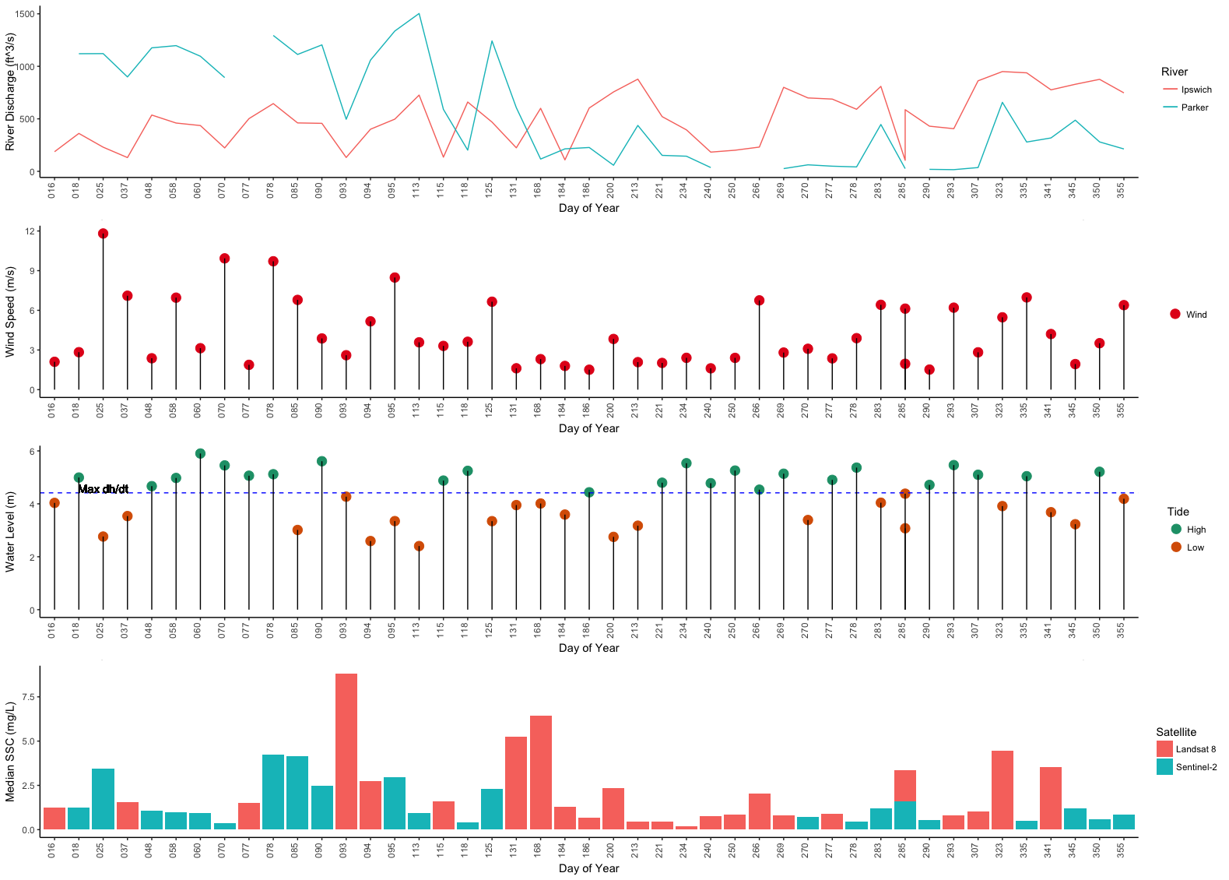
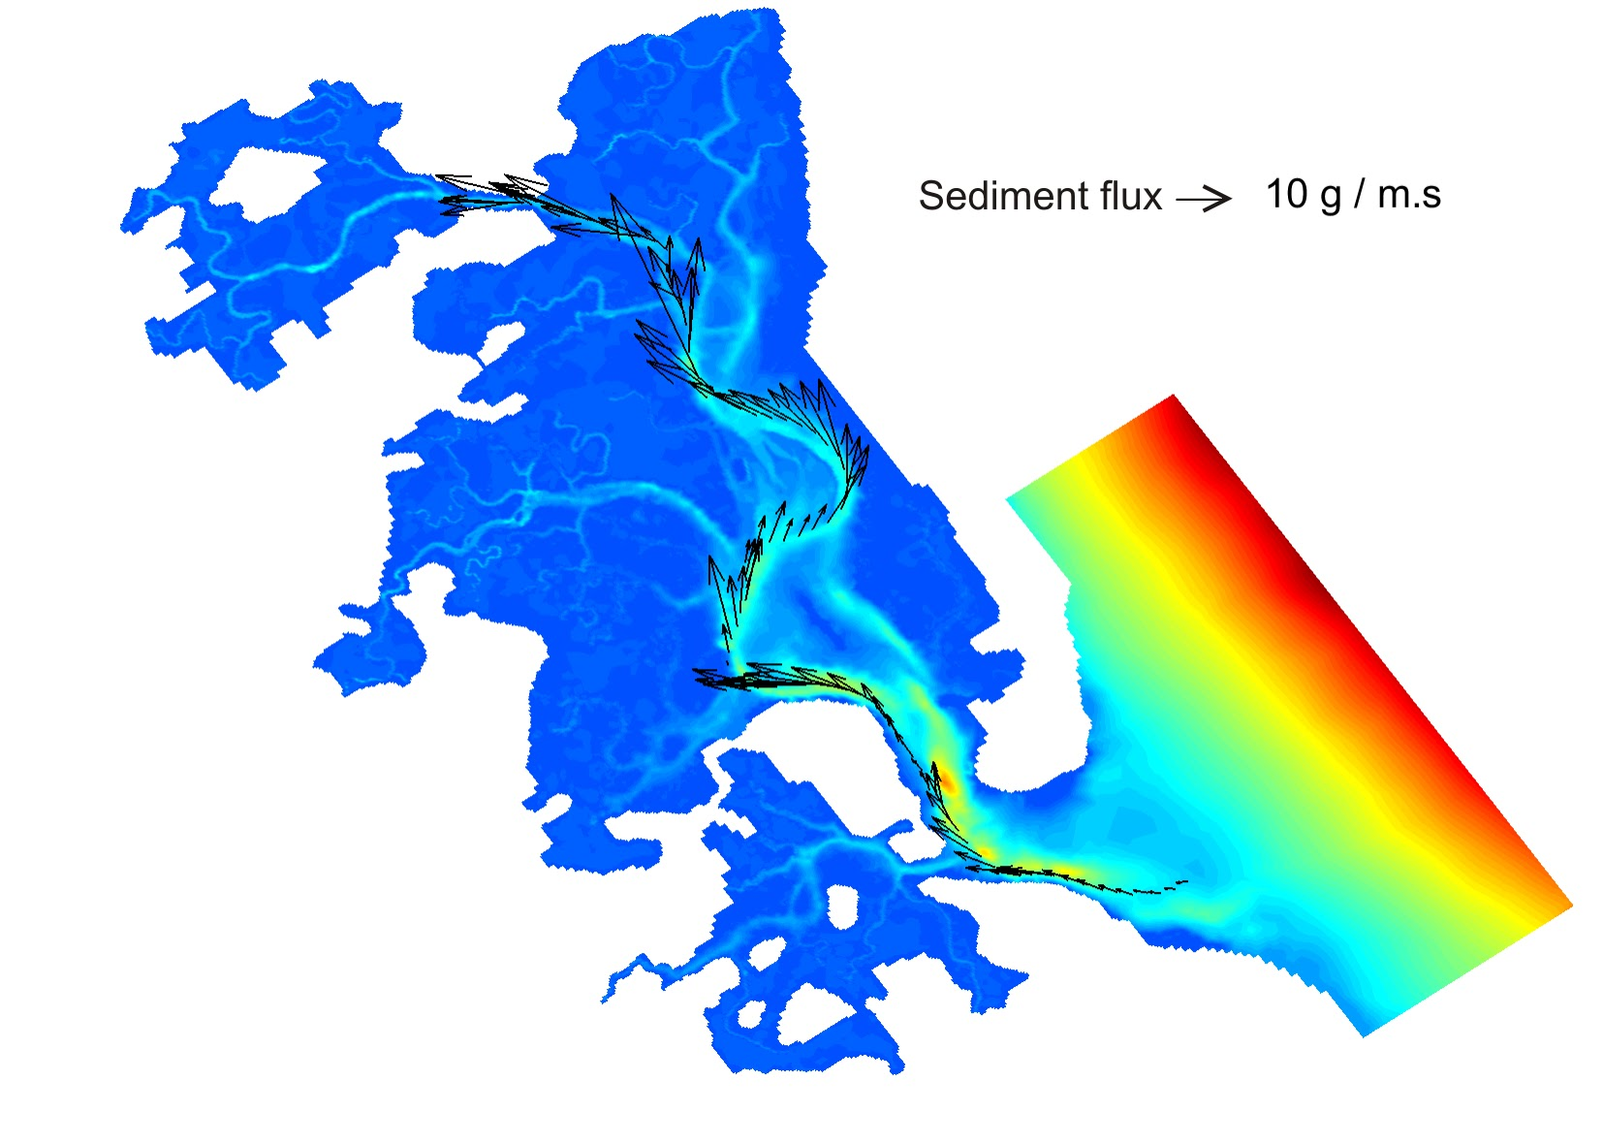
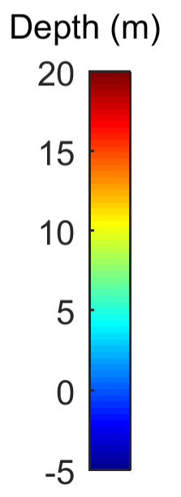
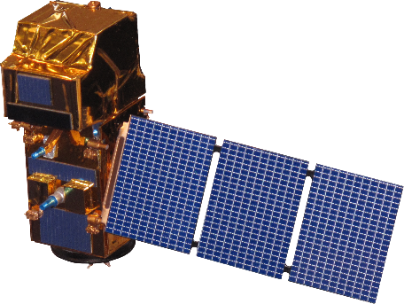
Employing Remote Sensing Techniques to Quantify Sediment Supply and Evaluate Marsh Vulnerability in the Plum Island Estuary
Abstract
Methodology
The Plum Island Estuary (PIE) in Massachusetts is New England’s largest salt marsh. This dynamic ecosystem plays an important role in the surrounding communities by providing ecosystem services and acting as a center for education, research, and recreation. However, marshes around the world are threatened by sea level rise. As the equilibrium between sediment supply, erosion rates, and vegetation growth is unbalanced by rising waters, marshes are liable to recede. Because sediment is so crucial, researchers use sediment budgets as a metric to assess PIE’s vulnerability to rising seas; however, established data collection methods are limited in scope. The project employed five years of imagery from Landsat 8 Operational Land Imager and three years of imagery from Sentinel-2 Multispectral Instrument, in conjunction with in situ data, to generate and refine a local algorithm that derives suspended sediment concentration from remote sensing reflectance. This information was used to generate a time series analysis, and a hydrodynamic model was used to analyze transport patterns and possible sediment sources, particularly the Merrimack River via coastal connectivity. Results of these analyses demonstrated that sediment in the estuary comes primarily from riparian rather than oceanic sources, making it unlikely that the Merrimack is a major sediment source. The use of remote sensing techniques will provide our partners at the US Geological Survey, US Fish and Wildlife Service, and Long Term Ecological Research Network, Plum Island Ecosystems LTER with higher spatial and temporal resolution data, which will allow for the development of more effective management practices.
Atmospheric correction
Algorithm development
Sediment flux estimation
Time Series analysis
Improved atmospheric correction with gains in SeaDAS
Developed an empirical algorithm in R and validated it with in situ data
Estimated sediment flux using Delft3D model
Conducted time series analysis to study what factors affect SSC
Results
February 6, 2017
February 17, 2018
Landsat 8
Sentinel-2
Study Area
Merrimack River
Parker River
Study Area
Rowley River
Plum Island
Atlantic Ocean
Ipswich River
Objectives
Improve algorithm to derive SSC from remote sensing reflectance
Create a time series displaying SSC change over the last 5 years
Quantify sediment flux in Plum Island Estuary using the Delft3D hydrodynamic model
Evaluate the Merrimack River as a source of sediment to Plum Island Estuary
Project Partners
US Geological Survey Woods Hole Coastal and Marine Science Center
Long Term Ecological Research Network Plum Island Ecosystems LTER
US Fish and Wildlife Service Parker River National Wildlife Refuge
Conclusions
Earth Observations
SSC is higher and more variable towards the Parker River at the northern part of the estuary.
SSC is influenced by river discharge and tidal level. Wind speed may affect SSC at the mouth of the estuary, but was not significant overall.
A higher number of in situ data points and a more refined mask allowed for more consistent retrieval of SSC.
A local algorithm relating turbidity to Rrs outperformed an established general turbidity algorithm for this area.
Landsat 8 OLI
16 day revisit time
30 m resolution
Sentinel-2 MSI
10 day revisit time
10-20 m resolution
Acknowledgements
Team Members
Dr. Neil Ganju, USGS
Dr. Anne Giblin, PIE LTER
Nancy Pau, USFWS
Dr. Cedric Fichot, Boston University
Dr. Sergio Fagherazzi, Boston University
Robert Russell, Merrimack River Watershed Council
John Macone, Merrimack River Watershed Council
Dr. Michael Dietze, Boston University
Xiaohe Zhang, Graduate Researcher
Carly Baracco, Undergraduate Researcher
Henrik Westerkam
Project Lead
Ruizhe Guo
Sydney Neugebauer
Linnea Smith
Plum Island Estuary Water Resources
Massachusetts - Boston | Summer 2018

