Slide 1
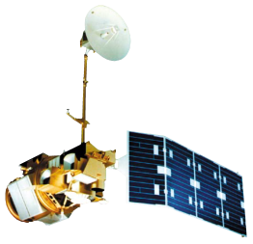
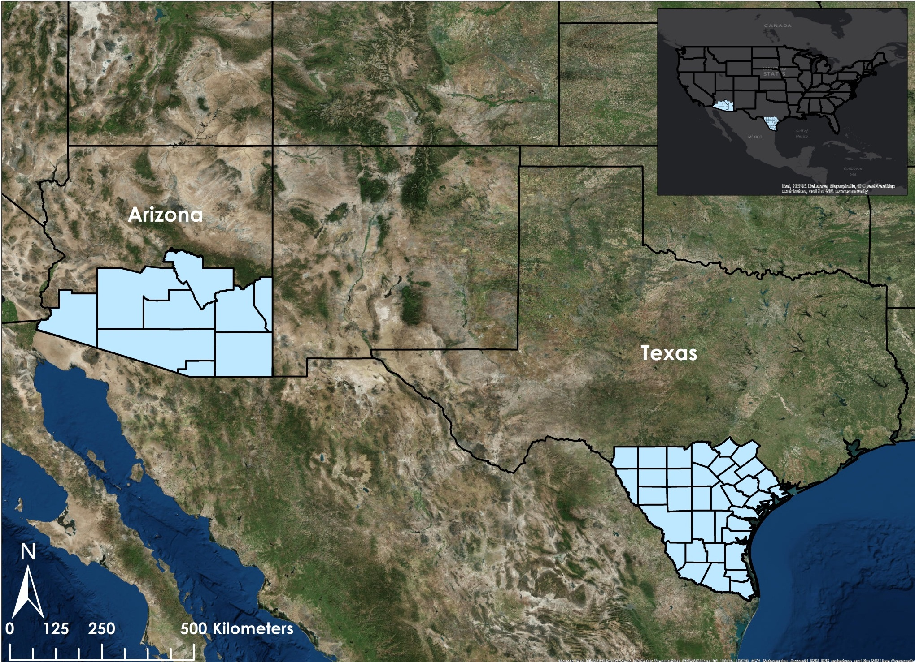
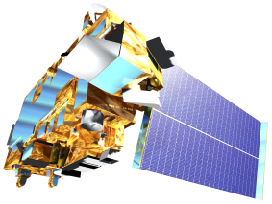
Texas and Arizona Ecological Forecasting
Utilizing NASA Earth Observations to Monitor and Manage Ocelot Habitat Loss
Daryl Ann Winstead (Project Lead), Kaushik Narasimhan, Christina Fischer, Amberle Keith
NASA DEVELOP National Program
Abstract
Objectives
Earth Observations
Placeholder: not finalized yet.
Identify areas of potential ocelot habitat for conservation purposes
Study impact of urban and agricultural growth on ocelot habitat
Study impact of road development on ocelot populations
Landsat 8 OLI
Landsat 5 TM
Terra MODIS, ASTER
Study Area (tentative figure)
Methodology (tentative figure)
Land Cover Classification
Maximum Entropy Model
Land Use & Land Cover Change
Habitat Probability Map
Proximity Risk Map
Habitat Percent Cover Map
Results
Use images.
Make sure that it has some sort of flow, that it makes sense. Show your results in a logical order.
No bullets.
Team Members
Conclusions
Project Partners
Use bullets.
Use complete sentences with periods.
Ken Kaemmerer, Pittsburg Zoo & PPG Aquarium
Dr. Joseph Gaspard, Pittsburg Zoo & PPG Aquarium
Dr. Michael Tewes, Caesar Kleberg Wildlife Research Institute at Texas A&M University-Kingsville
Humberto Perotto, Caesar Kleberg Wildlife Research Institute at Texas A&M University-Kingsville
Nanette Bragin, The Denver Zoo
Mitch Sternberg, South Texas Refuge Complex
Dr. John Young Jr., Texas Department of Transportation
Dr. Arturo Caso, SEMARNAT
Dr. Tyler Campbell, East Wildlife Foundation
Acknowledgements
The Texas and Arizona Ecological Forecasting team would like to say thank you to the wide array of partners, mentors and others/participants who provided their time, support, and expertise:
Dr. Jeffrey Luvall, NASA at NSSTC
Dr. Robert Griffin, University of Alabama in Huntsville, Assistant Professor of Atmospheric Science in the Earth System Science Program
Timothy Klug, NASA DEVELOP
Christina Fischer, Daryl Ann Winstead, Kaushik Narasimhan, Amberle Keith
NASA Marshall Space Flight Center

