Slide 1
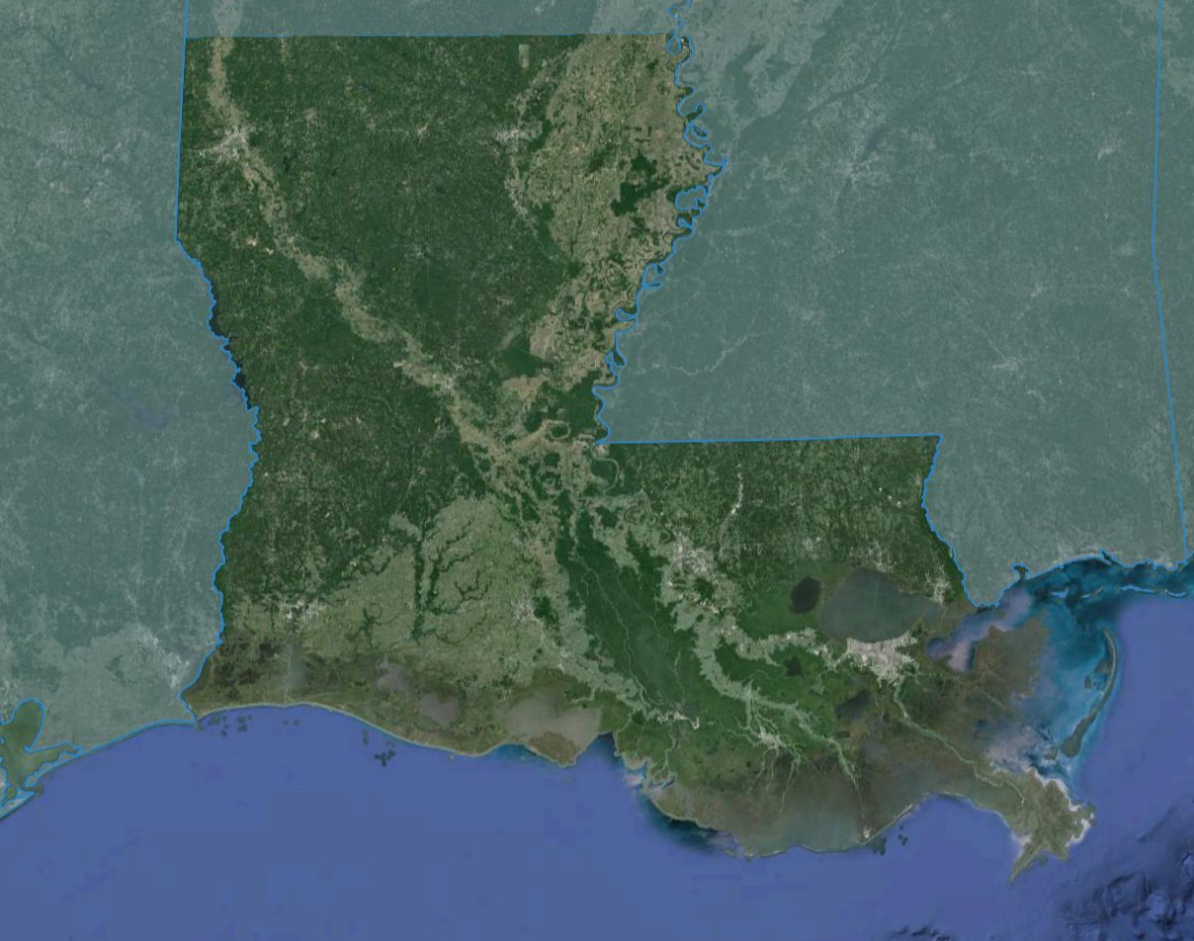
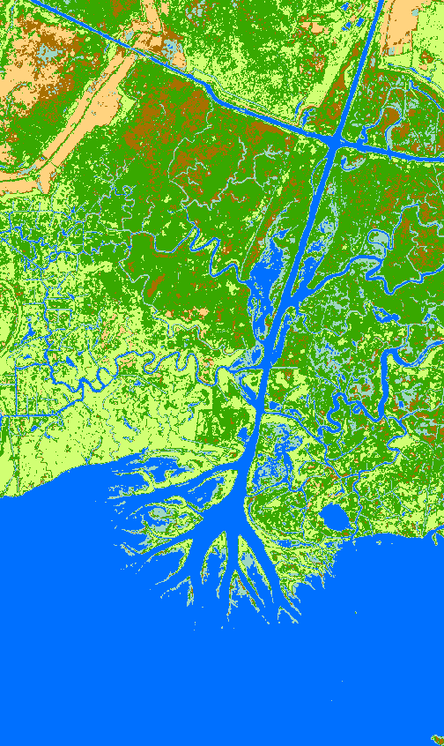
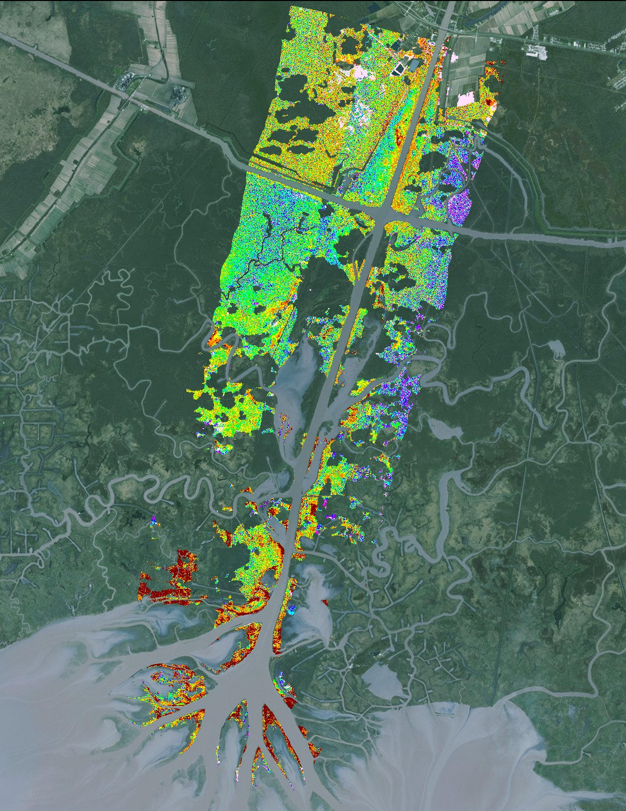
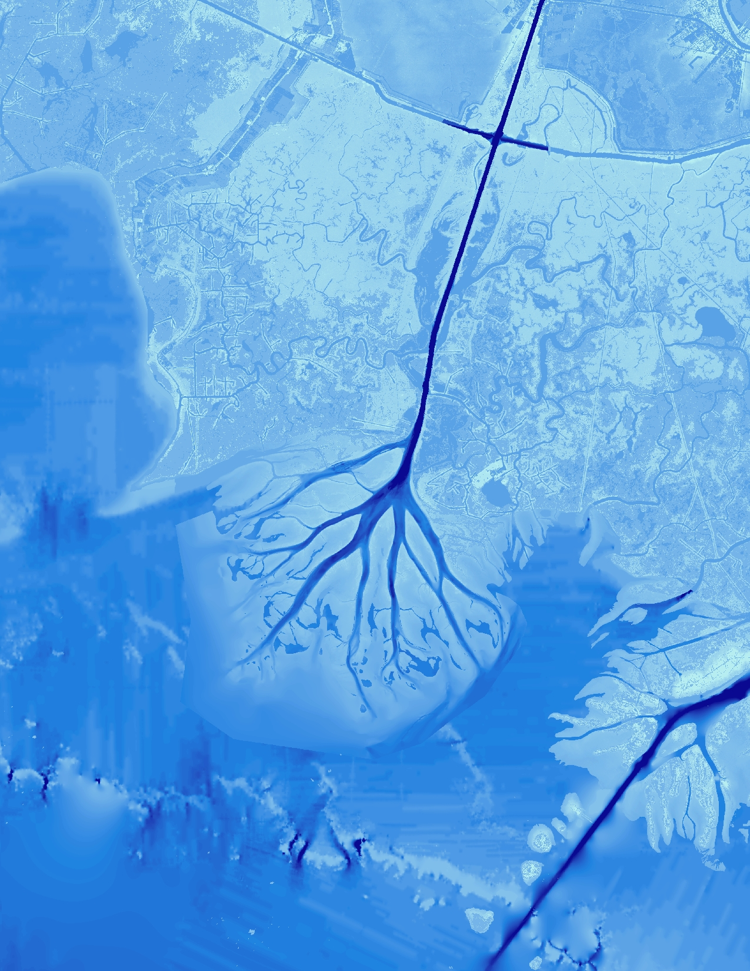
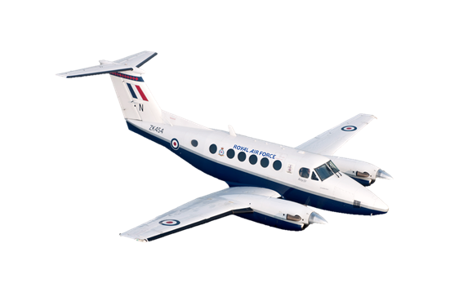
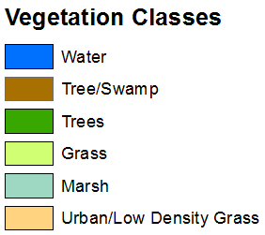
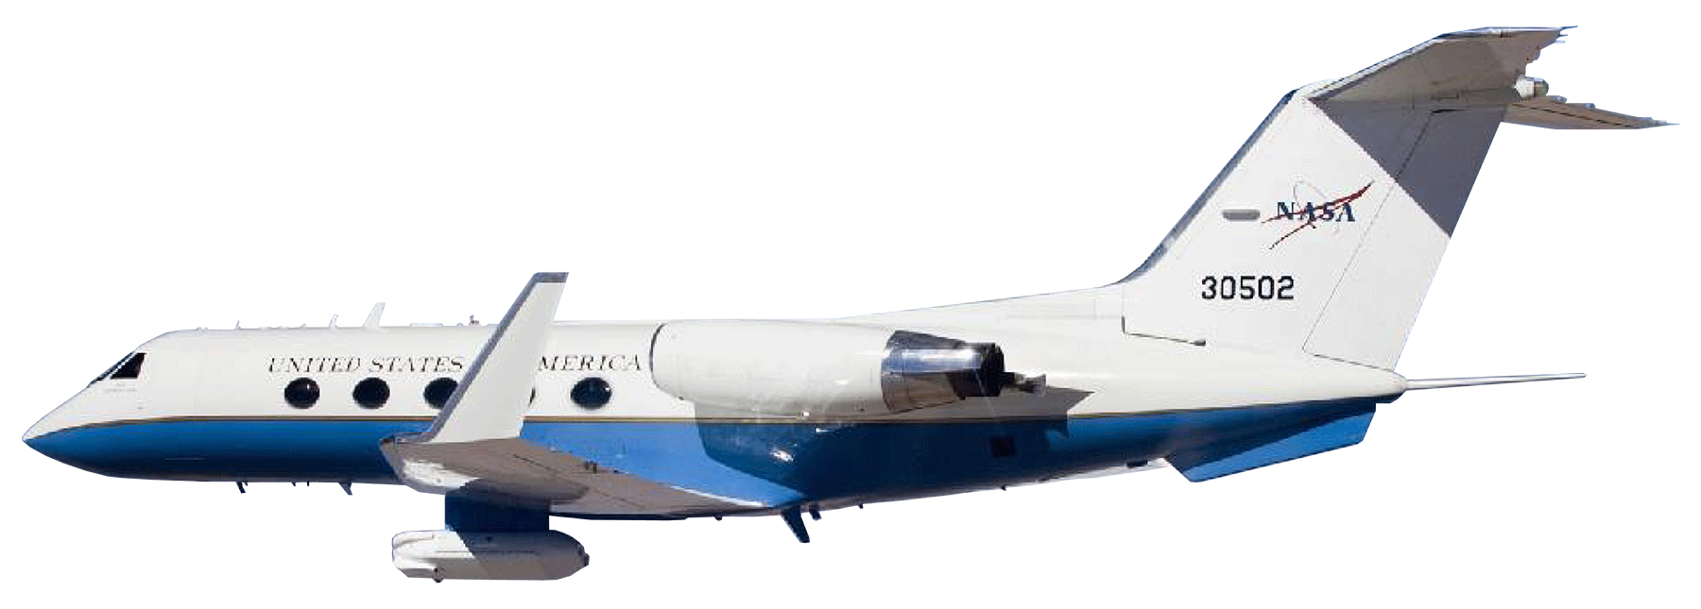
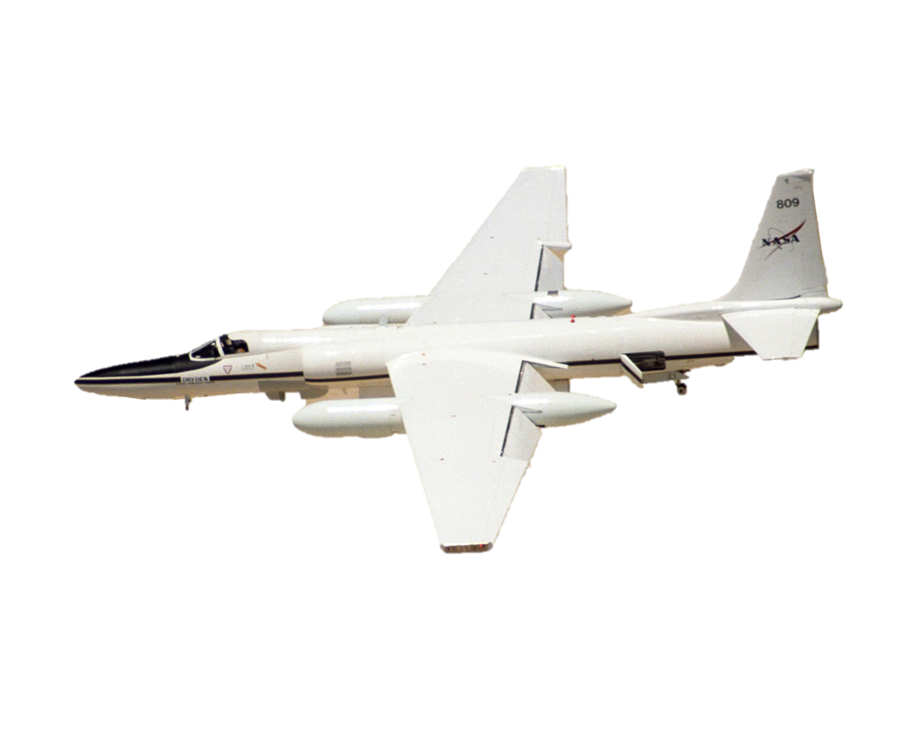
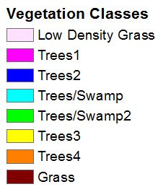
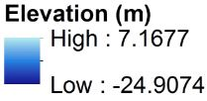
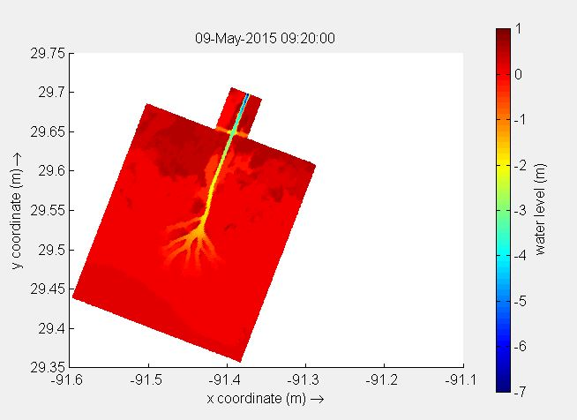
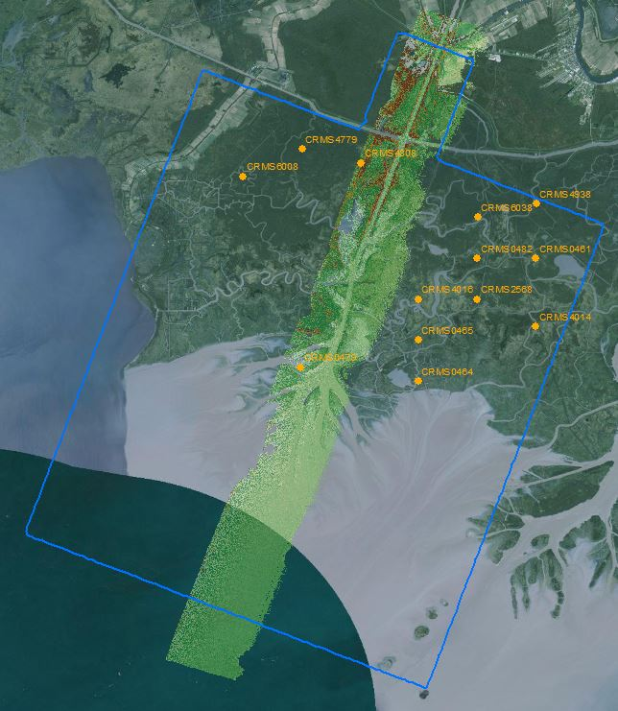
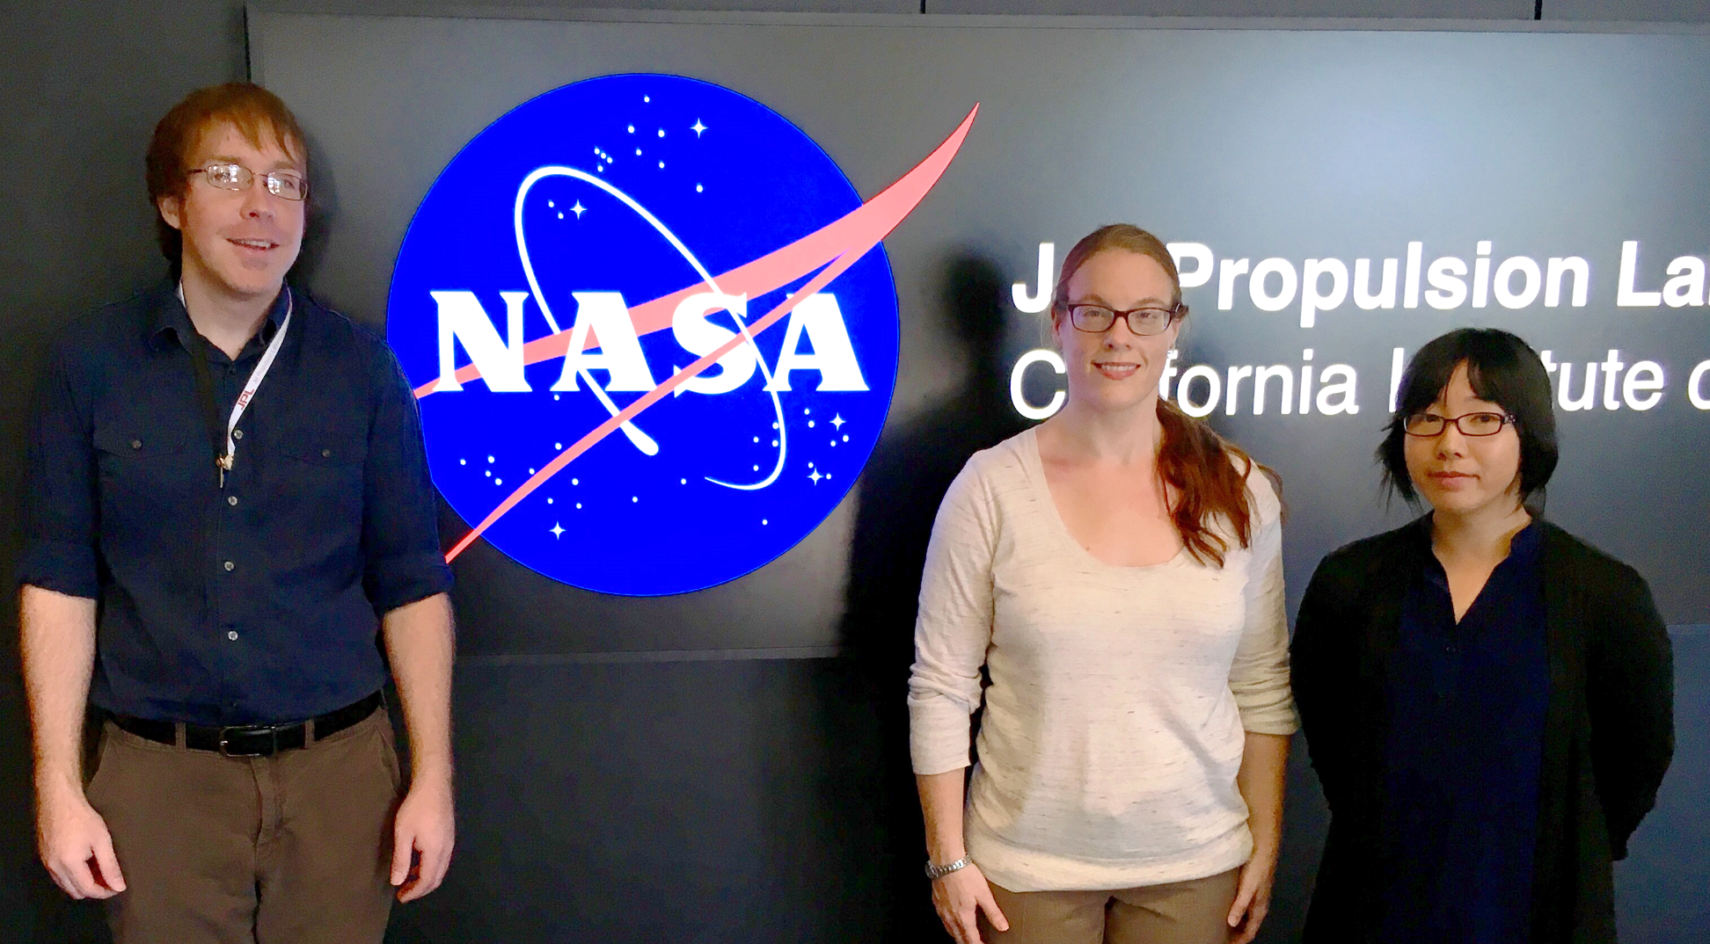
Louisiana Ecological Forecasting II
Using UAVSAR, AVIRIS, and AirSWOT to Model Coupled Water Flow and Sediment Transport for Delta Building within the Wax Lake Delta, Louisiana to Inform Coastal Restoration Efforts
Erika Higa (Project Lead), Emily Beck, Mark Barker
DEVELOP National Program at NASA Jet Propulsion Laboratory
Abstract
Objectives
Erosion, land subsidence, and sea level rise along the Louisiana coast have led to 4900 km² of land loss since the 1930's. It is estimated that Louisiana has the potential to lose an additional 4500 km² over the next 50 years if no restoration action is taken. While most of the Louisiana coast is eroding, the Wax Lake Delta has continued to grow at a rate of approximately 5 km² per year since the 1970's. Currently, labor intensive boat-based surveys are conducted to understand the delta building dynamics at Wax Lake. There have been a number of studies on the natural processes that contribute to this growth, but many of these studies lack tested models. We used remotely-sensed and in situ data, as well as Deltares Delft3D modeling software, to model water flow and sediment transport in the delta—calibrating the model using AirSWOT data. Model outputs will be used to inform coastal research by project partners at the United States Naval Research Laboratory in Mississippi and the Louisiana Universities Marine Consortium to assist the efforts of coastal managers in predicting coastline change and planning restoration projects to reduce land loss along Louisiana's coast.
Extrapolate delta vegetation elevations using UAVSAR
Model water flow and sediment transport using Deltares Delft3D
Calibrate resulting model with AirSWOT
Examine delta formation processes to gain a better understanding of why the Wax Lake Delta is aggregating
Methodology
Study Area
Vegetation Elevation Mask from UAVSAR
(Python)
+
Raster Datasets of Bathymetry
(ESRI ArcGIS)
In Situ Data: Vegetation Species, Water Level, Flow Rate
Delft3D Hydrological Model
Calibrate Model using AirSWOT Data
Modeled Sediment Transport
Vegetation Species Classification from AVIRIS
(Exelis ENVI)
Modeled Water Flow
Wax Lake Delta, Louisiana
Study Period: April 2015 – May 2015
Results
Earth Observations
AirSWOT
UAVSAR
Landsat 8 OLI
AVIRIS-NG
Project Partners
US Naval Research Laboratory, Dr. Richard Crout
Louisiana Universities Marine Consortium, Dr. Alex Kolker
Landsat 8 OLI data classified into six generalized vegetation classes
ISODATA Unsupervised Vegetation Classification of AVIRIS-NG data with clouds masked
Bathymetry layer that was created from the classified UAVSAR image merged with multiple topo-bathymetric datasets
Acknowledgements
Dr. Cathleen Jones, Science Advisor, NASA Jet Propulsion Laboratory
Dr. Marc Simard, Science Advisor, NASA Jet Propulsion Laboratory
Doug Edmonds, Delft3D
John Barras, USGS
Dr. John Shaw, University of Arkansas
Brittany Zajic and Raul Garcia, NASA DEVELOP
Left: Modeled water level in meters during one time step from the preliminary Delft3D model of the Wax Lake Delta
Right: Map of AirSWOT swath and CRMS stations
Team Members
Conclusions
Eight generalized land cover types were derived from AVIRIS-NG data, six land cover types were derived from Landsat 8 OLI data, and more work needs to be done to include vegetation biomass and roughness in Delft3D.
The modeled result will need further calibration with AirSWOT and in situ water level data to accurately model the aggregation process at Wax Lake Delta.
A combination of earth observation data and in situ data can be used to model the water flow in the delta with Delft3D.
From left to right: Mark Barker, Emily Beck, Erika Higa (Project Lead)
NASA Jet Propulsion Laboratory

