Slide 1
Missouri River Climate
Using NASA and NOAA Satellite Observations and In Situ data to better understand Runoff in the Missouri River Basin for Improved River System Management and Decision Support
Emily Sturdivant, Team Lead
Alec Courtright
Sam Swanson
Nancy Barnhardt
Jessica Sutton (Center Lead)
L. DeWayne Cecil (Science Advisor)

Slide 2
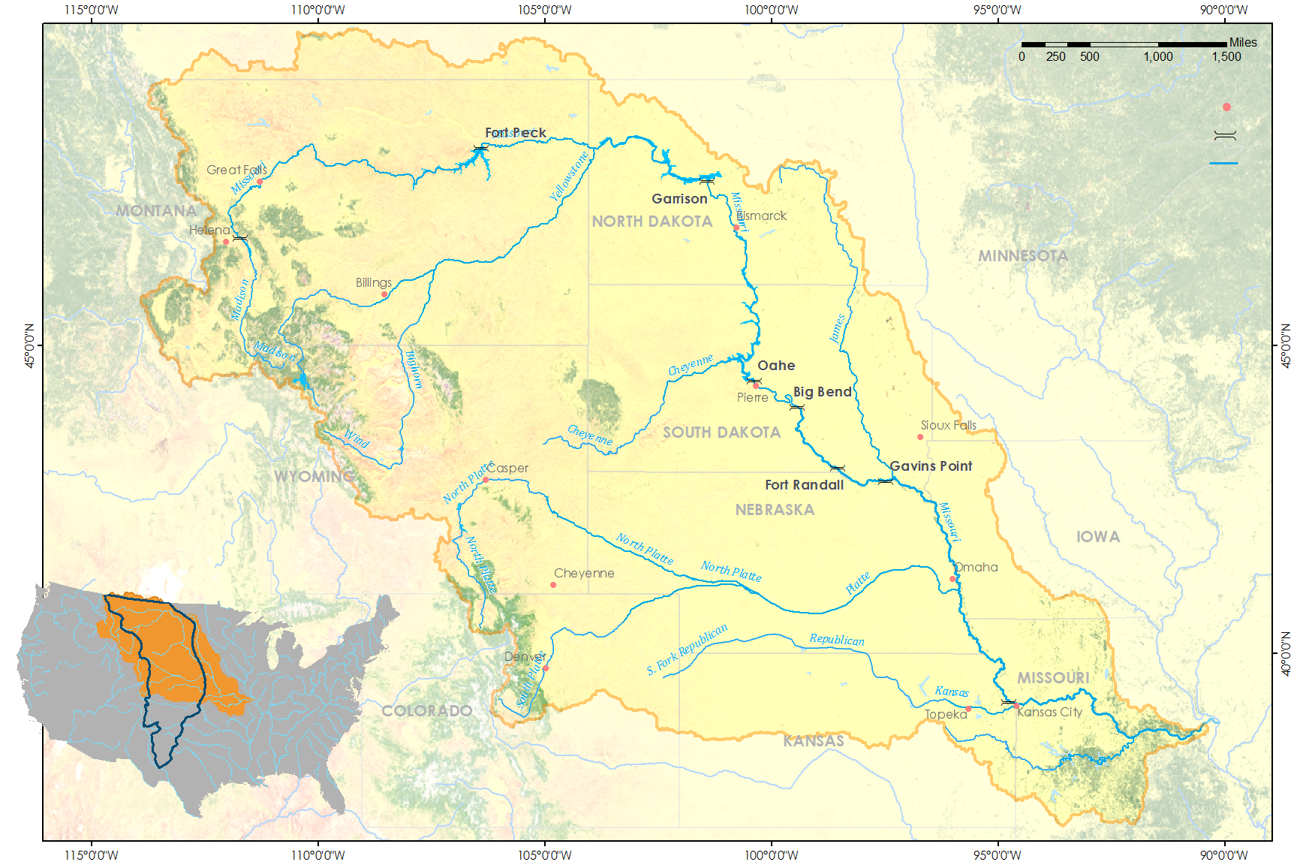
Missouri River Basin (MRB)
Cities
USACE Dams
Rivers
MRB
USA
Great Plains
Credit: Missouri River Climate team
Notes:
Background image source: https://commons.wikimedia.org/wiki/File:Missouri_River_south_of_Sioux_City_aerial_01A.jpg
Study Area Image: Made by Emily Sturdivant
Missouri River Basin
529,300 square miles
largest reservoir system (by storage) in the US
We focus on the upper Missouri River Basin [see MAP]
90% of water storage is contained in the three uppermost reservoirs: Fort Peck, Garrison, and Oahe [POINT]
Average runoff: 25.2 MAF. Runoff in 2011 was 61 MAF.
Northern Plains region:
largely unpopulated prairie-land
Components of the water table in this area are the greatest unknown
There is sparse distribution of on the ground monitoring stations.
heavy snowpack and rapid melt in 2011 played a major role in that year’s historic floods [USGAO, 2014].
Period of analysis: last 30+ years, some variation by dataset.

Slide 3
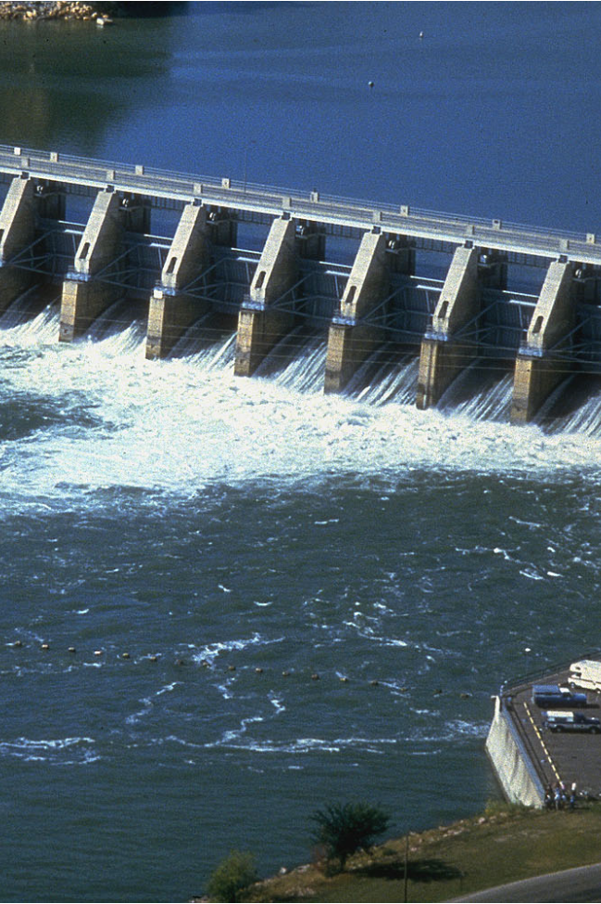
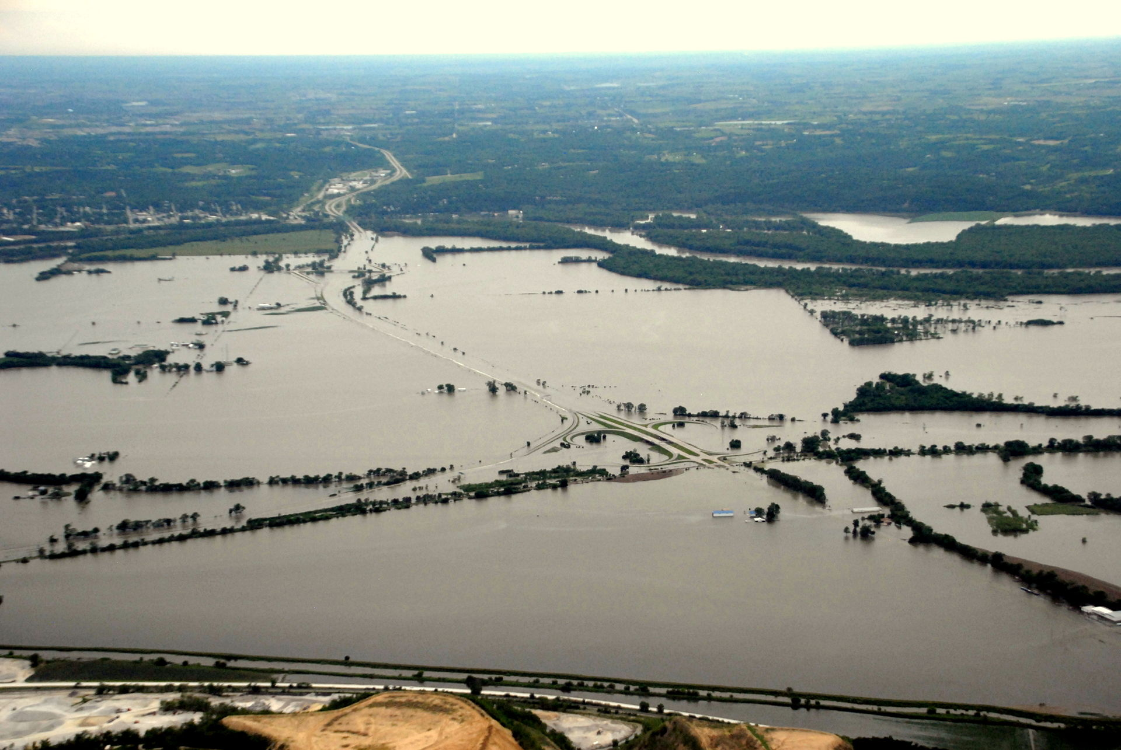
June 16, 2011
Council Bluffs, Iowa
Community Concerns
Water management decisions affect: flood control, navigation, irrigation, recreation, water quality, water supply, and hydropower generation
Endangered species in the basin rely on water availability
Stakeholders make decisions based on reservoir releases
Nebraska Radio Network
Notes:
May 2011: unpredicted high volumes of runoff into the Missouri River threatened to overtop reservoirs, so the Army Corps of Engineers released the largest amount since records began, which caused destruction downstream.
The 2011 flood was directly caused by an unprecedented rain-on-snow event after one of the largest snow years.
The Corps couldn’t predict the event until too late so they chose the least destructive option, which still damaged farms, homes, businesses, industries, public infrastructure, and transportation networks, costing approximately $1 billion.
The Government Accountability Office concluded that Corps officials could not have predicted such an event, but efforts should be made to improve long-term forecasting of Basin runoff.
Current forecasting protocol:
The Missouri River Basin Water Management Division (MRBWMD) uses a monthly runoff forecast to anticipate Basin conditions at six dam and reservoir locations.
Forecasts incorporate basin conditions (i.e. soil moisture and snowpack) from meteorological stations and volunteer data collection, historical trends, and climate estimations.
Data poor
Ground stations and volunteers are poorly distributed in the upper Missouri River Basin, especially the Northern Great Plains.
Incomplete understanding of historical trends, seasonality, and current conditions of the many hydrological inputs.
The influence of such environmental variables as frost depth, soil moisture, snowpack, and precipitation on the river system is poorly quantified.
E.g. Snowpack runoff is well-measured in the mountains, but there is little available information on surface water storage and snow water equivalents in the Northern Plains.
We aim to expand understanding of these data-sparse areas by incorporating remotely sensed data into Basin forecasting. Improved detection of these variables through validated NASA Earth Observations and NOAA Climate Data Records will enhance decision-making processes that impact basin flood control, fish and wildlife, irrigation, hydropower, recreation, navigation, and threatened and endangered species.

Slide 4
Project Partners
Kevin Grode: The Army Corps of Engineers, Missouri River Basin Water Management Team
Doug Kluck: Central Regional Climate Services Director
Dennis Todey: South Dakota State University, South Dakota State Climatologist
Notes:
The project sought to achieve a relevant and informative product for end-users by involving Kevin Grode, P.E., of the USACE MRBWMD, Dennis Todey, PhD, a State Climatologist and Associate Professor at South Dakota State University, and Doug Kluck, the NOAA Regional Climate Services Director for the Central Region.
Kevin directs the Reservoir Regulation Team, hydraulic engineers and computer specialists who conduct studies and produce short- and long-term forecasts pertaining to the regulation of the Missouri River Mainstem Reservoir System. It was Kevin who told us that soil moisture, frost depth, and snow water equivalent are pooly quantified in the Northern Plains region.
Dennis and Doug help to disseminate information to the public. Improved understanding of trends in these variables and their effect on runoff will aid in their communications with basin organizations and residents.
Dennis: expert on current climate conditions and outlooks across the Northern Plains and Midwest.
Doug works with Regional Climate Centers, state climatologists, federal and state governments… to develop climate data stewardship, build climate change capacity, and assess climate services needs by sector.

Slide 5
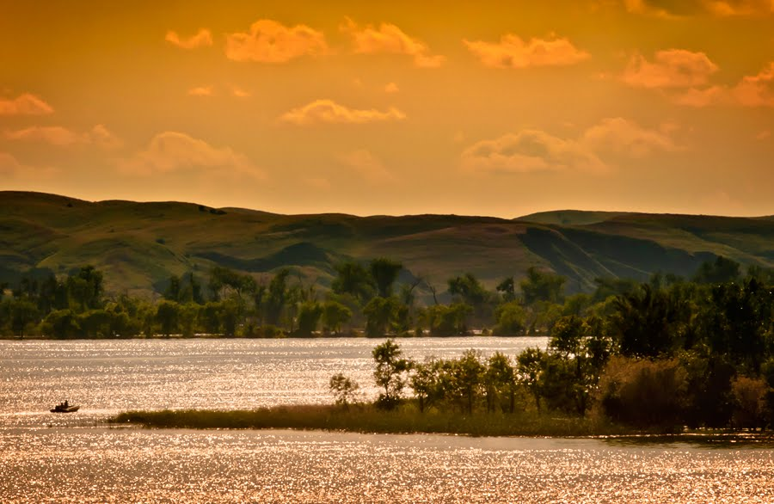
Objectives
1
Detect historic and present winter severity, soil moisture, and snow water equivalents through a combination of NASA and NOAA Earth Observations, Climate Data Records, modeled data, and in situ data
2
3
Document normal and anomalous conditions for Northern Plains region
Exploratory Analyses of the association between these driver variables and stream discharge
Chad Copess
Notes:
Image Source: http://www.dakotagraph.com/2011/08/lazy-afternoon-on-missouri-river.html
We use remotely sensed, reanalysis, and in situ data from the previous 35 years to improve the understanding of water supply and runoff in the Missouri River Basin. With a focus on the Northern Plains region of the basin, we
detected historic and present winter severity, soil moisture, and snow water equivalent through a combination of NASA Earth Observations, NOAA CDRs, and in situ data,
documented the normal and anomalous conditions for the Northern Plains region,
performed exploratory analyses of the association between these driver variables and stream discharge with a focus on seasonality and anomalous events.

Slide 6



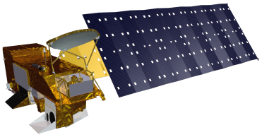
NASA/NOAA Satellites and Data Sources
Global Historical Climatology Network (GHCN) – Climate Data Records
GlobSnow – from Defense Meterological Satellite Program (DMSP) – DMSP satellite, Snow Water Equivalent product
North American Land Data Assimilation System (NLDAS) – from GOES satellite, Soil Moisture Product
Climate Prediction Center Morphing technique (CMORPH) - a compilation of satellites including Aqua, Precipitation product
Notes:
Kevin and his team rely almost entirely on ground data, so we wanted to explore the utility of remotely sensed datasets and model products. We drew on these satellites:
GHCN from NOAA
GlobSnow, ESA product result of collaboration between top-tier space programs
NLDAS, which uses the GOES
Image sources:
http://www.noaa.gov/
http://www.devpedia.developexchange.com/dv/index.php?title=Defense_Meteorological_Satellite_Program_(DMSP)
http://ldas.gsfc.nasa.gov/nldas/
*From top to bottom

Slide 7
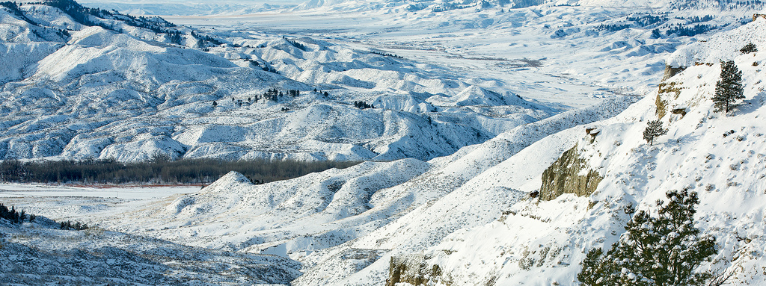
Todd Klassy
Methodology
Winter Severity
Soil Moisture
Snow Water Equivalent (SWE)
Notes:
Through discussion with our end-users we identified the primary area and key drivers of runoff to focus on. The US Army Corps of Engineers lacks comprehensive data in parts of the upper River Basin. The Northern Great Plains stretching from Eastern Montana through North and South Dakota contains only a few climate measurement stations. In particular, reliable in situ data on winter severity, soil moisture, and snow water equivalent was hard for the Corps to get its hands on. Our team decided to focus on these three variables within the northern plains region to find historical trends that could benefit the Corps management and forecasting methods.
Image source: https://www.flickr.com/photos/latitudes/8389646376

Slide 8
Winter Severity
Global Historical Climatology Network
Daily surface air temperature measurements (1981-2010)
Calculated
Freezing-degree days (FDD)
Air-freezing index (AFI)
Start date trends of freezing days
End date trends of freezing days
Length of freezing days
Analyzed
Notes:
According to our end-users (The Army Corps of Engineers and Central Regional Climate Services Director) seasonal variability has been increasing in the Missouri River Basin. Therefore, we decided to analyze winter severity and temporal trends to help them better understand long-term changes in seasonality. The Global Historical Climatology Dataset is a collection of measurement stations throughout the United States that consists of sites managed by NOAA, the National Weather Service, and other cooperative agencies. To analyze winter severity in the region we used daily surface air temperature from 1981-2010 as an indicator for freezing-degree days and the air-freezing index. Serially Completed data and accurate data was only available up to 2010. All of the temperature data was serially completed by NOAA and stored at NCEI in Asheville.
Using code and protocol developed by Anthony Arguez and Rocky Bilotta in their paper on Frost Depth (2015) we calculated the Freezing-Degree Days, a summation of daily average temperatures above freezing, and Air-Freezing Index, the difference between the highest and lowest points on a Freezing-Degree Days curve. Air-Freezing Index serves as an indicator of winter severity.
From these results we tracked the annual start date, the end date, and the length of days below freezing for each GHCN site. We then used a linear regression at each site to track long-term trends in each of the above mentioned variables.

Slide 9
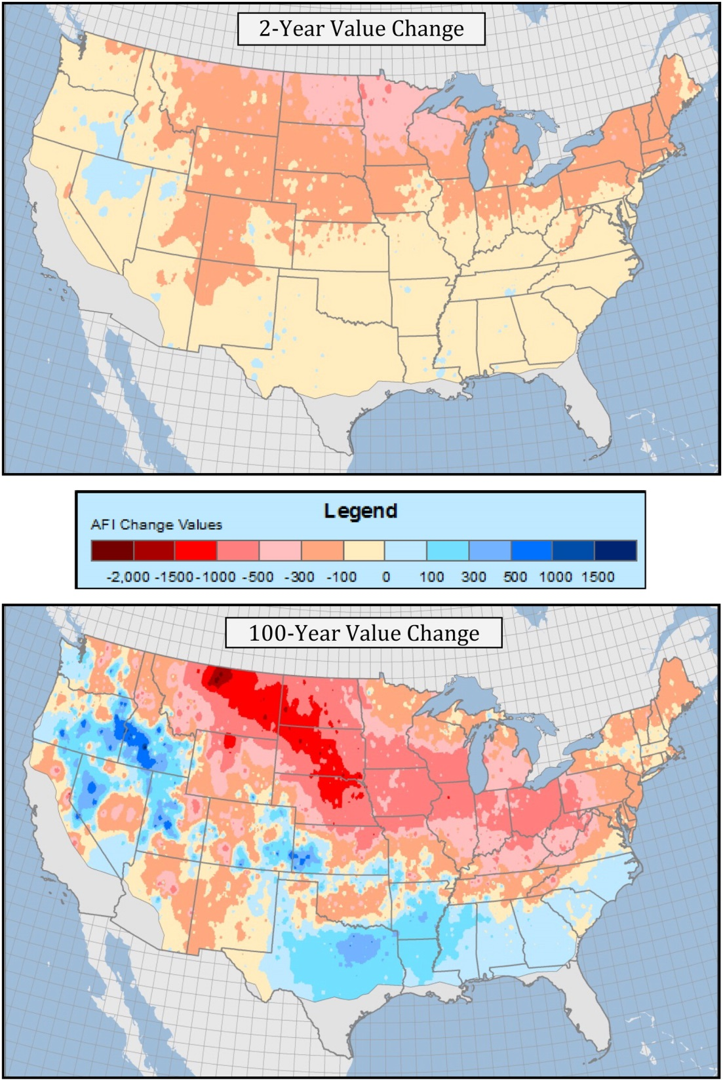
Results:
Winter Severity Trends
Start Date = on average XY days earlier/later over (time period)
End Date = on average XY days earlier/later over (time period)
Freezing Day Length = on average XY days longer/shorter
Image will be GIS graphics of changing winter severity trends. Will show graph of freezing day start date changes, one of end date changes, and one of freezing day length changes. (Current image is similar example - placeholder)
Rocky Bilotta (example image)
Notes:
*Will be similar to results section on poster. Each person will present the individual result they got from their variable.
Discuss found trends:
General changes in winter severity.
Start Date;
Changes over study period
Areas within basin most/least affected
Possible impacts
End Date;
Changes over study period
Areas within basin most/least affected
Possible impacts
Freezing Day Length;
Changes over study period
Areas within basin most/least affected
Possible impacts

Slide 10
Soil Moisture
SCAN/NLDAS
In situ soil moisture measurements with varying start dates
Model of soil moisture produced by data assimilation (1979-2015)
Calculated
Monthly averages of soil moisture present
Analyzed
Yearly trends of soil moisture
Seasonality of soil moisture
Validated the utility of each data set
Notes:
SCAN stands for Soil Climate Analysis Network. There are seven in situ sites that are collection soil moisture data from five different depths in the ground in the focus of our area of study (The Northern Great Plains). The five different depths are 2, 4, 8, 20 , and 40 inches. There aren’t too many due to the fact that this a very data poor region. This data varies in when it extends back to due to different installation times of the different stations.
NLDAS stands for North American Land Data Assimilation System. This is a model that takes into account in situ and satellite data from the Geostationary Operational Environmental Satellite (GOES satellite). This data goes back to 1979 and extends to present day.
For the Calculations, what we did was get the files into CSV format and then put them into R/ArcGIS so that we could see the data in both a graphic and a map. We then made monthly averages for all the years and tried to find any anomalies based off the average soil moisture. We then looked at each season to see the different trends those months together had.
Lastly, we used the data from each pixel from NLDAS that had a SCAN site in it and tried to validate the data from the satellite and vice versa to find the utility of each.

Slide 11
Results:
Soil Moisture Trends
Yearly trends= see when, on average, soil moisture fluctuates
Seasonality=see if the trends correlate to a specific season
The picture that will be put with this slide will be graphs of each of these trends from each data source (i.e. NLDAS/SCAN) The data will look similar to this graph for each source.
SCAN data-Nancy Barnhardt
Notes:
*Will be similar to results section on poster. Each person will present the individual result they got from their variable.
Discuss found trends:
Changes throughout the year and talk about the fluctuations over time such as when the max and min soil moisture happens
talk about any anomalous years
Discuss the seasonality
Talk about the findings of seasonality and whether or not they correlate to the seasons or if they have no correlation at all
Possible impacts of seasonality (i.e. does it happen at the same time as the snowpack melt, causing more saturation and possible flooding)

Slide 12
Snow Water Equivalent (SWE)
GlobSnow consortium dataset
Calculated
Analyzed
Daily satellite observations and ground station data (1979-2012)
Annual and average max SWE by pixel
Annual and average max SWE trends since 1979
Notes:
The European Space Agency’s GlobSnow consortium dataset is an estimated measurement of snow water equivalents from a combination of satellite and ground station data. It incorporates measurements from NASA Earth Observations’ SSM/I and SMMR sensors and from European weather station forecasts. GlobSnow provides daily and weekly estimates of SWE at 25 km grid spacing beginning in 1979, and are publically accessible. These estimations are shown to be especially accurate over medium elevation flat plains with seasonal snow cover, which accurately describes the Northern Plains region [Vuyovich et al., 2014].
Using “R”, we drew annual and average maximum SWE by pixel (or area), and then analyzed trends in the data since 1979. Because snow water equivalents accumulate on their own throughout the winter, maximum annual SWE is a common measurement for the amount of snow in a region when comparing to an average or finding anomalous years.

Slide 13
Results:
SWE Trends
Will include ArcGIS map of change in annual max SWE by pixel over 33 year period 1979-2012, and a graph of annual max SWE by pixel over time
Notes:
*Will be similar to results section on poster. Each person will present the individual result they got from their variable.
This map shows the change in annual max SWE by pixel over 33 year period 1979-2012. Some areas experienced more change than others, positive and negative, as highlighted by stronger colors on the map. The same data is visualized as a trending graph, which shows individual pixels declining (or rising) over time.

Slide 14
Precipitation
CMORPH precipitation
Data with temporal resolution of 30-min and spatial resolution 8km resolution (1991-present)
Calculated
Aggregate observations into daily and monthly averages
Analyzed
Trends in precipitation patterns across basin
Notes:
CMORPH is a very high resolution precipitation data set both spatially and temporally; down to 4 km and 30 minute measurements respectively. We used this data to provide the Corps and our other end-users with very detailed precipitation data. We also aggregated the data into daily and monthly measurements to compare to stream gauge results and lower resolution precipitation datasets.
Then, we analyzed for trends over the approximately 20 year period to get a better idea of any long-term changes occurring within the Missouri River Basin – especially the data sparse upper basin.

Slide 15
Results:
Precipitation Trends
Will include ArcGIS map of precipitation trends per 4km.
Notes:
*Will be similar to results section on poster. Each person will present the individual result they got from their variable.
This map will show trends found in precipitation analysis. The map will display high resolution trends, spatial = 4km and temporal = 30-min, from 1991-present.

Slide 16
Conclusions
Simplified result and its benefit to end-user.
Simplified result and its benefit to end-user.
Simplified result and its benefit to end-user.

Slide 17
Errors & Uncertainties
To be filled in when results are finalized.
Image Credit: Chad Copess
Notes:
Image Source: http://www.dakotagraph.com/2011/08/lazy-afternoon-on-missouri-river.html

Slide 18
Future Work
Probabilistic Runoff Model
Incorporate Current Model
Utilize Earth Observations
Yield Probability of Runoff Events
Interactive ArcGIS Online Map
Public Access
Forecast predictions displayed
Each Variable + Runoff outcome
Notes:
There are a few ways to continue the work we have done this term. One extension would be continue involving earth observations data and the historical trends that we found in a comprehensive runoff model. The US Army Corps of Engineers have a pretty steady runoff model. A new model would be helpful only if it could help improve the Corps current methods. A probabilistic model could be very beneficial to the Corps and MRBWM team by showing the probability of runoff events as opposed to coming up with a set level of runoff.
OR
Another secondary step could be to create an interactive map through ArcGIS Online.

Slide 19
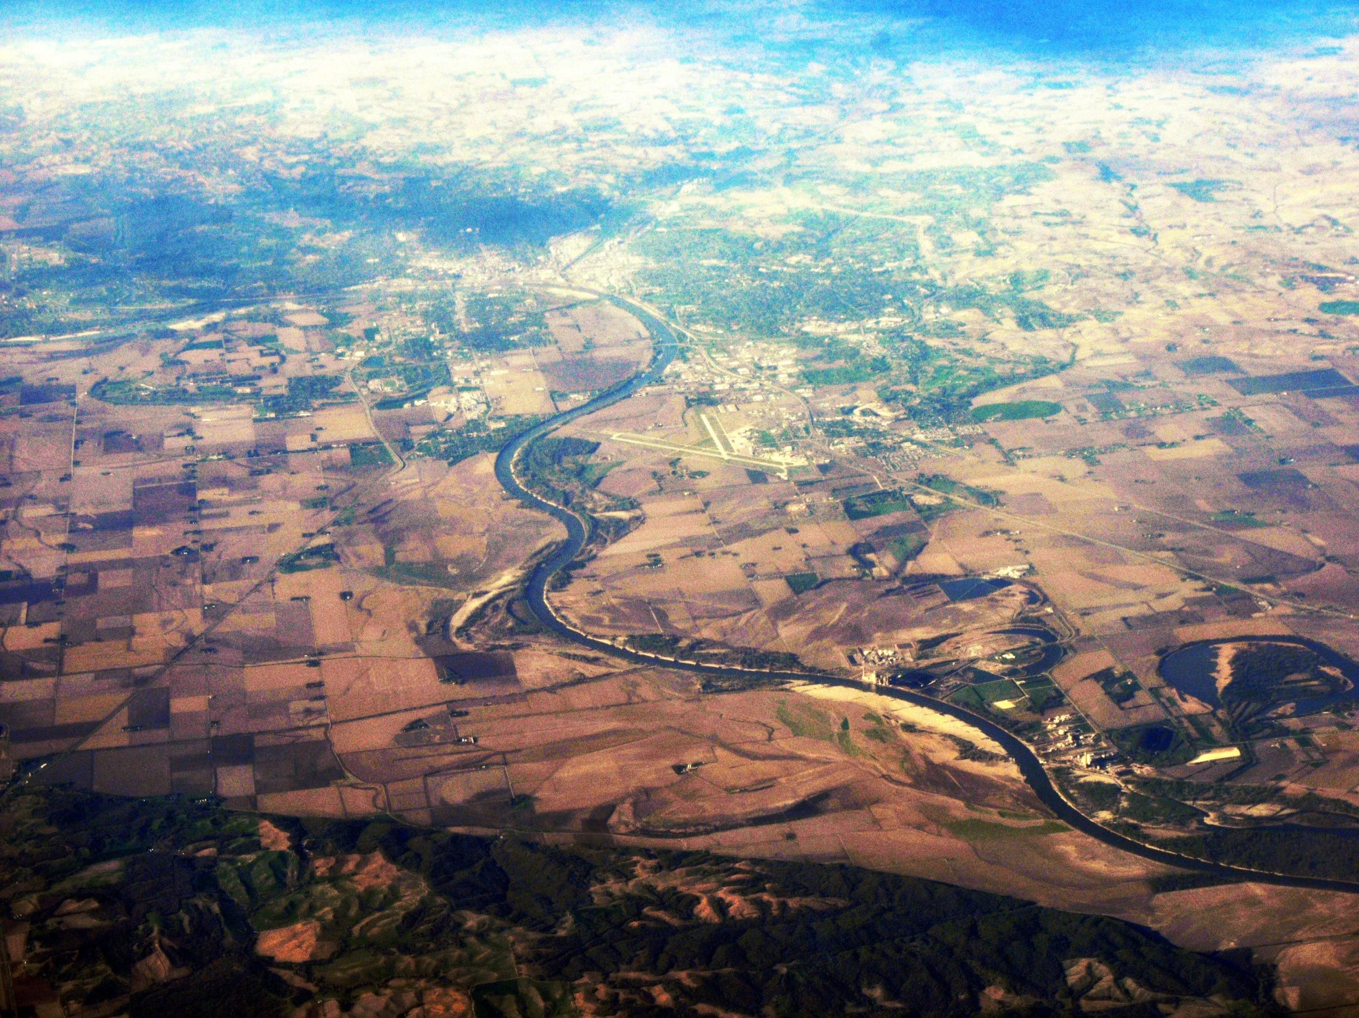
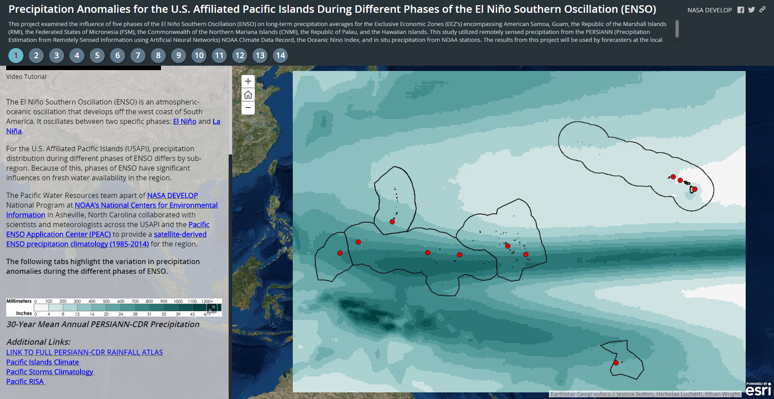
Notes:
This map was produced by our Center Lead during the Summer 2015 term at NCEI. This map allows users to see how ENSO events affect the Pacific Islands. The Corps and our end-user, Kevin Grode, have been working on ways to better communicate runoff forecasts and findings to the public. An interactive map showing how drivers of runoff, such as soil moisture, precipitation events, and snow-water equivalent affect runoff across the Missouri River Basin could provide the Corps with a simple way to make their work easily accessible to the public.

Slide 20
Advisors
L. DeWayne Cecil, Global Science & Technology
Jessica Sutton, NASA DEVELOP at NOAA NCEI: Center Lead
Partners
Kevin Grode, U.S. Army Corps of Engineers
Doug Kluck, NOAA Central Region Climate Services Director
Dennis Todey, South Dakota State University and State Climatologist
Others
Rocky Bilotta, NOAA NCEI
Anthony Arguez, NOAA NCEI
Ethan Shepherd, NOAA NCEI
Jesse E. Bell, CICS North Carolina
Carrie Vuyovich, U.S. Army Corps of Engineers

