Slide 1
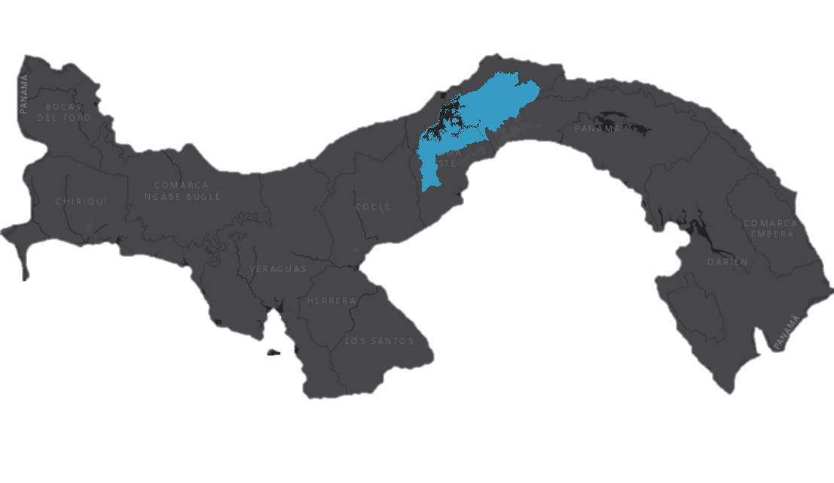
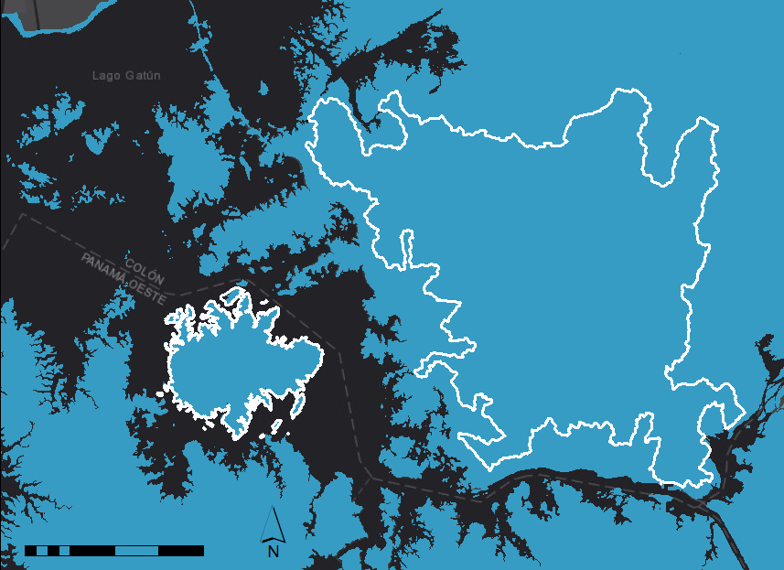
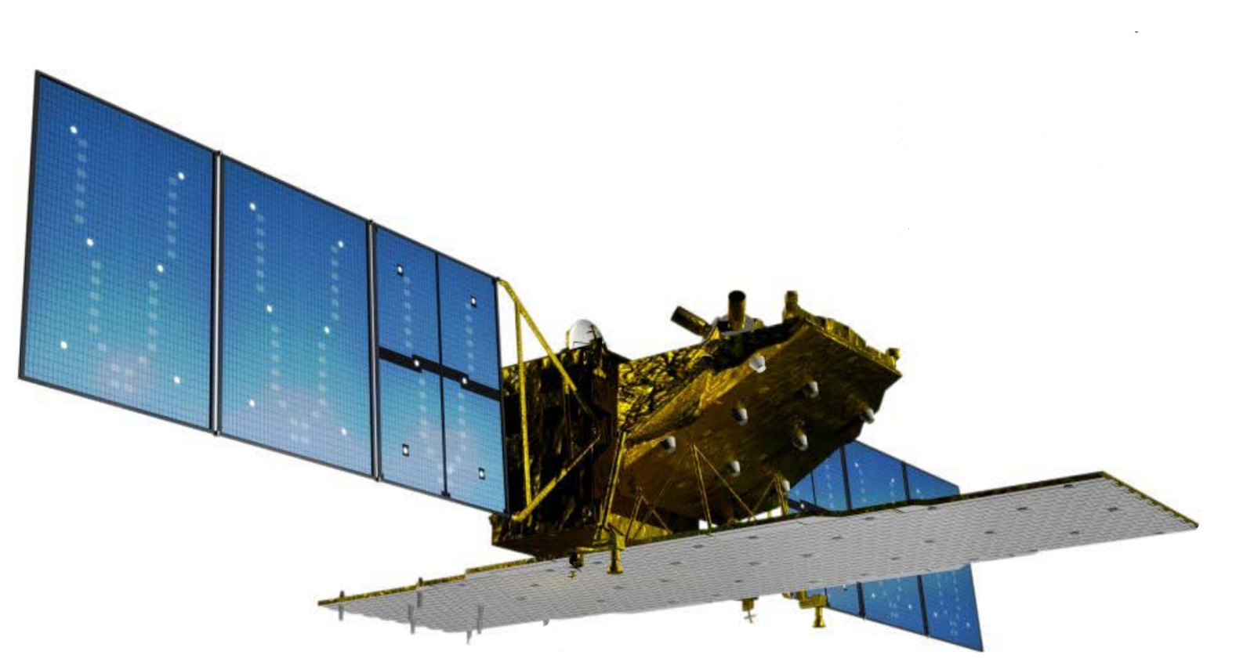
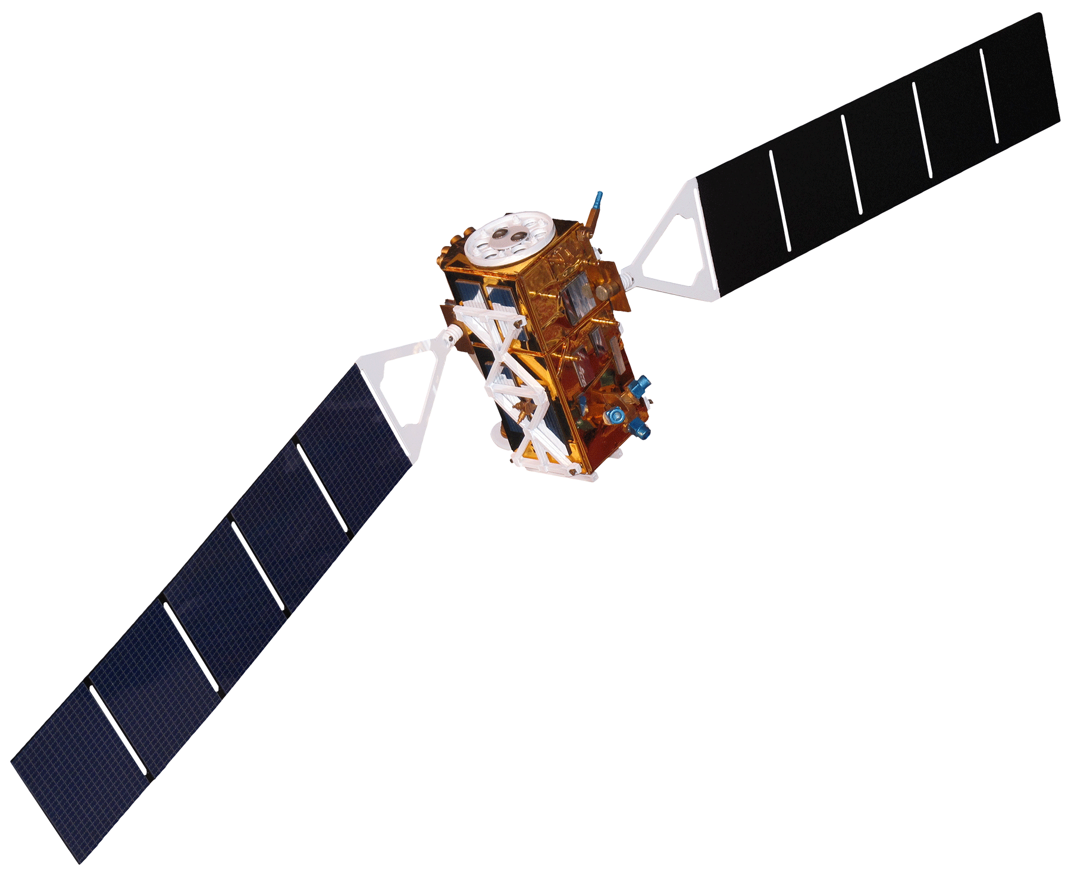
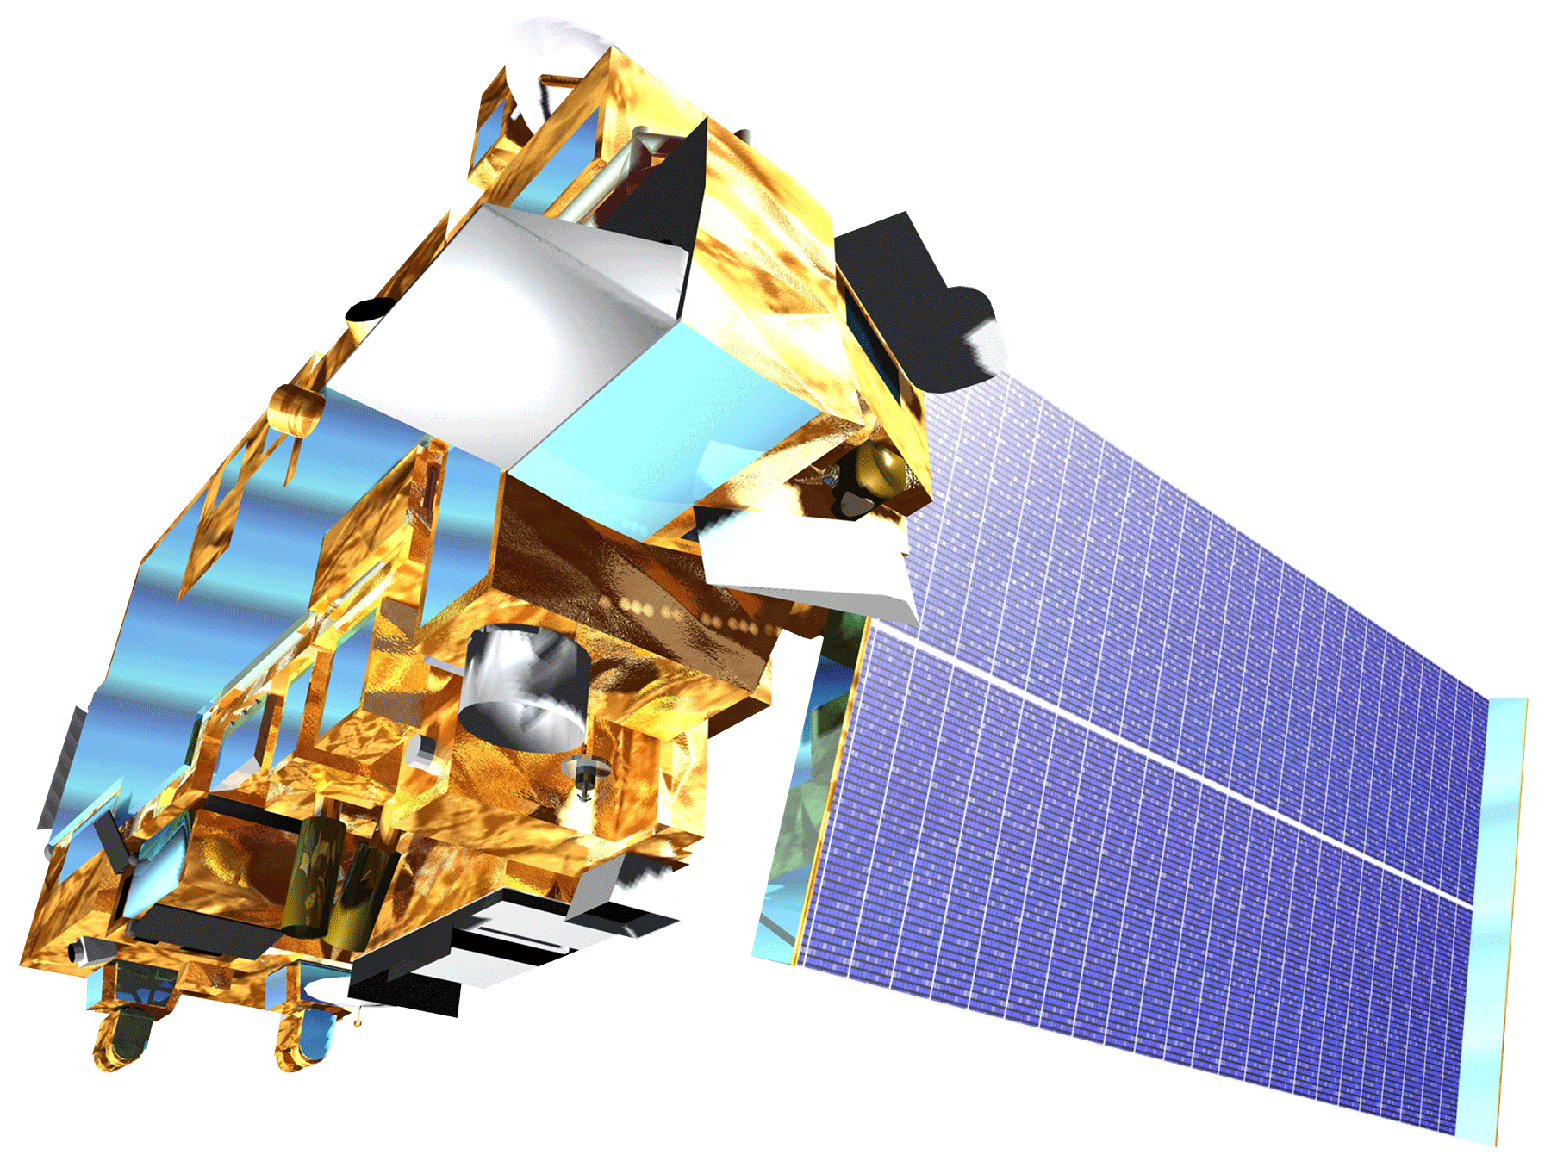
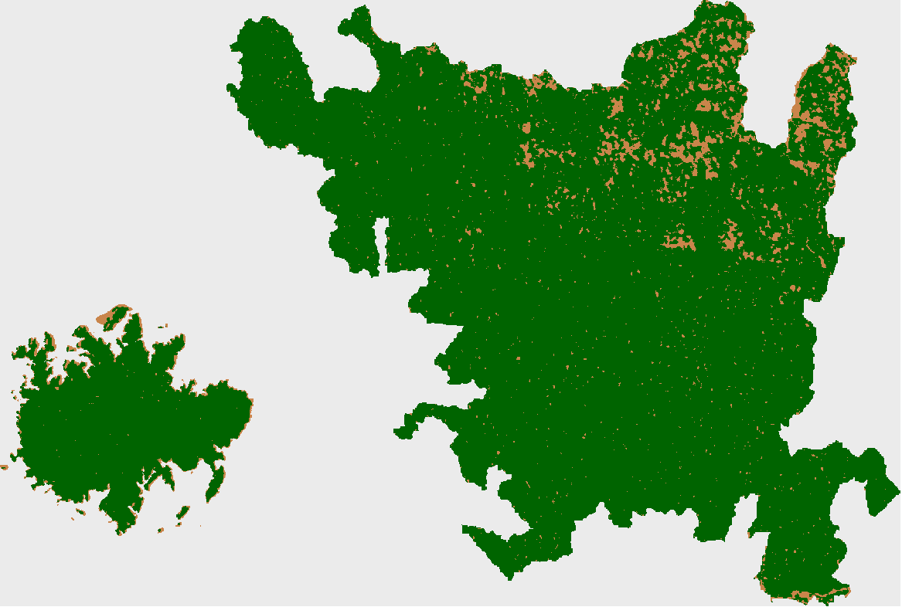
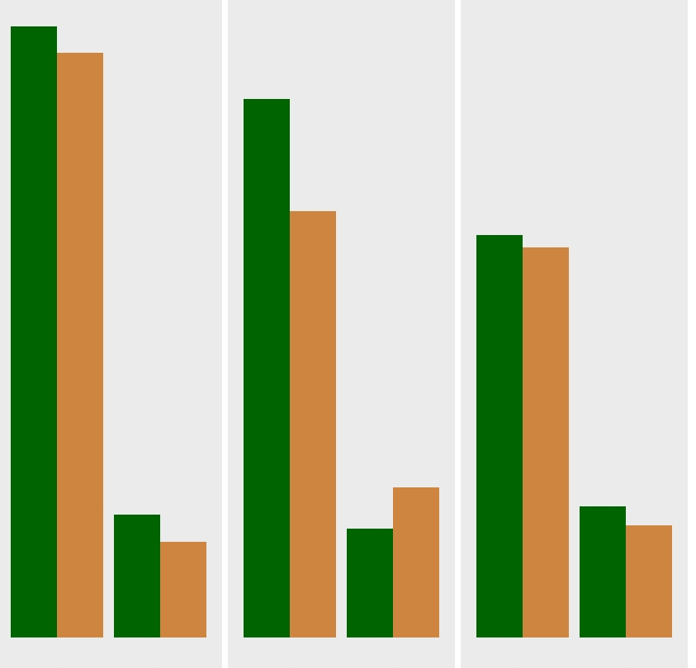
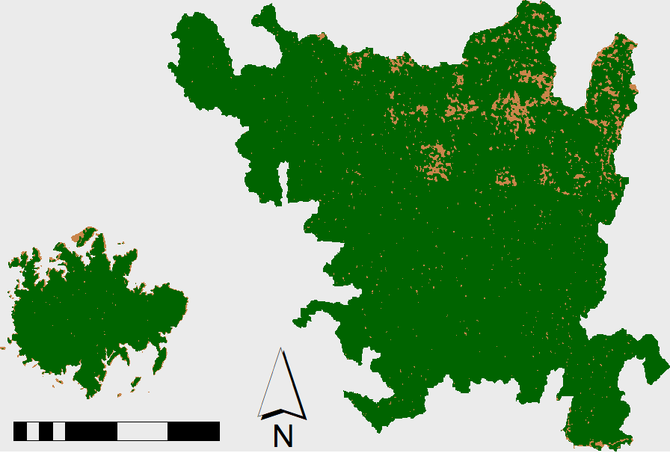
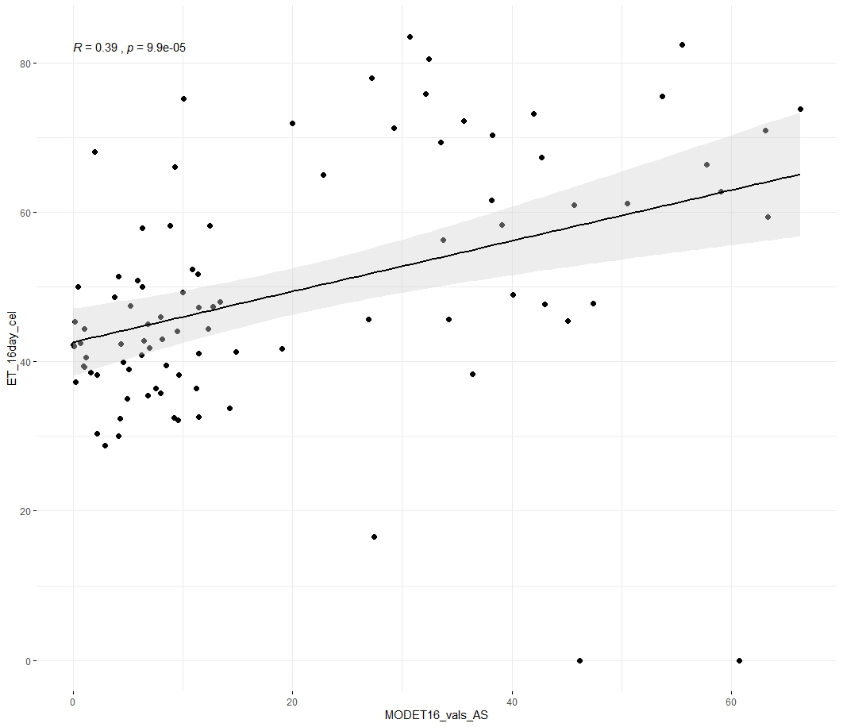
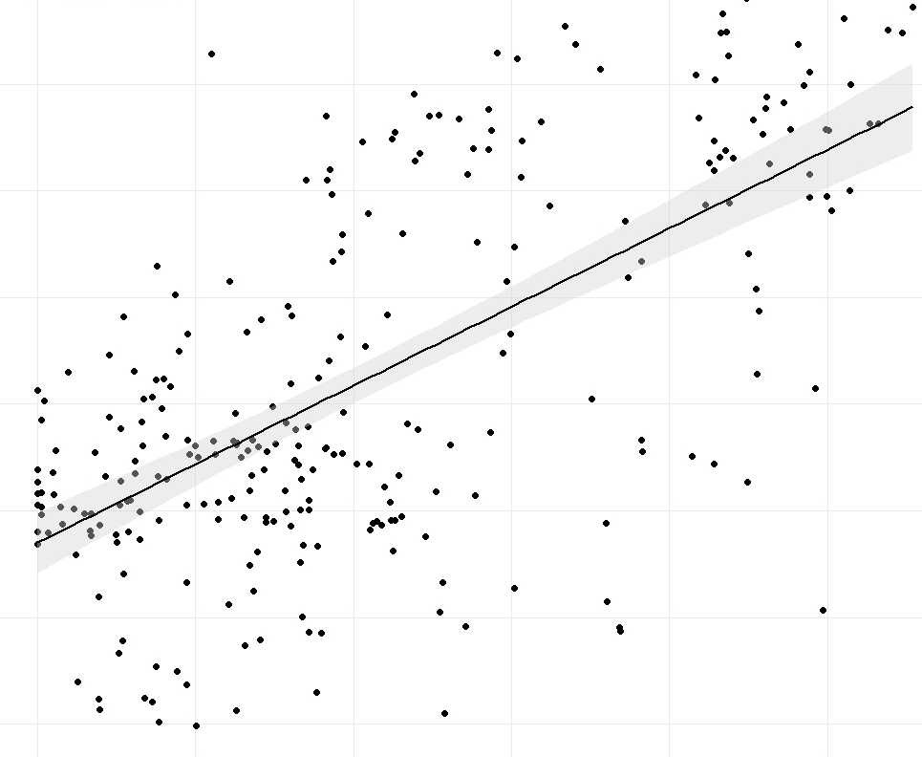
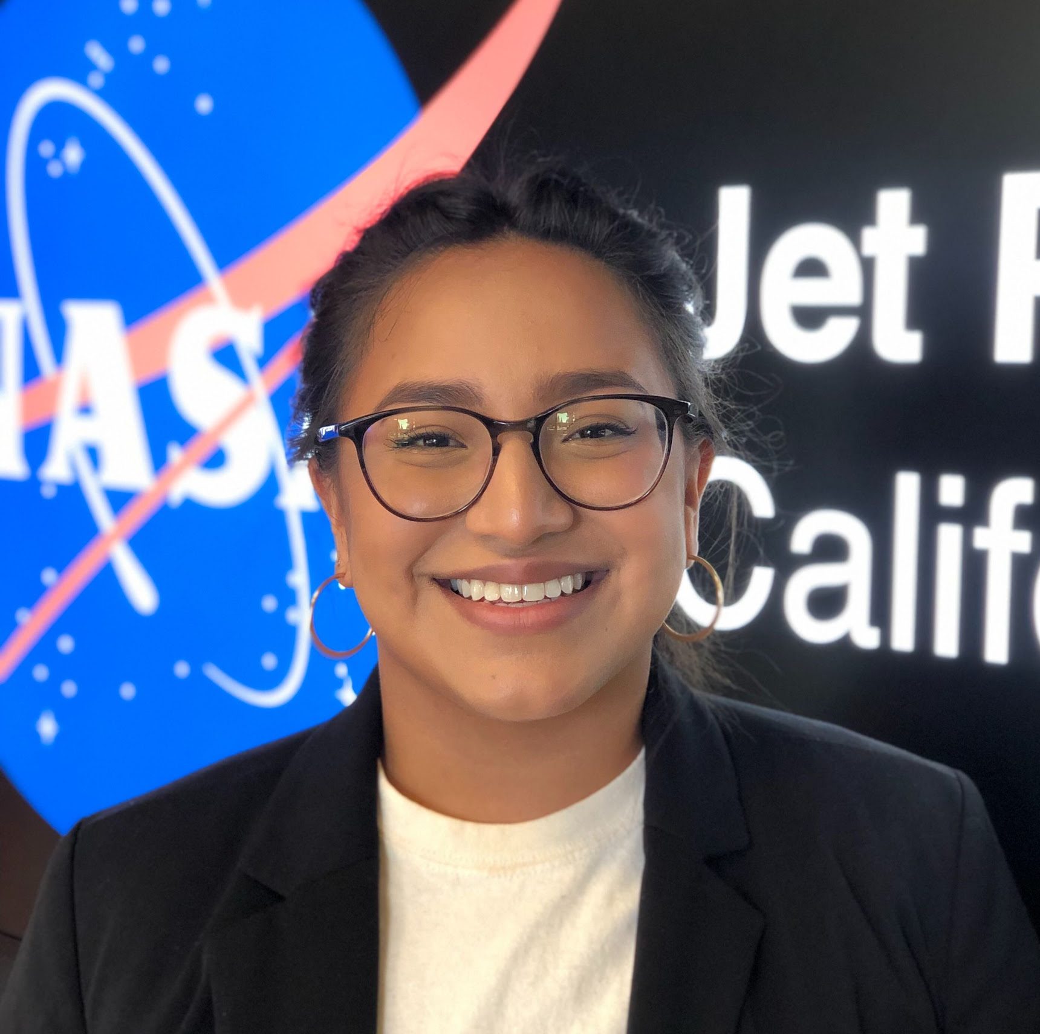
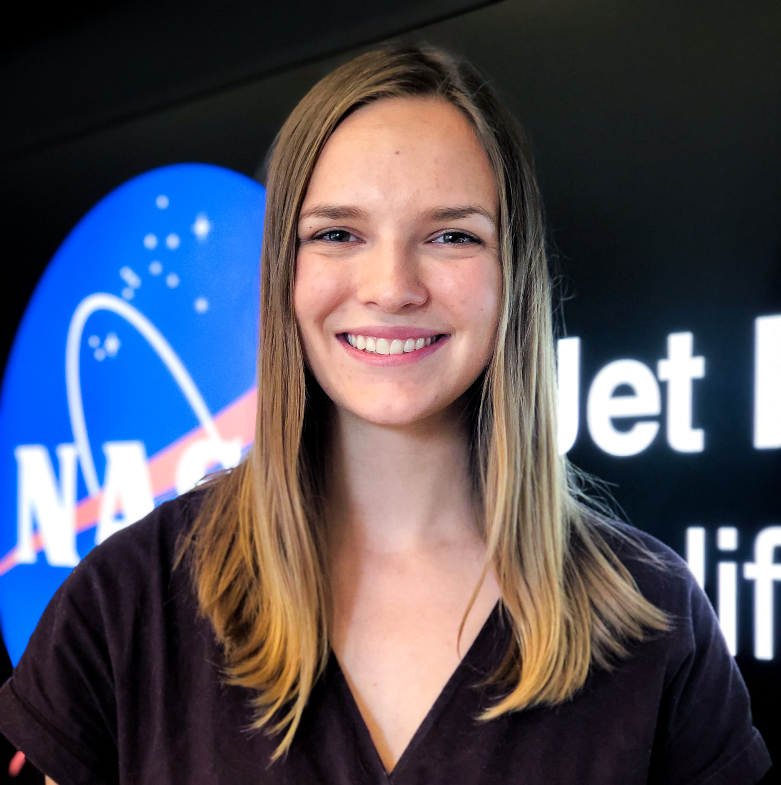
Characterizing Vegetation Water Use in the Panama Canal Watershed to Inform Water Management in the Panama Canal
Abstract
Study Area
The Panama Canal Watershed (PCW) is a major socioeconomic resource. The PCW provides potable water to surrounding cities and ensures the Panama Canal remains fully operational throughout each year. Over one million residents in Panama City, Colón, and San Miguelito rely on the PCW for electricity and potable water. Around three percent of global maritime shipping passes through the Panama Canal annually, which is dependent on water from the PCW to power and fill the locks for ships’ passage. The PCW must be carefully managed to maintain community water needs and operation of the Panama Canal during the dry season. Land cover in the PCW varies from pasture to secondary and old-growth forests. This project used NASA Earth observations and Synthetic Aperture Radar datasets in collaboration with data provided by the Smithsonian Tropical Research Institute to assess the vegetation structure and moisture regimes of different land cover types in the PCW during extreme wet and dry seasons. The team observed evapotranspiration in the PCW using data from Terra Moderate Resolution Imaging Spectroradiometer (MODIS). Using NASA Gulfstream III Uninhabited Aerial Vehicle Synthetic Aperture Radar (UAVSAR) and Advanced Land Observing Satellite (ALOS) Phased Array L-band Synthetic Aperture Radar (PALSAR), the team interpreted backscatter values to create land cover classifications. Measurements of evapotranspiration and land cover type classifications between 2007 and 2019, in both the wet and dry seasons, indicated that forests were the most effective land cover in maximizing water availability during the dry season.
Panama Canal Watershed
ASP
Agua Salud Project (ASP) and Barro Colorado Island (BCI) Study Areas
Republic of Panama
BCI
Panama Canal
0 1 2 4mi
Earth Observations
ALOS PALSAR-2
Sentinel 1 C-SAR
UAVSAR PolSAR
Terra MODIS
Objectives
Results
Evapotranspiration Timeseries
Create land cover maps using Synthetic Aperture Radar (SAR) data
Validate classifications and climatology data with in situ measurements
Compare MODIS evapotranspiration across land cover types, in different seasons, and between years
Develop a Standard Operating Procedure to relate evapotranspiration and land cover types
2007
Land Cover Maps
2007
2009
2010
2009
2009
2009
2010
Panama Water Resources
Methodology
2010
Seasonal Mean Evapotranspiration (mm/16 days)
SAR Imagery
MODIS Imagery
In Situ Station & Training Data
0 1 2 4mi
Classify forest and non-forested areas
Derive mean seasonal & 16-day evapotranspiration
Perform cleaning & processing
Forested
Non-Forested
Dry
Wet
Dry
Wet
Dry
Wet
MODIS & In Situ Correlation Scatterplots
Validate with in situ land cover & evapotranspiration data
Agua Salud Project
Barro Colorado Island
Identify trends in evapotranspiration by land cover type
R = .39, p < .0001
R = .63, p < .0001
Conclusions
Project Partners
In ASP and BCI, evapotranspiration is higher in forest land cover as well as during the dry season; however, only the second result is significant.
MODIS evapotranspiration is correlated with in situ measurements of potential evapotranspiration in ASP and BCI.
L-Band SAR is more effective in identifying tropical land cover than C-Band.
Ministerio de Ambiente de Panama
Smithsonian Tropical Research Institute
Team Members
Acknowledgements
We would like to acknowledge the following contributors:
Our science advisors Dr. Erika Podest (NASA Jet Propulsion Laboratory, California Institute of Technology) and Dr. Kyle McDonald (City College of New York, NASA Jet Propulsion Laboratory, California Institute of Technology)
Our partners with the Smithsonian Tropical Research Institute Dr. Robert Stallard, Dr. Jefferson Hall, Dr. Helene Muller-Landau, and Milton Solano
Our partnership with SICA representative Francisco Abre (Ministerio de Ambiente de Panama), facilitated by Sean McCartney (NASA Goddard Space Flight Center)
Our node support Cecil Byles, Dr. Ben Holt, and Jessica Fayne
This material contains modified Copernicus Sentinel data (2017), processed by ESA
Roger Ly
Project Lead
Max Dunsker
Erica Carcelen
Camille Pawlak
California - JPL | Fall 2019

