Slide 1
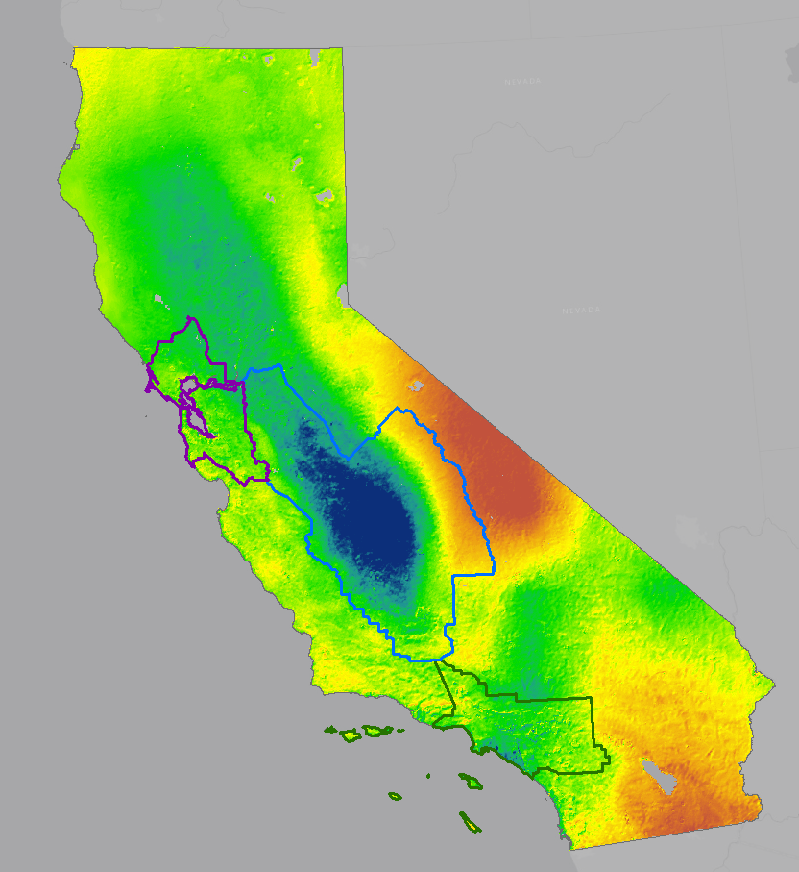
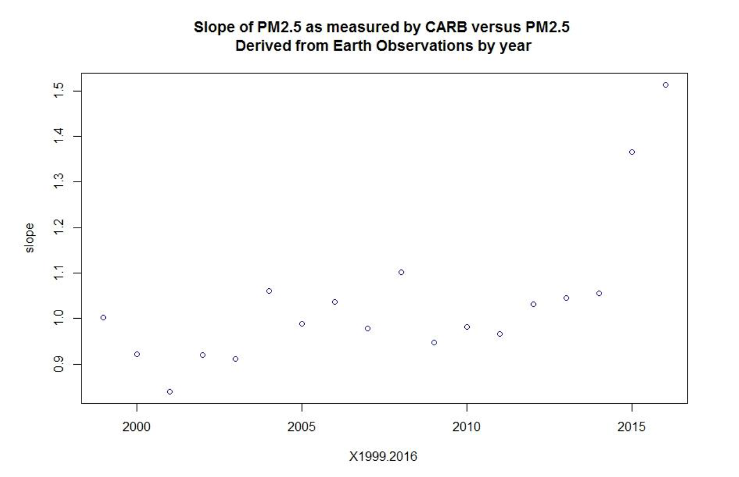
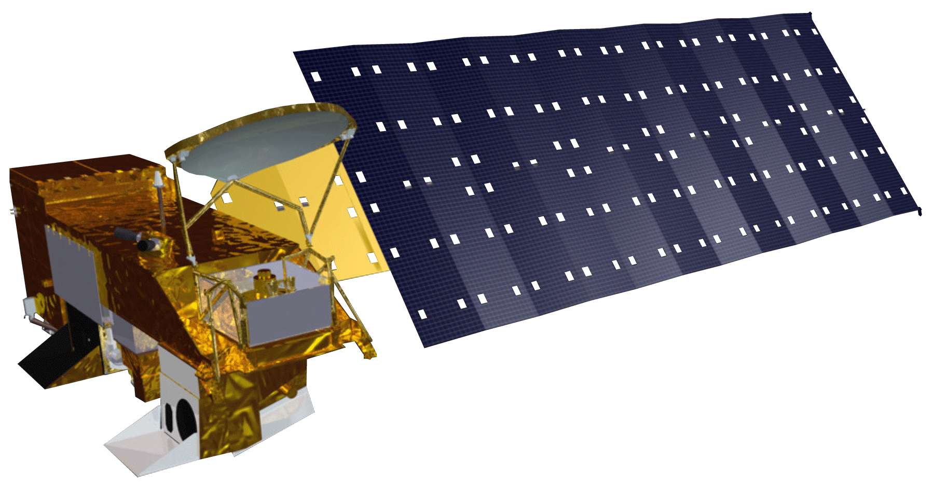
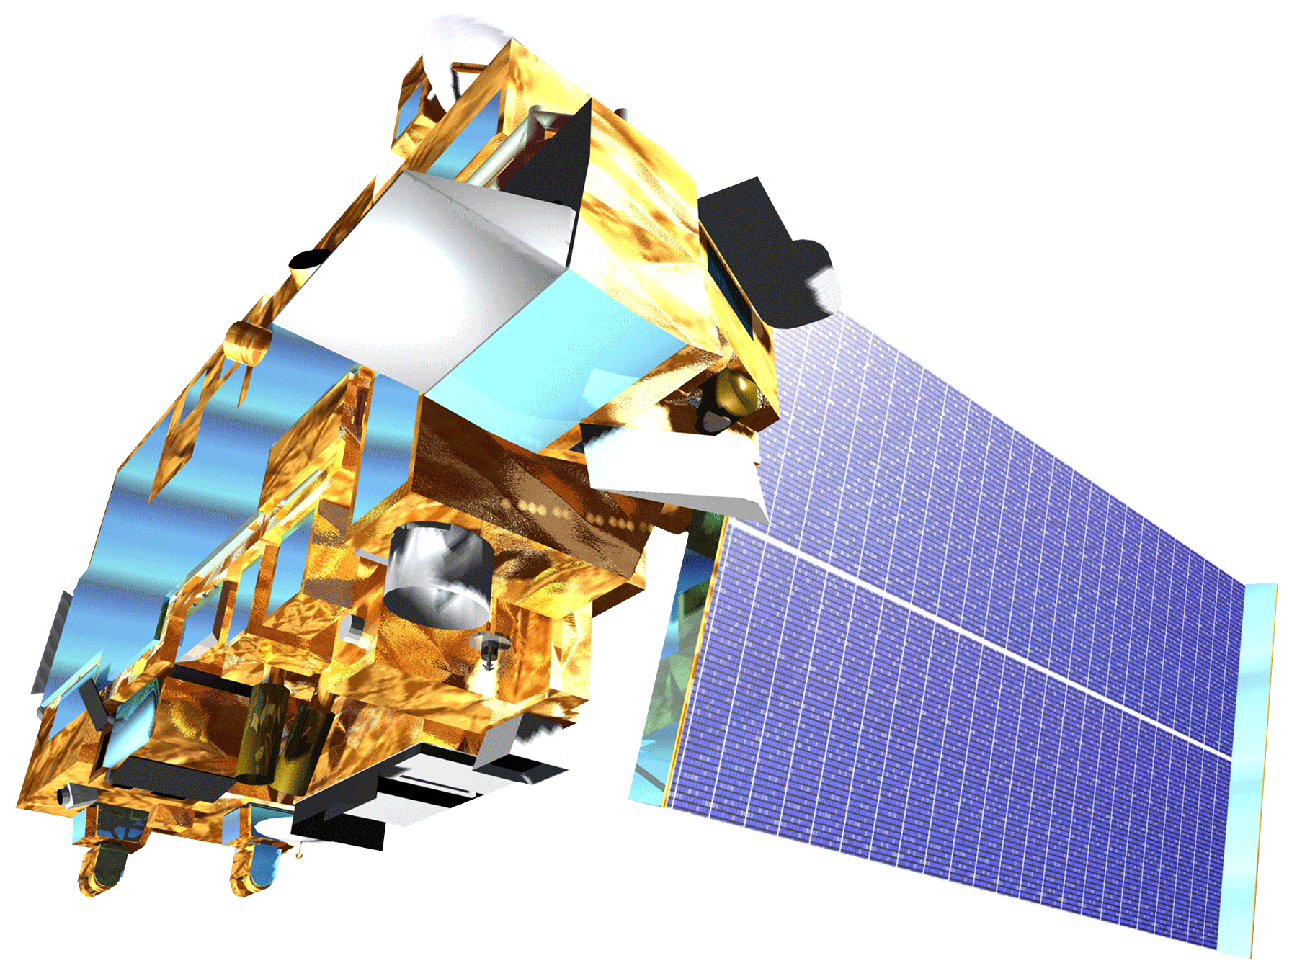
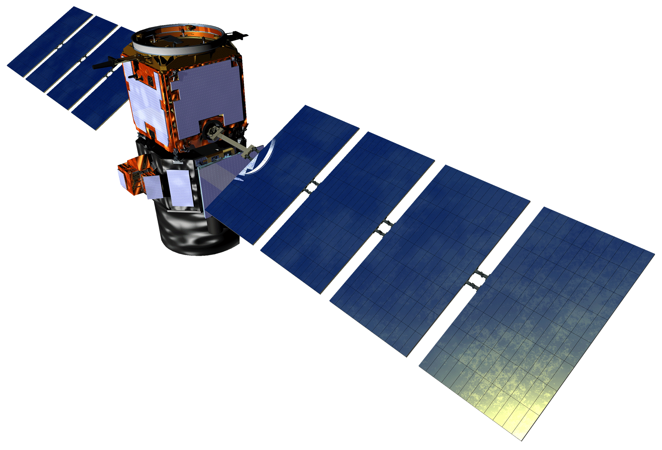
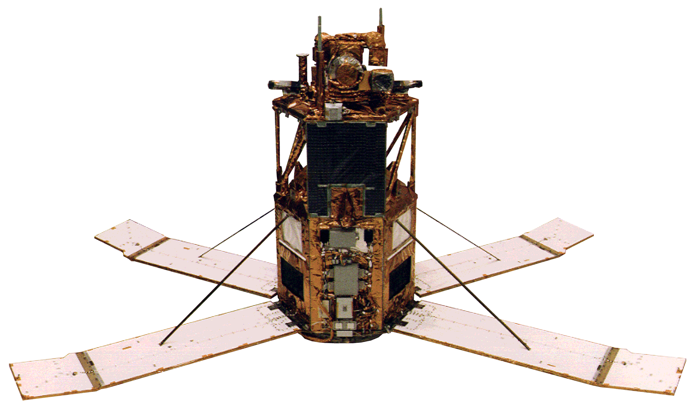
Measuring California Air Quality through the Use of NASA Earth Observations to Identify Spatial, Temporal, and Social Disparities in Particulate Matter Pollution
Abstract
Objectives
Thirty-five million California residents live in counties where they are more susceptible to contracting an air quality-related health ailment. Particulate matter less than 2.5 µm in size (PM_{2.5}) is an important metric of air quality and can cause significant health problems. Despite California’s policies targeted at reducing PM_{2.5} and other air pollutants, three major cities experienced increasing levels of PM_{2.5} from 2013 to 2015. California’s rapid population growth compounds these air quality problems and stresses the need for air pollution reduction policies. Current air quality remediation and regulations are based off in situ air quality monitors; however, these methods do not provide optimal spatial coverage. The NASA DEVELOP project team investigated the advantages of using PM_{2.5} data derived from remote sensing imagery taken from Moderate Resolution Imaging Spectroradiometer (MODIS), Multi-angle Imaging Spectroradiometer (MISR), Cloud-Aerosol Lidar and Infrared Pathfinder Satellite Observation (CALIPSO), and Sea-Viewing Wide Field-of-View Sensor (SeaWiFS), to study PM_{2.5} in California from 1998 to 2016. We analyzed trends in PM_{2.5} concentrations over time as well as the spatial distribution of PM_{2.5} relative to socioeconomic factors. With the results of these analyses, the California Air Resources Board will gain a clearer understanding of the spatial and temporal distribution of particulate matter pollution in the state, and which communities are more likely to face heightened health risks from air pollution.
Determine the feasibility of using a satellite-derived dataset to represent PM_{2.5} in California
Examine statewide spatial and temporal trends in PM_{2.5} concentration
Evaluate the correlation between satellite-derived PM_{2.5} and socioeconomic factors
Results
Slope of PM_{2.5} as Measured by CARB Monitors vs.
PM_{2.5} Derived from Earth Observations
Change in PM_{2.5} from 1998–2000 Mean to 2012–2014 Mean
1.5
1.4
1.3
Slope
1.2
1.1
1.0
PM_{2.5} (μg/m³)
0.9
1 km pixels
Study Area
High : 6.7
Earth Observations
2000
2005
Year
2010
2015
Low : -11.1
California
1000
1,600,000
California (CA)
1,400,000
Air Basin
800
1,200,000
San Francisco (SF)
600
1,000,000
800,000
San Joaquin Valley (SJV)
Acres Burned By Fire
South Coast (SC)
400
600,000
Aqua MODIS
Terra MODIS
200
400,000
0
200,000
0
PM_{2.5} anomaly
Fire acres
Mean cumul.
% Population White
% Population Latino/Hispanic
% Population Black
precip/1km pixel
2000
2010
2000
2010
2000
2010
25
CA
CA
CA
20
15
CALIPSO
CALIOP
OrbView-2 (SeaStar)
10
5
0
Methodology
25
SJV
SJV
SJV
20
15
PM_{2.5} Data
10
5
Annual PM_{2.5} averages used in this project were derived by the Dalhousie University Atmospheric Composition Analysis Group (ACAG), who applied a geographically weighted regression to a combination of the above Earth observations, the GEOS-Chem chemical transport model, and Aerosol Robotic Network (AERONET) ground-based observations. The NASA DEVELOP team did not perform these steps.
PM_{2.5} (μg/m³)
SF
SF
Q1&Q2
Q3
Q4
Q1&Q2
Q3
Q4
SF
15
10
5
Determine feasibility
25
SC
SC
SC
PM_{2.5} data
1999
2016
20
linear regression
15
CARB ground monitor measurements
10
5
Q1
Q2
Q3
Q4
Q1
Q2
Q3
Q4
Q1
Q2
Q3
Q4
Q1
Q2
Q3
Q4
Q1
Q2
Q3
Q4
Q1
Q2
Q3
Q4
Examine statewide trends
Quartiles (Q1–4) of Percent (%) Population that is a Certain Race or Ethnicity vs ACAG PM_{2.5} Concentrations. Linear regressions reveal statistical significance for every group in each year except for Latino/Hispanic in the San Francisco air basin in 2010.
PM_{2.5}
anomalies
vs
Vehicle miles traveled
Fire acreage
Mean
precipitation
Conclusions
1998
2014
While the ACAG PM_{2.5} data product adequately represents long-term exposure and large-scale spatial processes, the dataset’s coarse annual average temporal resolution may fail to capture all PM_{2.5}-related health risks.
Recent California air quality policies and regulations may be factors contributing to overall declines in PM_{2.5}, while precipitation, fire, and transportation patterns likely contribute to the inter-annual variability in the San Francisco, San Joaquin Valley, and South Coast air basins.
Low-income communities, especially those with higher percentages of minority populations, are more likely to experience greater annual mean PM_{2.5} concentrations.
PM_{2.5} data
linear regression
2000
&
2010
Evaluate correlation
box plots
Socioeconomic data
Acknowledgements
Team Members
Project Partners
Hyung Joo Lee (California Air Resources Board)
Madeline Brozen (University of California, Los Angeles, Institute of Transportation Studies)
Dr. Juan Torres-Pérez (Bay Area Environmental Research Institute, NASA Ames Research Center)
Jenna Williams (NASA DEVELOP, NASA Ames Research Center)
California Air Resources Board
University of California, Los Angeles, Institute of Transportation Studies
Amanda Wasserman
Ariana Nickmeyer
Megs Seeley
Project Lead
California Health & Air Quality
California – Ames| Spring 2018

