Slide 1
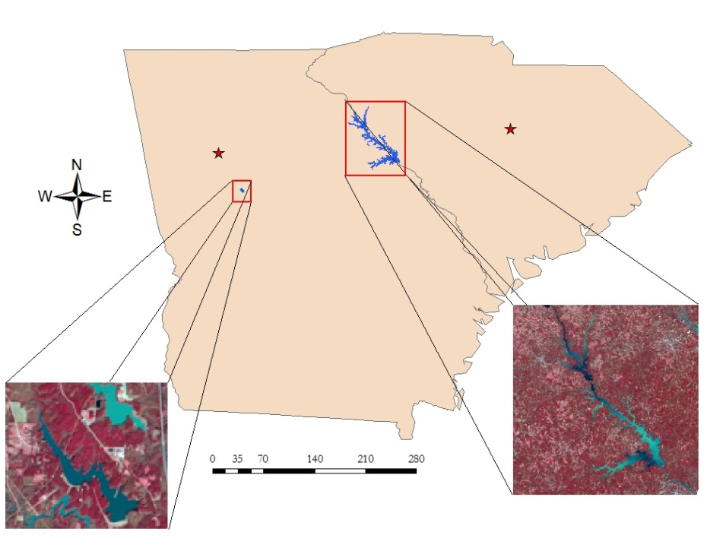
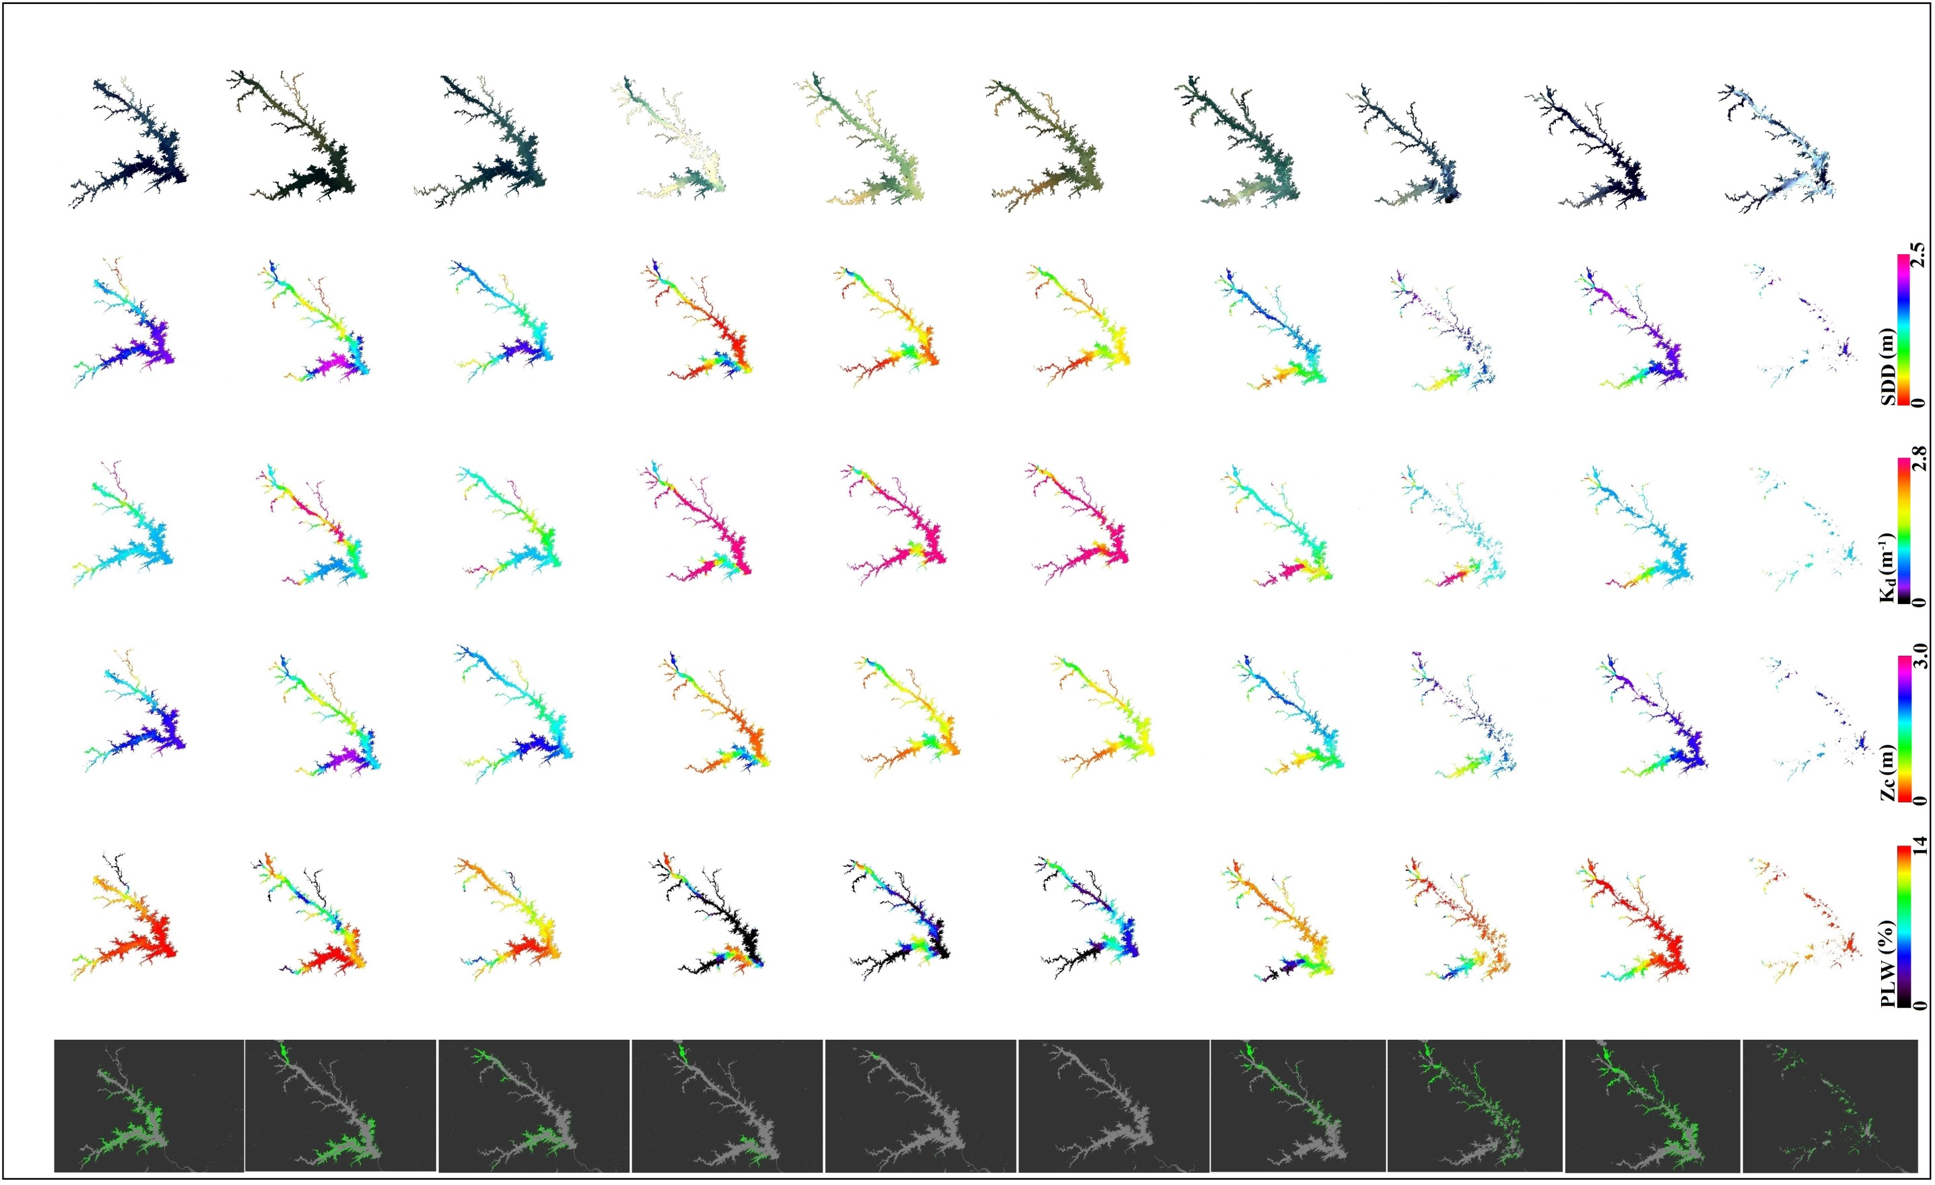
Utilizing NASA Earth Observations and Proximal Remote Sensing for Mapping the Spatio-Temporal Distribution of Hydrilla verticillata
Abstract
Objectives
Hydrilla verticillata is an invasive aquatic plant which has rapidly spread through many inland water-bodies across the Southeastern United States (SEUS) mainly through inadvertent transfer. Once in a water body, this invasive species generally out-competes native aquatic plants and becomes established as the most dominant vegetative species. Consumption of water for drinking, power generation, and recreational use of lakes has been threatened by the spread of Hydrilla. In recent years it was discovered that Hydrilla serves as a host for an epiphytic, toxic cyanobacteria (Aetokthonos hydrillicola) in some water bodies. Aetokthonos hydrillicola is now known to be the causative agent of the neurodegenerative disease avian vacuolar myelinopathy (AVM), which affects waterfowl, raptors, and amphibians. Using Landsat 8 Operational Land Imager (OLI) imagery, a rapid assessment tool was developed to accurately map the extent of Hydrilla on Lake Thurmond (GA/SC) and Long Branch reservoir in Henry County, Georgia. This tool will act as the foundation for later models intending to predict future locations in need of Hydrilla management.
Develop a model using NASA satellite imagery and in situ data to accurately map the current distribution of Hydrilla
Design the model to forecast potential Hydrilla growth
Estimate the maximum depth at which Hydrilla can colonize
Estimate the suitable light conditions required for colonization of Hydrilla
Study Area
South Carolina
Methodology
Atlanta
Columbia
In situ data
Satellite Data
Georgia
Hyperspectral R_{rs}
Secchi Disk Depth
LI-COR Light Meter
Atmospheric Correction
Accuracy Assessment of Correction
Landsat 8 R_{rs}
SDD Model Calibration
Km
Lake J. Strom Thurmond
Spatio-Temporal SDD Map
Comparative Validation
True Color Satellite Images
Long Branch Reservoir
NASA DEVELOP Southeast Ecological Forecasting III
July 2016
WGS 1984 UTM Zone 17N
Data provided by USGS, Esri, Henry County Water Authority, and U.S. Army Corps of Engineers
K_{d} & Z_{c} Model Calibration
Spatio-Temporal K_{d} & Z_{c} Map
Earth Observations
Spatio-Temporal PLW Map
Landsat 8 Operational Land Imager
Threshold Assessment
Southeast Ecological Forecasting III
Conclusions
Predictive Model
Hydrilla Distribution Map
The methodology developed during this term can be used to accurately predict and map Hydrilla distribution using Landsat 8 OLI imagery.
Ideal Hydrilla habitat was predicted in waters featuring high Secchi disk depth (SDD), low light attentuation coefficients (K_{d}), and consequently both high Z_{c} and high percent light through water column at Z_{c} (PLW).
The accuracy of the predictive model can be further improved by including nutrient and epiphyte data to derive percent light at leaf (PLL) from values of PLW.
Ideal conditions for the remote sensing of any submerged vegetation must be cloud-free, haze-free, and without sunglint; in addition, the method of atmospheric correction used must be very accurate.
Results
18th October
2015
26th November
2015
12th December
2015
13th January
2016
29th January
2016
14th February
2016
17th March
2016
2nd April
2016
18th April
2016
21st June
2016
True Color Images (RGB)
Secchi Disk Depth (SDD)
Light att. coeff.
(K_{d})
Acknowledgements
Advisors:
Dr. Deepak Mishra, University of Georgia, Department of Geography
Dr. Susan Wilde, University of Georgia, Warnell School of Forestry and Natural Resources
Partners:
Kenneth Boyd & Allen Dean, US Army Corps of Engineers
Kenneth Presley, Henry County Water Authority
Others:
SEUS Ecological Forecasting II Team: Pradeep Kumar Ragu Chanthar, Brandon Hays, Benjamin Page & Linli Zhu
SEUS Ecological Forecasting I Team: Wuyang Cai, Elizabeth Dyer & Peter Hawman
Max. Depth Col.
(Z_{C})
% Light at Z_{C}
(PLW)
Hydrilla Spatial Distribution
Team Members
Project Partners
US Army Corps of Engineers
Henry County Water Authority
Shuvankar Ghosh
Project Co-Lead
Austin Haney
Project Co-Lead
Frank Braun
Zachary Conner
Christopher Cooper
Abhishek Kumar
Any opinions, findings, and conclusions or recommendations expressed in this material are those of the author(s) and do not necessarily reflect the views of the National Aeronautics and Space Administration. This material is based upon work supported by NASA through contract NNL11AA00B and cooperative agreement NNX14AB60A.
University of Georgia – Summer 2016

