Slide 1
Tempe
Urban Development II
Establishing an Urban Heat Exposure Severity Score for Infrastructure Prioritization in Tempe, Arizona, Using NASA Earth Observations and LiDAR
Sydney Boogaard, John Dialesandro, Anson Pang, Blake Steiner
Arizona – Tempe
Notes:
This presentation is a review of the Tempe Urban Development II project completed by the Fall 2020 NASA DEVELOP Arizona team.
The team members include Sydney Boogaard, John Dialesandro, Anson Pang, and Blake Steiner. NEXT SLIDE

Slide 2
Fall 2020 AZ NODE
Brooklyn, NY
Sacramento, CA
B.A. Geography
Ph.D. Geography
Tucson, AZ
Phoenix, AZ
B.S. Health Policy
M.S. Natural Resources
Notes:
Our team is based out of the Tempe, Arizona Node, but we come from all across the United States. We have team members located in California, Arizona, and New York. Additionally, our team has diverse educational backgrounds, ranging from a PhD candidate to an undergraduate senior NEXT SLIDE

Slide 3
Outline
Project Overview
Methods
&
Results
2. Heat
Vulnerability
3. Heat
Priority
1. Heat
Exposure
4. Shade Analysis
5. Bus Stops &
Hot Zones
Conclusion
Notes:
The presentation will proceed as follows:
First the team will provide an overview of the DEVELOP projects
Second, we will review the team's methods & results
In the Methods & Results section we will be examining the methods of first, heat exposure and then reviewing the results for heat exposure, second examining the methods of heat vulnerability and then reviewing the associated results, that same pattern will follow for third, our heat priority analysis, fourth our shade analysis, and fifth our hot zone & bus stop analysis.
And we will end with some conclusions on future work and the challenges & limitations we face working on this project. NEXT SLIDE

Slide 4
Project Overview
Notes:
Transition Slide

Slide 5
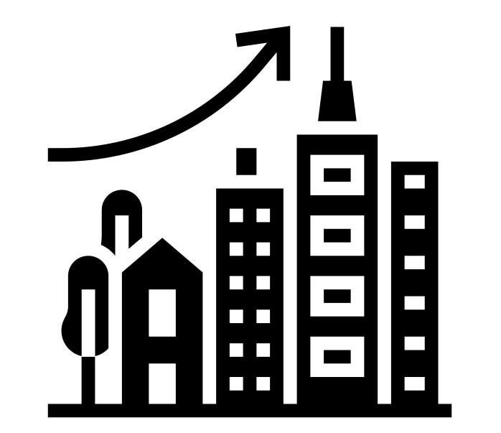
Community Concerns
Rapid Urbanization
Impervious Surfaces
Increased Temperature
Summer Daily Maximum
Temperature Regularly
Exceeding 100 ° F
Increased Temperatures
Threaten
Human Health
Increased Temperatures
Endanger Economic Stability
Notes:
A community concern in Tempe is that summer daily maximum temperature regularly exceeds 100 ° F. NEXT
Rapid urbanization has increased impervious surfaces, which has encouraged warming within the built environment and led Tempe to experience higher temperatures than its surrounding rural areas. This pattern is known as the Urban Heat Island effect. NEXT
High temperatures can diminish human health and quality of life, and overheating can even lead to death. NEXT
Heat endangers economic stability if it becomes too much of a threat to its population. NEXT SLIDE

Slide 6
Project Partners
City of Tempe
Located in Maricopa County, Arizona
Notes:
Our team partnered with the City of Tempe, located in Maricopa County, Arizona. NEXT SLIDE
------------------------------Image Information Below ------------------------------
Image Credit: NASA DEVELOP Fall 2020 Arizona Team

Slide 7
Project Partners
City of Tempe
Healthy Urban Environments (HUE)
Engage local municipalities and communities in urban heat management
Notes:
… and collaborated with the Health Urban Environments (HUE) initiative which is engages local municipalities and communities in urban heat management NEXT SLIDE
------------------------------Image Information Below ------------------------------
Image Credit: NASA DEVELOP Fall 2020 Arizona Team

Slide 8
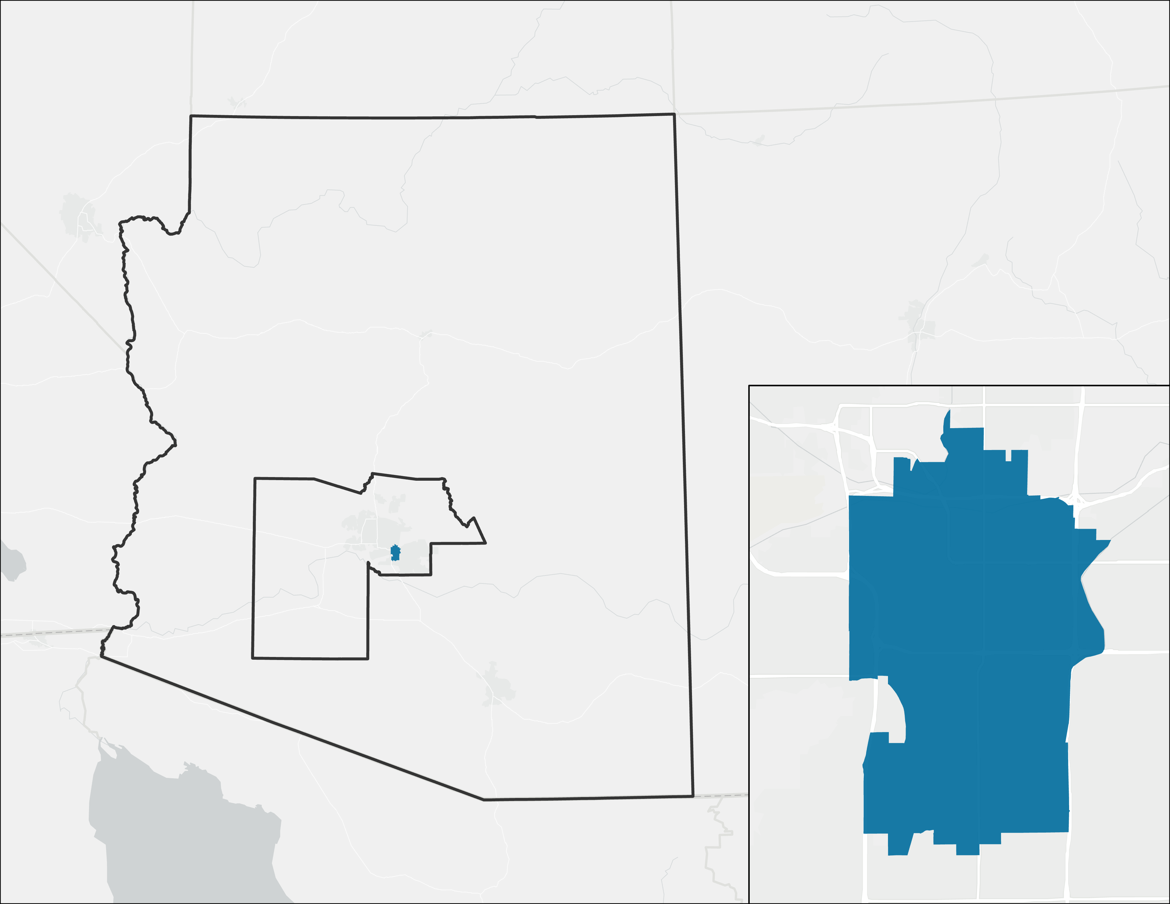
Study Area
195,000 Residents
Growing 3% Annually
Area: 40 Square Miles
Annual Averaged Temperature: 76.7 °F
Annual Averaged Rainfall: 8 inches
Arizona
Phoenix
Tempe
0 2 4
miles
Notes:
Our Team's project study area was the City of Tempe, and it is very close to Phoenix. Tempe is home to an emerging technology hub and Arizona State University, and the city has just under 200,000 residents, as well as a dynamic student population exceeding 60,000. NEXT SLIDE
------------------------------Base Map Information Below ------------------------------
Base Map Attribution: Sources: Esri, HERE, Garmin, © OpenStreetMap contributors, and the GIS user community, World_Light_Gray_Reference.

Slide 9
Project Objectives
NASA's Earth Observations
Identify areas experiencing high heat severity
Geodatabase
Create a user-friendly geodatabase
Creative Communication Tools
Produce ArcGIS StoryMap to help with understanding of urban heat impacts
Notes:
Our teams' project objectives included integrating the capabilities of NASA’s Earth observations and sociodemographic data to aid the City in identifying areas that experience the highest heat severity so that they can prioritize those areas for mitigation initiatives. CLICK.
We want to Provide Tempe with a sharable and user-friendly geodatabase to support future urban heat mitigation initiatives. CLICK.
We also produced a communication tool, ArcGIS StoryMap, to assist City staff, developers, and residents in understanding urban heat impacts in Tempe, Arizona. NEXT SLIDE​
​
NEXT SLIDE

Slide 10
Methods and Results
Notes:
Transition Slide

Slide 11
Study Period
April 2015
October 2020
*data collected through April – October months only​
Notes:
Our study period was April 2015 to October 2020. Representative cloud-free images were selected for the months of the summer season, May to September. The “shoulder” seasonal months of April and October were included to provide a more complete representation of when urban heat deaths and hospitalizations occur. NEXT SLIDE

Slide 12
Indices from Landsat 8 (TIRS/OLI)
Red, NIR
Proxy for green space
Normalized Difference Vegetation Index
(NDVI)
Red, NIR, Brightness temperature
Day Land Surface Temperature
(LST)
Proxy for air temperature
SWIR, NIR
Normalized Difference Building Index
(NDBI)
Landsat 8
OLI/TIRS
Proxy for urban space
Blue, Green, Red, NIR, SWIR1, SWIR2
Albedo
Measure of reflectance
Image Credit: NASA
Notes:
The team used remote sensing derivatives and ancillary data to benchmark a series of biophysical variables that plays a role in urban heat dynamics. The Landsat 8 model provided a lot of useful data, including the NDVI band to examine green spaces, Day LST as a proxy for air temperature, NDBI to examine urban space and albedo as a measure of reflectance. NEXT SLIDE
------------------------------Image Information Below ------------------------------
Image Credit: NASA (Public Domain), retrieved from DEVELOPedia
Image Source: http://www.devpedia.developexchange.com/dp/index.php?title=List_of_Satellite_Pictures

Slide 13
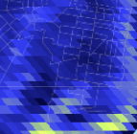
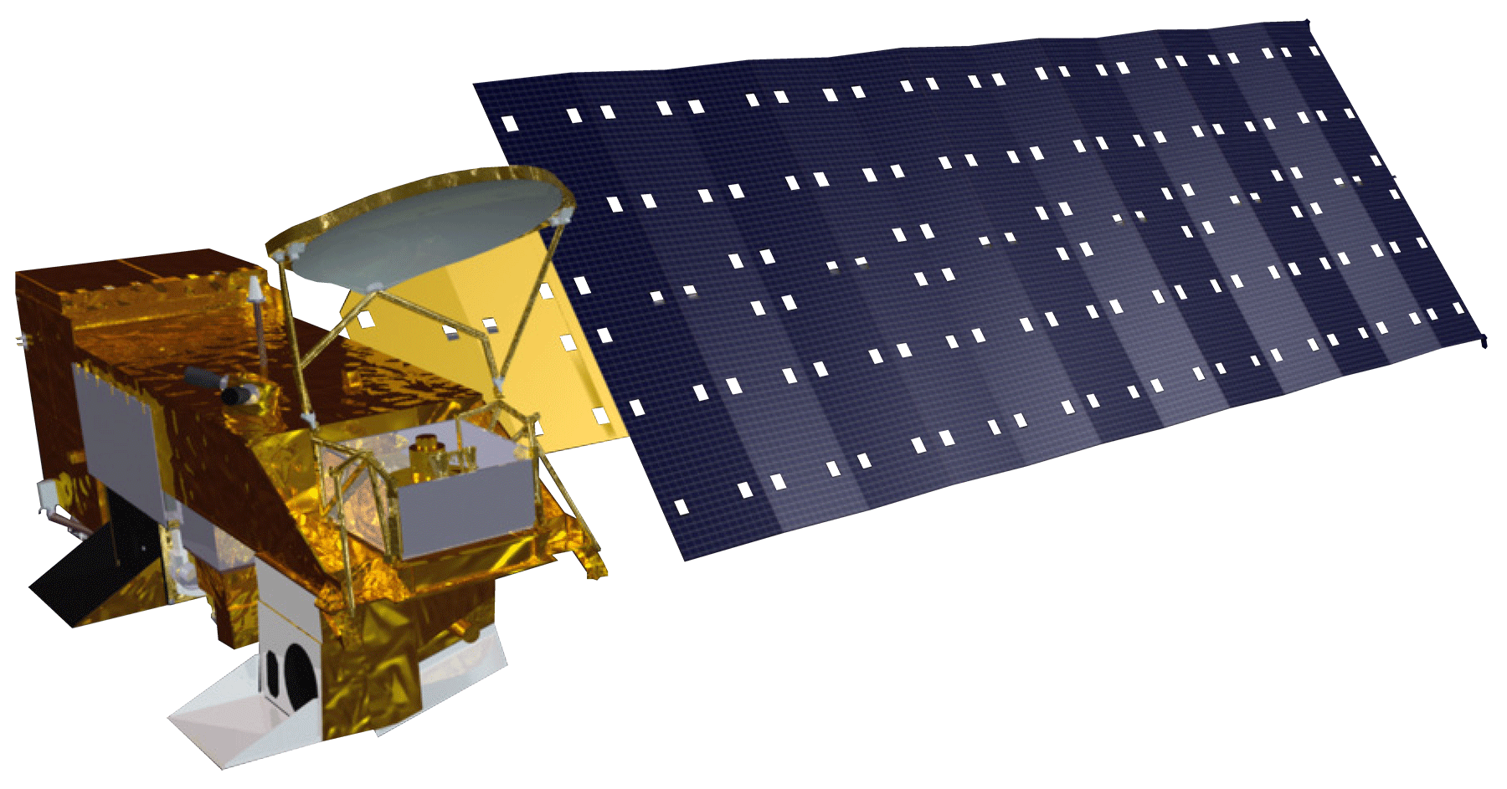
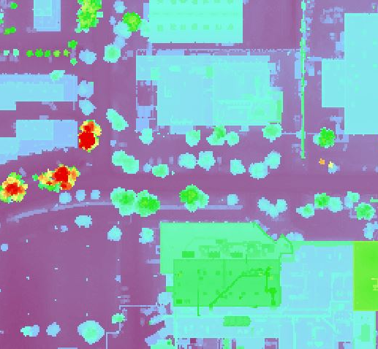
Indices from Aqua MODIS and City
SWIR, NIR
Normalized Difference Water Index
(NDWI)
Proxy for green space health
Night LST 1km
Night LST
Aqua MODIS
Proxy for nighttime air temperature
LiDAR 1-meter
Light Detection and Ranging (LiDAR)
Measure for shade
Image Credit: NASA
Notes:
The Aqua MODIS satellite was used to extract data like NDWI as a proxy for green space health and Night LST as a proxy for nighttime air temperatures. Lastly, the City has provided LiDAR data to allow the team to do some shading analyses. NEXT SLIDE
------------------------------Image Information Below ------------------------------
Image Credit: NASA (Public Domain), retrieved from DEVELOPedia
Image Source: http://www.devpedia.developexchange.com/dp/index.php?title=List_of_Satellite_Pictures

Slide 14
Social Variables
% Ethnic Minority
% Below Poverty Line
% Without HS Diploma
% 65 Years & Older % 65 Years Older Living Alone
% Living Alone
$ Total Median Income Total Population
2013-2018 (5-year Interval)
Notes:
We reviewed many sociodemographic variables but decided upon the variables that the literature uses to explain the most variation associted with heat vulnerability in Maricopa County. These included % Ethnic Minority, % Below Poverty Line, % Without High School Diploma, % Elderly, % Elderly Living Alone, %Living Alone, the Median Household Income, and total population per census tract. NEXT SLIDE.

Slide 15
1. Heat Exposure
Notes:
Transition Slide

Slide 16
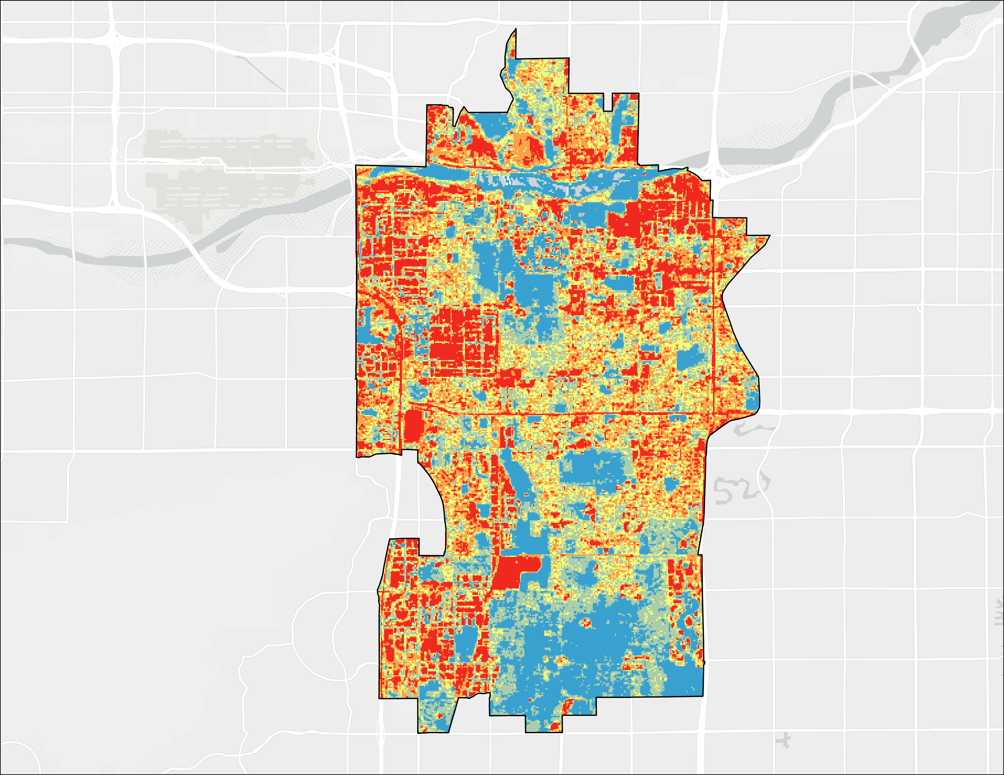
Land Surface Temperature (LST)
Median LST (°F)
≤ 162.3
≤ 121.2
≤ 118.2
≤ 115.6
≤ 111.4
City
Boundary
0 2 4​​​
miles
Notes:
This map is a composite of 55 images over 6 years from 2015 to 2020 and gives us a preliminary look into how LST varies across the city. Several areas in SW, NW and NE Tempe experiences LST between 121.2 and 162.3 °F, which is depicted in red in this map, and illustrates some of the hottest areas in Tempe based on LST. Areas that are in blue have a median LST less than 111.4 °F. These areas are located in SE and Northern Tempe.
NEXT SLIDE
------------------------------Base Map Information Below ------------------------------
Base Map Attribution: Sources: Esri, HERE, Garmin, © OpenStreetMap contributors, and the GIS user community, World_Light_Gray_Reference.

Slide 17
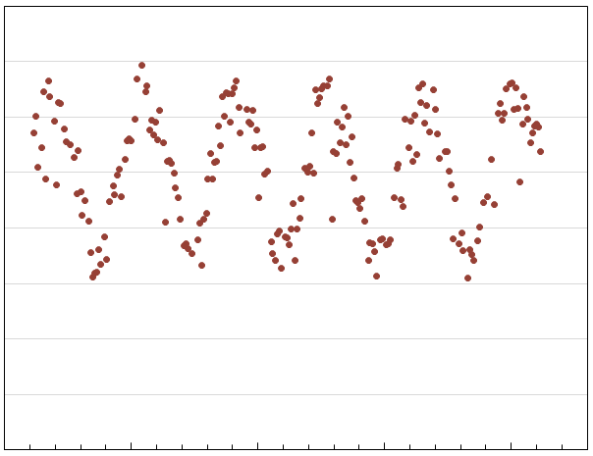
Land Surface Temperature (LST)
160
LST Time Series (2015 to 2020)
140
120
100
80
60
40
20
0
Dec-14
May-16
Sep-17
Feb-19
Jan-20
Notes:
This graph shows the seasonal oscillation of temperature readings from every available Landsat images taken between 2015 and 2020. Images that were cloudy were removed. You can see from the time series that images used from the warm season are taken near the peak of each seasonal wave representing the warm season.
Prompt to City Staff: Does anyone want more clarification if this data is useful to acknowledge? NEXT SLIDE
Base Map Attribution: Sources: Esri, HERE, Garmin, © OpenStreetMap contributors, and the GIS user community, World_Light_Gray_Reference.

Slide 18
Data Collection and Processing
Input Data (6)
Collection and Processing
Output spreadsheets for analysis
Software
R
Google
Earth
Engine
6 Environmental Variables
Collect and process the data for statistical analysis
Notes:
Overall, we have taken 14 variables into account. First we considered the env. Variables and used Google Earth Engine to collect and process them from satellite imagery. The Tidycensus package in R statistical software was used to collect the 8 social variables from the ACS data.
We tidied and filtered the datasets to produce spreadsheets that can be joined via the common GEOID attribute from the census tracts.
First, let us explore two of the environmental variables and their difference from Tempe-wide averages.
NEXT SLIDE.

Slide 19
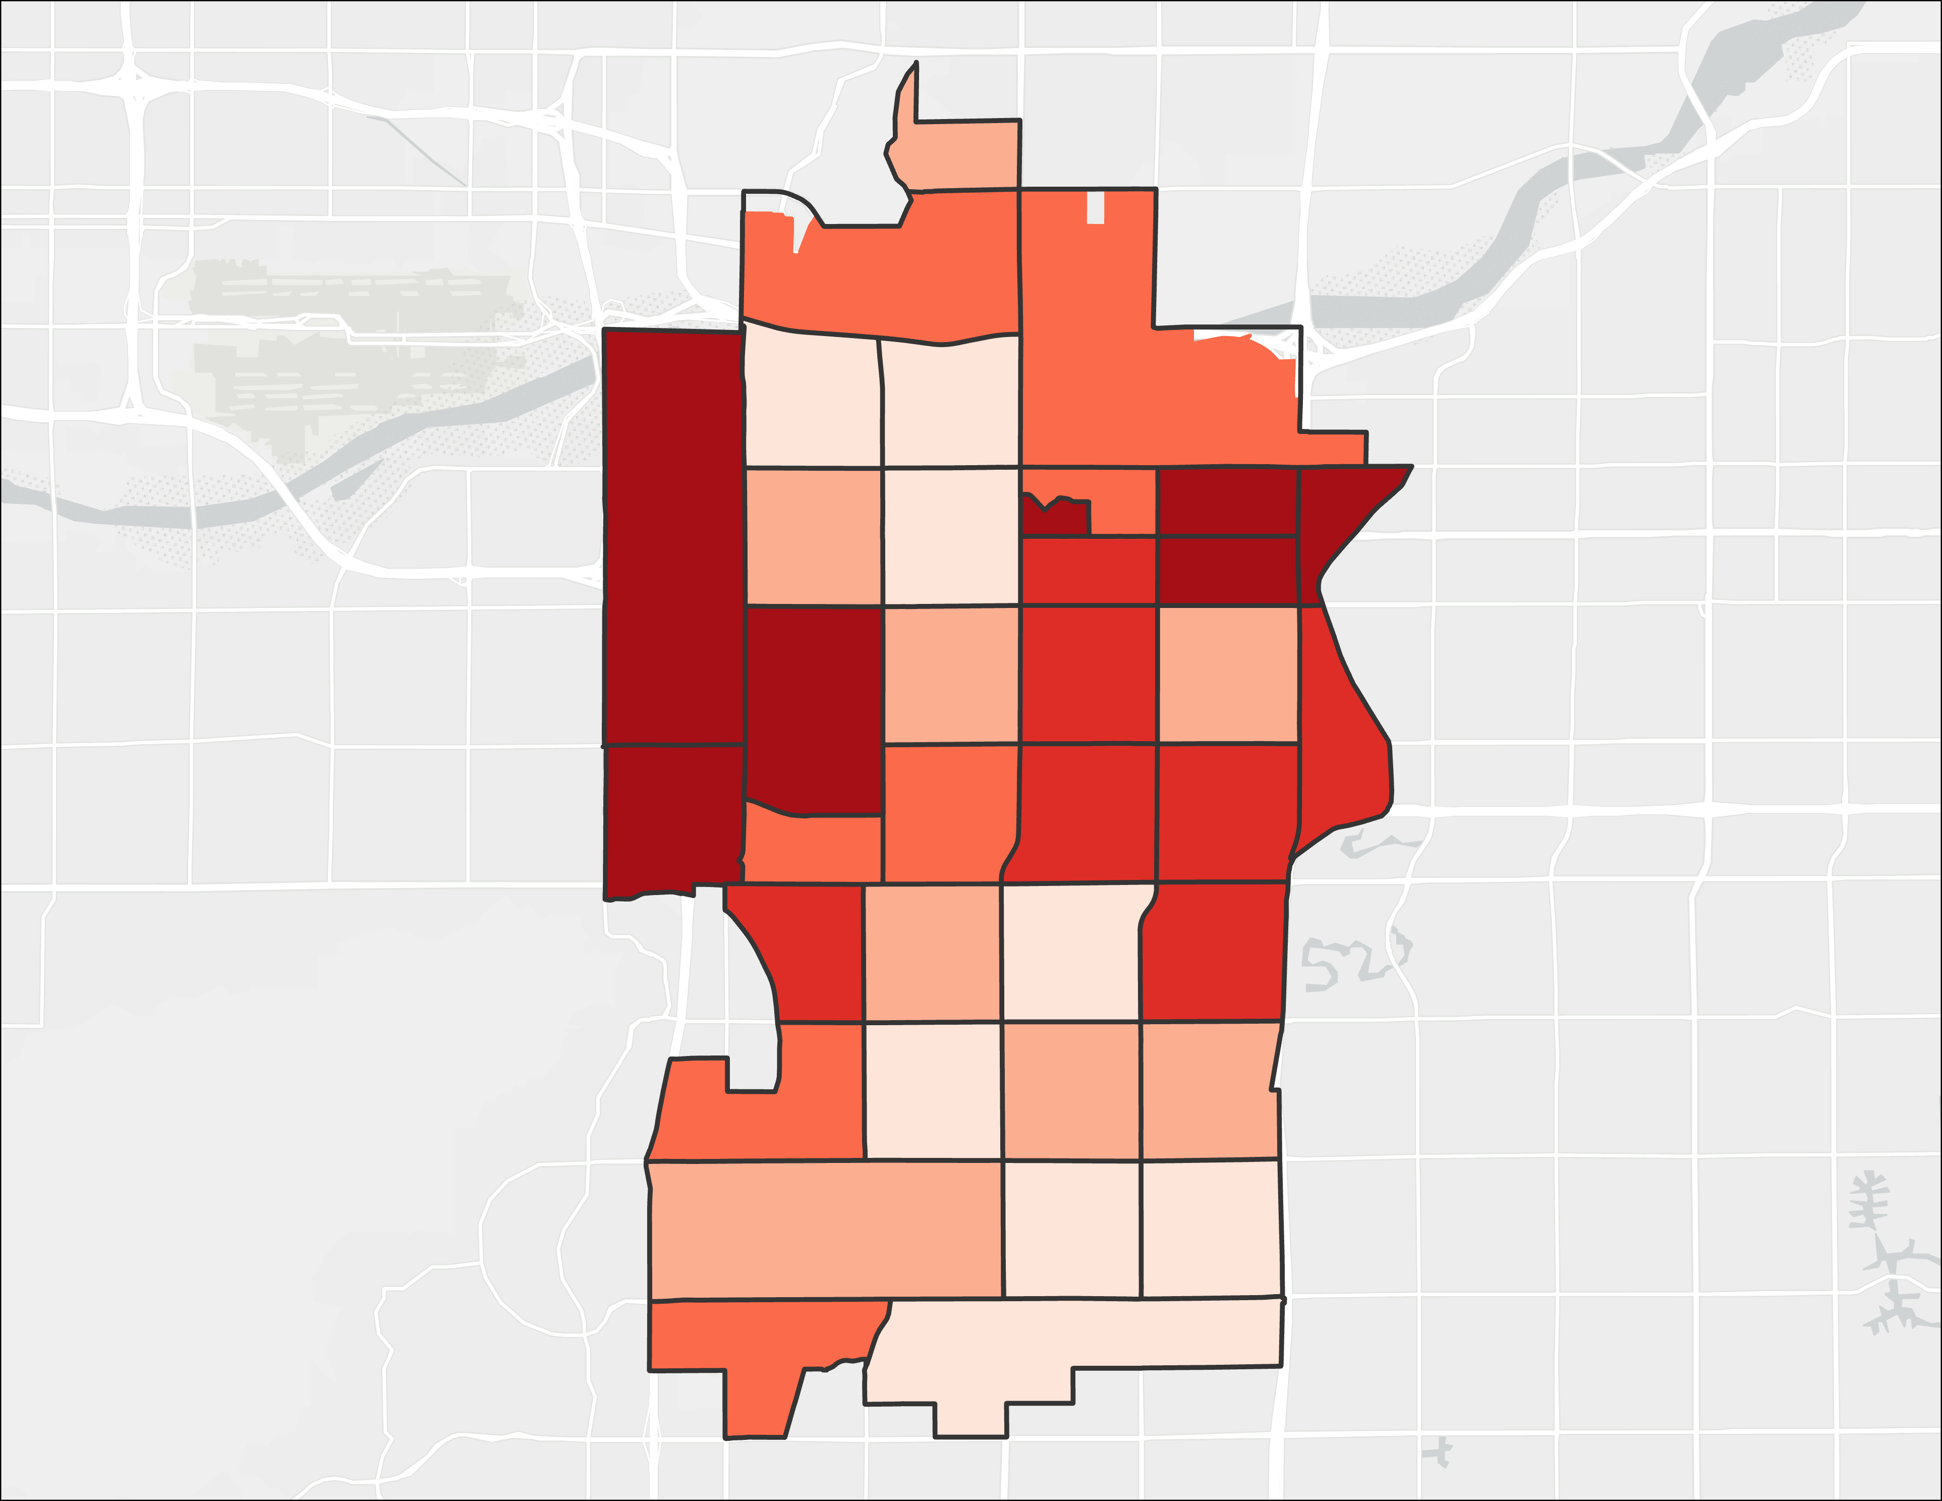
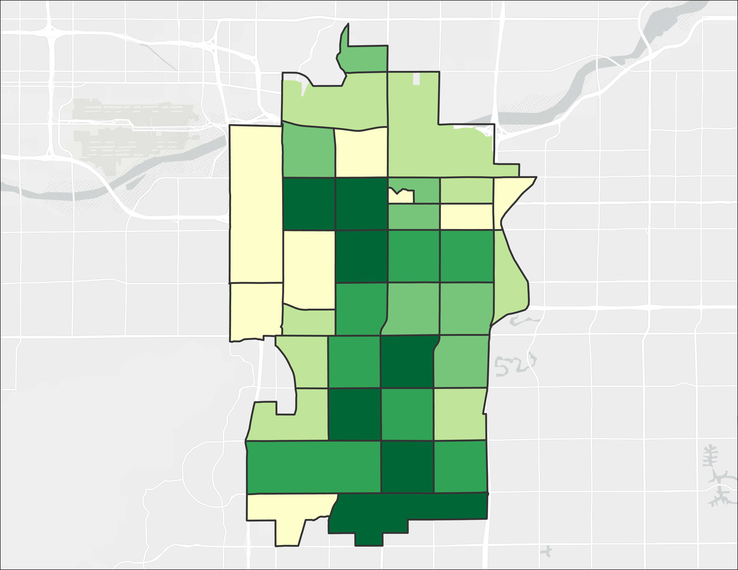
Biophysical Variables
LST Difference
From City Mean (° F)
NDVI Difference From City Mean
≤ -0.743
≤ 0.538
≤ 1.691
≤ 2.591
≤ 5.601
≤ 0.1647
≤ 0.1767
≤ 0.1939
≤ 0.2139
≤ 0.3144
City
Boundary
City
Boundary
0 2 4​
miles
0 2 4​​
miles
Notes:
Daytime LST is elevated in the areas of southern Tempe. Vegetation abundance is inversely correlated with LST and highest in the city’s western part of the city.
Prompt to City Staff: Now that we have a chance to look at the data, does anyone want any clarifications to the City? Do the results match up to what people see in reality and your own data?
NEXT SLIDE
------------------------------Base Map Information Below ------------------------------
Base Map Attribution: Sources: Esri, HERE, Garmin, © OpenStreetMap contributors, and the GIS user community, World_Light_Gray_Reference.

Slide 20
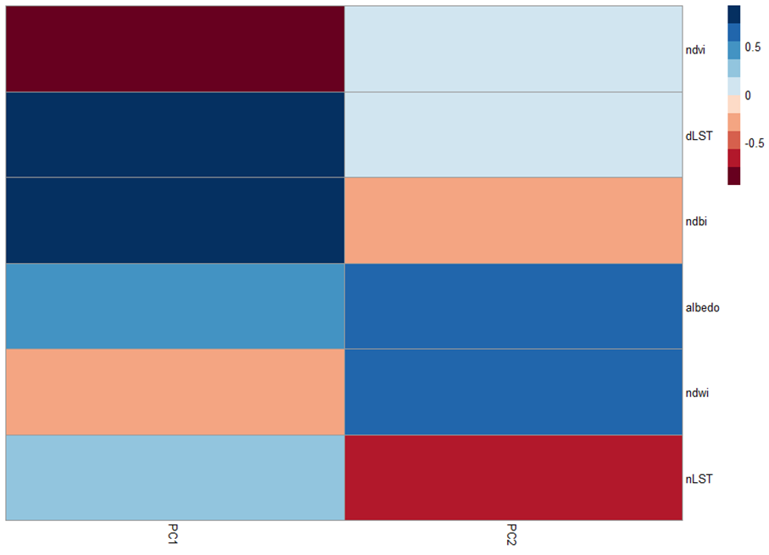
Heat Exposure PCA
NDVI
Day time LST
NDBI
Albedo
NDWI
Night time LST
0.5
0
-0.5
PC 1
PC 2
Notes:
A note to NPO:
Hello! Currently it is unclear whether or not we will keep these PCA correltation slides in the main presentation or move to after the acknoledgements to help answer partner questions after the presentation. Regardless, we would still love for you to review them and their speaker notes in case they do come up in the partner presentation. Thank you!
Our first PCA that examines environmental indices show that high day time LST and impervious surface via NDBI are positively correlated, whereas NDVI is negatively correlated. These 3 variables are important in the first Principal Component as they explain most of the variation in the satellite dataset. This implies that these variables are important factors in the urban heat island issue.
In the second Principal component, nighttime LST was inversely correlated with higher NDWI and higher albedo. NEXT SLIDE

Slide 21
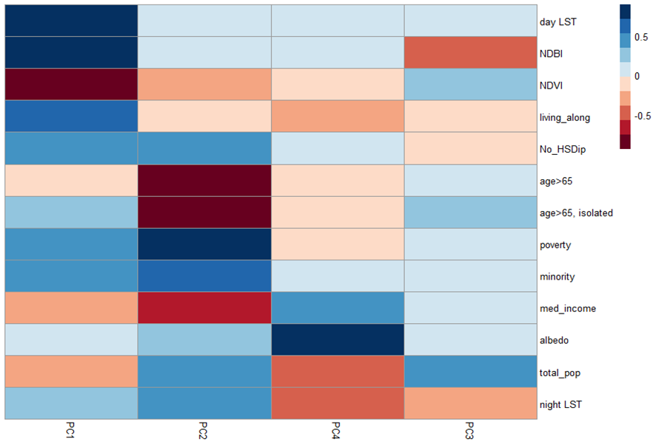
Principal Component Analysis (PCA)
Input Data from spreadsheets (6)
Select Components (2-4)
Score by Census Tract
High
R
Variables
Components
Low
Identify patterns and analyze spatial data into an index
Placement Image/Caption
Notes:
"To create the scores for heat exposure we used a Principal Component Analysis, which is also known as a PCA. In short, a PCA takes each variable and combines them into principal components, PCs. These PCs help us inspect the extent to which variables are correlated with each other. It is important all variables were normalized by the standard deviation.
We took the 6 environmental variables discussed previously and analyzed them using the PCA method. We then selected the 2-4 components that explained at least 80% of the data variation. These components were then used to develop an overall score for each census tract.

Slide 22
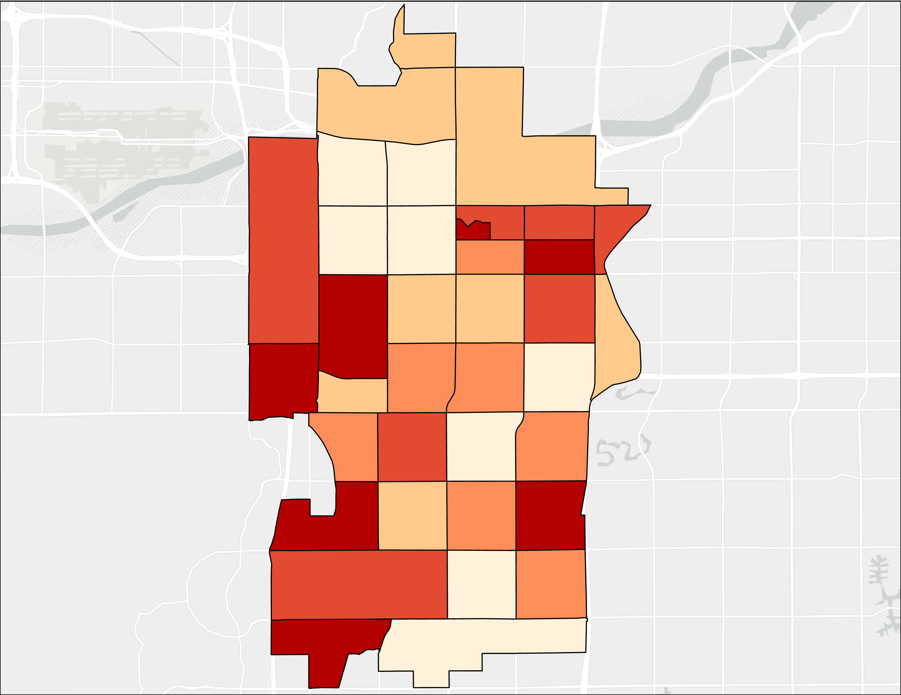
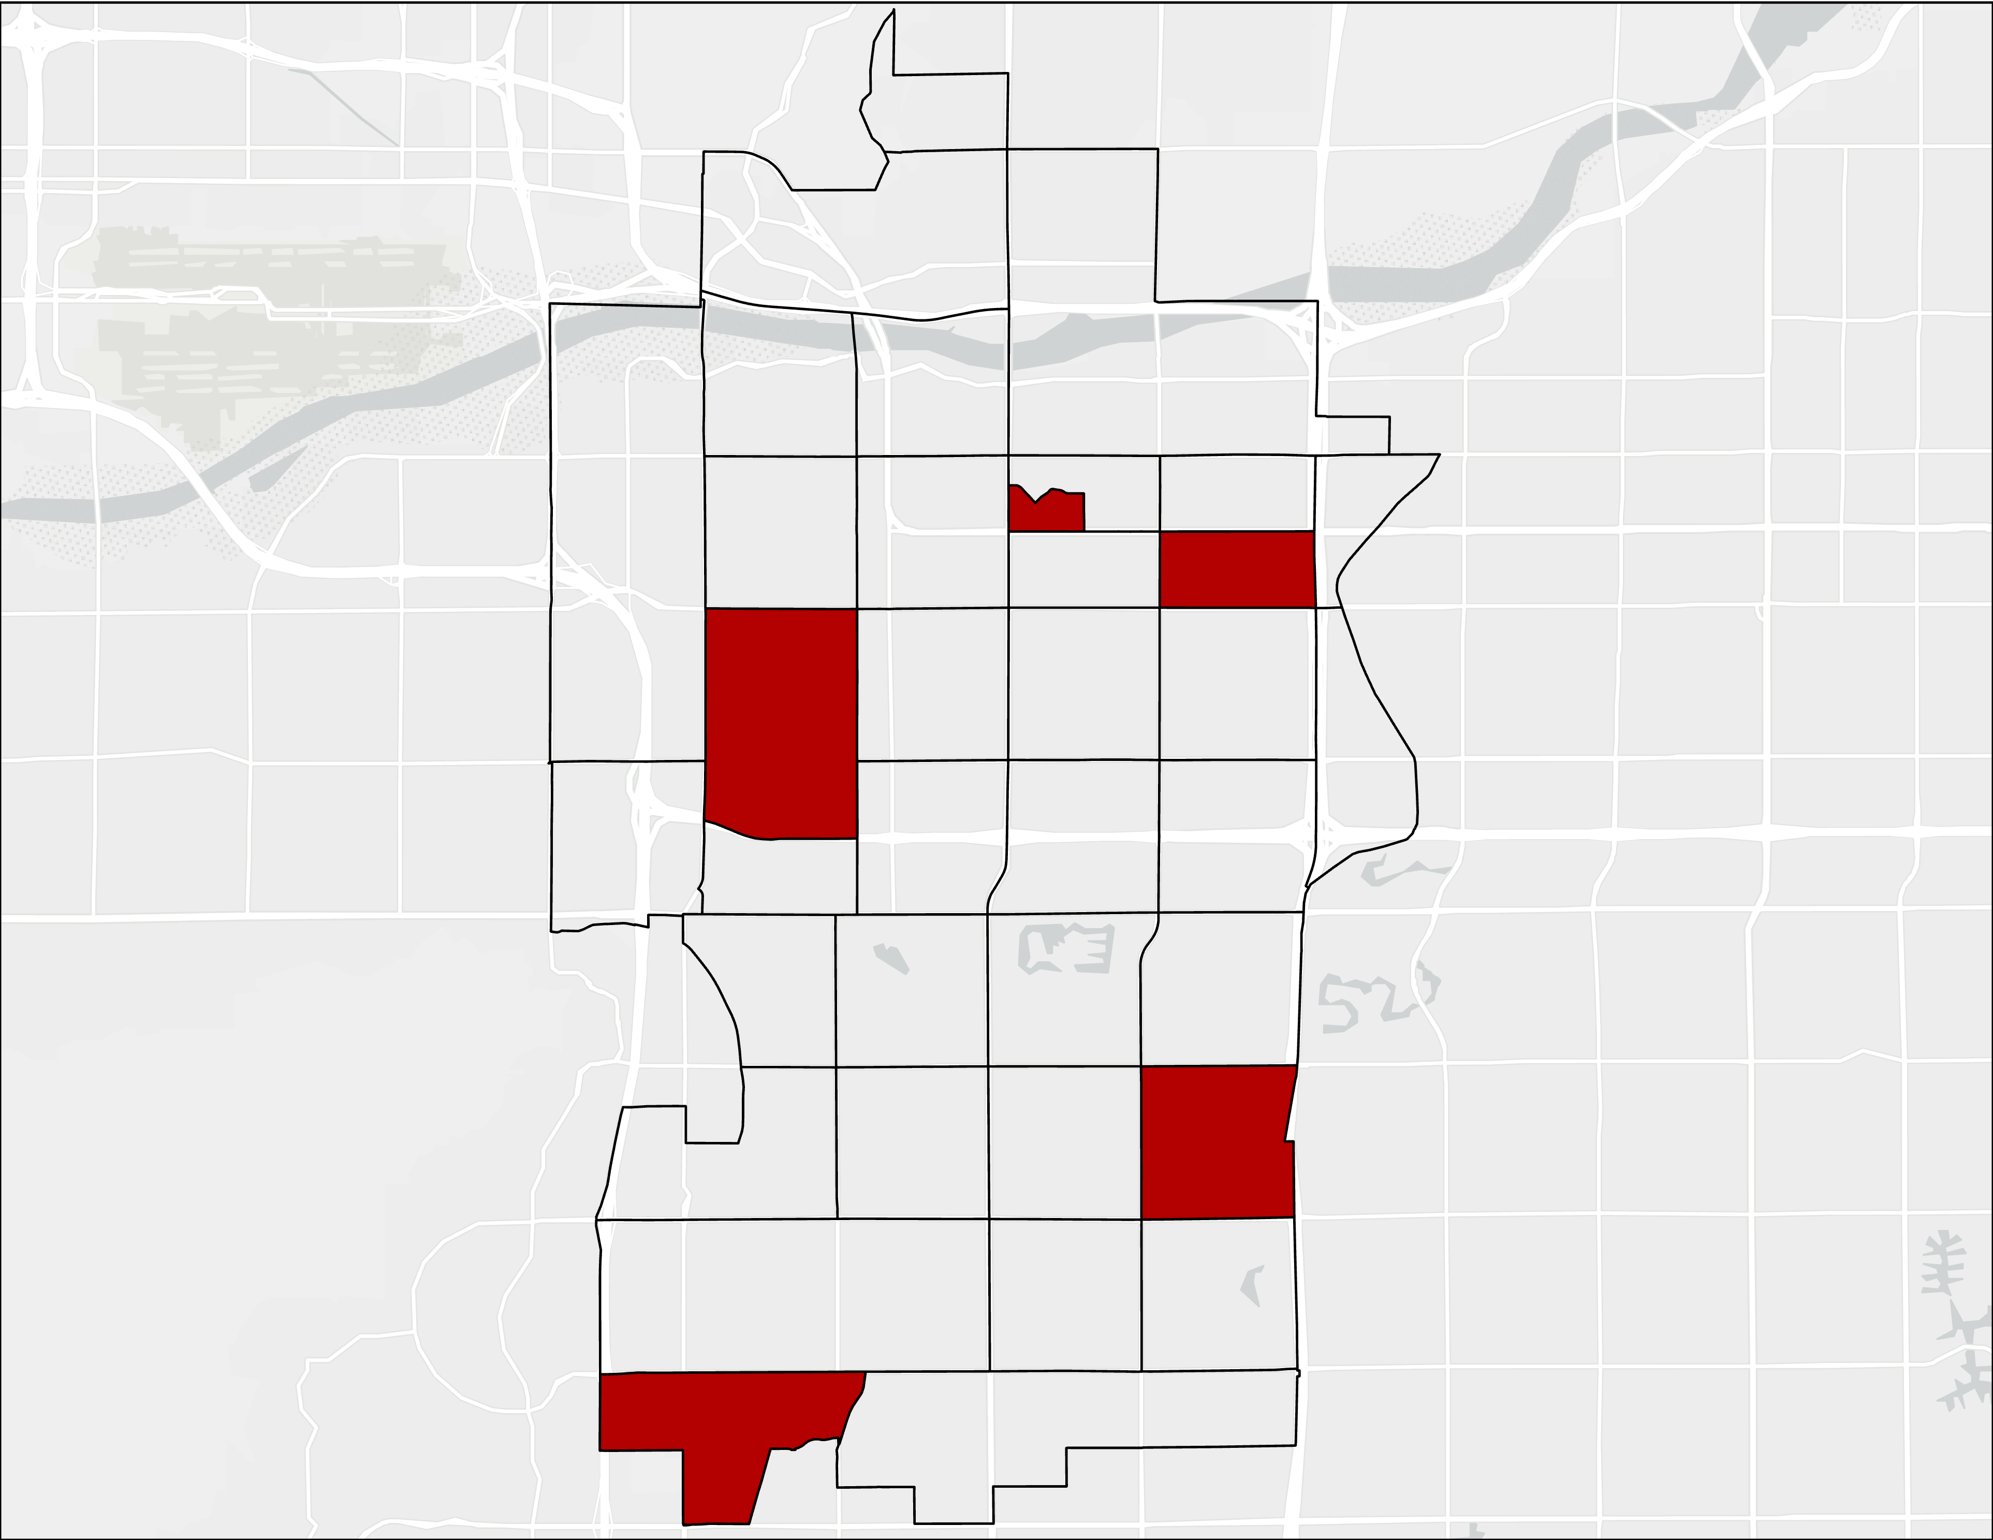
Heat Exposure Score Maps
2
3
Heat Exposure Score by Census Tracts
Top Five HES Census Tracts
5
4
3
2
1
1
City
Boundary
4
City
Boundary
5
0 2 4​​​
miles
0 2 4​​​
miles
Notes:
The CTs with the highest HES are 319705, 319101, 319202, 319906, and 810000. These CTs contain the Industrial Park along S. Industrial Park Ave., at University Pointe, Riviera Village Apartments, Camelot Village, and Chandler Crossing Estates.
Although there were several CTs that had a higher LST, due to a combination of low albedo, low NDWI, higher NDBI, and low NDVI these CTs ended up scoring higher.
For example, CT 8501 has an average LST of 120. However, its albedo and NDWI from the second PC, were notably higher, which was enough to lower its HES.
THIS DOESN'T MEAN THERE AREANT HOT SPOTS IN THE LOW CENSUS TRACTS
Prompt to City Staff: Does anyone want more clarity on the factors that are driving the urban heat island effect in relation to environmental variables? This is referring to the variables that are derived from the satellites discussed above. NEXT SLIDE
------------------------------Base Map Information Below ------------------------------
Base Map Attribution: Sources: Esri, HERE, Garmin, © OpenStreetMap contributors, and the GIS user community, World_Light_Gray_Reference.

Slide 23
2. Heat Vulnerability
Notes:
Transition Slide

Slide 24
Data Collection and Processing
Input Data (8)
Collection and Processing
Output spreadsheets for analysis
8 Socio-economic Variables
Software
R
Collect and process the data for statistical analysis
Notes:
For Heat Vulnerability we took into account 8 variables. The Tidycensus package in R statistical software was used to collect these 8 social variables from the ACS data.
We tidied and filtered the datasets to produce spreadsheets that can be joined via the common GEOID attribute from the census tracts. NEXT SLIDE.

Slide 25
Principal Component Analysis (PCA)
Input Data from spreadsheets (8)
Select Components (2-4)
Score by Census Tract
High
R
Variables
Components
Low
Identify patterns and analyze spatial data into an index
Placement Image/Caption
Notes:
We then needed to create the scores for heat vulnerability, so like with the Heat Exposure we used a PCA.
We took the 8 variables discussed previously and analyzed them using the PCA method. We then selected the 2-4 components that explained at least 80% of the data variation. These components were then used to develop an overall score for each census tract. NEXT SLIDE

Slide 26
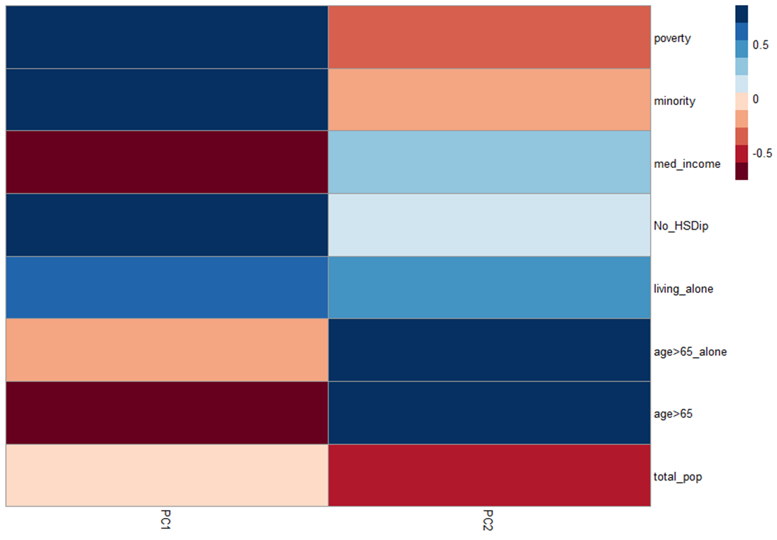
Heat Vulnerability PCA
% Poverty
% Minority
Median Income
% No HS Diploma over age of 25
% Living alone
% Age 65 or older and isolated
% Age 65 or older
Total population
0.5
0
-0.5
PC 1 PC 2
Notes:
For our second PCA that focuses on demographic variables, two components explained about 80% of the variation.
In PC1, % poverty, % minority, % no high school diploma over age of 25, and living alone were highly correlated together, thus when one factor is high the others are likely to be high as well.
Having a higher income and being a senior were inversely related and this is highlighted more in PC2. Both PCs explained almost the same amount of variation. NEXT SLIDE

Slide 27
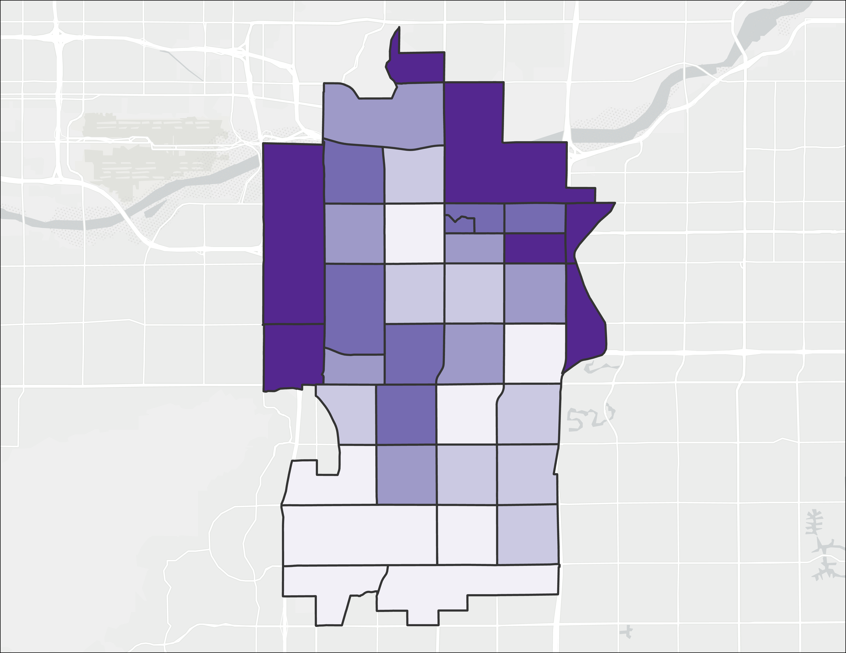
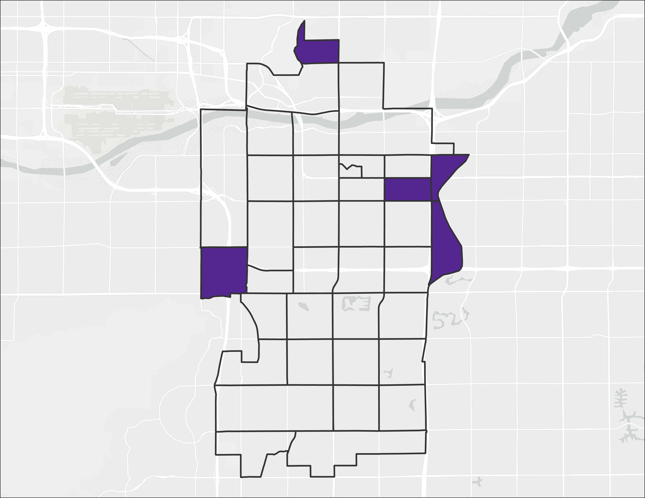
Heat Vulnerability Score Maps
5
Heat Vulnerability Score
by Census Tracts
4
1
Top Five HVS Census Tracts
5
4
3
2
1
2
3
City
Boundary
City
Boundary
0 2 4​​​
miles
0 2 4​​​
miles
Notes:
These census tracts included areas such as housing near Tempe Diablo Stadium, Gililland, London Park, Escalante, University Heights, and Scottsdale Gateway apartments near Papago Parkway
The census tracts that are considered most vulnerable are 319202, 319703, 319404, 319300 and, 318501.
The census tracts that ranked high here were due to a combination of high %s of minority, poverty, low education, over 65 years old, and low total household median income.
Prompt to City Staff: Does anyone want clarification on which demographic factors are driving up the vulnerability scores? We can also talk a little more about the top factors that are causing these 5 tracts with have the highest vulnerability based on ACS data. NEXT SLIDE
------------------------------Base Map Information Below ------------------------------
Base Map Attribution: Sources: Esri, HERE, Garmin, © OpenStreetMap contributors, and the GIS user community, World_Light_Gray_Reference.

Slide 28
3. Heat Priority
Notes:
Transition Slide

Slide 29
Data Collection and Processing
Input Data (14)
Collection and Processing
Output spreadsheets for analysis
8 Socio-economic Variables
Software
R
Google
Earth
Engine
6 Environmental Variables
Collect and process the data for statistical analysis
Notes:
Overall, we took 14 variables into account, 6 environmental variables and 8 sociodemographic variables. NEXT SLIDE.

Slide 30
Principal Component Analysis (PCA)
Input Data from spreadsheets (14)
Select Components (2-4)
Score by Census Tract
High
R
Variables
Components
Low
Identify patterns and analyze spatial data into an index
Placement Image/Caption
Notes:
We then needed to create the scores for heat priority, as with the Heat Exposure and Heat Vulnerability we used a PCA.
We took the 14 variables discussed previously and analyzed them using the PCA method. We then selected the 2-4 components that explained at least 80% of the data variation. These components were then used to develop an overall score for each census tract. NEXT SLIDE

Slide 31
(3) Overall Heat Priority PCA
Day time LST
NDBI
NDVI
% Living alone
% No HS Diploma Over 25
% Age 65 and Over
% Age 65 and Over, Isolated
% Poverty
% Minority
Median Income
Albedo
Total Population
Night time LST
0.5
0
-0.5
PC 1 PC 2 PC4 PC3
Notes:
We then needed to create the scores for heat priority, as with the Heat Exposure and Heat Vulnerability we used a PCA.
We took the 14 variables discussed previously and analyzed them using the PCA method. We then selected the 2-4 components that explained at least 80% of the data variation. These components were then used to develop an overall score for each census tract.
We acknowledge that these types of studies can be analyzed by a risk index, but we went with a PCA instead as it can take in the complexity of the variables in a multi-dimensional manner. A risk index and score does require more data and time to explore, and a PCA can simplify our results in a concise and useful way.

Slide 32
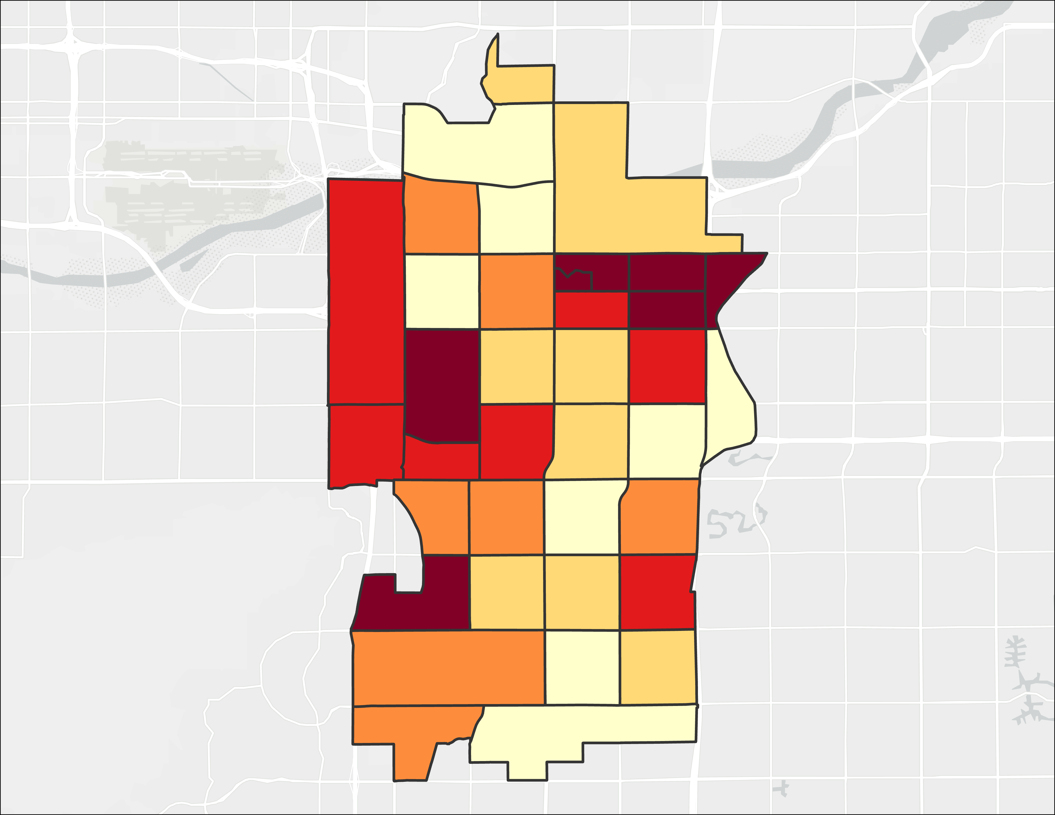
Heat Priority Score Map
Heat Priority Score
by Census Tract
5
4
3
2
1
City
Boundary
0 2 4​​​
miles
Notes:
When looking at the legend, the highest scores are 4 and 5, and are colored deep red. These census tracts represent the areas with the highest heat priority scores when considering both environmental and social factors. The lower score tracts are 1 and 2 and are colored in light yellow.
NEXT SLIDE
------------------------------Base Map Information Below ------------------------------
Base Map Attribution: Sources: Esri, HERE, Garmin, © OpenStreetMap contributors, and the GIS user community, World_Light_Gray_Reference.

Slide 33
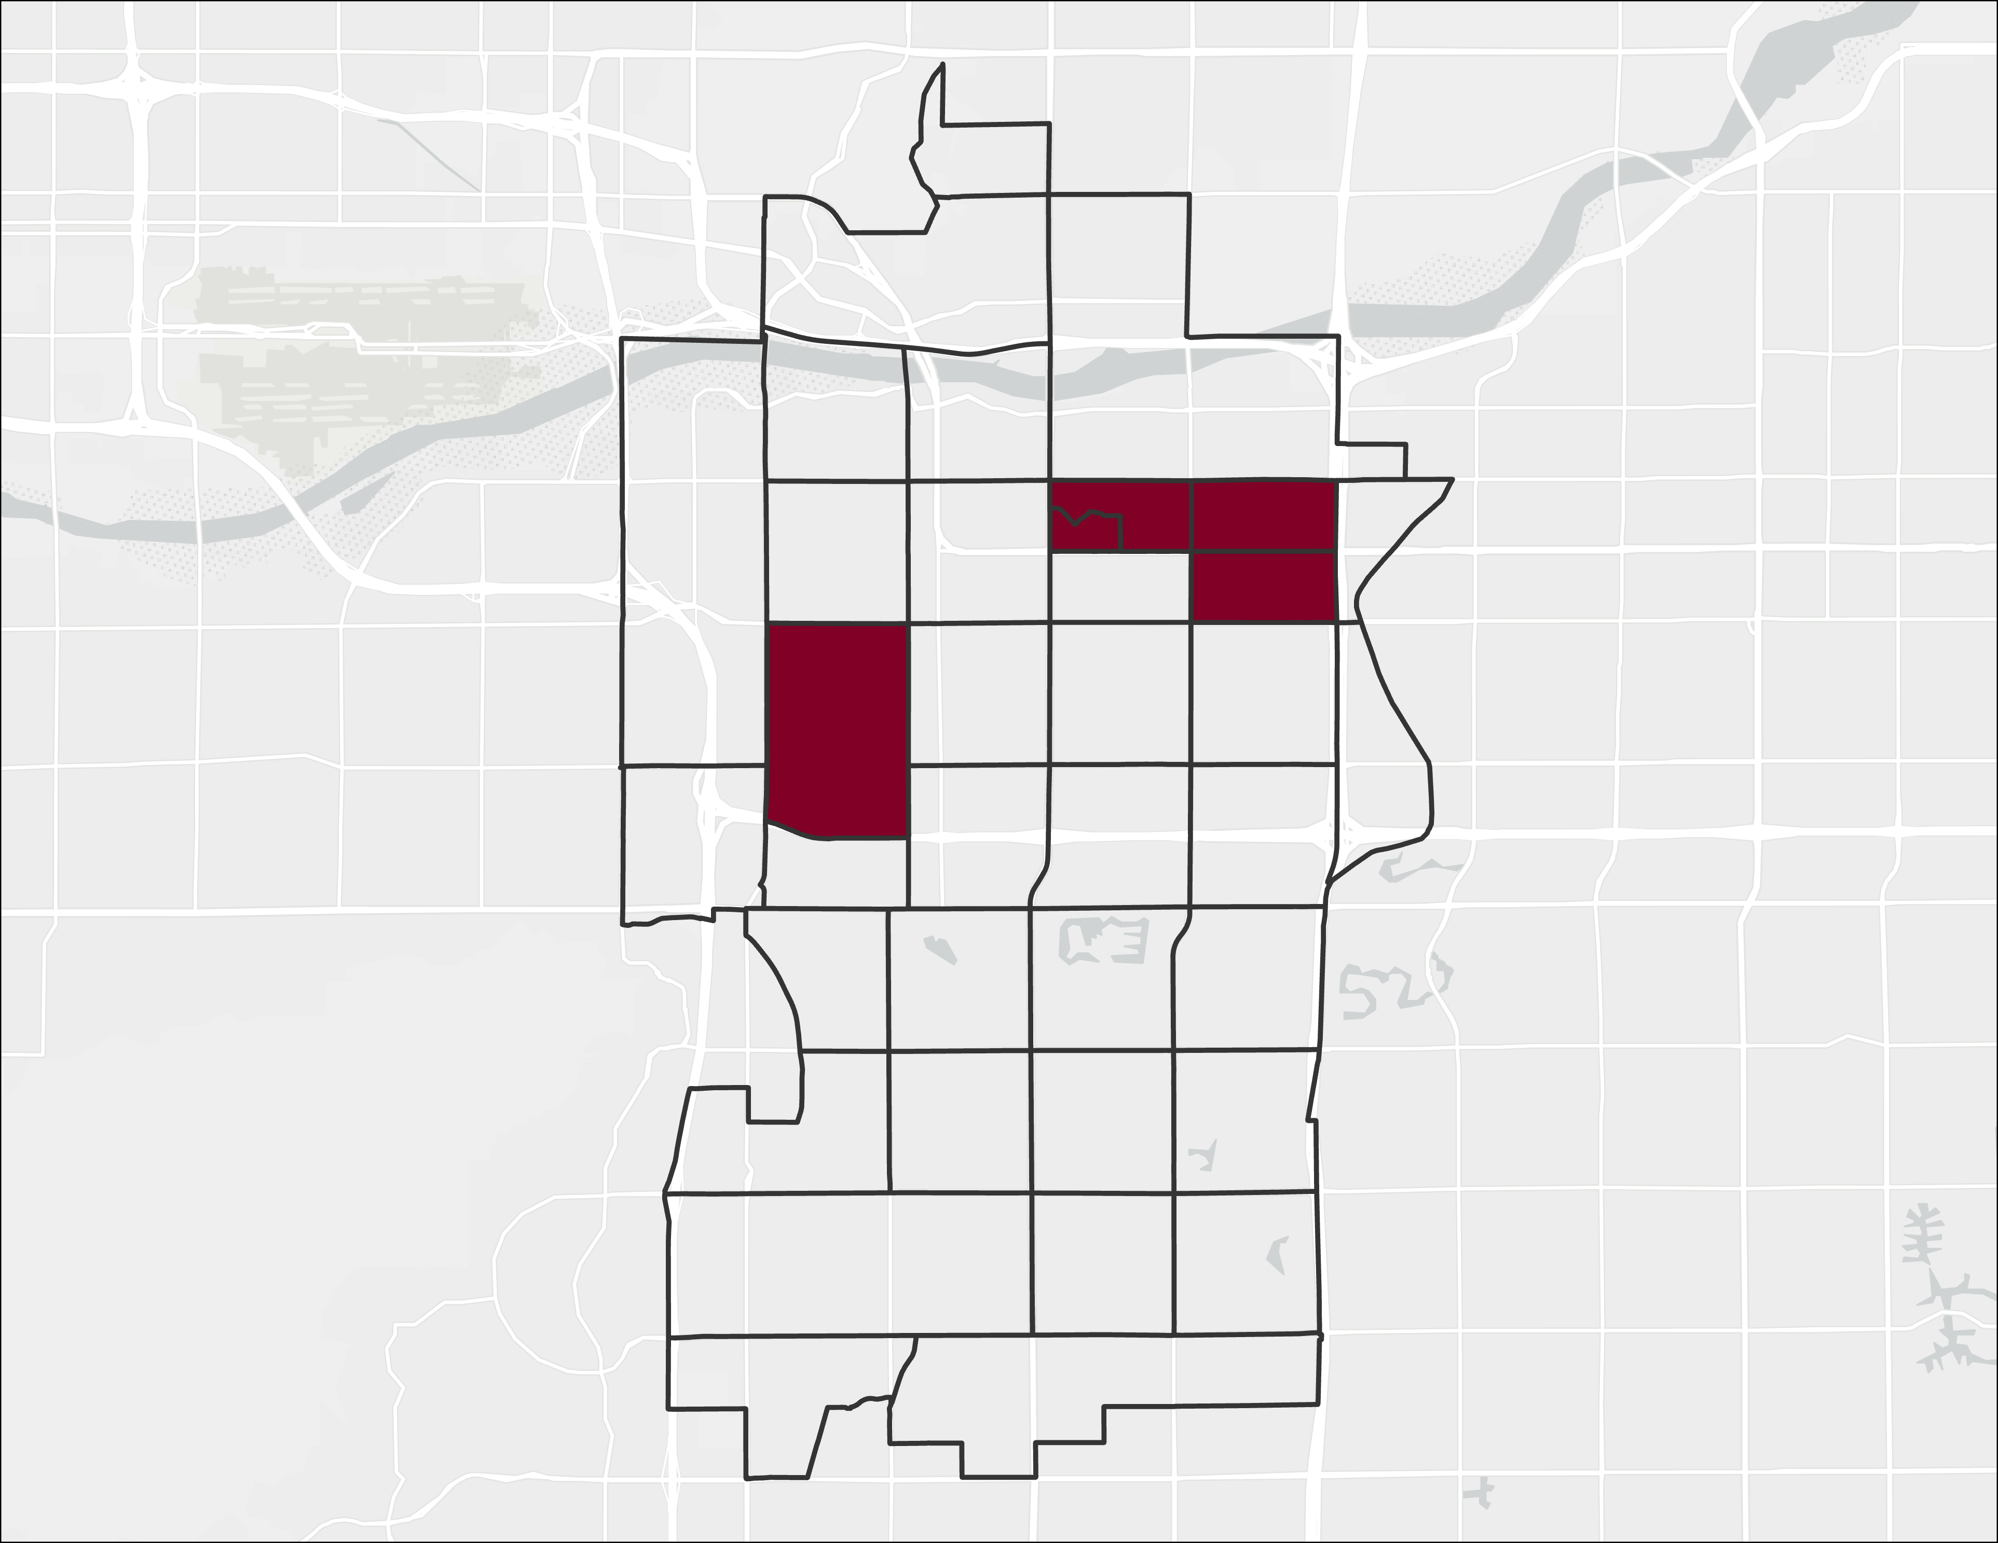
Heat Priority Score Map
3
5
1
4
Heat Priority Score
by Census Tract
2
City
Boundary
0 2 4​​​
miles
Notes:
The areas that scored in the top five are Escalante, Alagre Community, University Heights, and around Dwight Park. These CTs include 319101, 319705, 319103, 319202, 319201.
Census Tract 319101 – This area has the highest heat priority score due to a high percentage of the population having a low median income ($11,000), a high percent minority population (60%), a high level of the population lives below the poverty line, a high daytime LST, a high nighttime LST, a low NDVI, a high NDBI, and a low NDWI.
Prompt to City Staff: Does anyone want clarification or have any thoughts that come rushing to your mind?
NEXT SLIDE
------------------------------Base Map Information Below ------------------------------
Base Map Attribution: Sources: Esri, HERE, Garmin, © OpenStreetMap contributors, and the GIS user community, World_Light_Gray_Reference.

Slide 34
4. Shade Analysis
Notes:
Transition Slide

Slide 35
Shading Analysis
Input Data
Shadow Modeling
Areas of Highest Shade
High
Roads Layer
1-Meter DSM
Low
Creates a 1-meter raster file that yields shading raster
Placement Image/Caption
Image Credit: Sun shadow Volume Tool
Notes:
We used a 1-meter digital surface model derived from LASER point cloud data to map the three-dimensional urban fabric of two neighborhoods. The shading volume in these neighborhoods was used to calculate statistics and to also produce some shade-walks for important community landmarks. NEXT SLIDE
------------------------------ Image Information Below ------------------------------
Image Credit & Source: ASTROedu.com
**Website has been under maintenance have not been able to receive other citation information**

Slide 36
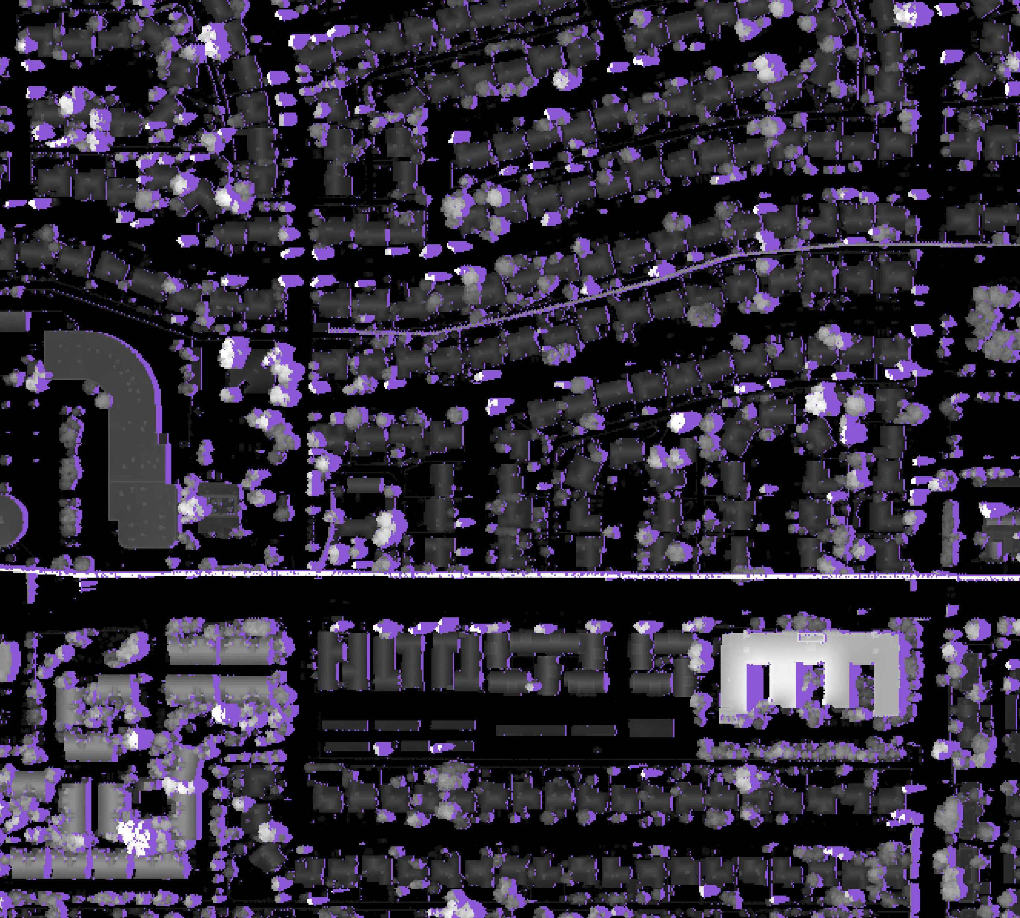
Shading Analysis
Single Family/
single-story
neighborhood
Shade
Surface Height
20 m
0 m
Multistory and multifamily households
Notes:
The digital surface model shown above shows a single-story residential area as well as a multifamily multistory apartment area (southern area) as well as several trees. Shade can be measured from both buildings and trees from this model. NEXT SLIDE

Slide 37
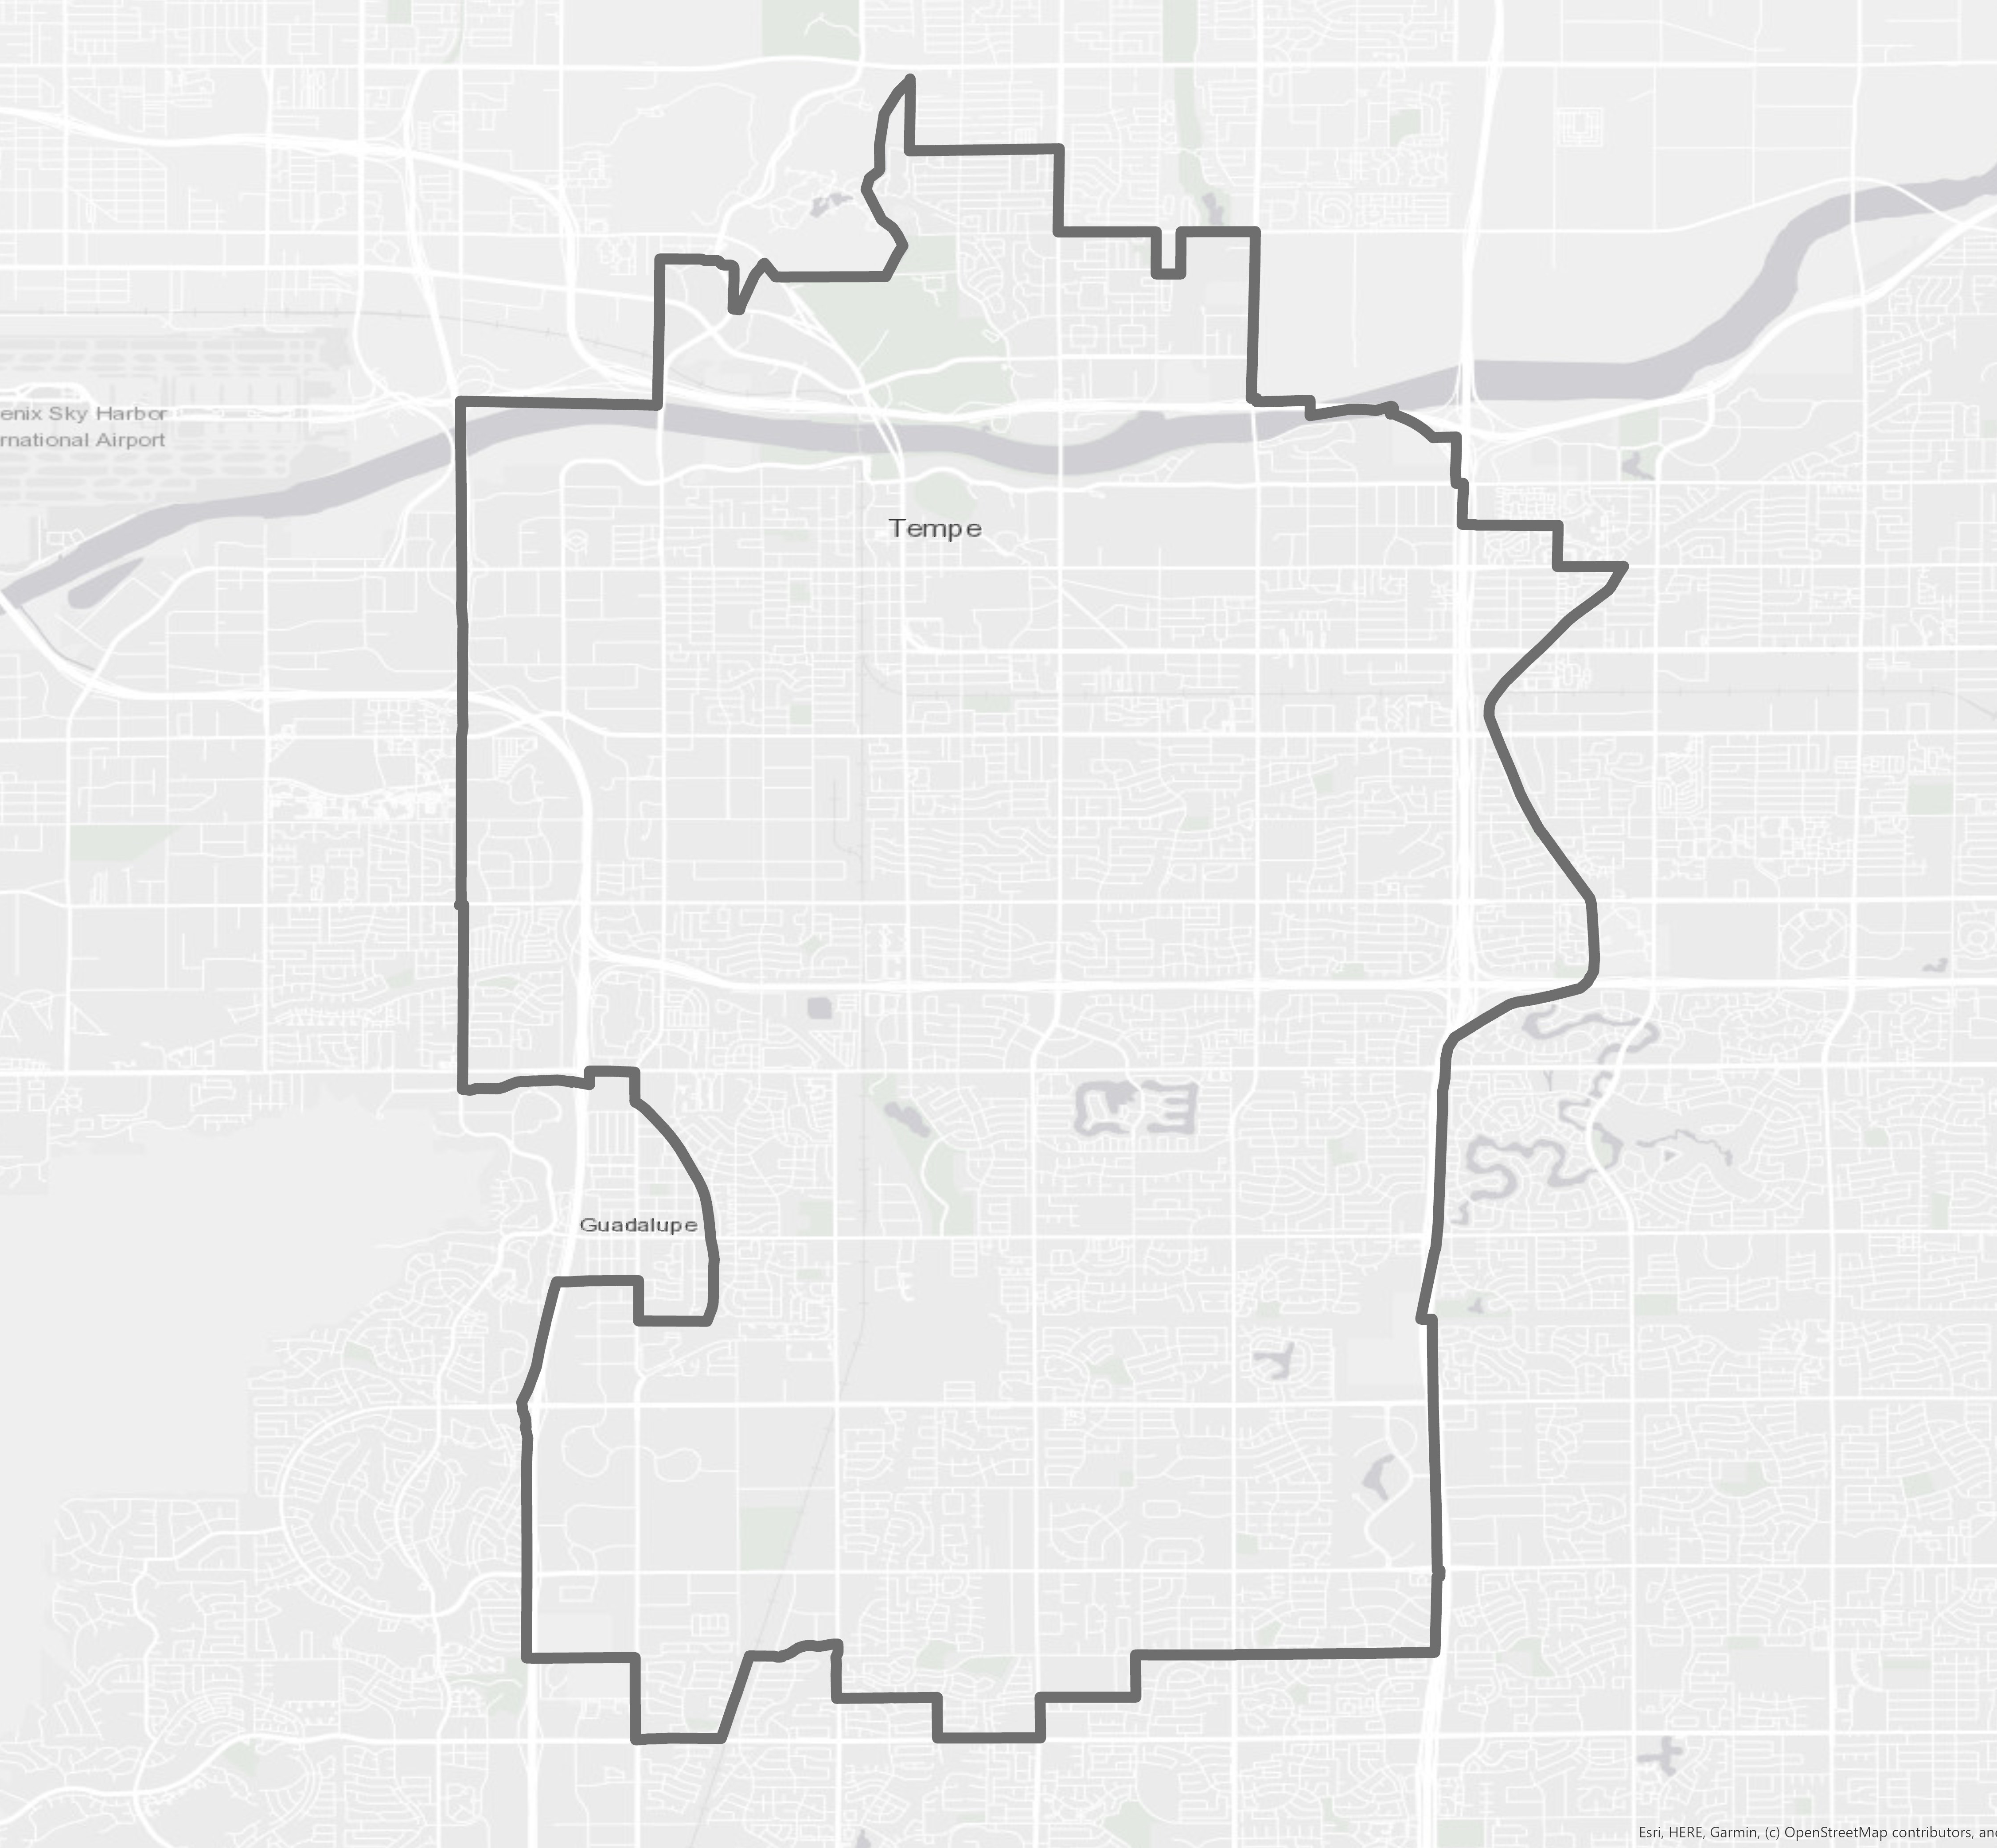
Neighborhoods Observed
LiDAR point cloud data converted to Digital Surface Model (DSM)
Gililland: single-story homes near industrial area​
Escalante: bisected by Highway 101, includes xeriscaped single story east side and irrigated greenspace multistory west side
Escalante
Gililland
0 2 4​
miles
Notes:
In other words, we looked at two neighborhood locations, Gililland and Escalante, to investigate the impact of shade on the thermal experience at a smaller scale. These neighborhoods varied by building design and landscape architecture, with the eastern side having more of a natural desert landscaping look and the west side having more irrigated vegetation.
As a note, Escalante and Gililland are both areas of medium high to high concern according the overall heat priority scores. NEXT SLIDE
------------------------------Base Map Information Below ------------------------------
Base Map Attribution: Sources: Esri, HERE, Garmin, © OpenStreetMap contributors, and the GIS user community, World_Light_Gray_Reference.

Slide 38
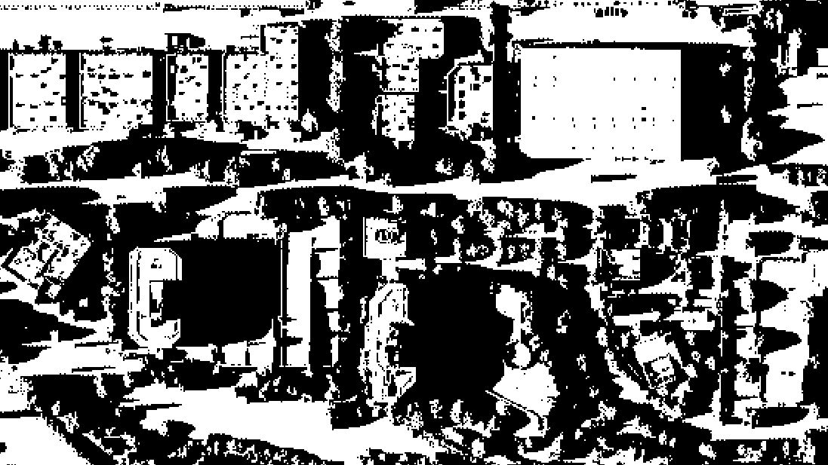
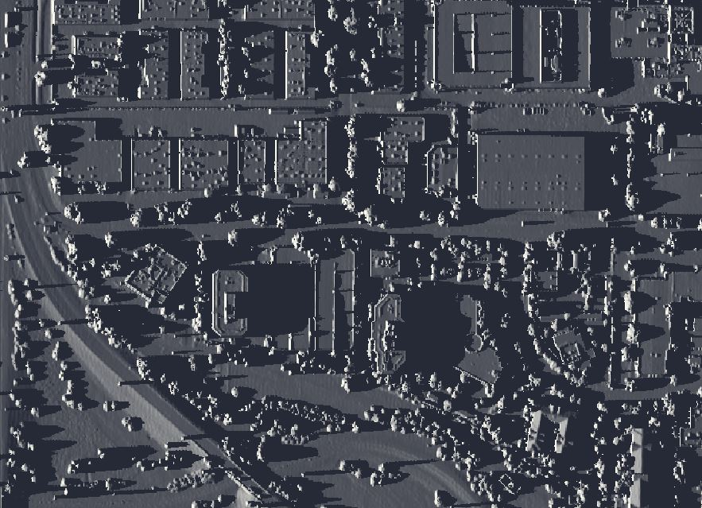
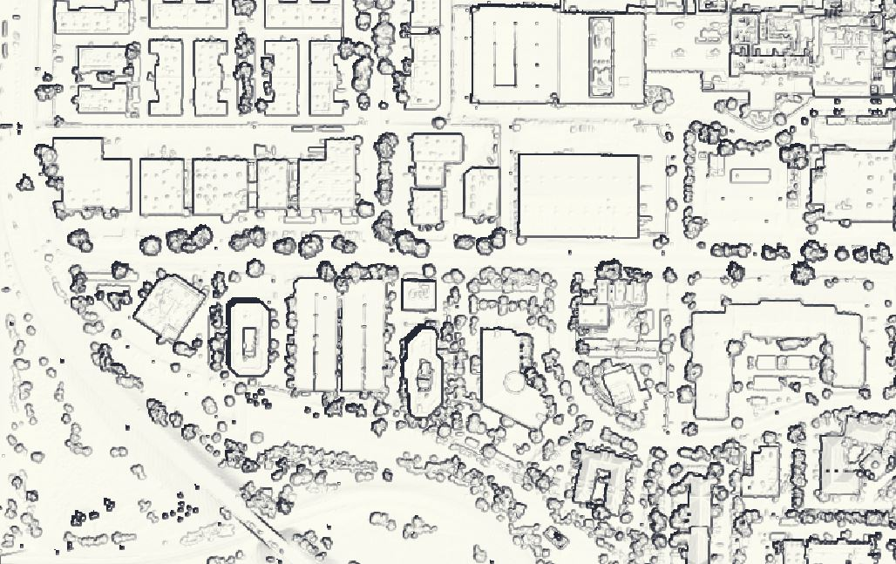
Community Walkshed Study Period
April 1 and June 21
Local noon and 4 pm
April 1, 4:00 pm
June 21, 12:00 pm
Notes:
Our shading analysis shows the variation in shade based on time of day. We simulated the data in the spring quarter in April, and in the summer in June. We also ran it in different time simulations to represent the noon time and the afternoon period, which should have more shade on these pavements as the sun starts to set at an angle. NEXT SLIDE

Slide 39
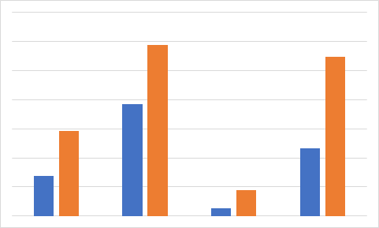
% Shade in Community Walkshed
60%
30%
20%
10%
0%
*60% = Excellent (MAG)
*30% = Good (MAG)
% Shade
*20% = Minimum (MAG)
Maricopa Association of Governments (MAG)
Gilliland
Escalante
April 1
12:00 pm
April 1
4:00 pm
June 21
12:00 pm
June 21
4:00 pm
Notes:
We took some streets data layers from Open Street Maps and it was able to represent the sidewalks in Tempe well. With the same Open Street Maps dataset, we established 800-meter buffer zones from the community features like schools, parks and community centers to estimate a 15-minute walk to-and-from these locations.
We compared those sidewalks to our shading results layer and found that (1) there is more shading in Escalante than Gilliland - this is reasonable as there are multi-story buildings in Escalante that creates more shade. (2) We also found that there tends to be more shade during the afternoon (because the sun is setting). (3) It is also important to note that 20% is said to be the minimum acceptable shade coverage. Escalante only reaches that threshold based on our analysis at the 4pm period. Otherwise, it is below 20% in the other time period at noon. There was no periods in the Gilliland walksheds that has pass the 20% threshold. NEXT SLIDE
Prompt to City Staff: Does anyone needs more clarification on how we got these figures, keeping in mind we have more results on the shading analysis.
https://www.azmag.gov/Programs/Transportation/Active-Transportation/Active-Transportation-Plan/Active-Transportation-Toolbox/Pedestrian-Infrastructure/Shade-and-Thermal-Comfort
MAG BENCHMARKS FOR SHADES (defined as noon through 6pm. Summer months):
Minimum acceptable shade coverage: 20%
Good shade coverage: 30%
Excellent shade coverage: 60%
Speaker notes: Within community areas near schools, parks, and community centers we mapped how much of roads and pedestrian walkways were shaded at 12:00 and 4:00 p.m. for April 1st and June 21st. Shade was greater in Escalante compared to Gilliland and was also greater in late afternoon. Some smaller roads were nearly completed shaded (South Torres Molino Circle) while a number of roads including had less than 10% shade. NEXT SLIDE

Slide 40
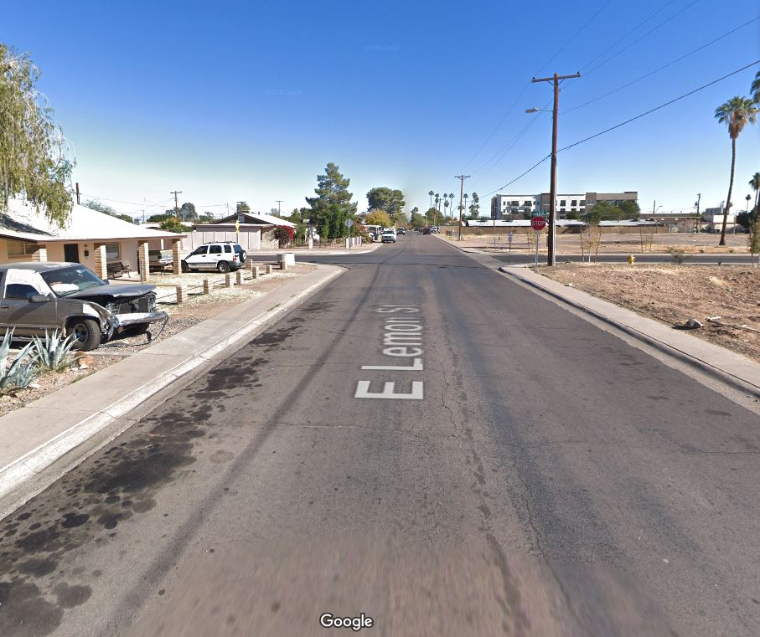
Escalante
Least Shaded Roads in Escalante Neighborhood
Escalante Park
Roads
Least shaded
Google Maps
East Lemon Street
Notes:
These are the least shaded roads in Escalante which is illustrated in yellow in the map, and one examples is East Lemon Road that is listed in this photo; it is south of Escalante Park and is fairly close to it. It is one of the least shaded streets in this walkshed and can potentially be prioritized for heat management purposes. NEXT SLIDE
------------------------------Image Information Below ------------------------------
Image Credit: Google Maps
Image Source: https://www.google.com/maps

Slide 41
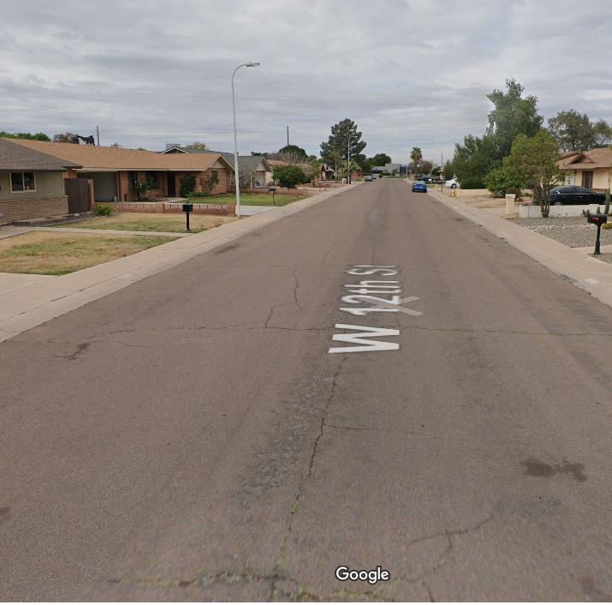
Gililland
Least Shaded Roads in Gililland Neighborhood
Parks
Roads
Least shaded
Google Maps
West 12th Street
Notes:
Similarly, these are the 10 least shaded roads in the Gililland Neighborhood, again highlighted in yellow. One of them is the W 12th Street, which again should be considered for heat prioritization. NEXT SLIDE
------------------------------Image Information Below ------------------------------
Image Credit: Google Maps
Image Source: https://www.google.com/maps

Slide 42
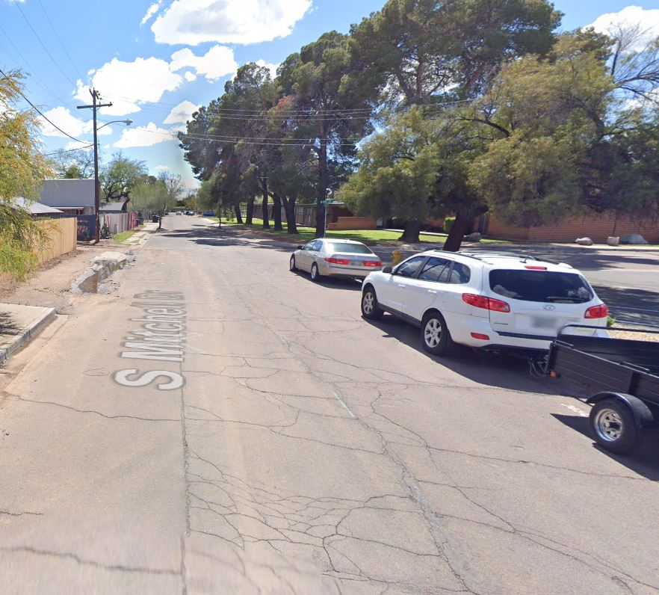
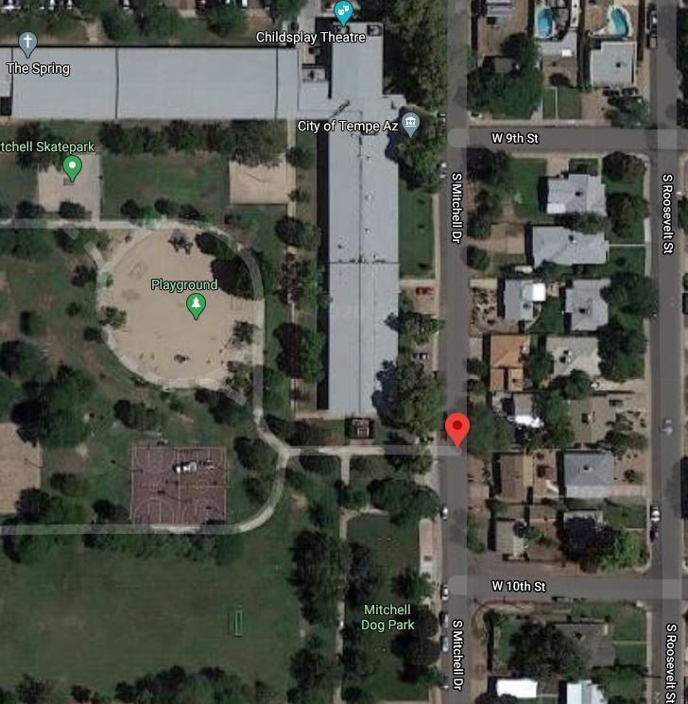
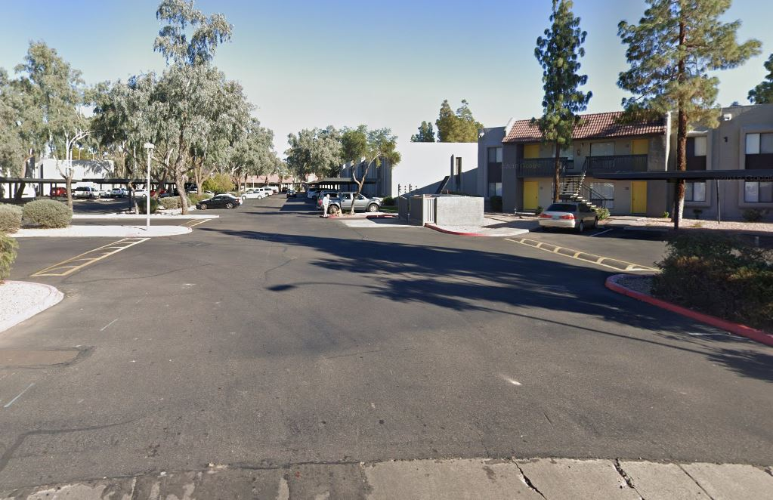
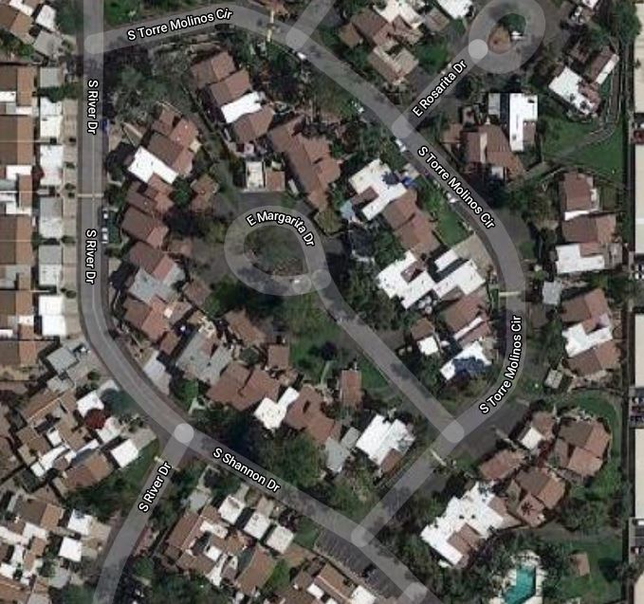
Walkshed
Gilliland April 1 4:00 P.M.
Street Name | Percent Shaded
Kyrene (Tempe Industrial) | 34.2%
West Brown Street | 25.5%
South Mitchell Drive | 20.8%
Escalante April 1 4:00 P.M.
South Torres Molino Circle | 92.0%
East Sanos Drive | 79.6%​
South Willow Creek Apartment Drive | 70.9%​
Google Maps
Notes:
On the other hand, we found out that the three streets with the highest shade in the Gilliland neighborhood are the Kyrene Avenue, which is near an industrial area, West Brown Street and South Mitchell Drive. These results were based on 4pm time frame.
In the Escalante neighborhood, the street with the highest shade percent is the South Torres Molino Circle which is at a high 92% - however, this is a cul-de-sac and is a residential area. The next top shadiest streets within our walkshed is East Sanos Drive and South Willow Creek Apartment Drive. NEXT SLIDE
------------------------------Image Information Below ------------------------------
Image Credit: Google Maps
Image Source: https://www.google.com/maps

Slide 43
5. Hot Zones & Bus Stops
Notes:
Transition Slide

Slide 44
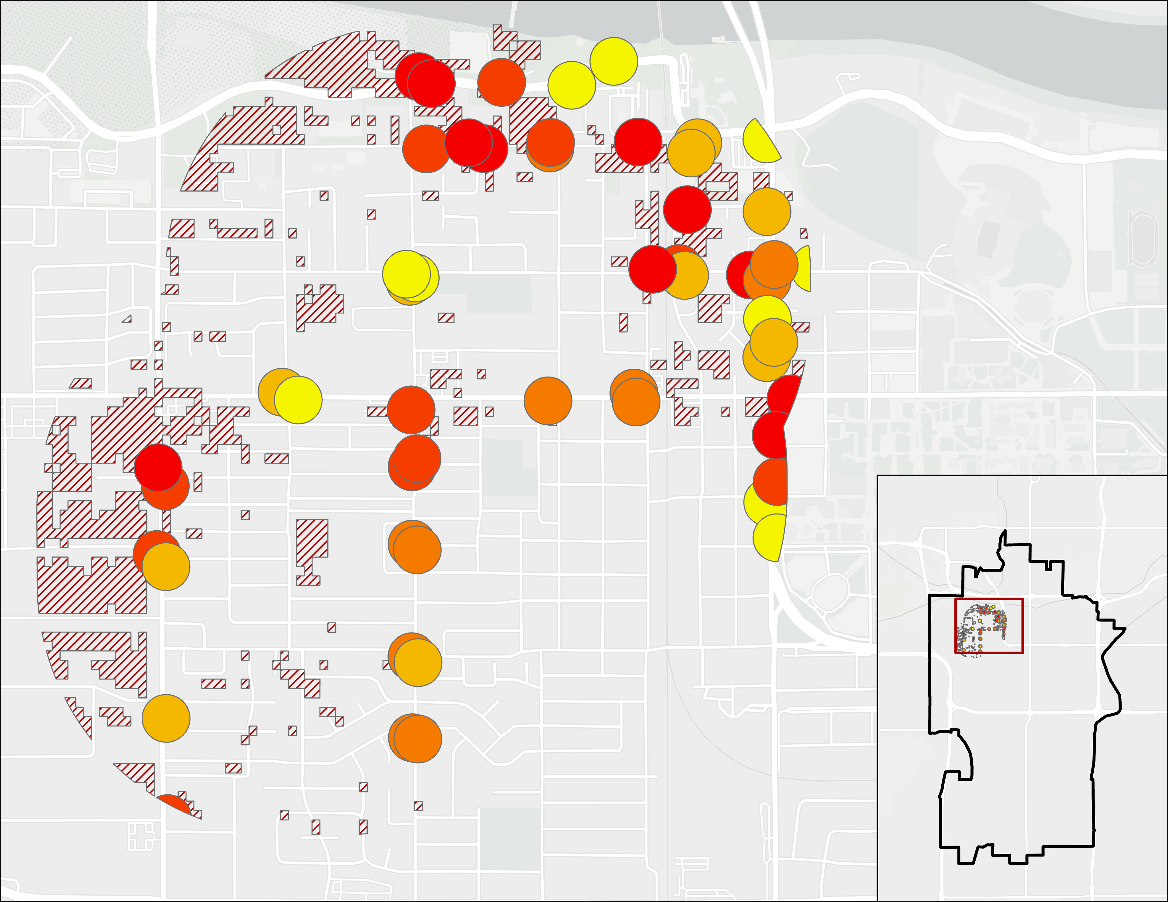
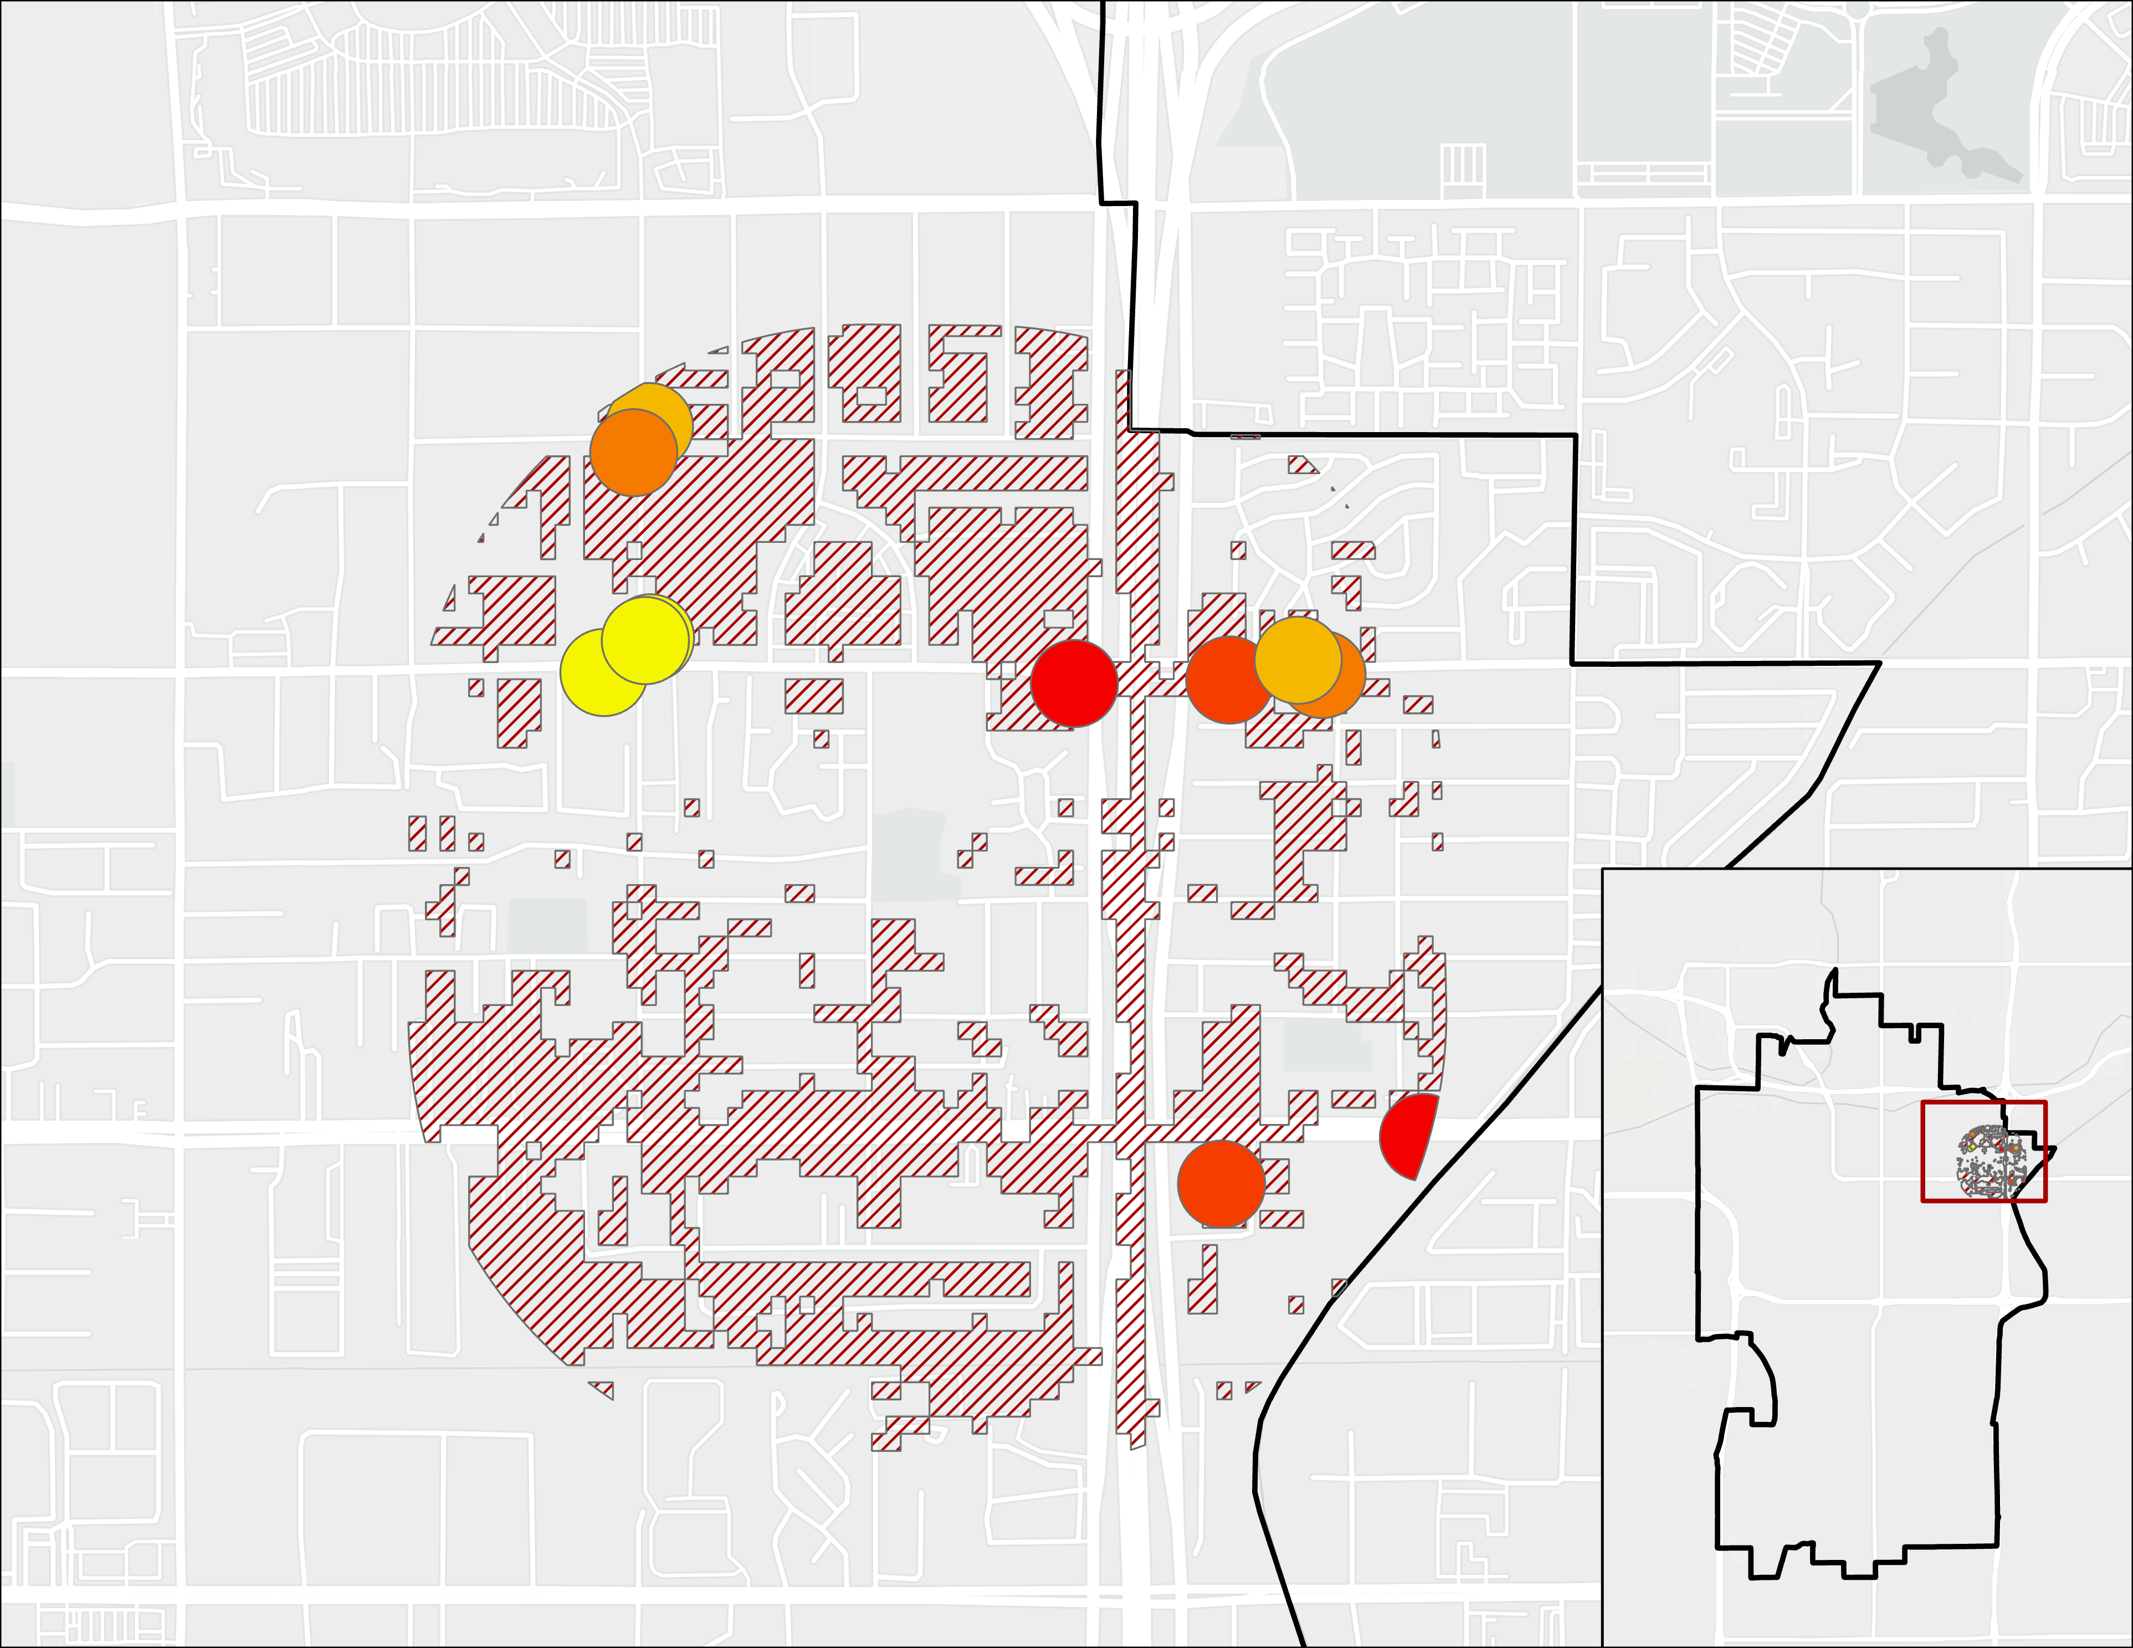
Neighborhood Bus Stops and Hot Zones
0 2 4​​​
miles
0 2 4​​​
miles
Hot
Hotter
Hottest
Hottest 20% Areas
Notes:
Speaker Notes: There are several bus stops that are unshaded in both Gililland and Escalante neighborhoods. The hottest stops in the Gililland walkshed was found along Apache as well as the northern part of S. Hardy drive. There were fewer unshaded bus stops in the Escalante neighborhood but were located along University Blvd.
The top three bus stop locations without shelters, (thanks, Bonnie!) in Gililland are:
RIO SALADO PKWY and HARDY DR
UNIVERSITY DR and MILL AVE
PRIEST DR and ELNA RAE ST
In Escalante, they are:
UNIVERSITY DR and PRICE RD
MAIN ST and LEBANON LN
UNIVERSITY DR and PRICE RD
Another feature to note are the size differences between the dark redhot spots. These may also be areas that, if under a higher priority area. NEXT SLIDE
------------------------------Base Map Information Below ------------------------------
Base Map Attribution: Sources: Esri, HERE, Garmin, © OpenStreetMap contributors, and the GIS user community, World_Light_Gray_Reference.

Slide 45
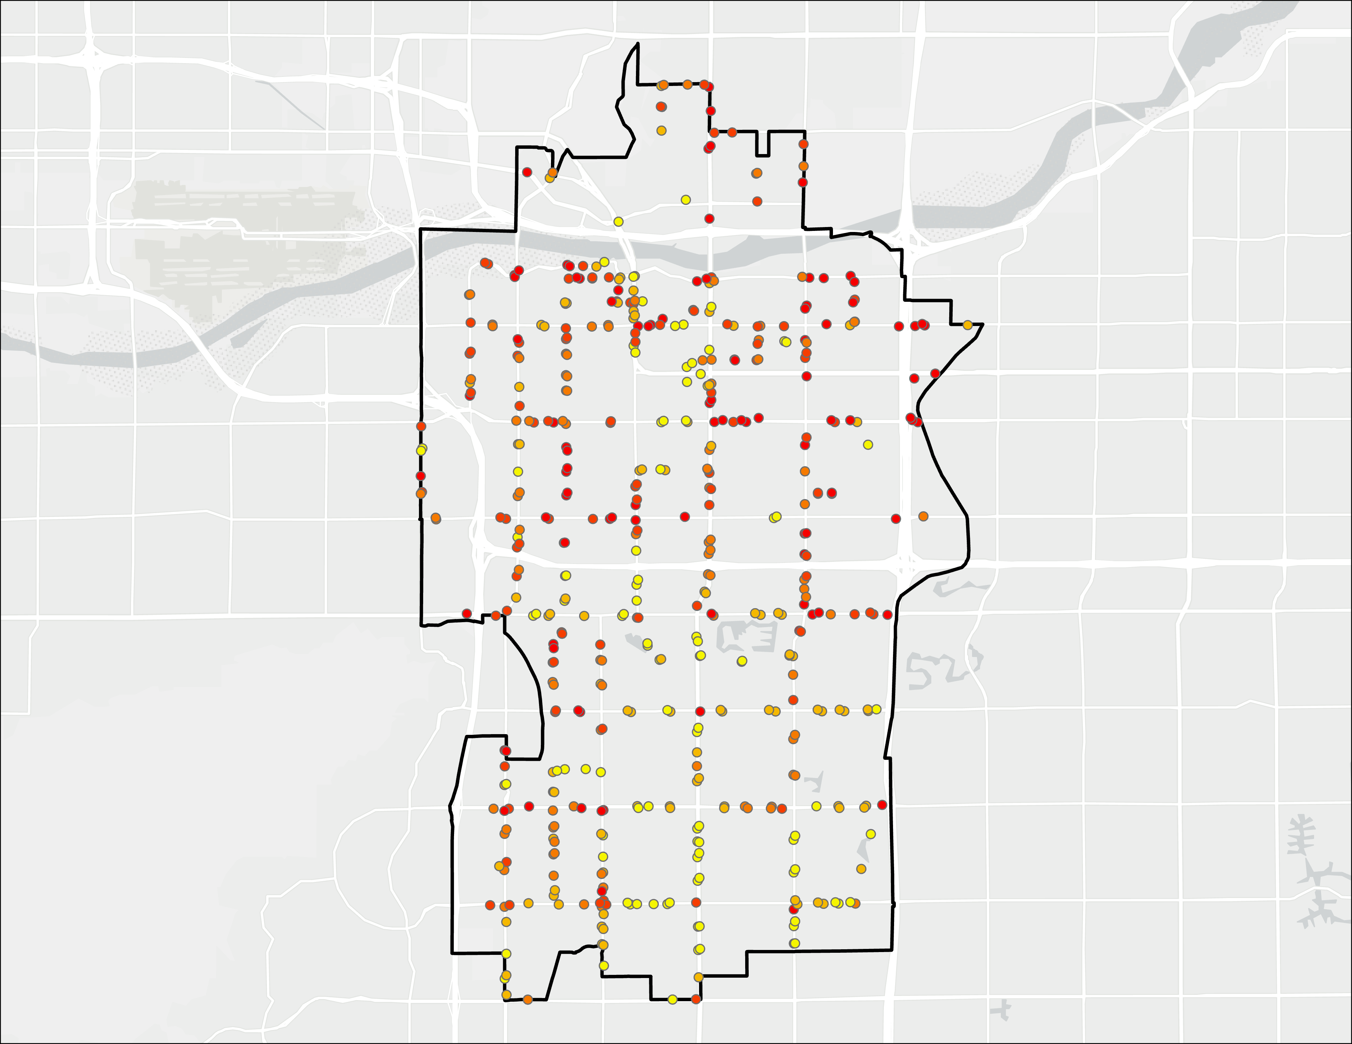
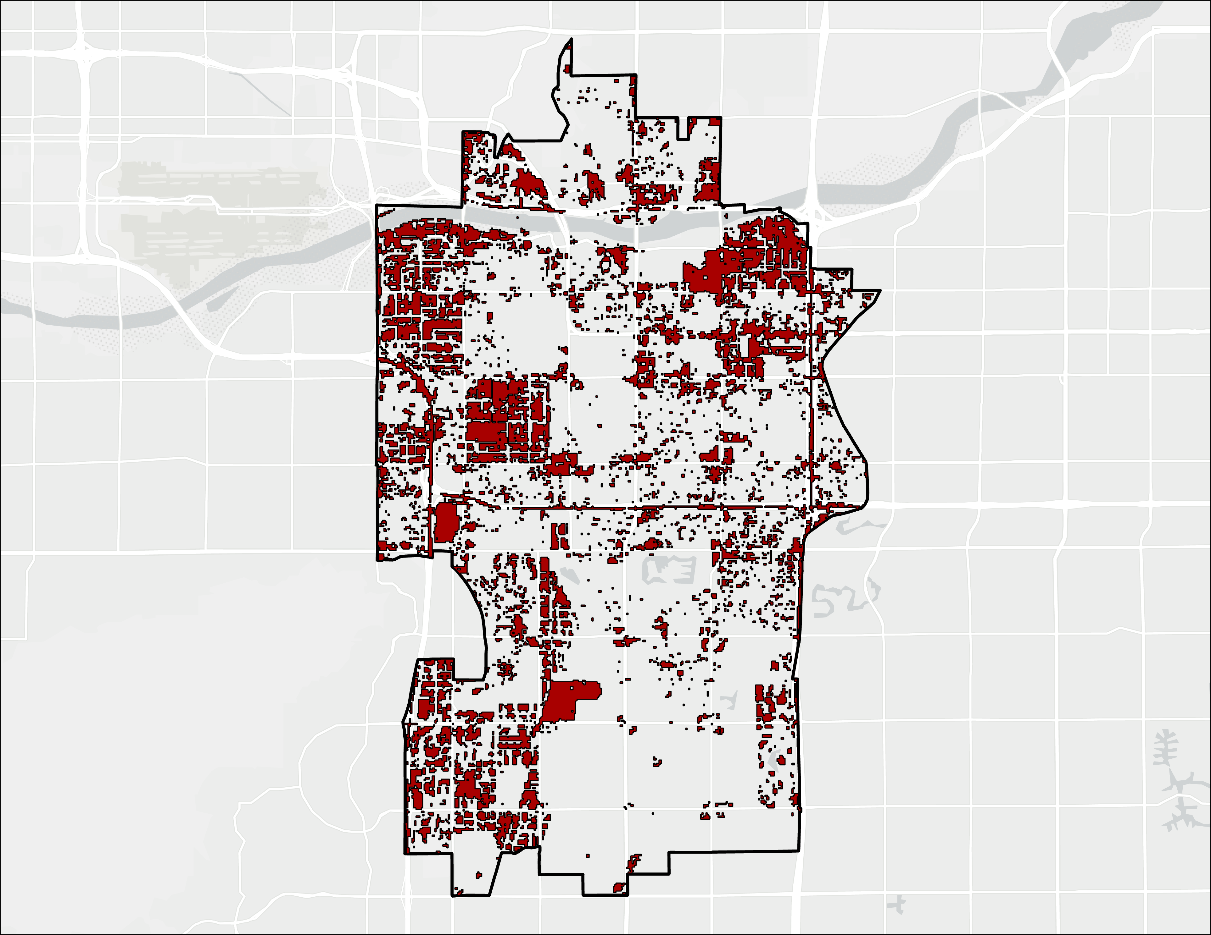
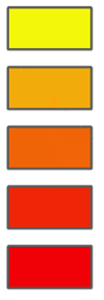
City Wide Bus Stops and Hot Zones
Mean LST for
Un-sheltered
Bus Stops
Top 20 % LST
Across Tempe °F)
≤ 113.48
≤ 116.10
≤ 118.04
≤ 119.56
≤ 125.72
121.2 -162.3
0 2 4​​​
miles
0 2 4​​​
miles
Notes:
If we zoom out, we can see non-sheltered bus stops across Tempe on the left and hot areas on the right.
On the left map, there are a large amount of hot bus stops along S. Hardy Dr., S. Mill Ave., and S. McClintock Dr. Of the whole city, the top 5 hot bus stops are at the cross streets of:
1. MCCLINTOCK DR and APACHE BLVD
2. MILL AVE and SOUTHERN AVE
3. HARDY DR and FAIRMONT DR
4. RIO SALADO PKWY and PACKARD DR
5. S MCCLINTOCK DR AT 526 S MCCLINTOCK.
An important feature to note about the hot zone map on the right are the size differences between the dark red hot spots. These may also be areas that, if under a higher priority area, may be manageable locations to take action at.
Prompt to city staff: Are there any areas that stand out to you, either groups of red bus stops or where hot zones are? NEXT SLIDE
------------------------------Base Map Information Below ------------------------------
Base Map Attribution: Sources: Esri, HERE, Garmin, © OpenStreetMap contributors, and the GIS user community, World_Light_Gray_Reference.

Slide 46
Conclusion
Notes:
Transition Slide

Slide 47
Summary
The PCA analysis showed that NDBI, NDVI and LST explained the most variation for the biophysical variables, while % poverty, % population over 65, and % minority explained the most variation in terms of vulnerability.
Based on the Heat Exposure map the area that scored highest is Industrial Park.
Based on the Heat Vulnerability map the area that scored the highest is the Escalante Community area.
Based on the Heat Priority map the area that scored the highest is near the University Heights and Alagre Community areas.
We conducted shading analysis on a neighborhood-scale and a bus stop heat analysis on a city-wide scale as an example of infrastructure analysis.
Notes:
The PCA analysis showed that NDBI, NDVI and LST explained the most variation for the biophysical variables, while % poverty, % population over 65, and % minority explained the most variation in terms of vulnerability.
Based on the Heat Exposure map the area that scored highest is Industrial Park.
Based on the Heat Vulnerability map the area that scored the highest is the Escalante Community area.
Based on the Heat Priority map the area that scored the highest is near the University Heights and Alagre Community areas.
We conducted shading analysis on a neighborhood-scale and a bus stop heat analysis on a city-wide scale as an example of infrastructure analysis. NEXT SLIDE

Slide 48
Project Objectives
NASA Earth Observations
Geodatabase
Creative Communication Tools
Notes:
Now, if we revisit our project objetives we have successfully used NASA’s Earth Observations to complete our analyses. NEXT
We have created a user-friendly and shareable geodatabase, and... NEXT
Have produced a creative communication tool via the public facing StoryMap to share our results. NEXT SLIDE

Slide 49
Uncertainties and Limitations
LST and Heat Indices are proxies for heat measurements
People are not stationary
Better spatial resolution in satellite imagery
Temporal sampling = Estimation (e.g. 2 images per month)
Notes:
Our study did come with a few caveats, for example, the land surface temperature and heat priority scores are simply proxies for temperature. It could vary from air temperature as well as psychologically perceived temperature. NEXT
The analysis assumes that individuals remain near their place of residence as a conclusive indication of where they are staying but in reality, people travel in and even out of Tempe for work, school and other purposes. NEXT
Acquiring higher resolution data would allow for a more detailed analysis, such as a more detailed quantification of individual buildings and sidewalks (which can better accompany our LiDAR shading analysis). NEXT
We have only taken 2 satellite images per month to represent the data and it does not provide us the complete picture of the actual temperatures. NEXT SLIDE

Slide 50
Future Work
Validation by (1) surveying residents, (2) ground measurements
User-friendly interface for easier workflow
Update demographic analysis with 2020 Census data
Analyze location-based heat deaths/illnesses
Notes:
We can validate our findings by taking ground measurements and compare those to our indices, and also survey residents to have a better understanding of how people feel on a physiological basis. NEXT
Future work can be focused on creating an user-friendly workflow so that the analysis can be updated in a simple action, allowing the analysis to be updated with new data (such as the 2030 Census Data in 2031). NEXT
We have used the 2018 ACS data, but future updates are recommended to help analyze the sociodemographic data in order to create a clearer picture of vulnerability. This would include trying to incorporate those experiencing homelessness. Currently, there is not tract level data for homelessness but the 2020 Census is trying to capture this data. NEXT
Finally, analyzing location-based heat deaths/illnesses can accompany our findings to provide a better investigation into how people react to heat. It can allow us to better examine who are vulnerable to heat events, such as the homeless and whether the City can help them have more access to resources. NEXT

Slide 51
A special thank you to our Science Advisor and Team Fellow for their direction and support
Dr. David Hondula (Arizona State University, Associate Professor)
Ryan Hammock (NASA DEVELOP, Fellow/Lead)

Slide 52
A special thank you to our Science Advisor and Team Fellow for their direction and support
Dr. David Hondula (Arizona State University, Associate Professor)
Ryan Hammock (NASA DEVELOP, Fellow/Lead)
Thank you to our Project Partners who provided us the with data and their expertise throughout the project
Dr. Braden Kay (City of Tempe, Sustainability Director)
All City of Tempe Staff & Faculty
All contributors of the Healthy Urban Environments (HUE) Initiative
Notes:
Thank you to our Project Partners who provided us the with data and their expertise throughout the project
Dr. Braden Kay, all the City of Tempe staff & faculty, and all the members and contributors for the Health Urban Environments (HUE) Initiative.
NEXT SLIDE

Slide 53
A special thank you to our Science Advisor and Team Fellow for their direction and support
Dr. David Hondula (Arizona State University, Associate Professor)
Ryan Hammock (NASA DEVELOP, Fellow/Lead)
Thank you to our Project Partners who provided us the with data and their expertise throughout the project
Dr. Braden Kay (City of Tempe, Sustainability Director)
All City of Tempe Staff & Faculty
All contributors of the Healthy Urban Environments (HUE) Initiative
Thank you to the past Tempe Urban Development I Project for providing us a wonderful base from which to work
Hannah Bonestroo, Roger Alvarez, Elizabeth Swanson, and Taylor Quinn
Notes:
Thank you to our Project Partners who provided us the with data and their expertise throughout the project
Dr. Braden Kay, all the City of Tempe staff & faculty, and all the members and contributors for the Health Urban Environments (HUE) Initiative.
NEXT SLIDE

Slide 54
A special thank you to our Science Advisor and Team Fellow for their direction and support
Dr. David Hondula (Arizona State University, Associate Professor)
Ryan Hammock (NASA DEVELOP, Fellow/Lead)
Thank you to our Project Partners who provided us the with data and their expertise throughout the project
Dr. Braden Kay (City of Tempe, Sustainability Director)
All City of Tempe Staff & Faculty
All contributors of the Healthy Urban Environments (HUE) Initiative
Thank you to the past Tempe Urban Development I Project for providing us a wonderful base from which to work
Hannah Bonestroo, Roger Alvarez, Elizabeth Swanson, and Taylor Quinn
Lastly, thank you to Lance Watkins (Arizona State University, Ph.D. Geography Candidate) for providing vital code and guidance on our statistical analyses
Notes:
Thank you to our Project Partners who provided us the with data and their expertise throughout the project
Dr. Braden Kay, all the City of Tempe staff & faculty, and all the members and contributors for the Health Urban Environments (HUE) Initiative.
NEXT SLIDE

Slide 55
Backup Slide
Notes:
Transition Slide

Slide 56
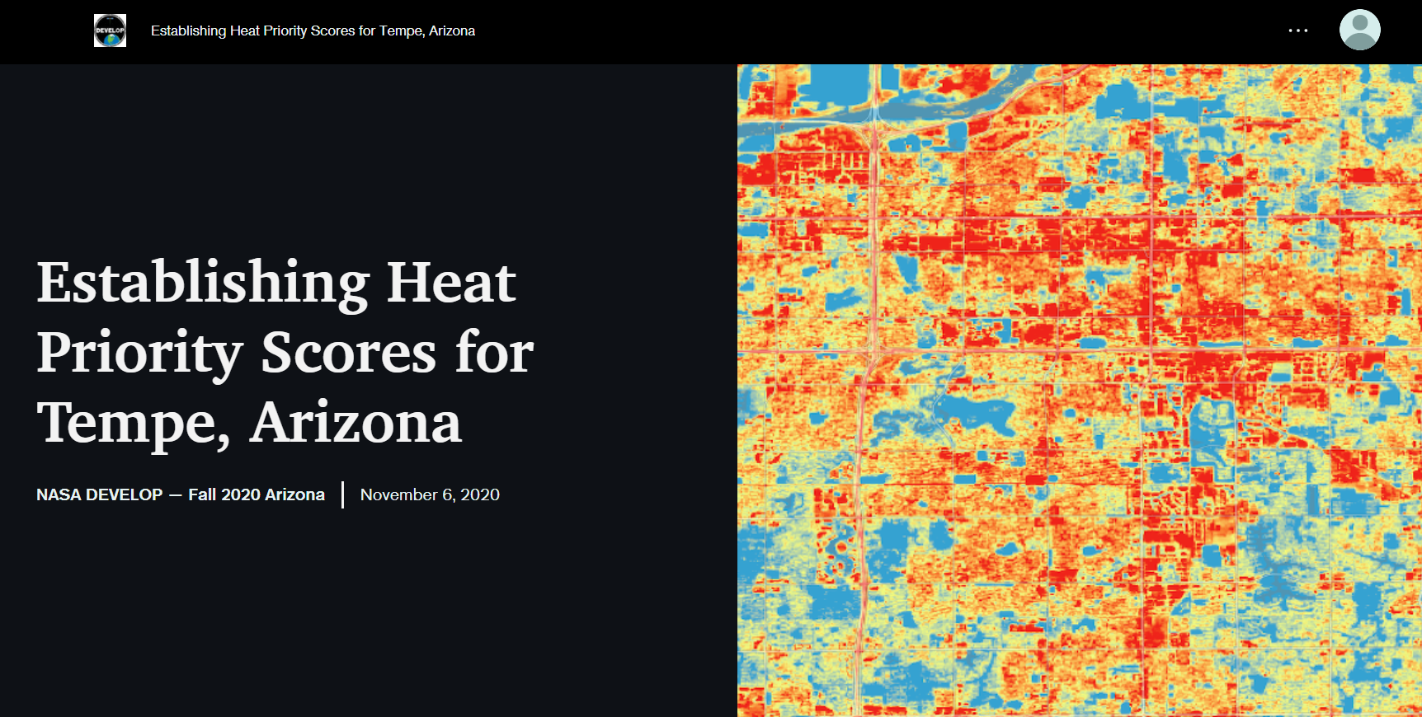
AGOL Story Map
Notes:
To communicate the results of this project, the team produced a creative communication tool via the public facing StoryMap in ArcGIS Online.

