Slide 1
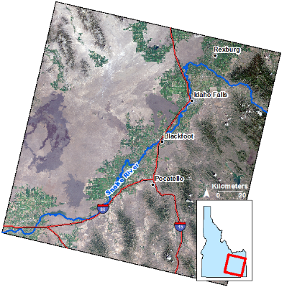
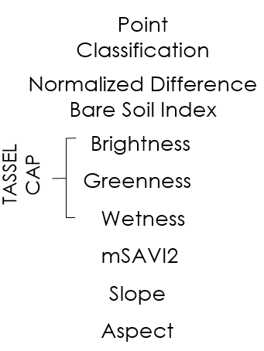
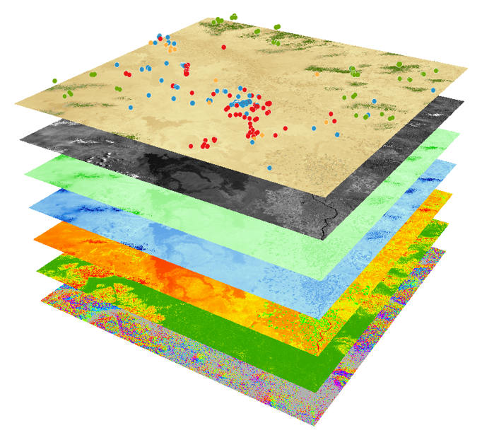
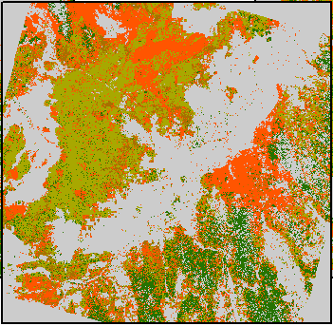
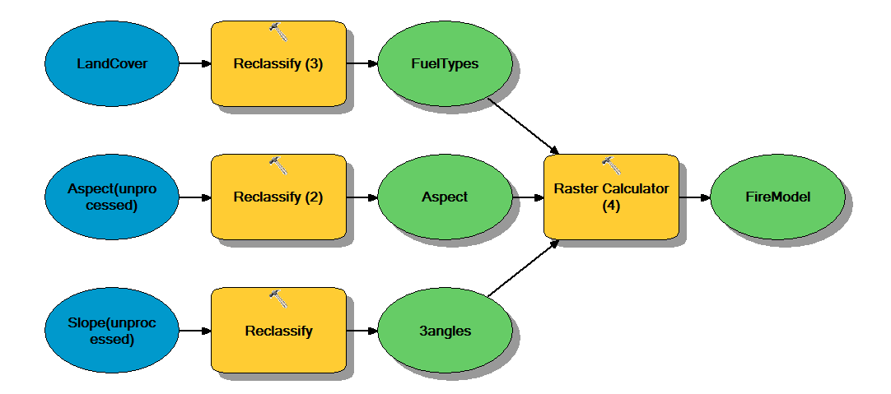
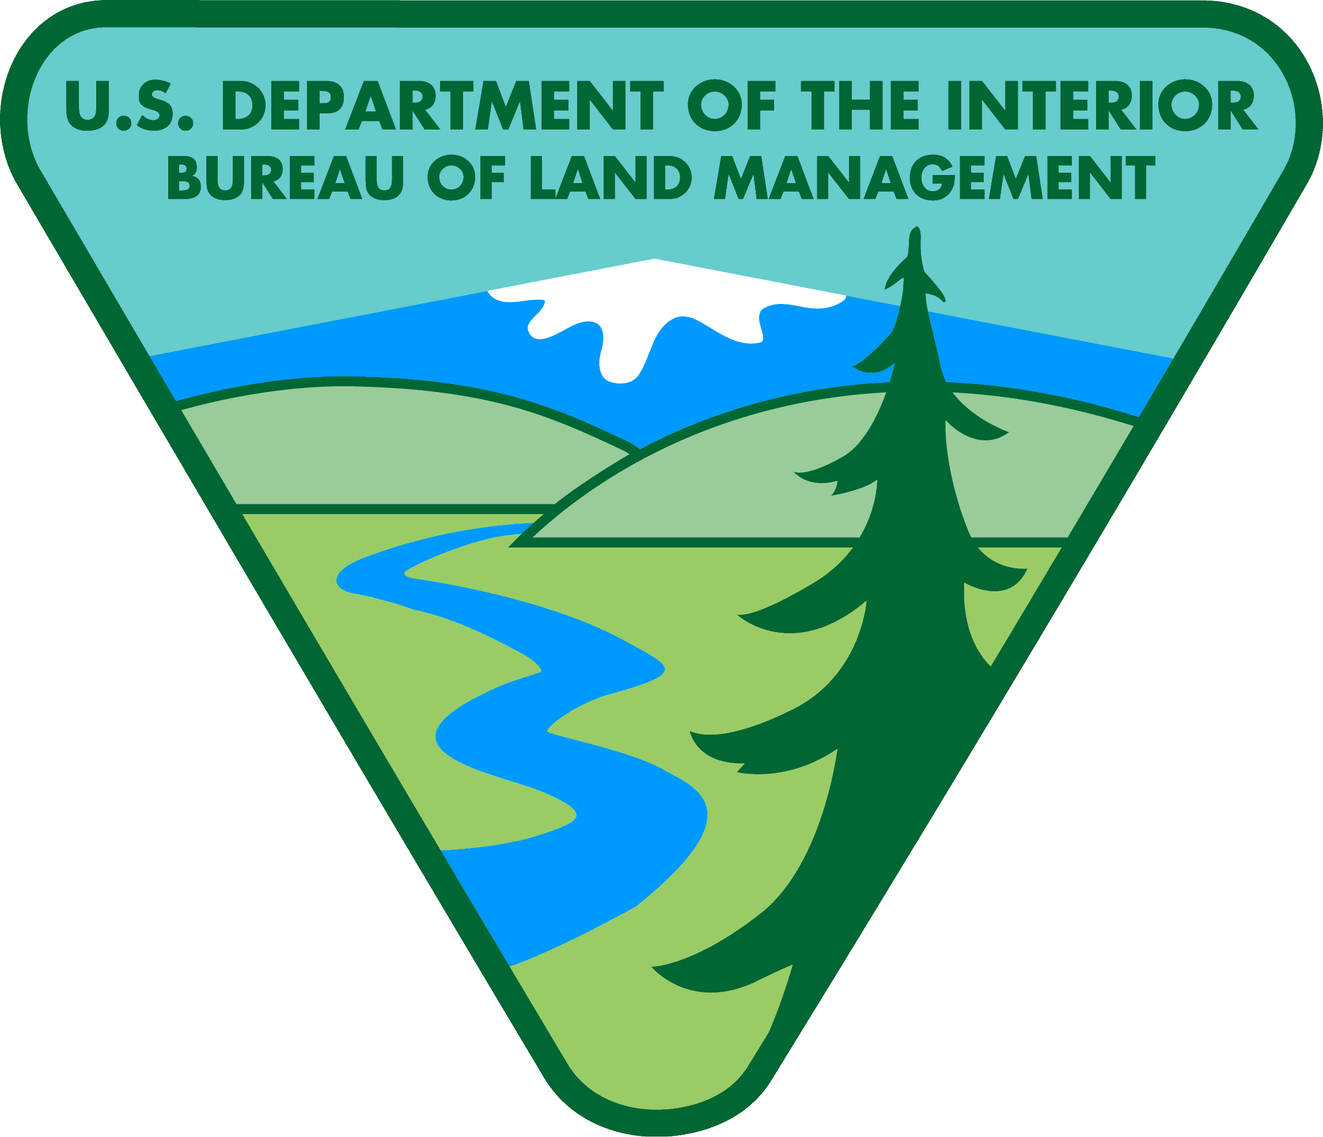
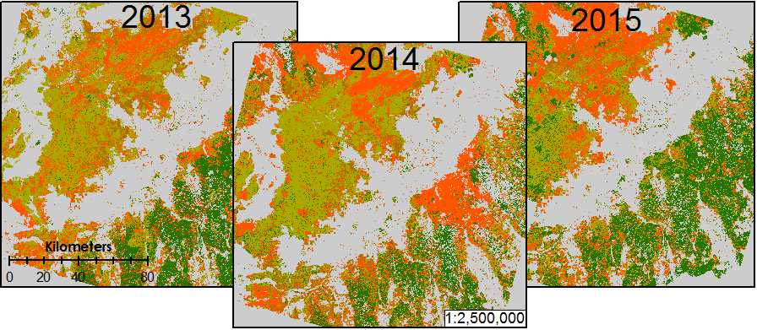
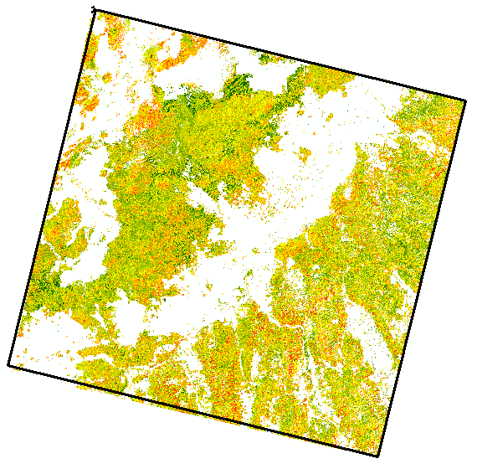
Idaho Disasters III
Using Landsat earth observations to identify increased fire susceptibility due to invasion by cheatgrass (Bromus tectorum)
Jeff May(Project Lead), Jenna Williams, Zach Simpson
Affiliation(s)
Abstract
Objectives
Wildfires, coupled with the presence of invasive plant species, are primary drivers of change in semi-arid savanna ecosystems. These wildfires disrupt ecosystems, human localities, critical habitats of the endangered Greater Sage Grouse (Centrocercus urophasianus), and create opportunities for invasive species to expand their populations. Wildland fire regimes have changed dramatically due to Bromus tectorum (cheatgrass), an invasive annual grass, which has effectively lengthened the wildfire season and increased fire frequency. Cheatgrass’ ability to quickly establish in disturbed areas creates a positive feedback cycle with wildland fire, resulting in landscapes that burn more frequently and becomes increasingly dominated by this invasive plant. This creates a need for more advanced landscape and wildfire monitoring tools that can identify the prominence of invasive plants in order to provide better information regarding fire susceptibility. Currently, there are no active cheatgrass management plans in Idaho due to the overwhelming capabilities of the plant to dominate landscapes. However, effective management of this species requires knowledge of its distribution in order to evaluate wildfire regimes and prevent cheatgrass expansion in recently disturbed landscapes. This study used spring/summer 2013, 2014, and 2015 imagery from Landsat 8 Operational Land Imagery (OLI) and decision-tree-based classification to create a vegetation distribution map of SE Idaho that identified cheatgrass and was subsequently used to create a fire susceptibility map for the study area. These results enhance the Bureau of Land Management’s and Idaho Department of Land’s decision making with respect to resource allocations and supports post-fire rehabilitation planning and fuel reduction programs.
Create a vegetation map that can be incorporated into fire susceptibility and hazard model
Provide benefit to End-users regarding resource allocation and identifying high fire susceptibility areas.
Understand the relationship between the distribution of Bromus tectorum and other vegetation types with wildfire regimes in Southeast Idaho
Produce a fire susceptibility map using the resultant. vegetation map and topographic information.
Study Area
Southeast Idaho
Landsat WRS-2 Path 39 Row 30
Methodology
The Modified Soil-adjusted index was calculated for
Images retrieved from LANDSAT 8 OLI (path 39
Row 30)for the growing seasons of 2013, 2014, 2015.
Climate data retrieved from the Bureau of Reclamation’s
Agrimet was used to detected the early green up of cheatgrass. This was then used to create a classification scheme that designates Cheatgrass as a separate classification than other prevalent vegetative types.
Earth Observations
Landsat 8 Operational Land Imager (OLI)
Conclusions
Use bullets.
Use complete sentences with periods.
Project Partners
Bureau of Land Management (BLM)
Idaho Department of Lands
United States Geological Survey (USGS)
NASA RECOVER
Results
Acknowledgements
Include anyone who has helped you with the project.
If this is a continuation project, credit the previous team members and contributors.
If you are including affiliations, use DEVELOP as the affiliation for a DEVELOPer or former DEVELOPer—not their school or former school.
Team Members
Year | Overall Accuracy | Kappa
2013 | 64.706% | 0.487962
2014 | 78.992% | 0.692347
2015 | 64.706% | 0.482983
Left to right: Jeff May, Jenna Williamsand Zach Simpson
BLM at Idaho State University GIS TReC

