Slide 1
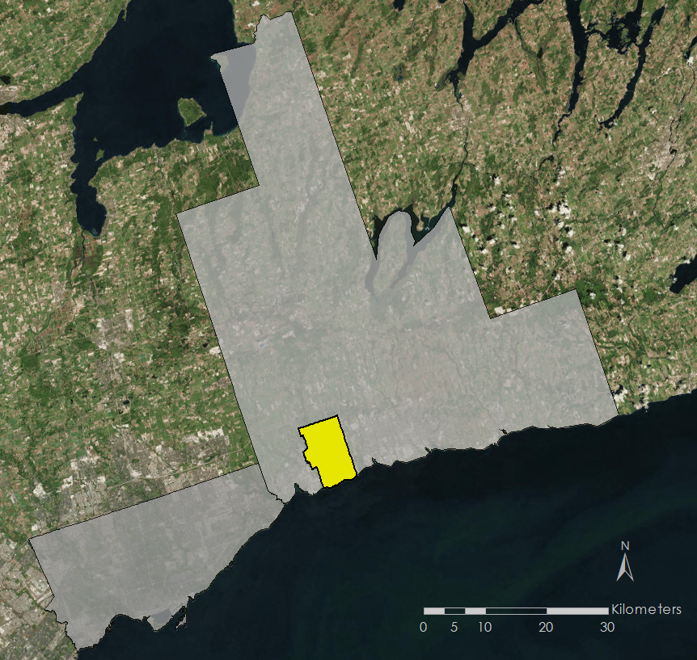
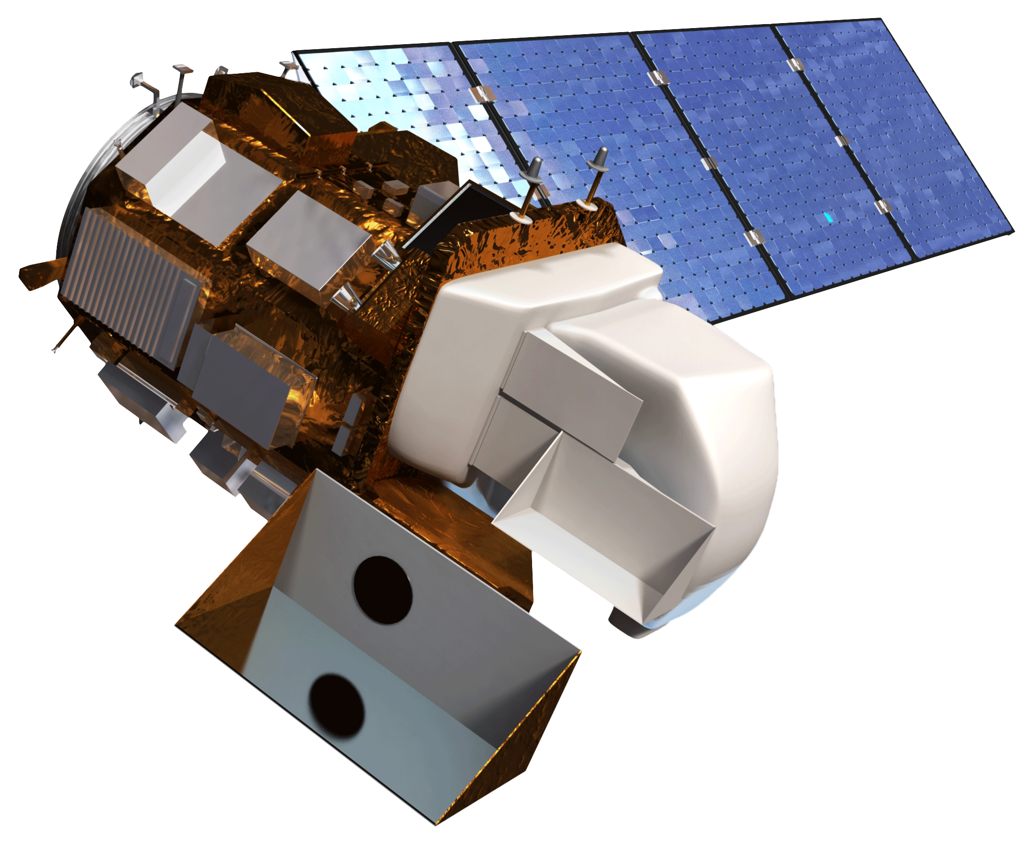
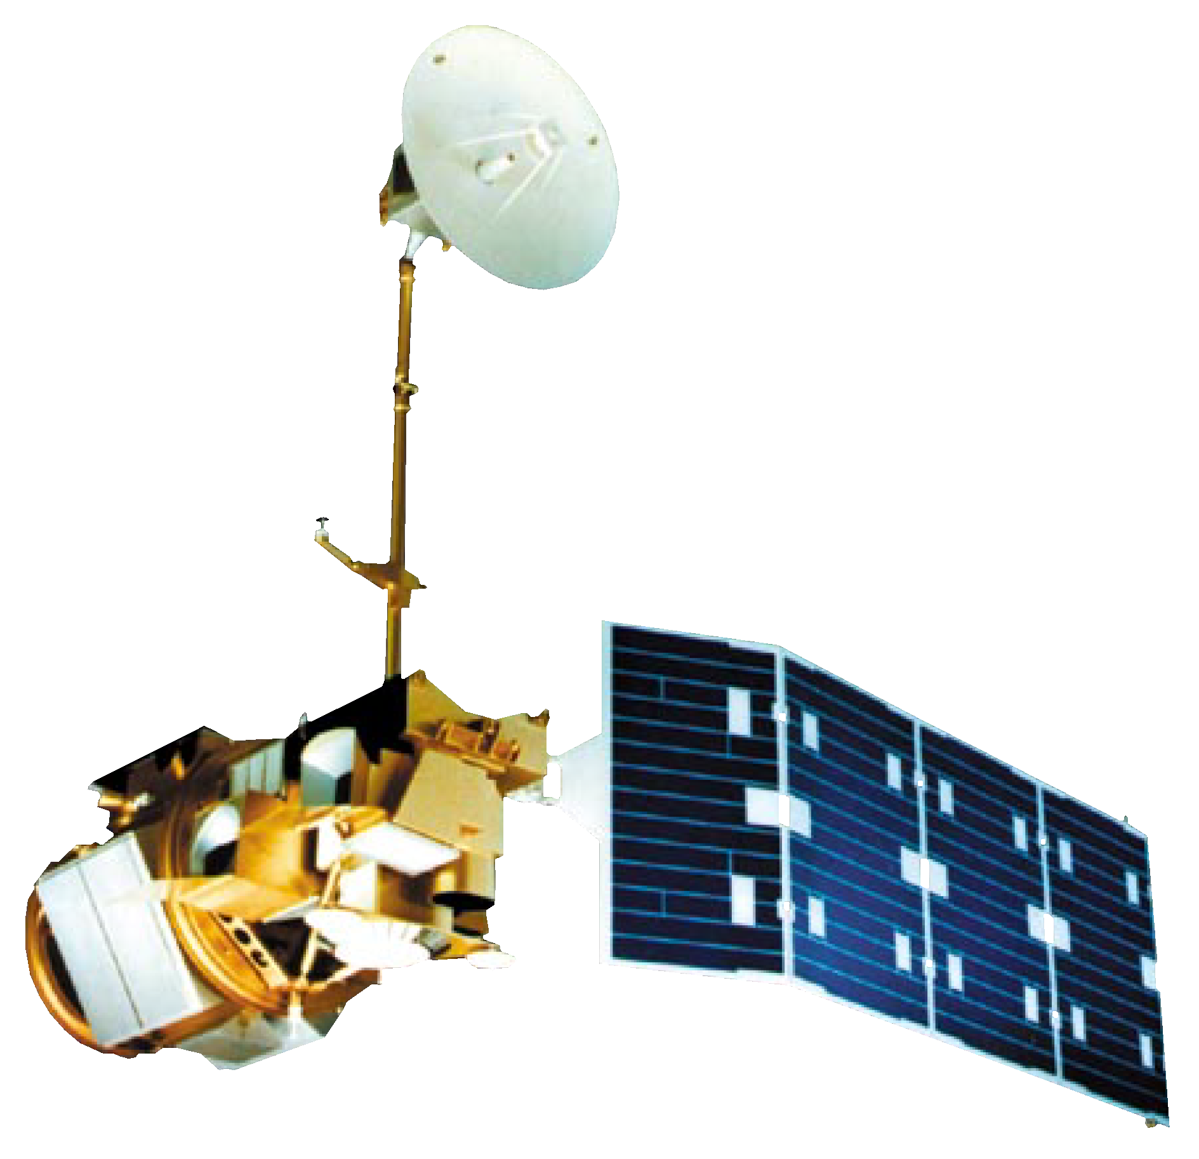
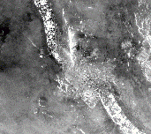
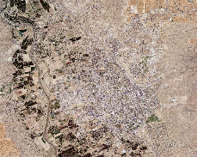
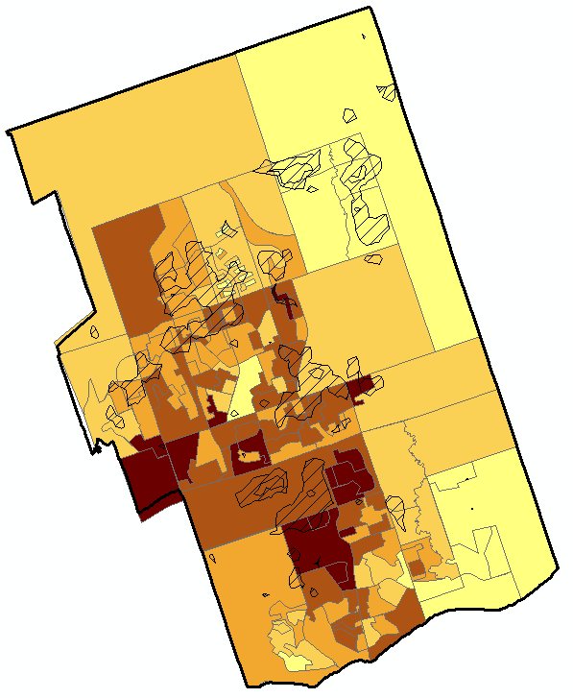
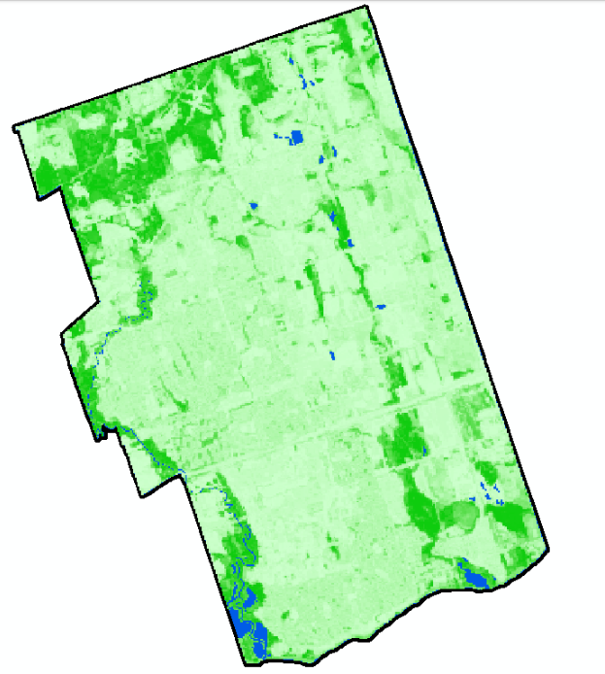
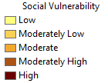
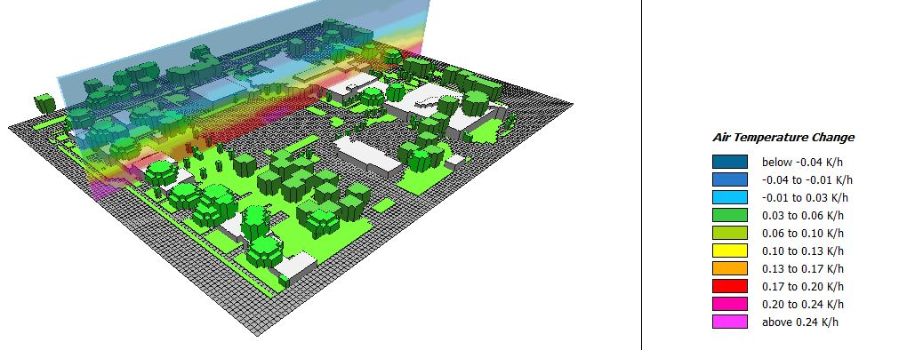
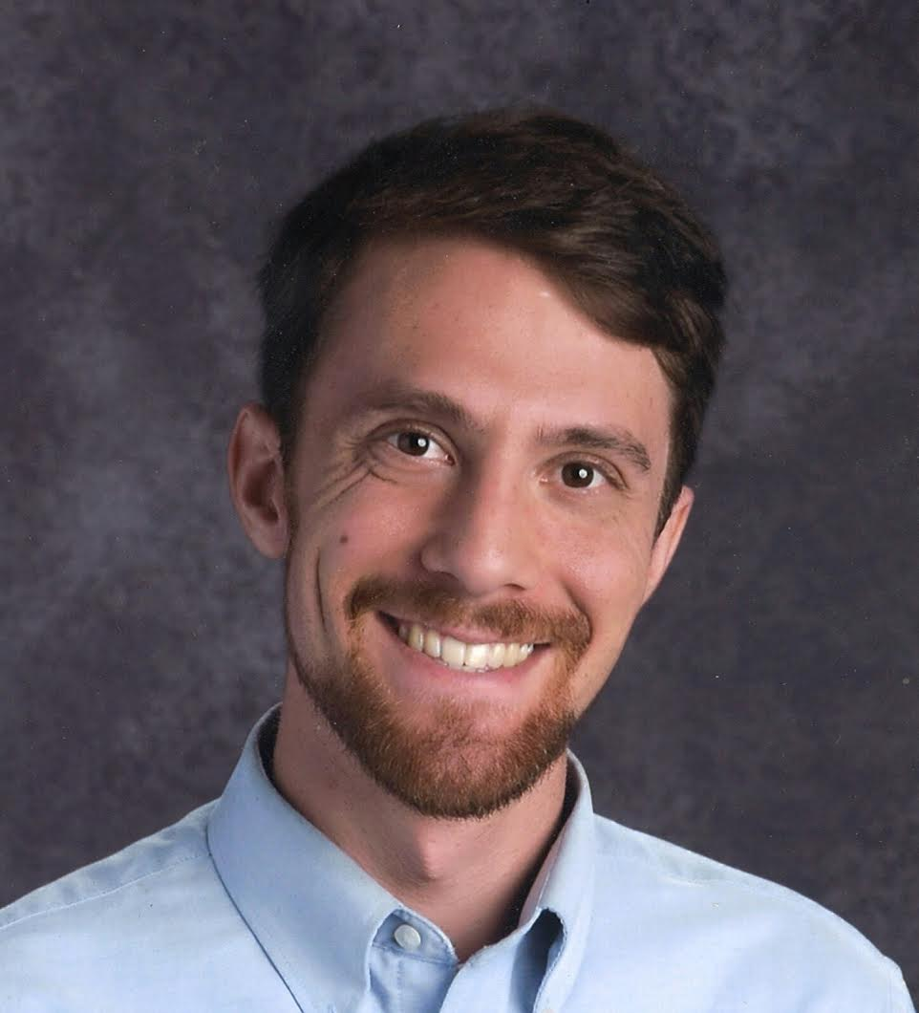
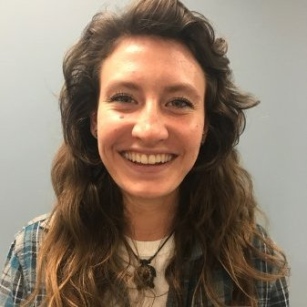
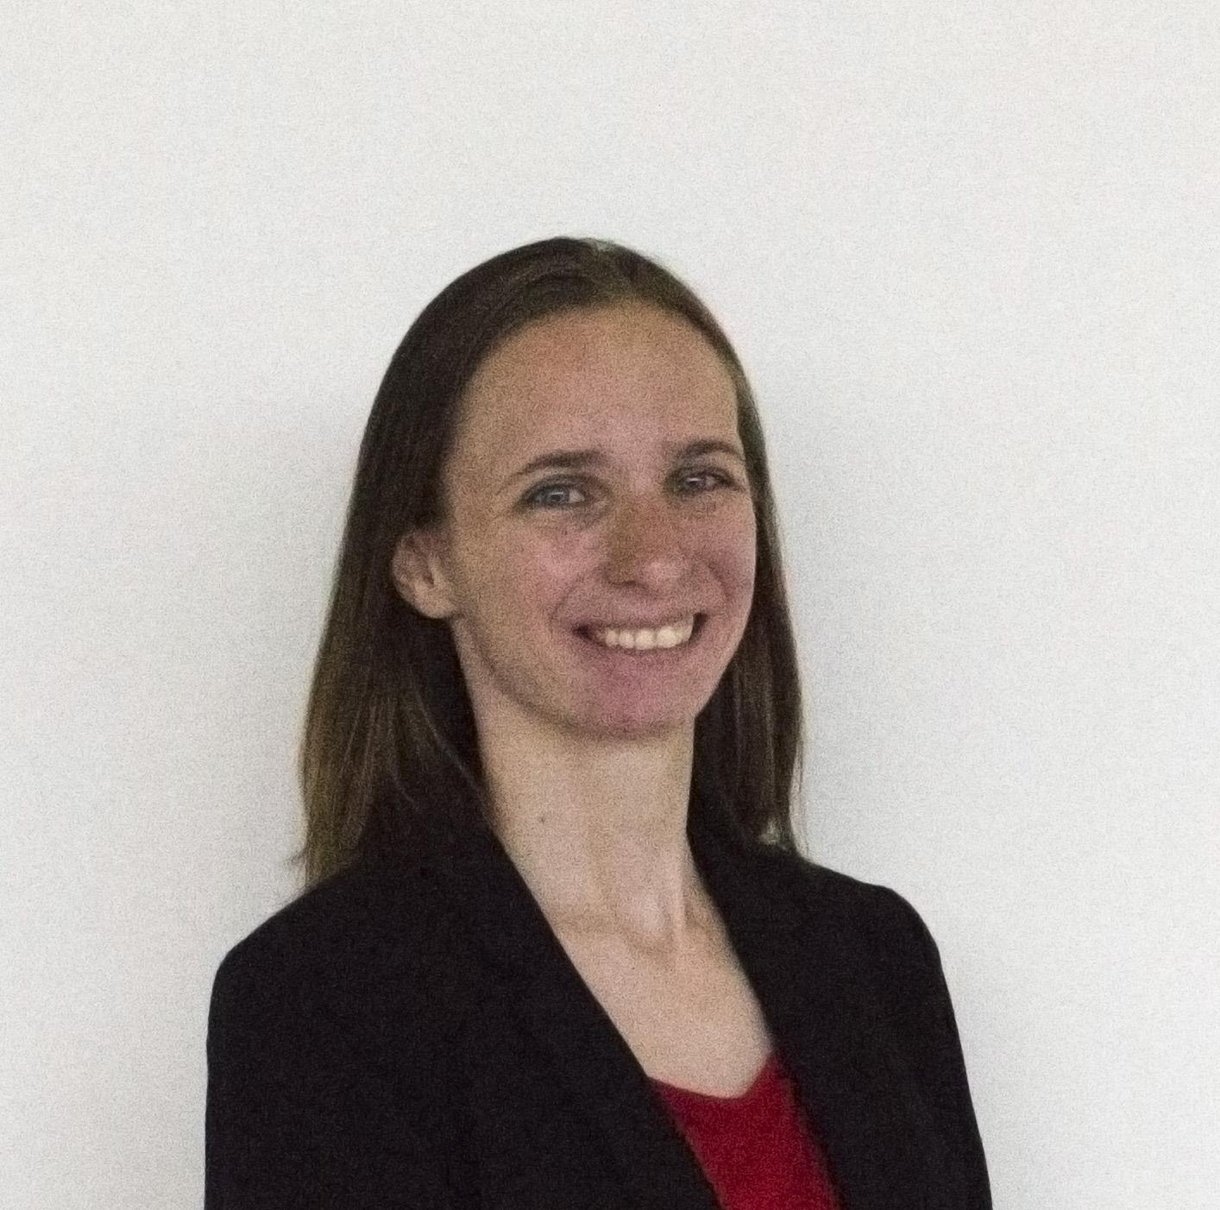
Utilizing NASA Earth Observations to Assess Urban Forest as an Adaptation Strategy for Extreme Heat in Ajax, ON, Canada
Abstract
Objectives
The town of Ajax, Ontario received a report from Specialists in Energy, Nuclear and Environmental Sciences (SENES) Consultants detailing the likely changes in local weather patterns for 2040-2049. The climate model predicts an increase in the frequency and intensity of monthly rainfall, a decrease in annual snowfall, and an increase in average annual temperature of approximately 4 °C. The Town of Ajax, Operations & Environmental Services aims to take early action to mitigate the potential impacts of these changes, such as increased tree fatalities and extreme temperature. In particular, tree fatalities due to increased stress, disease, and infestation are of special concern because trees are an important resource for ameliorating extreme temperatures via shading and evapotranspiration. To create a model for how tree stress varies in conjunction with climate variables, Landsat 5, Landsat 8, and high-resolution imagery from 2000 to 2016 were used to estimate the tree canopy coverage and land cover classes. Combined with meteorological data, these classifications were used to examine the relationship between tree stress and climate variables such as temperature and precipitation. To supplement these results, the group used an ENVI-MET model simulation to perform a case study that determined the optimal tree placement and orientation in a vulnerable residential area within the city. These results will provide city planners with tools needed to plan for the predicted increase in extreme heat events and mitigation of the effects on the community.
Analyze arrangements of trees, at the block scale, that will help mitigate the vulnerability and risks associated with extreme heat
Forecast tree stress based on projected changes in weather patterns
Identify regions where Ajax residents are most vulnerable to extreme heat
Create a 2017 land use and land cover classification for the town of Ajax, Ontario
Study Area
Earth Observations
Methodology
Landsat 8
Data
Processing
Analysis
Durham Region
Landsat 5, 8
Planet Scenes
Orthoimagery
SENES
Daymet
Census of Canada
Climate Time Series
Land Surface Temperature
Vegetation Index
Social Vulnerability Layers
Landcover Classes
Tree Health Forecast
Heat Vulnerability Analysis
Local Tree Placement Optimization
Lake Ontario
Toronto
Ajax
Landsat 5
Project Partners
Town of Ajax, Operations & Environmental Services
Great Lakes and St. Lawrence Cities Initiative
Arizona State University, Urban Climate Research Center
Results
Social Vulnerability in Ajax, Ontario
Tree Cover in Ajax, Ontario
Conclusions
Some results indicate that average maximum and minimum temperatures of the previous winter may be a rough indicator of tree health in areas with natural cover.
Areas with consistent tree cover tended to be in residential areas.
Low correlation between climatic variables & NDVI in residential areas may be due to residential areas being better managed.
Areas in central Ajax tend to be more vulnerable to extreme heat.
The map on the left is a compositional map of a social vulnerability index and land surface temperatures for 2016. The overlapping areas between the two areas represent geographic locations where the populations are most vulnerable to extreme heat. The map on the right displays Ajax tree cover for 2016, calculated using a Random Forest regression with Landsat 8 surface reflectance data.
Acknowledgements
The image to the left shows how air temperature flux varies around Ajax’s Town hall. The vegetated areas have a lower temperature flux than the paved areas, indicating that added vegetation could reduce the maximum temperature and increase thermal comfort. The graph below depicts correlation coefficients for climate variables of the previous year as a function of annual NDVI averaged out in forested areas of Ajax for the 2000 – 2016 time period. Average maximum winter temperatures are shown with the highest R-squared value at 0.4.
The authors would like to thank:
Dr. David Hondula, Arizona State University, DEVELOP Arizona Advisor
Dr. Qunshan Zhao, Arizona State University, DEVELOP Arizona Advisor
Dr. Kenton Ross, National Science Advisor, DEVELOP National Project Office
Team Members
Huntington Keith
Project Lead
Eleanor
Dhuyvetter
Dean Blumenfeld
Elizabeth Dyer
Ajax Urban Development
Arizona – Tempe | 2018

