Slide 1
Elkhorn Slough Ecological Forecasting
Irma Caraballo Álvarez
Detecting Eutrophication Sources, Hotspots, and Nutrient Levels in a Central California Estuary to Support Watershed Management Decisions
Abigail Childs
Kirsten Jurich

Slide 2
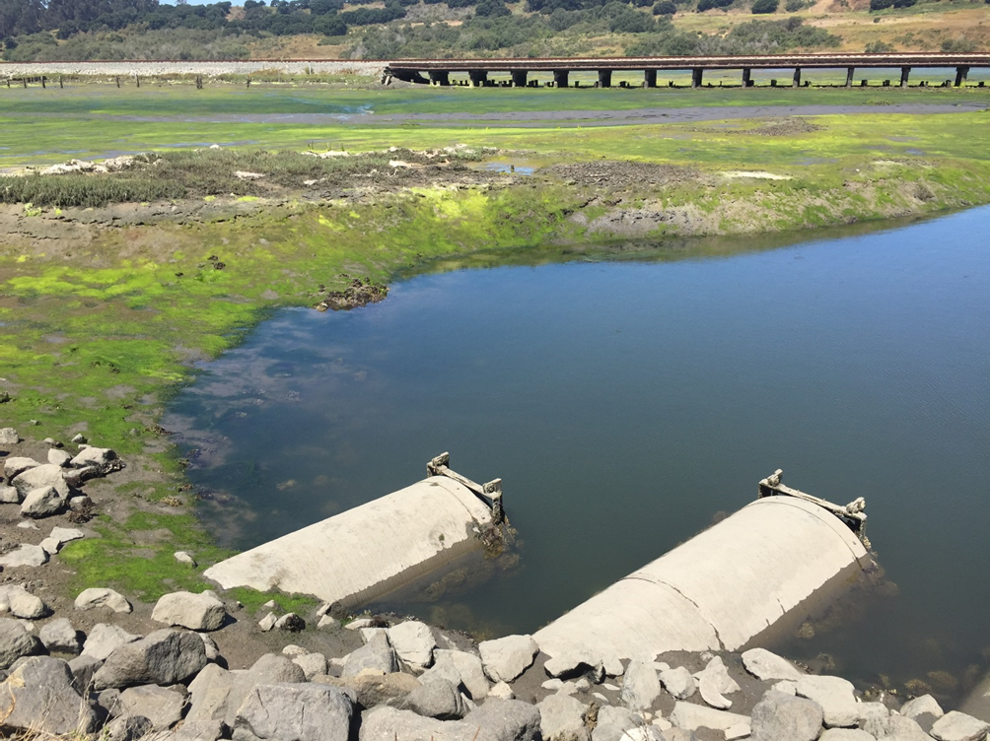
Outline
Study area
Community concerns
Objectives
Models
NASA satellites & sensors
Methodology
Results
Conclusions
Acknowledgements
Figure 1. Algal mats in a muted tidal section of Watsonville Creek.
Image credit: Kirsten Jurich

Slide 3
Study Area
Elkhorn Slough, CA
12km² tidal wetland
Characterized by brackish water, coastal marsh vegetation, and a temperate climate
Surrounded by agricultural cultivation with high fertilizer inputs
March 1995 – June 2016
Forecasting: 2020
Figure 2. Elkhorn Slough watershed delineation (yellow) and
stream network (blue) from SWAT in Monterey County, CA.
Source: Landsat 8 OLI, Author: Irma Caraballo Álvarez
Notes:
Since the onset of industrial nitrogen production in the mid-20th century, nutrient pollution has become the single largest pollution problem affecting coastal waters of the United States. Nutrient loading from agricultural runoff contributes to a condition known as eutrophication, which can lead to algal blooms, hypoxia events, decreases in biodiversity, and even dead zones. Regions particularly susceptible to nutrient loading include those in close proximity to agricultural fields and urbanized areas. The Elkhorn Slough in central California is presented as a case study of estuarine eutrophication as a result of fertilizer-rich runoff from nearby agricultural fields.
The Elkhorn Slough is a 12sq km tidal wetland at the northern reaches of Monterey County, California.
The watershed drainage system encompasses approximately 588sq km and has a mean annual precipitation of 40cm. The study site is characterized by brackish water and coastal marsh vegetation in addition to being surrounded by agricultural fields growing primarily strawberries, artichokes, and Brussels sprouts

Slide 4
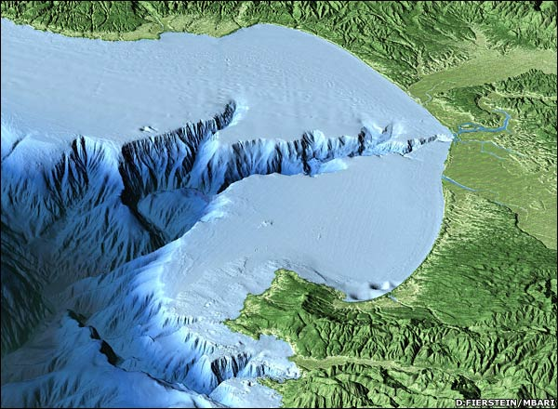
Study Area
Elkhorn Slough
The estuary is located at the coastal edge of the Monterey Bay Submarine Canyon, subjecting the site to influxes of deep-water nutrient upwelling
Tidal exchange is truncated by water control structures in muted areas
Image Credit: Lolako.com
Figure 3. Bathymetry shows the Monterey Bay Submarine Canyon meeting the Elkhorn Slough.
Image credit: MBARI, D. Fierstein
Notes:
The Elkhorn Slough is situated at the tip of the Monterey Bay Submarine Canyon, which contributes to a dynamic between agricultural runoff and deep-water upwelling from the marine canyon.

Slide 5
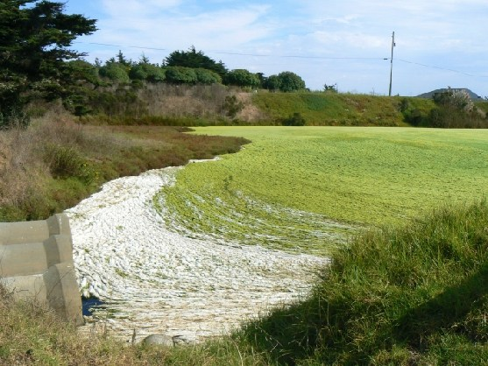
Community Concerns
High nitrate and turbidity levels can lead to: eutrophication, hypoxia, and implications on the trophic cascade of aquatic and terrestrial species
Eutrophication – overabundance of nutrients in water
Partnered with Elkhorn Slough National Estuarine Research Reserve (ESNERR) and Monterey Bay Aquarium Research Institute (MBARI)
Image Credit: Lolako.com
Figure 4. Water control structures mute tidal exchanges.
Image credit: Lolako.com
Notes:
Our project partners at ESNERR have voiced concern regarding increasing trends of eutrophication as a result of agricultural runoff.

Slide 6
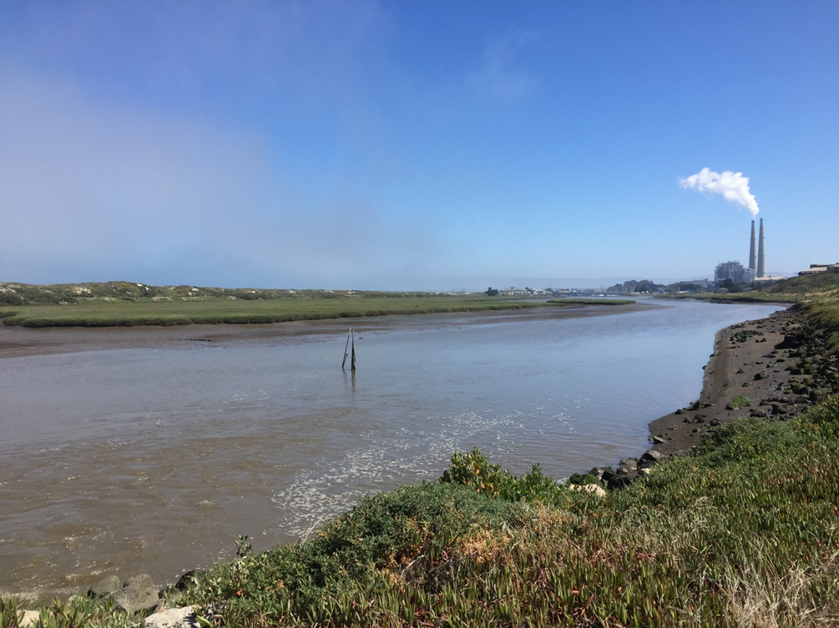
Objectives
Identify and track patterns of eutrophication within Elkhorn Slough from 1995 – 2016 and determine relationship to drought and El Niño events
Assess land use changes from 2000 – 2010 and forecast land use practices for 2020
Detect and quantify primary contributors of nutrient and sediment loadings by sub-basin
Credit: UCSC
Figure 5. Highly turbid water from the Moro Cojo Slough entering the Elkhorn Slough. Image credit: Kirsten Jurich
Image Credit: DEVELOP Team
Notes:
This study addresses the ecological forecasting, water resources, and climate application areas within NASA’s Applied Sciences Program. The main objective remains to identify and track patterns and sources of eutrophication in the slough and anticipate future hotspots as contributed from sub-watersheds in the greater basin. Primary and secondary indicators of eutrophication—FAI, SSC, NDTI— were employed as metrics of eutrophic hotspots in a historic image time-series of the study site. Additional analyses examined the relationship between land use changes, climatic variations and eutrophic composition over time.
The goals of the study are to identify and track patterns of eutrophication and their sources in the estuary and forecast future eutrophication hotspots based on nutrient sources and historical data. Results will inform coastal management of the region and help end-users make more informed decisions about combating eutrophication in the estuary.

Slide 7
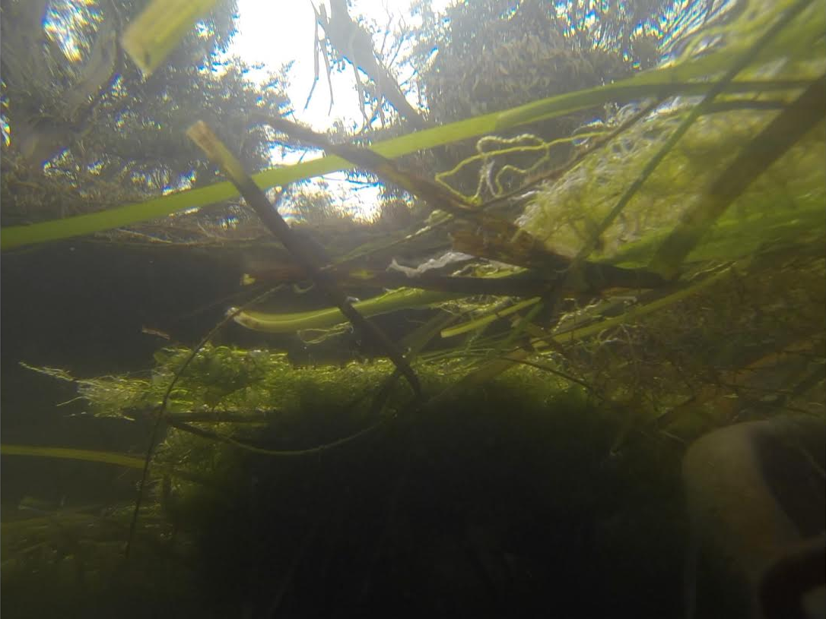
Models
TerrSet
Earth Trends Modeler (ETM)
Floating Algal Index (FAI)
Normalized Difference Turbidity Index (NDTI)
Normalized Difference Suspended Sediment Index (NDSSI)
Land Change Modeler (LCM)
Soil & Water Assessment Tool (SWAT)
Credit: UCSC
Figure 6. Underwater view of algal mats in the Elkhorn Slough.
Image credit: Kirsten Jurich
Image Credit: NASA Landsat
Image Credit: Lolako.com
Notes:
Mention Clark Labs, Texas A&M and USDA. One introductory sentence for each model.

Slide 8
NASA Satellites & Sensors
Image Credit: DEVELOP Team
Image Credit: DEVELOP Team
Image Credit: DEVELOP Team

Slide 9
Methodology
Landsat Data Preprocessing
Cloud Obstruction
Images with above 50% cloud cover were dropped
Landsat 7 Striping
Data gap fill to correct Landsat 7 images 2003-present
Python codes for FAI, NDTI, NDSSI indices
Figure 7. Example of a Landsat 7 scene of the study area with striping. Image credit: NASA Landsat 7.
Notes:
The satellite imagery scenes in this study are Landsat terrain-corrected Level 1T products further atmospherically corrected to surface reflectance; these were obtained from the United States Geological Survey’s (USGS) GLOVIS (http://glovis.usgs.gov/). The Landsat scenes were found in path 44, row 34 and cover central California, including the study site at Elkhorn Slough. The 30m spatial resolution of Landsat Thematic Mapper (TM) and Operational Land Imager (OLI) for the multi-bands is optimal to monitor eutrophication hotspots in this moderately sized watershed. The images were downloaded in 16 day intervals, from March 1995 - June 2016.

Slide 10
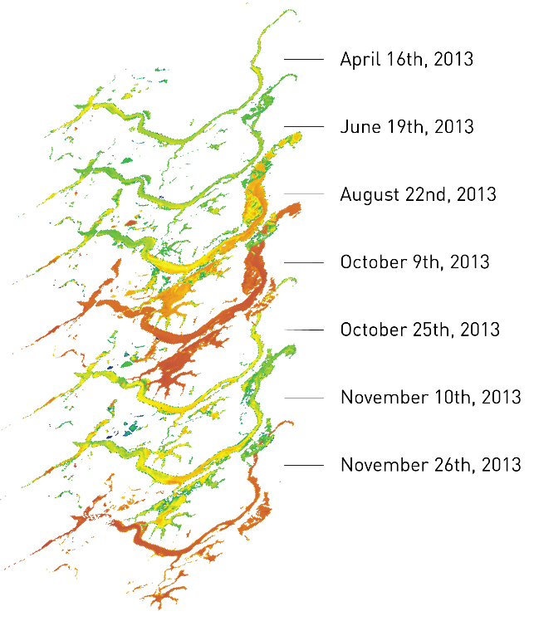
Methodology: ETM
Earth Trends Modeler (ETM)
Analysis of image time series to rapidly assess long term eutrophication trends and isolate true change from normal environmental variability
Detect spatial patterns of eutrophication hotspots
NDTI
FAI
NDSSI
ETM
Landsat
Scenes
High 1.0
Low -1.0
Figure 8. Flowchart of methodology for identifying eutrophication hotspots.
An example of the inputs is presented on the left and a subset of FAI outputs on the right.
Notes:
Earth Trends Modeler (ETM) is a tool within Clark Labs’ TerrSet that analyzes remotely sensed time series data; it can rapidly assess long term climatic trends, measure seasonality in environmental data, and decompose an image within a time series to detect patterns in both space and time. This program automated analysis of image time series and detected perceivable trends and patterns. Through a vertical application process, this software facilitated delineation of eutrophic composition in the Elkhorn Slough over a twenty year time period.
The Land Change Modeler (LCM) module was employed to forecast future land use distribution in the area immediately surrounding the slough. This modeling technique incorporated historic land use maps as baseline indicators of change in an effort to forecast future land cover change potential and highlight areas of high historic change.

Slide 11
Methodology: LCM
Land Change Modeler (LCM)
Model land cover transition potentials for various land cover classes surrounding the Elkhorn Slough
Figure 9. Methodology employed to forecast land use changes for year 2020.
Inputs are located to the left and the results on the right.
Notes:
Earth Trends Modeler (ETM) is a tool within Clark Labs’ TerrSet that analyzes remotely sensed time series data; it can rapidly assess long term climatic trends, measure seasonality in environmental data, and decompose an image within a time series to detect patterns in both space and time. This program automated analysis of image time series and detected perceivable trends and patterns. Through a vertical application process, this software facilitated delineation of eutrophic composition in the Elkhorn Slough over a twenty year time period.
The Land Change Modeler (LCM) module was employed to forecast future land use distribution in the area immediately surrounding the slough. This modeling technique incorporated historic land use maps as baseline indicators of change in an effort to forecast future land cover change potential and highlight areas of high historic change.

Slide 12
Methodology: SWAT
Soil and Water Assessment Tool (SWAT)
Model watershed dynamics to identify sources of nutrient and sediment loadings
Calibrate and validate modeled outputs with river discharge in-situ data
1993 - 2012
Figure 10. Simplified methods for running a SWAT simulation.
Basic inputs are represented on the left and an example of the outputs on the right.
Notes:
The Soil and Water Assessment Tool (SWAT) is a watershed-scale hydrological model used to assess the implications of land management practices on water resources
The SWAT analysis models watershed dynamics using three main inputs: LULC maps, soil maps, and a DEM. LULC maps were obtained from the USGS and the National Oceanographic and Atmospheric Administration (NOAA) and are derived from various Landsat missions. The soil map and database were acquired from the Natural Resource Conservation Service’s (NRCS) Web Soil Survey: the Soil Survey Geographic Database (SSURGO). This dataset contains both spatial and tabular data that required preprocessing and manipulation before incorporated into the model.
In order to identify potential sources of eutrophication within the study area, the SWAT model analyzed all inputs and divided the watershed in sub-basins and hydrologic response units (HRUs).

Slide 13
Results: FAI
1997-1998
El Nino
2014
Drought
2015-2016
El Nino
1995-2016
FAI Composite
Image Credit: Monet

Slide 14
Results: NDTI
1997-1998
El Nino
2014
Drought
2015-2016
El Nino
1995-2016
NDSSI Composite
Image Credit: Monet

Slide 15
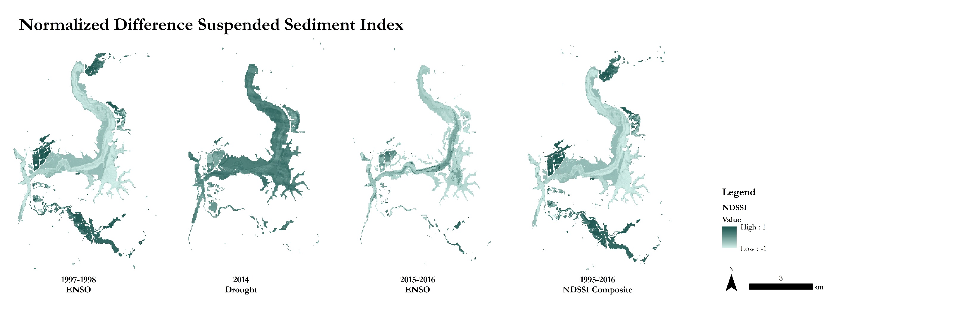
Results: NDSSI
1997-1998
El Nino
2014
Drought
2015-2016
El Nino
1995-2016
NDSSI Composite
Image Credit: Monet

Slide 16
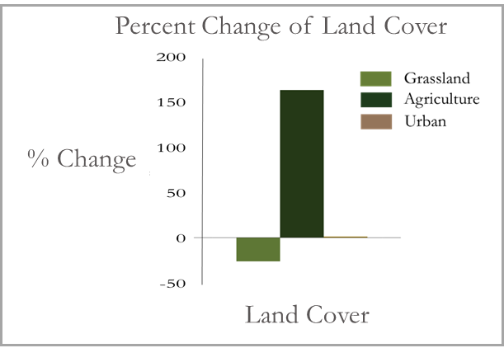
Results: LCM
Land Cover Forecast 2020
Figure 15. Land cover transition potential for 2000 – 2020 show a 161% increase for agriculture.
Figure 14. 2020 land cover forecast based on 2000 and 2010 maps.

Slide 17
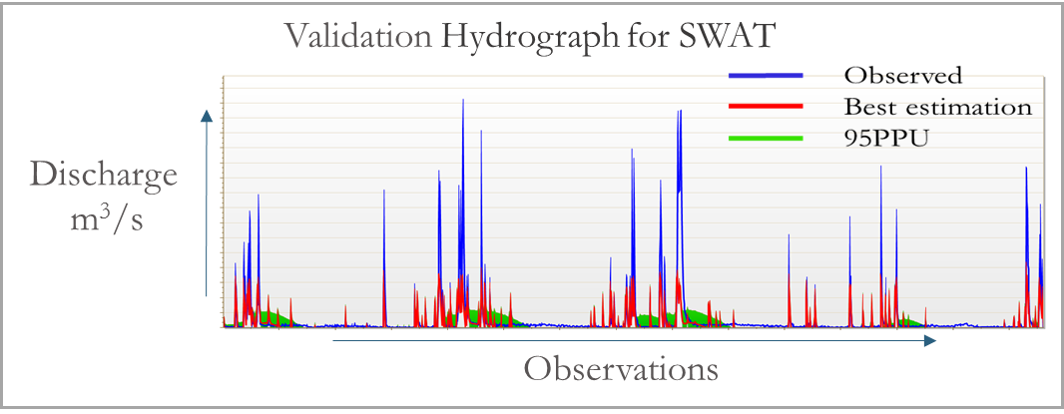
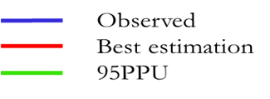
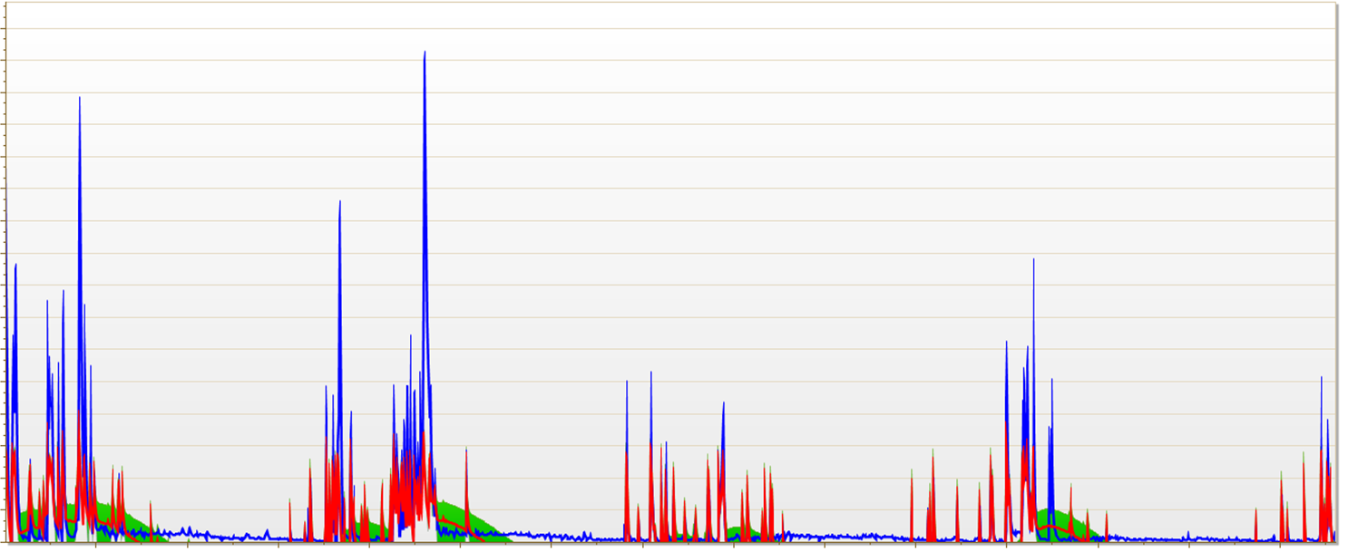
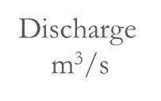
Results: SWAT
SWAT Calibration and Validation
Figure 16. 2005 – 2008 SWAT calibration results: R² = 0.53, NS = 0.45. Observed discharge peaks and base flow are higher than modeled data peaks.
Figure 17. 2009 – 2012 SWAT validation results: R² = 0.60,
NS = 0.46. Observed discharge peaks are higher than modeled data peaks.

Slide 18
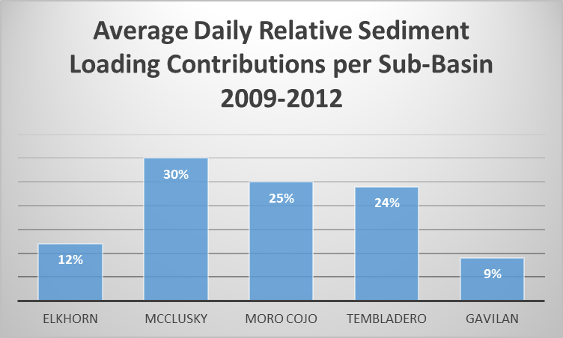
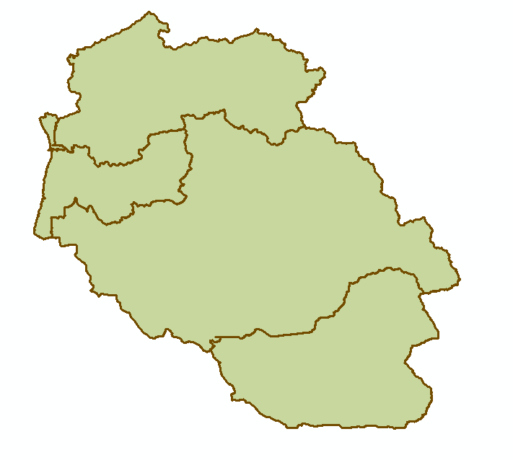
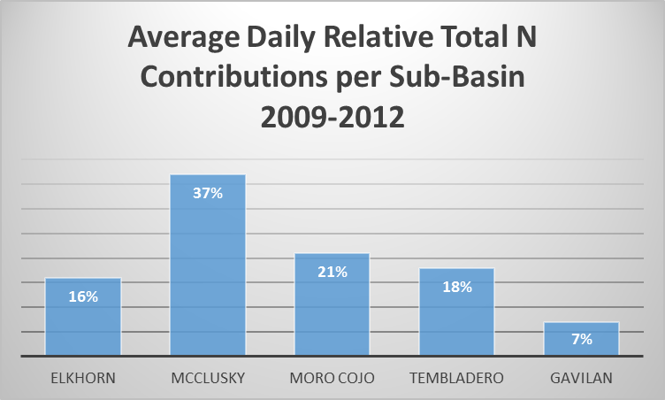
Results: SWAT
Sediment and Nutrient Outputs
SWATcheck identified a potential underestimation of nutrients
Figure 19. Sediment transported with water out
of each sub-basin.
Elkhorn
McClusky
Moro Cojo
Tembladero
Gavilan
Figure 18. Watershed delineation with sub-basins.
Figure 20. Total nitrogen transported with
water out of each sub-basin.

Slide 19
Conclusions
Muted tidal exchange areas experience the highest levels of floating algal mats
Land change forecasting for 2020 indicates substantial agricultural conversion within the watershed
Figure 21. Water control structures and algal mats in study area. Image credit: Kirsten Jurich

Slide 20
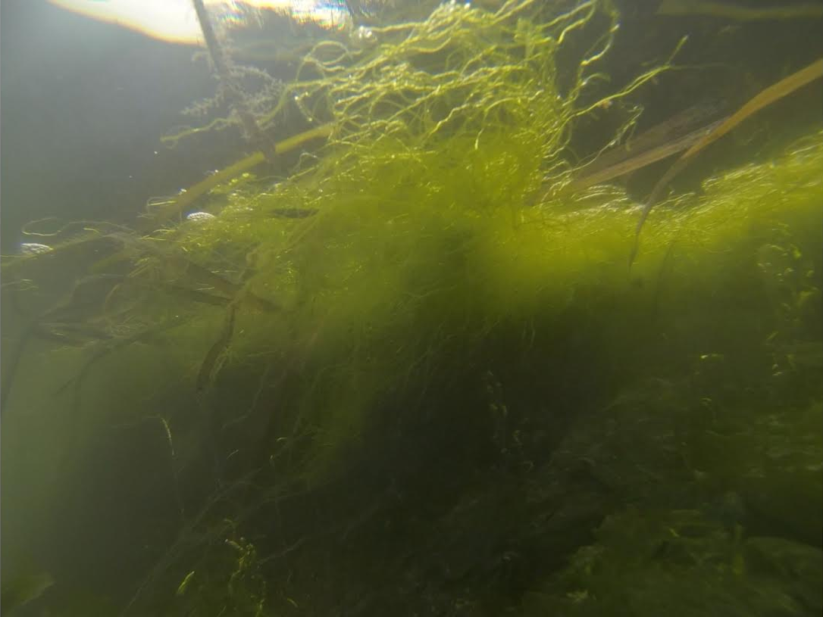
Conclusions
More comprehensive in situ datasets may yield more suitable model outputs with less uncertainty
The McClusky sub-basin contributes the highest levels of total N and sediment loadings
ETM confirms SWAT outputs
Figure 22. Underwater view of algal mats in the Elkhorn Slough.
Image credit: Kirsten Jurich
Notes:
Results obtained from SWAT may be underestimated due to simplified dynamics and/or do not account for all watershed processes.

Slide 21
Bay Area Environmental Research Institute (BAERI)
Dr. Juan L. Torres-Pérez
Dr. Sherry L. Palacios
Chase Mueller
Elkhorn Slough National Estuarine Research Reserve (ESNERR)
ARC DEVELOP
Chippie Kislik
Vickie Ly
Mackenzie Taggart
Martha Sayre
Monterey Bay Aquarium Research Institute (MBARI)

