Slide 1
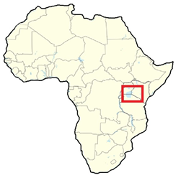
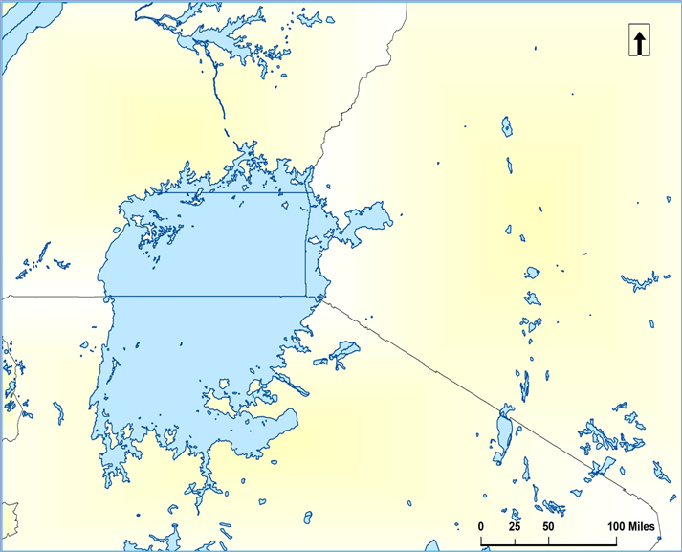
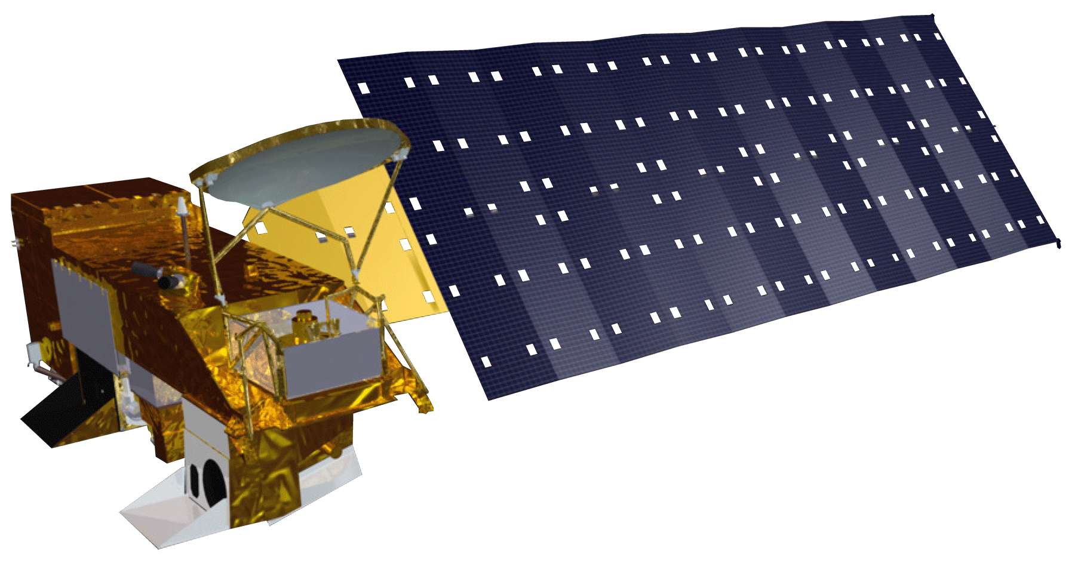
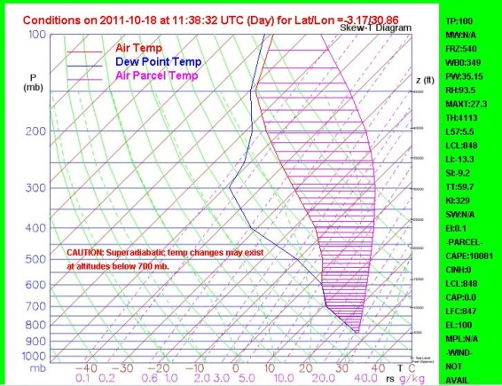
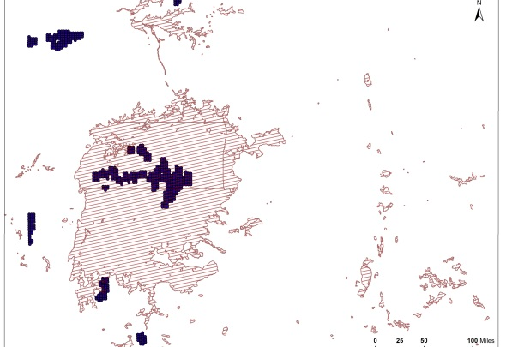
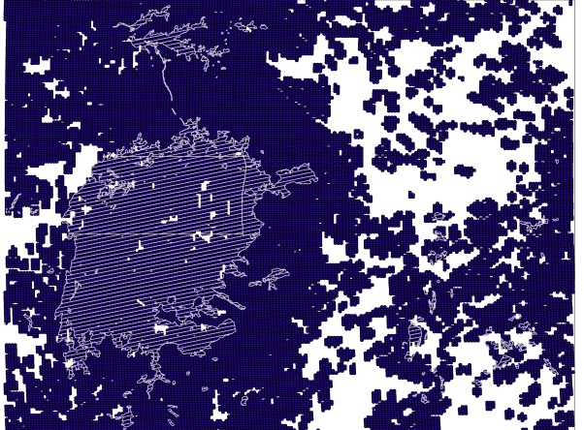
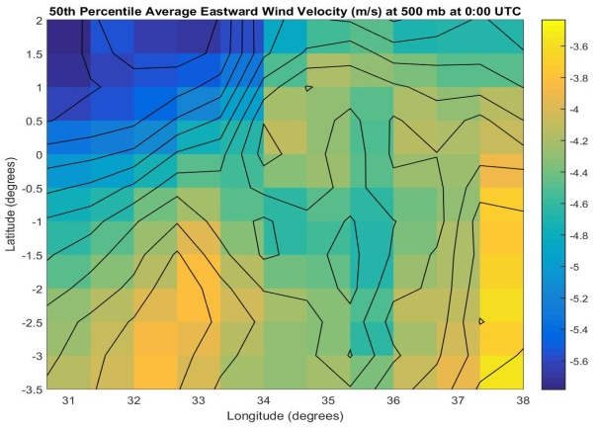
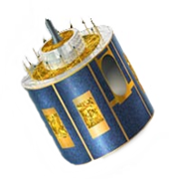
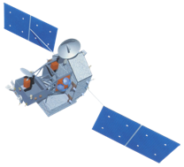
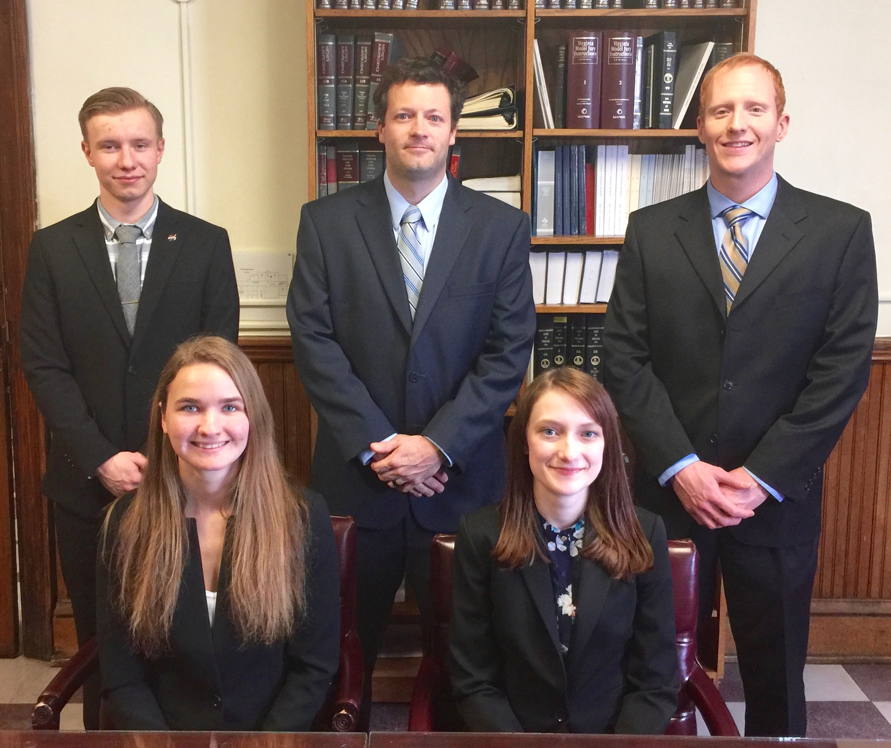
African Great Lakes Weather II
Utilizing NASA Earth Observations to Identify Indicators to Help Predict Deadly Storms over African Great Lakes
Annabel White (Project Lead)¹, Jakub Blach¹, Michael Brooke¹, Megan Buzanowicz¹, Kathy Dooley¹, Rajkishan Rajappan¹, Ryan Umberger^{1,}
Dr. Kenton Ross¹, Kristopher Bedka², Dr. DeWayne Cecil³, Bob VanGundy⁴ ¹NASA DEVELOP National Program, ²Climate Science Branch at NASA Langley’s Science Directorate
³Global Science and Technology, NOAA NCEI, ⁴The University of Virginia’s College at Wise
Abstract
Objectives
Keep this blank for now.
Body text point size should be at least 24.
Caption text point size should be at least 16.
Feel free to rename, move, and resize sections as needed.
Identify and analyze climatic variables surrounding intense thunderstorm events over Lake Victoria, Africa as identified by overshooting top activity.
Create weather variable contour maps for days of average and severe weather to highlight significant differences that occur during storm events.
Improve understanding of weather patterns over Lake Victoria to aid the project partner in local storm forecasting efforts.
Methodology
Study Area
50th Percentile
(days with average number of OTs)
AIRS
Skew-T Log-Ps
Uganda
HSED
Compile OTs and organize by percentiles
Uganda
Kenya
Lake Victoria
Kenya
LIS
Lake
Victoria
MERRA
Variables
Wind
Pressure
Temperature
Humidity
Vertical pressure velocity
Tanzania
99th Percentile
(days with most OTs)
Contour Maps
Tanzania
Image credit: https://upload.wiki
media.org/wikipedia/commons/7/7b/ISD_highres_STS030_STS030-89-59.jpg
Earth Observations
TRMM
AQUA
Results
Meteosat 8, 9
Use images.
Make sure that it has some sort of flow, that it makes sense. Show your results in a logical order.
No bullets.
Conclusions
Use bullets.
Use complete sentences with periods.
Team Members
Project Partners
Acknowledgements
Left to Right: Megan Buzanowicz, Jakub Blach, Kathy Dooley, Michael Brooke, Annabel White, Ryan Umberger, Rajkishan Rajappan
Kenya Meteorological Department
Dr. Kenton Ross – NASA DEVELOP National Program
Kristopher Bedka – Climate Science Branch at NASA Langley’s Science Directorate
Steve Licata - Jet Propulsion Laboratory, Atmospheric Infrared Sounder Project
Dr. DeWayne Cecil – Global Science and Technology, Inc.
Robert VanGundy – University of Virginia’s College at Wise
April Huff – NASA DEVELOP/Wise County Clerk of Court’s Office
Fall 2015 African Great Lakes Weather I Team

