Slide 1
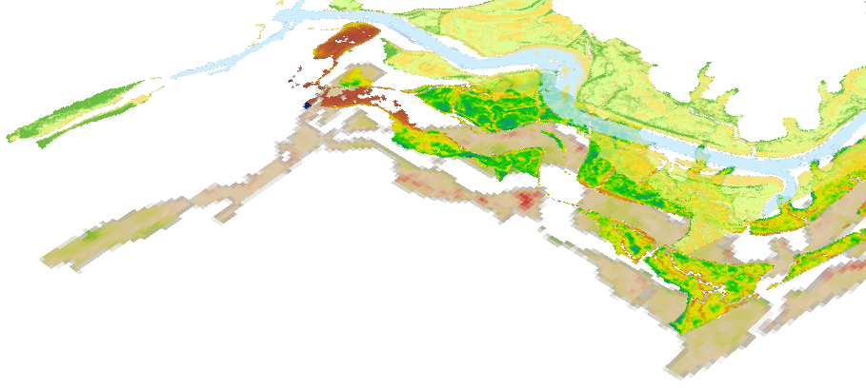

ELKHORN SLOUGH ECOLOGICAL FORECASTING II
Melanie Feen
Hannah Friedrich
Past, Present, and Future Assessment of Marsh Resilience
Stephanie Ly

Slide 2
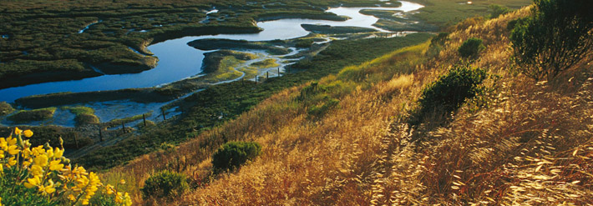
Background Information - Marshes
Provide ecosystem services
  Blue carbon sequestration
  Water filtration
  Flood abatement
  Habitat
Facing local and global threats
  Development
  Sea level rise
  Water pollution
Image Credit: Elkhorn Slough Foundation
Notes:
Image Source: http://www.elkhornslough.org/gallery/index.php?/category/2

Slide 3
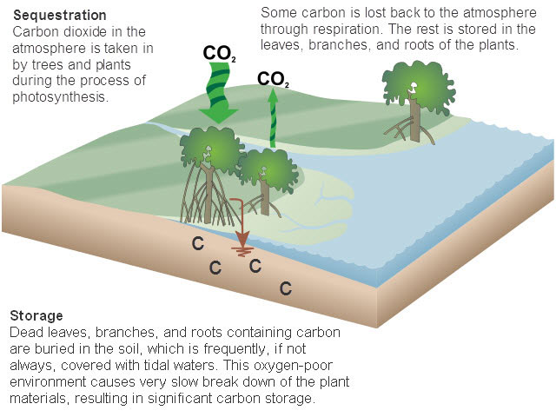
Community Concerns
Marshes cover 140 million ha. Of Earth’s surface (Crooks et al., 2011)
Disappearing at a rate of 1-2% annually – 50% lost historically (Crooks et al., 2011)
Marshes are important to the global carbon cycle because they sequester what is referred to as blue carbon
Image Credit: NOAA Habitat Conservation National Marine Fisheries Service
Notes:
Image Source: http://www.habitat.noaa.gov/images/carbon_cycle.jpg

Slide 4
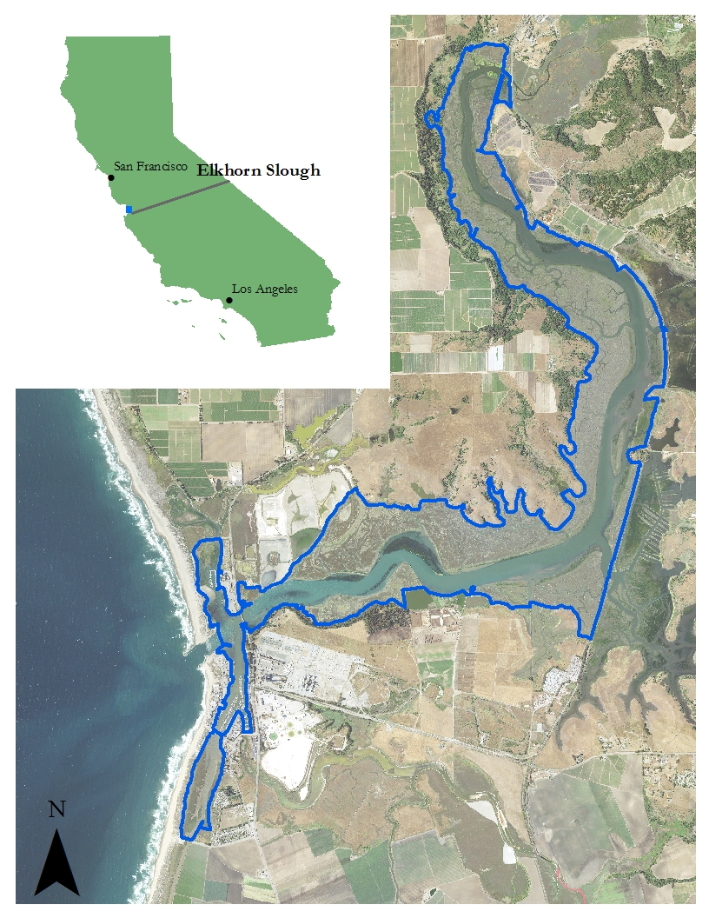
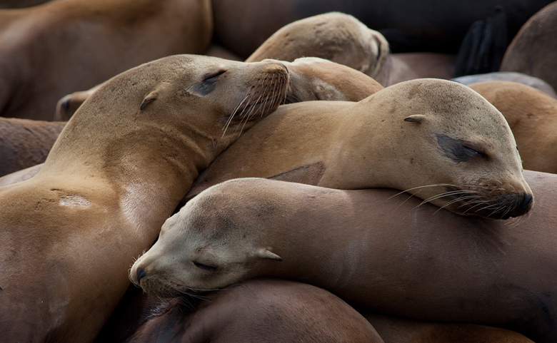
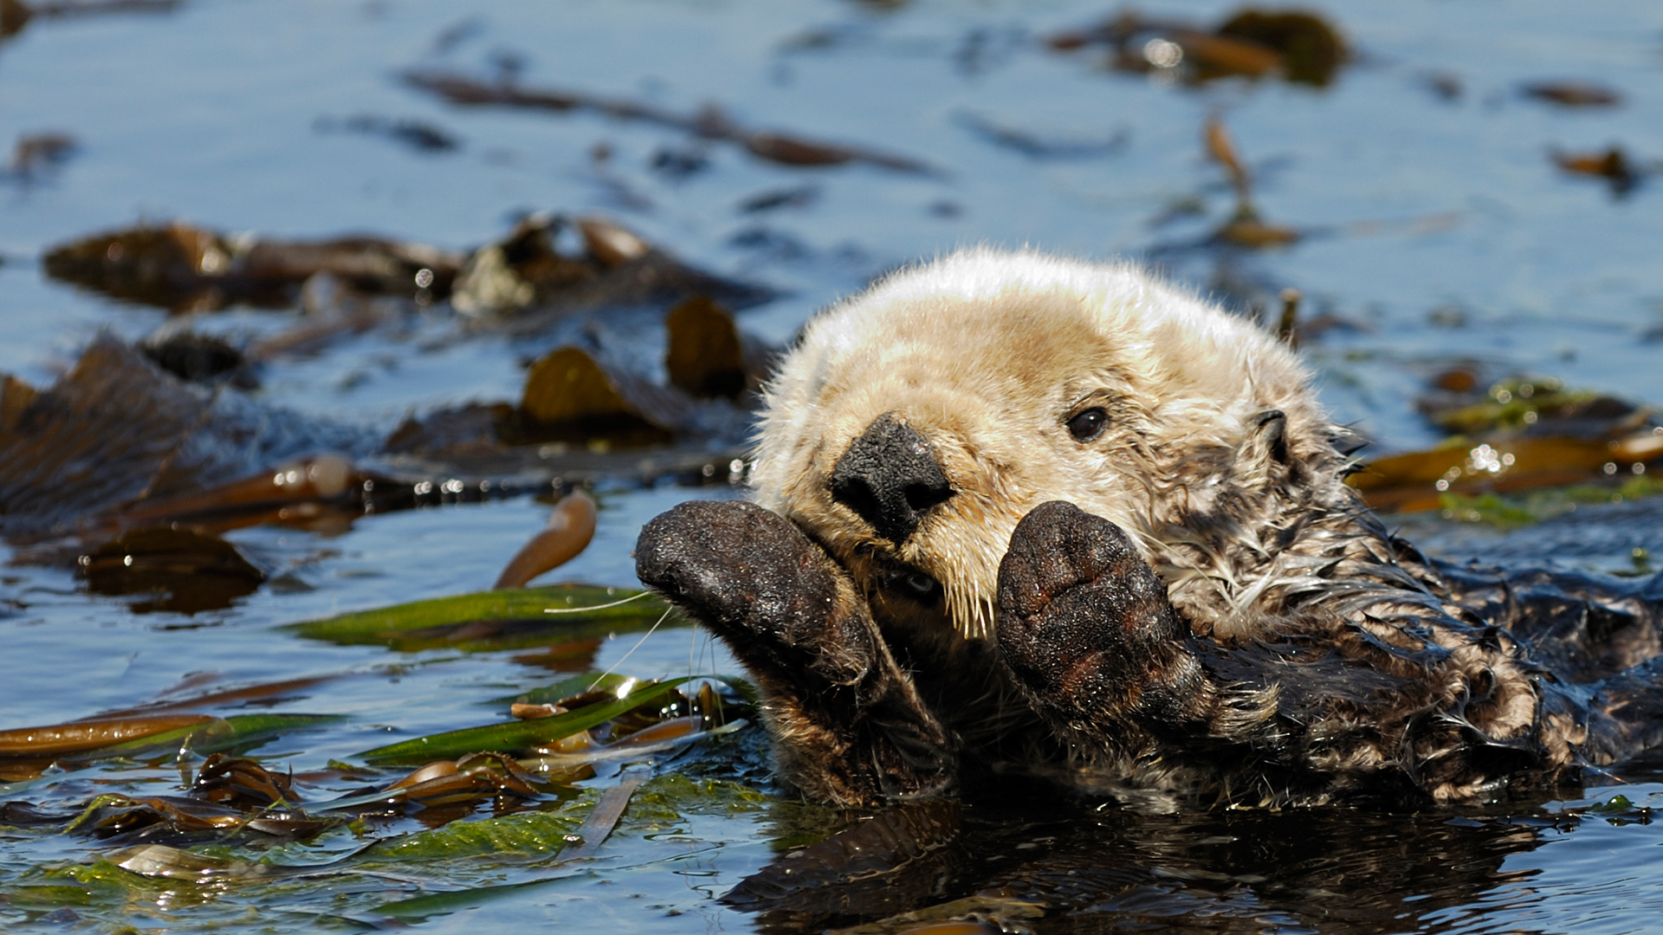
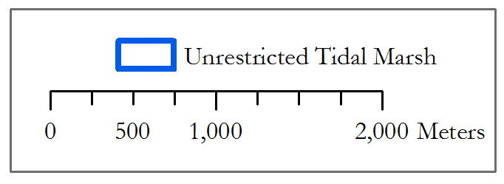
Study Area
Second largest tidal salt marsh in California (ESNERR, 2016)
Located in Monterey Bay
State Ecological Reserve and Wildlife Management Area (ESNERR, 2016)
Research underway to restore marsh and habitat
Image Credit (left to right): PBS, Elkhorn Slough Foundation
Notes:
Image Source: http://www.pbs.org/big-blue-live/live-cams/elkhorn-slough-otter-cam/
http://media.gettyimages.com/photos/sea-otter-in-elkhorn-slough-california-picture-id623360615?k=6&m=623360615&s=170667a&w=0&h=4A7ulGOJcJ2wMKiPadzbSDvaeXdva-6feVNKS6slQYc=
http://www.elkhornslough.org/photography/image_gallery/
Map Base Imagery: National Agricultural Imagery Program
Map “Unrestricted Tidal Marsh” layer provided by our partner, Elkhorn Slough Estuariene Research Reserve (ESNERR)

Slide 5
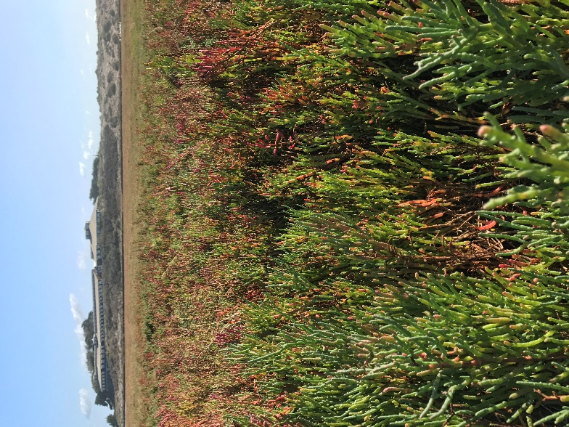
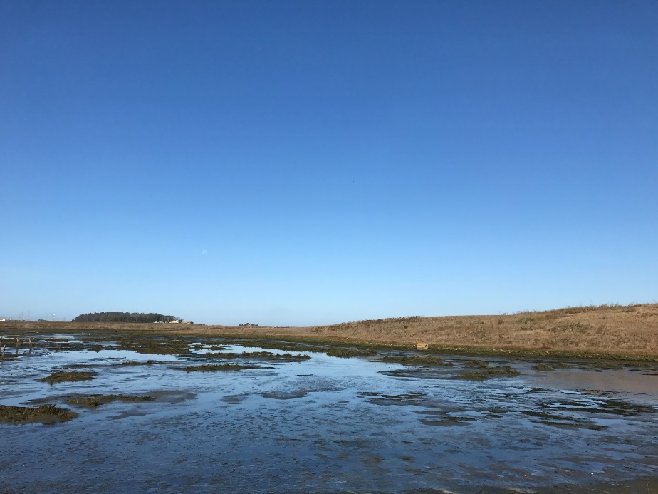
Project Scope
What are the effects of different scenarios of sea level rise and climatic patterns on marsh vegetation health?
A subsiding marsh in Elkhorn Slough that is partially flooded.
Pickleweed (Sarcocornia pacifica) is the dominant vegetation species in Elkhorn Slough.

Slide 6
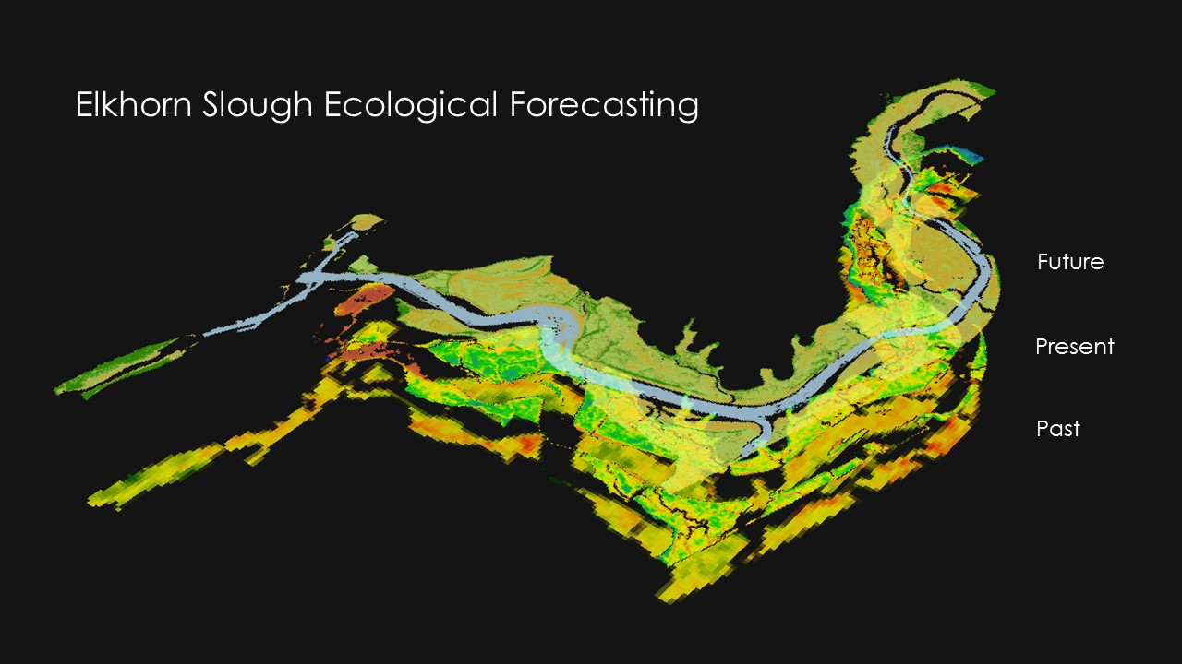
Objectives
Identify historical spatial and temporal trends for marsh vegetation using NASA Earth observations and Google Earth Engine
Detect current vegetation health in comparison to in situ data
Forecast future marsh resilience to different sea level scenarios

Slide 7
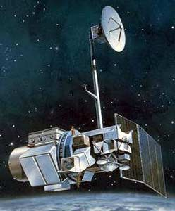

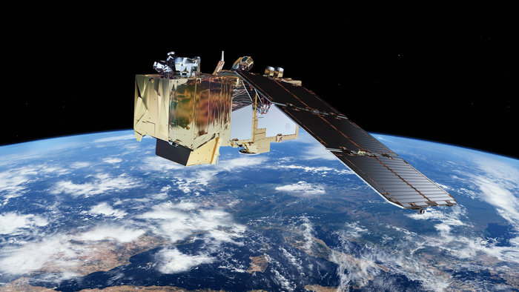
NASA Satellites & Sensors
Landsat 5 TM
30m Resolution
March 1984 – January 2013
Landsat 8 OLI
30m Resolution
February 2013 - present
Sentinel-2 MSI
10m, 20m, 60m Resolution
June 2015 - Present
Image Credit: NASA, European Space Agency (ESA)
Notes:
1. http://landsat.gsfc.nasa.gov/wp-content/uploads/2013/06/nu_611.jpg
2. http://landsat.gsfc.nasa.gov/wp-content/uploads/2012/12/L7_satellite2.png
3. http://www.esa.int/spaceinimages/Images/2015/03/Sentinel-2

Slide 8




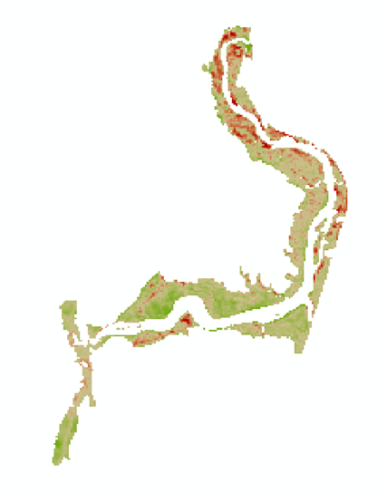
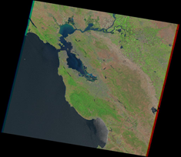
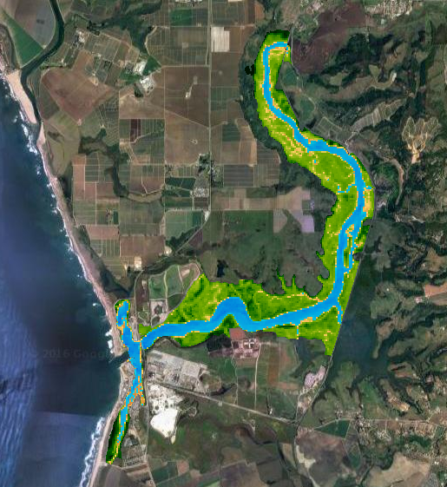
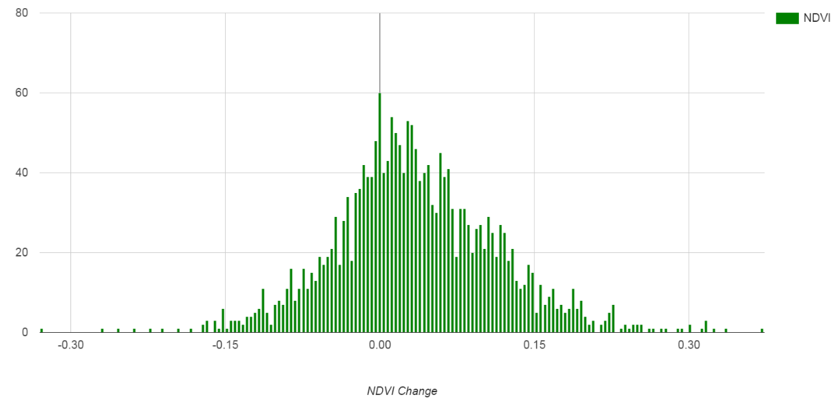
Methods: Historical Time Series

Slide 9

Landsat Images
Landsat Earth Observation System | Date of Image
Landsat 5 Thematic Mapper (TM) | 06/23/1997 06/26/1998 06/05/2002 06/24/2003 04/05/2009 04/08/2010
Landsat 8 Operational Land Imagery (OLI) | 06/25/2015 06/27/2015
Landsat scenes were acquired during peak biomass season between April to June.
Notes:
- Cloud-Free scenes
Landsat calibrated Top-of-Atmosphere (TOA) Reflectance
Fmask algorithm applied to mask cloud and cloud shadows
Low tide was verified with NOAA’s Historic Tides & Water Levels data for the Monterey Station.

Slide 10
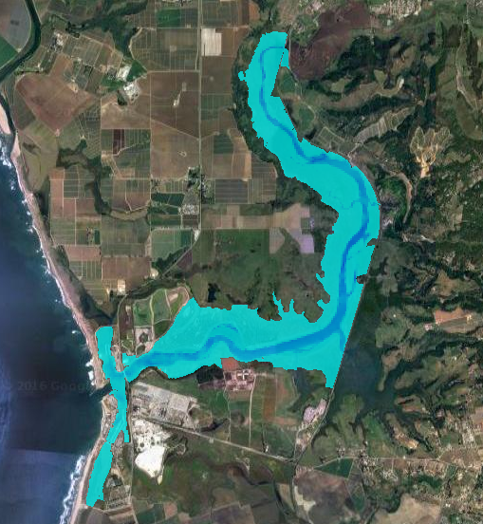
Utilizing Google Earth Engine
Applying Normalized Difference Water Index (NDWI)
  Masks out known water areas from study area
Calculating Normalized Difference Vegetation Index (NDVI)
  (NIR – RED) / (NIR + RED)

Slide 11
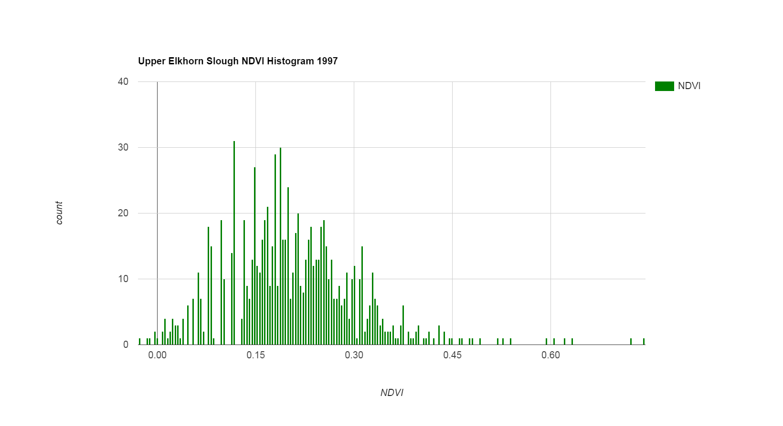
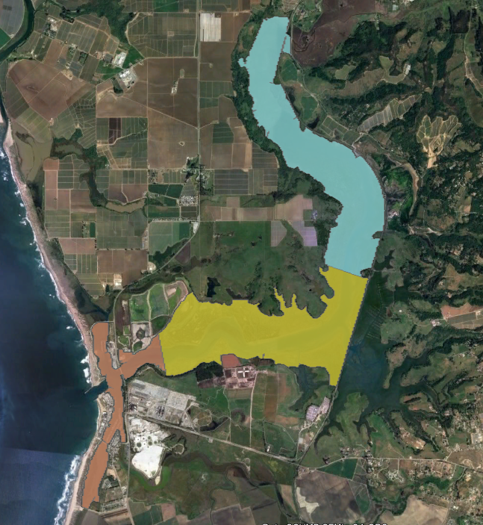
Regional Analysis of NDVI
Cut study area polygon into regions: lower, middle, and upper marsh.
Import into GEE and clip image by region for each study year.
Produce NDVI Histogram in GEE to identify vegetation trends by region.

Slide 12
ENSO Index and NDVI Comparison
Notes:
We pursued this approach in an attempt to identify a correlation, but the r-squared values indicates there is generally random correlation between NDVI and ENSO index throughout the El Nino years for each region and the entire study area
A limitation of this could be Landsat’s lower spatial resolution of 30m
We cannot derive any conclusion without further analysis
This opens up future avenues of research for our partners at ESNERR to explore other indices for comparison with NDVI, since ENSO is unpredictable

Slide 13
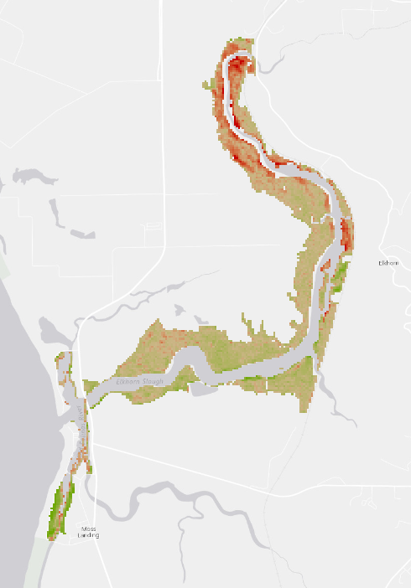
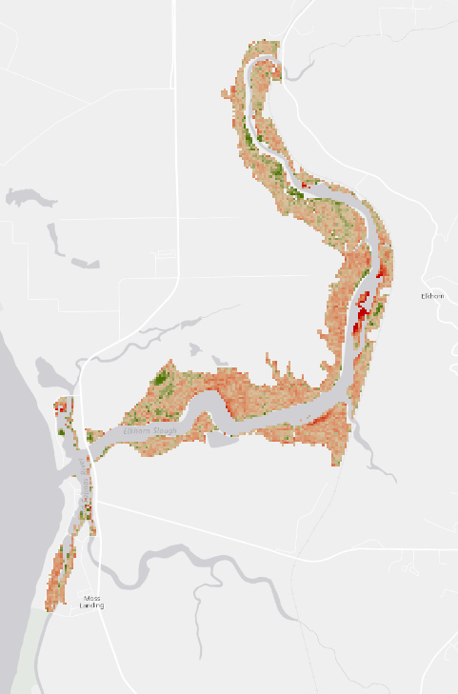
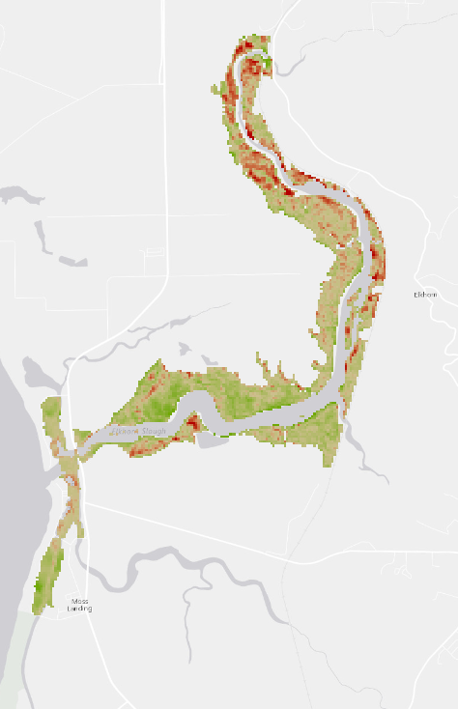
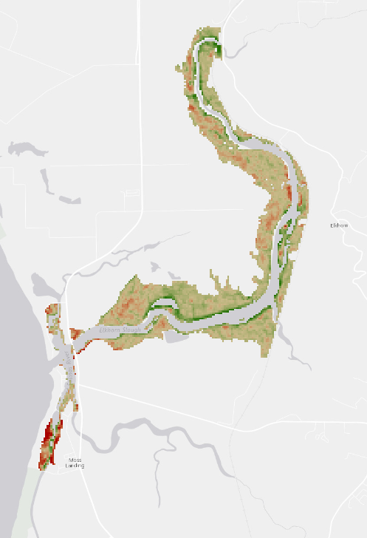
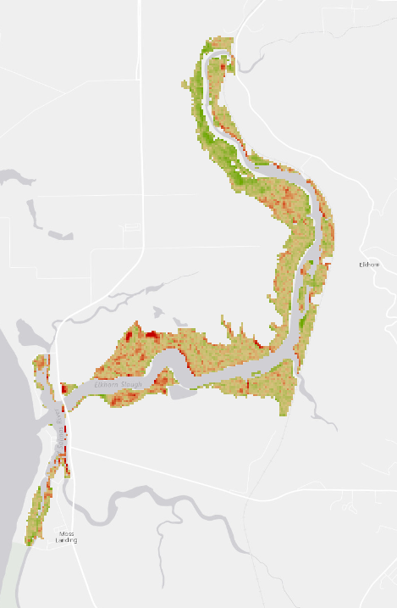
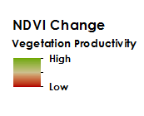
Time-Series of 1997-2016 NDVI Change
1997 to 1998
2002 to 2003
2009 to 2010
2015 to 2016
1997 to 2016

Slide 14
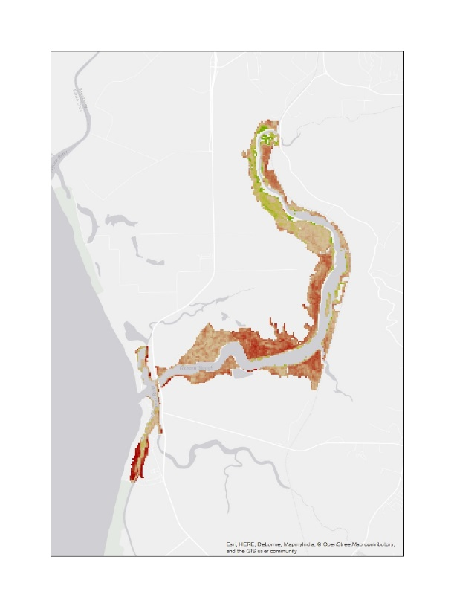
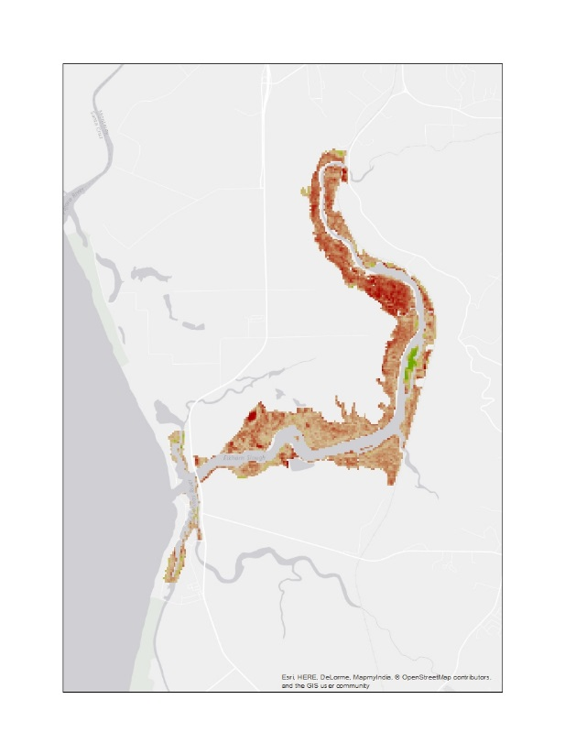
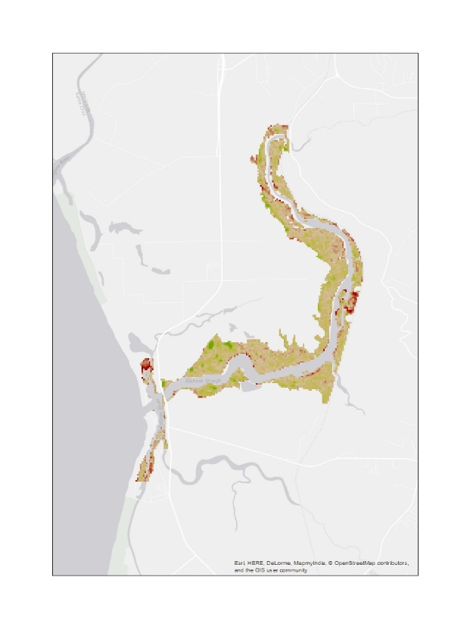
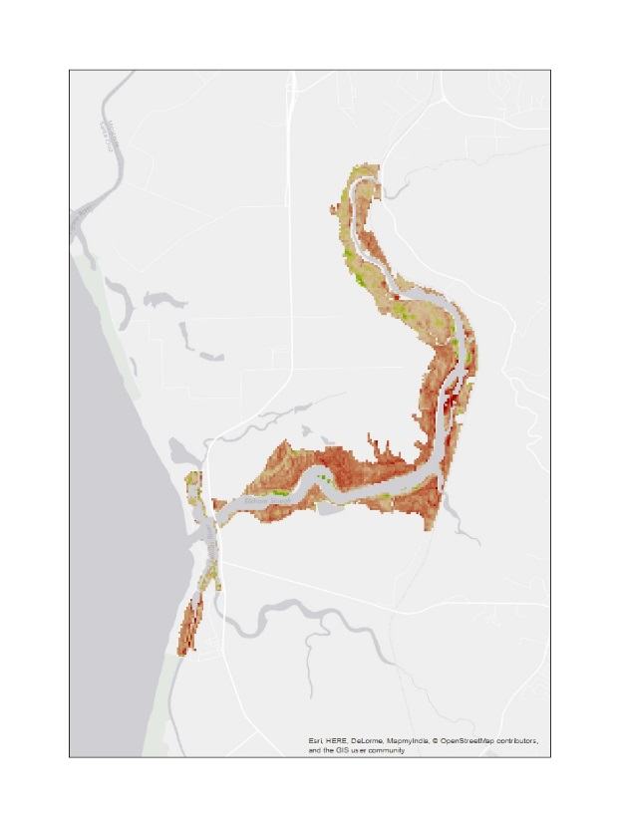
Results: Historical Time-Series Analyses
Overall, there was positive NDVI productivity between 1997 to 2016.
There was a weak negative correlation between El Niño Southern Oscillation Index (ENSO) and Normalized Difference Vegetation (NDVI) averages taken from the entire study area and three delineated regions for each El Niño year.
Vegetation productivity decreased in years without ENSO.
1996 to 1997
2001 to 2002
2006 to 2009
2013 to 2015

Slide 15
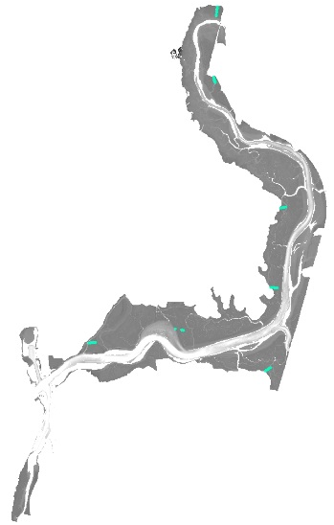
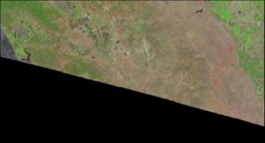
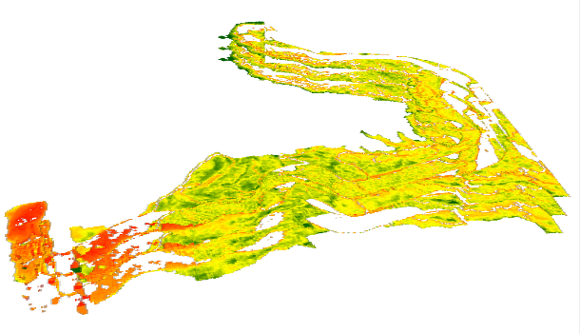

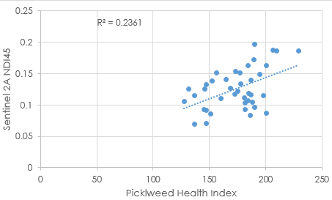
Methods: Present Day Comparison
Vegetation Indices Applied (GEE) to clipped,
water masked out Study Area
Plot data and run regression to detect trends between imagery and in situ data
Import in situ point level vegetation transect data
Extract Vegetation Index Values to in situ points
Acquire
Sentinel 2A Image
(August 13, 2016)

Slide 16
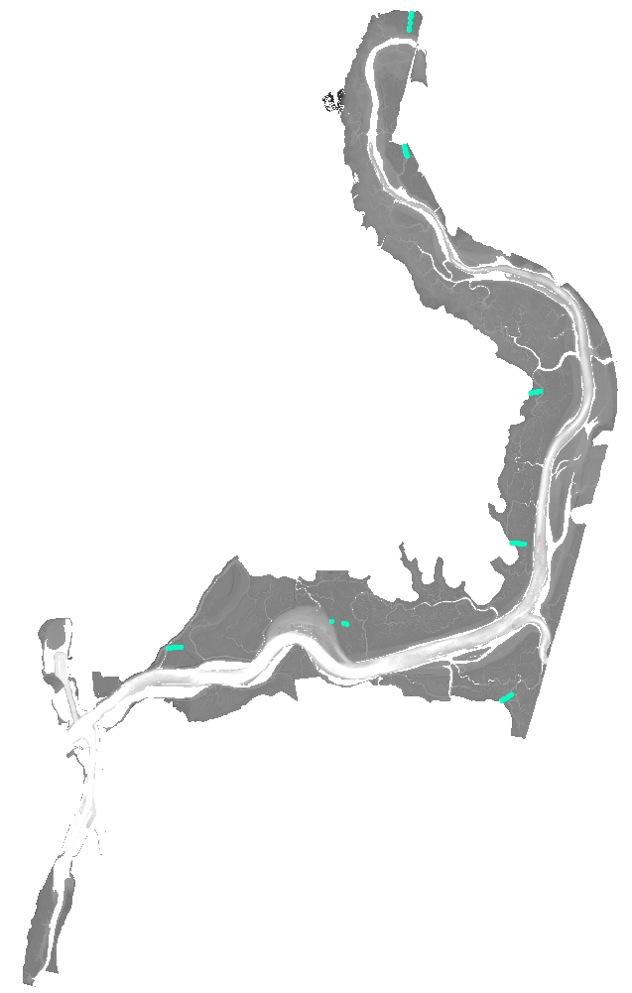
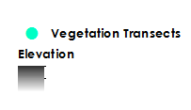

In situ Transect Data
All 49 Quadrants distributed across Study Area
In situ data gathered by ESNERR September 2016.
Of the total 80 quadrants of data collected, 49 quadrants were used that were:
Within Study Area (unrestricted tidal marsh)
Pickleweed Health Index > 0
Pickleweed Health Index =
Canopy Height
+
% Cover
+
% that is Juicy
8 quadrants distributed across 1 transect (Azevedo Marsh)

Slide 17
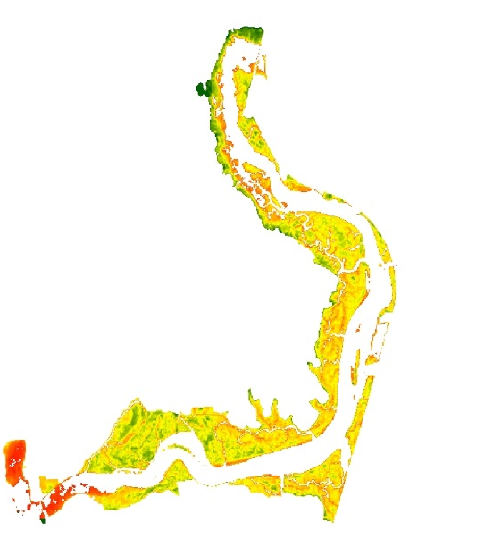
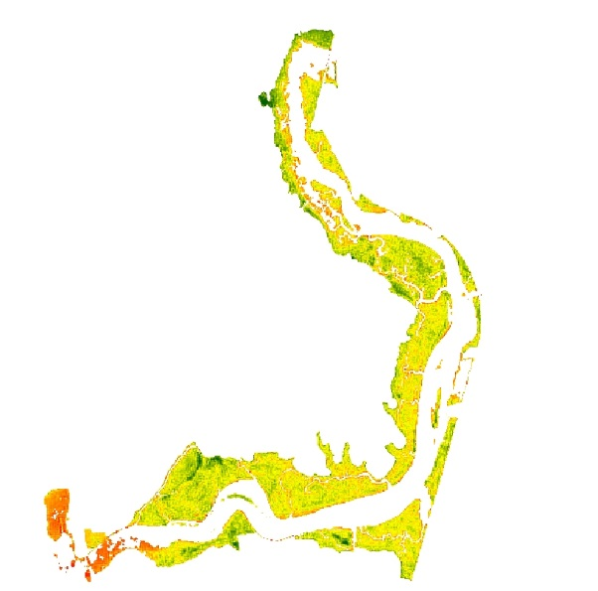
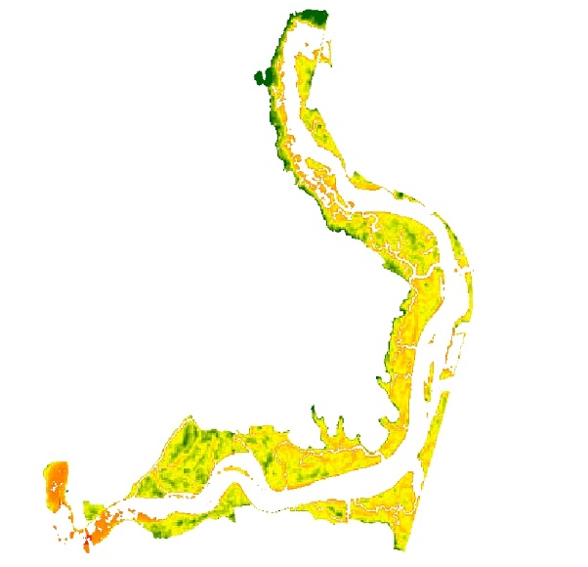
Results: Present Day Analysis
Sentinel 2A Image from August 13th, 2016 (all 10m resolution)
Normalized Difference Vegetation Index (NDVI)
(NIR - R)/(NIR + R)
Normalized Difference Index 45(NDI45)
(NIR - R)/(NIR + R)
Inverted Red-Edge Chlorophyll Index (IRECI)
(NIR - R)/(RE1/RE2)

Slide 18
Results: Present Day Analysis
NDVI R-squared
0.22
NDI45 R-squared
0.27
IRECI R-squared
0.22

Slide 19
Results: Present Day Analysis
For all indices, stronger correlation in higher elevation marsh (>156 cm) than lower elevation (<156 cm) marsh.
High Elevation Marsh R-squared
0.16
Low Elevation Marsh R-squared
0.06
High Elevation Marsh R-squared
0.14
Low Elevation Marsh R-squared
0.15
High Elevation Marsh R-squared
0.33
Low Elevation Marsh R-squared
0.08

Slide 20
Results: Present Day Analysis
Inverted Red-Edge Chlorophyll Index (IRECI) among the three indices correlates the strongest with high elevation marsh
High Elevation Marsh R-squared
0.18
High Elevation Marsh R-squared
0.16
High Elevation Marsh R-squared
0.34

Slide 21
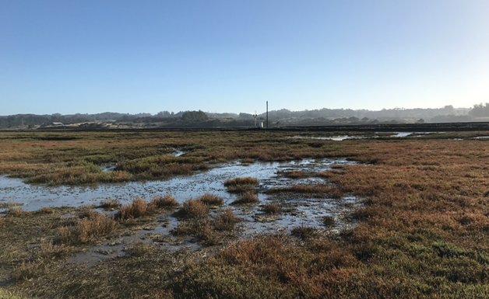
Results: Present Day Analysis
Question of scale – size of quadrat vs. size of pixel
Pickleweed Health Index the most comprehensive measure?
Future field work – different in situ plots?

Slide 22
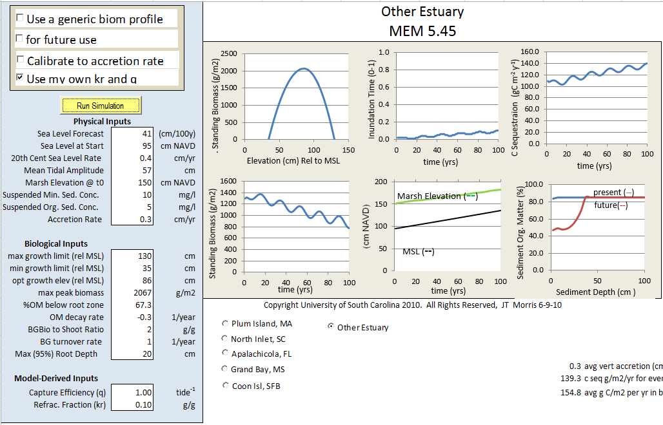
The Marsh Equilibrium Model (MEM)
Incorporates in situ data to predict marsh resilience to sea level rise and carbon sequestration capabilities
Hindcasting can be used to site specific calibration
Forecasting100 years with varied sea level rise scenarios
Image Credit: JT Morris, University of South Carolina, 2010

Slide 23
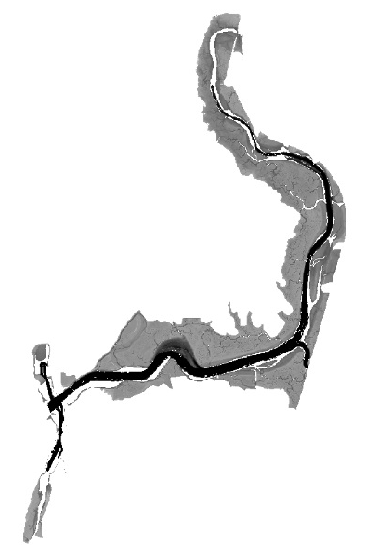
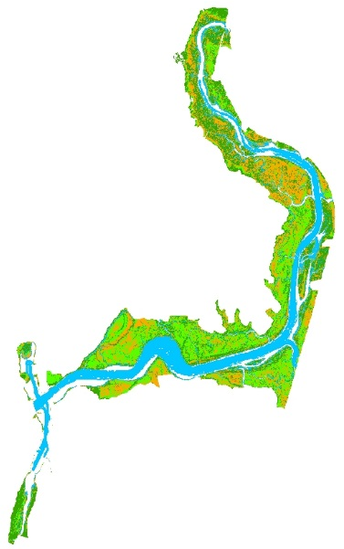
Methods: Resilience to Climate Change
The Marsh Equilibrium Model (MEM) (Morris et al., 2002) was run with data provided by ESNERR, Schile et al. (2014) and NOAA mean sea level trends
Acquired
2013 NOAA Coastal California TopoBathy Merge Project DEM and corrected the DEM using code created by Buffington et al. (2016)
MEM output was overlaid onto the DEM using the ArcMap Model builder created by Schile et al., 2014
Image Credit: JT Morris, University of South Carolina, 2010

Slide 24

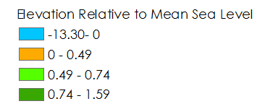
Results: DEM Correction
Ran code provided by Buffington et al. (2016) with an NDVI threshold of -0.5 improved RMSE 0.2 to 0.07

Slide 25
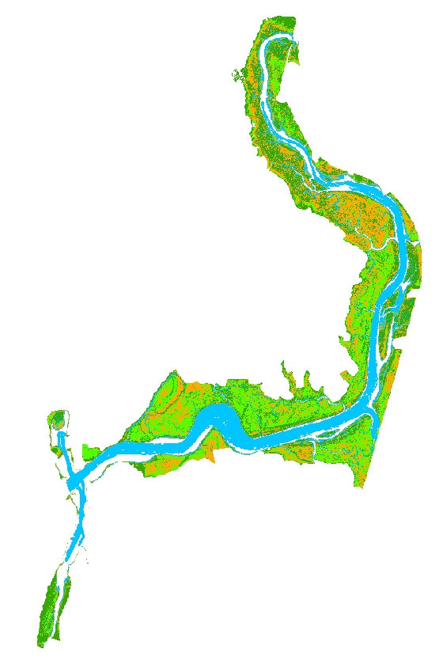
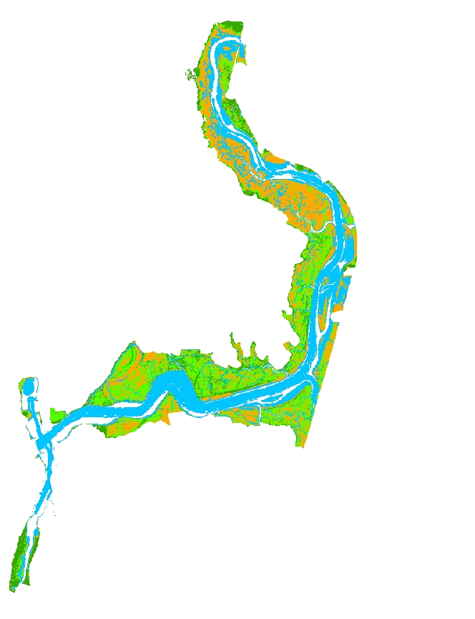
Results: Resilience to Climate Change
14 cm
100 cm
Corrected DEM
14 and 100 cm sea level rise scenarios over a century
Subsidence of 27 cm was added to the total sea level rise
Marsh improved with a small amount of sea level rise
Marsh appeared unchanged with 100 cm sea level rise

Slide 26

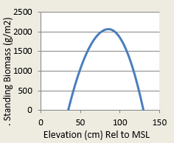
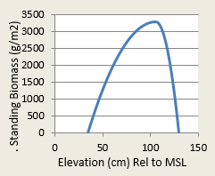
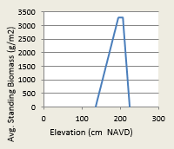
Discussion: Resilience to Climate Change
Why does the model not capture Elkhorn Slough’s decline?
  Elkhorn Slough is dynamic and not in equilibrium
  Vegetation type impacts the standing biomass curve (Janousek et al., 2016)
  Parameters may need adjustments to accommodate marsh variability
Images Created using the Marsh Equilibrium Model

Slide 27
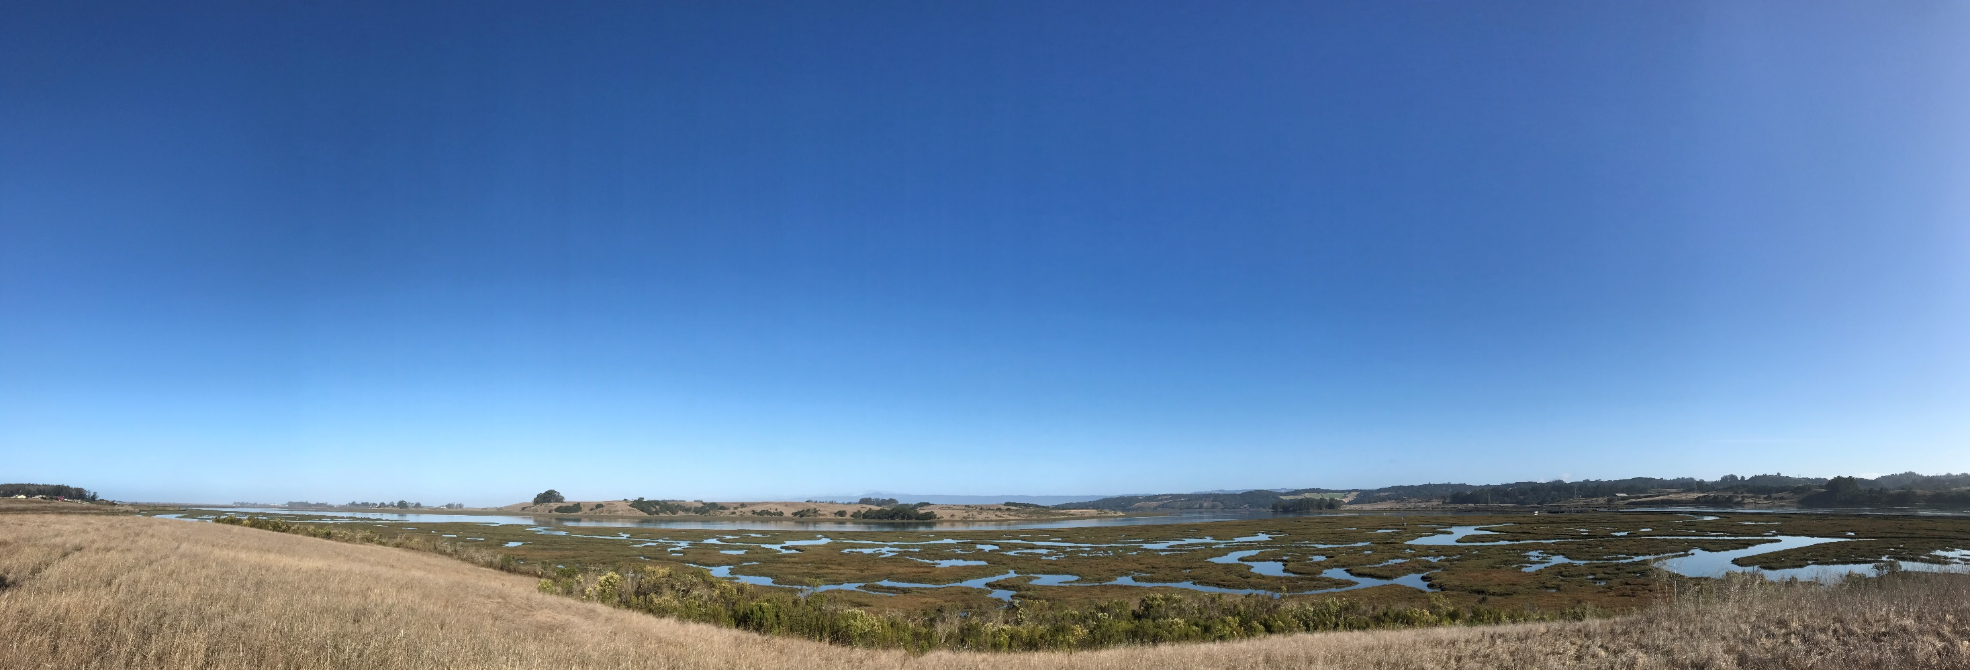
Conclusion & Future Work
Analyze the effects of other climatic variables
In situ scale is important
Apply different vegetation indices to hyperspectral imagery for following years
Adjust MEM parameters and perform additional simulations to assess the slough’s resilience to climate change
Notes:
Further research analysis for years without the presence of El Niño would be beneficial in identifying the possibility of a lag effect on vegetation health.

Slide 28
We would like to thank the following for their continued support and guidance:
Bay Area Environmental Research
Institute (BAERI)
Dr. Juan Torres-Perez
Dr. Sherry L. Palacios
Elkhorn Slough National Estuarine
Research Reserve (ESNERR)
Dr. Kerstin Wasson
Charlie Endris
Andrea Woolfolk
Monique Fountain
ARC DEVELOP
Brittany Zajic
Jenna Williams
Past Contributors: Irma Caraballo Álvarez, Abigail Childs, Kirsten Jurich
US Geological Survey (USGS)
Dr. Kristin Byrd

Slide 29
References
Buffington, K.J., Dugger, B.D., Thorne, K.M., & Takekawa, J.Y. (2016). Statistical correction of lidar-derived
digital elevation models with multispectral airborne imagery in tidal marshes. Remote Sensing of Environment, (186), 616-625.
Crooks, S., Herr, D., Laffoley, D., Tamelander, J., & Vandever, J. (2011). Regulating Climate Change Through
Restoration and Management of Coastal Wetlands and Near-shore Marine Ecosystems: Mitigation
Potential and Policy Opportunities. World Bank, IUCN, ESA PWA, Washington, Gland, San Francisco.
Elkhorn Slough: Conservation. (n.d.). Retrieved September 29, 2016, from
http://www.elkhornslough.org/conservation/index.htm
Janousek, C.N., Buffington, K.J., Thorne, K.M., Guntenspergen, G.R., Takekawa, J.Y., & Dugger, B.D. (2016). Potential effects of sea-level rise on plant productivity:species-specific responses in northeast Pacific tidal marshes. Marine Ecology Progress Series, 548, 111-125.
Morris, J.T., Sundareshwar, P.V., Nietch, C.T., Kjerfve, B., & Cahoon, D.R. (2002). Responses of coastal
wetlands to rising sea level. Ecology, 83(10), 2869-2877.
Schile, L. M., Callaway, J. C., Morris, J. T., Stralberg, D., Parker, V. T., & Kelly, M. (2014). Modeling tidal
marsh distribution with sea-level rise: Evaluating the role of vegetation, sediment, and upland habitat
in marsh resiliency. PloS one, 9(2), e88760.
Van Dyke, E., & Wasson, K. (2005). Historical ecology of a central California estuary: 150 years of habitat
change. Estuaries, 28(2), 173-189.

