Slide 1
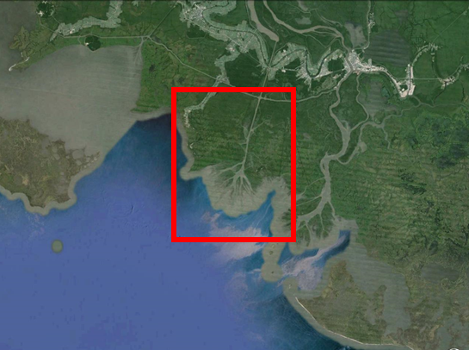
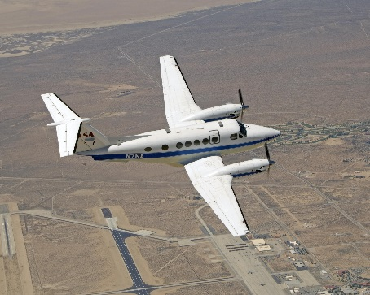
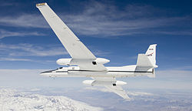
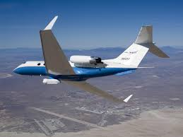
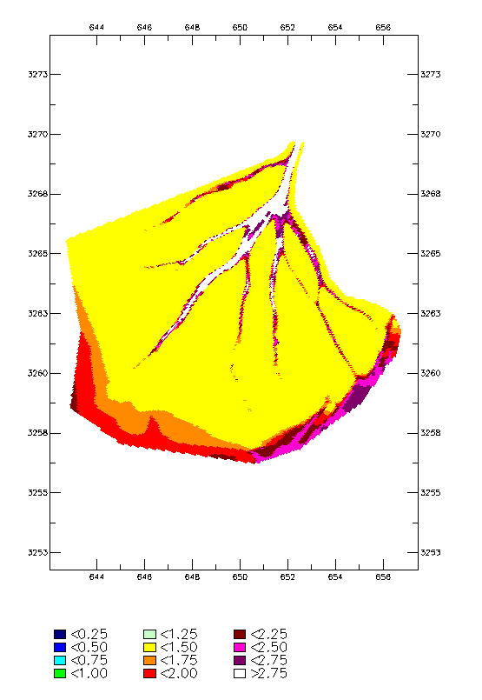
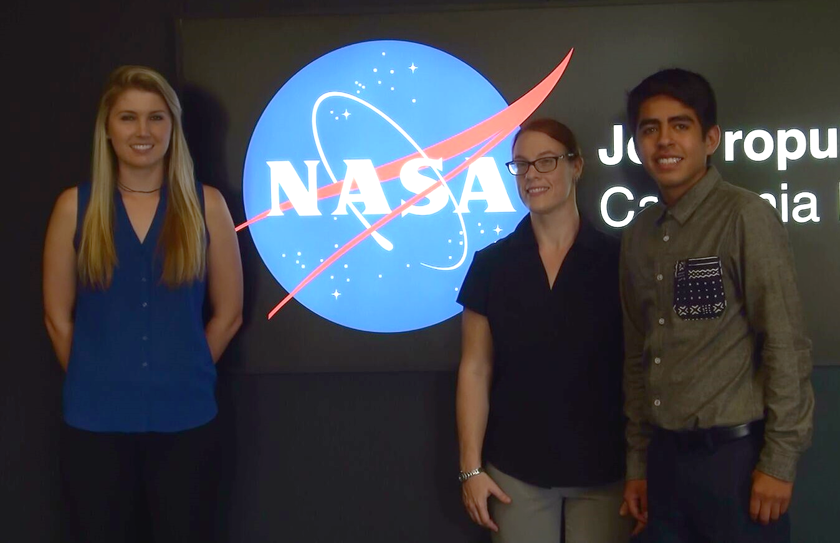
Louisiana Ecological Forecasting
Examining historic trends and modeling sediment transport in delta building within Louisiana’s Wax Lake Delta using UAVSAR and AirSWOT instruments to inform restoration efforts
Emily Beck (Project Lead), Raul Garcia, Brittany Zajic
DEVELOP National Program at NASA Jet Propulsion Laboratory
Abstract
Objectives
Keep this blank for now.
Body text point size should be at least 24.
Caption text point size should be at least 16.
Feel free to rename, move, and resize sections as needed.
Model water flow and sediment transport with the use remotely sensed data, in-situ data, and modeling software to predict the future extent of Wax Lake Delta
Improve coastline change prediction accuracy
Gain a better understanding of why the study area is experiencing aggregation
Methodology
Study Area
ArcGIS Inputs
Include a map that has easily readable text and a legend.
Study Period: May 2009 – May 2015
Vegetation Info from AVIRIS
Modeled sediment transport
Louisiana Wax Lake Delta
Delft3D Hydrological Model
Model Calibration Using AirSWOT Data
In Situ Data
Modeled water flow
Earth Observations
AirSWOT
UAVSAR
AVIRIS
Wave Info from UAVSAR
Results
Conclusions
Use images.
No bullets.
Use bullets.
Use complete sentences with periods.
TBD
Output showing modeled water level in the Delta (Real results TBD).
Team Members
Project Partners
Acknowledgements
Naval Research Laboratory
Louisiana Universities Marine Consortium
Our science advisors, Marc Simard and Cathleen Jones
Doug Edmonds, Delft 3D
Gwen Miller, DEVELOP
Brittany Zajic, Emily Beck, Raul Garcia
NASA Jet Propulsion Laboratory

