Slide 1
Texas Water Resources
Utilizing NASA Earth Observations to Assess Soil Moisture in Texas for Wildfire Mitigation
Greg Hoobchaak(Project Lead)
Jessica Jozwik
Alyx Riebeling

Slide 2
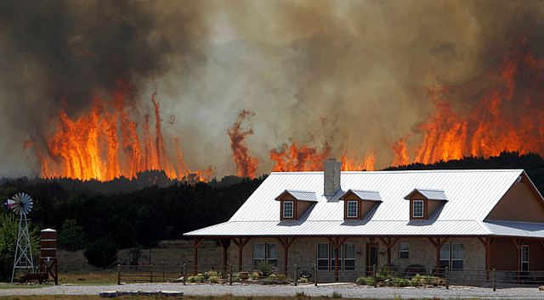
Community Concerns
Image Credit: State Farm
Droughts
Wildfires
Damages to property, infrastructure and life.
Environmental Degradation
Economic
Losses
Notes:
In recent years, droughts have increased in both severity and frequency. Droughts beget wildfires, 80% of which occur within two miles of a community. These wildfires damage property, infrastructure, and safety. They result in soil degradation, soil erosion loss of biodiversity, and agricultural losses. Ultimately, there are incredible economic losses as a result of rampant wildfires. In 2011, an estimated $5.2 billion was lost in agricultural resources and damaged roads and infrastructure.
Image Link: https://www.flickr.com/photos/statefarm/12333738624/in/photolist-jMTCMW-9Aho7S-eLSsDv-9LZzo2-akjGEf-ajTPu9-A2nGa8-AhFQko-aHBBpi-9GNWvP-9GNWug-ak3aLc-62GcYX-ajFkug-ajYTZG-aeeiQN-aAzb59-ak32BB-9AdmyZ-cQ44R1-v2p2H3-62GgfF-9d5RQ-9cTJZ-9cTHo-9cTHQ-9cTKi-9cTEP-ak8SZx-62GBnk-ajgmEi-9d5Rz-an7r4y-9d5PU-9d5QW-9d5Ps-9d5Pg-9d5Qw-aT3Guc-64pGEu-6fH7ZL-63hKQB-62HiTX-aejc7w-awWmmw-ajhUXn-aeDLb8-ajS8MM-ajS6yt-ajS6a8

Slide 3
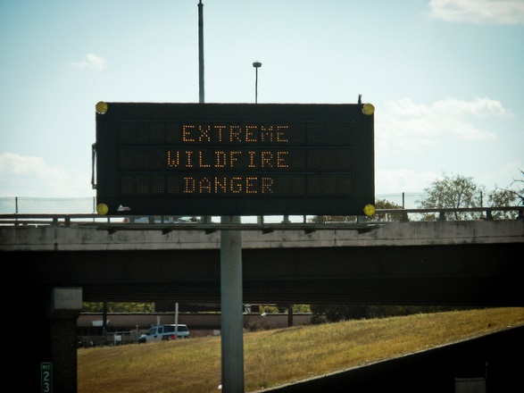
Current Practices
Texas A&M Fire Assessment Risk Assessment Portal
Prediction using Keetch-Byram Drought Index
  Estimates soil moisture from precipitation and temperature
Image Credit: VXYA
Notes:
The Texas Forest Service currently operates a Risk Assessment Portal that is free and open to the public. Individual users or community planning bodies can calculate their Fire Risk Potential and respond according to the threat. The TFS uses the Keetch-Byram Drought Index in these calculations, which utilizes precipitation and temperature readings to estimate evaporation, soil moisture, fuel ignition potential, etc.
Image Credit: https://www.flickr.com/photos/vxla/6144739838/in/photolist-amZp5j-9zZwhX-9zZyyk-9zZyov-9zZyt2-9A3x7C-9zZyvP-9A3wQj-9zZwQt-9zZxH4-9zZx7e-9A3wt9-9A3wvC-9zZxED-9zZx22-9zZx58-9A3wjo-9zZxC8-9zZyDM-9zZxhp-9A3wof-9zZxuB-9zZyGc-9zZxwH-9zZxzv-9A3wEA-9A3vUQ-9A3xhA-9A3vRu-9zZyJg-9A3xJw-9zXdtB-b5GcCa-aHxHAp-ajTPuE-jMTCMW-9Aho7S-eLSsDv-9LZzo2-akjGEf-ajTPu9-A2nGa8-AhFQko-aHBBpi-9GNWvP-9GNWug-ak3aLc-62GcYX-ajFkug-ajYTZG

Slide 4
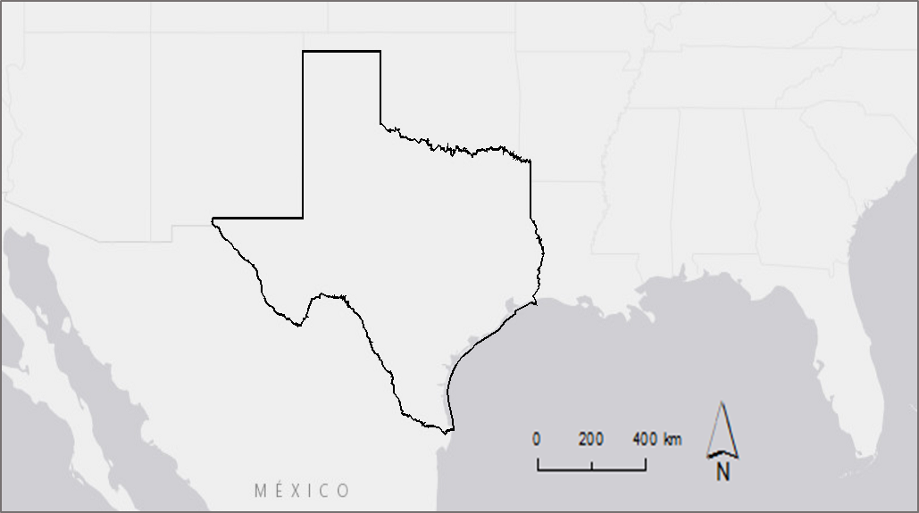
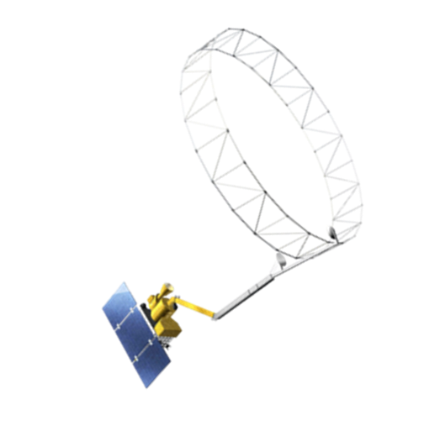
Study Area and Period
Study Area: Texas
Study Period:
April 21, 2015-
February 1, 2016
Earth Observation Systems
Soil Moisture Active Passive (SMAP)
Notes:
We partnered with the Texas Forest service to incorporate data from the Soil Moisture Active Passive (SMAP) Satillite into their Texas wildfire predictions. SMAP was launched in January of 2015 and began recording data on April 21, 2015. Our study period is thus April 21, 2015-February 1, 2016. In July, one of the SMAP radar’s power amplifier failed. However SMAP continues to transmit accurate data, but at 36km resolution, as opposed to 9km resolution.

Slide 5
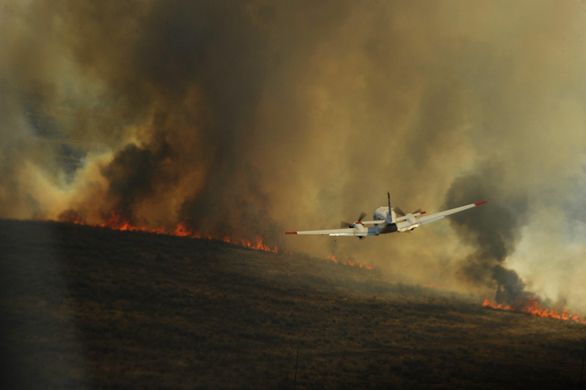
Objectives
1. Establish a Day of Year Baseline Climatology.
2. Relate SMAP data with SCAN data.
3. Create a rolling three day minimum data set.
4. Identify a {relative number-TBD} for future comparisons.
Image Credit: Staff Sgt. Eric Harris
Image Credit: Monet
Notes:
We had four objectives for our project. The Texas Forest Service requested a method to relate daily soil moisture readings with historical records to identify changes or particularly high or low values. So we created a Day of Year Baseline Climatology. We also needed to validate the SMAP data. The Soil Climate Analysis Network has daily soil moisture sensors throughout Texas, which allowed us to validate the SMAP data. Thirdly, we wanted to create a three day minimum data set so the Texas Forest Service can the entire state of Texas without gaps in the data. Finally, we identified a (number) for the Forest Service to utilize in future analysis of SMAP data.
Image Link: https://www.flickr.com/photos/dvids/5664249483/in/photolist-9CwL2R-8tVDvo-9d5Qe-amD2x7-9A3xuN-9A3wLJ-9A3wHy-9A3wWf-9zZwvt-9zZwrV-9zZwmT-9zZz2x-9zZy6H-9A3uHA-zWHboS-8zTqVs-aeeiFs-9A3xXL-9A3weC-aJ6n3X-9zZy9Z-9A3xoW-9zZyPn-9zZwzi-9A3xRj-9zZwCK-9zZwNe-9A3vnE-9zZwWe-9zZwEe-amZp5j-9zZwhX-9zZyyk-9zZyov-9zZyt2-9A3x7C-9zZyvP-9A3wQj-9zZwQt-9zZxH4-9zZx7e-9A3wt9-9A3wvC-9zZxED-9zZx22-9zZx58-9A3wjo-9zZxC8-9zZyDM-9zZxhp

Slide 6

Acquire Data:
Soil Moisture Active Passive (SMAP), Soil Climate Analysis Network (SCAN), Texas Mesonet Data
Establish Baseline Climatology
Relate SMAP and in situ Data
Create a Rolling 3 Day Minimum Data Set
Using Excel:
-Establish Day of Year (DOY)
-Find average for each DOY using a Pivot Table
Using ArcMap:
-Create semivariograms by season
-Ordinary Krig on a day by day basis
Using Excel:
-Create individual file by day
Using ArcMap:
-Match Raster to point values using Extract By Value in ArcMap
Using Excel:
-Create one table with SMAP and Reference Data
-Find correlations in data using [TBD]
Using ArcGIS Model Builder:
-Set nulls
-Mosaic to New Raster
Identify a [relative number-TBD] for future comparisons.
Notes:
We had several objectives operating in parallel with one another. We downloaded our SMAP, SCAN, and Mesonet data, then began processing and analyzing the data to achieve our objectives.

Slide 7

Acquire Data:
Soil Moisture Active Passive (SMAP), Soil Climate Analysis Network (SCAN), Texas Mesonet Data
Establish Baseline Climatology
Relate SMAP and in situ Data
Create a Rolling 3 Day Minimum Data Set
Using Excel:
-Establish Day of Year (DOY)
-Find average for each DOY using a Pivot Table
Using ArcMap:
-Create semivariograms by season
-Ordinary Krig on a day by day basis
Using Excel:
-Create individual file by day
Using ArcMap:
-Match Raster to point values using Extract By Value in ArcMap
Using Excel:
-Create one table with SMAP and Reference Data
-Find correlations in data using [TBD]
Using ArcGIS Model Builder:
-Set nulls
-Mosaic to New Raster
Identify a [relative number-TBD] for future comparisons.
Notes:
ESTABLISH BASELINE CLIMATOLOGY: In Excel, we organized the data by date, then found the average for each date using a Pivot Table [Explain use of Pivot Table]. Then, using ArcMap, we geographically interpolated within the data to measure the variance relationship between data points. Our data had many gaps in between points, so this will allow the Texas Forest Service to use satellite data to “fill in the blanks” between testing stations. To do this, we first determined several seasons to account for variability throughout the year. Those seasons were : [TBS: Create new slide when determined]. We then created semi-variograms in Arc to create a model that will account for seasons and distances between points. Then we used Ordinary Kriging to interpolate within the data and create an estimated image of soil moisture throughout Texas by Day of Year.

Slide 8
Acquire Data:
Soil Moisture Active Passive (SMAP), Soil Climate Analysis Network (SCAN), Texas Mesonet Data
Establish Baseline Climatology
Relate SMAP and in situ Data
Create a Rolling 3 Day Minimum Data Set
Using Excel:
-Establish Day of Year (DOY)
-Find average for each DOY using a Pivot Table
Using ArcMap:
-Create semivariograms by season
-Ordinary Krig on a day by day basis
Using Excel:
-Create individual file by day
Using ArcMap:
-Match Raster to point values using Extract By Value in ArcMap
Using Excel:
-Create one table with SMAP and Reference Data
-Find correlations in data using [TBD]
Using ArcGIS Model Builder:
-Set nulls
-Mosaic to New Raster
Identify a [relative number-TBD] for future comparisons.
Notes:
RELATE SMAP AND IN SITU DATA: We also sought to relate SMAP data with in situ data from the Soil Climate Analysis Network. We organized the SCAN data by date, then geographically referenced them using ArcMap. We then matched the SMAP raster to each Point Values using Extract by Value. After creating a table with both SCAN and SMAP data, we used [Excel/R] to find correlations between the data.

Slide 9
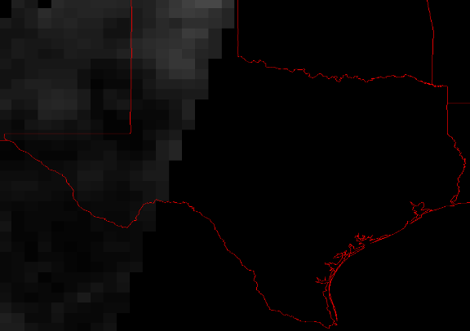
Notes:
As you can see, when looking at one day’s SMAP data, there areas of the image in Texas without data. In order to get a complete image of Texas without these gaps, we created a data set comprised of minimum values within a 3 day period.

Slide 10
Acquire Data:
Soil Moisture Active Passive (SMAP), Soil Climate Analysis Network (SCAN), Texas Mesonet Data
Establish Baseline Climatology
Relate SMAP and in situ Data
Create a Rolling 3 Day Minimum Data Set
Using Excel:
-Establish Day of Year (DOY)
-Find average for each DOY using a Pivot Table
Using ArcMap:
-Create semivariograms by season
-Ordinary Krig on a day by day basis
Using Excel:
-Create individual file by day
Using ArcMap:
-Match Raster to point values using Extract By Value in ArcMap
Using Excel:
-Create one table with SMAP and Reference Data
-Find correlations in data using [TBD]
Using ArcGIS Model Builder:
-Set nulls
-Mosaic to New Raster
Identify a [relative number-TBD] for future comparisons.
Notes:
CREATE A ROLLING 3 DAY MINIMUM DATA SET: In order to get a complete image of Texas without data gaps, we created a data set comprised of minimum values within a 3 day period. We set the nulls to ______ and mosaicked the values to a new raster. Then:

Slide 11
Acquire Data:
Soil Moisture Active Passive (SMAP), Soil Climate Analysis Network (SCAN), Texas Mesonet Data
Establish Baseline Climatology
Relate SMAP and in situ Data
Create a Rolling 3 Day Minimum Data Set
Using Excel:
-Establish Day of Year (DOY)
-Find average for each DOY using a Pivot Table
Using ArcMap:
-Create semivariograms by season
-Ordinary Krig on a day by day basis
Using Excel:
-Create individual file by day
Using ArcMap:
-Match Raster to point values using Extract By Value in ArcMap
Using Excel:
-Create one table with SMAP and Reference Data
-Find correlations in data using [TBD]
Using ArcGIS Model Builder:
-Set nulls
-Mosaic to New Raster
Identify a [relative number-TBD] for future comparisons.
Notes:
ID A NUMBER: Finally, we found a {tbd……)

Slide 12
Results

Slide 13
Conclusions

Slide 14
Errors and Uncertainty

Slide 15
Future Work

Slide 16
Advisors
Dr. Kenton Ross, DEVELOP National Program
Partners
Texas Forest Service
Curt Stripling,Geospatial System Coordinator
Tom Spencer,Department Head of Predictive Services
Others
Emily Adams, Center Lead, DEVELOP Langley Research Center
NASA DEVELOP Texas Water Resources I Team:
Megan Buzanowicz
Laura Lykens
Zacary Richards
Jeff Close

